Slide 2
The Story of Bing Apps: Delight Across Multiple Form Factors
2-544
Sandhya Vankamamidi

Slide 3
Designers are crazy and yet sane enough to know where to draw the line.
— Benjamin Valbret

Slide 4
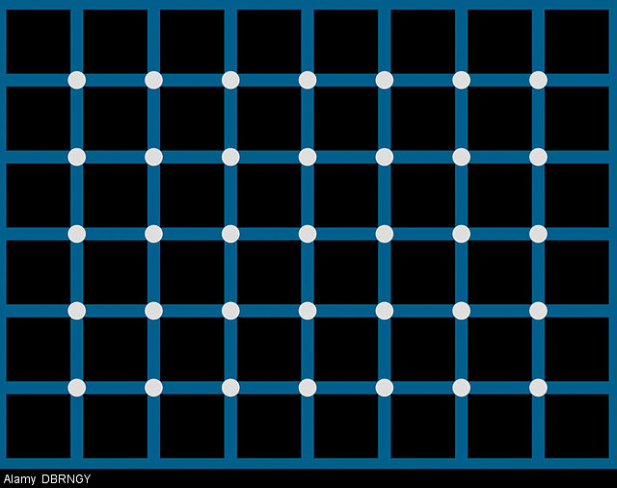
Guess the number of black dots…

Slide 5
The Bing Apps Story: Delight Across Multiple Form Factors
Sandhya Vankamamidi
Sr. Program Manager
ICE
Information and Content Consumption Experiences

Slide 6







The family of Bing Apps
Bing News
Bing Weather
Bing Finance
Bing Sports
Bing Food and Drink
Bing Travel
Bing Health & Fitness

Slide 7
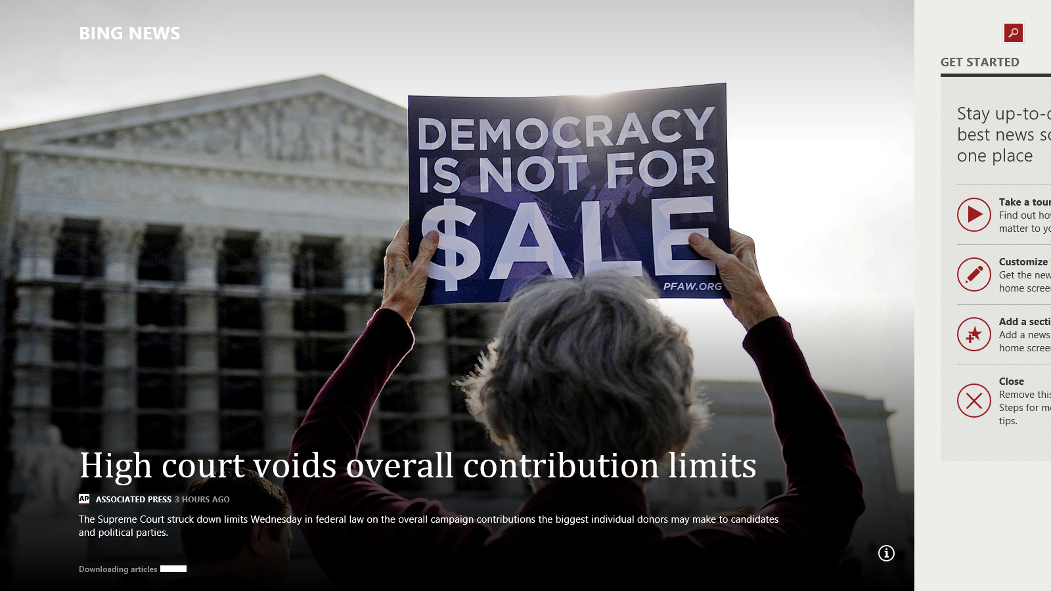
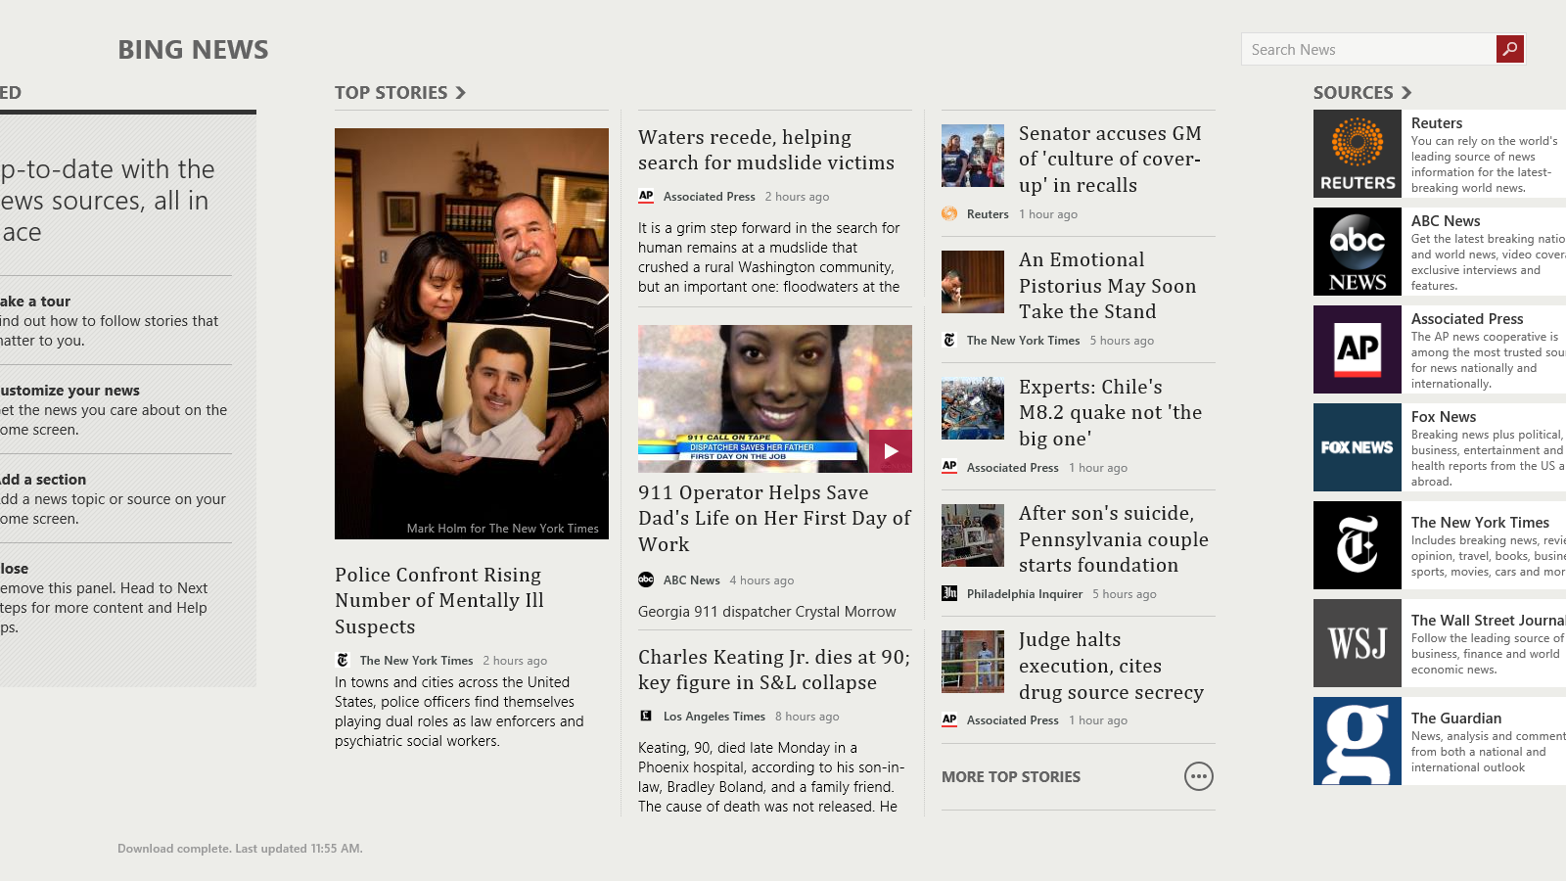
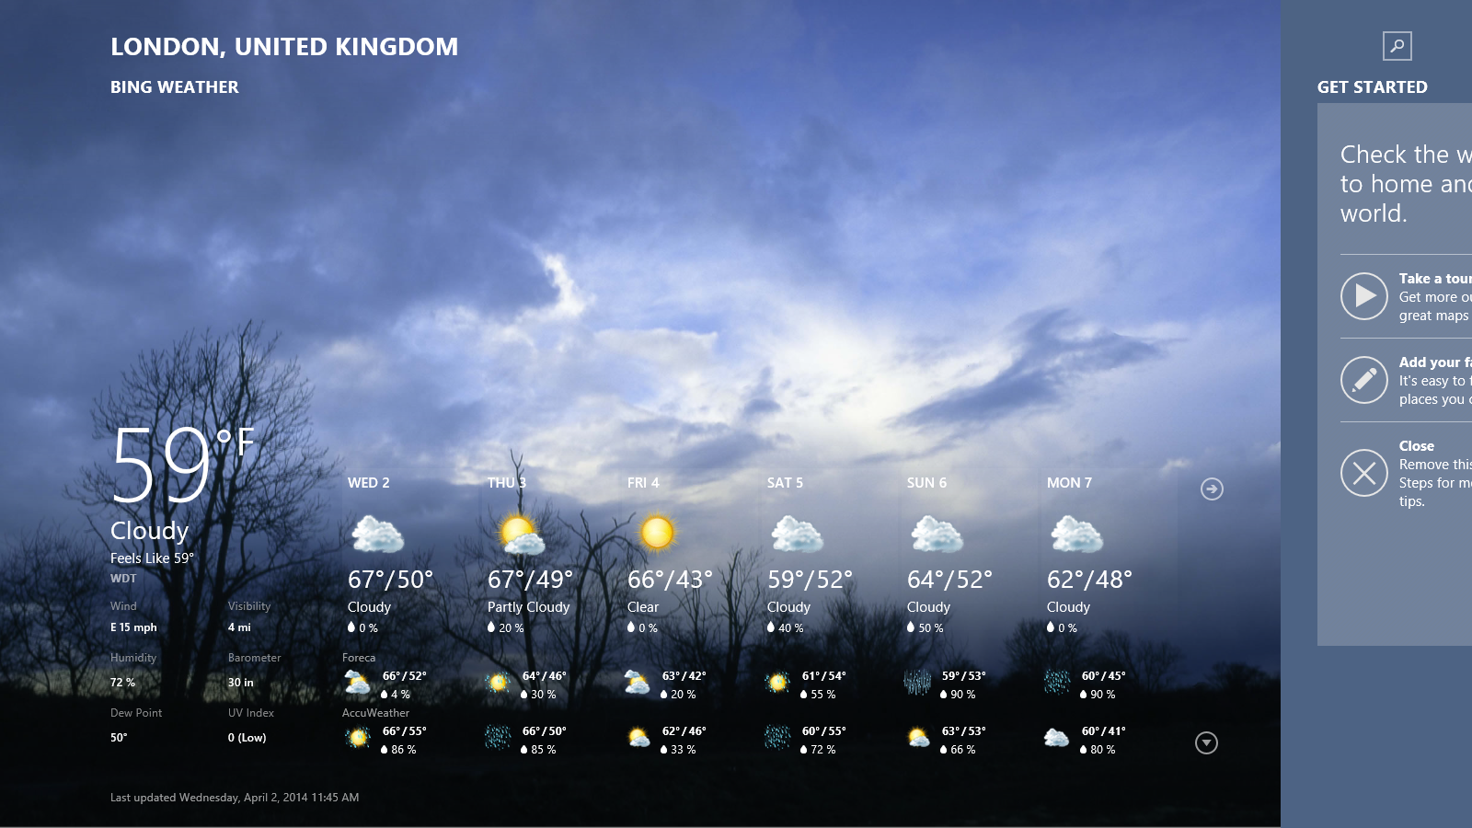
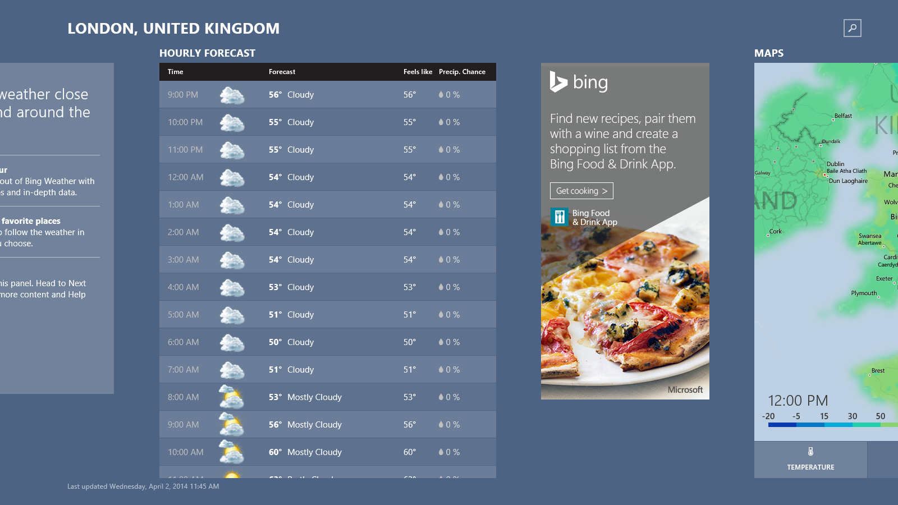
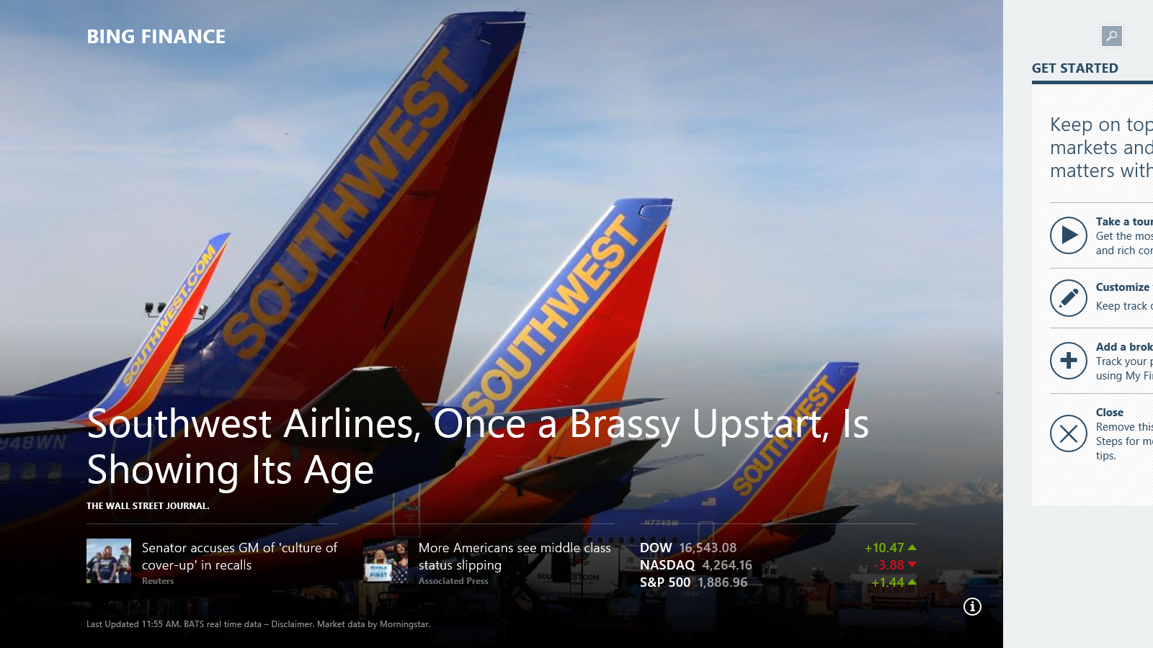
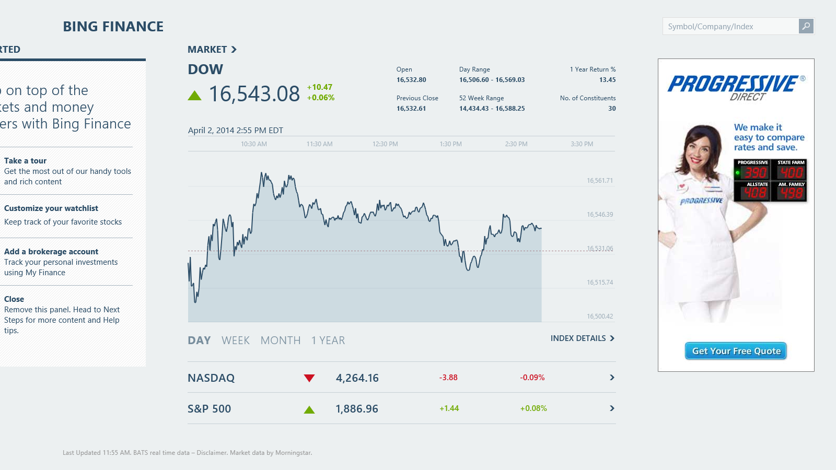
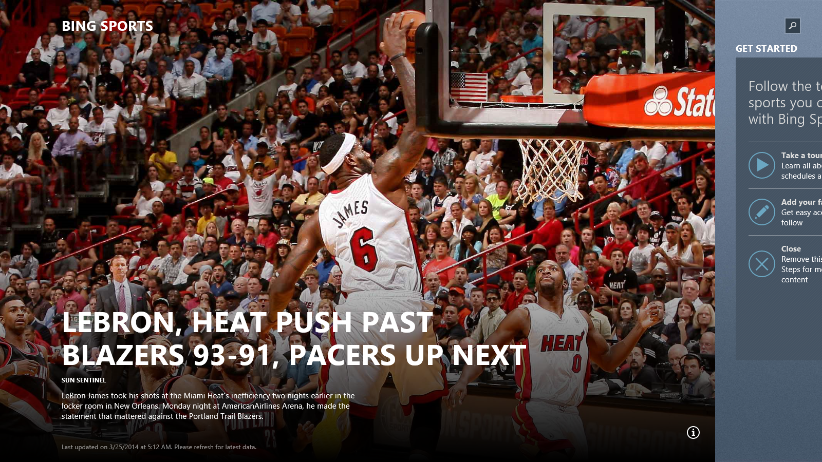
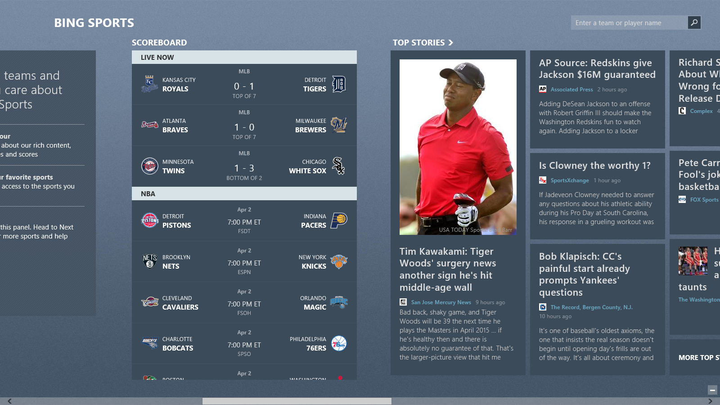
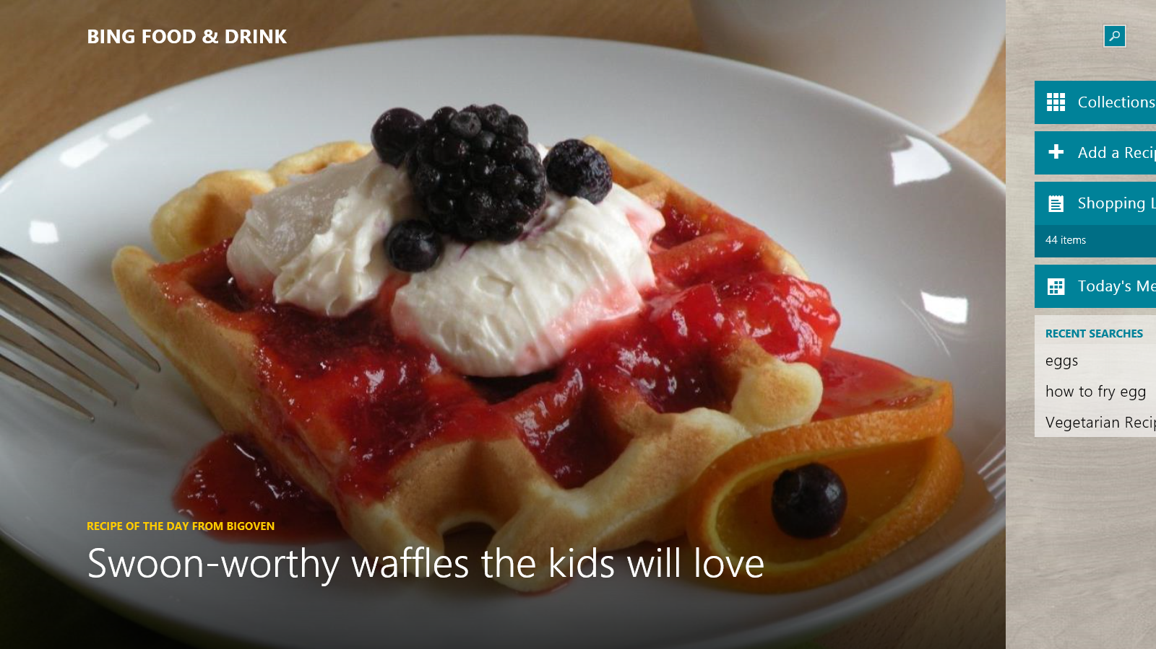
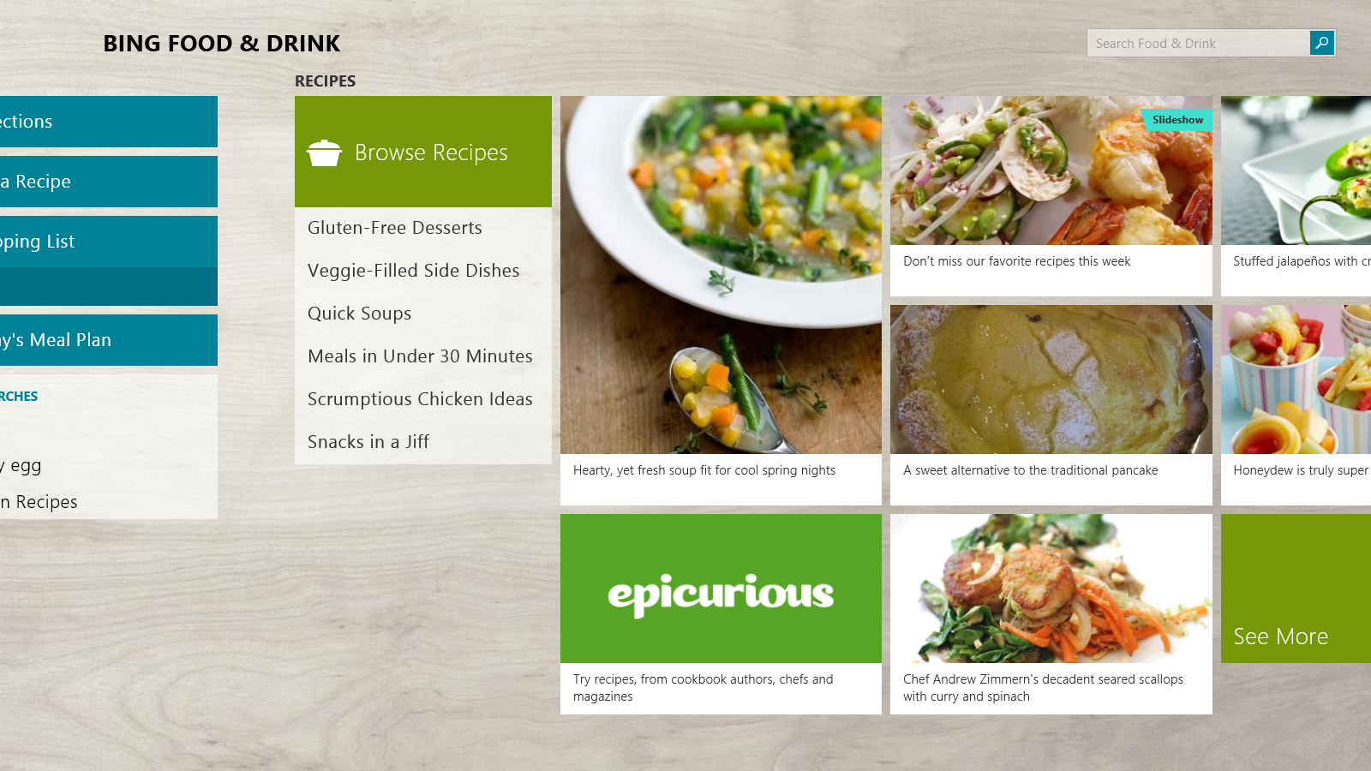
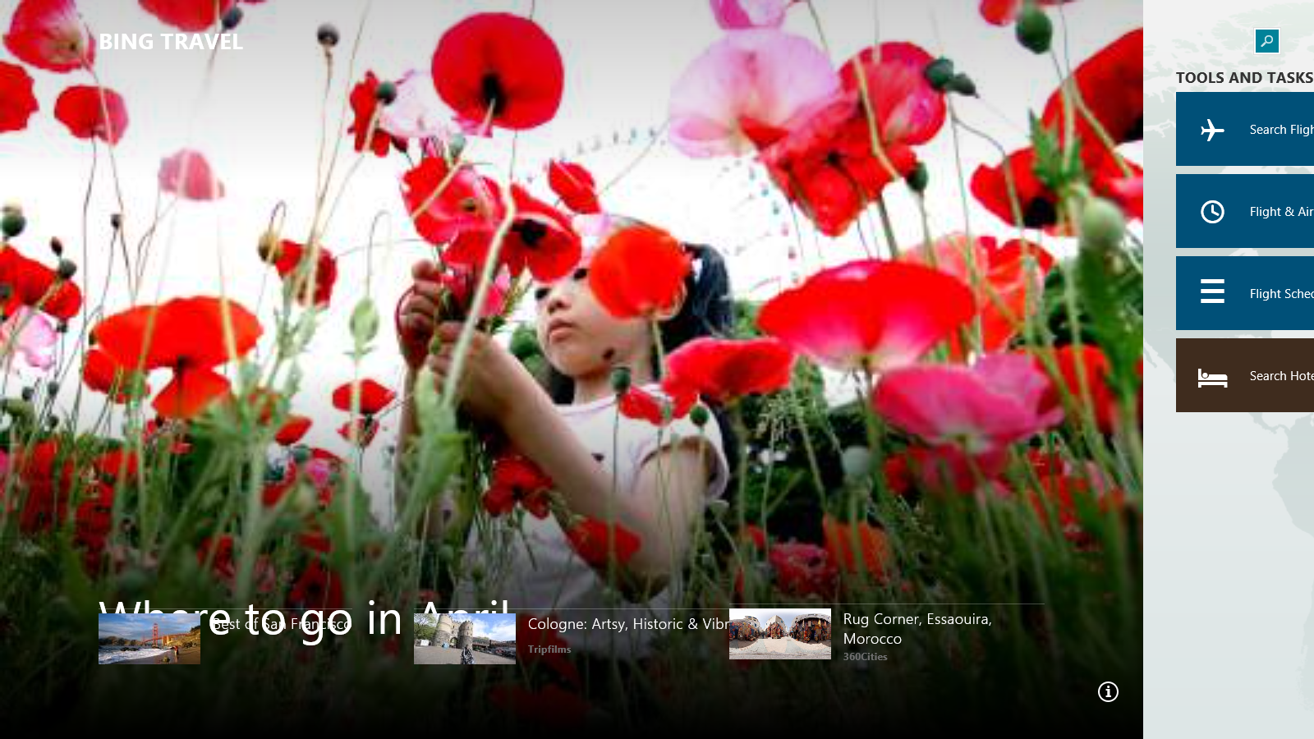
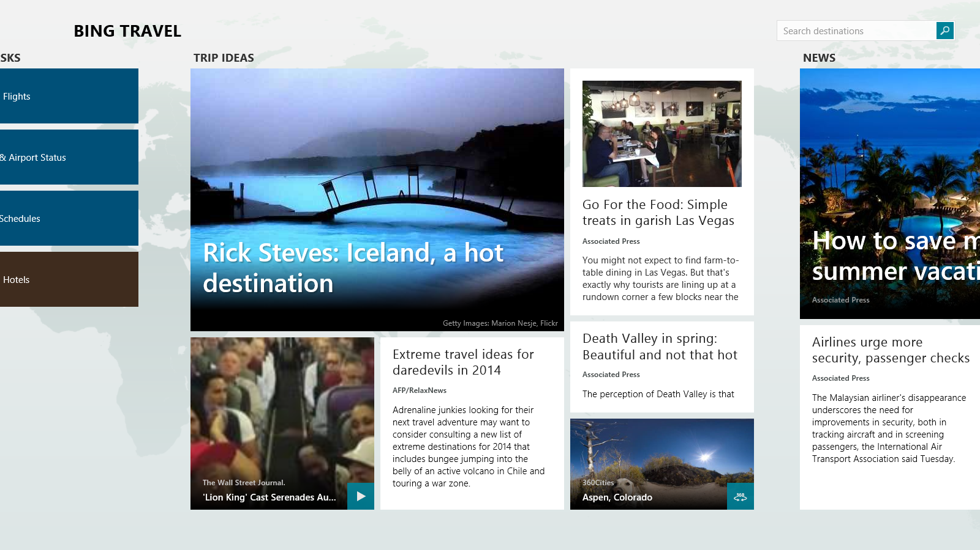
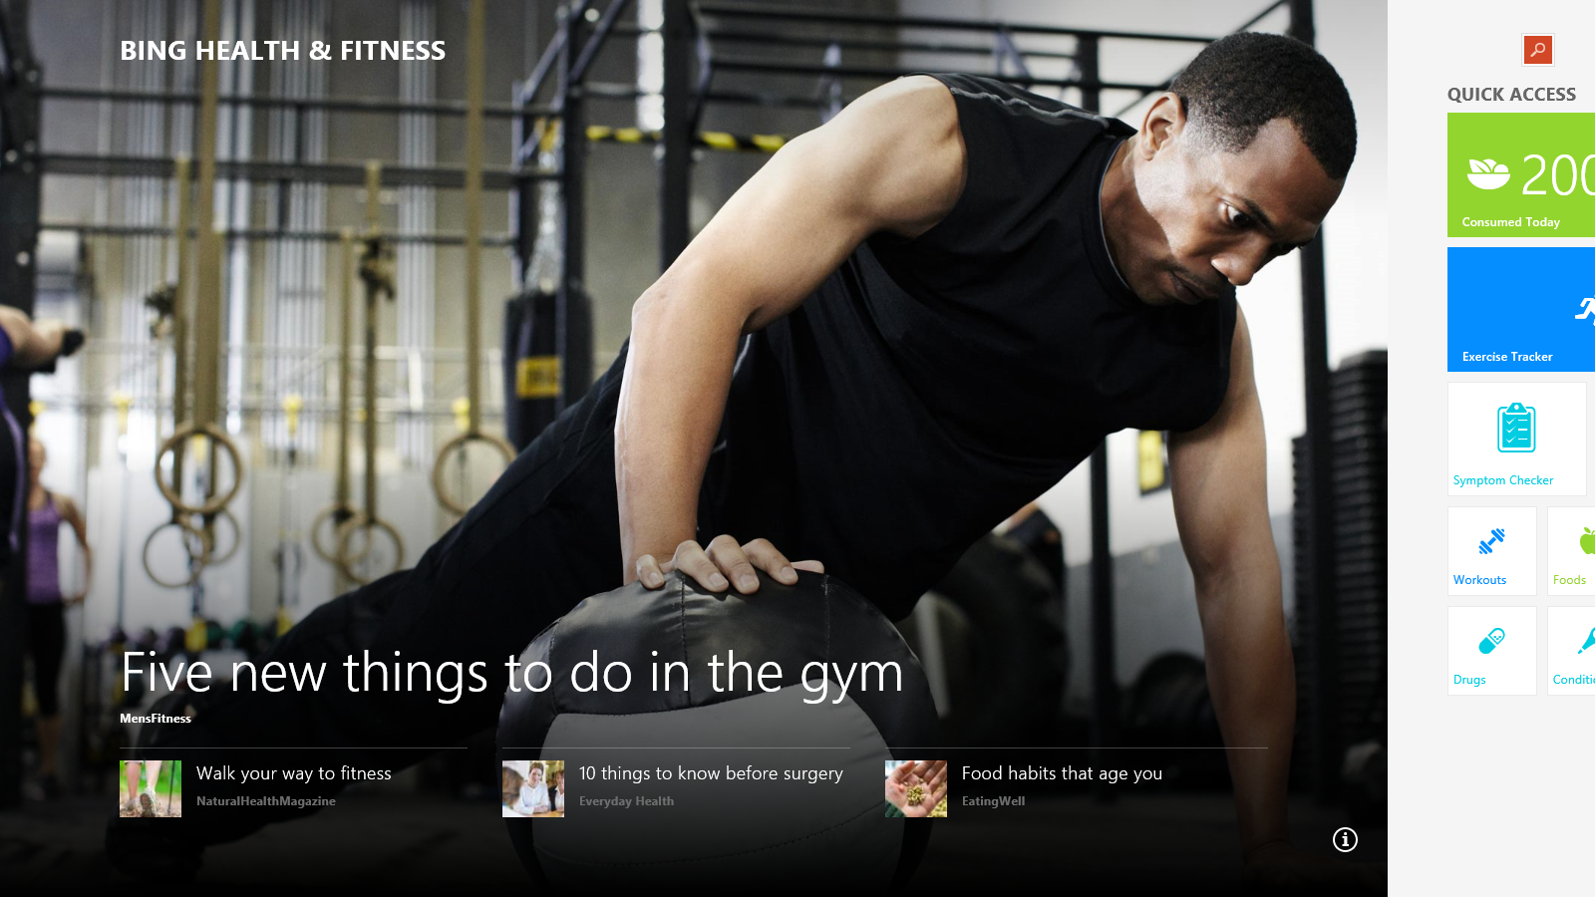
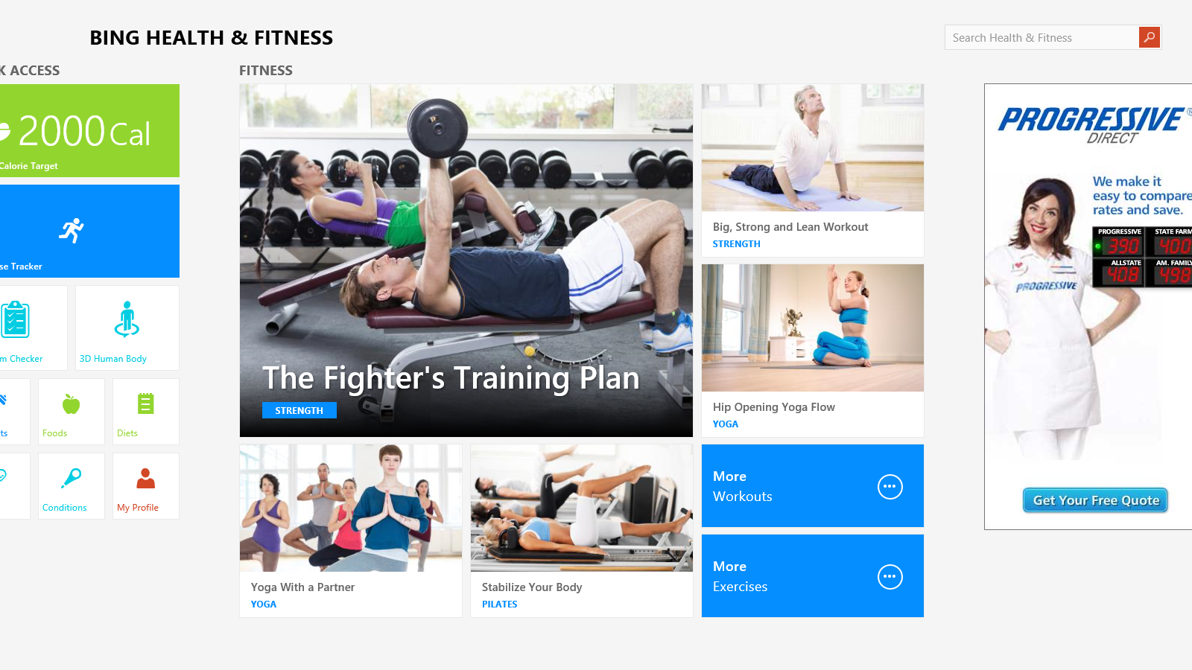
Content Experiences on Windows

Slide 8
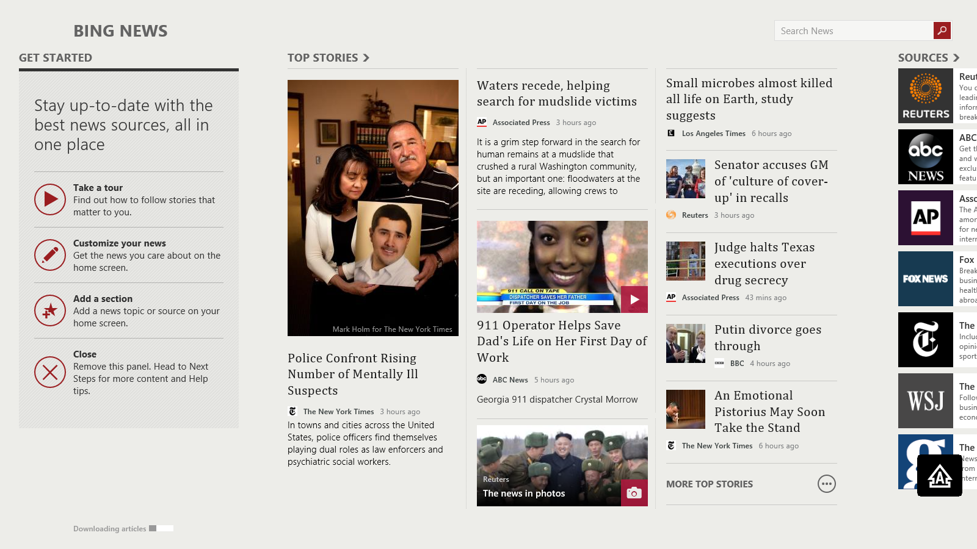
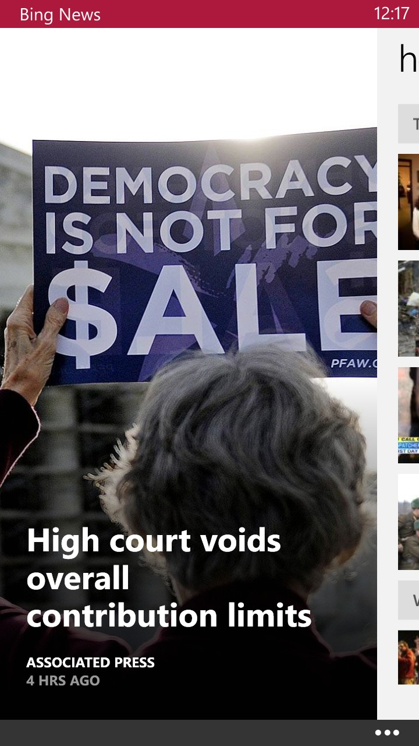
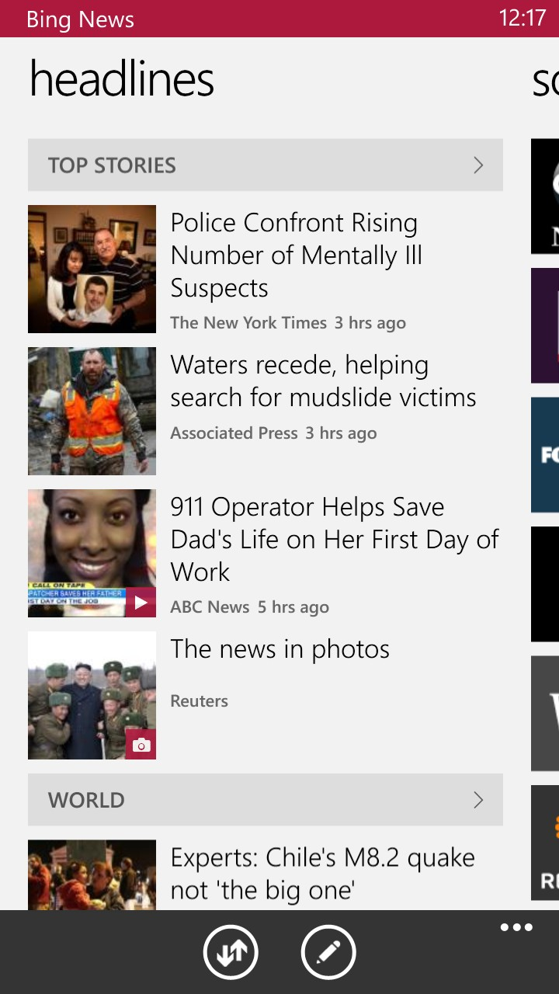
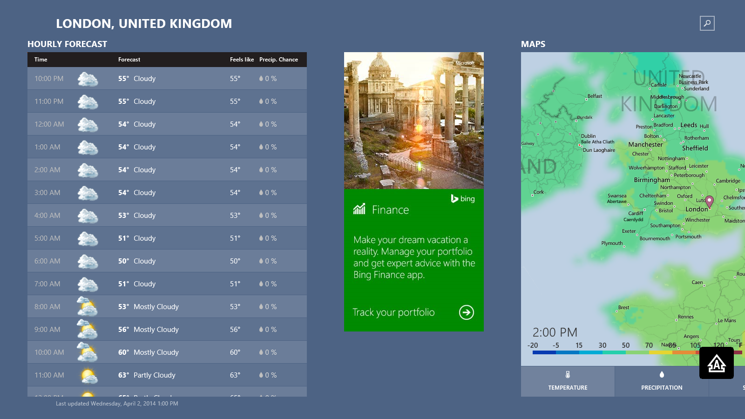
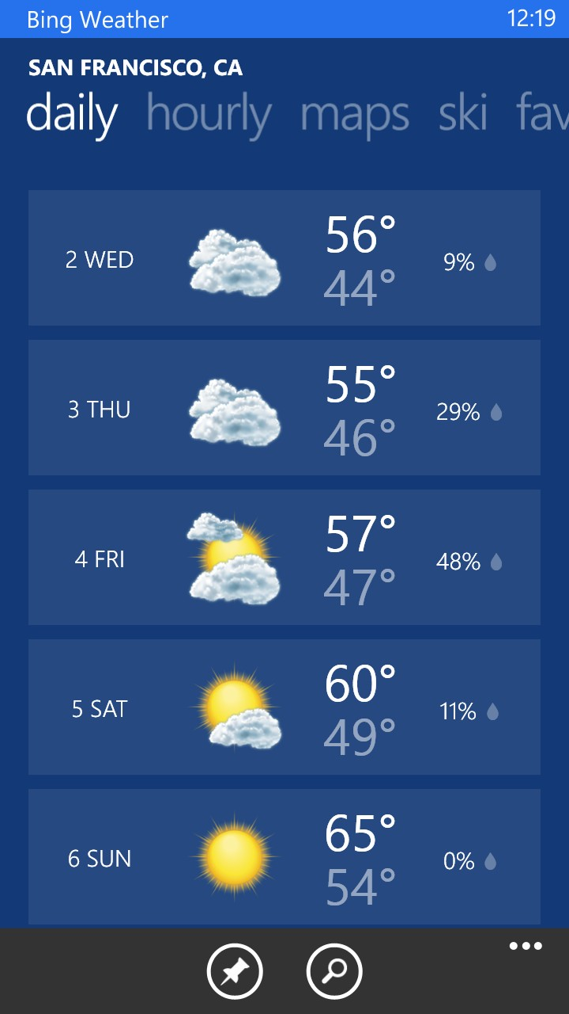
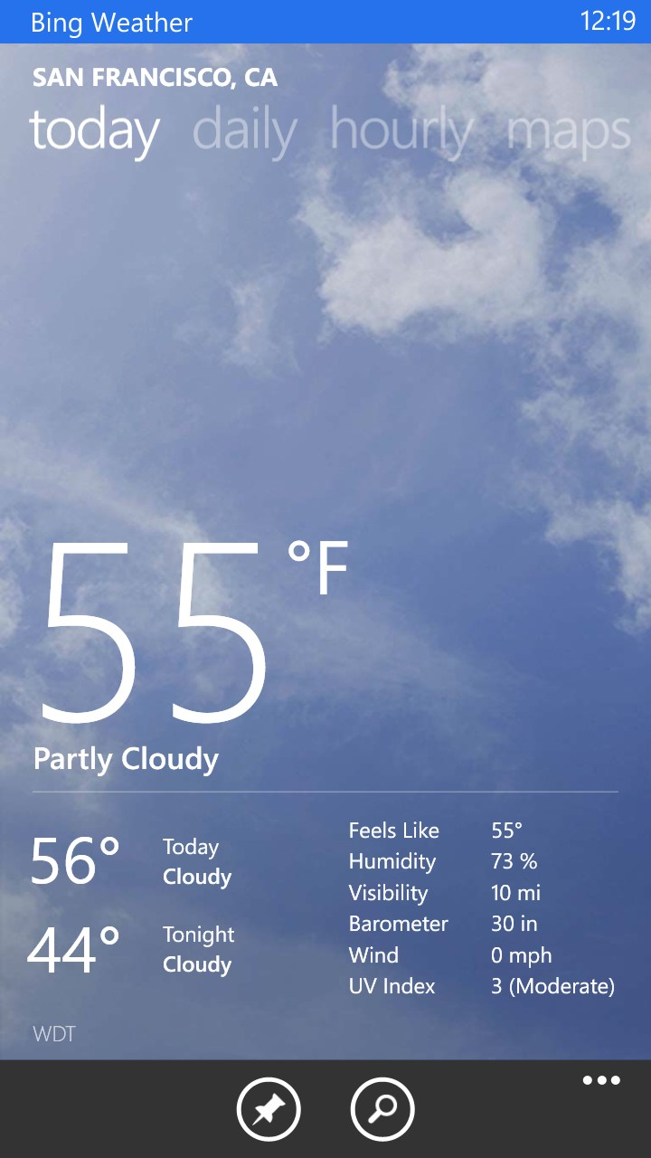
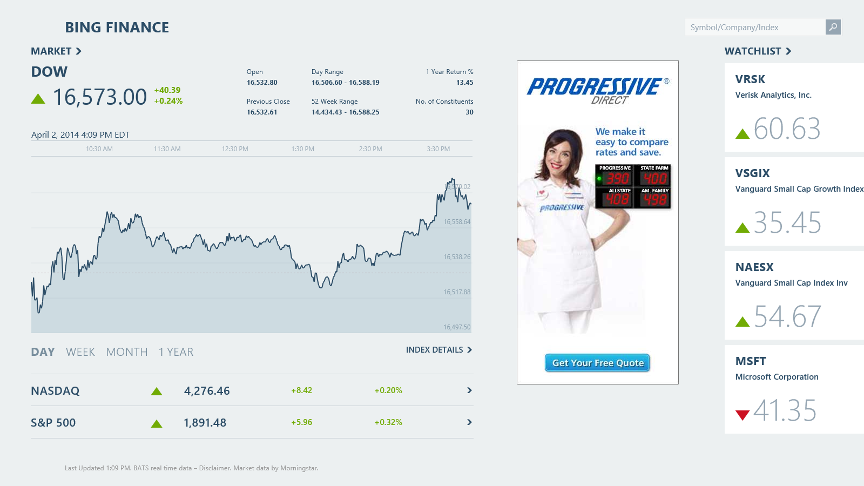
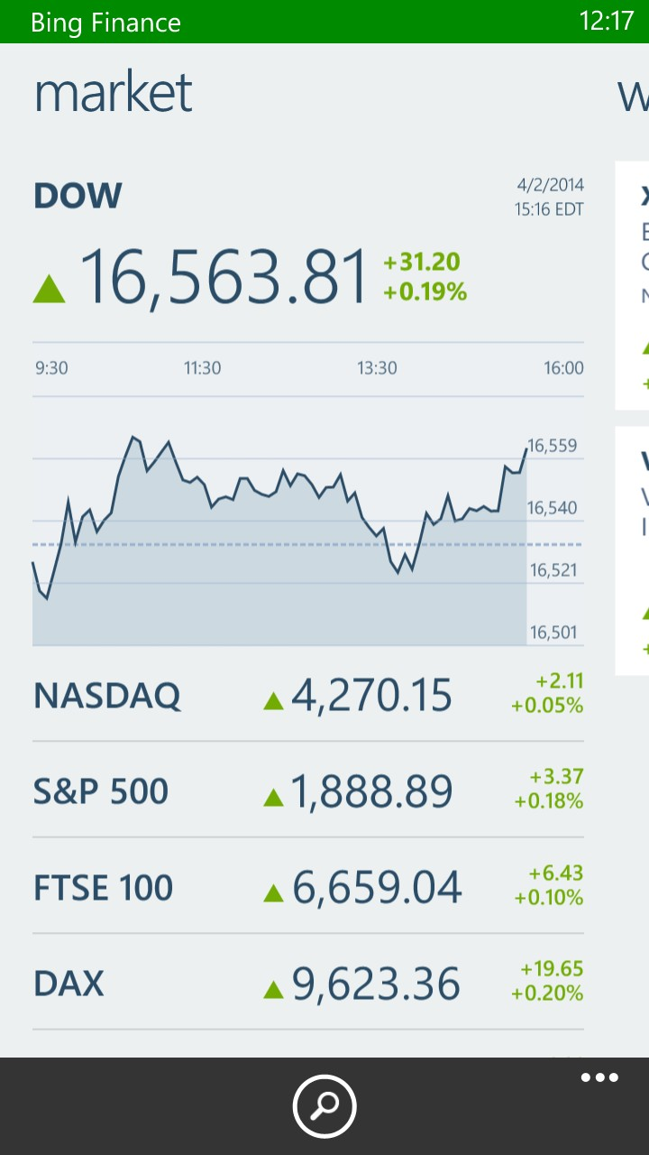
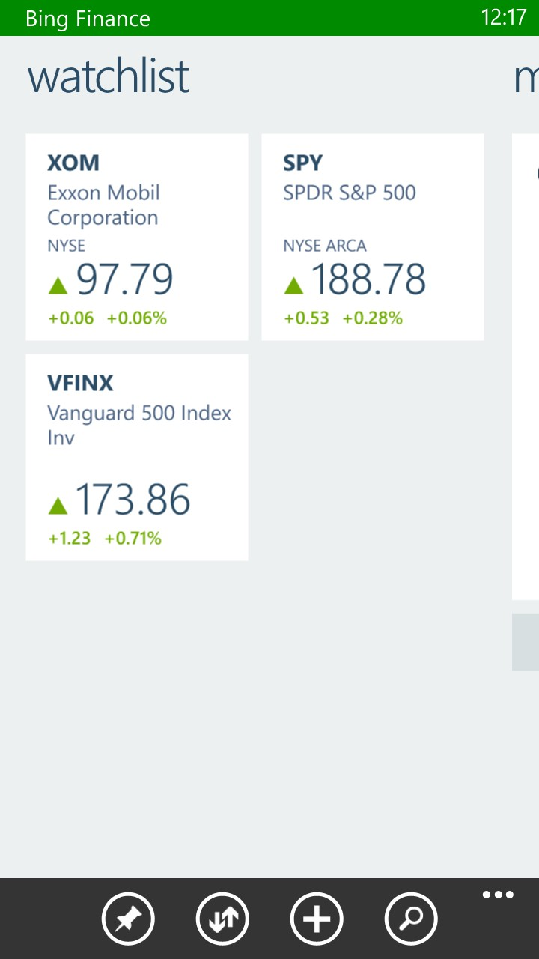
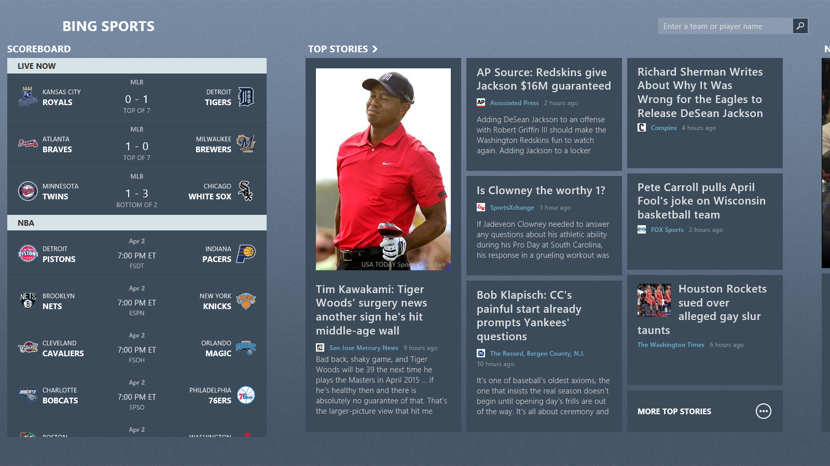
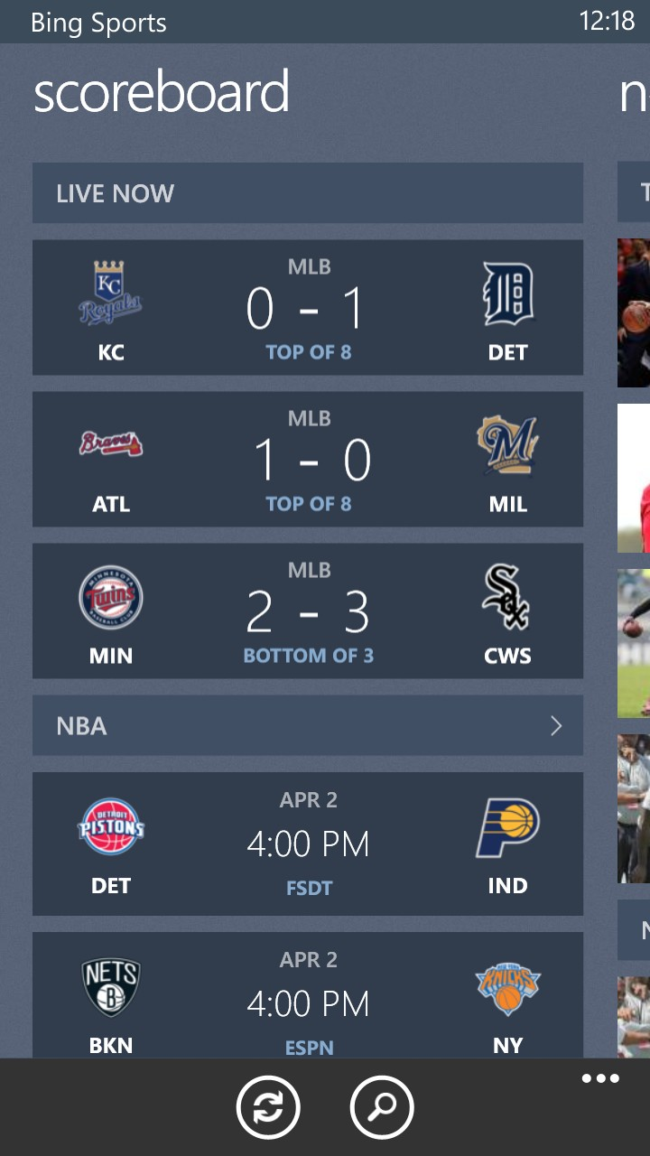
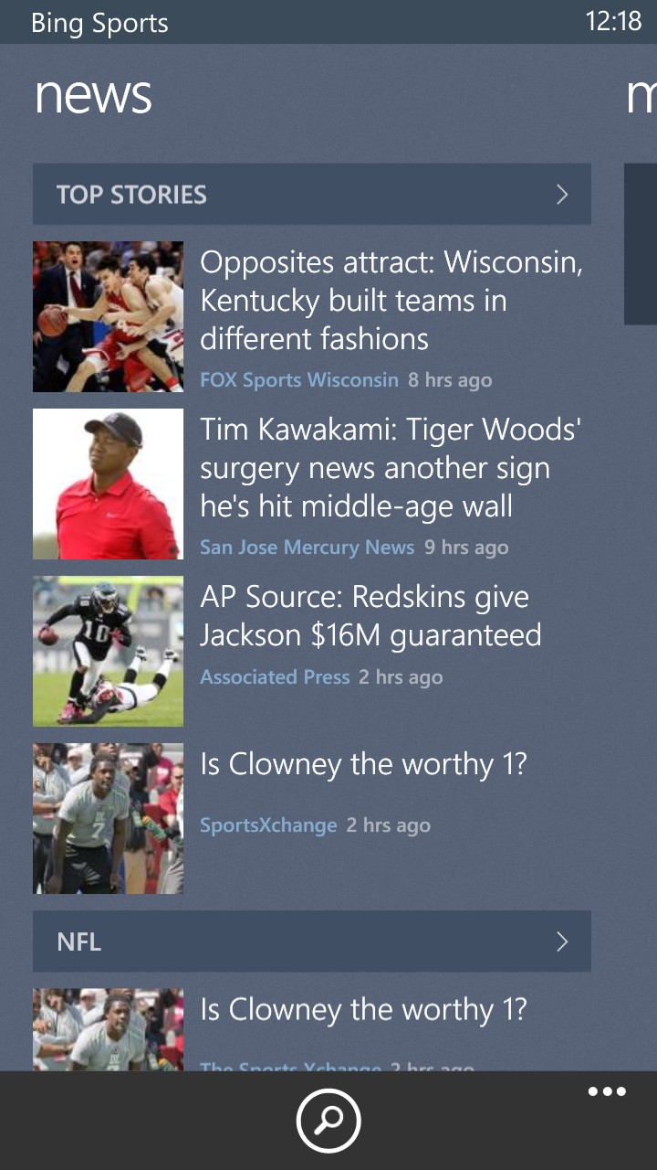
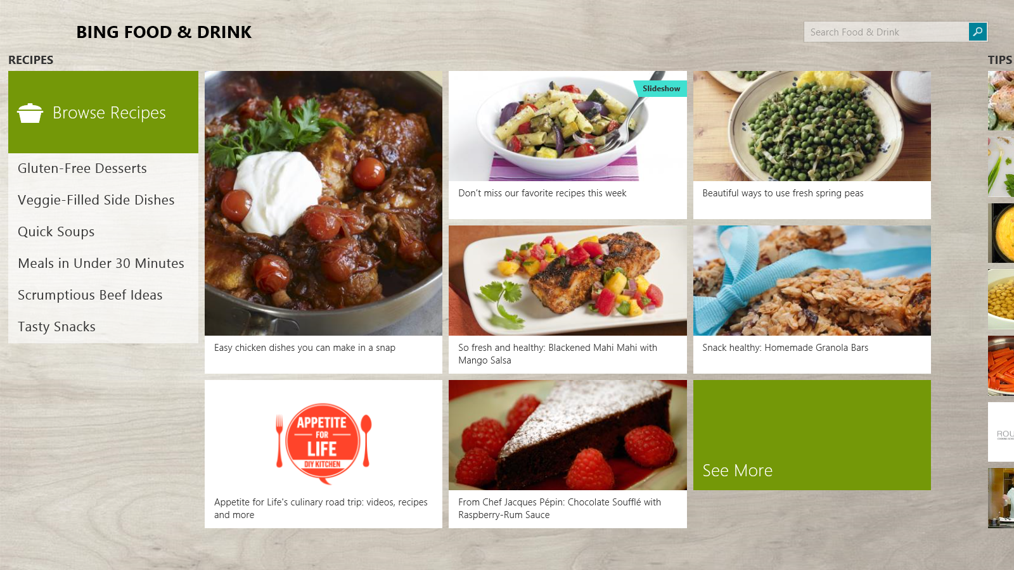
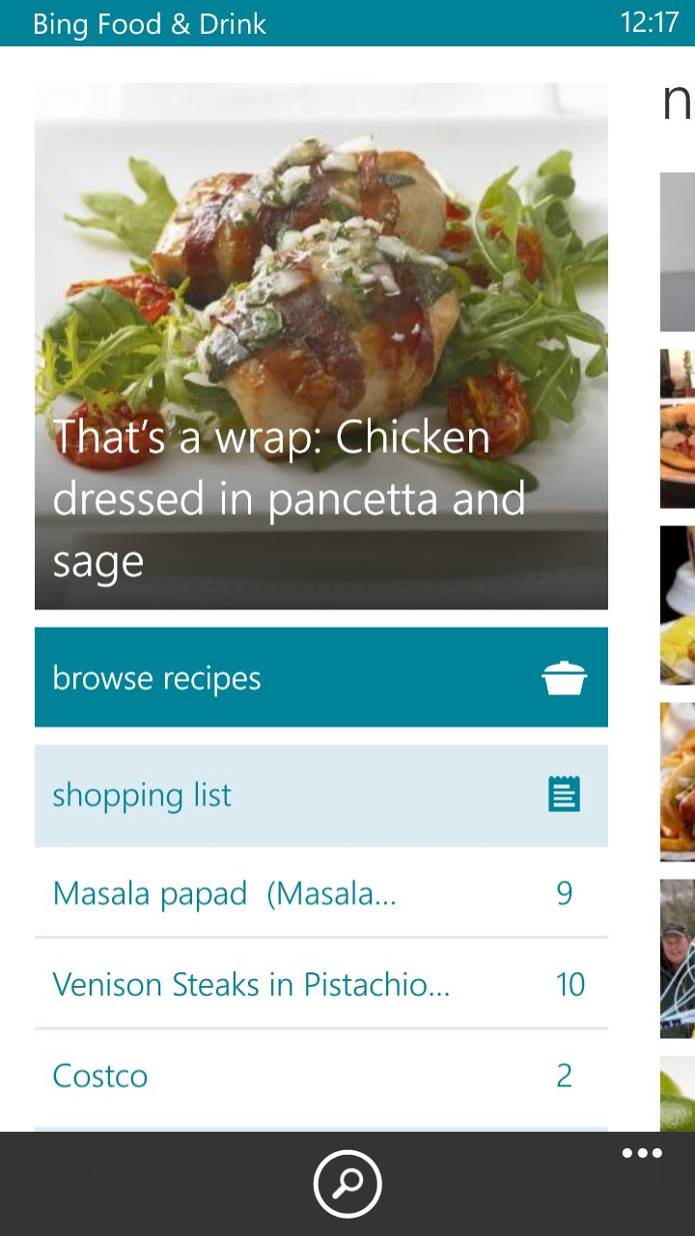
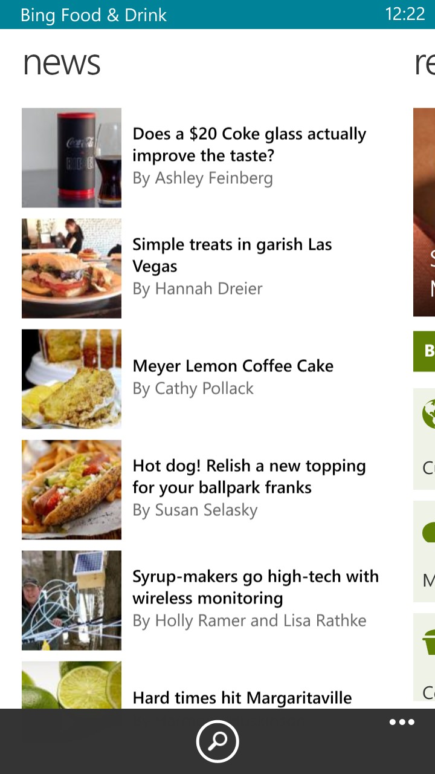
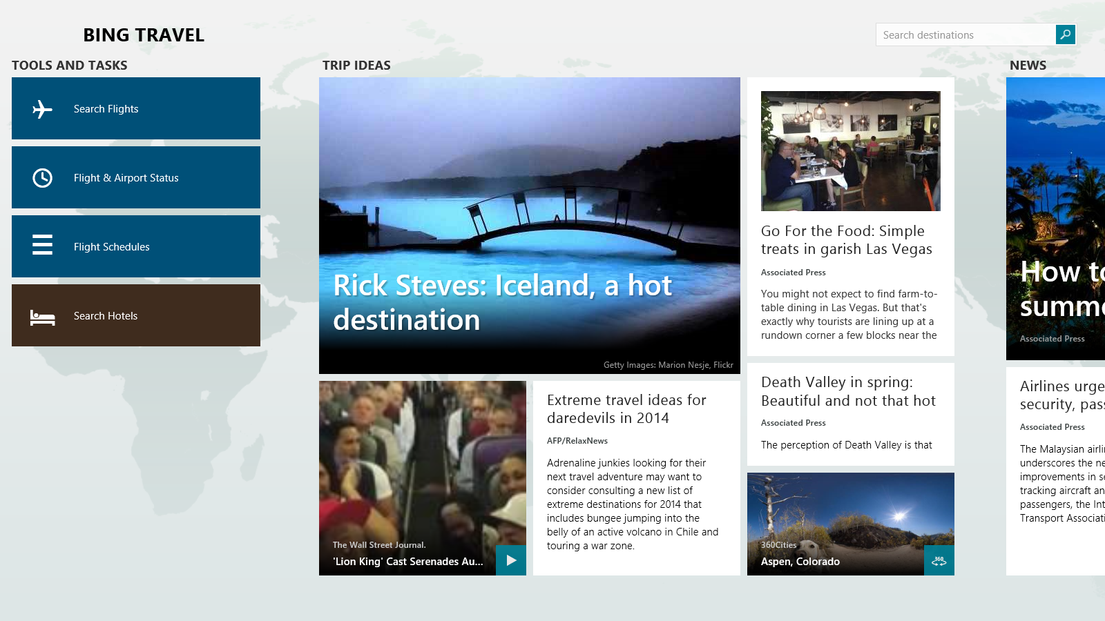
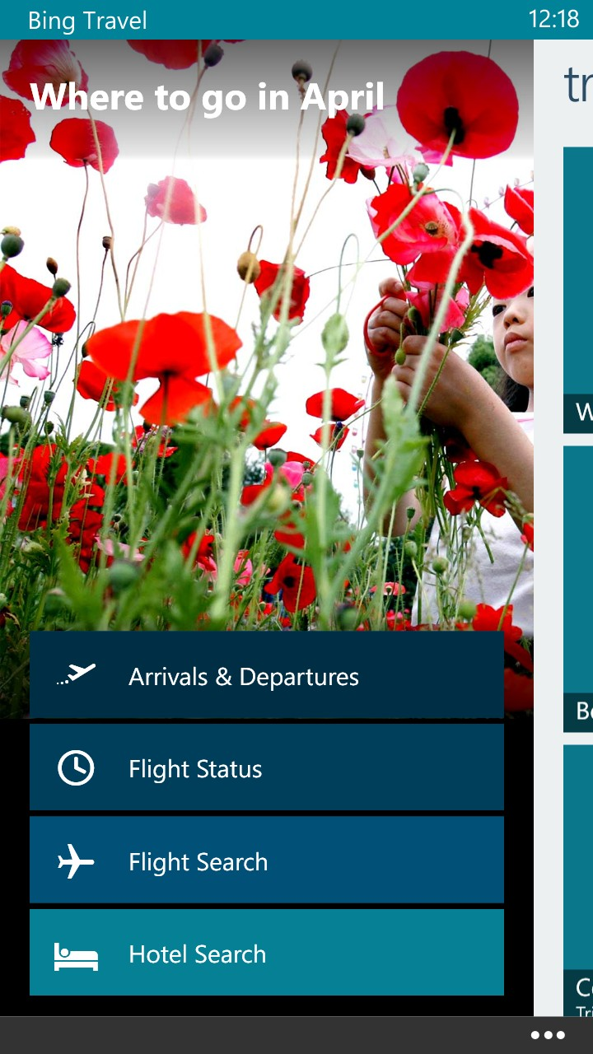
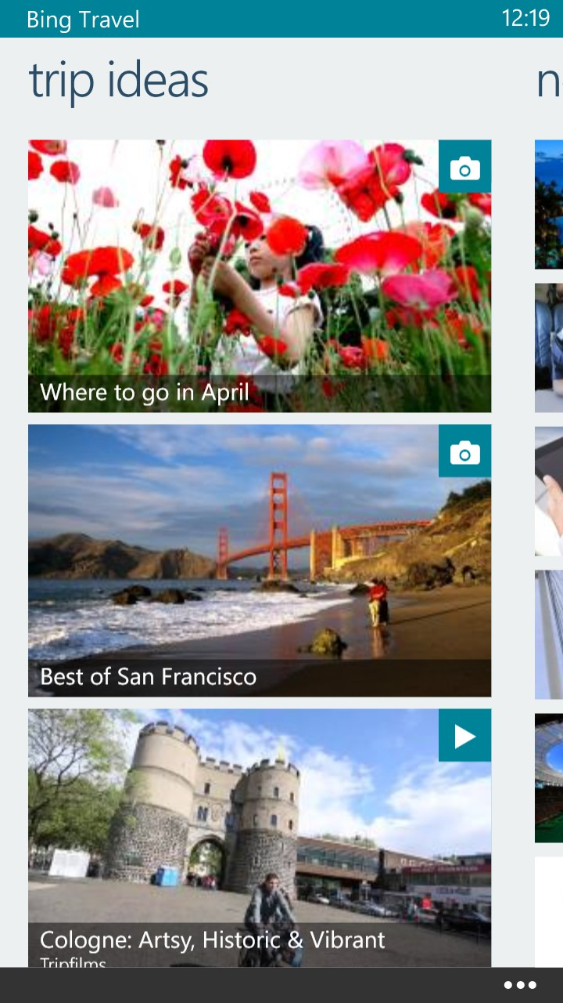
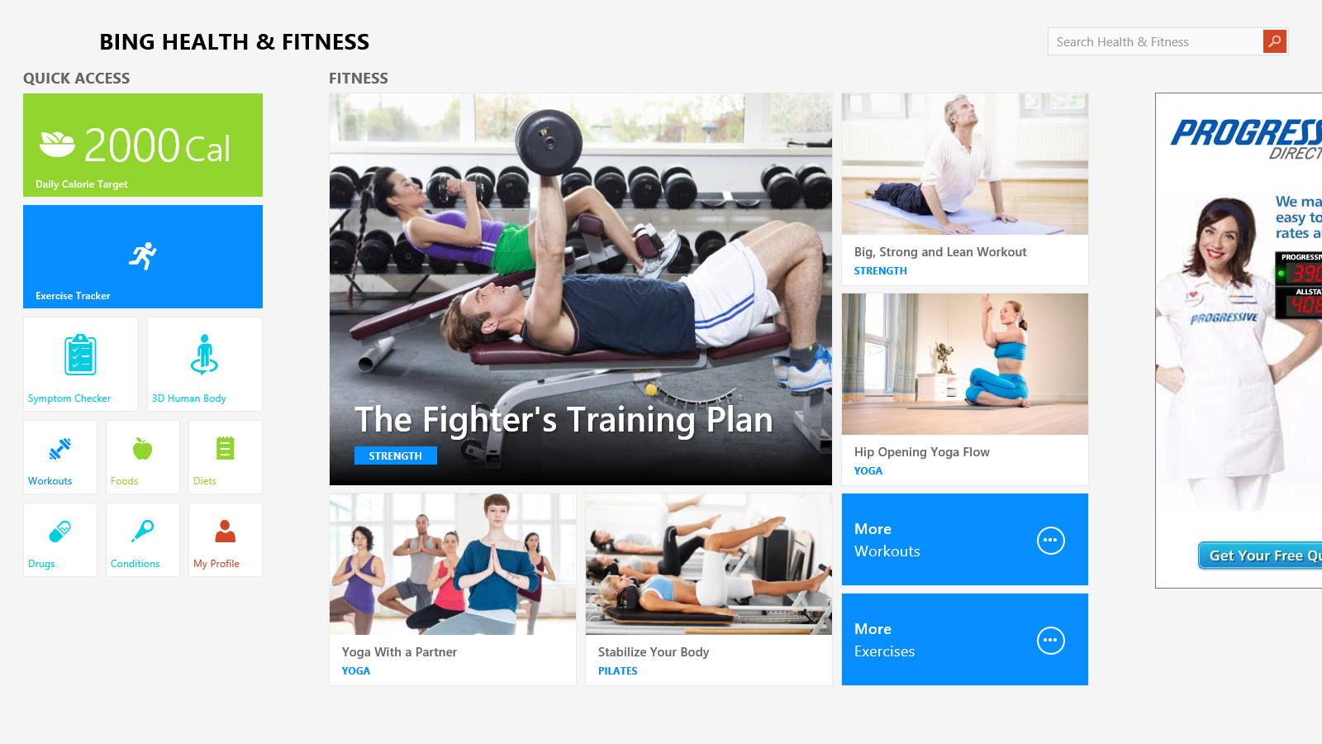
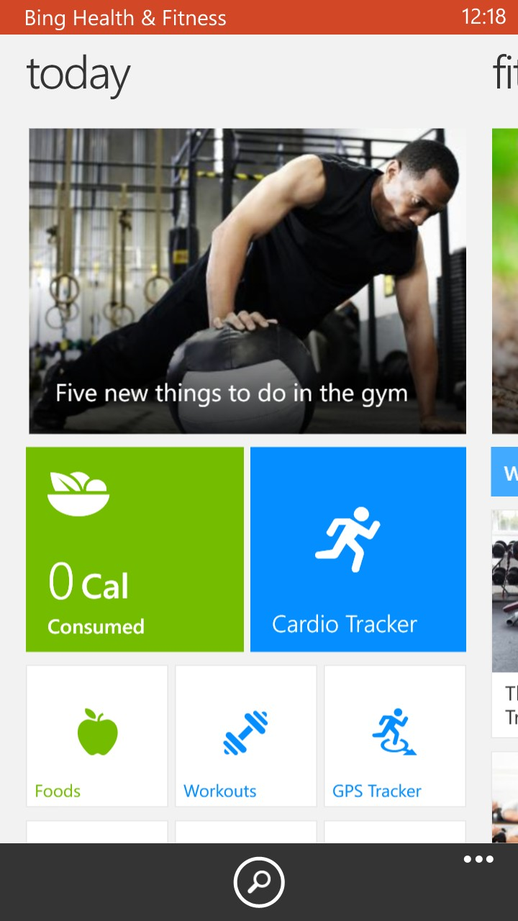
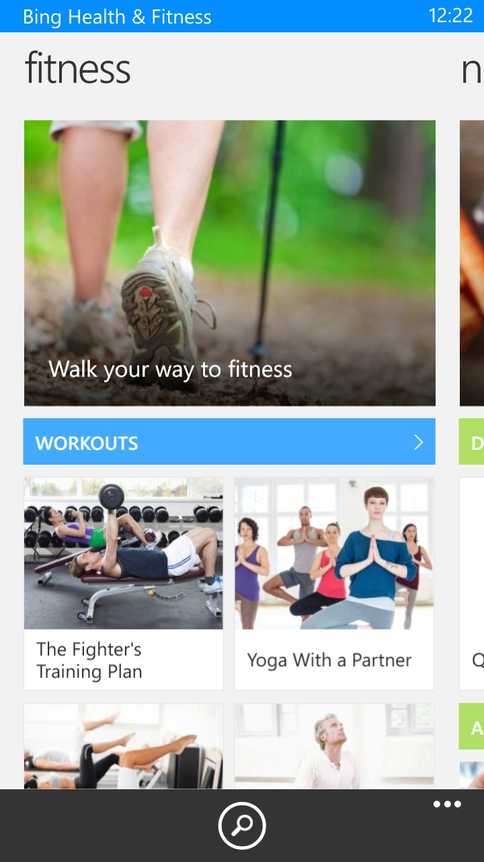
and Windows Phone…

Slide 9
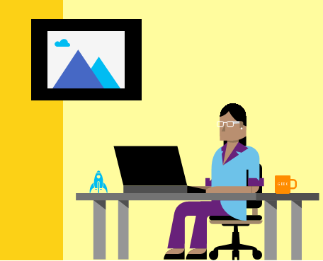
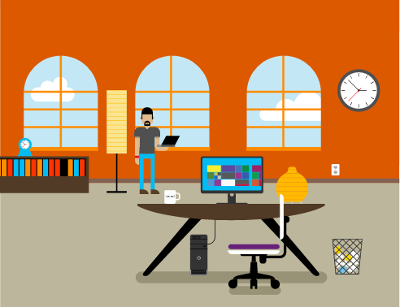


Form Factor Challenge
Blending of Boundaries

Slide 10
Clutter and overload are not attributes of information, they are failures of design.
— Edward Tufte

Slide 11
Designing across Form Factors
Design Patterns & Size of screen
User Engagement Style
Input Modality

Slide 12
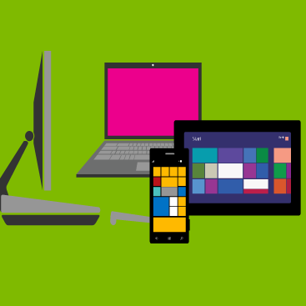
Demo
Design Patterns & Size of screen
User Engagement Style
Input Modality

Slide 13
Design Patterns & Screen Size
Minimize user learning
  Use & extend Platform Design Patterns
  Leverage the ecosystem for interaction paradigms
Optimize Info-Architecture for device
  Tie your apps across devices in with Color, Font and High-level IA
Tune data density for device

Slide 14
User Engagement Styles
Fun
Deep reading
Kill time
On the go
Understanding User Intent
Look for something
Analysis
Task completion

Slide 15
Demo
Design Patterns & Size of screen
User Engagement Style
  To snack or not to snack
  Tasks, Tasks, Tasks
  Search It!
Input Modality

Slide 16
Key Takeaways – User Engagement Style
Prioritize for user intent
…for every device!
Fun
Analysis
Kill time
On the go
Look for something
Task completion
Deep reading

Slide 17
Input Modality
Mouse & Keyboard
Touch
Camera
Leveraging device capability for input
Trackers
Voice
Sensors

Slide 18
Demo
Design Patterns & Size of screen
User Engagement Style
Input Modality
  Touch & Camera
  Voice
  Sensors

Slide 19
Demo
Design Patterns & Size of screen
User Engagement Style
Input Modality
  Touch & Camera
  Voice
  Sensors

Slide 20
Voice Command: Inside the covers
Step 1
Step 2
Step 3
Define the commands
Register the command
Handle voice activation

Slide 21
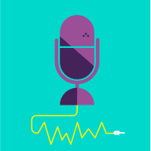
Code Walkthru

Slide 22
Key Takeaways – Voice Command
Step 1 : Define command
      <CommandPrefix>Bing Health</CommandPrefix>
      <Example> had 2 eggs for breakfast </Example>
      <Command Name="DietTrackerAll">
      <Example> had 2 eggs for breakfast </Example>
      <ListenFor>[had]{number} [*] {foodItem} [*] {mealTime}</ListenFor>
      <ListenFor>[ate]{number} [*] {foodItem} [*] {mealTime}</ListenFor>
      <Feedback> Adding {number} servings of {foodItem} for {mealTime} to Diet Tracker</Feedback>
      <Navigate Target="Pages\EditDietTrackerFoodPage.xaml"/>
      </Command>

Slide 23
Key Takeaways – Voice Command
  Step 1 (contd): Define slot values
    <PhraseList Label="number">
    OR
    <PhraseTopic Label="foodItem“ Scenario=“search">
    OR
    <PhraseTopic Label="dictatedCommand" Scenario=“dictation">
  Step 2: Register the Grammar
      VoiceCommandService.InstallCommandSetsFromFileAsync(new Uri("ms-appx:///VoiceCommandDefinition.xml"));
  Step 3: Handle callback in the app

Slide 24
Key Takeaways - Pros and Cons
Phrase List (Windows Phone 8.0)
  Pro: Rich feedback
  Cons : Works for categories which are inherently bounded
Phrase Topic - Scenario=search (Windows Phone 8.1)
  Pro: Supports entities which are ‘things’ – typically something you would look for in Bing.
  Con: Might not match user’s favorites if they are non standard. Requires internet connectivity.
  Phrase Topic - Scenario=dictation (Windows Phone 8.1)
  Pro: Complete control over parsing from within the app w/ significant increase in accuracy
  Con: Feedback is limited for eg., “Starting Bing Health”. Requires internet connectivity.

Slide 25
Input Modality – Sensors
Smart data collection using Nokia SensorCore API
Low power processing of sensor data
Centralized data logging for instant app experience
Activity tracking and places

Slide 26
Demo
Design Patterns & Size of screen
User Engagement Style
Input Modality
  Touch & Camera
  Voice
  Sensors

Slide 27
Key Takeaways
Step 1: Modify App Manifest
  2 Capabilities
      <DeviceCapability Name="location" />
      <m2:DeviceCapability Name="humaninterfacedevice">
  Define <Extensions>
Step 2: Add calls to SensorCore from App
  API’s to retrieve current step count and history
  // initialize
  StepCounter stepCounter = await StepCounter.GetDefaultAsync();
  // get current reading
  StepCounterReading currentSteps = await stepCounter.GetCurrentReadingAsync();
  // get logged events for the past 1 hour
  IList<StepCounterReading> steps = await stepCounter.GetStepCountHistoryAsync
  ( DateTime.Now.AddHours( -1 ), TimeSpan.FromHours( 1 ) );

Slide 28
Input Modalities – Sky is the limit!

Slide 29
Perfection is achieved, not when there is nothing more to add, but when there is nothing left to take away.
— Antoine de Saint Exupéry

Slide 30
Conclusion
Intuitive
Fun
Smart
Reducing user cognition
Tune for data density for device
Prioritize, prioritize, prioritize…
Bringing in new modality which solve the scenario

Slide 31
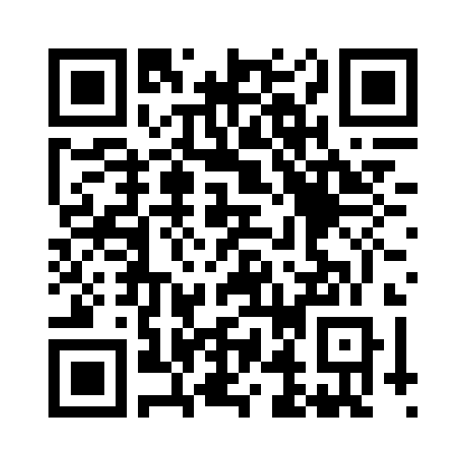
Your Feedback is Important
Fill out an evaluation of this session
and help shape future events.
Scan the QR code to evaluate
this session on your mobile device.
You’ll also be entered into
a daily prize drawing!

Slide 32

© 2014 Microsoft Corporation. All rights reserved. Microsoft, Windows, Windows Vista and other product names are or may be registered trademarks and/or trademarks in the U.S. and/or other countries.
The information herein is for informational purposes only and represents the current view of Microsoft Corporation as of the date of this presentation. Because Microsoft must respond to changing market conditions, it should not be interpreted to be a commitment on the part of Microsoft, and Microsoft cannot guarantee the accuracy of any information provided after the date of this presentation. MICROSOFT MAKES NO WARRANTIES, EXPRESS, IMPLIED OR STATUTORY, AS TO THE INFORMATION IN THIS PRESENTATION.

