Slide 2
Wrap a Mobile API Around your Enterprise and Take Data Offline with NoSQL on Windows Phones and Tablets
2-547
Rob Tiffany
Enterprise Mobility Strategist
Author, Keeping Windows 8 Tablets in Sync with SQL Server 2012

Slide 3
enterprise mobility

Slide 4
What are the Ingredients of Enterprise Mobility?
The best way to be Mobile-First is to be API-First
CIOs want to move data from any backend system out to any mobile device
Integrate and orchestrate diverse, proprietary APIs across myriad backend systems
Bring performance and scalability to backend systems that aren’t designed for web scale
Create mobile-friendly APIs to expose those backend systems to mobile devices
Publish APIs with a Mobile Access Gateway
Create apps for devices that can interact with API data and keep working in an offline state

Slide 5
Message
Bus
CRM
Flat
Files
Custom
Systems
Backend
Database
ERP
Web
Service
EDI
Server Facade
How do you get from here
To here?
API Tier
DMZ
Devices

Slide 6
api orchestration

Slide 7
How do you Mashup Disparate Systems?
Some vertically integrated backend systems are designed to communicate with mobile devices directly, but others will need help
Don’t spend your time trying to speak the language of each backend system by writing unmaintainable, system-specific code
Utilize pre-built, enterprise application integration (EAI) adapters like those found in SQL Server Integration Services (SSIS) to interface with each system
Visually connect data sources and destinations to move, transform, aggregate and cache composite data in SQL Server staging tables

Slide 8
Message
Bus
CRM
Flat
Files
EAI
Custom
Systems
Backend
Database
EAI
EAI
ERP
Web
Service
EAI
EAI
EAI
EAI
EDI
2 Terabytes per hour
SSIS
Adapters
2 Terabytes per hour
SQL Server
Staging
Tables
XML
API Orchestration
DB2
SAP
HTTP
EDI
FTP
LDAP
IMS
ADO.NET
MQ Series
VSAM
MSMQ
SQL Server Compact
FoxPro
Siebel
ODBC
SMTP
WebSphere
OLEDB
Ingres
ADABAS
Custom
SharePoint
webMethods
API Tier
PostgreSQL
Access
MySQL
Informix
Tibco Rendezvous
Oracle
Sybase
Salesforce
Dynamics
SeeBeyond
DMZ
Teradata
Lotus Notes
Hyperion
Flat Files
Web Services
Internet

Slide 9
scaling out

Slide 10
Scale out your Data
Prepare SQL Server for data sharding by creating a shared-nothing, horizontally partitioned architecture
Why allow millions of devices to overwhelm a single database?
Replication and AlwaysOn are built-in features of SQL Server
It’s better to have smaller groups of devices connect to multiple, replicated copies of the database
Filter and replicate databases, tables, and columns to other SQL Server nodes
Create read-only, Transactional replication subscribers to scale data
Utilize memory-optimized, subscriber tables in SQL Server 2014
Facilitate geo-replication via Peer to Peer Transactional Replication

Slide 11
Backend
SQL Server
Subscriber
(Read)
Replication
Replication
SQL Server
Subscriber
(Read)
1
SQL Server
Publisher
(Write)
Data Sharding
SQL Server
Subscriber
(Read)
SQL Server
Subscriber
(Read)
Replication
Replication
Parallelism
Parallelism
API Tier
DMZ
Internet
Demo

Slide 12
welcome to the api economy

Slide 13
APIs
APIs before apps
Use Multichannel Transports and Data Formats
REST is how the mobile Internet communicates
JSON is how the mobile Internet serializes data
GZip/Deflate is how the mobile Internet compresses data
Build an API Tier
Convert proprietary APIs and wire protocols to mobile-friendly APIs
Retrieve Data from backend systems to hydrate your Business Objects
Serialize coarse-grained collections of business objects as JSON
Pre-fetch data instead of making frequent, fine-grained API calls
Performance + Scalability + Availability
Cache frequently used data via the MemoryCache class, Azure Cache, or AppFabric Caching
Load-balance API servers (IIS, Web Roles and IaaS)

Slide 14
Backend
1
2
1
2
SQL Server
Subscriber
(Read)
SQL Server
Subscriber
(Read)
SQL Server
Subscriber
(Read)
SQL Server
Subscriber
(Read)
1
2
NLB Cluster
NLB Cluster
1
2
SQL Server
Subscriber
(Read)
SQL Server
Subscriber
(Read)
SQL Server
Subscriber
(Write)
Scale Out
SQL Server
Subscriber
(Write)
Virtual
IP
Virtual
IP
NLB Cluster
NLB Cluster
Virtual
IP
Virtual
IP
Cache
Cache
Cache
Cache
API
Server
API
Server
API
Server
API
Server
API
Server
API
Server
API Tier
API
Server
API
Server
DMZ
Internet
Demo

Slide 15
gateway

Slide 16
Mobile Access Gateway
Securely publish on-premise APIs from your corporate network out to the Internet
Web Application Proxy
A new Remote Access server role in Windows Server 2012 R2
Sits in the DMZ between front and back firewalls with inbound and outbound network interface cards
Works with an AD FS server to securely publish services that use claims-based authentication or Kerberos
A reverse proxy routes requests from external URLs to internal URLs
Workplace Join
Register with Active Directory so devices become “known” to IT
Supports multifactor authentication
Single Sign On (SSO)

Slide 17
Backend
Server Facade
API
Server
API
Server
API
Server
NLB Cluster
API
Server
API
Server
API
Server
API Tier
API
Server
Virtual
IP
API
Server
Back Firewall
NLB Cluster
DMZ
Mobile Access Gateway
Virtual
IP
Mobile Access Gateway
Front Firewall
Internet

Slide 18
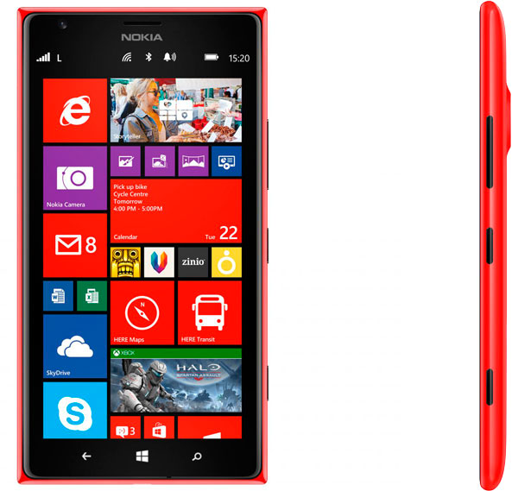
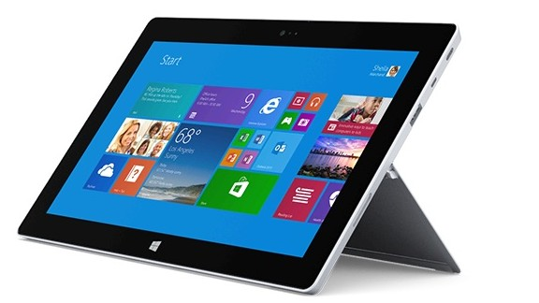
bring your device to life with data

Slide 19
Consume APIs and Work Offline with NoSQL
Data is the new oil
HttpClient is your new best friend
Asynchronously call RESTful APIs
Support automatic decompression via GZip and Deflate
Download JSON data results and de-serialize into object collections
Serialize newly created data on your device as JSON and upload
Utilize NoSQL tables to implement offline data capabilities for Windows Phones and Tablets
Keep your customers working in the absence of network connectivity
Create Tables and use LINQ to query in-memory object collections
Execute SQL operations like SELECT, INSERT, UPDATE, and DELETE
Perform multi-table JOINs

Slide 20
Demo
Backend
Server Facade
API Tier
Back Firewall
NLB Cluster
DMZ
Mobile Access Gateway
Virtual
IP
Mobile Access Gateway
Front Firewall
NoSQL
Internet
NoSQL
NoSQL
NoSQL
NoSQL
NoSQL

Slide 21
Message
Bus
CRM
Flat
Files
EAI
Custom
Systems
Backend
Database
EAI
EAI
ERP
Web
Service
EAI
EAI
EAI
EAI
EDI
SSIS
Adapters
1
2
Replication
1
2
SQL Server
Subscriber
(Read)
SQL Server
Subscriber
(Read)
Replication
SQL Server
Subscriber
(Read)
SQL Server
Subscriber
(Read)
1
2
NLB Cluster
SQL Server
Publisher
(Write)
NLB Cluster
1
2
SQL Server
Subscriber
(Read)
SQL Server
Subscriber
(Read)
SQL Server
Subscriber
(Read)
Server Facade
Replication
Replication
SQL Server
Subscriber
(Read)
Virtual
IP
Virtual
IP
NLB Cluster
NLB Cluster
Virtual
IP
Virtual
IP
Cache
Cache
Cache
Cache
API
Server
API
Server
API
Server
NLB Cluster
API
Server
API
Server
API
Server
API Tier
API
Server
Virtual
IP
API
Server
Back Firewall
NLB Cluster
DMZ
Mobile Access Gateway
Virtual
IP
Mobile Access Gateway
Front Firewall
NoSQL
Internet
NoSQL
NoSQL
NoSQL
NoSQL
NoSQL

Slide 22
we’re done

Slide 23
Your Feedback is Important
Fill out an evaluation of this session and help shape future events.
Scan the QR code to evaluate this session on your mobile device.
You’ll also be entered into a daily prize drawing!

Slide 24
© 2014 Microsoft Corporation. All rights reserved. Microsoft, Windows, Windows Vista and other product names are or may be registered trademarks and/or trademarks in the U.S. and/or other countries.
The information herein is for informational purposes only and represents the current view of Microsoft Corporation as of the date of this presentation. Because Microsoft must respond to changing market conditions, it should not be interpreted to be a commitment on the part of Microsoft, and Microsoft cannot guarantee the accuracy of any information provided after the date of this presentation. MICROSOFT MAKES NO WARRANTIES, EXPRESS, IMPLIED OR STATUTORY, AS TO THE INFORMATION IN THIS PRESENTATION.

