Slide 2
Windows App Studio Beta
2-565
Bryan Tomlinson
Senior Product Marketing Manager
Ricardo Minguez Pablos
Senior Application Development Manager

Slide 3
Can you build an app for my garage band?
Can you teach my kid’s class how to code?
I can’t program a VCR, but I want to
build an app, can you help me?
We have a lunch meeting with a client in a half hour, can you whip up a basic app for them?

Slide 4
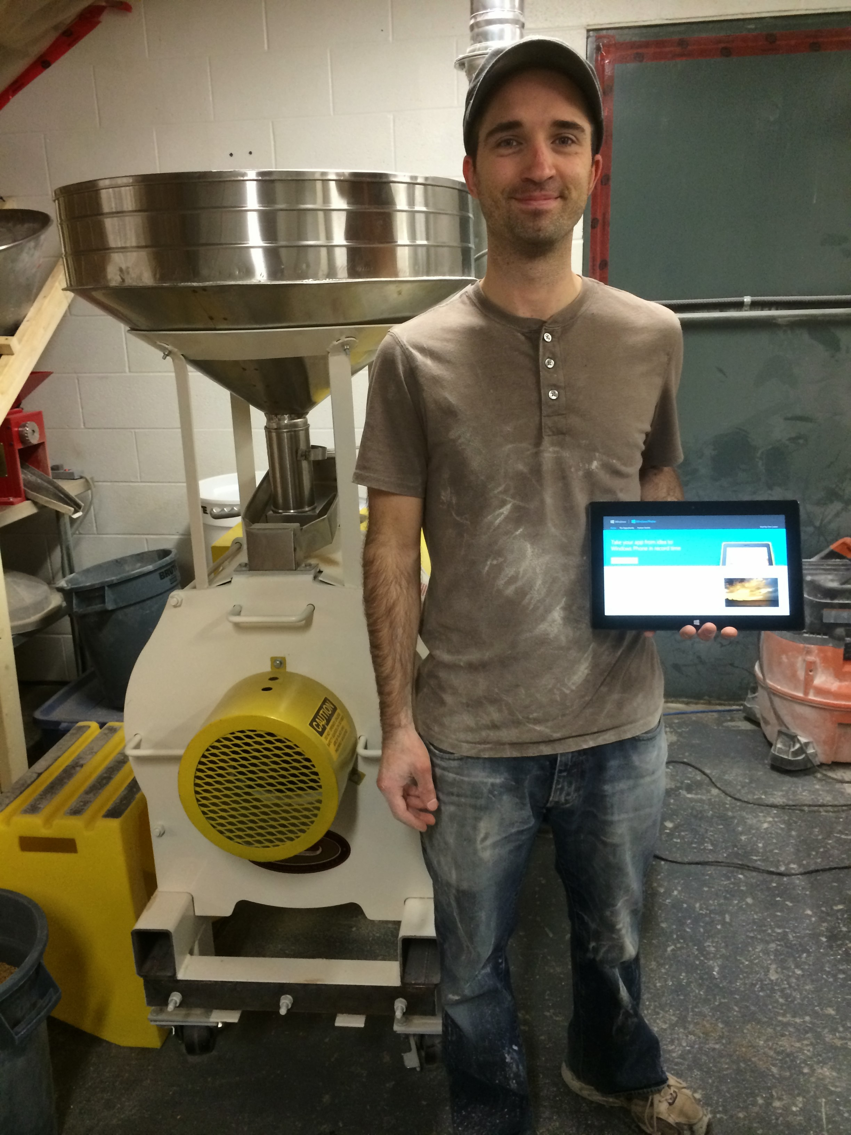
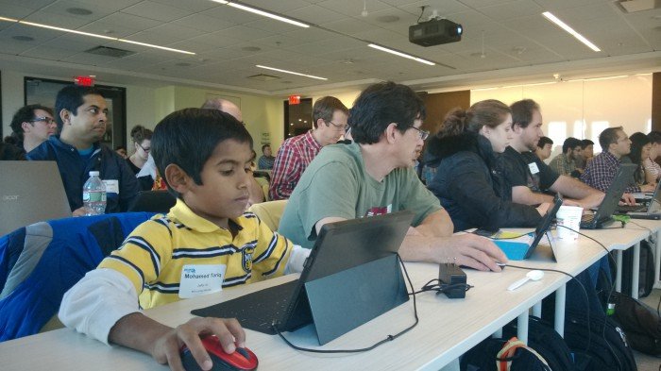
Windows Phone App Studio Beta: The first 8 months
370,000 app projects
20,000 apps published to Windows Phone Store

Slide 5
Windows Phone App Studio Beta
Windows App Studio Beta
appstudio.windowsphone.com
Launch 04.3.14 9:00AM PST
Quickly turn your content into apps for Windows and Windows Phone users worldwide.

Slide 6
App Development Lifecycle
Plan/Design
Use Visual Studio to Modify App
Test/Debug App in Emulator
Test App on Real Device
Publish App in App Store
Use App Studio to Create App

Slide 7
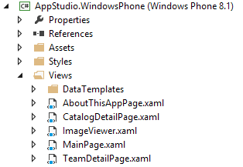
Apps Architecture. Sections.

Slide 8
Demo
appstudio.windowsphone.com
appstudio.windows.com
Choosing a template
Adding Content
Configuring Themes and Tiles
Preparing an app for Store
Generating an app
Extending in Visual Studio

Slide 9
Demo
appstudio.windowsphone.com
appstudio.windows.com
Choosing a template
Adding Content
Configuring Themes and Tiles
Preparing an app for Store
Generating an app
Extending in Visual Studio

Slide 10
MVVM
View
XAML
Code-Behind
View
Data-binding and commands
Change notification
XAML
View Model
Data Model
Code-Behind
Event Handlers
Data Model
State + Operations

Slide 11
Data Sources
WP8 Generated Code and adding Twitter
MVVM and Solution Structure
Adding the Twitter DataSource

Slide 12
Editing Layouts
Publishing to Store
Publishing a Universal Windows app
 | Windows Phone 8.0 | Windows Phone 8.1 | Windows 8.1
Runtime | Silverlight | XAML
Tool | VS 2012 Express | VS 2013 Express + Update 2
Project | Windows Phone Project | Universal Project
Runs | WP8.0 | WP8.0 & WP8.1 | Windows 8.1
Side loading (QR) | X | X
Side loading (PowerShell) |  |  | X
Store Packages | X | (*)X | X

Slide 13
Additional Resources
User Voice
http://wpdev.uservoice.com/forums/216486
Support Forum
http://social.msdn.microsoft.com/Forums/wpapps/en-US/home?forum=wpappstudio
Curriculum – for teachers and presenters
http://aka.ms/appstudioeducation

Slide 14
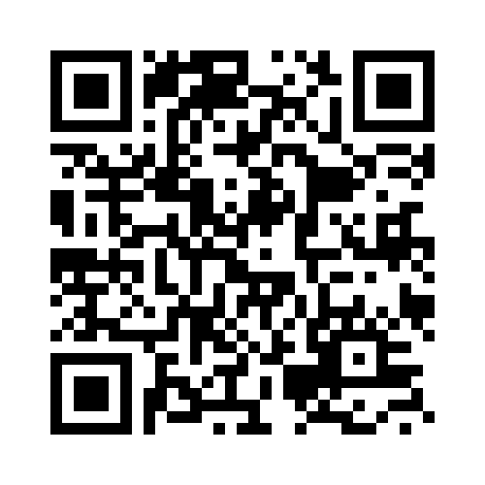
Q&A
Your Feedback is Important
Fill out an evaluation of this session and help shape future events.
Scan the QR code to evaluate this session on your mobile device.
You’ll also be entered into a daily prize drawing!

Slide 15
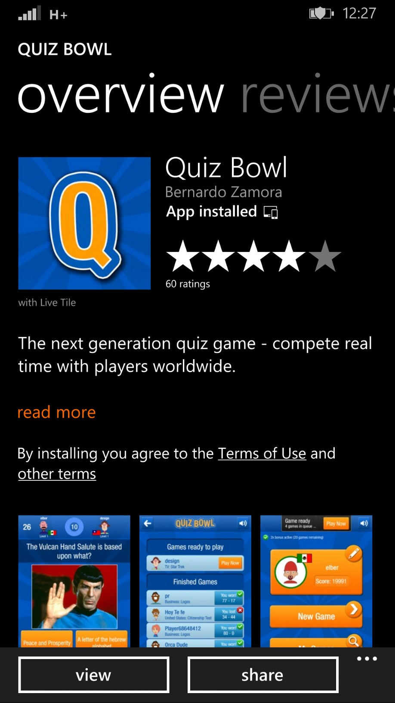
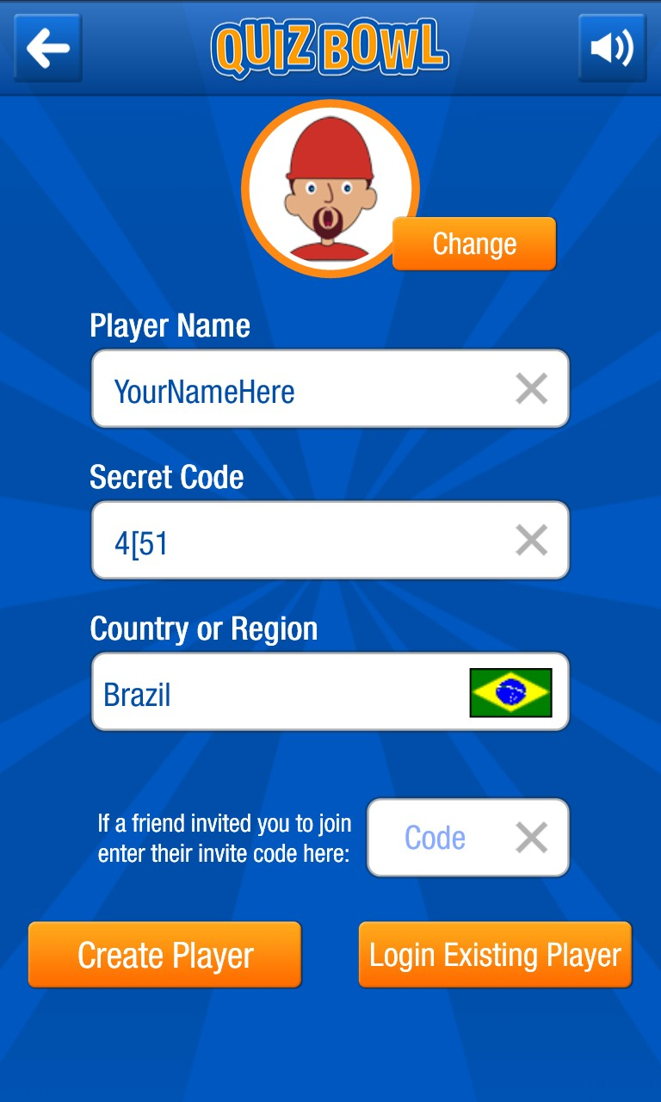
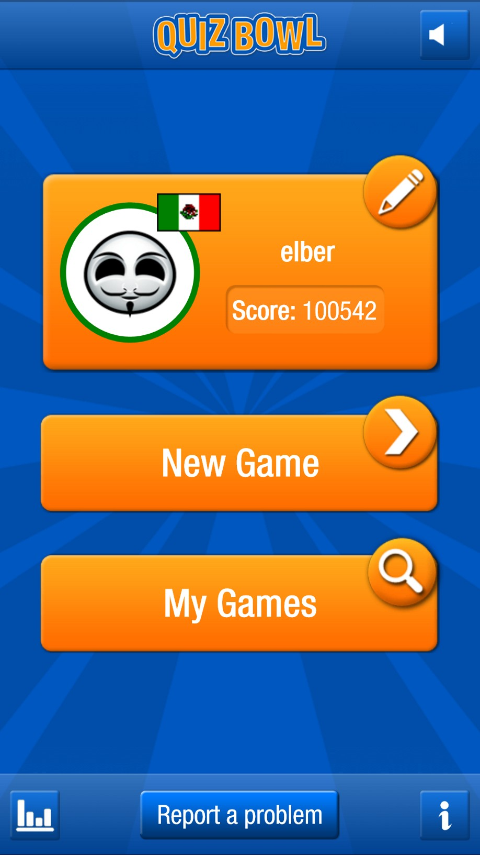
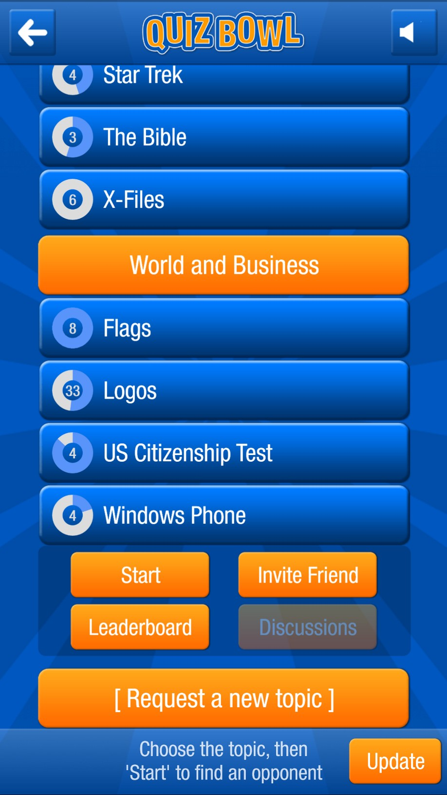
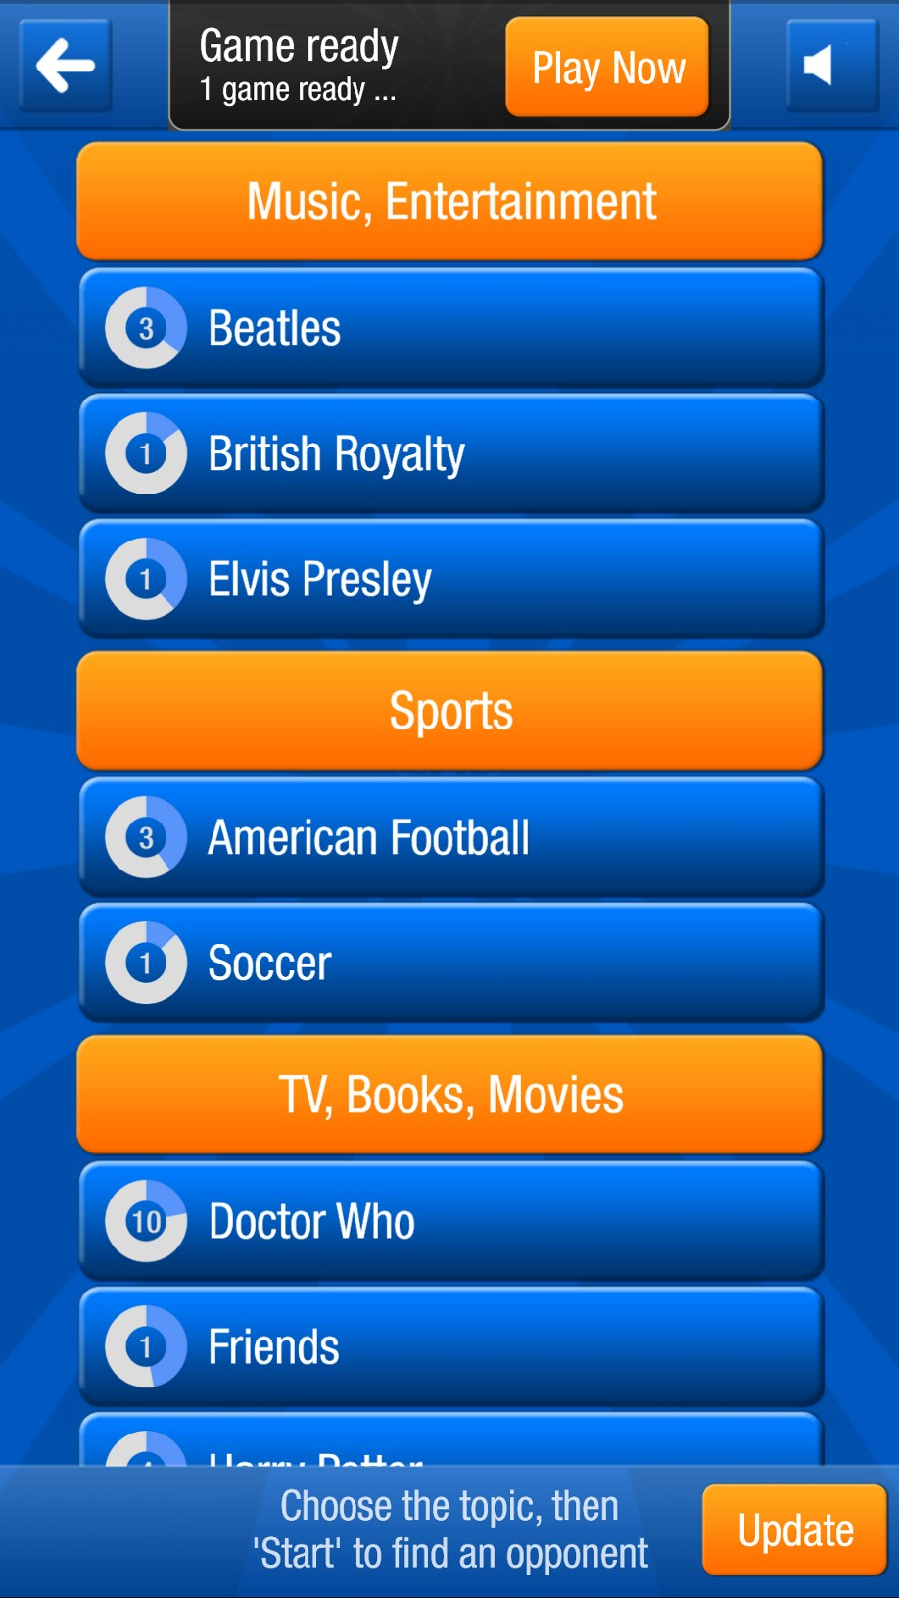
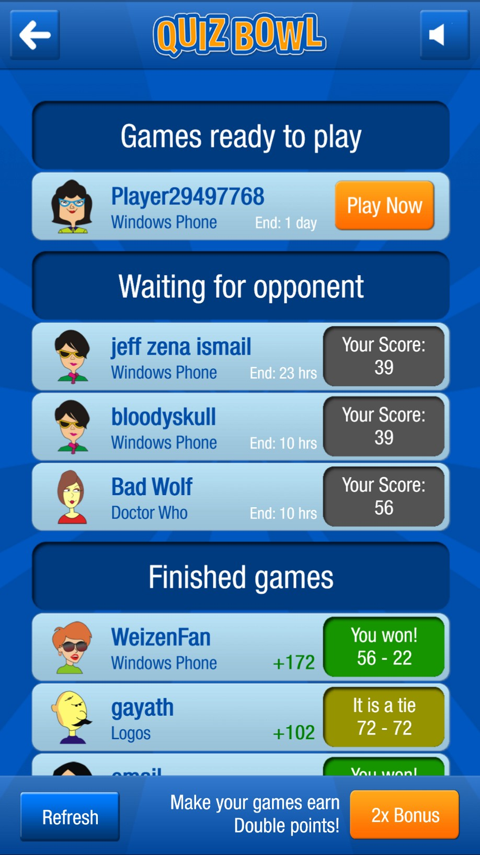
INSTRUCTIONS: 1) Install Quiz Bowl and Create a Profile (player name doesn’t matter) 2) Select New Game 3) Select Windows Phone topic (in World and Business category). Select Start (If you don’t see the topic, select Update in bottom right) 4) Select Play Now 5) Find a Match and Select Play Now (7 questions). 6) When you see your final score, stay on that page and show us
App Studio Challenge
❶
❷
❸
❹
❺
RULES:
You can more than once; however, your last game played counts! You have 5 minutes and only games started and finished during those 5 minutes count!
Time counts! So answer questions correctly and quickly.
The highest score wins a Lumia 1520
In the event of a tie, I’ll ask a final challenge question.
.

Slide 16
© 2014 Microsoft Corporation. All rights reserved. Microsoft, Windows, Windows Vista and other product names are or may be registered trademarks and/or trademarks in the U.S. and/or other countries.
The information herein is for informational purposes only and represents the current view of Microsoft Corporation as of the date of this presentation. Because Microsoft must respond to changing market conditions, it should not be interpreted to be a commitment on the part of Microsoft, and Microsoft cannot guarantee the accuracy of any information provided after the date of this presentation. MICROSOFT MAKES NO WARRANTIES, EXPRESS, IMPLIED OR STATUTORY, AS TO THE INFORMATION IN THIS PRESENTATION.

Slide 17
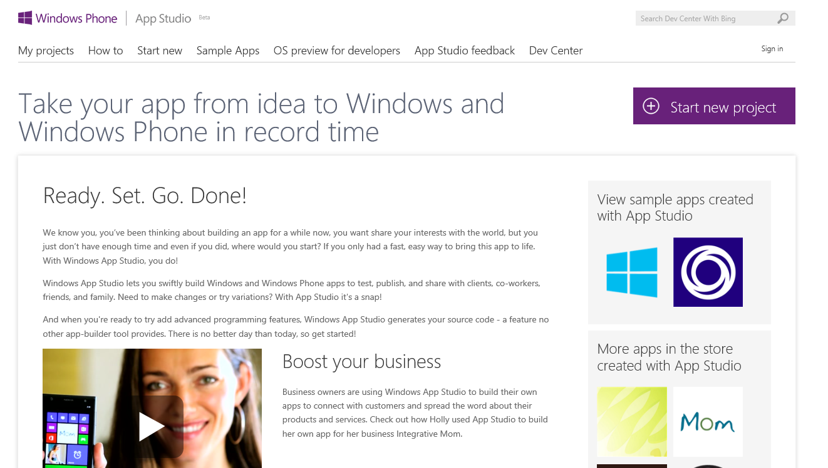
Appendix
Complete “User Guide”
Sign in with Microsoft (LIVE ) ID
View your App Studio app projects
Reference Apps in Store created with App Studio

Slide 18
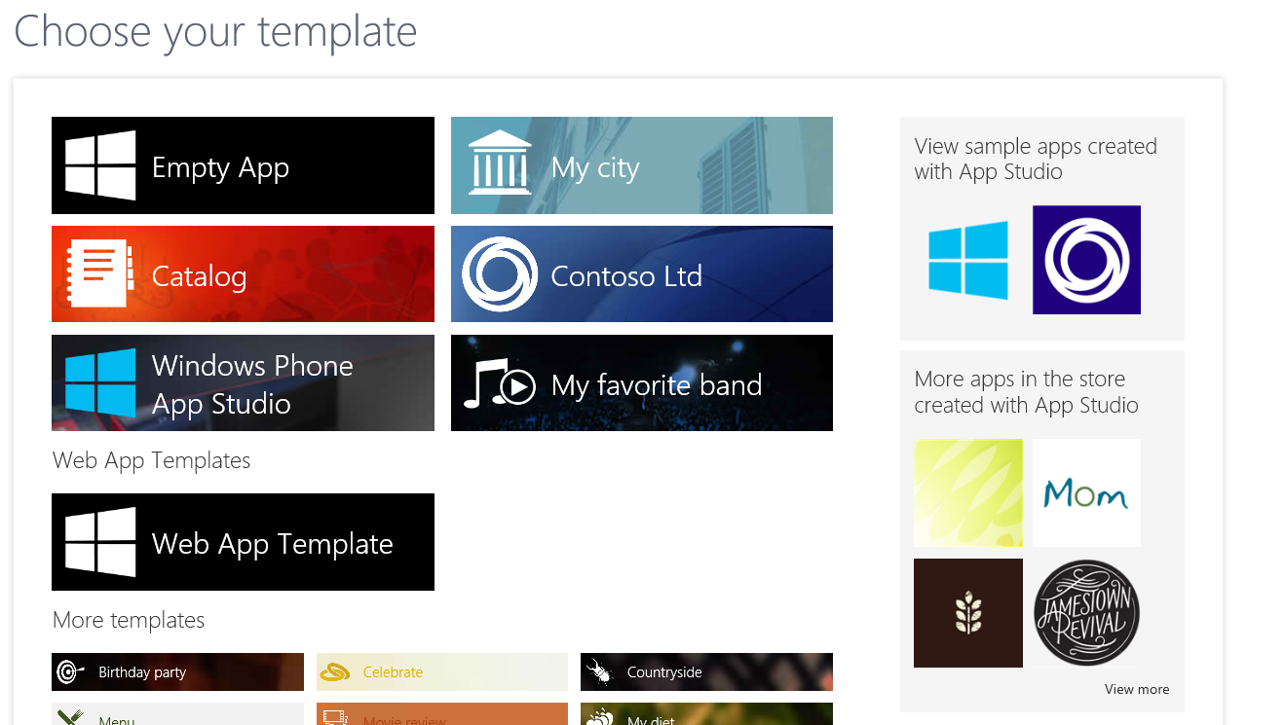
Appendix
Most commonly used templates
Start a “blank” app
Start Web App Template (Windows Phone only)

Slide 19
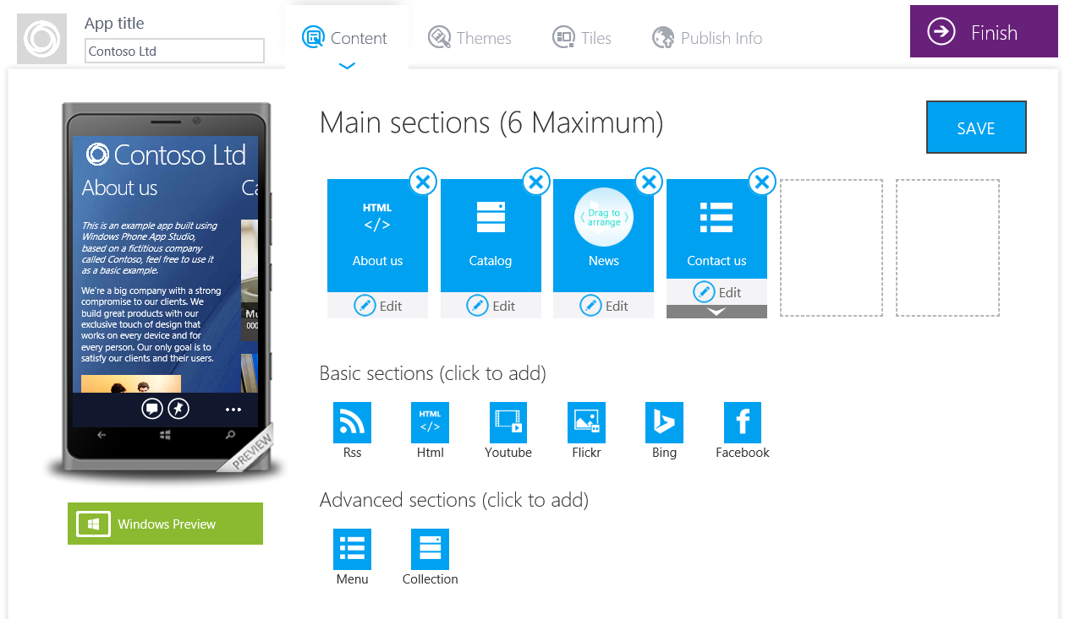
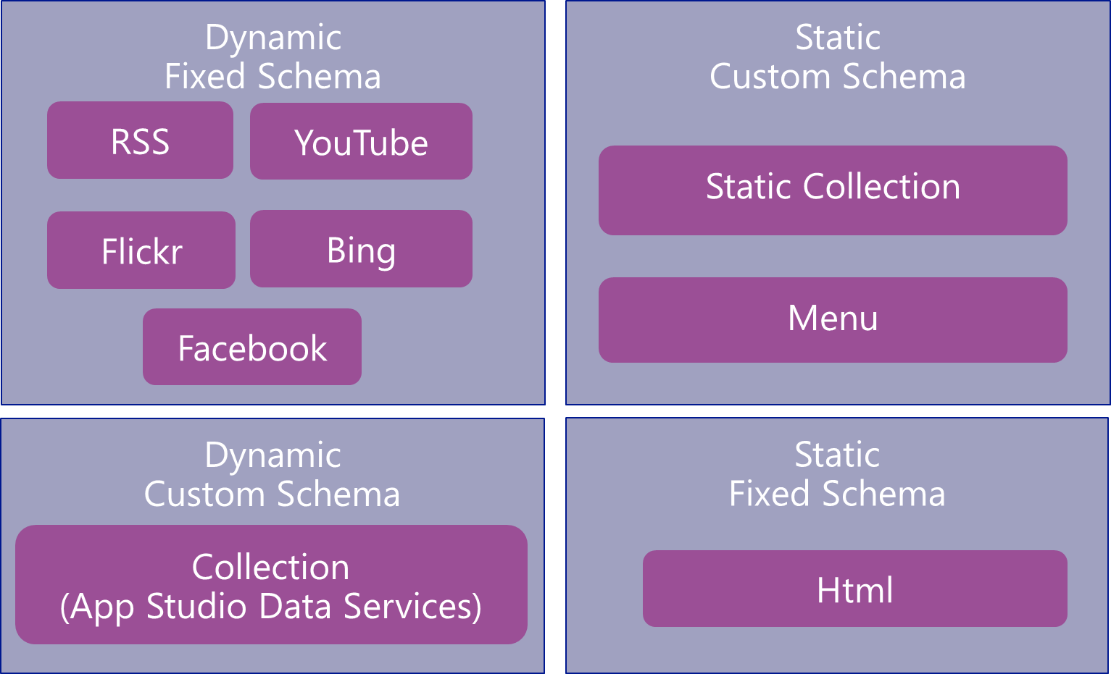
Appendix
MAIN VIEW: 8.0 Panorama and 8.1 HUB Control
Sections
Abstract Representation:
Data Sources
Schema + Implementation
Views (ItemList, ItemDetail)
Menus
Actions

Slide 20
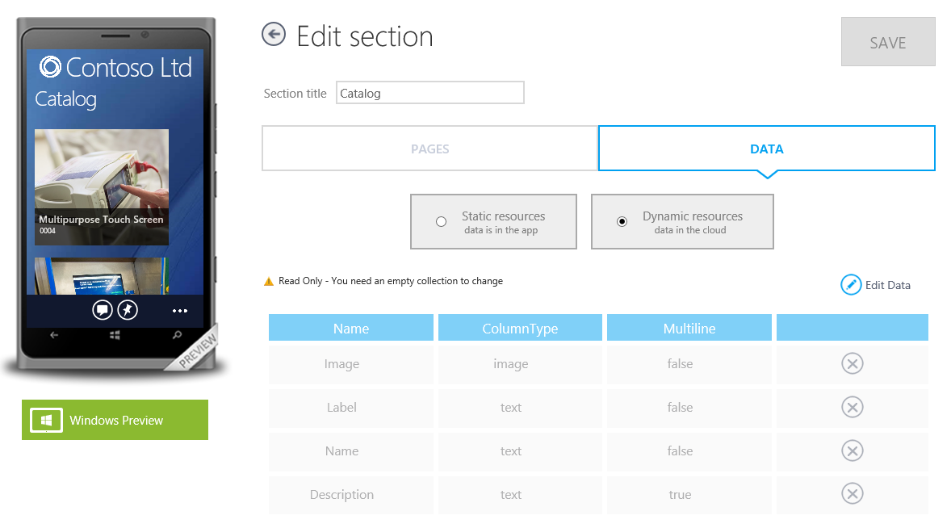
Appendix
Data Sources
Dynamic, Stored in Azure
Static, Hard-Coded into the app

Slide 21
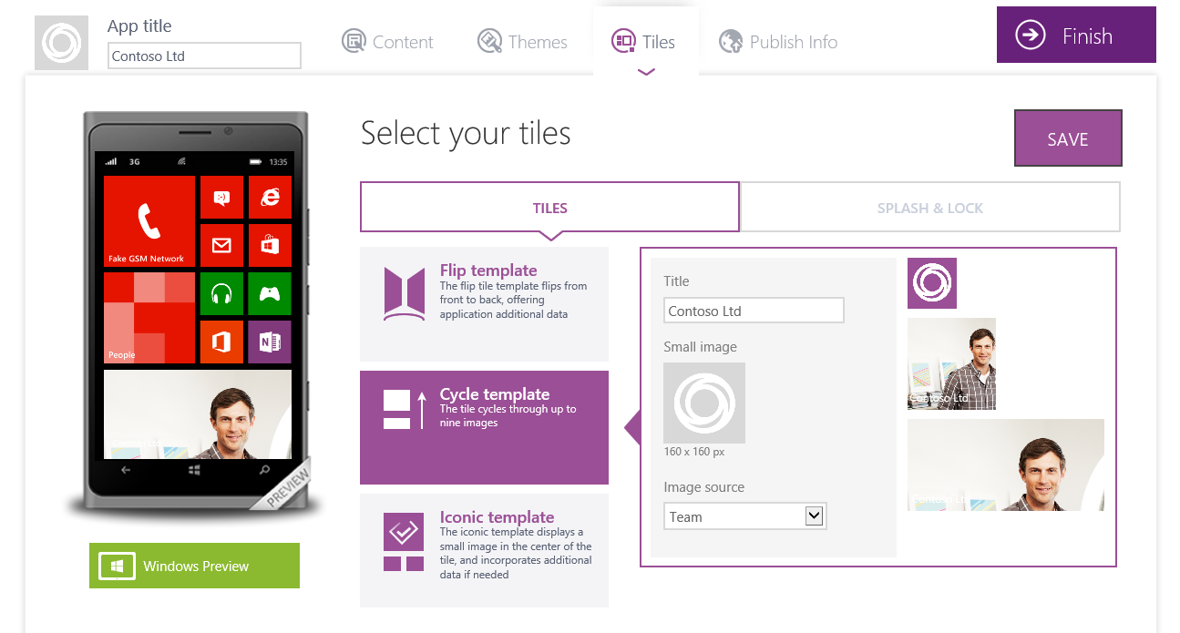
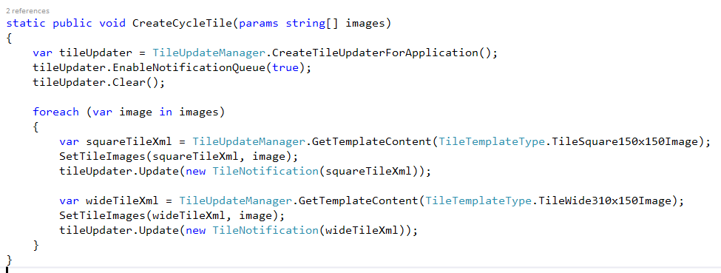
Appendix
3 Types of Tiles
Bound to Data Sources
If Dynamic, requires Background processing

Slide 22
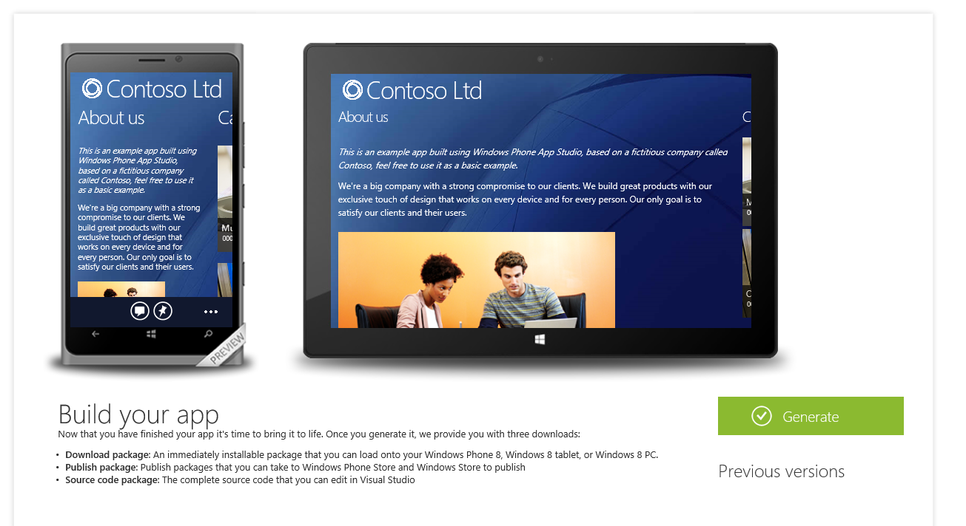
Appendix
3 Types of Tiles
Bound to Data Sources
If Dynamic, requires Background processing
Sideloading
Company Apps (w/ MSFT Certificate)
Signed package
URL to allow sharing (QR Code)
Store Publishing
Unsigned Package
Source Code

Slide 23
Appendix
Universal Windows projects
Existing projects can be generated as WP8.0 or Universal Windows projects
Only change required to support Windows apps is Splash Screen configuration
Visual Studio Express Editions Compatible. WP8.0 SDK includes VS Express
Universal requires VS Express 2013 for Windows and Update 2

