Slide 2
User data management in Windows Phone 8.1
2-566
Tony Pendolino
Program Manager

Slide 3
Themes
Richer access to user data
Getting things done with system UI
Deeper integration in core experiences

Slide 4
Contacts
Get to know the user’s contacts and introduce him to some new ones

Slide 5
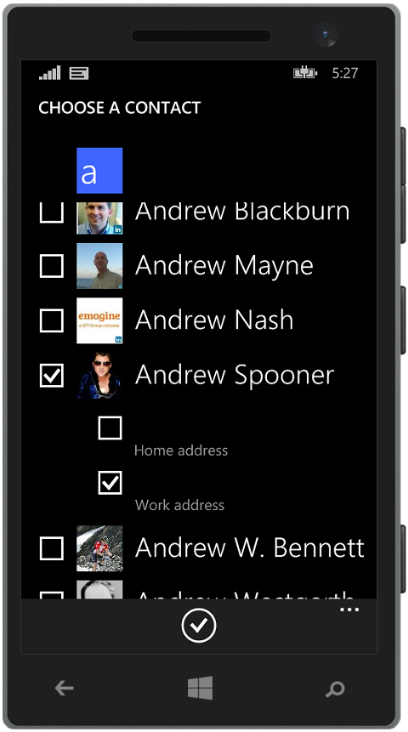
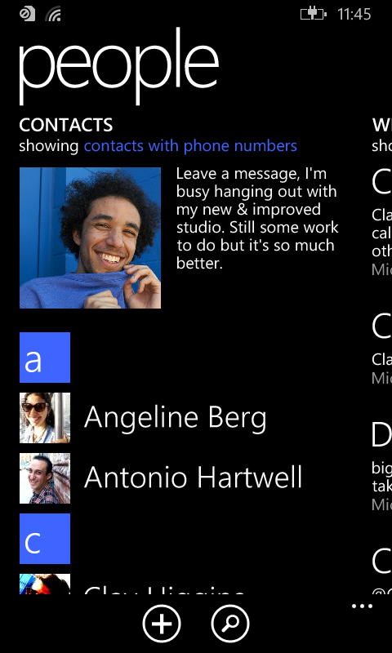
Contacts – Programmatic read access
WinRT versions of contact search
Scenarios
Display user’s contacts in custom UI
Read contacts database to make connections
Features (requires contacts capability for disclosure)
Shared Contact type from Windows 8.1
Searches name, email and phone numbers
Aggregated contact information

Slide 6
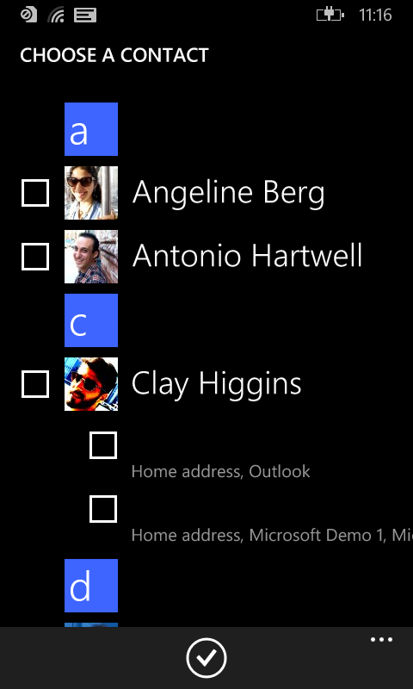
Contacts – Contact picker
Pick a contact using system UI
Scenarios
Invitation apps
Messaging apps
Features (Windows Phone Runtime Apps only)
Filter based on fields present
Email, Phone, or Postal Address
Single or multi-pick

Slide 7
Text messages
Short message sent

Slide 8
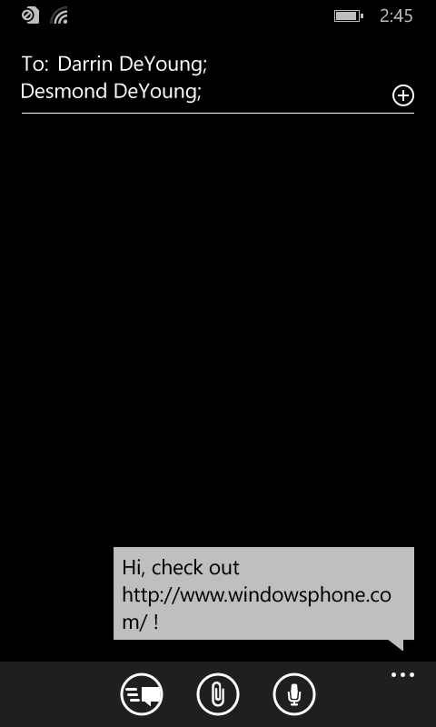
Text messages– Compose SMS
WinRT version of Compose SMS
Scenarios
Easily send an SMS
Features
Launches the Messaging application
Optionally specify body and recipient(s)

Slide 9
Email
I heard that this one has been requested a few times…

Slide 10
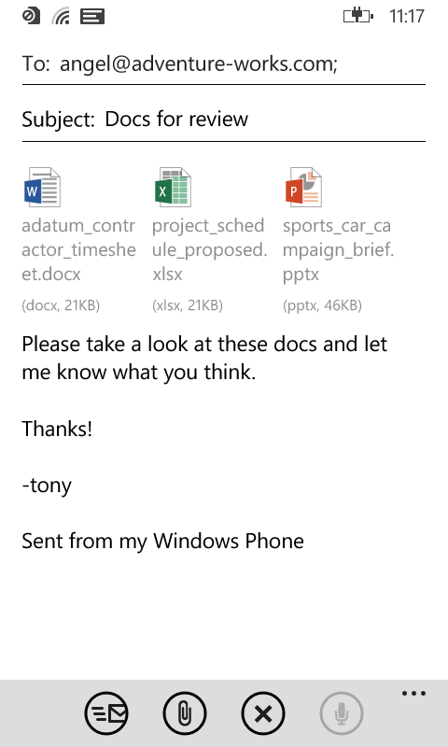
Email - Compose with attachment
WinRT version of Compose Email
Scenarios
Attach files to an email message
Features
Any file type supported
No limits on number or sizes
Pictures are resized for sending

Slide 11
SMS and email using contact picker demo

Slide 12
Calendar
What’s the user doing these days?

Slide 13
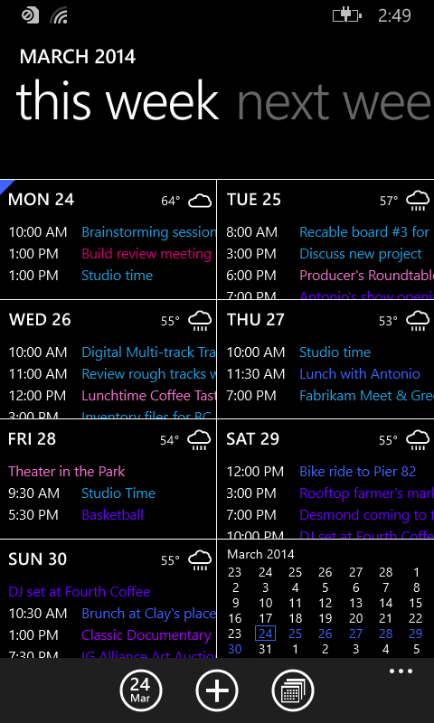
Calendar – Programmatic read access
WinRT versions of Appointments
Scenarios
Display user calendar data in unique ways
Use appointment data to solve problems
Features (requires appointments capability for disclosure)
Get appointments across multiple sources
Display calendars within those sources

Slide 14
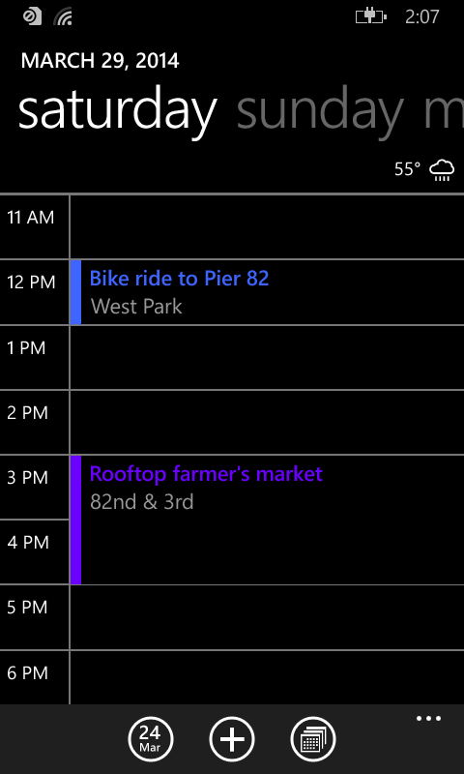
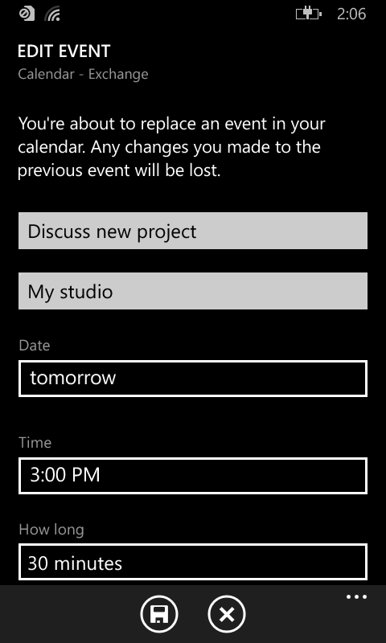
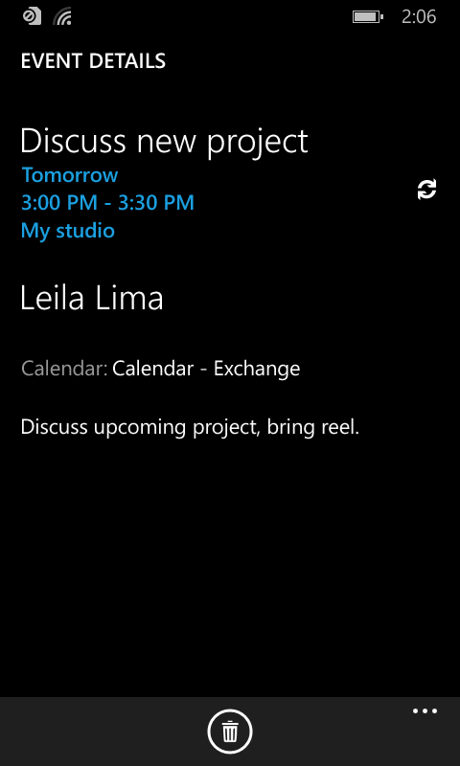
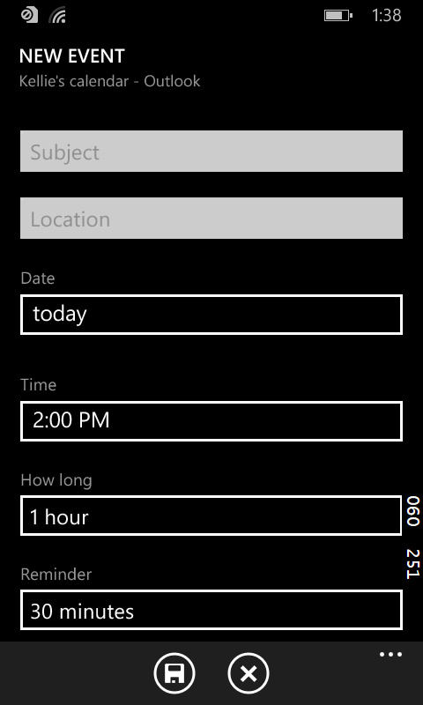
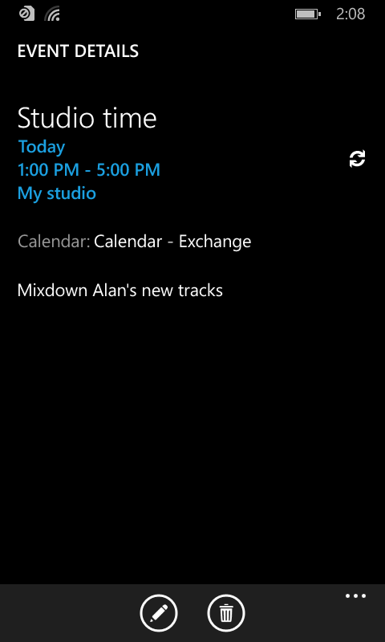
Calendar- Actions
Actions to manipulate the user’s appointments
Scenarios:
Add Appointment*
Replace Appointment*
Remove Appointment*
Show Timeframe*
Edit New Appointment
Show Appointment Details
*available on Windows 8.1

Slide 15
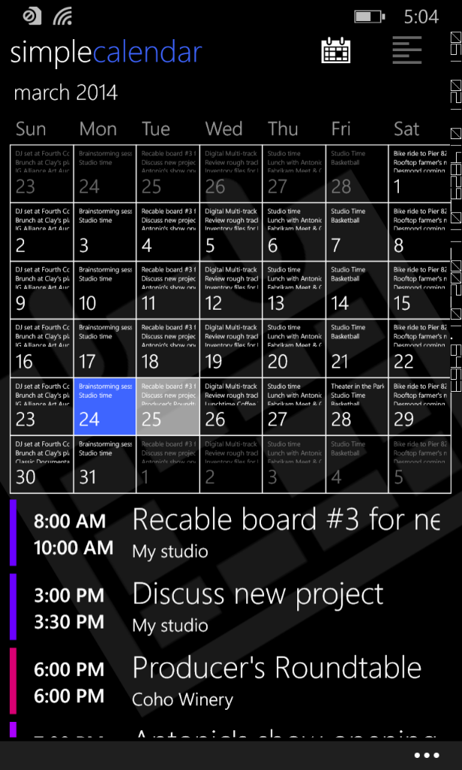
Simple Calendar
Edit/delete appointments (#1 request)
View private appointments (#2 request)
Distinguish individual calendars
Updating Simple Calendar ~2 hours
v4.x now available for all WP 8.1 phones

Slide 16
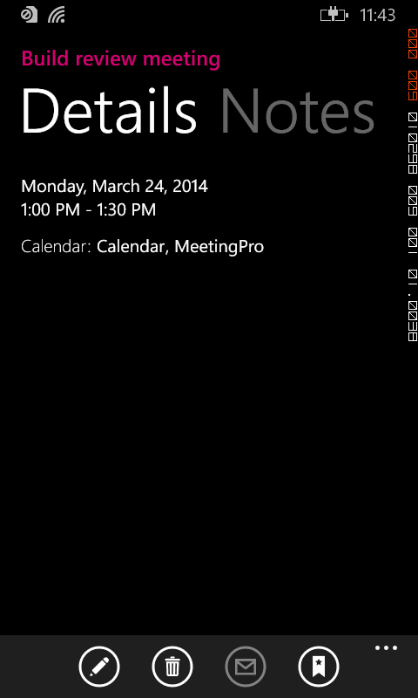
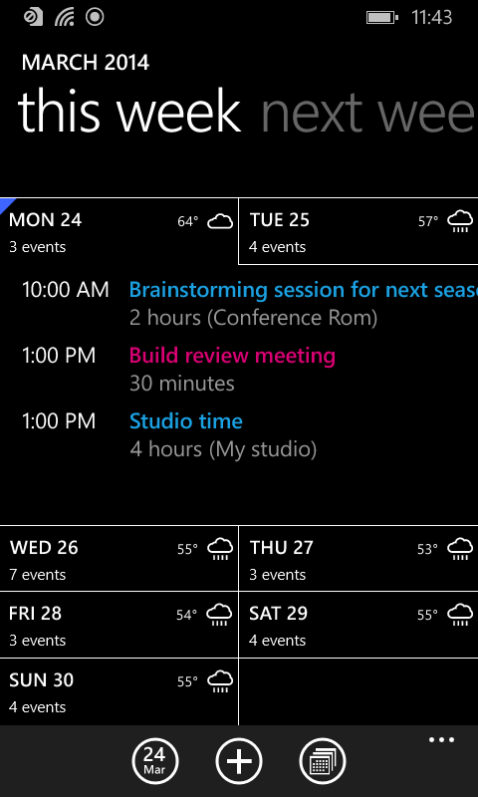
Calendar– Programmatic write access
App store for Appointments
Scenarios
Writing events from your app
Syncing appointment data
Features (requires appointments capability for disclosure)
Activate your app for details
Rich experience for your appointments
Data sharing access levels
Appointment change tracking

Slide 17
Meeting Pro demo

Slide 18
Online media
Your network’s photos and videos

Slide 19
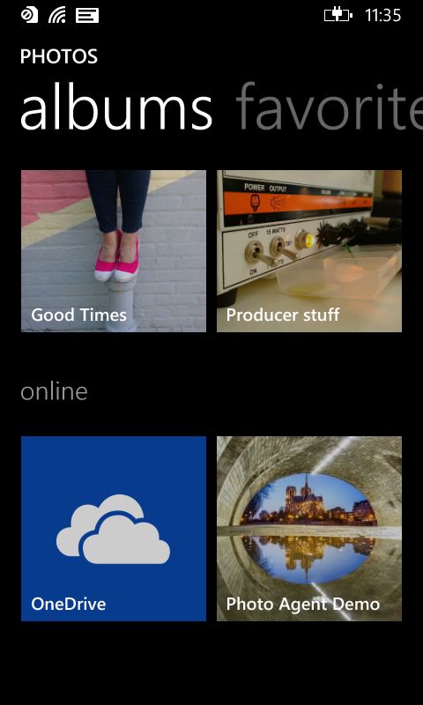
Online media – Integrate in photo hub
Tile and albums for viewing your network’s media
Scenarios
Albums that contain pictures and videos
Features (for Windows Phone Silverlight 8.1 apps only)
Deep link back to your app
Photos and videos show up in picker scenarios automatically

Slide 20
Contact bindings
Do you know someone special?

Slide 21
Contact bindings – In contact card
Connect pivot tile for launching into your app’s experiences
Scenarios
See friend’s complete profile
Quickly open a chat conversation
Features (for Windows Phone Silverlight 8.1 apps only)
Creates binding with just a piece of information
Customize tiles with personalized images

Slide 22
Media and bindings demo

Slide 23
Themes
Richer access to user data
Getting things done with system UI
Deeper integration in experiences

Slide 24
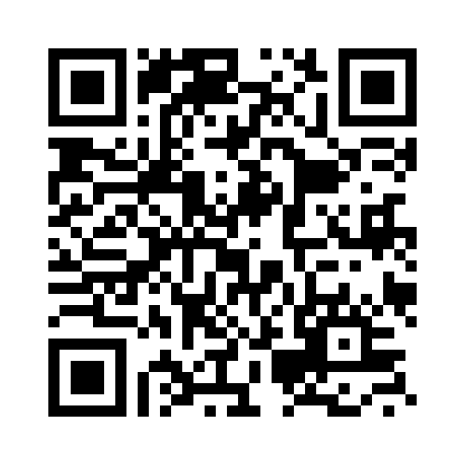
Your Feedback is Important
Fill out an evaluation of this session and help shape future events.
Scan the QR code to evaluate this session on your mobile device.
You’ll also be entered into a daily prize drawing!

Slide 25
© 2014 Microsoft Corporation. All rights reserved. Microsoft, Windows, Windows Vista and other product names are or may be registered trademarks and/or trademarks in the U.S. and/or other countries.
The information herein is for informational purposes only and represents the current view of Microsoft Corporation as of the date of this presentation. Because Microsoft must respond to changing market conditions, it should not be interpreted to be a commitment on the part of Microsoft, and Microsoft cannot guarantee the accuracy of any information provided after the date of this presentation. MICROSOFT MAKES NO WARRANTIES, EXPRESS, IMPLIED OR STATUTORY, AS TO THE INFORMATION IN THIS PRESENTATION.

