Slide 2
Mobile push notifications to any client with Azure Notification Hubs
2-616
Elio Damaggio @eliodamaggio
Program Manager

Slide 3
From any back-end to all mobile platforms

Slide 4
Push to single users or millions at a time

Slide 5
Agenda
Why Notification Hubs?
What’s new
Quick start: send targeted notifications
How to manage devices from your back-end
Templates
Advanced scenarios: “Push to sync”, Retargeting

Slide 6
Push notifications are essential in all apps
For consumer apps
Richer than SMS
10000s times cheaper
For enterprise apps
Keep users up to date
Not only for alerts
‘push to sync’ notifications

Slide 7
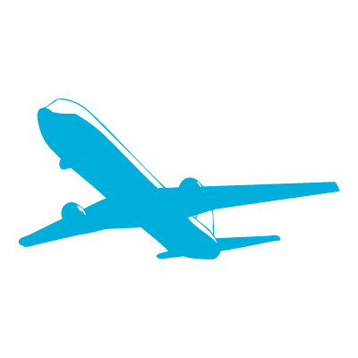
Mobile push is everywhere
Breaking news
News/Media
SMS replacement, Deals, Back-office
Banking/Insurance
Prescriptions, Appointments,
LOB (maintenance)
Healthcare
Reservation changes, Deals, Back-office
Travel/Hospitality/Airlines
Orders, Product UX,
Back-office
Discrete manufacturing/Auto
Offers, Orders, Back-office
Retail

Slide 8
Push notification lifecycle
Registration at app launch
Client app contacts Platform Notification Service, to retrieve current channel (e.g. ChannelURIs, device tokens, registrationIds)
App updates handle in back-end
Sending Notification
App back-end send notification to PNS
PNS pushes the notification to the app on the device
Maintenance
Delete expired handles when PNS rejects them
Platform
Notification
Service
App back-end

Slide 9
Challenges of push notifications
Platform dependency
Different communication protocols to PNS’ (e.g. HTTP vs TCP, xml payload vs json payload)
Different presentation formats and capabilities (tiles vs toasts vs badges)
Routing
PNS’ provide a way to send a message to a device/channel
Usually notifications are targeted at users or interest groups (e.g. employees assigned to a customer account)
App back-end has to maintain a registry associating device handles to interest groups/users
Scale
App back-end has to store current handles for each device → high storage and VM costs
Broadcast to millions of devices with low latency requires parallelization (DB ad VM)

Slide 10
Using Notification Hubs
One-time set up
Create a Notification Hub
Register
The client app retrieves its current handle from the PNS
Client app creates (or updates) a registration on the Notification Hub with the current handle
Send Notification
The app back-end sends a message to the Notification Hub
Notification Hub pushes it to the PNS’
iOS app
Windows app
MPNS
GCM
WNS
APNs
App back-end
ADM
Notification Hub

Slide 11
Advantages of using Notification Hubs
X-plat: from any back-end to any mobile platform
Backend can be on-prem or in the cloud, .NET/Node/Java/PHP/Node/anything.
Support Windows Phone/Windows/iOS/Android and (as of today) Kindle Fire.
No need to store device information in the app back-end
Notification Hub maintains the registry of devices and the associations to users/interest groups
Routing and interest groups
Target individual users and large interest groups using tags
Personalization and localization
Keep your back-end free of presentation concerns like localization and user preferences using templates
Broadcast at scale, multicast, unicast
Push notifications to millions of devices (across platforms) with a single call
Telemetry
Rich telemetry available through portal or APIs

Slide 12
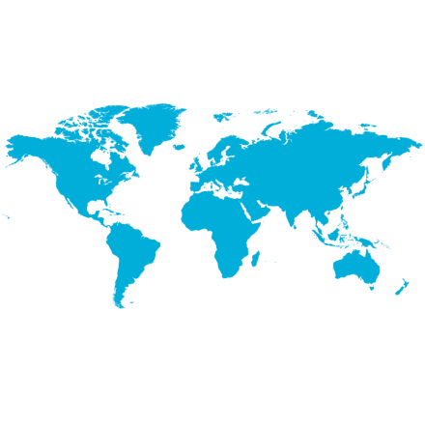
Case studies
Bing (news, finance, sports, …)
Sochi 2014
Preinstalled on windows
Millions of devices
Interest groups
(countries, disciplines, athletes)
Localized notifications
10s
100s
Millions of notifications/day
Minutes to delivery
Million devices
(iOS, Android, WP)
Million notifications
3+
<2
3+
150+

Slide 13
What’s new
Kindle support
Tag Expressions
Visual Studio integration
Mobile Services integration
New pricing (completely push-based)
Bulk registration mgmt APIs (private preview)

Slide 14
Demo: Get Started

Slide 15
Some snippets
Register
Send
Windows / Windows Phone
await hub.RegisterNativeAsync(channel.Uri);
.NET
var toast = @“<notification payload>";
hub.SendWindowsNativeNotificationAsync(toast);
iOS
[hub registerNativeWithDeviceToken:deviceToken
tags:nil
completion:^(NSError* error) { … }];
Node / Mobile Services
hubService.wns.sendToastText01(null, { text1: 'Hello from Node!' }, function (error) { … }
);
Android / Kindle
hub.register(regid);

Slide 16
Agenda
Why Notification Hubs?
What’s new
Quick start: send targeted notifications
How to manage devices from your back-end
Templates
Advanced scenarios: “Push to sync”, retargeting

Slide 17
Tags
Tags as interest groups
Client app can register with a set of tags
Tags are simple strings (no pre-provisioning is required)
App back-end can target all clients with the same tag
You can use tags also for
Multiple type of interest groups, e.g.
Follow bands: tag “followband:Beatles”
Follow users: tag “followuser:Alice”
Tag devices with a user id
App back-end
Tag:”Beatles”
Notification Hub
Tag:”Wailers”
Tag:”Beatles”

Slide 18
Some snippets
Register
Windows / Windows Phone
await hub.RegisterNativeAsync(channel.Uri, new string[] {"myTag", "myOtherTag"});
iOS
[hub registerNativeWithDeviceToken:deviceToken tags:@[@"myTag", @"myOtherTag"] completion:
^(NSError* error) {
…
}];
Android / Kindle
hub.register(regid, "myTag“, "myOtherTag");

Slide 19
“How do I read tags from my hub?”
Notification Hubs is not a storage system
Maintain an authoritative store for your tags
In the device
Every platform provides apps a way to store user information locally or in the cloud
E.g. Roaming settings, iCloud
In your app back-end
Usually stored by user
Try not to replicate device information
Register methods always overwrite tags
Each time you update the channel, overwrite all the tags

Slide 20
Demo: Coupons

Slide 21
Tags can be user preferences or system information

Slide 22
Tag expressions
Social “All my group except me” group:id && !user:id
Events Touchdown event is send to everybody following either team Followteam:A || Followteam:B || followplayer:1 || followplayer:2 …
Hours Send notifications at specific times. E.g. Tag with timezone, @12pm in Seattle send: timezone:PST && follows:thaifood
Versions & platforms Send a reminder to update to your first Android app version: version:1.0 && platform:Android

Slide 23
Agenda
Why Notification Hubs?
What’s new
Quick start: send targeted notifications
How to manage devices from your back-end
Templates for x-plat and localization
Advanced scenarios: “Push to sync”, Retargeting

Slide 24
When to register from your app back-end
When tags have to be secured
When devices register, they can register for any tag
Sometimes tags have to secure (e.g. using ‘{userId}’ as tag)
App back-end can authenticate the user before registering the device
When back-end has to modify tags
Tags change as a result of:
Actions on different devices (e.g. adding a tag from the web app)
Other user’s actions (e.g. a manager adding an employee to a work group)
Tags are derived from analytics or other user data

Slide 25
Registering from the back-end
Identify your device
Cannot use ChannelURIs/device tokens/…
Keep long-living NH registration ids in device storage
Register
First time only,
Request registration id from hub, and
Store it on device storage
CreateOrUpdate device registration (@ every app start)
Back-end can verify and/or add tags (e.g. performing auth)
Notes
Nothing is stored in the app back-end
Do not use device SDK (risk: multiple registrations for each device)
createId()
upsert({id}, channel, tags)
App back-end
Notification Hub
{id}

Slide 26
Back-end driven tag updates
Use a tag to identify user
Back-end usually refers to users and not devices
Register devices with a tag like ‘userid:{id}’
Back-end updates tags
Retrieve device registration(s) by userid
Update tags
Note
No device information in app back-end
Back-end only refers to users
getByTag(userid)
update(tags)
App back-end
Notification Hub

Slide 27
Demo: Coupons app registering from back-end

Slide 28
Super easy with Mobile Services integration

Slide 29
Agenda
Why Notification Hubs?
What’s new
Quick start: send targeted notifications
How to manage devices from your back-end
Templates
Advanced scenarios: “Push to Sync”, Retargeting

Slide 30
Using templates for multi-platform push
Registration
Client apps can register with a platform specific template, e.g.
Windows tablet registers with Windows Store ToastText01 template
iPhone with the Apple JSON template: { aps: {alert: “$(message)”}}
Send notification
App back-end sends a platform independent message: {message: “Hello!”}
Notes
Multiple templates can be specified for each device
Each template can have a different set of tags
<toast>
<visual>
<binding template=\"ToastText01\">
<text id=\"1\">$(message)</text>
</binding>
</visual>
</toast>
Hello!
{
message: “Hello!”
}
Notification Hub
App back-end
Hello!
{
aps: {
alert: “$(message)”
}
}

Slide 31
Using templates for localization
Registration
Client apps can register with personalized templates, e.g.
Windows tablet wants to receive news in English
iPhone wants Italian
Send notification
App back-end sends a message including both languages: {news_en: “Hello!”, news_it: “Ciao!”}
Template Expressions
Templates support a simple expression language:
E.g. {‘Elio, ’+$(friend)+’ added you to ’+$(groupName)}
<toast>
<visual>
<binding template=\"ToastText01\">
<text id=\"1\">$(news_en)</text>
</binding>
</visual>
</toast>
Hello!
{
news_en: “Hello!”,
news_it: “Ciao!”
}
Notification Hub
App back-end
Ciao!
{
aps: {
alert: “$(news_it)”
}
}

Slide 32
Agenda
Why Notification Hubs?
What’s new
Quick start: send targeted notifications
How to manage devices from your back-end
Templates
Advanced scenarios: “Push to Sync”, Retargeting

Slide 33
Push to Sync
Updates app state
Does not show a message to the user
Example: music app
User changes playlist on desktop
Back-end sends a ‘push-to-sync’ notifications to user’s devices
Phone receives push and starts downloading new song
User finds the new song already on their phone!
Platform-dependent
Windows/Windows Phone (only lock-screen apps)
iOS (only since iOS 7)
Android/Kindle
Push to sync
Notification Hub
App back-end
Download new song
Add new song

Slide 34
Rich push & Secure push
Deliver content directly from BE
Rich media (images, videos, html, …)
Retrieve the content securely from BE
Note
Same platform differences as push to sync
Secure push has to use a long lived auth token on app
Push to sync
(no sensitive info)
Notification Hub
App back-end
Download media/msg

Slide 35
Demo: Push to Sync

Slide 36
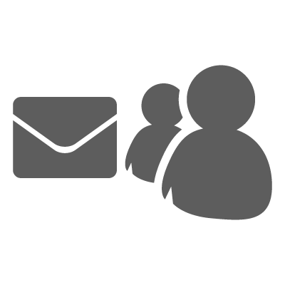
Pulling it all together - Retargeting
Send a targeted coupon
Use tags for user preferences, location, system properties, timezone, …
Target with tag expressions
Push UX & feedback
Use Rich push & push to sync to provide best UX
Contextually report to your app back-end (who tapped, who visited the page, who received it)
Retarget
(perform analysis on user data)
Update tags from your back-end with the new information
Send alternative offer to users that did not participate
Loc:SF && Food
Update tags
Loc:SF && Food
&& !tapped
Notification Hub
App back-end
Report push usage
CRM/DMP system

Slide 37
Telemetry, security, and scale
Telemetry
Portal dashboard and programmatic access for all outcomes exposed by PNS’.
Security
Role-based security available to restrict access to hub for:
Device registration management rights
Sending rights
PNS credentials rights
Scale
Guidance for very high scale depends on specific scenarios
Any audience <5million devices and <5million pushes per day can use a single hub

Slide 38
Resources
Documentation
Notification Hubs service page
Get started (Windows/Phone, iOS, Android, Kindle)
MSDN documentation
APIs references and download
REST surface documentation
Debugging guide
Pricing
Videos
Cloud Cover 116 – X-plat notifications
Cloud Cover 118 – Geo-location
Azure Friday – Broadcasting
Azure Friday – Tags
Azure Friday – Templates
Azure Friday – User-specific notifications

Slide 39
Related sessions
3-623 Thu 5:30pm Powerful mobile apps with Mobile Services and ASP.NET Web API
3-622 Fri 12:30pm Building a cross-platform line of business apps with mobile services

Slide 40
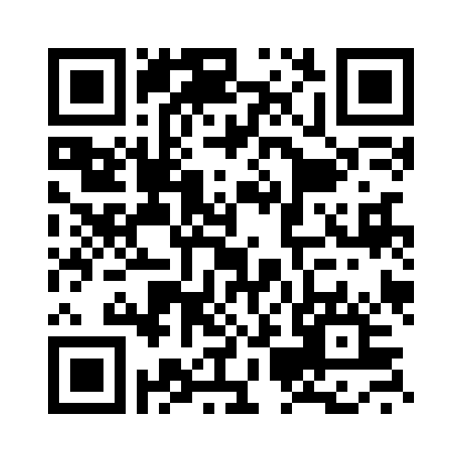
Your Feedback is Important
Fill out an evaluation of this session and help shape future events.
Scan the QR code to evaluate this session on your mobile device.
You’ll also be entered into a daily prize drawing!

Slide 41
© 2014 Microsoft Corporation. All rights reserved. Microsoft, Windows, Windows Vista and other product names are or may be registered trademarks and/or trademarks in the U.S. and/or other countries.
The information herein is for informational purposes only and represents the current view of Microsoft Corporation as of the date of this presentation. Because Microsoft must respond to changing market conditions, it should not be interpreted to be a commitment on the part of Microsoft, and Microsoft cannot guarantee the accuracy of any information provided after the date of this presentation. MICROSOFT MAKES NO WARRANTIES, EXPRESS, IMPLIED OR STATUTORY, AS TO THE INFORMATION IN THIS PRESENTATION.

