Slide 2
Building Azure Websites with Visual Studio Online “Monaco”
2-646
Chris Dias
Principal Program Manager
Building Azure Websites with Visual Studio Online “Monaco”

Slide 3
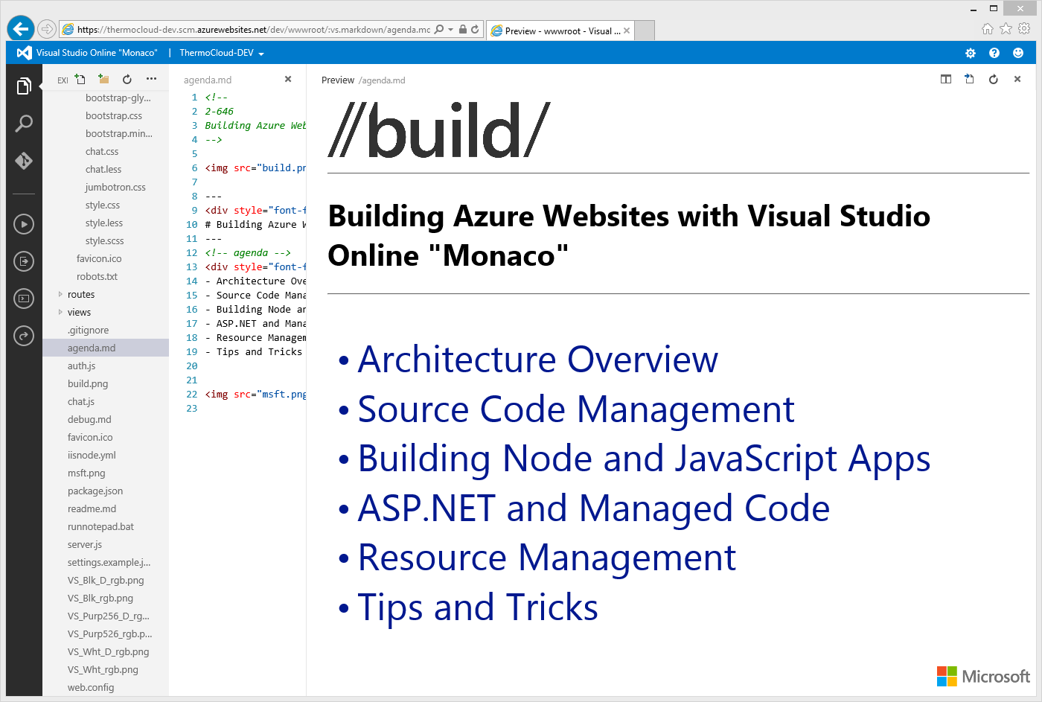

Slide 4
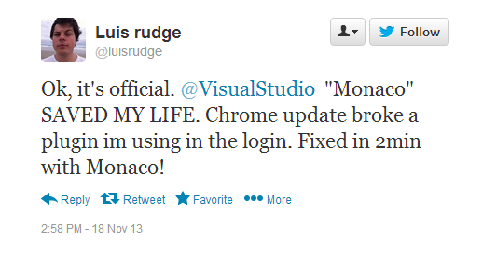

Slide 5
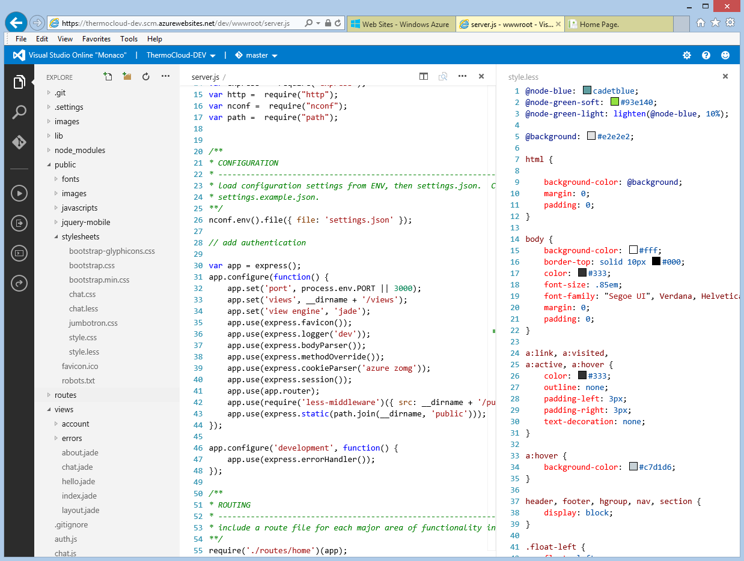
Monaco
Lightweight, friction free
Companion to VS IDE, accessible from modern browsers on any device, on any platform
Optimized for Azure
Build, maintain, and run Websites directly in Azure
Rich editing experiences
Fast, fluid code editing, navigation, and understanding in the browser, without the feel of a browser
Support for today’s frameworks and languages
HTML5 and JavaScript (including TypeScript), Node , PHP, ASP.NET sites, and apps

Slide 6
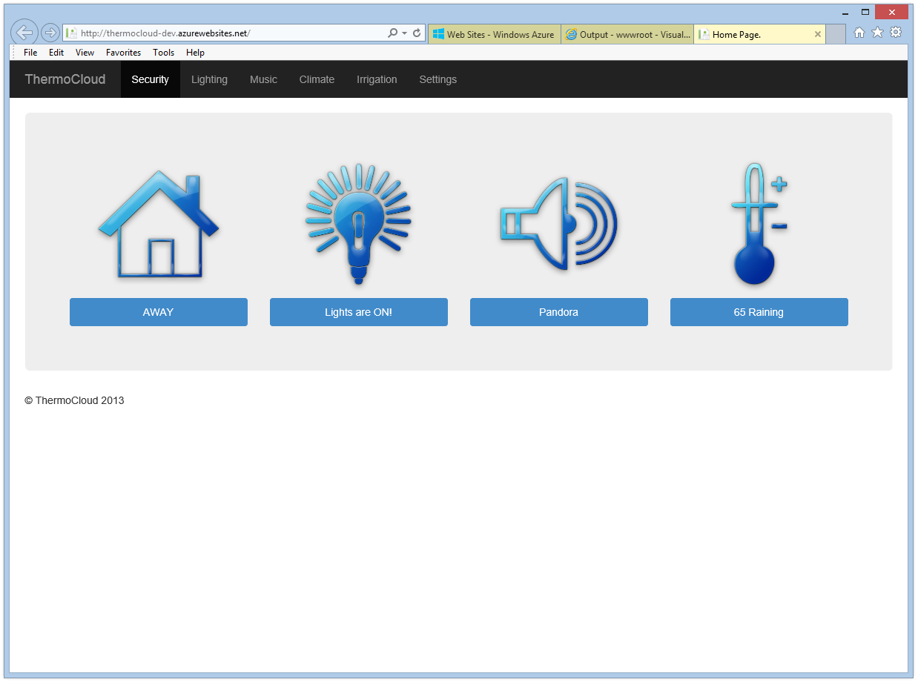
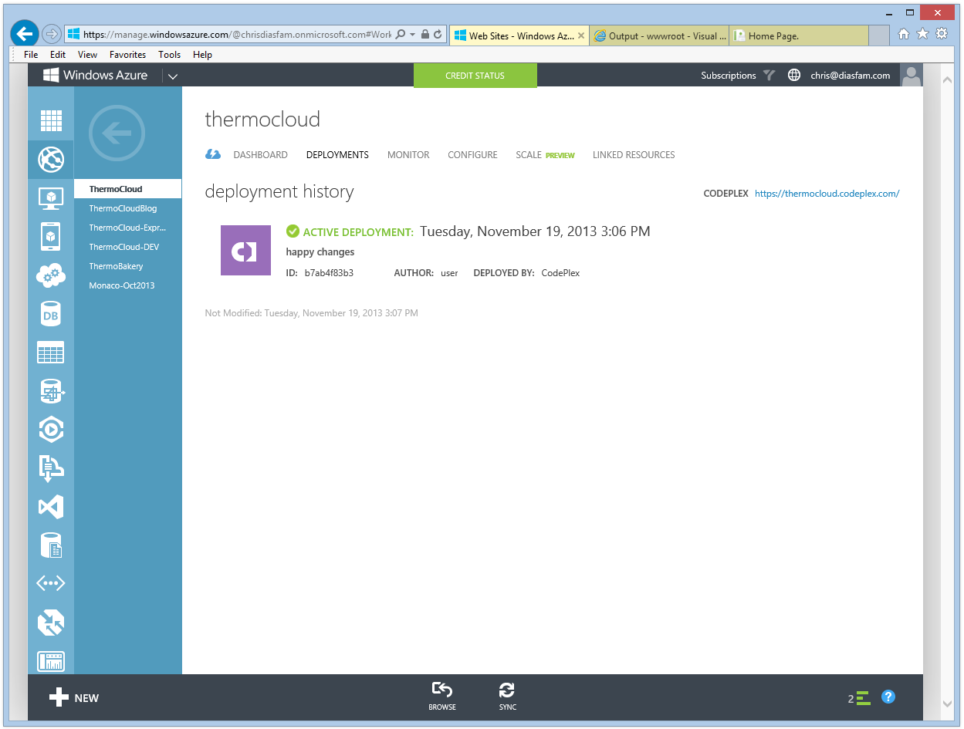
Architecture
Monaco service available as site extension on every Azure site
Access gated by site configuration option and deployment credentials
Tools access via the “.scm” endpoint, live edit wwwroot
Runs as peer to Azure deployment services (“Kudu”)
ThermoCloud site
http://thermocloud.azurewebsites.net
IIS
Node,
PHP, etc.
runs
Site Extension
wwwroot
Monaco
Services
r/w
access
https://thermocloud.scm.azurewebsites.net/dev
Site Extension
writes
Azure SCC Deploy
https://thermocloud.scm.azurewebsites.net/thermocloud.git

Slide 7
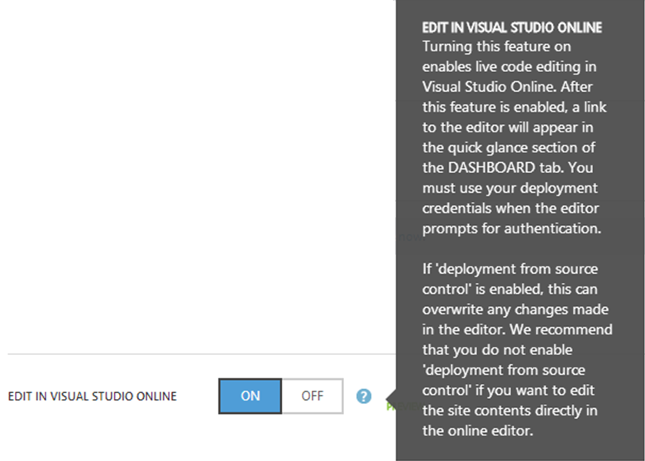
A word of caution!
If ‘deployment from source control’ is enabled, this can overwrite any changes made in the editor…

Slide 8
Source code management
Integrated Git support
Connect to any public or private Git repository
Git viewlet, streamlined Git UI experiences, full command line control
For quick updates to live sites
Changes are automatically saved to the site (in wwwroot!)
Ideal for quickly getting started, simple, static sites (e.g., WordPress, HTML/JavaScript)
Not recommended for sites that require transform on deployment
For in-depth modifications
Upload or clone sources into a provisional development site
Make modifications, build, test, run in the development site
Push to production: git endpoint, staging, or production site

Slide 9
Demo: New Azure website from gallery
Production Site
http://mysite.azurewebsites.net
Monaco: Enabled
Deploy via SCC: Disabled

Slide 10
Source code management best practices
Create a provisional development site
Clone from git repository
Develop, build, test in development site
Push…
Directly to production
Staging site first, hot swap with production
Git repository linked to staging or production
Continuous build, test, and deploy

Slide 11
Companion development site
Production site
mysite.azurewebsites.net
Monaco: Disabled
Deployment from SCC: Local Git Repo
git
myproject.visualstudio.com
Kudu
remote: origin
git
clone
push
Development site
mysite-dev.azurewebsites.net Monaco: Enabled
Deployment from SCC: Disabled
git
Dev git

Slide 12
Push to production from development
Production site
mysite.azurewebsites.net
Monaco: Disabled
Deployment from SCC: Local Git Repo
git
myproject.visualstudio.com
Kudu
remote: origin
git
push
clone
push
Development site
mysite-dev.azurewebsites.net Monaco: Enabled
Deployment from SCC: Disabled
git
Dev git

Slide 13
Deploy from linked repo to production
Production site
mysite.azurewebsites.net
Monaco: Disabled
Deployment from SCC: VSOnline, GitHub, etc.
git
myproject.visualstudio.com
Linked Branch
Kudu
remote: origin
git
clone
push
Development site
mysite-dev.azurewebsites.net Monaco: Enabled
Deployment from SCC: Disabled
git
Dev git
Pushing to origin will result in a pull to production

Slide 14
Deploy from linked repo to staging
Staging site
mysite.azurewebsites.net (staging)
Monaco: Disabled
Deployment from SCC: VSOnline, GitHub, etc.
git
myproject.visualstudio.com
Linked Branch
Kudu
remote: origin
git
clone
push
Development site
mysite-dev.azurewebsites.net Monaco: Enabled
Deployment from SCC: Disabled
git
Dev git
Deploy to staging site lets you hot swap to production

Slide 15
Continuous deployment
VS online build, test
Production or staging site
mysite.azurewebsites.net
Monaco: Disabled
Deployment from SCC: VS Online
git
Kudu
myproject.visualstudio.com
remote: origin
Development site
mysite-dev.azurewebsites.net Monaco: Enabled
Deployment from SCC: Disabled
git
clone
push
git
Dev git
Pushing to origin triggers a VSO build, test, and deploy to staging or production

Slide 16
Language Experiences
Level | Experiences | Languages
Basic | Smart editing with coloring, bracket matching, auto indent, textual completion | C#, VB, Razor, Markdown, Handlebars, HTML, XML, INI, Batch, Jade, CoffeeScript
Good | Error checking as you type, IntelliSense, go to definition, outline, rename symbol | JavaScript, JSON, CSS, LESS, SASS, PHP
Great | Reference searching across files | TypeScript

Slide 17
Demo: Building node applications

Slide 18
Demo: Building ASP.NET web apps

Slide 19
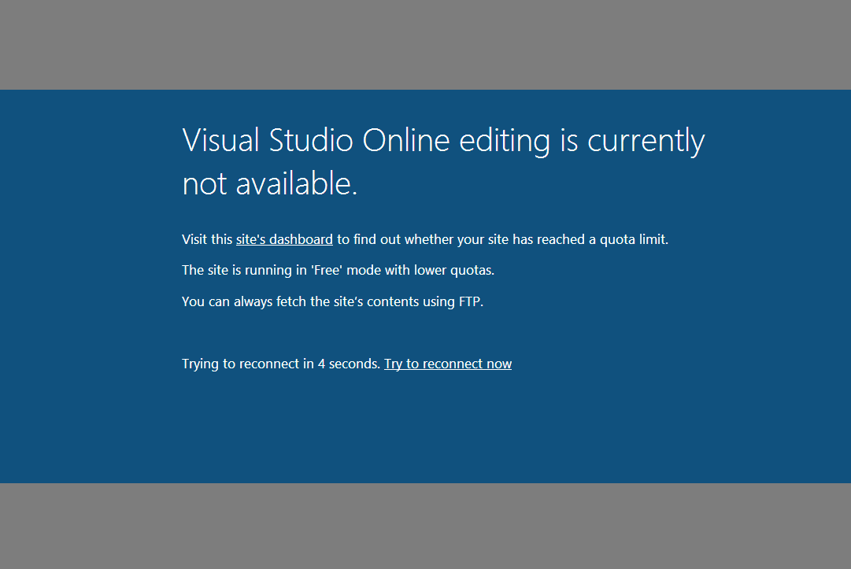
Not Done

Slide 20
Avoiding out of quota
Azure Dashboard will warn when approaching quota limits.
Scale development site if performing CPU and memory intensive tasks.

Slide 21
Tips and tricks
Find in folders | Multiple cursors
Ctrl+click to open to side | Editor commands
Quick open | Ctrl+arrow to cycle values
Ctrl+hover preview | Select for compare
User, team settings | Stage selected changes

Slide 22
Resources
Learn
Get started with the Monaco Channel9 Series
Keep informed on the Monaco Blog
Do
Enable “Edit in Visual Studio Online” for your Dev sites
Clone in code from Git repos on visualstudio.com
Develop, build, test, and push to production
Talk
Send a Smile!
@visualstudio #monaco

Slide 23
Your Feedback is Important
Fill out an evaluation of this session and help shape future events.
Scan the QR code to evaluate this session on your mobile device.
You’ll also be entered into a daily prize drawing!

Slide 24
Thank You!

Slide 25
© 2014 Microsoft Corporation. All rights reserved. Microsoft, Windows, Windows Vista and other product names are or may be registered trademarks and/or trademarks in the U.S. and/or other countries.
The information herein is for informational purposes only and represents the current view of Microsoft Corporation as of the date of this presentation. Because Microsoft must respond to changing market conditions, it should not be interpreted to be a commitment on the part of Microsoft, and Microsoft cannot guarantee the accuracy of any information provided after the date of this presentation. MICROSOFT MAKES NO WARRANTIES, EXPRESS, IMPLIED OR STATUTORY, AS TO THE INFORMATION IN THIS PRESENTATION.

