Slide 2
Xbox One and Kinect Sessions at //Build!
Time Slot | Room | Presenter | Code | Session Title
Wed, April 2nd 1:00 - 2:00 | 3024 | Nikola Metulev | 2-649 | Building Windows, Windows Phone, and Xbox One Apps with HTML/JS/CSS & C++
Wed, April 2nd 2:30 – 3:30 | 3024 | Gersh Payzer | 2-647 | Building Xbox One Apps using HTML and JavaScript
Wed, April 2nd 4:00 - 5:00 | 3024 | Chris White | 2-514 | Kinect 101: Introduction to Kinect for Windows
Thurs, April 3rd 1:00 - 2:00 | 2004 | Rob Cameron | 3-648 | Leveraging Windows Features to build Xbox One App Experiences
Thurs, April 3rd 4:00 - 5:00 | 2004 | Kevin Kennedy | 2-532 | Bringing Kinect into your Windows Store app
Thurs, April 3rd 5:30 - 6:30 | 3018 | Alain Maillot | 2-637 | Extending Xbox Experiences to Devices
Fri, April 4th 9:00 - 10:00 | 3014 | Eddie Mays | 2-650 | Designing the Ultimate 10’ Experience
Fri, April 4th 10:30 - 11:30 | Hall 1A | Frank Savage | 2-651 | Understanding the Xbox One Game Platform Built on Windows
Fri, April 4th 12:30 - 1:30 | 2018 | Bryan Nealer | 2-652 | Xbox Music API – Music for every app

Slide 3
Building Windows, Windows Phone, and Xbox One Apps with HTML/JS/CSS and C++
2-649
Nikola Metulev
Program Manager/Technical Evangelist

Slide 4
We are on the path to Windows, Windows Phone, and Xbox Convergence

Slide 5
Agenda
Comparisons
Sharing Code
Going Native
Khan Academy across devices

Slide 6
Agenda
Comparisons
Sharing code
Going native
Khan Academy across devices

Slide 7
The Windows runtime
Three devices running on one shared platform.
Windows.ApplicationModel
Windows.Foundation
Windows.Storage
Windows.Networking
Windows.Globalization
MediaFoundation
Search
…

Slide 8
Platform specific features
Differentiated features and APIs.
Xbox One
Achievements
Challenges
Rich presence
OneGuide
SmartGlass
NUI/VUI
Xbox data platform
Pinning
…
Windows
Share
Type to search
Sensors
Background tasks*
Lock Screen
Geofences
Video Editing
Printing/3D printing
…

Slide 9
Form factors

Slide 10
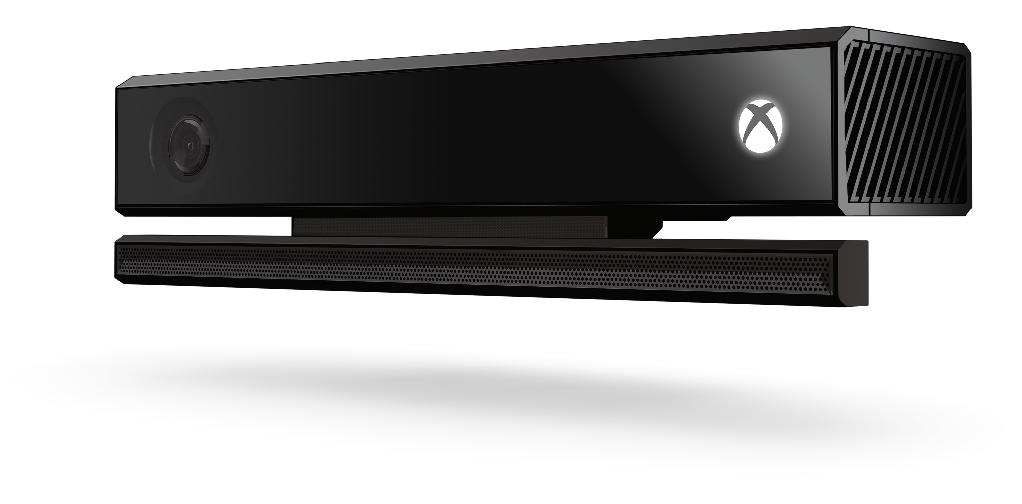
Keyboard | Touch | Mouse
versus
Controller | Gesture | Voice

Slide 11
Design a native user experience for each platform

Slide 12
Languages
HTML5/JS for markup and logic
C++/CX for shared libraries and community experience/background services

Slide 13
WinJS is not required
Community frameworks
Entire applications can be written without WinJS
All runtime and input APIs are available via Javascript
Need to write support for all input modalities

Slide 14
Adding NUI and VUI support
WinJS Controls on Xbox One support Voice and Gesture natively
Adding support for voice in custom controls:
<div data-win-voice="{
srcElement: select('.display-text'),
targetElement: select('.win-voice-textdisplay'),
handler: playArtist,
pronunciation: ‘M N M'
confidence: 0.7,
}“ />

Slide 15
Adding NUI and VUI support
Xbox One implements the same touch interaction engine as Windows
Kinect interaction is exposed as MSPointer events
In most case it just works

Slide 16
WinJS
 | Xbox One | Windows 8.1 | Windows Phone 8.1
ListView | X | X | X
Repeater | X | X | X
Hub | X | X
Pivot |  |  | X
ItemContainer | X | X | X
MediaTile | X
Flyout | X | X
FlipView | X* | X | X
Controls
Promises
Navigation
Localization
Application
Xhr
Binding
Templating
Namespaces
Classes
Utilities
Animations

Slide 17
Agenda
Comparisons
Sharing code
Going native
Khan Academy across devices

Slide 18
Reuse techniques
Share source files
Pick an architecture pattern
Abstract platform specific code
Use fragments and modular components
Separate styles

Slide 19
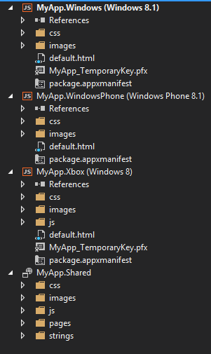
Share source files
Use the shared project for all shared source files
Use the platform specific project for all platform specific code

Slide 20
Don’t try to share everything
Keep separate default files
.html – include appropriate version of WinJS, application specific AppBar commands, flyout definitions
.js – handle differentiated protocol activations, initiate system services, shared code can be separated into a shared file
.css – global styles for each device
Platform specific code should be abstracted into a separate file
Styles for each view should be kept in the appropriate platform project

Slide 21
Demo: Sharing code across platforms

Slide 22
Pick an architecture pattern
Separate sharable code from platform specific code.
Example: MVVM
Separation of concerns
Model handles data
View Model handles the logic of converting the model data into data the view can use
View handles UI
Use binding and templates
Model and View Model can be shared across platforms
Certain parts of View can also be shared

Slide 23
Abstract platform specific code
if (Shared.Utilities.isXbox){
hub = XboxJS.UI.Hub;
hubSection = XboxJS.UI.HubSection;
} else if (!WinJS.Utilities.isPhone) {
hub = WinJS.UI.Hub;
hubSection = WinJS.UI.HubSection;
} else {
hub = WinJS.UI.Pivot;
hubSection = WinJS.UI.PivotItem;
}
WinJS.Namespace.define('Shared.UI', {
Hub: hub,
HubSection: hubSection
});

Slide 24
<section data-win-control="Shared.UI.Hub">
<div data-win-control="Shared.UI.HubSection"
data-win-options="{header: 'Section1'}">
<div data-win-control="Controls.Section1"></div>
</div>
<div data-win-control="Shared.UI.HubSection"
data-win-options="{header: 'Section2'}">
<div data-win-control="Controls.Section2"></div>
</div>
</section>

Slide 25
Use fragments and modular components
Split up components in more modular and easy to manage components
Each component should have it’s own view and view model
<div data-win-control="Shared.UI.HubSection"
data-win-options="{header: 'Section1'}">
<div data-win-control="Controls.Section1"></div>
</div>

Slide 26
Demo: Sharing code across platforms

Slide 27
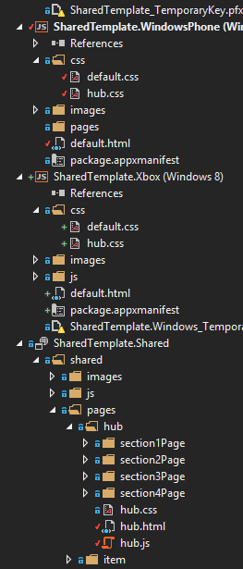
Separate styles
<head>
<title>hubPage</title>
<link href="hub.css" rel="stylesheet" />
<link href="/css/hub.css" rel="stylesheet" />
<script src="hub.js"></script>
</head>
<body...

Slide 28
Demo: Sharing code across platforms

Slide 29
Agenda
Some comparisons
Sharing code
Going native
Khan Academy across devices

Slide 30
C++ / CX
Code sharing across platforms
Thousands of existing libraries with decades of community experience
Resource intensive tasks and high performance

Slide 31
Demo: video effect

Slide 32
Agenda
Some comparisons
Sharing code
Going native
Khan Academy across devices

Slide 33
Khan Academy on Windows, Windows Phone, and Xbox One

Slide 34
Summary
Xbox One is built on Windows Core
Take advantage of the Windows platform today and build Windows Store/Windows Phone Apps
We have a room at Expert 1:1, come talk to the Xbox Apps team! :-)
Please fill out a session survey!

Slide 35
Xbox Apps Developer Partner Program
Partners that offer Developer Services and Middleware are encouraged to join the Xbox Developer Partner Program
Email xboxdpp@microsoft.com for more information

Slide 36
Credits
Matthias Shapiro
@matthiasshap
Flickr: matthiasxc
Pete Brown
Drifting In The Oceans Of Europa
SoundCloud: psychlist1972

Slide 37
Your Feedback is Important
Fill out an evaluation of this session and help shape future events.
Scan the QR code to evaluate this session on your mobile device.
You’ll also be entered into a daily prize drawing!

Slide 38
© 2014 Microsoft Corporation. All rights reserved. Microsoft, Windows, Windows Vista and other product names are or may be registered trademarks and/or trademarks in the U.S. and/or other countries.
The information herein is for informational purposes only and represents the current view of Microsoft Corporation as of the date of this presentation. Because Microsoft must respond to changing market conditions, it should not be interpreted to be a commitment on the part of Microsoft, and Microsoft cannot guarantee the accuracy of any information provided after the date of this presentation. MICROSOFT MAKES NO WARRANTIES, EXPRESS, IMPLIED OR STATUTORY, AS TO THE INFORMATION IN THIS PRESENTATION.

