Slide 2
Understanding the Xbox One game platform built on Windows
2-651
Frank Savage Partner Dev Lead

Slide 3
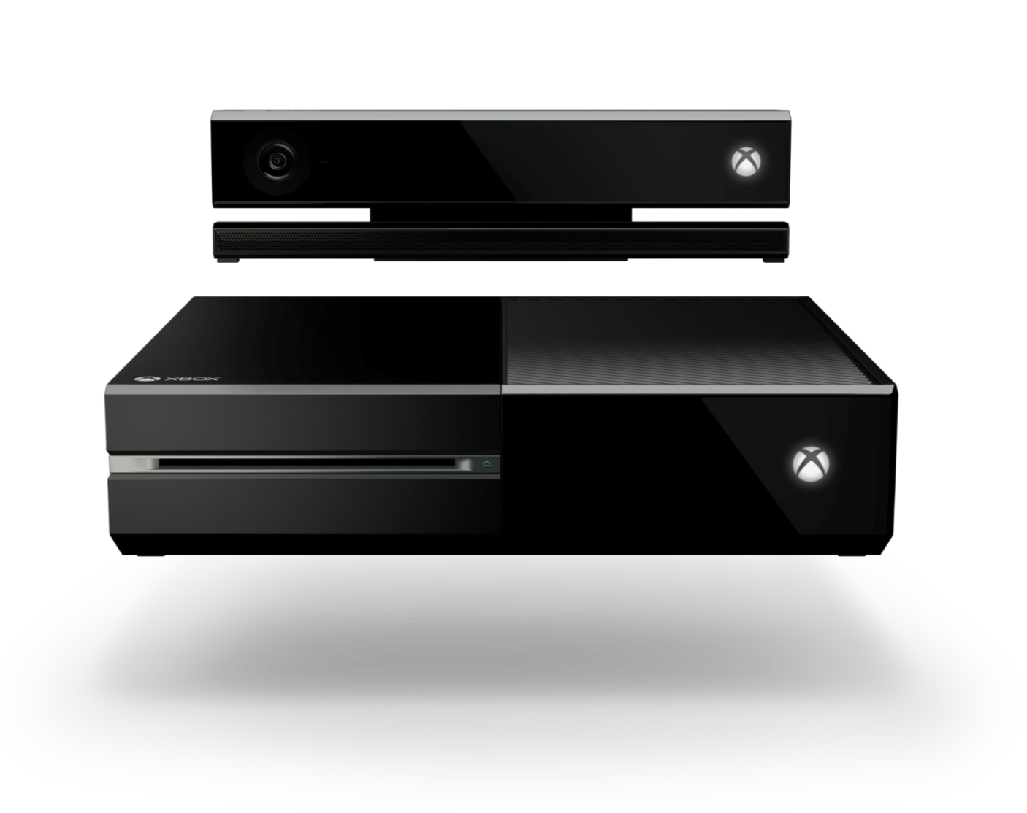
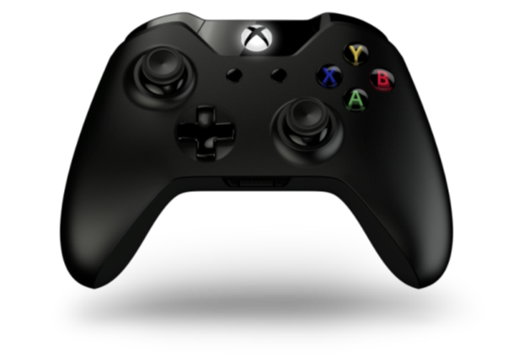
Next gen performance
Modern architecture
Kinect built-in
Seamless and instant
Cloud powered
Works with what you own
Xbox One
All in one entertainment

Slide 4
Best multiplayer service
Dedicated servers
Smartmatch
Cloud processing and AI

Slide 5
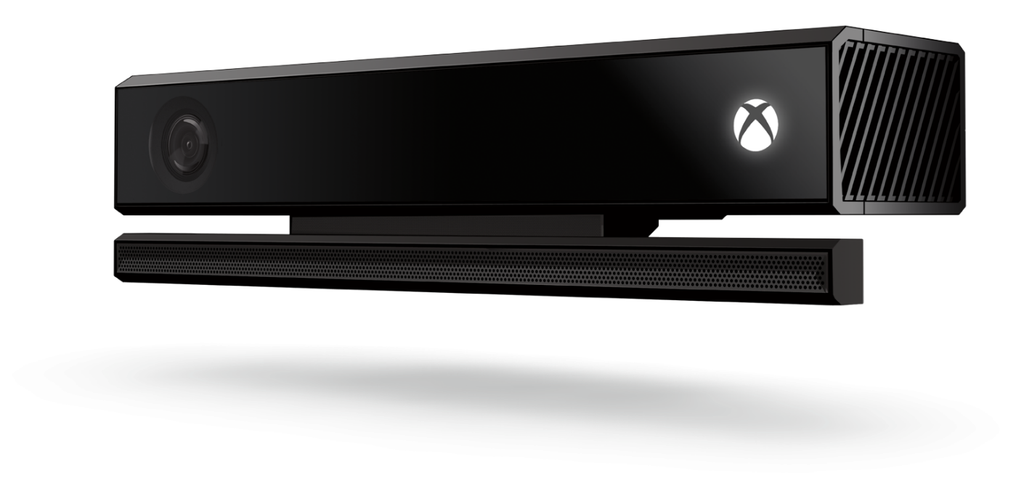
Voice and gesture control
Identity and recognition
Skype video in HD
10x power

Slide 6
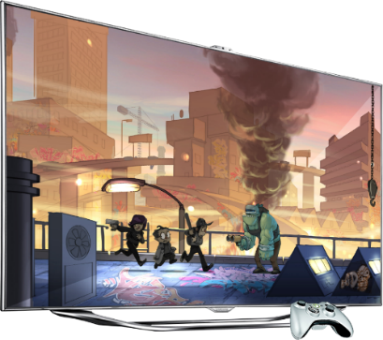
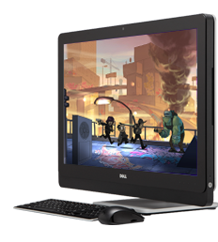
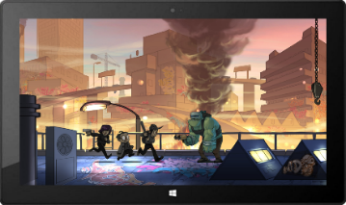
Cross platform development
Windows 8.1 Surface
Xbox One
Windows Phone

Slide 7
Understanding the next generation
New markets and devices
Multitasking
New technology

Slide 8
Games
Art > code
Predictability
IP protection

Slide 9
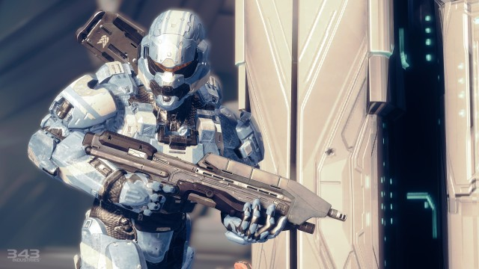
Operating system goals
Embrace predictability and power
Embrace unpredictable future

Slide 10
OS Architecture
Shared partition
Exclusive partition
Shared apps
Exclusive game
Xbox shell
System services
OS
Exclusive OS
Host OS

Slide 11
What do we mean by unique features?
Xbox (Prime, original, you know the first Xbox One!)
Hard drive
Content cache
Someplace to save/load games
DLC/persistent storage
Ethernet port
Multiplayer
Xbox LIVE
DLC/delivery mechanism

Slide 12
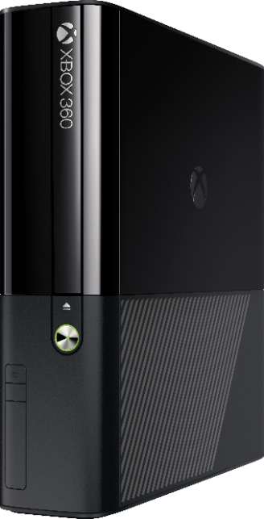
What do we mean by unique features?
Xbox 360
LIVE enabled
Console managed connection
Console managed LIVE profile
Dashboard → shell
Evolved from housekeeping to central hub
Launch pad for all experiences
Constantly evolving
Kinect
New way of interacting with games
Whole new class of games

Slide 13
Xbox One Unique Features
Kinect in every box
SmartGlass
Xbox Cloud computing services
Fast app switching
Cloud storage
Streaming install
ESRAM
Quiet!

Slide 14
ESRAM residency: info
32 MB high-speed ESRAM memory
Dedicated and high bandwidth (duplex)
Intended for render and depth targets, shadow maps, lightmaps, and other high-bandwidth resources
New resource creation settings to specify ESRAM residency
Works for buffers, texture 1D, 2D, and 3D
Default and immutable usages onlyNo CPU access to ESRAM
No swap chains in ESRAM

Slide 15
Xbox Cloud Computing
Move CPU work into the cloud
Running on Microsoft Azure
GSDK used to build cloud servers
More of a preview at this point than actionable

Slide 16
Process lifetime management
Different modes
Much like an origami square
SharedOS and normal ExclusiveOS
SharedOS and constrained ExclusiveOS
SharedOS and suspended ExclusiveOS
Just SharedOS
Low power mode
We can fold the system into different shapes to meet the needs of the current apps and loads
Doesn’t require any code changes! (Mostly!)

Slide 17
Process lifetime management: ERA states
ERA constrained mode
ERA suspend mode
4 CPU cores → Cores 0-3
Cores 4 and 5 folded onto Cores 2 and 3 respectively
50% of GPU
No Controller focus, 100% of network
Game is Running in the BAT
1 second from time event fires to suspend
Game may never wake up from Suspend! → Save State!
If it does wake up, you get a Resume event

Slide 18
Connected storage
Dedicated block of memory (16 MB)
Microsoft guarantees it will get to the cloud
You decide how player picks up experience on return
Player gets to switch away to something else quickly with no loss
Game gets notification of impending switch
One (1) second to make sure game has what it needs to recover in 16 MB
Probably means just streaming the current object model in RAM won’t work
Probably not what the designers will intend for returning from the switch
Probably won’t fit in 16 MB

Slide 19
Streaming install
System designed to get game playable ASAP
Industry is already moving this way
Not just download and run whole thing!
Steam, GameStop, etc.
Optical disks are still there and work like they did on previous gen!
Enables the pre-download/launch day run scenario
ODD delivery == cloud delivery

Slide 20
Streaming install
This is a hard problem to solve!
Can’t just stream/run title from the ODD like you do today
Has to be installed first just like from cloud
Deep understanding of title asset utilization at any given moment essential
Remove redundancies in assets
Understand what different parts of title have in common
Assets must be broken into chunks to allow fast installation of bits needed at start
And start might have a bunch of different meanings

Slide 21
Streaming Install
Have to understand how the player will move through your game
Can be a very hard problem for open worlds, easier for others
Game design considerations
Understand how you game is compartmentalized
Even open world games generally have starter areas
Unlocking multiplayer maps instead of just handing out all of them
Player UGC assets staged
Compression
Squeezing assets as tightly as possible
Leave compressed on HD, use cores at load to decompress

Slide 22
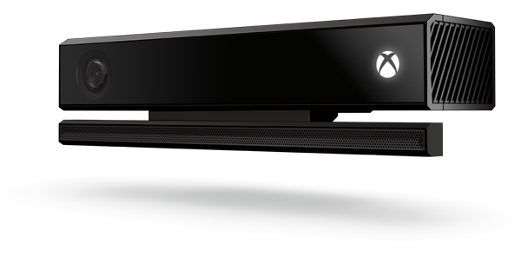
Kinect
You can count on Kinect being there!
No more Kinect title versus controller title
Think about how to integrate Kinect with title
Gestures
Body Motion
Speech
Pointing

Slide 23
Your Feedback is Important
Fill out an evaluation of this session and help shape future events.
Scan the QR code to evaluate this session on your mobile device.
You’ll also be entered into a daily prize drawing!

Slide 24
© 2014 Microsoft Corporation. All rights reserved. Microsoft, Windows, Windows Vista and other product names are or may be registered trademarks and/or trademarks in the U.S. and/or other countries.
The information herein is for informational purposes only and represents the current view of Microsoft Corporation as of the date of this presentation. Because Microsoft must respond to changing market conditions, it should not be interpreted to be a commitment on the part of Microsoft, and Microsoft cannot guarantee the accuracy of any information provided after the date of this presentation. MICROSOFT MAKES NO WARRANTIES, EXPRESS, IMPLIED OR STATUTORY, AS TO THE INFORMATION IN THIS PRESENTATION.

