Slide 2
Promote Your App in Search Results Boost your app’s discoverability and engagement with Bing App Linking
2-655
Evan Lew (Principal Program Manager, Bing)
Eric Aleshire (Software Development Engineer, Windows Phone)

Slide 3
Agenda
Industry context
What is app linking?
How do I implement it?
Example

Slide 4
Industry Context – Opportunity
Percentage of time spent on mobile devices
Mobile web
2 hrs 41 mins
Apps
Flurry Analytics, April 2014

Slide 5
Industry Context – Challenges
Nearly 2/3 of iOS apps get no downloads. (AdEven)
App Discoverability
66% of app users don’t open an app more than 10 times in total. (Localytics)
App Engagement

Slide 6
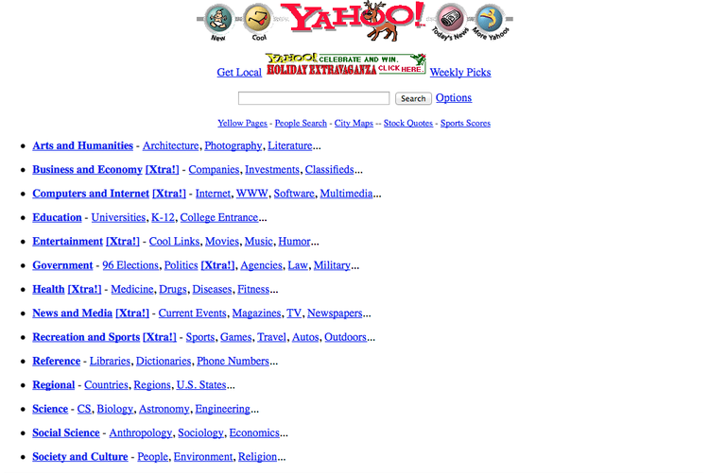
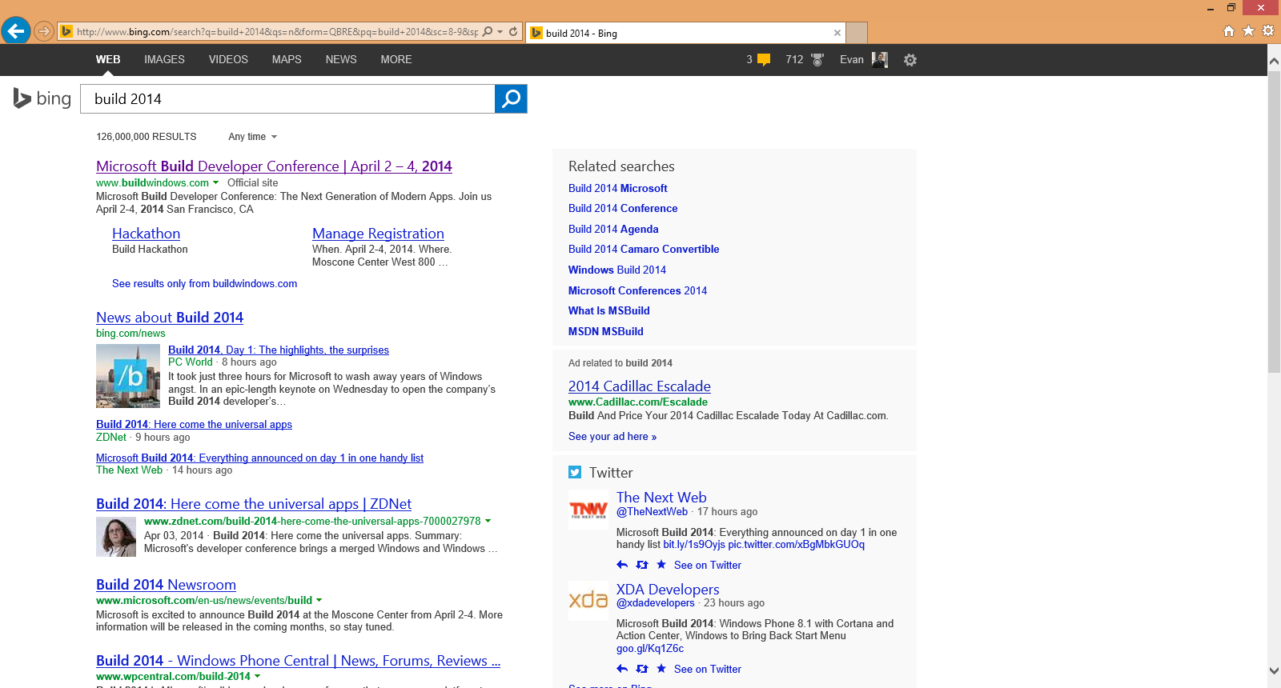
Industry Context – Web Discoverability

Slide 7
Industry Context
hulu
?
watch modern family

Slide 8
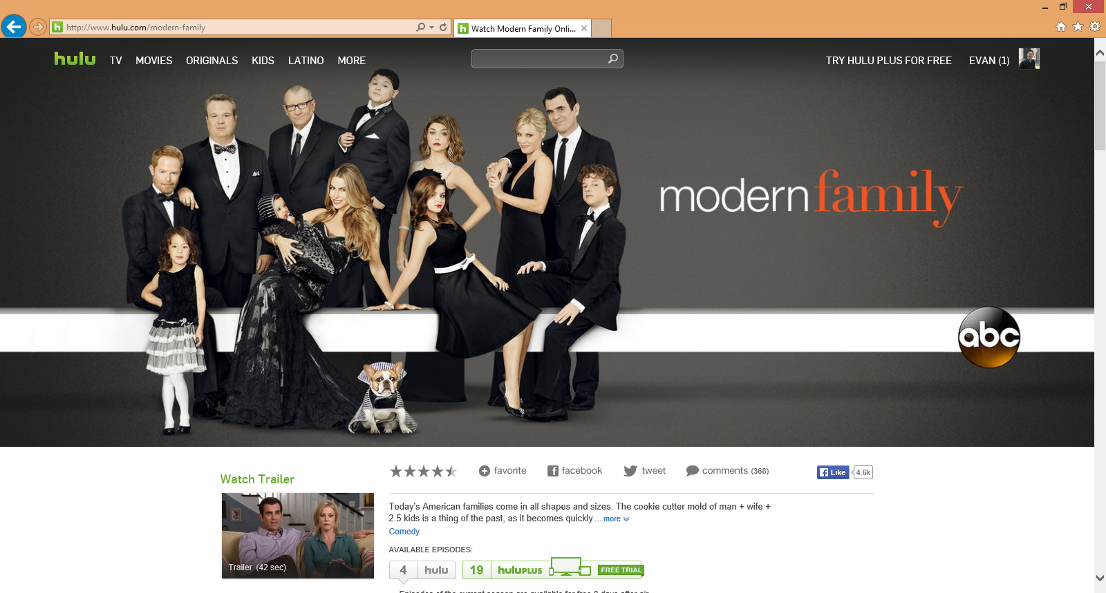
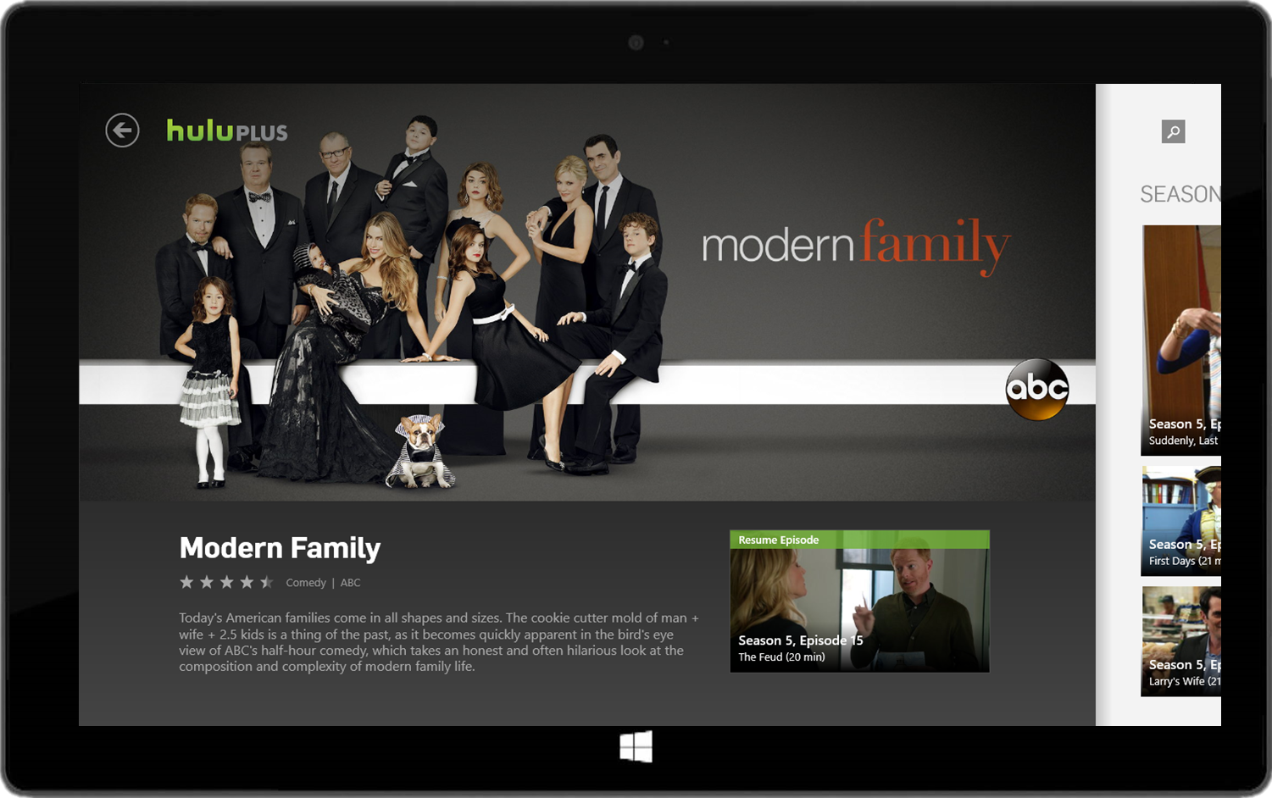
Industry Context
hulu
watch modern family
www.hulu.com/modern-family

Slide 9
Demo

Slide 10
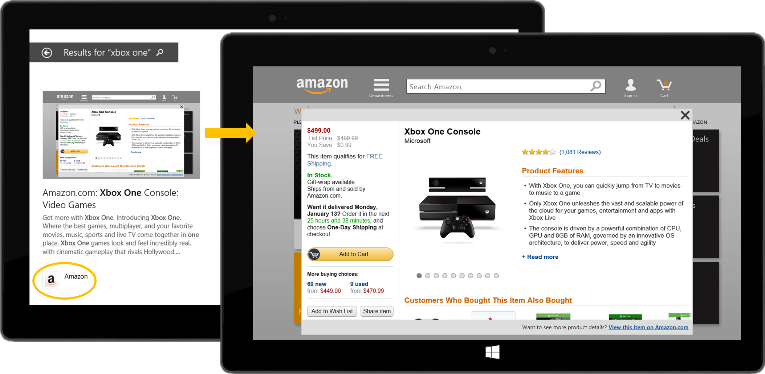
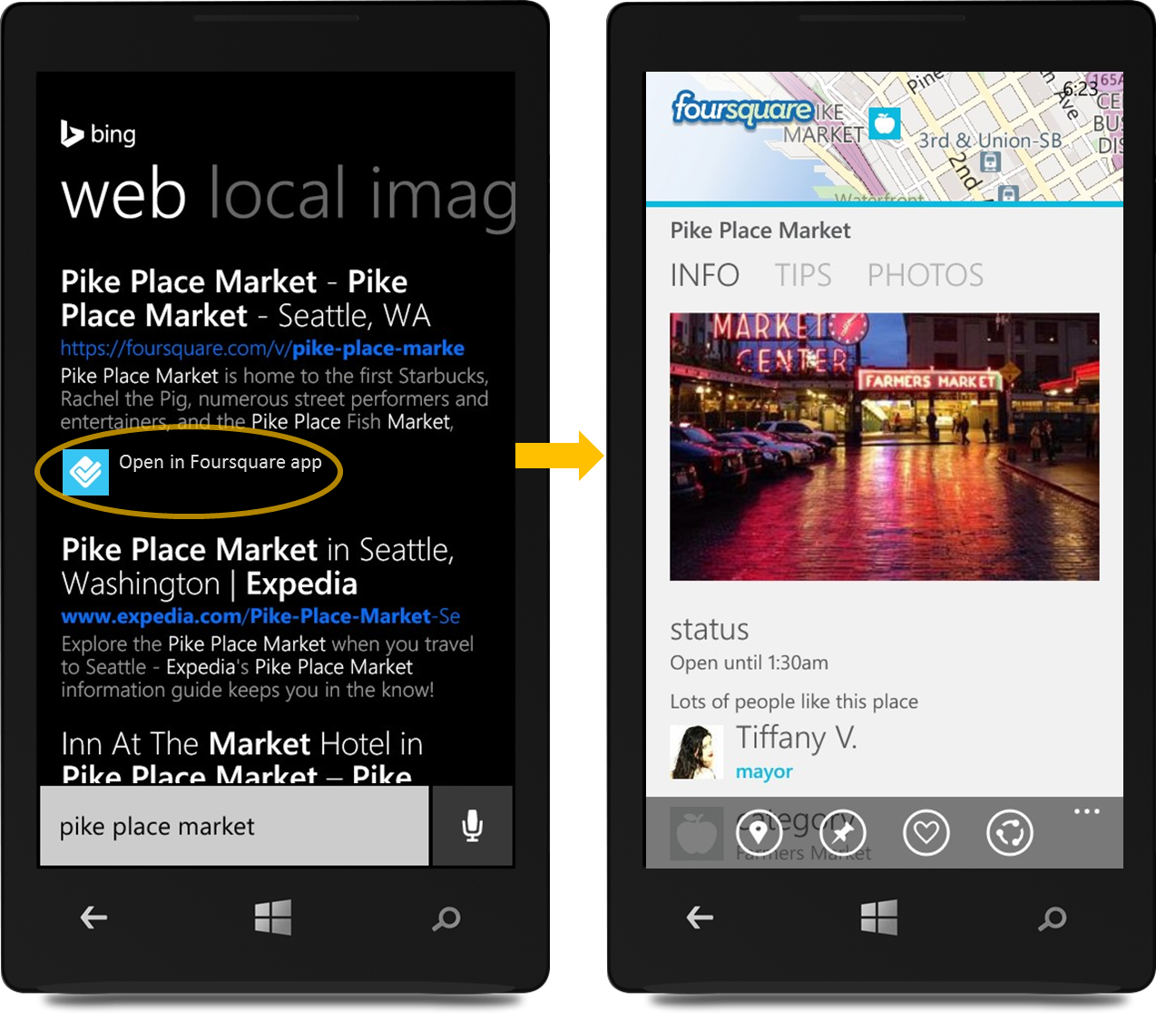
Bing App Linking
More discoverable.
Deeper engagement.
Easy and free.

Slide 11
App Linking Available for Windows and WP apps
Coming soon
OS
Windows 8.1
Windows Phone 8.1
Windows Phone 8.0
Yes
All Windows 8 apps
Windows Runtime
Yes
All WP 8 and 7.1 apps
Windows Runtime and Silverlight
Yes, for domain-level results
All WP 8 and 7.1 apps
Silverlight
App linking?
Apps
Framework
Visit Bing.com/applink to get started.

Slide 12
Implement App Linking in 4 Easy Steps
Bing webmaster portal
1
4
MyWebsite.com
My App
2
3
</>
</>
Website
Search
App

Slide 13
Implement App Linking in 4 Easy Steps
Bing webmaster portal
1
4
MyWebsite.com
My App
2
3
</>
</>
Website
Search
App

Slide 14
Implement App Linking in 4 Easy Steps
Bing webmaster portal
Link website to app
Markup webpages
Enable deep linking
Register app
1
4
1
4
1
MyWebsite.com
My App
2
3
2
3
2
</>
</>
3
Website
Search
App
4

Slide 15
1. Link your website to your app

Slide 16
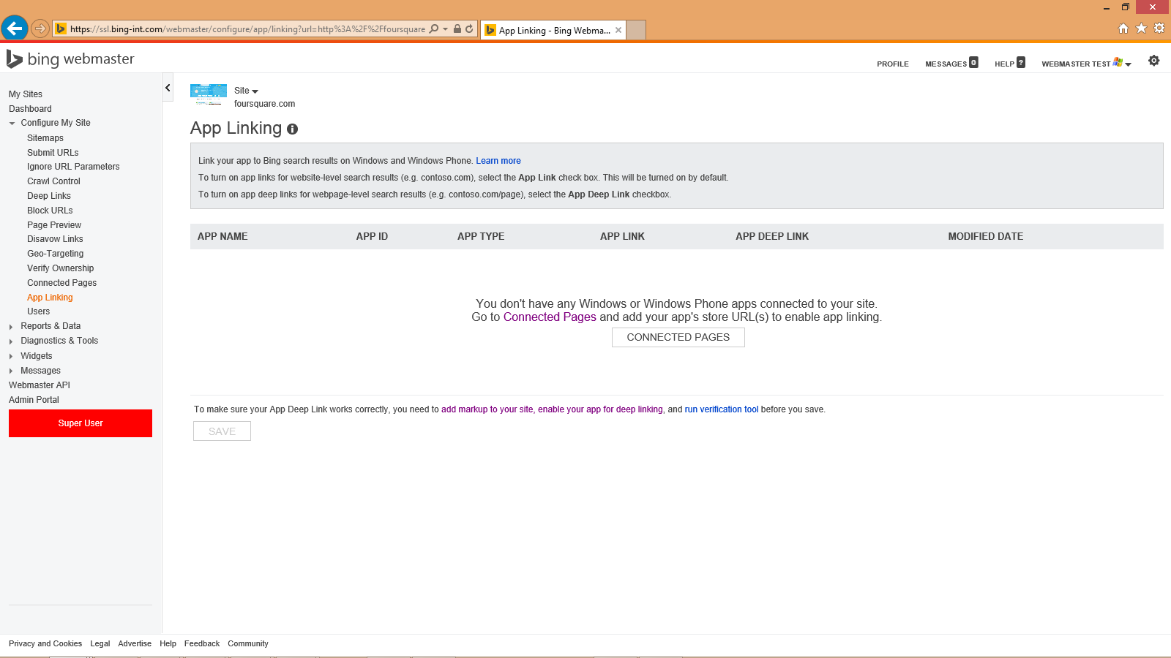
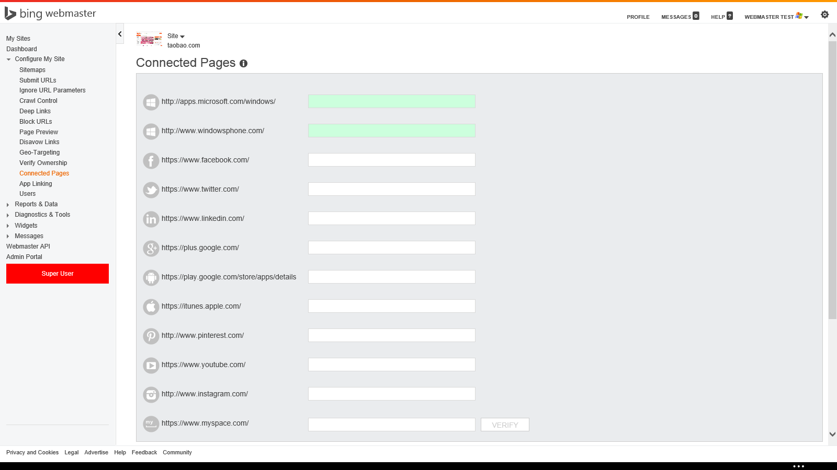
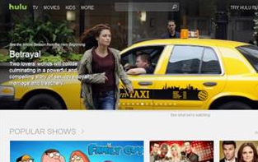
EVAN LEW
hulu.com

Slide 17
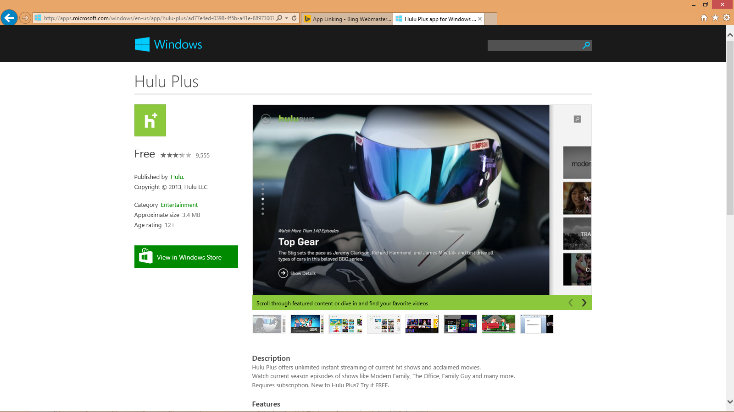
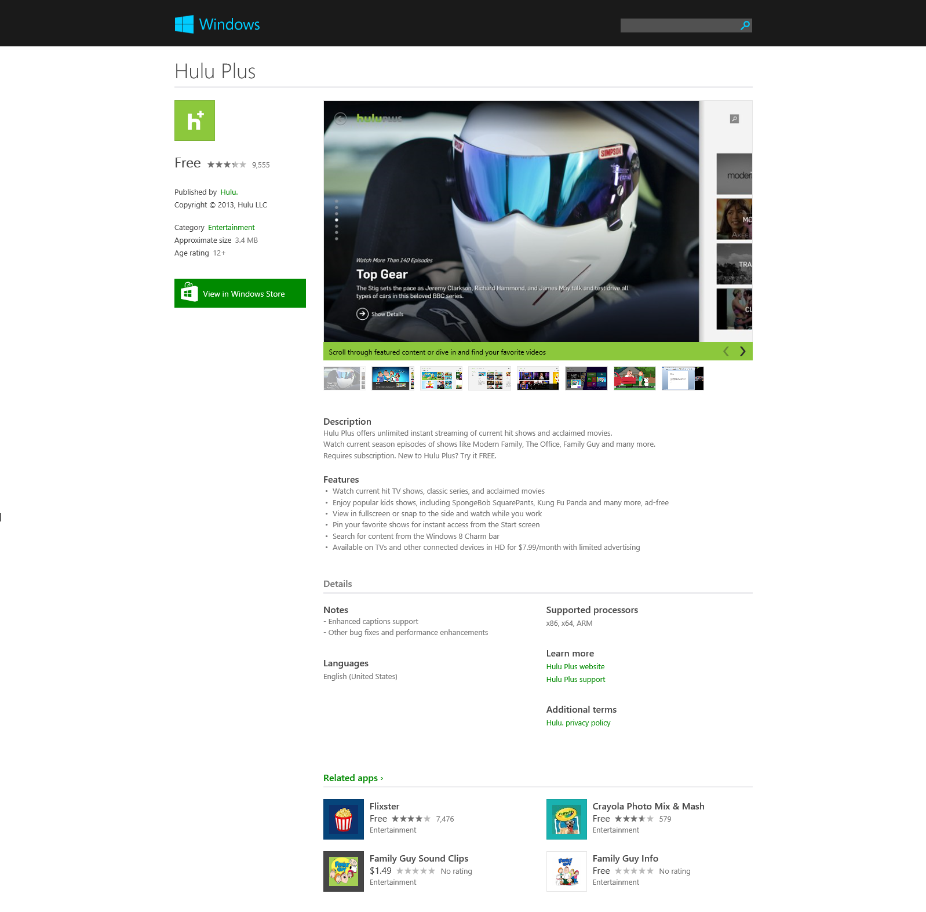

Slide 18
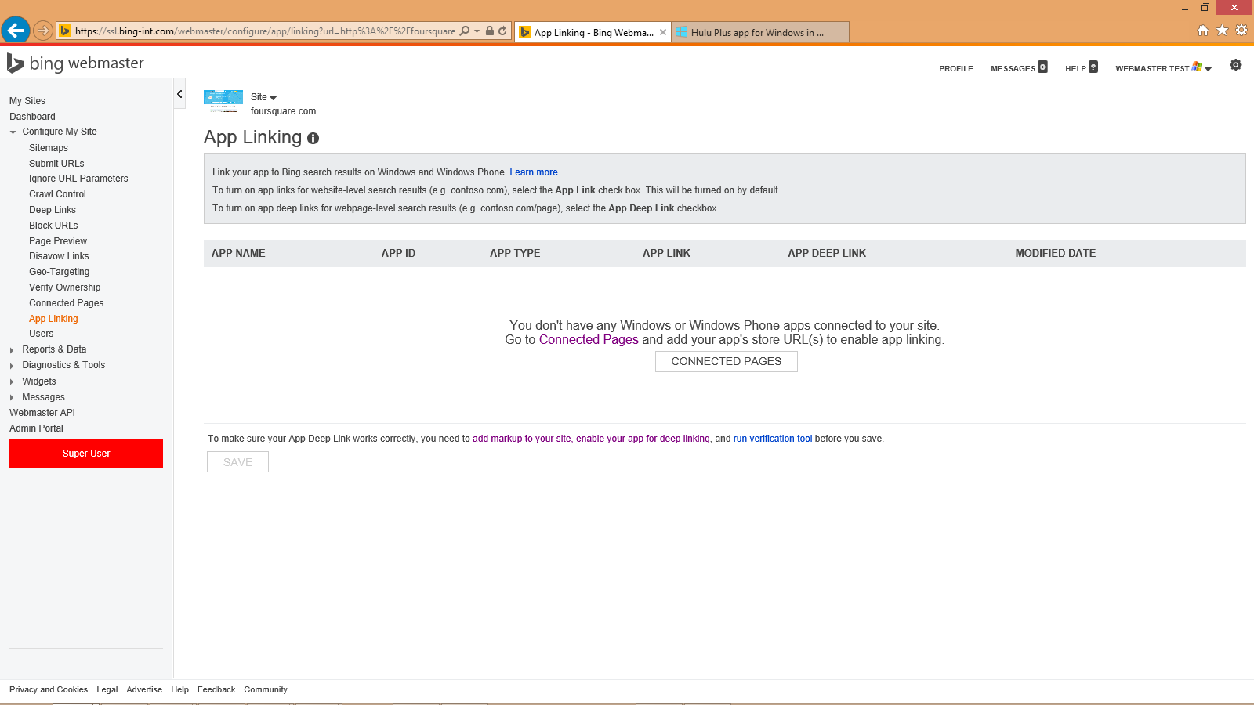
EVAN LEW
EVAN LEW
hulu.com
-plus/ad77e4ed-0398-4f5b-a41e-88973007dca1
-plus/ad77e4ed-0398-4f5b-a41e-88973007dca1

Slide 19
www.hulu.com

Slide 20
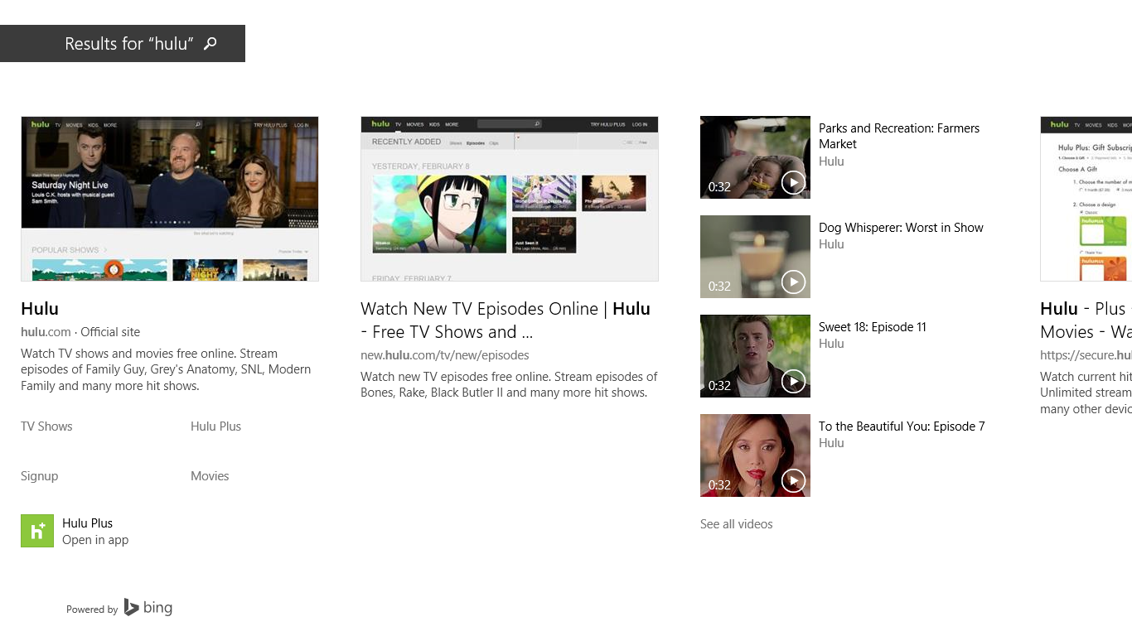

Slide 21
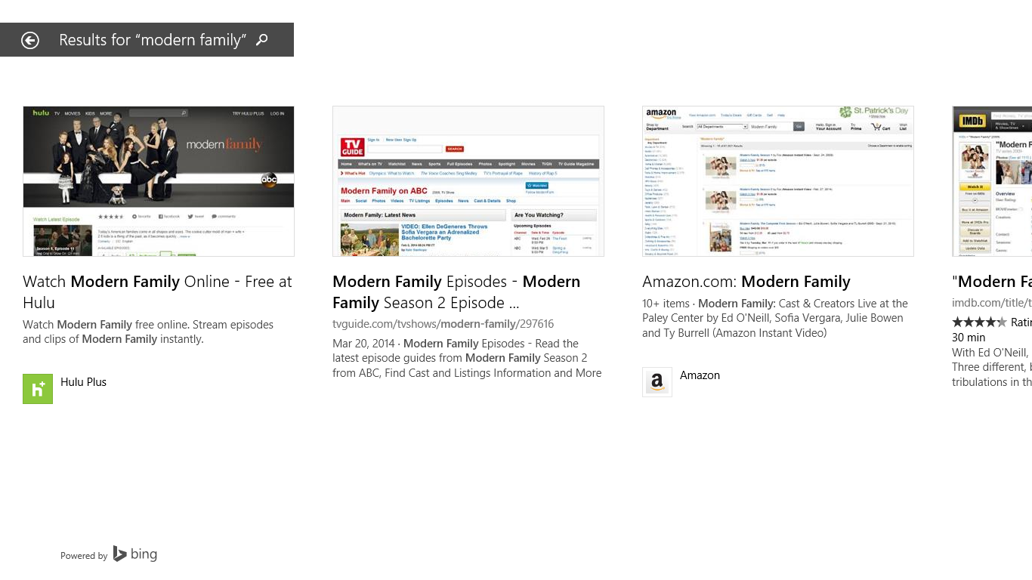

Slide 22
Hulu app
Hulu.com
Hulu.com/ Modern-Family
Hulu.com/ Glee

Slide 23
Hulu app
Hulu.com
<.../>
<.../>
<launch arg Modern-Fam>
<launch arg Glee>
Hulu.com/ Modern-Family
Hulu.com/ Glee

Slide 24
2. Markup webpages
<body>
<span itemscope itemtype="http://schema.org/WebPage">
<span itemprop="operation" itemscope itemtype="http://schema.org/ViewAction">
<span itemprop="actionHandler" itemscope itemtype="http://schema.org/WindowsActionHandler">
<meta itemprop="applicationId" content="4db19603-c4e0-4112-895e-46981d785682">
<meta itemprop="packageFamilyName" content="Contoso.Contoso_54ggd3ev8bvz6">
<meta itemprop="arguments" content="cityId=1&restaurantId=5609"
<meta itemprop="minVersion" content="2.2.0.12"> // Optional
</span>
<span itemprop="actionHandler" itemscope itemtype="http://schema.org/WindowsPhoneActionHandler">
<meta itemprop="applicationId" content="08f1f665-222d-422c-9f99-bc3e0dd34433">
<meta itemprop="packageFamilyName" content="Contoso.Contoso_54ggd3ev8bvz6">
<meta itemprop="arguments" content="cityId=1&restaurantId=5609"
<meta itemprop="minVersion" content="3.0.1.00"> // Optional
</span>
</span>
</span>
</body>

Slide 25
2. Markup webpages
App ID
Which app?
Pkg family name
Launch args
What content in the app?
Min version
What version of the app? (optional)

Slide 26
2. Markup webpages
App ID
http://www.windowsphone.com/en-us/store/app/contoso/ 08f1f665-222d-422c-9f99-bc3e0dd34433
08f1f665-222d-422c-9f99-bc3e0dd34433
Pkg family name
Launch args
Min version

Slide 27
2. Markup webpages
App ID
Pkg family name
Does not apply for Silverlight apps
Launch args
Min version

Slide 28
2. Markup webpages
Launch arguments can be expressed as:
App ID
URL-valid query string
e.g. key1=value1&key2=value2
A.
Windows Runtime apps
Silverlight apps
Pkg family name
or
Relative or absolute URL
e.g. /r/5609/Rays or http://www.contoso.com?foo
B.
Windows Runtime apps
Launch args
Escape special characters
e.g. www.foo.com/piquín www.foo.com/piqu%C3%ADn
url=http://foo.com url=http%3A%2F%2Fwww.foo.com
Min version

Slide 29
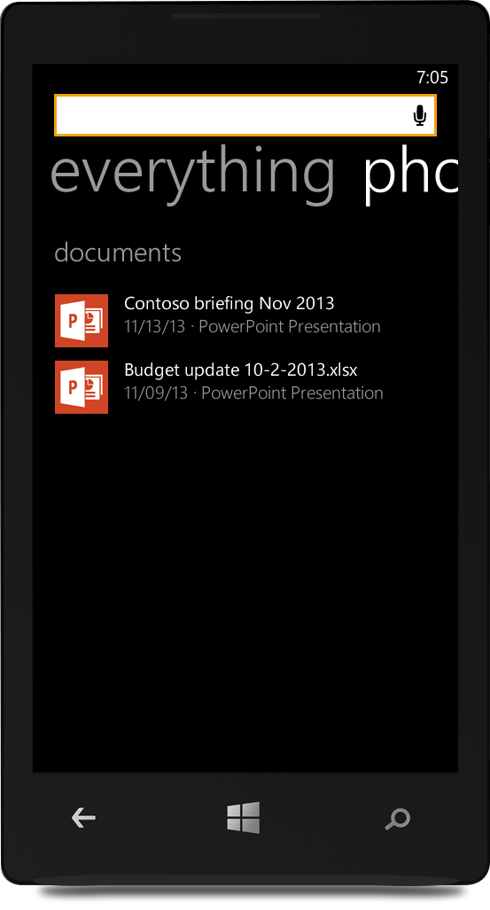
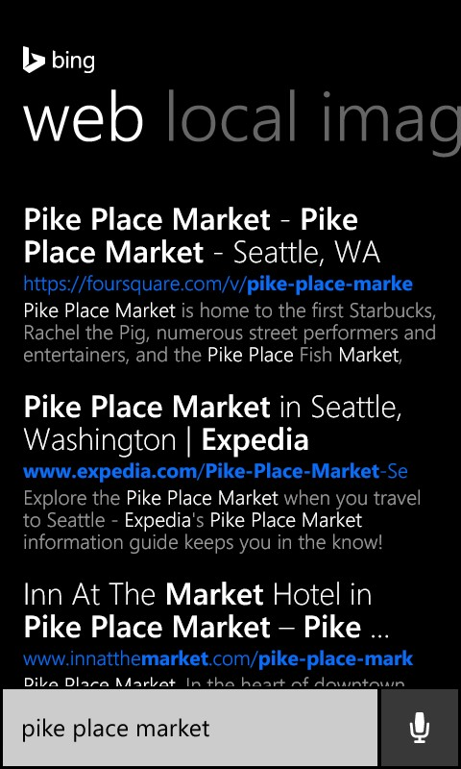
2. Markup webpages
App ID
Pkg family name
Update Foursquare app
Launch args
Min version

Slide 30
2. Markup webpages
Microdata
or
JSON-LD
<body>
<span itemscope itemtype="http://schema.org/WebPage">
<span itemprop="operation" itemscope itemtype="http://schema.org/ViewAction">
<span itemprop="actionHandler" itemscope itemtype="http://schema.org/WindowsActionHandler">
<meta itemprop="applicationId" content="4db19603-c4e0-4112-895e-46981d785682">
<meta itemprop="packageFamilyName" content="Contoso.Contoso_54ggd3ev8bvz6">
<meta itemprop="arguments" content="cityId=1&restaurantId=5609"
<meta itemprop="minVersion" content="2.2.0.12"> // Optional
</span>
<span itemprop="actionHandler" itemscope itemtype="http://schema.org/WindowsPhoneActionHandler">
<meta itemprop="applicationId" content="08f1f665-222d-422c-9f99-bc3e0dd34433">
<meta itemprop="packageFamilyName" content="Contoso.Contoso_54ggd3ev8bvz6">
<meta itemprop="arguments" content="cityId=1&restaurantId=5609"
<meta itemprop="minVersion" content="3.0.1.00"> // Optional
</span>
</span>
</span>
</body>
Schema.org: industry-standard markup vocabulary that search engines (e.g. Bing, Google, and Yahoo!) rely on to improve the display of search results.

Slide 31
2. Markup webpages
Microdata
or
JSON-LD
<script type="application/ld+json">
{
"@context": "http://schema.org",
"@type": "WebPage",
"operation": {
"@type": "ViewAction",
"actionHandler": [
{
"@type": "WindowsActionHandler",
"applicationId": "4db19603-c4e0-4112-895e-46981d785682",
"packageFamilyName": "Contoso.Contoso_54ggd3ev8bvz6",
"arguments": "cityId=1&restaurantId=5609",
"minVersion": "2.2.0.12"
},{
"@type": "WindowsPhoneActionHandler",
"applicationId": "08f1f665-222d-422c-9f99-bc3e0dd34433",
"packageFamilyName": "Contoso.Contoso_54ggd3ev8bvz6",
"arguments": "cityId=1&restaurantId=5609",
"minVersion": "3.0.1.00"
}
]
}
}
</script>

Slide 32
3. Enable your app for deep linking

Slide 33
3. Enable your app for deep linking
Windows Runtime apps
app.xaml
protected override void OnLaunched(LaunchActivatedEventArgs e) {
...
if (rootFrame.Content==null) {
...
if (!rootFrame.Navigate(typeof(MainPage), e.Arguments))
{throw new Exception("Failed to create initial page");}
}
Window.Current.Activate();
}

Slide 34
3. Enable your app for deep linking
Windows Runtime apps
app.xaml
protected override void OnLaunched(LaunchActivatedEventArgs e) {
...
if (rootFrame.Content==null) {
...
if (!rootFrame.Navigate(typeof(MainPage), e.Arguments))
{throw new Exception("Failed to create initial page");}
}
Window.Current.Activate();
}

Slide 35
3. Enable your app for deep linking
Windows Runtime apps
app.xaml
protected override void OnLaunched(LaunchActivatedEventArgs e) {
...
if (rootFrame.Content==null) {
...
if (!rootFrame.Navigate(typeof(MainPage), e.Arguments))
{throw new Exception("Failed to create initial page");}
}
if (!String.IsNullOrEmpty(e.Arguments))
{
}
Window.Current.Activate();
}

Slide 36
3. Enable your app for deep linking
Windows Runtime apps
app.xaml
protected override void OnLaunched(LaunchActivatedEventArgs e) {
...
if (rootFrame.Content==null) {
...
if (!rootFrame.Navigate(typeof(MainPage), e.Arguments))
{throw new Exception("Failed to create initial page");}
}
if (!String.IsNullOrEmpty(e.Arguments))
{if (!rootFrame.Navigate(typeof(AppLinkPage), e.Arguments))
{throw new Exception("Failed to create app link page");}
}
Window.Current.Activate();
}

Slide 37
3. Enable your app for deep linking
Windows Runtime apps
app.xaml
protected override void OnLaunched(LaunchActivatedEventArgs e) {
...
if (rootFrame.Content==null) {
...
if (!rootFrame.Navigate(typeof(MainPage), e.Arguments))
{throw new Exception("Failed to create initial page");}
}
if (!String.IsNullOrEmpty(e.Arguments))
{if (!rootFrame.Navigate(typeof(AppLinkPage), e.Arguments))
{throw new Exception("Failed to create app link page");}
}
Window.Current.Activate();
}
AppLinkPage.xaml
protected override void OnNavigatedTo(NavigationEventArgs e) {
base.OnNavigatedTo(e);
Args.Text = e.Parameter.ToString(); }

Slide 38
3. Enable your app for deep linking
Silverlight apps
app.xaml
private void InitializePhoneApplication() {
...
RootFrame.UriMapper = new CustomUriMapper();
/MainPage.xaml?a=123&b=456
CustomUriMapper
class CustomUriMapper : UriMapperBase {
public override Uri MapUri(Uri uri)
{
String tempUri = uri.ToString();
if (tempUri.Contains("MainPage.xaml?"))
{
String launchArguments = tempUri.Substring(tempUri.IndexOf("?") + 1);
String newUri = String.Format("/AppLinkPage.xaml?{0}", launchArguments);
return new Uri(newUri, UriKind.Relative);
/AppLinkPage.xaml?a=123&b=456
AppLinkPage.xaml
protected override void OnNavigatedTo(NavigationEventArgs e) {
...

Slide 39
3. Enable your app for deep linking
Once you’ve updated your app…
Test. Test tool available at Bing.com/AppLink.
Submit your app to the Store.

Slide 40
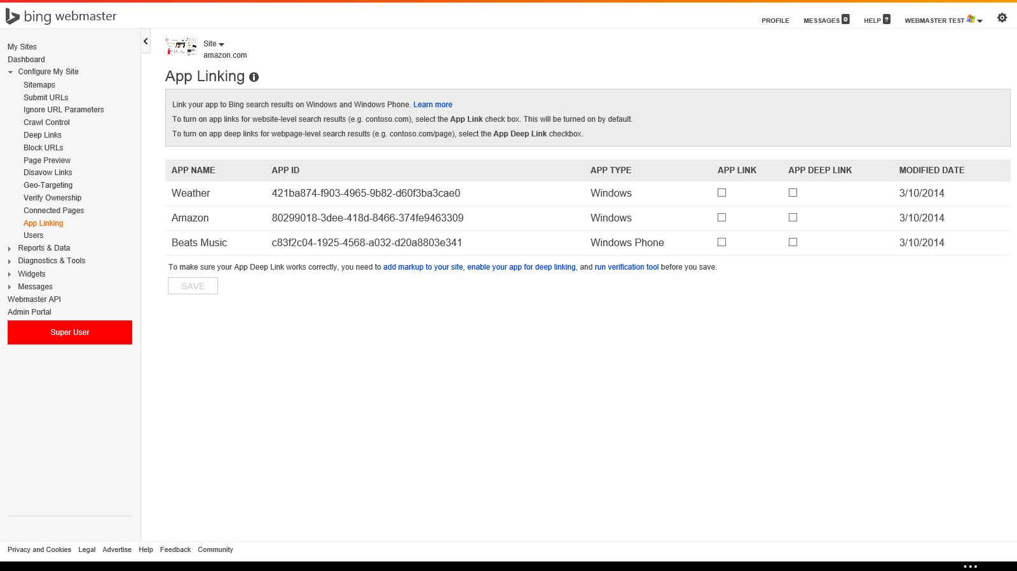
4. Register your app for deep linking
EVAN LEW
contoso.com
Contoso 4db19603-c4e0-4112-895e-46981d785682
Contoso 08f1f665-222d-422c-9f99-bc3e0dd34433

Slide 41
Example

Slide 42
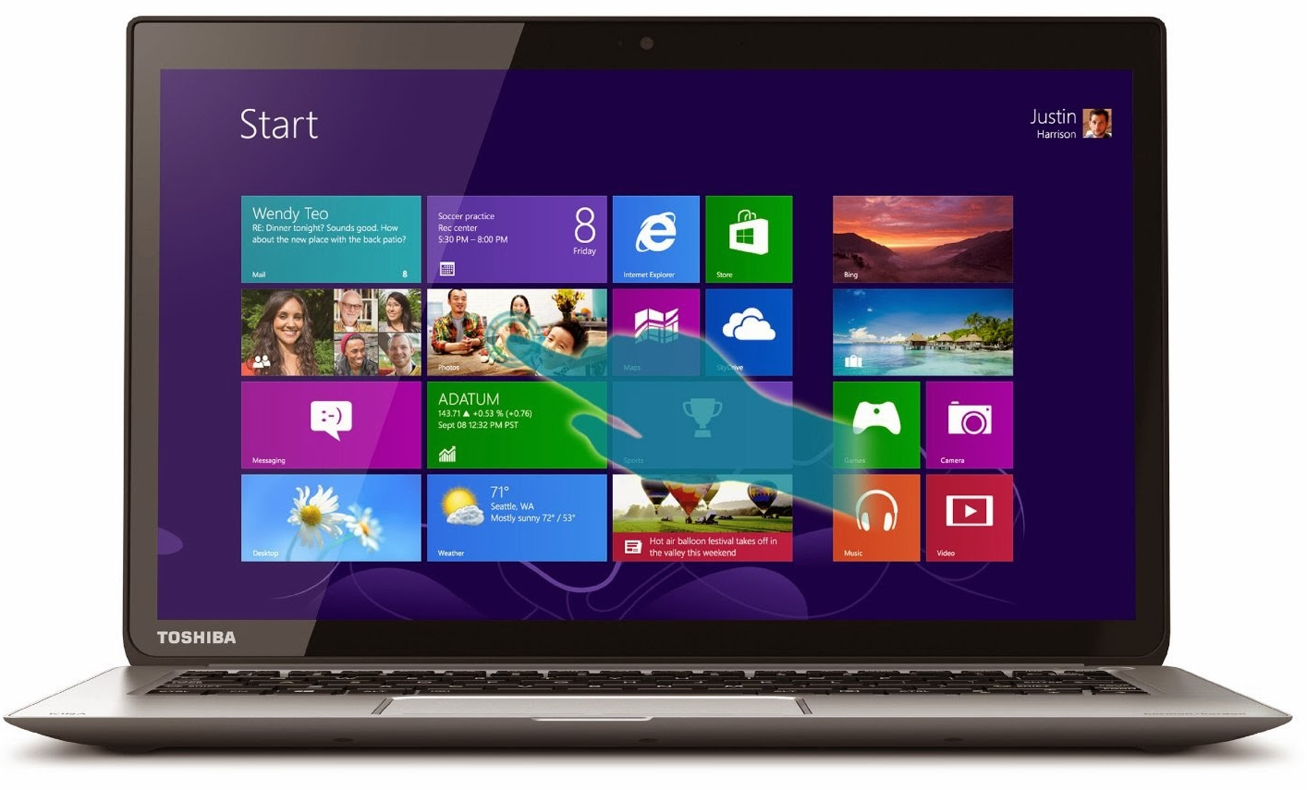
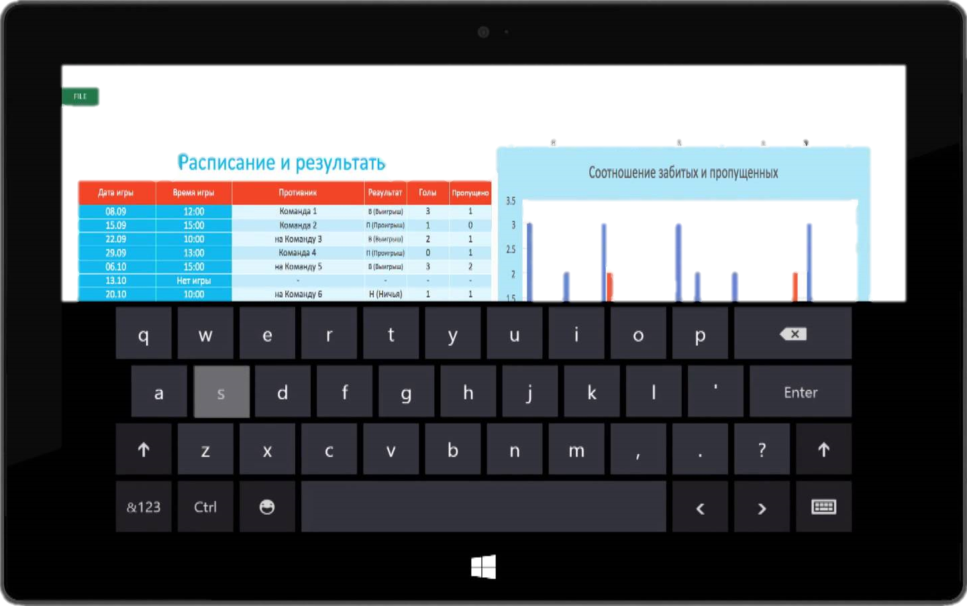
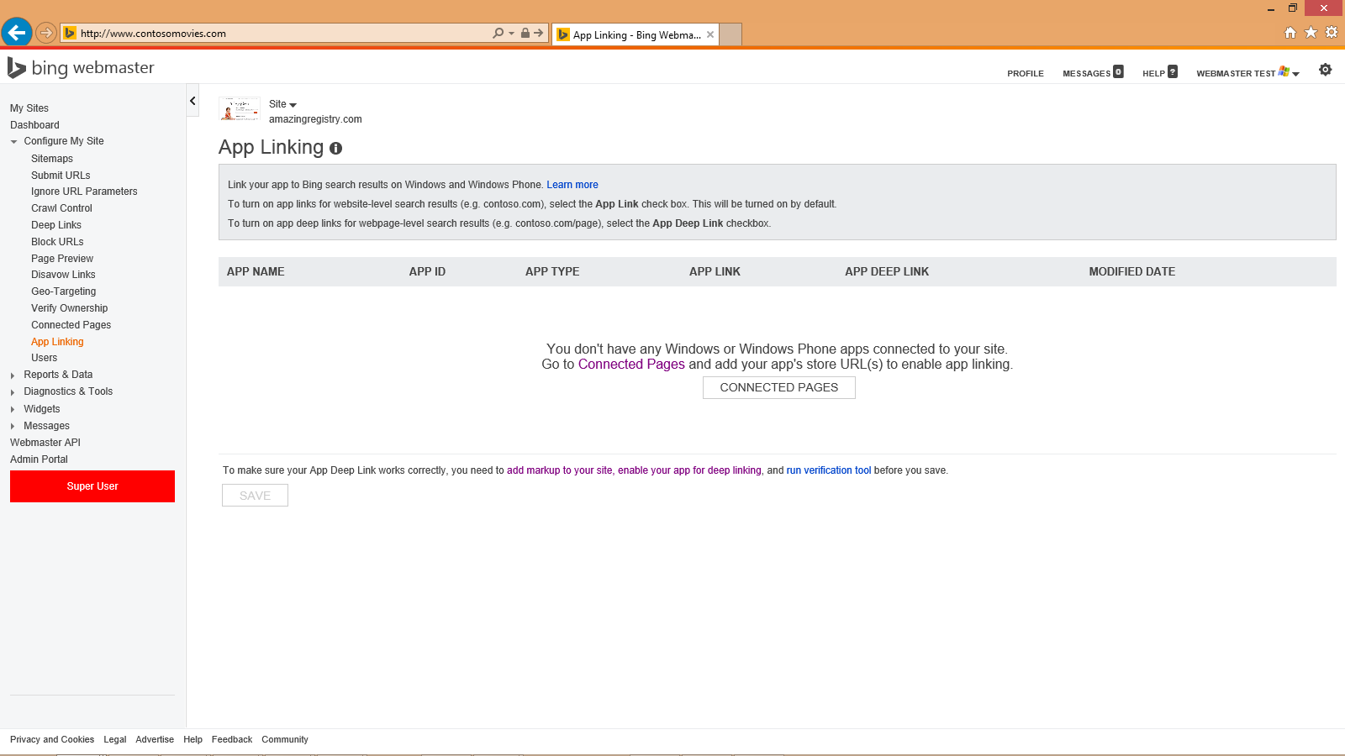
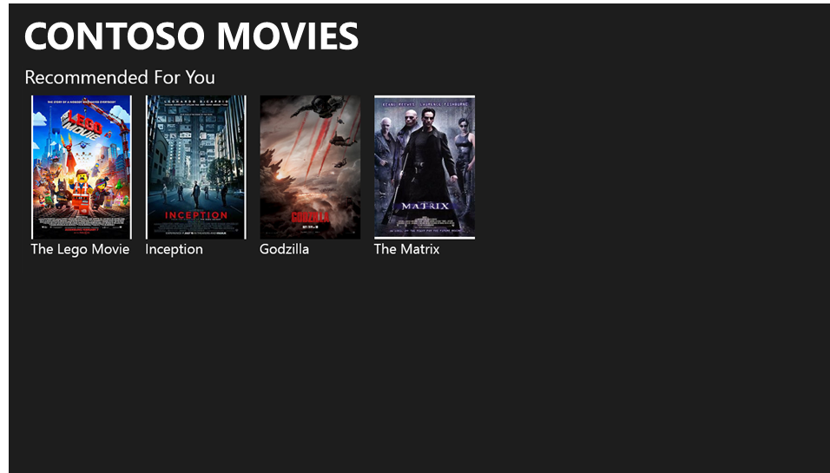
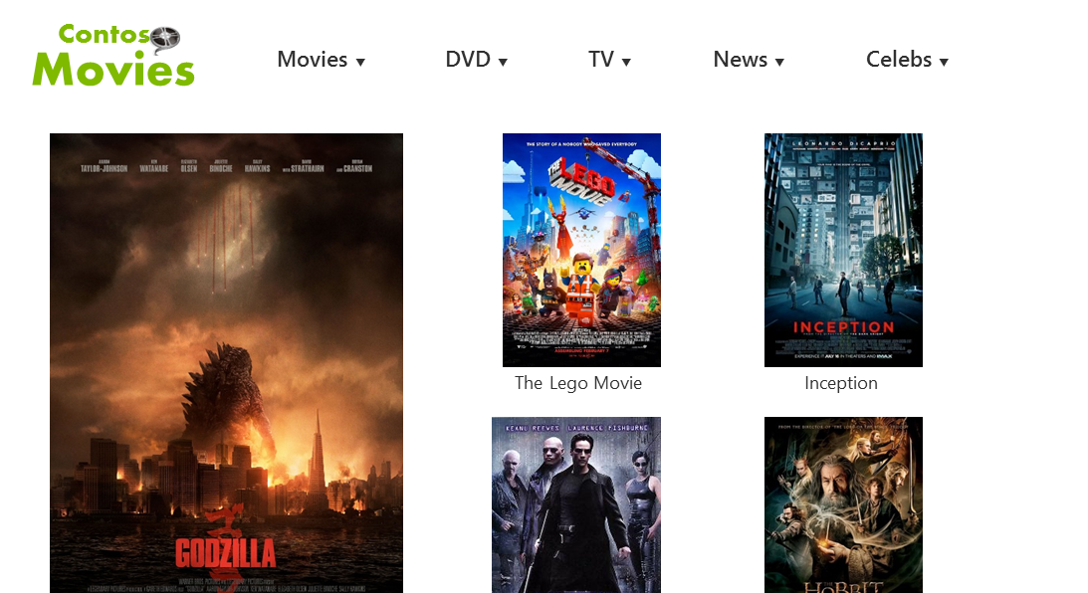
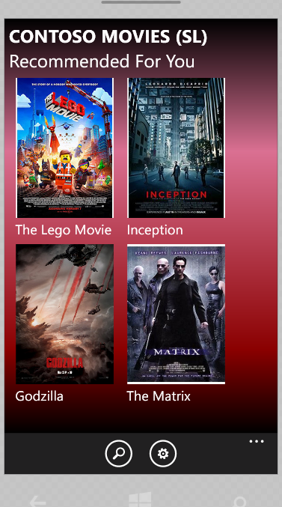
Contoso
Movies
Contoso Movies
http://www.contosomovies.com
Windows app
Windows Phone app
Website

Slide 43
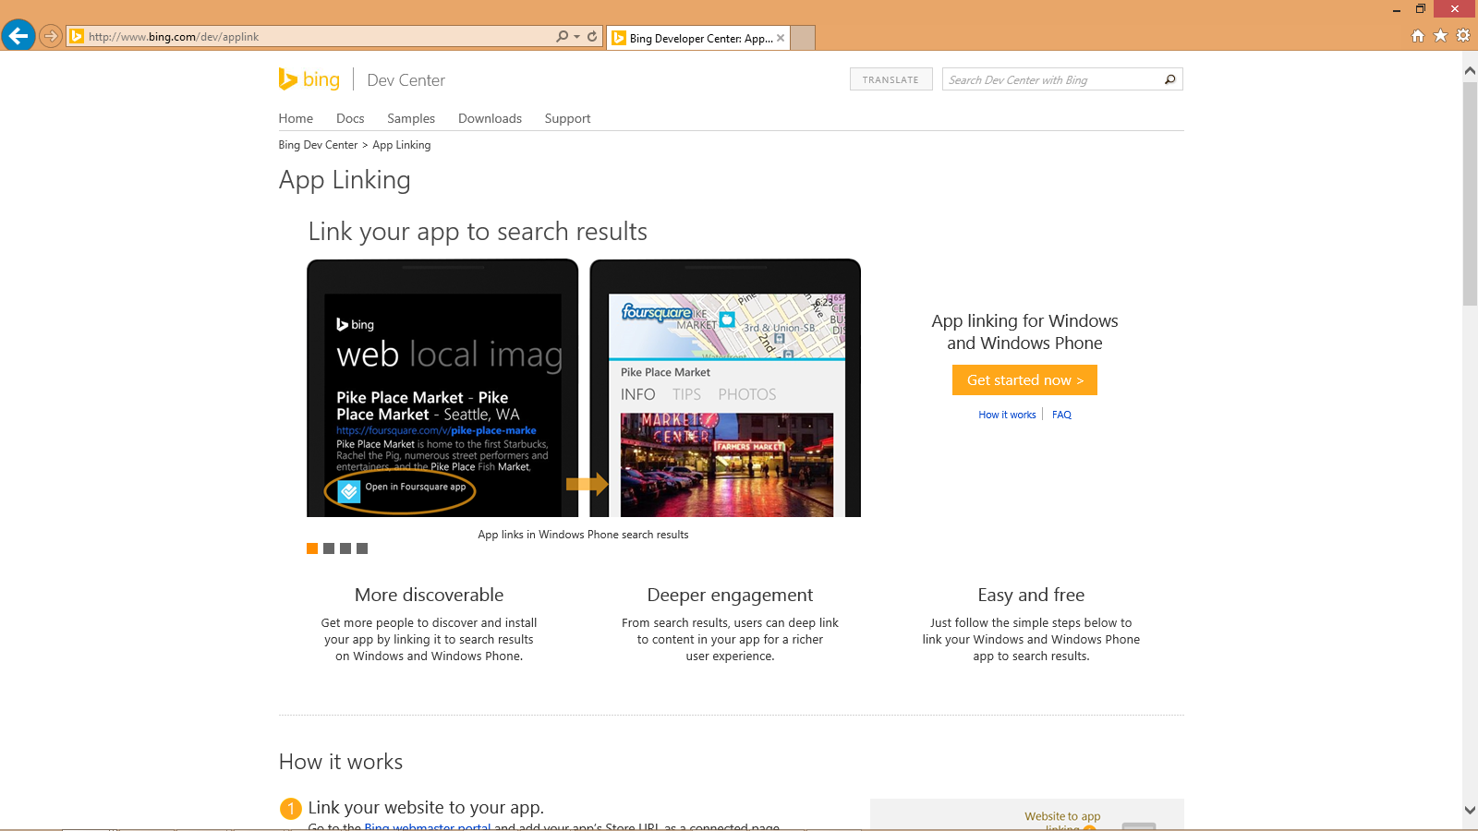

Slide 44
EVAN LEW
contosomovies.com

Slide 45
EVAN LEW
contosomovies.com

Slide 46
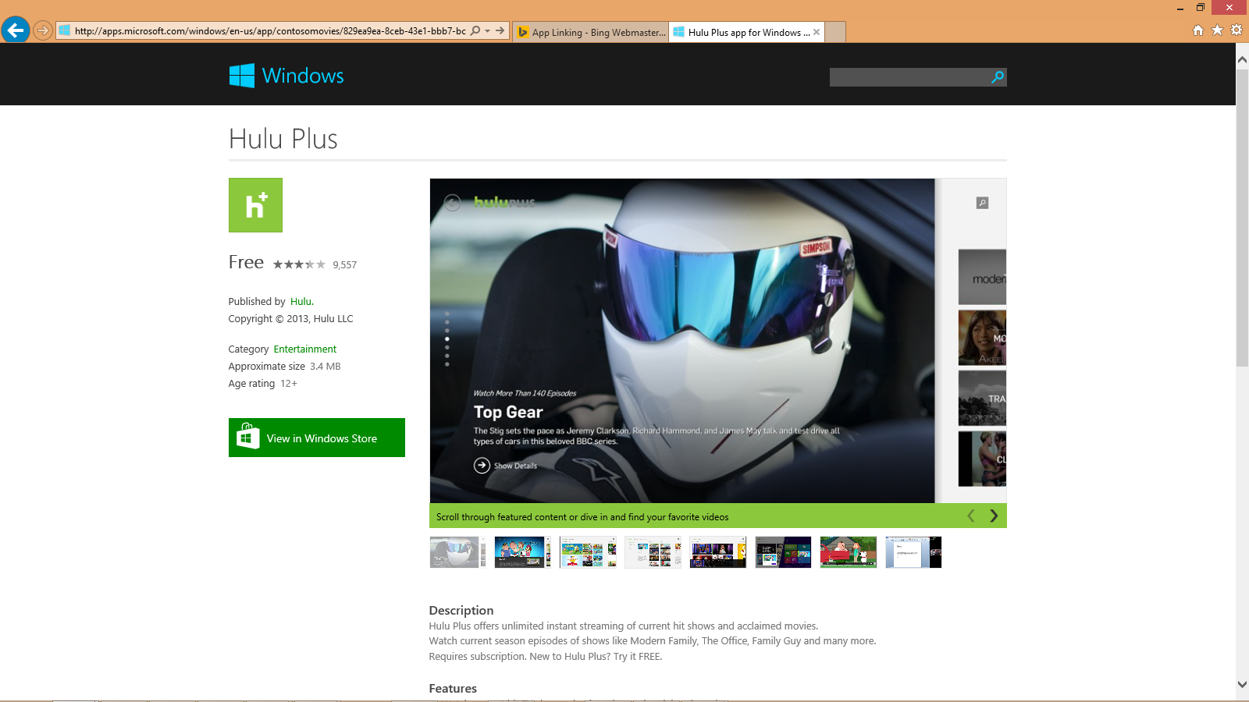
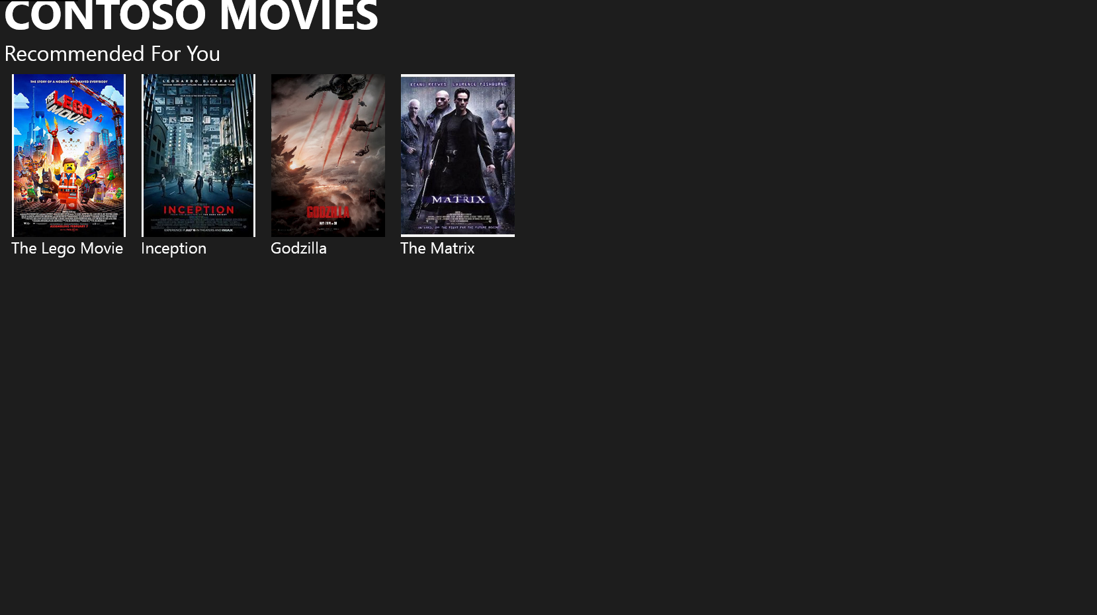
Contoso Movies for Windo…
Contoso Movies
CONTOSO MOVIES
Contoso
@ 2014, Contoso
Entertainment

Slide 47
Contoso Movies for Windo…
EVAN LEW
contosomovies.com
vies/829ea9ea-8ceb-43e1-bbb7-bc89078e3eae

Slide 48
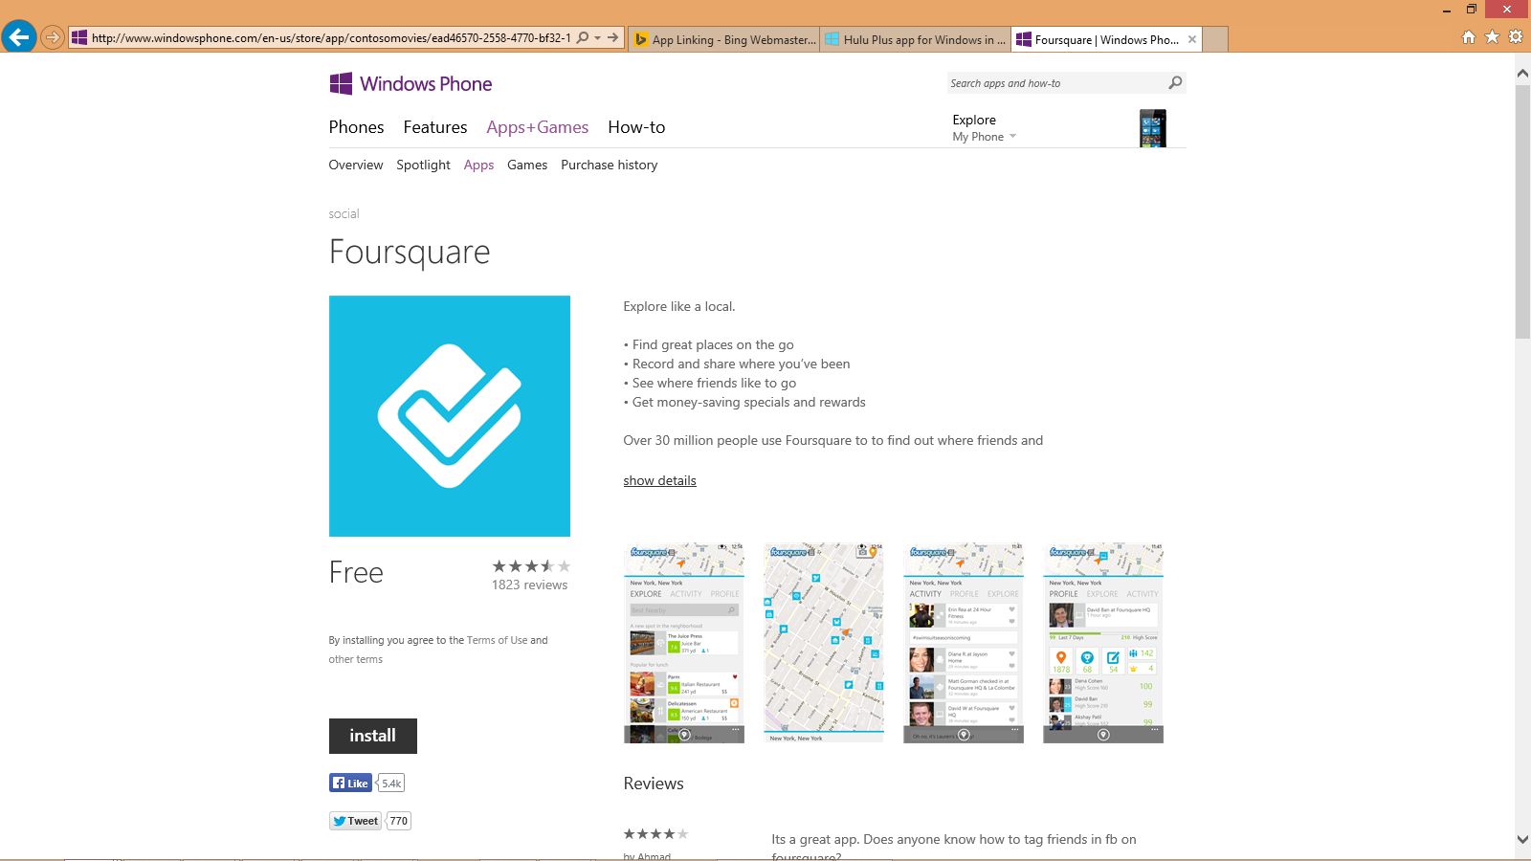
Contoso Movies for Windo…
Contoso Movies for Windo…
entertainment
Contoso Movies
Get the latest on the hottest movies.

Slide 49
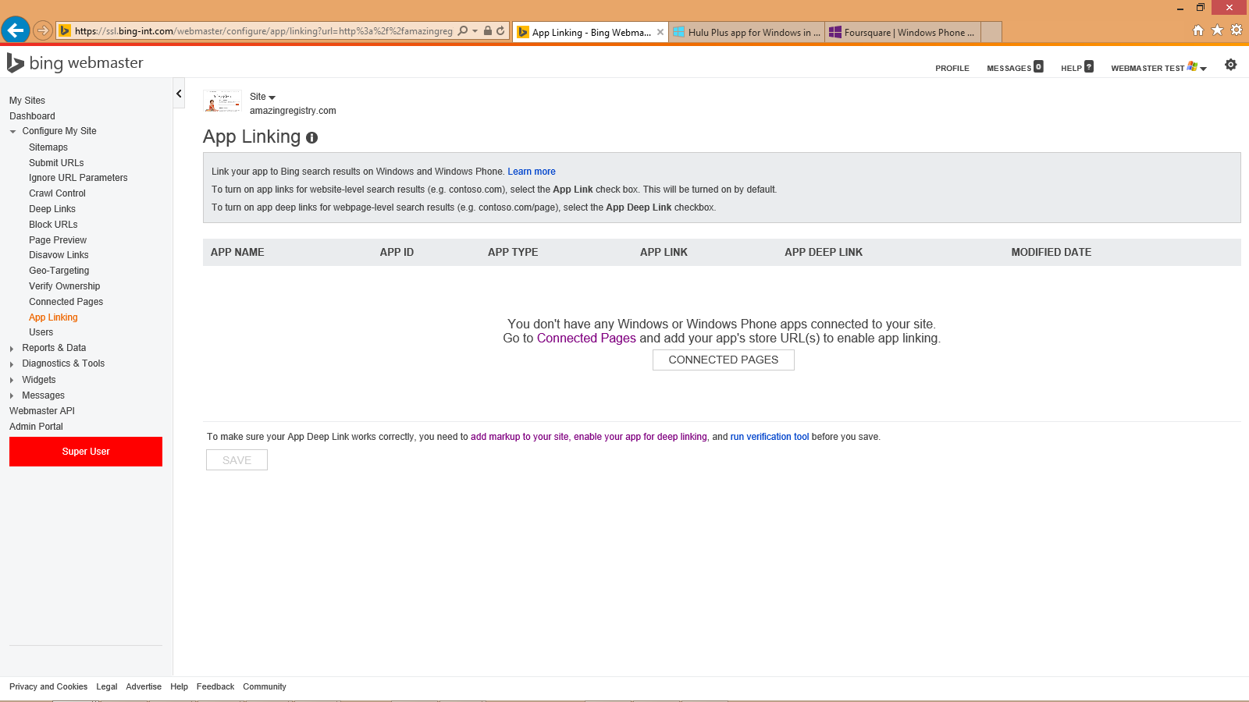
Contoso Movies for Windo…
Contoso Movies for Windo…
EVAN LEW
contosomovies.com
vies/829ea9ea-8ceb-43e1-bbb7-bc89078e3eae
ovies/ead46570-2558-4770-bf32-1f1bda0fb567
VERIFY

Slide 50
Demo

Slide 51
Contoso
Movies
Contoso Movies - Godzilla
Movies ▼
DVD ▼
TV ▼
News ▼
Celebs ▼
Godzilla (2014)
The world's most famous monster is pitted against malevolent creatures who, bolstered by humanity's scientific arrogance, threaten our very existence.
Director: Gareth Edwards
Writers: Max Borenstein (screenplay), Dave Callaham (story)
Stars: Aaron Taylor-Johnson, Elizabeth Olsen, Bryan Cranston

Slide 52
<html>
<body>
CONTOSO MOVIES<br>
<img src="http://contosomovies.com/Godzilla.jpg"/><br>
<b>Godzilla (2014)</b><br>
The world's most famous monster is pitted against malevolent creatures who, bolstered by humanity's scientific arrogance, threaten our very existence.
<br>
<br>
Director: Gareth Edwards<br>
Writers: Max Borenstein (screenplay), Dave Callaham (story) <br>
Stars: Aaron Taylor-Johnson, Elizabeth Olsen, Bryan Cranston <br>
...
</body>
</html>

Slide 53
<html>
<body>
CONTOSO MOVIES<br>
<img src="http://contosomovies.com/Godzilla.jpg"/><br>
<b>Godzilla (2014)</b><br>
The world's most famous monster is pitted against malevolent creatures who, bolstered by humanity's scientific arrogance, threaten our very existence.
<br>
<br>
Director: Gareth Edwards<br>
Writers: Max Borenstein (screenplay), Dave Callaham (story) <br>
Stars: Aaron Taylor-Johnson, Elizabeth Olsen, Bryan Cranston <br>
...
</body>
</html>

Slide 54
<html>
<body>
<span itemscope itemtype="http://schema.org/WebPage">
<span itemprop="operation" itemscope itemtype="http://schema.org/ViewAction">
<span itemprop="actionHandler" itemscope itemtype="http://schema.org/WindowsActionHandler">
<meta itemprop="applicationId" content="">
<meta itemprop="packageFamilyName" content="">
<meta itemprop="arguments" content="">
</span>
<span itemprop="actionHandler" itemscope itemtype="WindowsPhoneActionHandler">
<meta itemprop="applicationId" content="">
<meta itemprop="arguments" content="">
</span>
</span>
</span>
CONTOSO MOVIES<br>
<img src="http://contosomovies.com/Godzilla.jpg"/><br>
<b>Godzilla (2014)</b><br>
The world's most famous monster is pitted against malevolent creatures who, bolstered by humanity's scientific arrogance, threaten our very existence.
<br>
<br>
Director: Gareth Edwards<br>
Writers: Max Borenstein (screenplay), Dave Callaham (story) <br>
Stars: Aaron Taylor-Johnson, Elizabeth Olsen, Bryan Cranston <br>
...
</body>
</html>

Slide 55
<html>
<body>
<span itemscope itemtype="http://schema.org/WebPage">
<span itemprop="operation" itemscope itemtype="http://schema.org/ViewAction">
<span itemprop="actionHandler" itemscope itemtype="http://schema.org/WindowsActionHandler">
<meta itemprop="applicationId" content="829ea9ea-8ceb-43e1-bbb7-bc89078e3eae">
<meta itemprop="packageFamilyName" content="">
<meta itemprop="arguments" content="">
</span>
<span itemprop="actionHandler" itemscope itemtype="WindowsPhoneActionHandler">
<meta itemprop="applicationId" content="">
<meta itemprop="arguments" content="">
</span>
</span>
</span>
CONTOSO MOVIES<br>
<img src="http://contosomovies.com/Godzilla.jpg"/><br>
<b>Godzilla (2014)</b><br>
The world's most famous monster is pitted against malevolent creatures who, bolstered by humanity's scientific arrogance, threaten our very existence.
<br>
<br>
Director: Gareth Edwards<br>
Writers: Max Borenstein (screenplay), Dave Callaham (story) <br>
Stars: Aaron Taylor-Johnson, Elizabeth Olsen, Bryan Cranston <br>
...
</body>
</html>

Slide 56
<html>
<body>
<span itemscope itemtype="http://schema.org/WebPage">
<span itemprop="operation" itemscope itemtype="http://schema.org/ViewAction">
<span itemprop="actionHandler" itemscope itemtype="http://schema.org/WindowsActionHandler">
<meta itemprop="applicationId" content="829ea9ea-8ceb-43e1-bbb7-bc89078e3eae">
<meta itemprop="packageFamilyName" content="9c9b5e34-4ff1-4bdd-9354-59dfec5633e7_rs8z7k7900xft">
<meta itemprop="arguments" content="">
</span>
<span itemprop="actionHandler" itemscope itemtype="WindowsPhoneActionHandler">
<meta itemprop="applicationId" content="">
<meta itemprop="arguments" content="">
</span>
</span>
</span>
CONTOSO MOVIES<br>
<img src="http://contosomovies.com/Godzilla.jpg"/><br>
<b>Godzilla (2014)</b><br>
The world's most famous monster is pitted against malevolent creatures who, bolstered by humanity's scientific arrogance, threaten our very existence.
<br>
<br>
Director: Gareth Edwards<br>
Writers: Max Borenstein (screenplay), Dave Callaham (story) <br>
Stars: Aaron Taylor-Johnson, Elizabeth Olsen, Bryan Cranston <br>
...
</body>
</html>

Slide 57
<html>
<body>
<span itemscope itemtype="http://schema.org/WebPage">
<span itemprop="operation" itemscope itemtype="http://schema.org/ViewAction">
<span itemprop="actionHandler" itemscope itemtype="http://schema.org/WindowsActionHandler">
<meta itemprop="applicationId" content="829ea9ea-8ceb-43e1-bbb7-bc89078e3eae">
<meta itemprop="packageFamilyName" content="9c9b5e34-4ff1-4bdd-9354-59dfec5633e7_rs8z7k7900xft">
<meta itemprop="arguments" content="id=2">
</span>
<span itemprop="actionHandler" itemscope itemtype="WindowsPhoneActionHandler">
<meta itemprop="applicationId" content="">
<meta itemprop="arguments" content="">
</span>
</span>
</span>
CONTOSO MOVIES<br>
<img src="http://contosomovies.com/Godzilla.jpg"/><br>
<b>Godzilla (2014)</b><br>
The world's most famous monster is pitted against malevolent creatures who, bolstered by humanity's scientific arrogance, threaten our very existence.
<br>
<br>
Director: Gareth Edwards<br>
Writers: Max Borenstein (screenplay), Dave Callaham (story) <br>
Stars: Aaron Taylor-Johnson, Elizabeth Olsen, Bryan Cranston <br>
...
</body>
</html>

Slide 58
<html>
<body>
<span itemscope itemtype="http://schema.org/WebPage">
<span itemprop="operation" itemscope itemtype="http://schema.org/ViewAction">
<span itemprop="actionHandler" itemscope itemtype="http://schema.org/WindowsActionHandler">
<meta itemprop="applicationId" content="829ea9ea-8ceb-43e1-bbb7-bc89078e3eae">
<meta itemprop="packageFamilyName" content="9c9b5e34-4ff1-4bdd-9354-59dfec5633e7_rs8z7k7900xft">
<meta itemprop="arguments" content="id=2">
</span>
<span itemprop="actionHandler" itemscope itemtype="WindowsPhoneActionHandler">
<meta itemprop="applicationId" content="ead46570-2558-4770-bf32-1f1bda0fb567">
<meta itemprop="arguments" content="">
</span>
</span>
</span>
CONTOSO MOVIES<br>
<img src="http://contosomovies.com/Godzilla.jpg"/><br>
<b>Godzilla (2014)</b><br>
The world's most famous monster is pitted against malevolent creatures who, bolstered by humanity's scientific arrogance, threaten our very existence.
<br>
<br>
Director: Gareth Edwards<br>
Writers: Max Borenstein (screenplay), Dave Callaham (story) <br>
Stars: Aaron Taylor-Johnson, Elizabeth Olsen, Bryan Cranston <br>
...
</body>
</html>

Slide 59
<html>
<body>
<span itemscope itemtype="http://schema.org/WebPage">
<span itemprop="operation" itemscope itemtype="http://schema.org/ViewAction">
<span itemprop="actionHandler" itemscope itemtype="http://schema.org/WindowsActionHandler">
<meta itemprop="applicationId" content="829ea9ea-8ceb-43e1-bbb7-bc89078e3eae">
<meta itemprop="packageFamilyName" content="9c9b5e34-4ff1-4bdd-9354-59dfec5633e7_rs8z7k7900xft">
<meta itemprop="arguments" content="id=2">
</span>
<span itemprop="actionHandler" itemscope itemtype="WindowsPhoneActionHandler">
<meta itemprop="applicationId" content="ead46570-2558-4770-bf32-1f1bda0fb567">
<meta itemprop="arguments" content="id=2">
</span>
</span>
</span>
CONTOSO MOVIES<br>
<img src="http://contosomovies.com/Godzilla.jpg"/><br>
<b>Godzilla (2014)</b><br>
The world's most famous monster is pitted against malevolent creatures who, bolstered by humanity's scientific arrogance, threaten our very existence.
<br>
<br>
Director: Gareth Edwards<br>
Writers: Max Borenstein (screenplay), Dave Callaham (story) <br>
Stars: Aaron Taylor-Johnson, Elizabeth Olsen, Bryan Cranston <br>
...
</body>
</html>

Slide 60
Demo

Slide 61
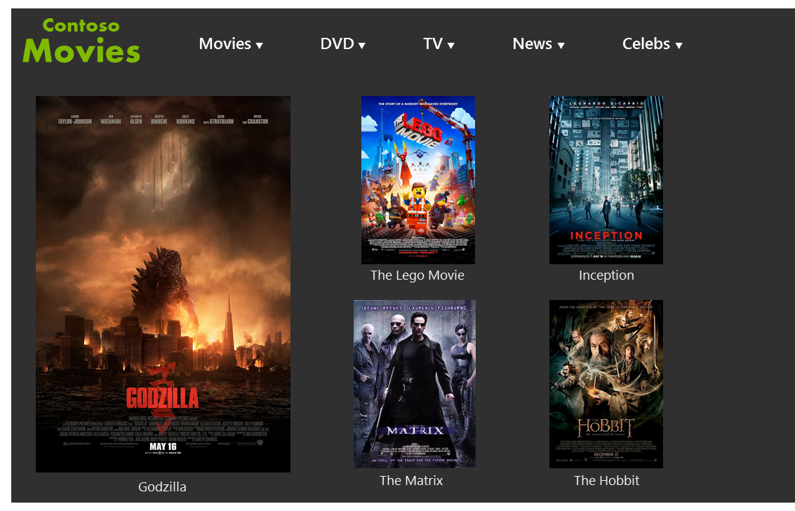
EVAN LEW
contosomovies.com
Contoso Movies 829ea9ea-8ceb-43e1-bbb7-bc89078e3eae
Contoso Movies ead46570-2558-4770-bf32-1f1bda0fb567

Slide 62
Demo

Slide 63
Thank you!
Visit Bing.com/AppLink to get started.
EvanLew@microsoft.com
EricAle@microsoft.com

Slide 65
Your Feedback is Important
Fill out an evaluation of this session and help shape future events.
Scan the QR code to evaluate this session on your mobile device.
You’ll also be entered into a daily prize drawing!

Slide 66
© 2014 Microsoft Corporation. All rights reserved. Microsoft, Windows, Windows Vista and other product names are or may be registered trademarks and/or trademarks in the U.S. and/or other countries.
The information herein is for informational purposes only and represents the current view of Microsoft Corporation as of the date of this presentation. Because Microsoft must respond to changing market conditions, it should not be interpreted to be a commitment on the part of Microsoft, and Microsoft cannot guarantee the accuracy of any information provided after the date of this presentation. MICROSOFT MAKES NO WARRANTIES, EXPRESS, IMPLIED OR STATUTORY, AS TO THE INFORMATION IN THIS PRESENTATION.

