Slide 2
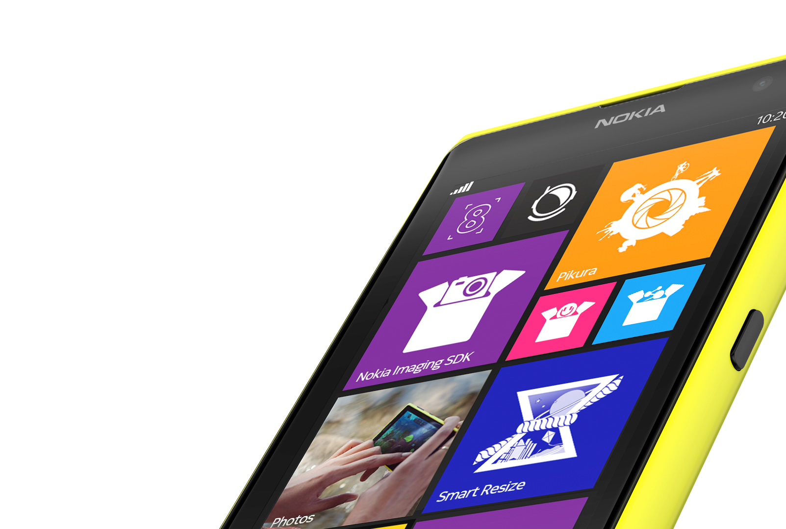
NOKIA
EXTENSIBILITY
Lucian Tomuta
Chief Engineer, Developer Experience, Nokia

Slide 3
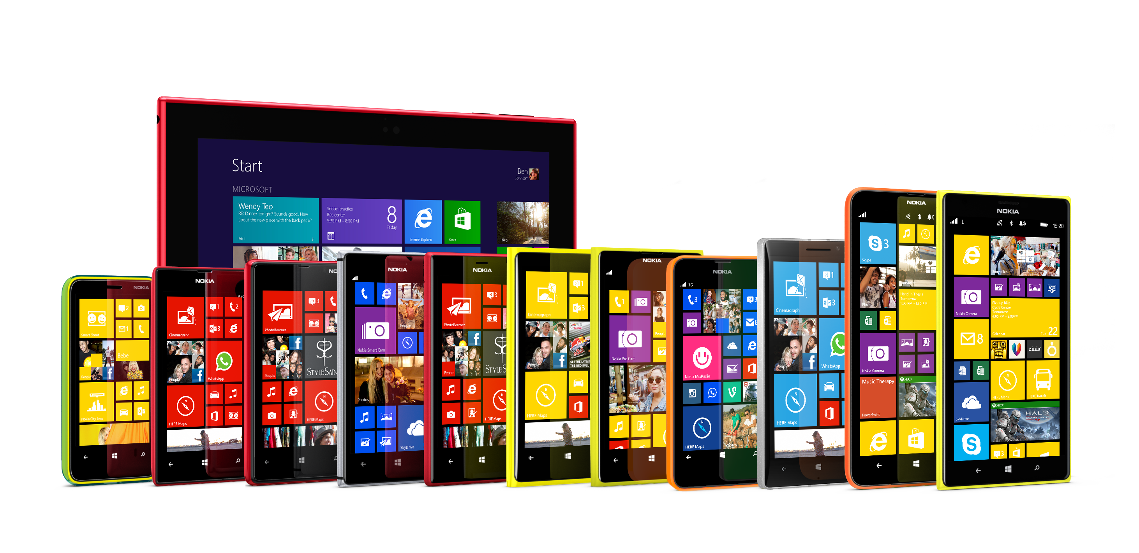
LUMIA FAMILY

Slide 4





LUMIA DIFFERENTIATION
Get noticed from the crowd
IMAGING
LOCATION
CONTEXT
LOCATION
MUSIC
MUSIC
WINDOWS PHONE USER EXPERIENCE
HARDWARE DESIGN & ENGINEERING

Slide 5
Nokia
Imaging
sdk

Slide 6








WHAT IS The NOKIA IMAGING SDK?
Includes more than 50 ready to use image processing filters and effects, with various adjustment parameters
Supports creation of totally custom filters
Accessible from managed and native code
Supports various source types: bitmaps, streams, files and camera viewfinder
Partial JPEG decoding - using RAJPEG technology, access image data without decoding a whole JPEG image for a fast previews, application of effects, rotation, and cropping of high resolution images.

Slide 7
NOKIA IMAGING SDK
Makes imaging magic
BETA
1.0
1.1
1.2
JUL 2013
FEB 2014
APR 2014
Easy to use, 50+ filters,
1,500+ apps
Performance enhancements, Lens blur, HDR, Foreground picker
Easy GIF creation,
Local image blend, Even more performance enhancements

Slide 8
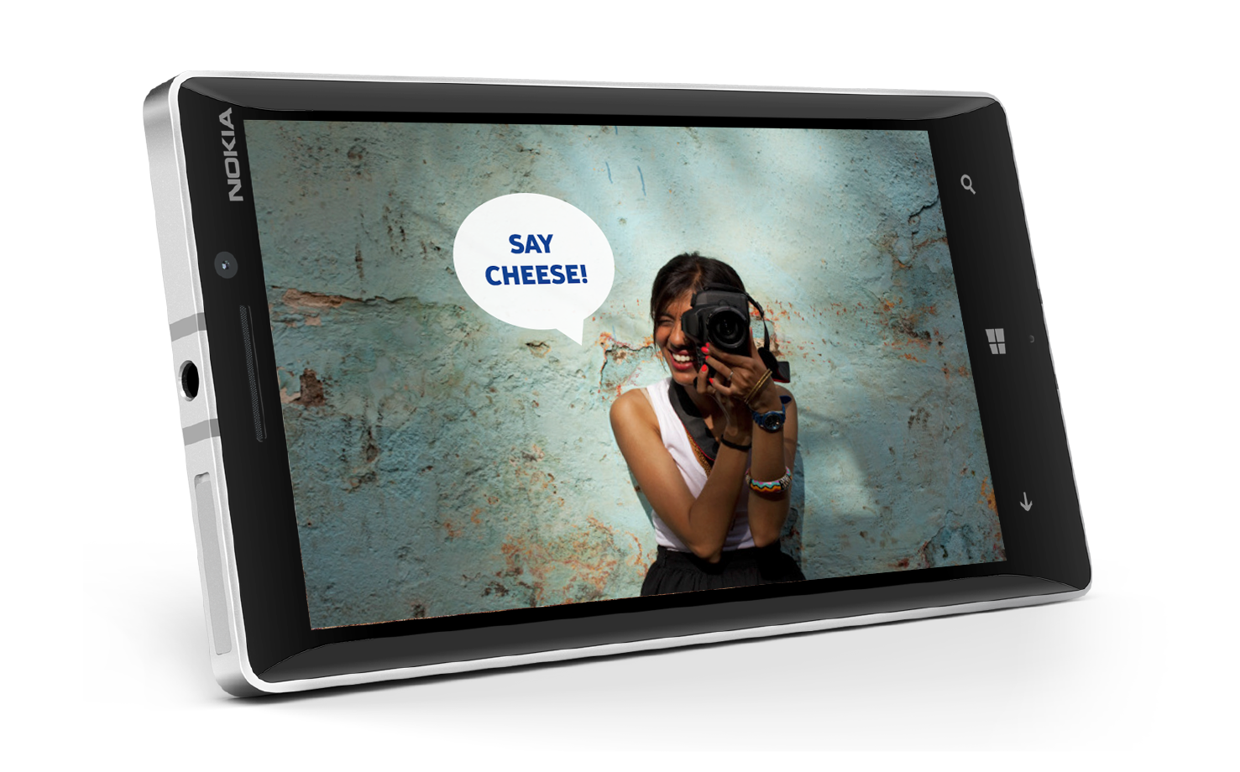
WHAT’S NEW IN THE 1.2 (BETA) VERSION?
Supports Windows Phone 8.1
Extends Windows 8.1 support to include x64 configuration
Blend Filter Target Area
Image Aligner
Animated GIF renderer
Low memory custom effects

Slide 9

FILTERS AND EFFECTS

Slide 10


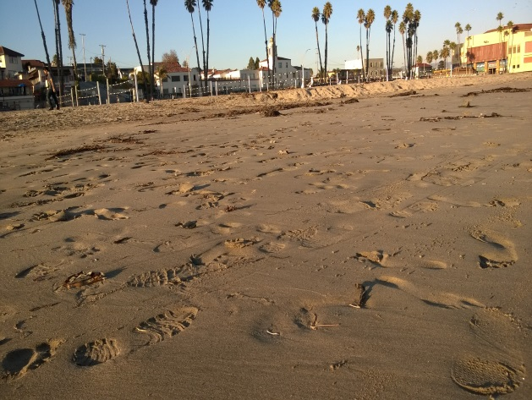
CHROMAKEY

Slide 11




BLEND MODES
BLEND MODE: COLOR
BLEND MODE: ADD
BLEND MODE: COLOR BURN

Slide 12
GENERAL ARCHITECTURE OVERVIEW
IMAGE SOURCE
Library contains three architectural building blocks:
  Image sources (such as bitmaps, streams, files)
  Effects (built-in or custom)
  Renderers (outputs bitmaps or files)
Combining these building blocks, developer creates rendering pipeline
Once pipeline is created, it is possible to change filter parameters, or their sequence.
FILTER EFFECTS
CARTOON FILTER
FOG FILTER
…
Full details in Lumia Developer Library
http://developer.nokia.com/resources/library/Lumia/
RENDERER

Slide 13
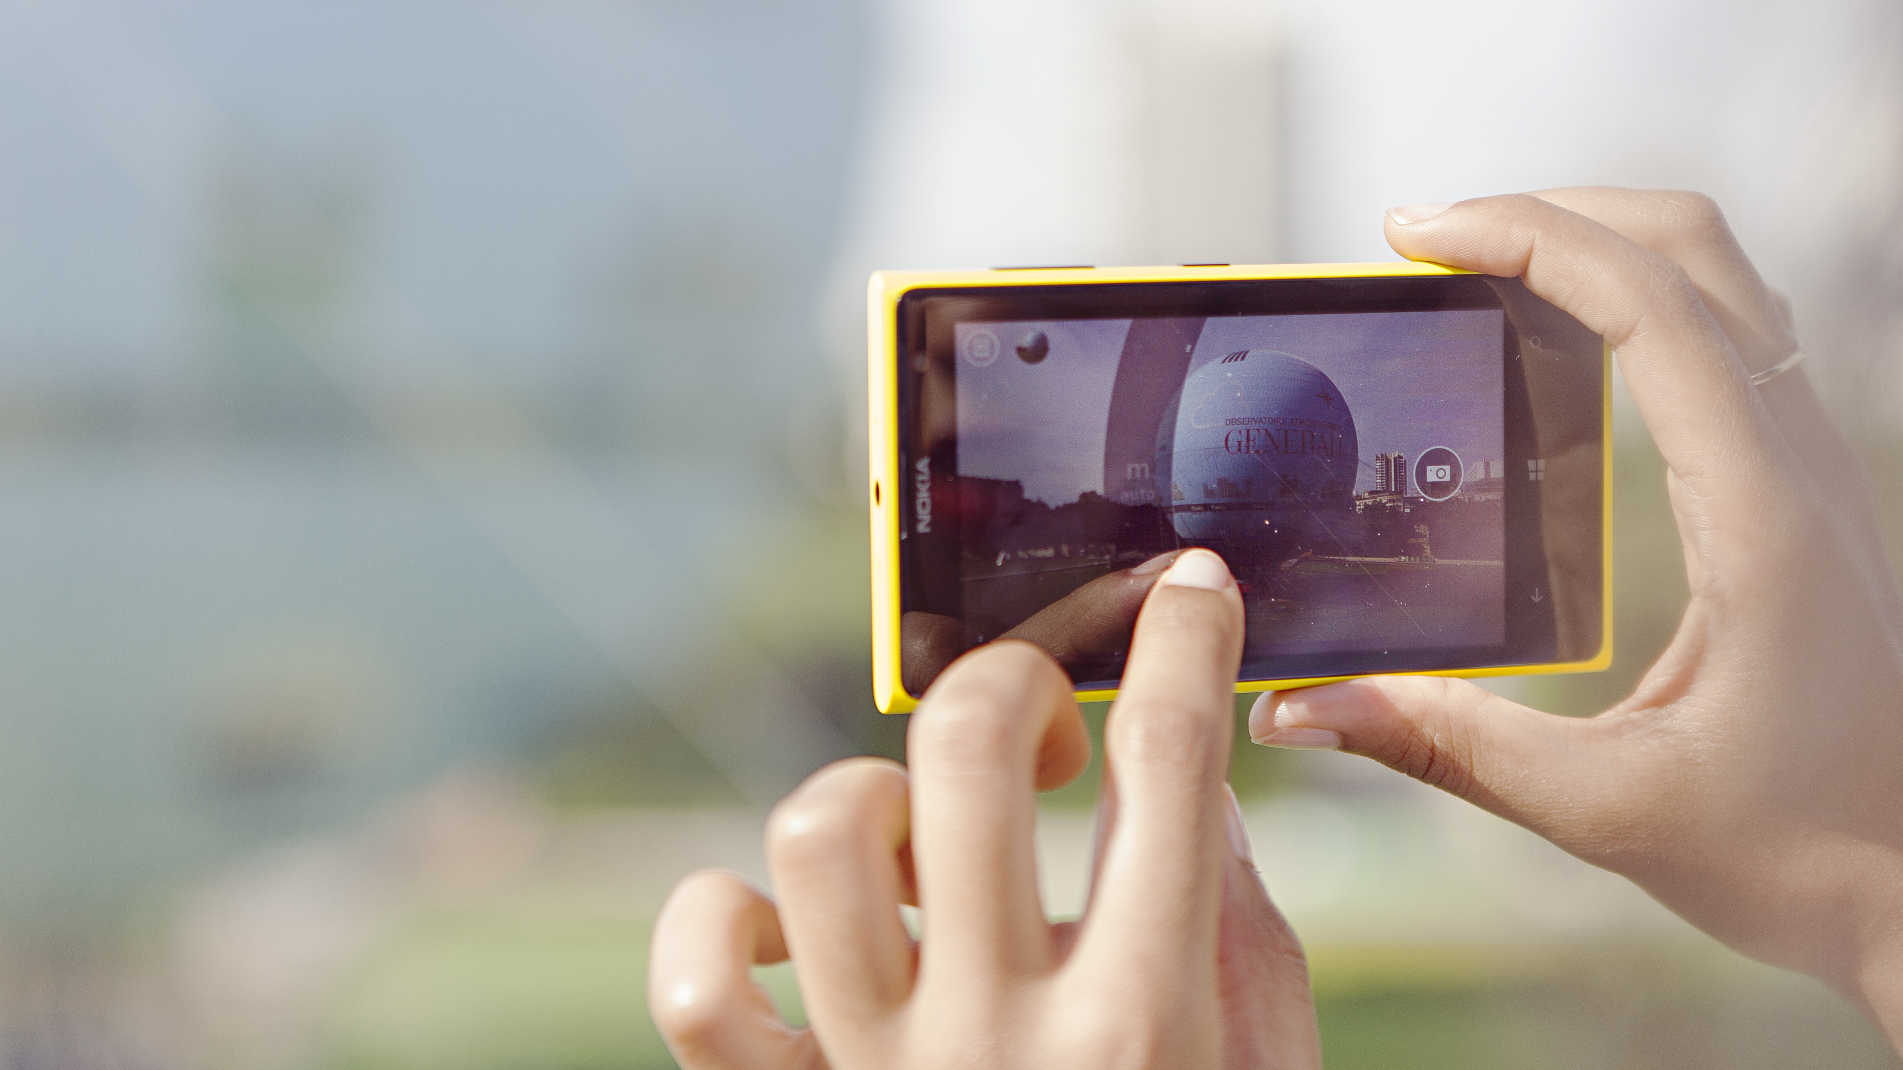
demo
Hands-On:
Taking the SDK into
use, Applying filters

Slide 14




INTERACTIVE FOREGROUND SEGMENTER

Slide 15


LENS BLUR

Slide 16
demo
Hands-On:
Interactive Foreground Segmenter & Lens Blur

Slide 17
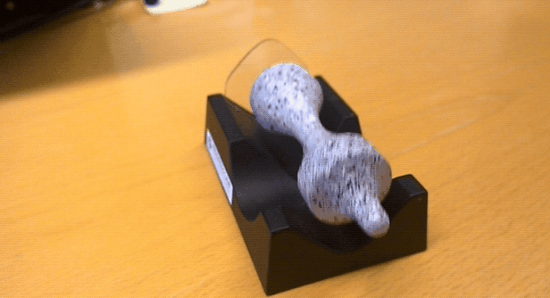
ANIMATED GIF RENDERER

Slide 18
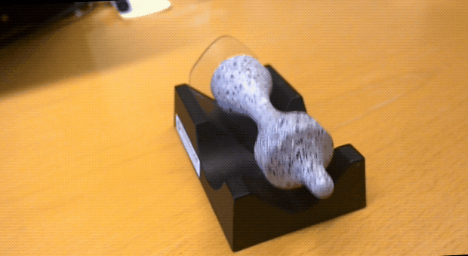
IMAGE ALIGNER

Slide 19
demo
Hands-On:
Image Aligner & GIF renderer

Slide 20


IMAGIN8
MISSION
Create an outstanding imaging app
and win a trip to experience zero gravity
Nokia.ly/Imagin8

Slide 21

Nokia
sensorcore sdk
Private BETA

Slide 22
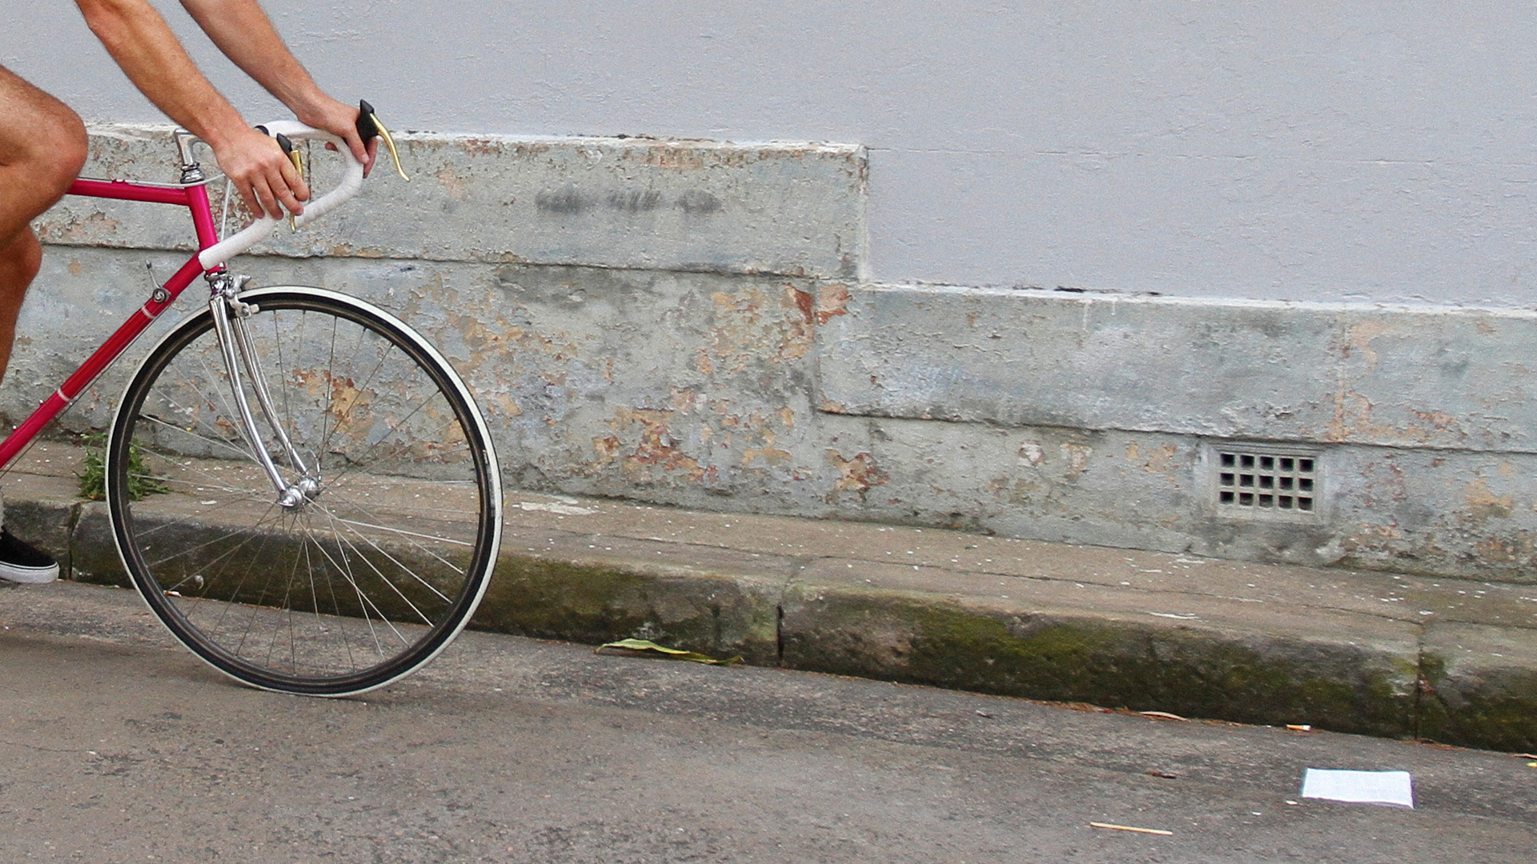
SENSORCORE SDK
Create the perfect experience for every context
WHERE
Discover activity locations, favorite places, and routes to and from them
HOW
Sense if walking, running, driving,
or idle
WHEN
Play back activities up to 10 days past, even if your app was just installed

Slide 23
WHAT’S IN THE PACKAGE?
SensorCore SDK is a collection of APIs for four different sensors:
  Step Counter
  Activity Monitor
  Place Monitor
  Route Tracker
  Enabled by always running low power mode sensors
  User has the option to turn the feature on/off and to clear already collected data.

Slide 24
ALL APIs HAVE…
// initialize
StepCounter stepCounter = await StepCounter.GetDefaultAsync();
// support check
if (await StepCounter.IsSupportedAsync()) …
// COM exceptions based error handling
switch (SenseHelper.GetSenseError(failure.HResult))
// activate & deactivate methods for managing app lifecycle
stepCounter.ActivateAsync();
stepCounter.DeactivateAsync();

Slide 25
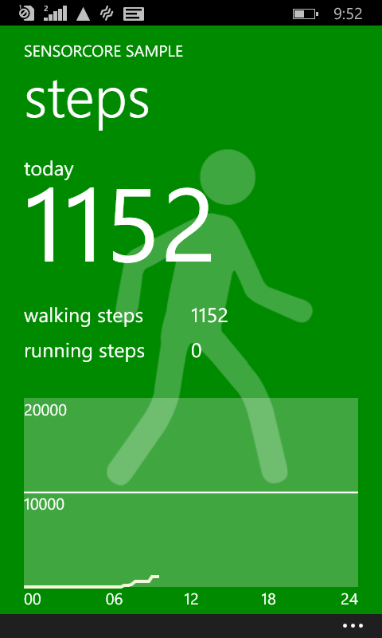
STEP COUNTER
It’s all about steps. Walking steps, running steps.
// get current reading
StepCounterReading currentSteps = await stepCounter.GetCurrentReadingAsync();
// get logged events for the past 1 hour
IList<StepCounterReading> steps = await
stepCounter.GetStepCountHistoryAsync ( DateTime.Now.AddHours( -1 ), TimeSpan.FromHours( 1 ) );
Logged data may go back up to 10 days, with 5 minutes granularity for the entries.

Slide 26
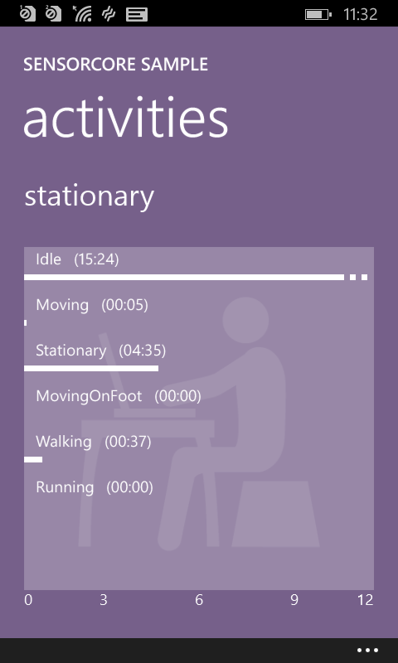
ACTIVITY MONITOR
Subscribe to activity change events
Other
  Idle
  Stationary
  Moving
    Moving on foot
      Walking
      Running
// read current activity
ActivityMonitorReading reading = await activityMonitor.GetCurrentReadingAsync();
// register a ReadingChanged event handler
activityMonitor.ReadingChanged += activityMonitor_ReadingChanged;
// read logged activities
IList<ActivityMonitorReading> activities = await activityMonitor.GetActivityHistoryAsync( DateTime.Now.AddDays( -1 ), TimeSpan.FromDays( 1 ) );

Slide 27
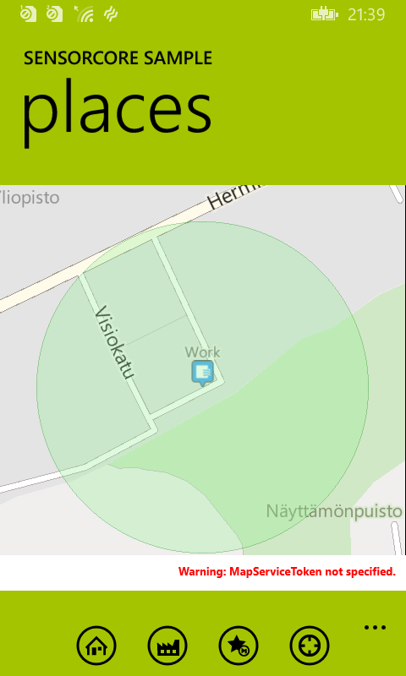
PLACE MONITOR
Place monitor provides information about different places user has visited frequently. It also tries to automatically deduce home and work location.
Place contains: position & radius, type, length of stay, …
// get current place
Place place = await placeMonitor.GetCurrentPlaceAsync();
// register a PlaceChanged event handler
placeMonitor.PlaceChanged += placeMonitor_PlaceChanged;
// get logged places
IList<Place> places = await placeMonitor.GetPlaceHistoryAsync
(DateTime.Now.AddHours( -1 ), TimeSpan.FromHours( 1 ) );

Slide 28
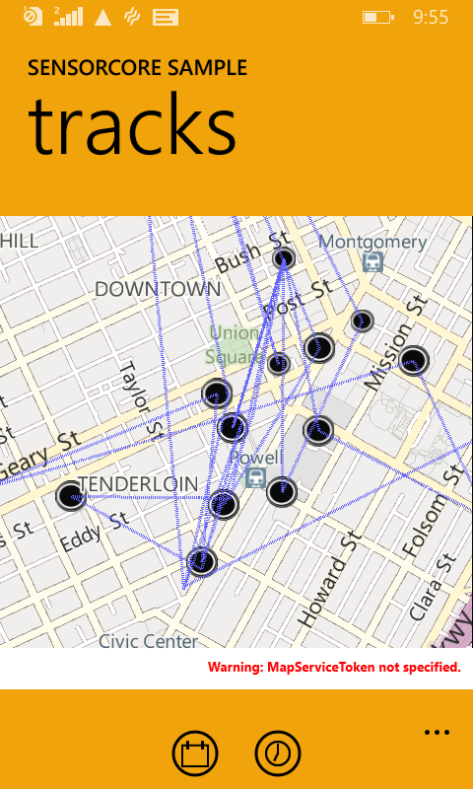
ROUTE TRACKER
Route tracker provides information about user’s movements.
RoutePoint contains: position, heading, length of stay…
// get user’s position at specified time
RoutePoint routePoint = await routeTracker.GetPointAtAsync( DateTime.Now.AddHours( -1 ) );
// get user’s route at specified interval
IList<RoutePoint> routePoints = await routeTracker.GetRouteAsync
(DateTime.Now.AddHours( -1 ), TimeSpan.FromHours( 1 ) );

Slide 29
demo
Activity Monitor

Slide 30
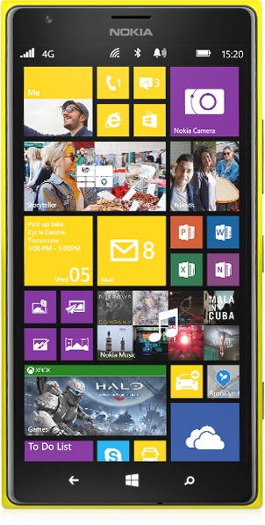
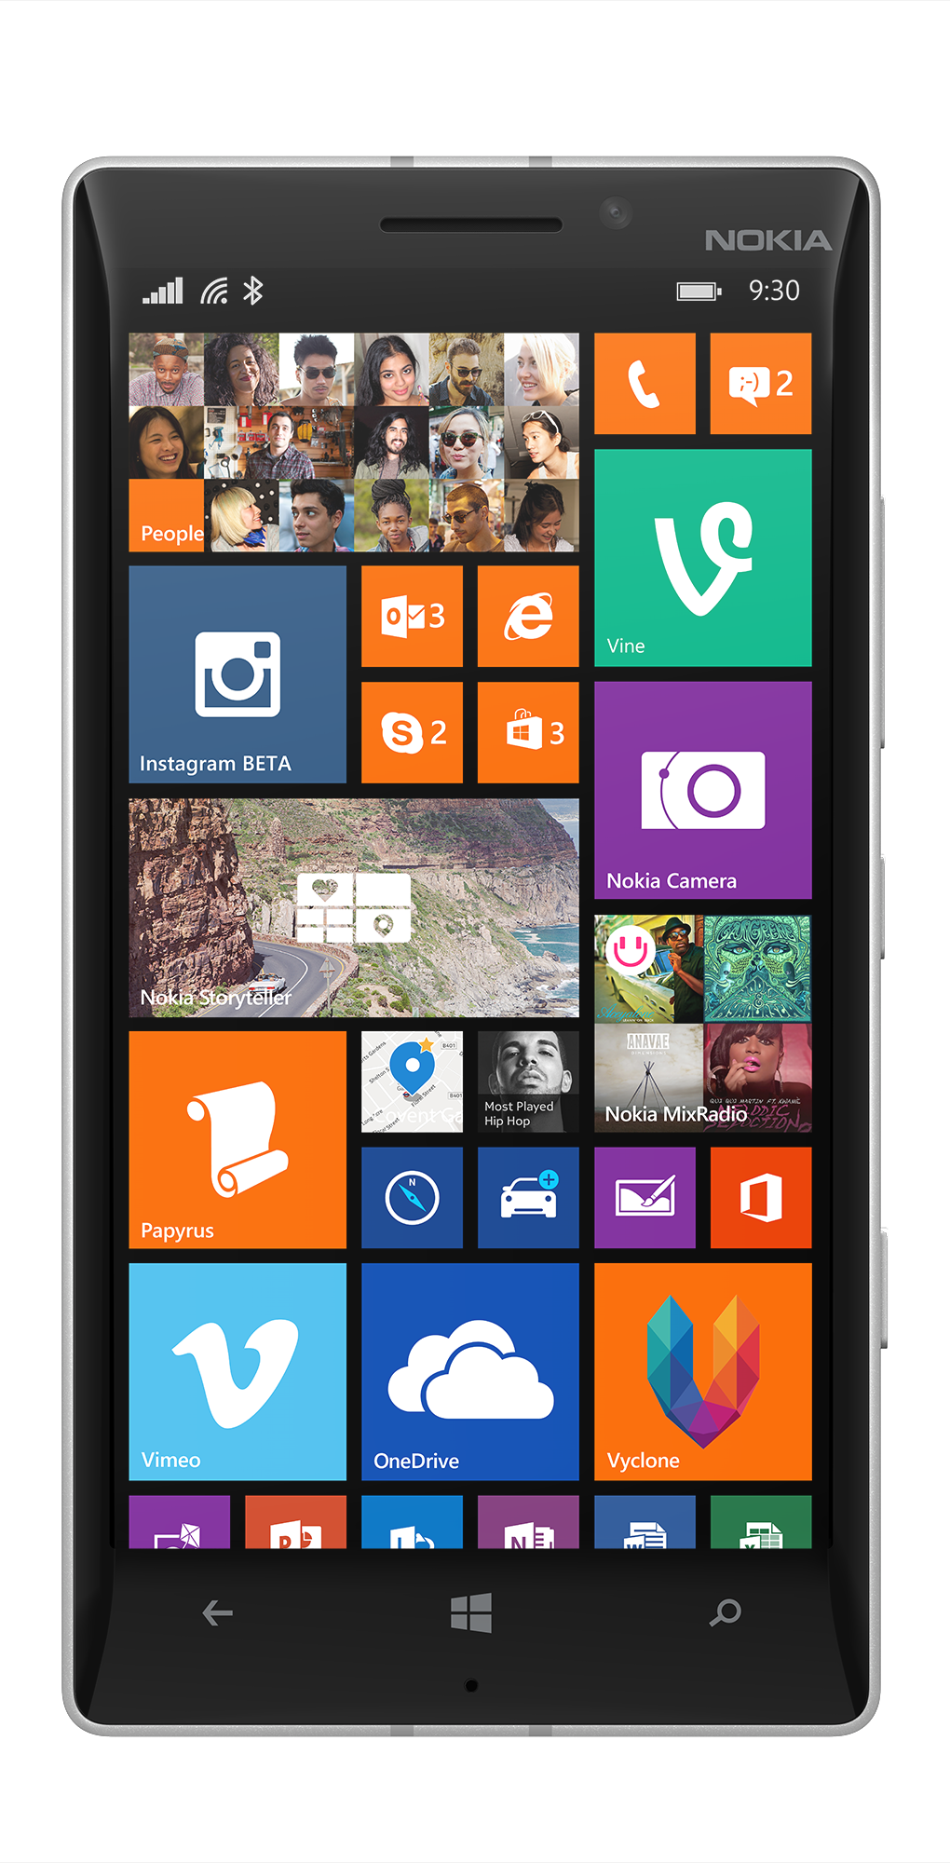
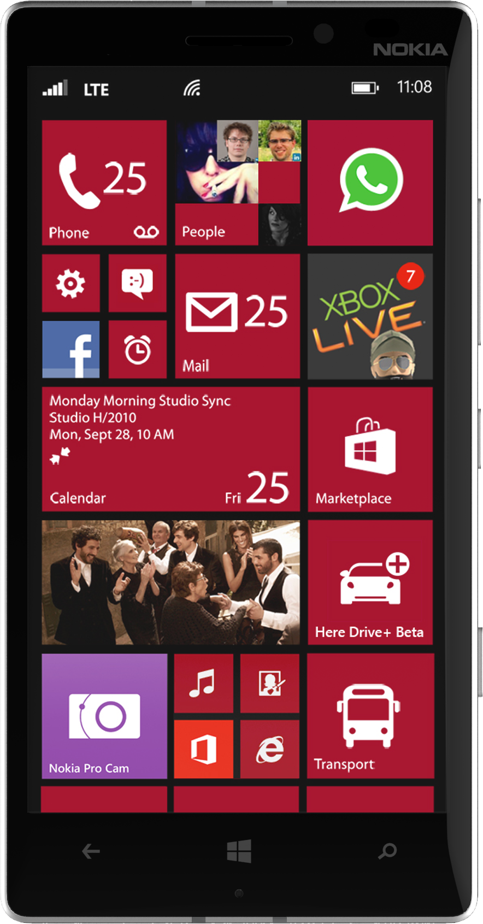
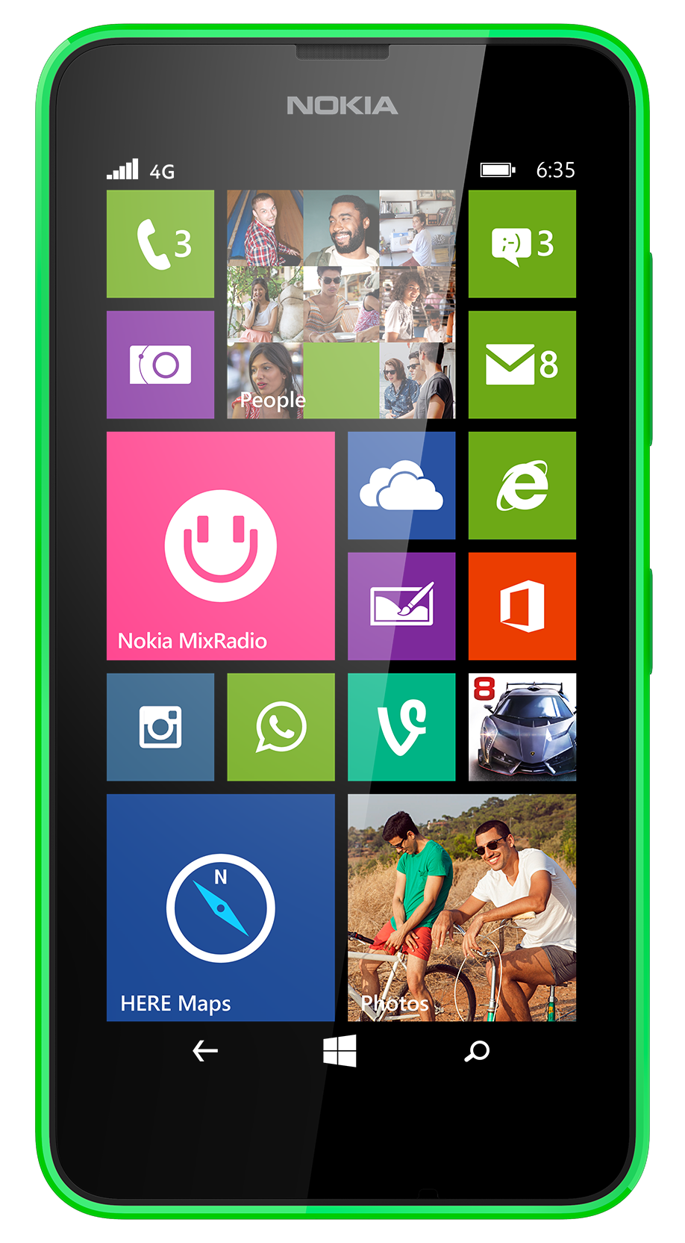
SUPPORTED OS AND DEVICES
The SDK has dependency on Windows Phone 8.1 and has specific hardware requirements.
Available on
  Nokia Lumia 930
  Nokia Lumia 635
  Nokia Lumia 630

Slide 31

Sign up to TRY SensorCorE
Make sure that your badge gets scanned as you exit the room, and when doing that, let us know that you are interested.

Slide 32
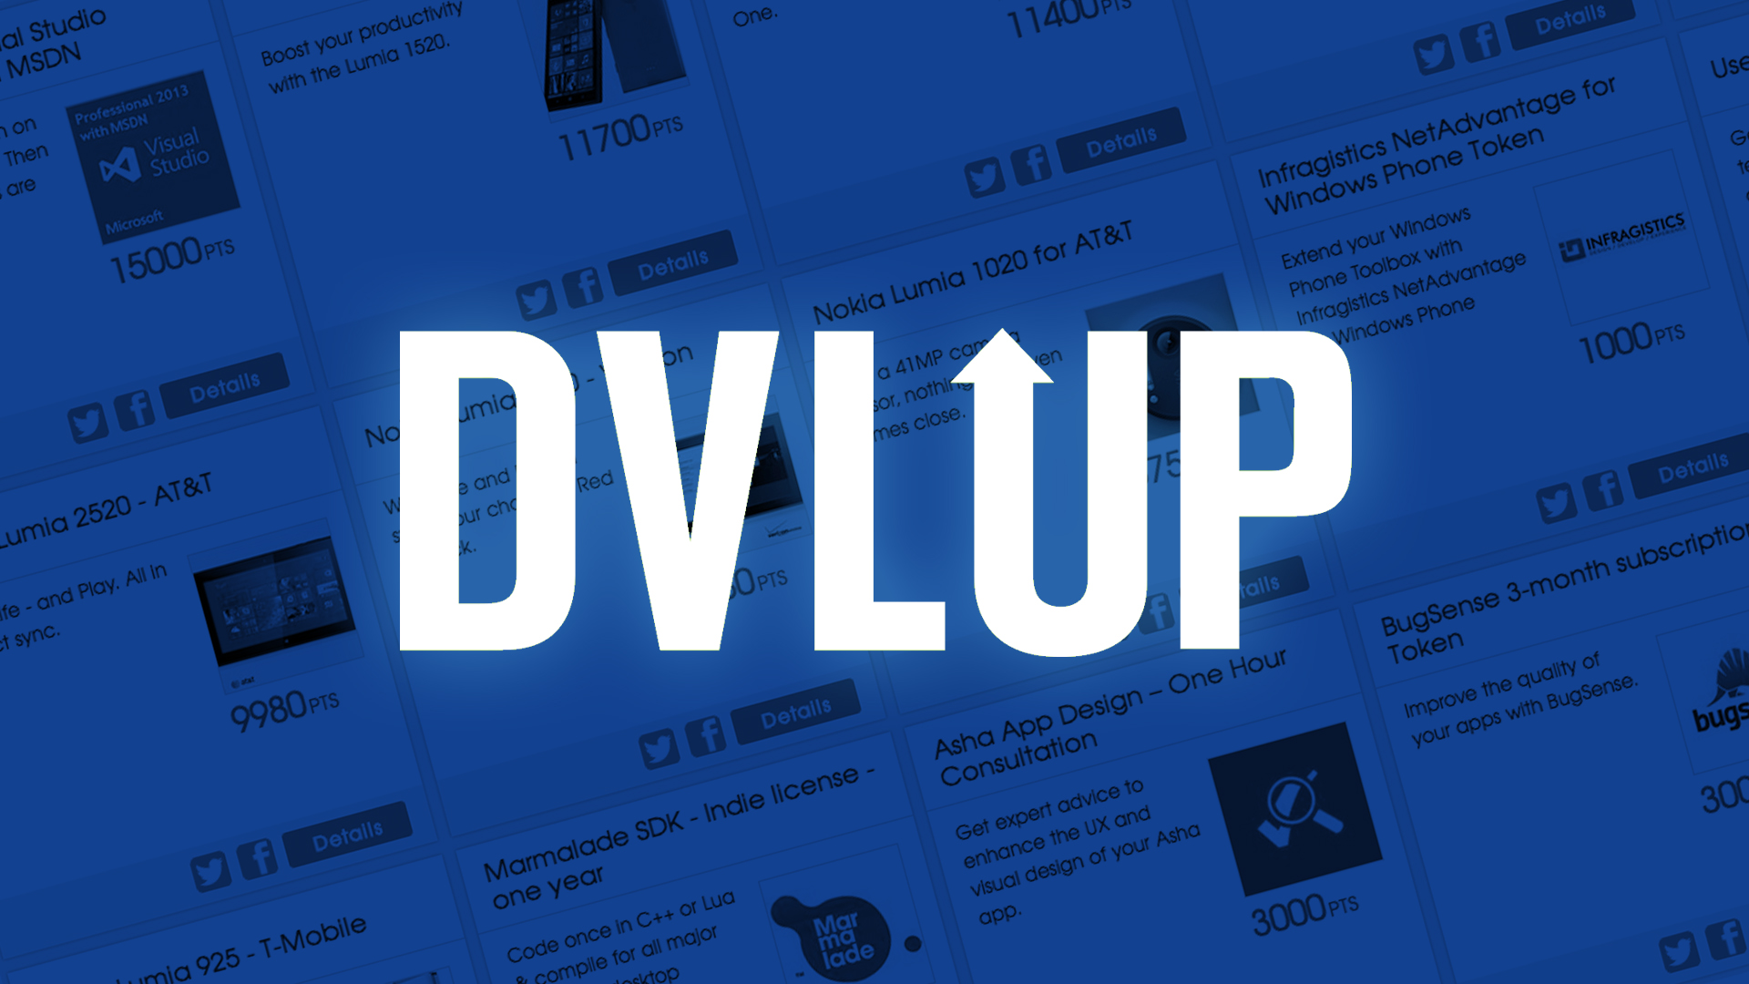

Slide 33

THANK
YOU
developer.nokia.com/lumia

Slide 34
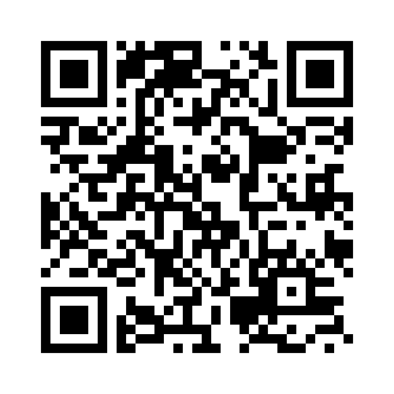
Your Feedback is Important
Fill out an evaluation of this session
and help shape future events.
Scan the QR code to evaluate
this session on your mobile device.
You’ll also be entered into
a daily prize drawing!

