Slide 2
Modern C++: What You Need to Know
2-661
Herb Sutter
Partner Program Manager

Slide 3
Modern C++: What You Need to Know
2-661
Herb Sutter
Partner Program Manager

Slide 4
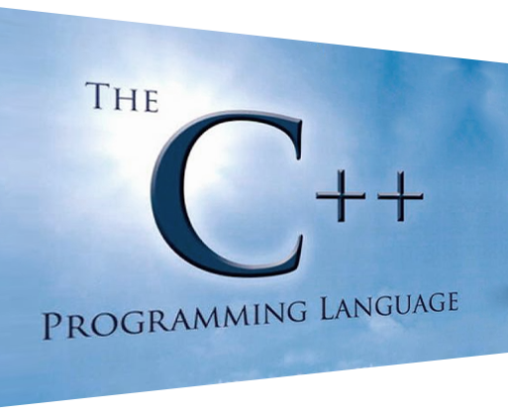
Agenda
Updates: ISO C++, VC++ roadmap
Modern C++: What you need to know
What you need to know next

Slide 5
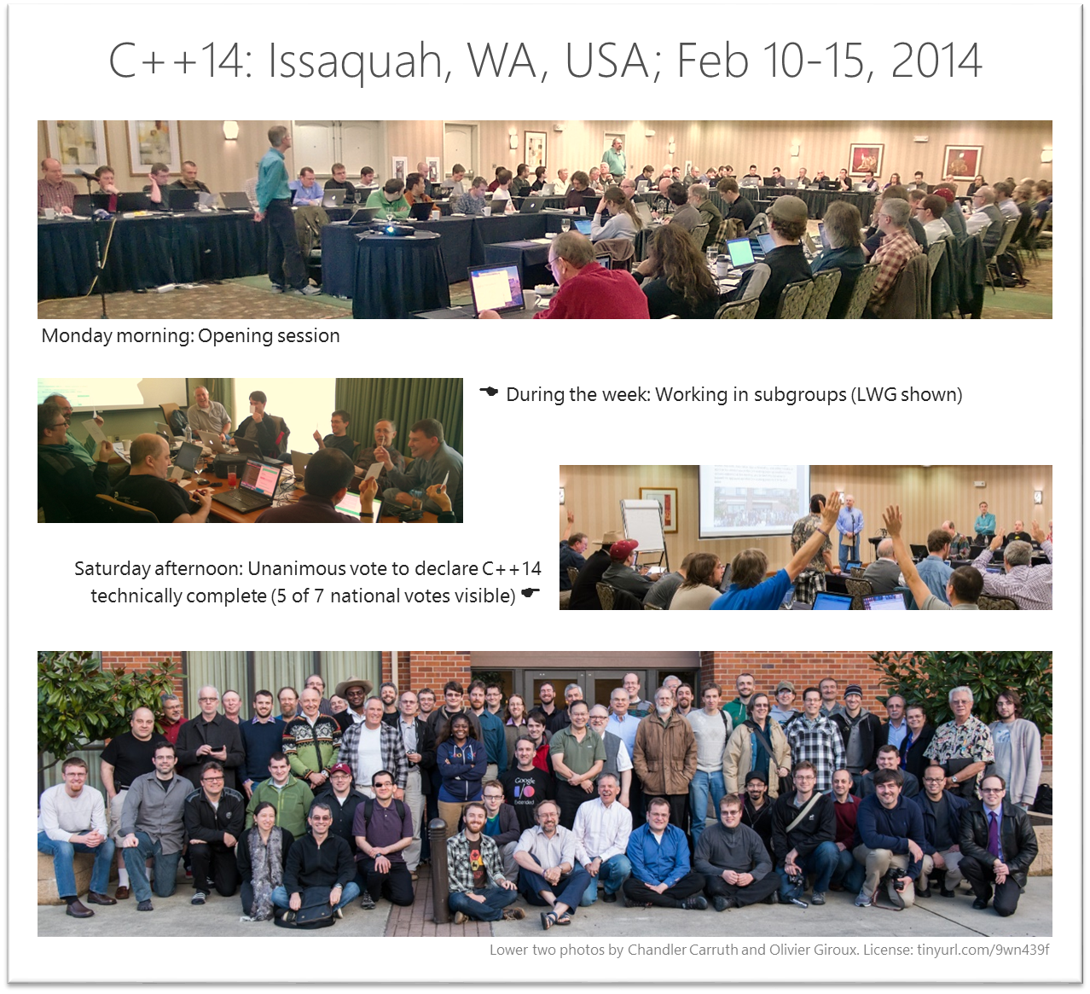
A Living Language
C++98
(major)
C++03
(TC, bug fixes only)
C++11
(major)
C++14
(minor)
C++17
(major)
You are here
98
99
00
01
02
03
04
05
06
07
08
09
10
11
12
13
14
15
16
17
18
File System TS
Lib Fundamentals TS
+ more (modules, …)
Library TR (aka TS)
Performance TR
Networking TS
Tx Memory TS
Concepts TS
Concurrency TS
Array Exts. TS
Parallelism TS

Slide 6
VC++ Conformance Update
VC++ 2013 Preview | VC++ 2013 RTM
Explicit conversion operators | Non-static data member initializers | __func__ Extended sizeof | Thread-safe function local static init | Inline namespaces | constexpr (incl. ctors, literal types)
Raw string literals | = default | Implicit move generation | alignof alignas | Universal character names in literals | Expression SFINAE
Function template default arguments | = delete | Ref-qualifiers: & and && for *this | noexcept (unconditional) | noexcept (incl. conditional) | C++11 preprocessor (incl. C++98 & C11)
Delegating constructors | “using” aliases C++14 libs: type aliases | C++14 decltype(auto) | Inheriting constructors | char16_t, char32_t Attributes | C++98 two-phase lookup
Uniform init & initializer_lists | C99 variable decls C99 _Bool | C++14 auto function return type deduction | User-defined literals | thread_local | C++14 generalized constexpr
Variadic templates | C99 compound literals | C++14 generic lambdas (partial) | C++14 generalized lambda capture | Unrestricted unions | C++14 variable templates
C++14 libs: cbegin/ greater<>/make_unique | C99 designated initializers | C++TS? async/await (partial) | C++14 libs: std:: user-defined literals | constexpr (except ctors, literal types) | C++TS concepts lite
VC++ Nov 2013 CTP

Slide 7
VC++ Conformance Update
VC++ 2013 Preview | VC++ 2013 RTM
Explicit conversion operators | Non-static data member initializers | __func__ Extended sizeof | Thread-safe function local static init | Inline namespaces | constexpr (incl. ctors, literal types)
Raw string literals | = default | Implicit move generation | alignof alignas | Universal character names in literals | Expression SFINAE
Function template default arguments | = delete | Ref-qualifiers: & and && for *this | noexcept (unconditional) | noexcept (incl. conditional) | C++11 preprocessor (incl. C++98 & C11)
Delegating constructors | “using” aliases C++14 libs: type aliases | C++14 decltype(auto) | Inheriting constructors | char16_t, char32_t Attributes | C++98 two-phase lookup
Uniform init & initializer_lists | C99 variable decls C99 _Bool | C++14 auto function return type deduction | User-defined literals | thread_local | C++14 generalized constexpr
Variadic templates | C99 compound literals | C++14 generic lambdas (partial) | C++14 generalized lambda capture | Unrestricted unions | C++14 variable templates
C++14 libs: cbegin/ greater<>/make_unique | C99 designated initializers | C++TS? async/await (partial) | C++14 libs: std:: user-defined literals | constexpr (except ctors, literal types) | C++TS concepts lite
VC++ CTP.next (upcoming)
High confidence
VC++ Nov 2013 CTP
Med confidence

Slide 8
Agenda
Updates: ISO C++, VC++ roadmap
Modern C++: What you need to know
What you need to know next

Slide 9
FAQ #1: When should I use C++? FAQ #2: What should I know about C++ if I’m a {Java|C#|Javascript|Python|…} dev?

Slide 10
“Use C++ for …”
A
B
… cross-platform portability and compatibility
Share model code across mobile and client platforms (native UI per platform)
Access rich portable C++ libraries
… high performance and full control
Memory layout control: Essential for high performance
Determinism control: Prompt cleanup/release
+ next point…
… full access to hardware and OS resources
Graphics: DirectX, OpenGL
Vector Units: Vectorization and /Qvec
GPU for computation (GPGPU): C++ AMP & upcoming Parallelism TS
C++
Some highlights:
Value types by default
Determinism by default
Contiguous by default

Slide 11
Modern C++ is not C++98: Clean + safe But modern C++ is still C++: Flexible + fast

Slide 12
What’s different: At a glance
Then: C++98 code
circle* p = new circle( 42 );
vector<shape*> v = load_shapes();
for( vector<shape*>::iterator i = v.begin(); i != v.end(); ++i ) { if( *i && **i == *p ) cout << **i << “ is a match\n”; }
// … later, possibly elsewhere …
for( vector<shape*>::iterator i = v.begin(); i != v.end(); ++i ) { delete *i; }
delete p;

Slide 13
What’s different: At a glance
auto type deduction
T* → shared_ptr<T>
new → make_unique or make_shared
Then: C++98 code
Now: Modern C++
circle* p = new circle( 42 );
vector<shape*> v = load_shapes();
for( vector<shape*>::iterator i = v.begin(); i != v.end(); ++i ) { if( *i && **i == *p ) cout << **i << “ is a match\n”; }
// … later, possibly elsewhere …
for( vector<shape*>::iterator i = v.begin(); i != v.end(); ++i ) { delete *i; }
delete p;
auto p = make_shared<circle>( 42 );
auto v = load_shapes();
for( auto& s : v ) { if( s && *s == *p ) cout << *s << “ is a match\n”; }
range-for
not exception-safe
missing try/catch, __try/__finally
no need for “delete” – automatic lifetime management
exception-safe

Slide 14
Example: Compute arithmetic mean of numbers
Python
C++14 + concepts
using a concept (note: not yet VC++)
def mean(seq):
n = 0.0
for x in seq:
n += x
return n / len(seq)
auto mean(const Sequence& seq) {
auto n = 0.0;
for (auto x : seq)
n += x;
return n / seq.size();
}
automatic return type deduction

Slide 15
Types: Can express all, value types are the default
Category | Java | C# | JS | C++
Value types | Built-in types only | Built-in types struct Val { … } // bitcopy only |  | Built-in types class val { … }; // any copying semantics

Slide 16
Types: Can express all, value types are the default
Category | Java | C# | JS | C++
Value types | Built-in types only | Built-in types struct Val { … } // bitcopy only |  | Built-in types class val { … }; // any copying semantics
Reference types | class foo : ifoo { @Override public int bar() { } } | class Foo : IFoo { public override int Bar() { } } |  | class foo { … public: int bar() override { } foo(foo&) =delete; void operator=(foo&) =delete; };
Interfaces | interface ifoo { int bar(); } | interface IFoo { int bar(); } |  | class ifoo { public: … virtual int bar() =0; foo(foo&) =delete; void operator=(foo&) =delete; };

Slide 17
Types: Can express all, value types are the default
Category | Java | C# | JS | C++
Value types | Built-in types only | Built-in types struct Val { … } // bitcopy only |  | Built-in types class val { … }; // any copying semantics
Reference types | class foo : ifoo { @Override public int bar() { } } | class Foo : IFoo { public override int Bar() { } } |  | class foo { … public: int bar() override { } foo(foo&) =delete; void operator=(foo&) =delete; };
Interfaces | interface ifoo { int bar(); } | interface IFoo { int bar(); } |  | class ifoo { public: … virtual int bar() =0; foo(foo&) =delete; void operator=(foo&) =delete; };
Generic types | class Map<Key,Value> { … } // type-erased, all virtual | class Map<Key,Value> { … } // all virtual calls |  | template<class Key, class Value> class map { … }; // direct calls, (partial) specialization

Slide 18
Types: Can express all, value types are the default
Category | Java | C# | JS | C++
Value types | Built-in types only | Built-in types struct Val { … } // bitcopy only |  | Built-in types class val { … }; // any copying semantics
Reference types | class foo : ifoo { @Override public int bar() { } } | class Foo : IFoo { public override int Bar() { } } |  | class foo { … public: int bar() override { } foo(foo&) =delete; void operator=(foo&) =delete; };
Interfaces | interface ifoo { int bar(); } | interface IFoo { int bar(); } |  | class ifoo { public: … virtual int bar() =0; foo(foo&) =delete; void operator=(foo&) =delete; };
Generic types | class Map<Key,Value> { … } // type-erased, all virtual | class Map<Key,Value> { … } // all virtual calls |  | template<class Key, class Value> class map { … }; // direct calls, (partial) specialization
Optional types | Integer i = new Integer(10); | int? i = 10; | var i = 10; | boost::optional<int> i = 10;
Dynamic types |  | dynamic x = “str”; x = 10; | var x = “string”; x = 10; | boost::any x = “string”; x = 10;

Slide 19
Value types & move efficiency
set<widget> load_huge_data() { set<widget> ret; // … load data and populate ret … return ret; }
widgets = load_huge_data();
Matrix operator+( const Matrix&, const Matrix& );
m4 = m1+m2+m3;
efficient, no deep copies
efficient, no deep copy
clean semantics of value types
+
efficiency of reference types

Slide 20
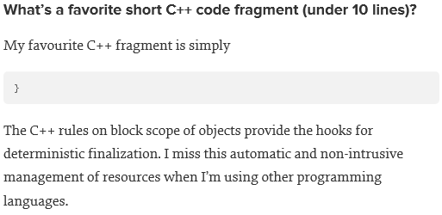
If you must pick one: The most important C++ feature?
}
Said by many, but quoting Roger Orr
if (auto x = …) { … }
int do_work() { auto x = …; }
class widget { gadget g; };

Slide 21
Default Lifetime: Scoped = Efficient + Exception Safe
class widget {
private: gadget g;
public: void draw(); };
void f() { widget w; :::
w.draw();
:::
}
“all types are IDisposable”
lifetime automatically tied to enclosing object
no leak, exception safe
lifetime automatically tied to enclosing scope
constructs w, including the w.g gadget member
automatic destruction and deallocation for w and w.g
automatic propagation, as if “widget.dispose() { g.dispose(); }”
automatic exception safety, as if “finally { w.g.dispose(); w.dispose(); }”

Slide 22
Destructors: Deterministic cleanup
C++ has always had Dispose built in as a first-class feature, integrated throughout the language
All types have Dispose (aka MyType::~MyType()) – automatically generated by default, including chaining
Object lifetimes are scoped by default:
to functions (implicit “finally”/”using”)
to other objects (automatic Dispose chaining)
Default: Code is efficient and deterministic by construction

Slide 23
1. Allocate in a scope (stack, or object)
Declarative
Deterministic
Safe by construction
{
widget a;
gadget b;
vector<int> c;
:::
}
c
b
a

Slide 24
2. Allocate on heap with make_{unique|shared}
vs. “GC everything”
Still declarative
Still deterministic
Still safe by construction
The smart pointers themselves are objects that are owned in some scope
“Everything is owned by someone”

Slide 25
Real arrays
“If you’re serious about performance, you’ll love arrays”
Not just Lists and ArrayLists
Disclaimer/context: Of course, don’t forget your other data structures!
Trees, graphs, hash tables – all cool where appropriate
Especially when not visiting all elements of a collection
BUT: Contiguous arrays are just as important, and often missed – if you are visiting many objects, you seriously want to visit them in adjacent address order

Slide 26
stack
heap
heap
c
ptr
a
ptr
ptr
arr
b
A
 | Contents are not contiguous
Java/C# | class widget { … } var arr = new ArrayList(); arr.Add( new widget() ); // etc.
C++ | class widget { … }; vector<unique_ptr<widget>> arr; arr.push_back( make_unique<widget>() ); // etc.

Slide 27
stack
heap
heap
stack
heap
c
ptr
a
c
ptr
b
ptr
a
arr
b
arr
A
B
 | Contents are not contiguous | Contents contiguous
Java/C# | class widget { … } var arr = new ArrayList(); arr.Add( new widget() ); // etc. | // not possible for class types
C++ | class widget { … }; vector<unique_ptr<widget>> arr; arr.push_back( make_unique<widget>() ); // etc. | class widget { … }; vector<widget> arr{ a, b, c };

Slide 28
stack
heap
heap
stack
heap
stack
c
ptr
a
c
ptr
b
c
ptr
a
b
arr
b
arr
a
A
B
C
 | Contents are not contiguous | Contents contiguous | Contents contiguous
Java/C# | class widget { … } var arr = new ArrayList(); arr.Add( new widget() ); // etc. | // not possible for class types | // not possible for class types
C++ | class widget { … }; vector<unique_ptr<widget>> arr; arr.push_back( make_unique<widget>() ); // etc. | class widget { … }; vector<widget> arr{ a, b, c }; | class widget { … }; array<widget,N> arr{ a, b, c };

Slide 29
Real arrays (Reprise)
“If you’re serious about performance, you’ll love arrays”
Not just Lists and ArrayLists
In C# in particular, there are tricks possible:
Use pointers to structs in unsafe code
Allocate structs in generic wrapper objects
But they are tricks that work against the language and runtime, so they come at significant cost

Slide 30
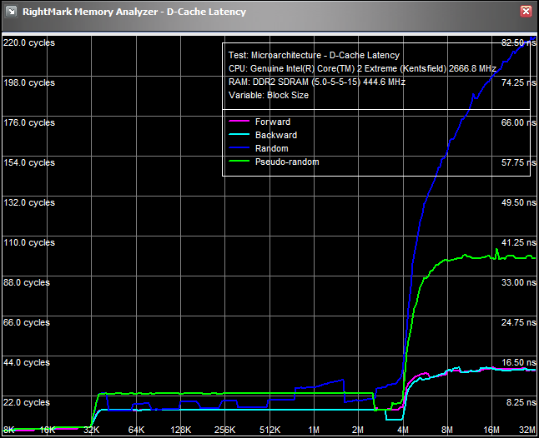
Sample Machine: Samsung tablet, 32K L1D$, 4M L2$
Access patterns matter
Linear = not bad
Random = awful
Arrays (real arrays)
Smaller = further left, faster
Often on lower curves = faster
Node-based pointer-chasing data structures
Bigger = further right, slower
On higher curves = slower
array, vector
list, tree, graph, …
You can see it trying to prefetch, scrambling madly to stay ahead and keep the pipeline full…!

Slide 31
How much would you pay for a CPU with ∞ MB of cache? You have one in your pocket if you know how to use it.

Slide 32
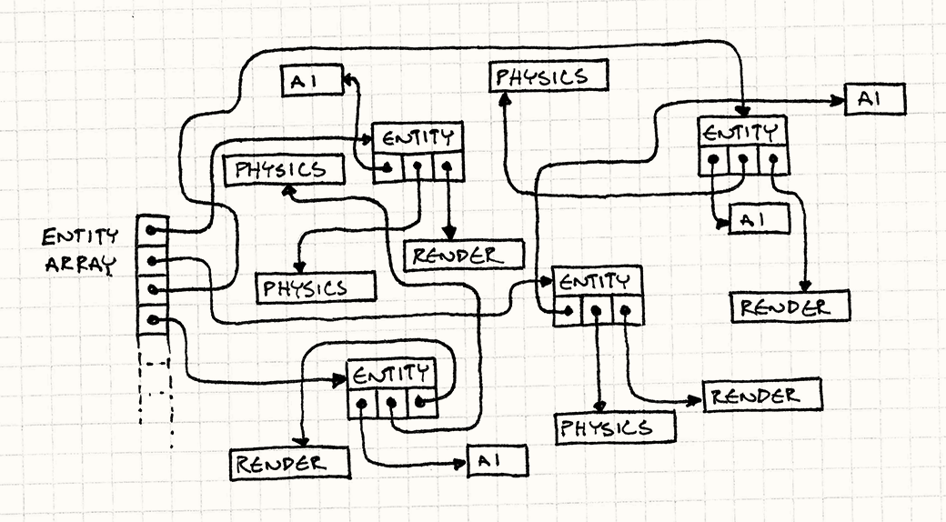
Example: Game performance
Why “real arrays” matter
Example drawn from “Data Locality” by Bob Nystrom
http://gameprogrammingpatterns.com/data-locality.html

Slide 33
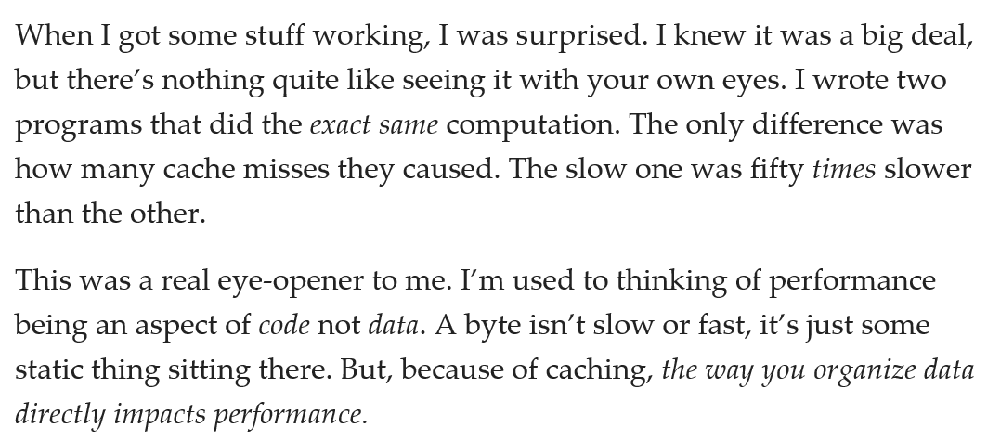
Bob Nystrom:
“

Slide 34
What’s different?
Original code
class GameEntity { AIComponent* ai_; PhysicsComponent* physics_; RenderComponent* render_;
::: };
vector<GameEntity> entities;
for(auto& e : entities) { e->ai()->update(); }
for(auto& e : entities) { e->physics()->update(); }
for(auto& e : entities) { e->render()->update(); }
::: // other game loop machinery

Slide 35
What’s different?
Original code
Fifty times faster
Note: GameEntity is undisturbed
class GameEntity { AIComponent* ai_; PhysicsComponent* physics_; RenderComponent* render_;
::: };
vector<GameEntity> entities;
for(auto& e : entities) { e->ai()->update(); }
for(auto& e : entities) { e->physics()->update(); }
for(auto& e : entities) { e->render()->update(); }
::: // other game loop machinery
class GameEntity { AIComponent* ai_; PhysicsComponent* physics_; RenderComponent* render_;
::: };
vector<GameEntity> entities; vector<AIComponent> cai; vector<PhysicsComponent> cphysics vector<RenderComponent> crender;
for(auto& e : cai) { e.update(); }
for(auto& e : cphysics) { e.update(); }
for(auto& e : crender) { e.update(); }
::: // other game loop machinery
Just storing the objects in a different order (!)

Slide 36
What’s different?
class GameEntity { AIComponent* ai_; PhysicsComponent* physics_; RenderComponent* render_;
::: };
vector<GameEntity> entities;
for(auto& e : entities) { e->ai()->update(); }
for(auto& e : entities) { e->physics()->update(); }
for(auto& e : entities) { e->render()->update(); }
::: // other game loop machinery
class GameEntity { AIComponent* ai_; PhysicsComponent* physics_; RenderComponent* render_;
::: };
vector<GameEntity> entities; vector<AIComponent> cai; vector<PhysicsComponent> cphysics vector<RenderComponent> crender;
for(auto& e : cai) { e.update(); }
for(auto& e : cphysics) { e.update(); }
for(auto& e : crender) { e.update(); }
::: // other game loop machinery

Slide 37
Bob Nystrom:
“

Slide 38
Example: Array vs. linked list for mid insert/delete
Doing the Element Shuffle, a new dance craze sweeping the nation
“Why “real arrays” can surprise you
Original benchmark from Jon Bentley (Programming Pearls). Slides and measurements from Bjarne Stroustrup (GoingNative 2013 & “Make Simple Things Simple”)
Free store info
data

Slide 39
Array vs. linked list for mid insert/delete
Generate N random integers and insert them into a sequence so that each is inserted in its proper position in the numerical order. 5 1 4 2 gives:
5
1 5
1 4 5
1 2 4 5
Remove elements one at a time by picking a random position in the sequence and removing the element there. Positions 1 2 0 0 gives
1 2 4 5
1 4 5
1 4
4
The sequence grows incrementally
For which N is it better to use a linked list than an array?

Slide 40
Array vs. linked list for mid insert/delete
*100,000 elements
Vector beats list massively for insertion and deletion
For small elements and relatively small numbers (up to 500,000 on my machine)
Your mileage will vary

Slide 41
Array vs. linked list for mid insert/delete
Free store info
Space: The amount of memory used differs dramatically
List uses 4+ words per element
Vector uses 1 word per element
Allocation: An unoptimized list does more allocations
One per element
Can be eliminated by pre-allocation
Access order: Memory access is relatively slow
Unpredictable memory access gives many more cache misses
Find the insertion and deletion points
Linear search
Use a map?
But then we could use binary search and indexed access for a vector
Also: this misses the point. Don’t just optimize for the exercise
data
This completely dominates

Slide 42
Array vs. linked list… vs. map
Implications:
Don’t store data unnecessarily.
Keep data compact.
Access memory in a predictable manner.
Measure!
Your intuition is not reliable
Complexity theory is only a very rough guide

Slide 43
What collection types do I use?
By default, use vector<T>
Contiguous by default
Dynamically resizes to fit
If you want to avoid using the heap entirely and don’t need to change the number of elements, consider std::array
For dictionary lookup, use:
map<Key,Value> (tree-based)
unordered_map<Key,Value> (hash-based)

Slide 44
But: What about heterogeneous containers?
Same memory layout as C#/etc. node-based collections
(Because you can)
Typical answer is: container< smart_ptr<base> >
Owning: Prefer unique_ptr, shared_ptr
vector< unique_ptr<shape> > shapes;
Non-owning: *
vector< shape* > shapes;
Pro tip: Consider splitting into homogeneous containers for speedup in perf-sensitive code

Slide 45
Loops & algorithms
for/while/do → std:: algorithms [&] lambda functions
Then
Now
for( auto i = v.begin(); i != v.end(); ++i ) { ::: ::: ::: }
auto i = v.begin(); for( ; i != v.end(); ++i ) { if (*i > x && *i < y) break; }
for_each( begin(v), end(v), []( string& s ) { ::: ::: ::: } );
auto i = find_if( begin(v), end(v), [](int i) { return i > x && i < y; } );
for_each to visit each element
arbitrary length lambda bodies, just put the loop body inside the lambda
find_if to find a match

Slide 46
Speaking of STL… Parallel STL
A convergence of PPL, TBB, AMP, CUDA, Thrust
Implementations underway by Microsoft, Nvidia, …
In progress: Parallel STL TS
Example: Word count
string s = ... ;
int num_words =
inner_product( vec, // in parallel (incl. vector lanes)
begin(s), end(s)-1, begin(s)+1, // for every pair of chars
0, plus<>(), // start at 0 and add 1
[](char left, char right) { return isspace(left) && !isspace(right); } ); // every time we start a word
if( !isspace(s[0]) ) ++num_words;
Microsoft prototype coming next week: https://parallelstl.codeplex.com
Includes all parallel algorithms & std::par. Future release will add std::vec.

Slide 47
Agenda
Updates: ISO C++ VC++ roadmap
Modern C++: What you need to know
What you need to know next

Slide 48
“One C++”
2014-15: Multiple C++14 complete implementations
My personal estimates, not official:
Clang: Releasing every 6-7 months (Jun/Dec), likely to make “14 in 14.”
GCC: Releasing every spring, 4.9 may not get all the way (?), but if not then the next one seems likely to make “14 in just-past-14.”
VC++: Moving fast now, ETA for full conformance forthcoming (will keep you posted). Targeting whole “C++14 wave” incl. Concepts.

Slide 49
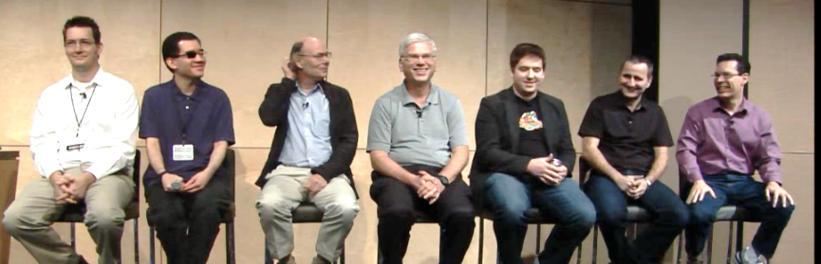
GoingNative 2012
C++’s biggest conference ever
Sold out, 18 countries, 23 states
Global live webcast: Over 20,000 viewers
Global on demand: Over 600,000 viewers

Slide 50
GoingNative 2013
And we did it again!
Sold out, 10 countries, 26 states
Global live webcast: Over 20,000 viewers
Global on demand: Over 1,000,000 viewers

Slide 51
GoingNative 2014
?

Slide 52
“GoingNative++” = larger & deeper
>10x content: 5 days x ~5 tracks x 5+ talks
CppCon 2014 estimate: 150+ full- and half-length talks
Invited talks/panels and domain experts
+ Lightning talks
+ Evening events and “unconference” time

Slide 53
Call for Submissions open now:
libraries & frameworks
functional programming
parallelism & multiprocessing
C++11 & C++14
cppcon.org
concepts & generic programming
real-world app experience reports
high-perf & low-latency computing
industry-specific (mobile, embedded, game, trading, scientific, robotics, …)
tools & processes
& more …

Slide 54
Your Feedback is Important
Fill out an evaluation of this session and help shape future events.
Scan the QR code to evaluate this session on your mobile device.
You’ll also be entered into a daily prize drawing!

Slide 55
© 2014 Microsoft Corporation. All rights reserved. Microsoft, Windows, Windows Vista and other product names are or may be registered trademarks and/or trademarks in the U.S. and/or other countries.
The information herein is for informational purposes only and represents the current view of Microsoft Corporation as of the date of this presentation. Because Microsoft must respond to changing market conditions, it should not be interpreted to be a commitment on the part of Microsoft, and Microsoft cannot guarantee the accuracy of any information provided after the date of this presentation. MICROSOFT MAKES NO WARRANTIES, EXPRESS, IMPLIED OR STATUTORY, AS TO THE INFORMATION IN THIS PRESENTATION.

