Slide 2
Building Enterprise Social Apps
(Windows 8 & WP8) using the Yammer Platform
3-571
Jose M. J. Comboni
Sr. Software Development Engineer
Microsoft

Slide 3

The foundation of any great app is a growing and engaged user base.

Slide 4
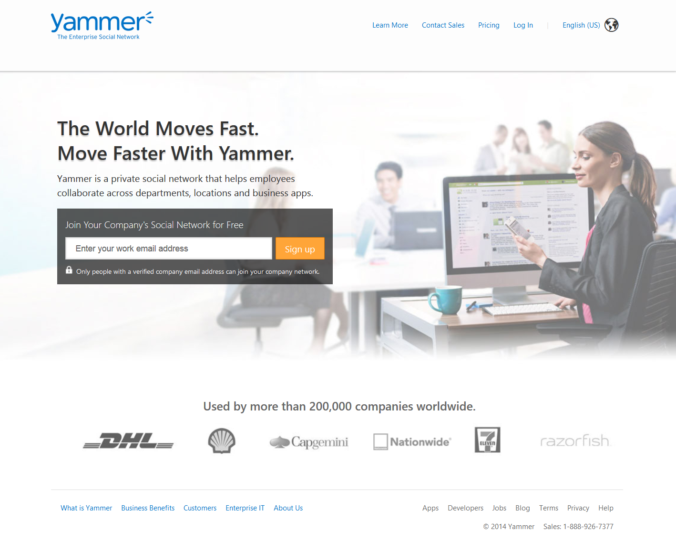
Sign up for free.
Grouped into private networks by email domain.

Slide 5
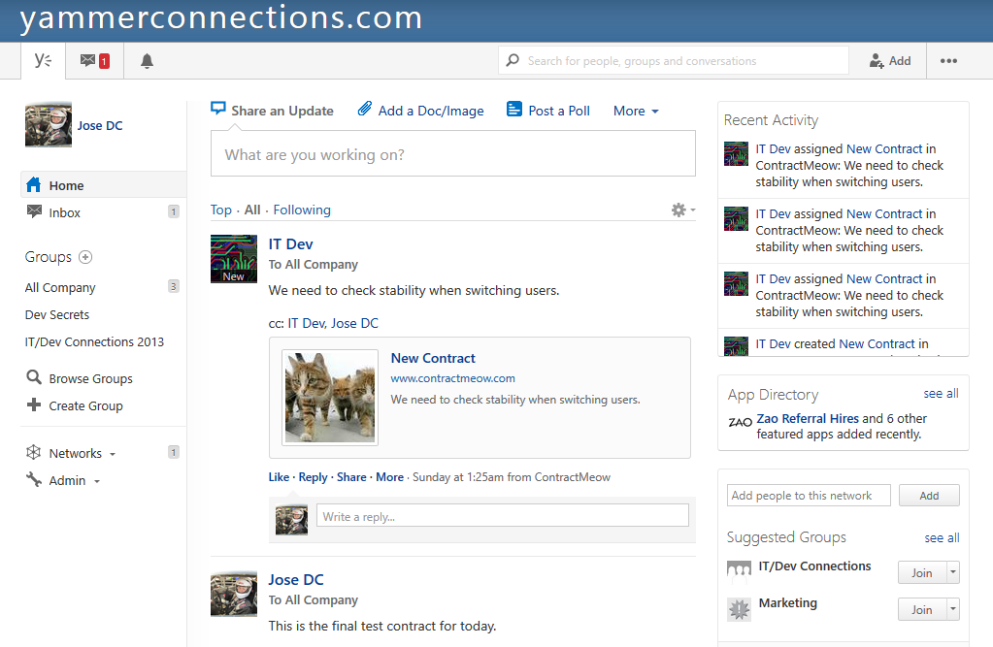
Post messages in the publisher.
User-generated messages appear in the feed.
User’s (joined) Groups
Users create groups.

Slide 6
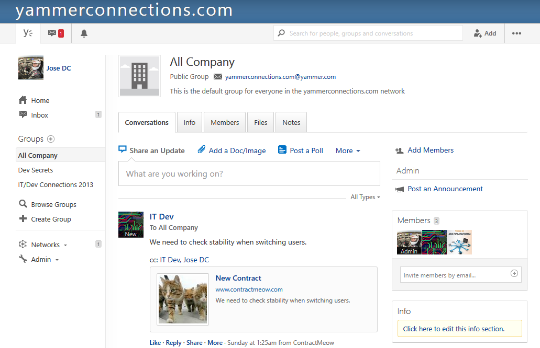
Group’s Feed
Groups files and Notes (UGC)
Group Members Feed

Slide 7
System generated events appear in the ticker.
Partners develop apps.

Slide 8
Demo
Yammer Windows Store Apps

Slide 9
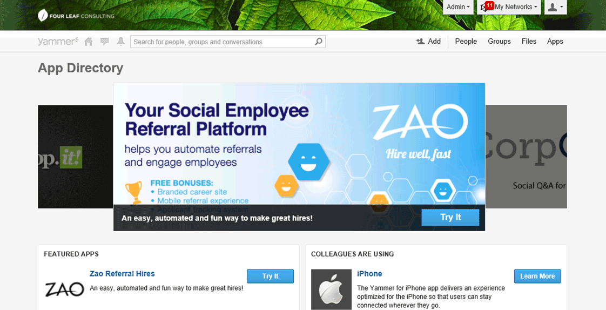

Yammer App Directory

Slide 10
Yammer App Directory
Sign-up
Use Corporate email
Request Access
Upload Photo
Register your Yammer App

Slide 11
Demo
Register a new App in Yammer

Slide 12
OAuth2 Authentication
Register your application in your Yammer network.
Obtain the ClientId and Secret by going to your profile
OAuth2 is the method for authenticating
Use the OAuth2 token in the Authorization header {bearer}

Slide 13
OAuth2 flow
a) User Authentication
b) App
Authorization
c) App Authentication
https://www.yammer.com/dialog/oauth?client_id=[:client_id]&redirect_uri=[:redirect_uri]&state=[:selfgeneratedtoken]
App Authorization – User Interactions (assuming Allow)
  http://[:redirect_uri]?code=[:code]
https://www.yammer.com/oauth2/access_token.json?client_id=[:client_id]&client_secret=[:client_secret]&code=[:code]

Slide 14
Demo
Authenticate App using ClientId/Secret

Slide 15
REST API Endpoints
Autocomplete:
  https://www.yammer.com/api/v1/autocomplete/
Messages:
  https://www.yammer.com/api/v1/messages.json
Attachments:
  https://www.yammer.com/api/v1/pending_attachments
Search:
  https://www.yammer.com/api/v1/search.json
Notifications:
  https://www.yammer.com/api/v1/streams/notifications.json

Slide 16
API Rate Limits
Enforced per user per app
Four main rate limits enforced
  Autocomplete: 1 request per second (or up to 10 per 10 seconds)
  Messages: 1 request per 3 seconds (or up to 10 per 30 seconds)
  Notifications: 1 request per 3 seconds (or up to 10 per 30 seconds)
  Other: 1 request per second (or up to 10 per 10 seconds)
Exceeding any rate limits will result on API calls returning a status code of 429 (too many request)

Slide 17
Activity Streams and Open Graph Objects
Use Open Graph Objects to maintain your user base engaged or communicate events and activities.
Sign In With Yammer
Embed Yammer actions (Like and Follow)
Send activities stories to send object metadata.
Why Open Graph? User growth and engagement.

Slide 18
Open Graph Objects
Used for generating Activities and sharing information
Activities take the form of:
  <actor><action><object> on <App name>: <message>
  E.g.: “John Doe” created “Sales Contract” on “Yammer Activities”: “Scheduled a new activity”
For more info go to
  http://developer.yammer.com/opengraph

Slide 19
OGO JSON Representation
{ "activity":{
"actor":{
"name":"John Doe",
"email":“jose@yammerconnections.com"},
"action":"create",
"object": {
"url":"https://www.yammerconnections.com",
"title":"Sales Contract"},
"message":"Signed a new client!"
"users":[
{"name":"Jane Doe",
"email":"jane@contract-meow.com"}
] }
}

Slide 20
Demo
Use SDK to send OGOs

Slide 21
AutoComplete
Endpoint:
  https://www.yammer.com/api/v1/autocomplete/ranked
Parameters
      ?models={modelName}:{count}&prefix={string}
      ?models=user:20&prefix=Matt
      ?models=user:20

Slide 22
Auto-Complete Response (JSON)
{ "user": [ {
"id": "1505261926",
"full_name": “Jose Comboni",
"email": “jose@yammerconnections.com",
"job_title": “Sr Dev",
"photo": "https://mug0.assets-yammer.com/mugshot/images/fvccH2chj9TtV8CdxF-2881z4wQDWzxP",
}, …] }

Slide 23
The YammerSDK (.NET)
A simple way to integrate Yammer into .NET projects
This is a Platform agnostic SDK (uses Portable Class Libraries)
Offers strongly-typed API call responses
Offers generic JSON based responses
Available in codeplex
Available through NuGet (coming soon)

Slide 24
The Yammer App Directory
Get your application in the App Directory for everyone to consume.
Get your App working.
Complete the App Directory submission form.
Deploy it to your Network App Directory first.
Request Global App Status and App Directory placement.
Get in touch with our Business Development Team.

Slide 25

Summary
Yammer provides that social layer across business applications
We provide values to your apps and business by providing two main components:
  user growth
  User engagement
You can make your app available to a very large user base by registering it in the Yammer App Directory.

Slide 26
Yammer .NET SDK References
Windows Phone 8 SDK (Documentation)
  http://developer.yammer.com/mobile/#winphone-sdk
Windows 8 SDK (Documentation)
  http://developer.yammer.com/mobile/#win8-sdk
Yammer .NET SDK (source & sample code)
  http://yammercontractmeow.codeplex.com/
  http://yammersdk.codeplex.com/

Slide 27
Other References
Yammer API Documentation
  http://developer.yammer.com/
  http://developer.yammer.com/restapi
Yammer Developers’ Network
  http://www.yammer.com/yammerdevelopersnetwork/
iOS/javascript/Ruby/Python SDKs
  http://developer.yammer.com/yammer-sdks/

Slide 28
Contact
Jose M. J. Comboni
Sr. SDE
Email: jocombon@microsoft.com
Twitter: @josecomboni
Channel9:

Slide 29
Resources
Use this slide to list resources, white papers,
videos and links.

Slide 30
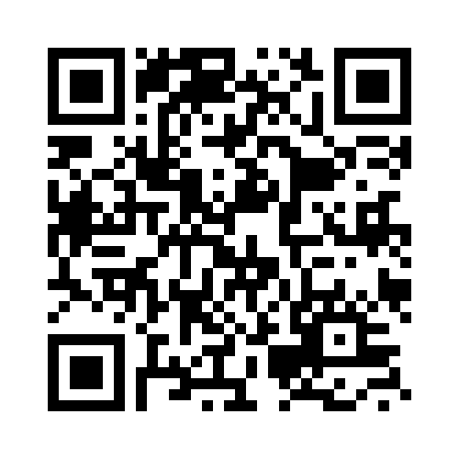
Your Feedback is Important
Fill out an evaluation of this session
and help shape future events.
Scan the QR code to evaluate
this session on your mobile device.
You’ll also be entered into
a daily prize drawing!

Slide 31

© 2014 Microsoft Corporation. All rights reserved. Microsoft, Windows, Windows Vista and other product names are or may be registered trademarks and/or trademarks in the U.S. and/or other countries.
The information herein is for informational purposes only and represents the current view of Microsoft Corporation as of the date of this presentation. Because Microsoft must respond to changing market conditions, it should not be interpreted to be a commitment on the part of Microsoft, and Microsoft cannot guarantee the accuracy of any information provided after the date of this presentation. MICROSOFT MAKES NO WARRANTIES, EXPRESS, IMPLIED OR STATUTORY, AS TO THE INFORMATION IN THIS PRESENTATION.

