Slide 2
Developing Office 365 Cloud business apps
3-573
@BethMassi
Senior Program Manager – Microsoft Visual Studio

Slide 3
Today’s business app
Any device, anywhere, anytime
New discovery channels
New ways of working
Redefined expectations for apps

Slide 4
Overview of the Cloud app model
Bring the concept and value of apps to Office and SharePoint
Unified and Cloud ready
Works on-premises and in Office 365
App lifecycle, built in monitoring, telemetry, and isolation
Web-standards based
Embraces web technologies including HTML, JavaScript REST/ODATA, and OAuth
Build a web app that is connected to Office & SharePoint APIs & services

Slide 5
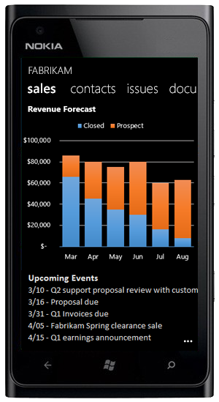
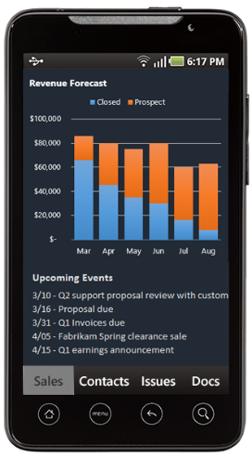
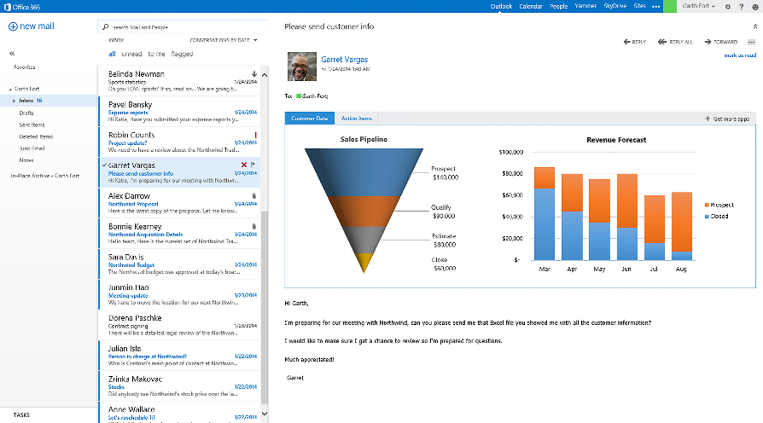
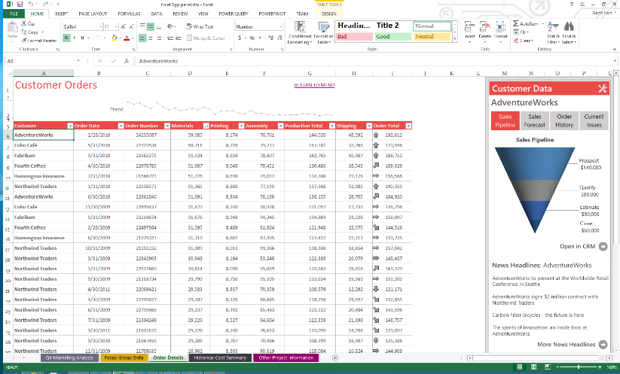
Office 365 platform
Contextual apps
Robust Office 365 API’s
Discovery
Flexible tools
Documents | People | groups
Mail | Tasks
Calendars | REST web services
Store

Slide 6
App anatomy
Web Page
App Manifest
App
HTML/CSS/JS
<XML>

Slide 7
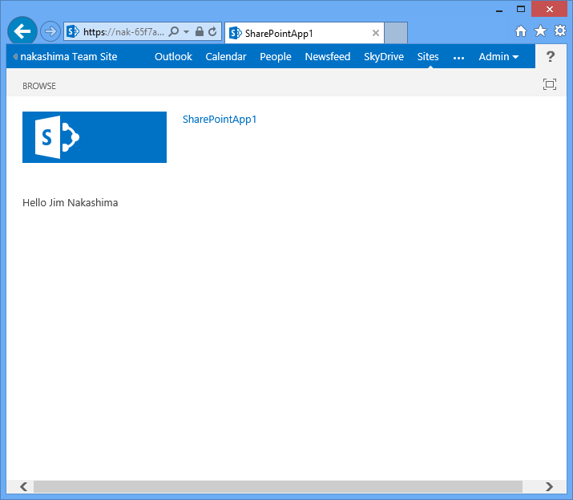
Anatomy of a cloud business app
ADO.NET OData
Custom
Office Store
SharePoint app catalog
Manifest
SharePoint
OAuth
Service layer (Azure Website)
Data sources
REST CSOM
OData (JSON light)
A Cloud business app is an app for SharePoint that has a Cloud hosted middle-tier and connects to data source(s)
The provider hosted middle-tier is authenticated with SharePoint via OAuth.
Clients talk to SharePoint via cross-domain calls
Middle-tier service layer can model SharePoint and external data sources
Modern browser client (HTML5)

Slide 8
SharePoint apps and Cloud business apps Rapid application development over SharePoint
Cloud business app
N’ tier project structure–ready to go
HTML 5 client with responsive design
Service tier with common data runtime
Screen, Entity, and Query designers
Office 365 cloud integration
People, documents, newsfeeds, …
Visually design first
Code second
SharePoint app
Assembly required
ASP.net MVC/web forms
App container with manifest
SharePoint configuration
App web list definitions
Resource configuration

Slide 9
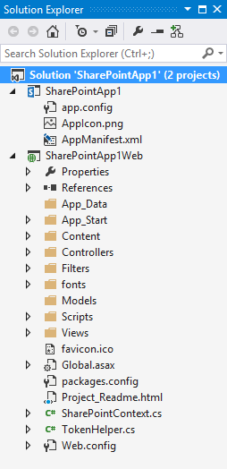
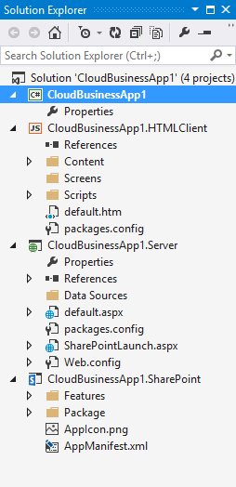
SharePoint and Cloud business app
SharePoint project
Cloud business app
HTML5 responsive design SPA
MVC/WebForms
Service project
SharePoint app

Slide 10
Demo – Survey app
SharePoint
Product documents
SAP
Customers and products
SQL database
Surveys
SharePoint app
Office 365
Service tier OData Service
Azure
HTML 5 SPA
Responsive design
Mobile client

Slide 11
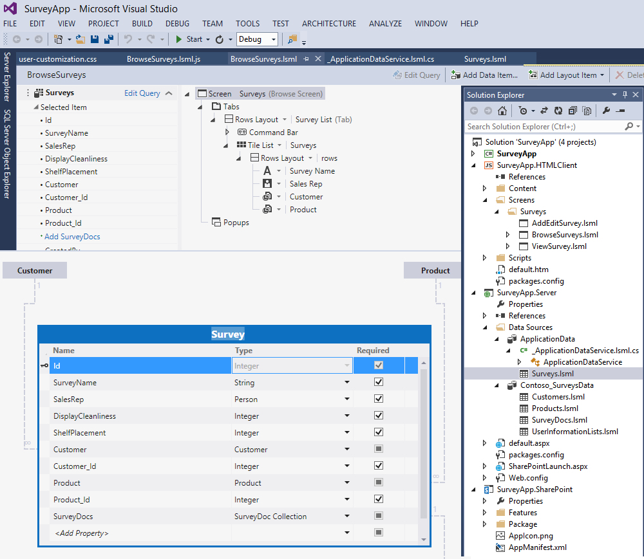
What did we cover?
Aggregated data sources
Sap
Application database
SharePoint document library
Posted to NewsFeeds ^{(Social)}
Added business rules
Server side data processing (C#/VB)
Client side UI logic (JavaScript)
Customized style sheets
Responsive design principles

Slide 12
What about publishing?

Slide 13
SharePoint app hosting
Provider-hosted App
Bring your own server hosting infrastructure
SharePoint Web
Your Hosted Site
including Azure
Cloud-hosted Apps
Autohosted App
Windows Azure + SQL Azure provisioned automatically as apps are installed
SharePoint Web
Azure
Get remote events from SharePoint
Use CSOM/REST + OAuth
SharePoint-Hosted App
Reuse web elements (lists, out-of-box web parts). Client side technologies and declarative workflows. No server-side code.
Host
web
App Web
(from WSP)

Slide 14
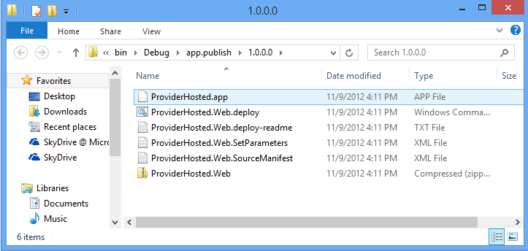
App package

Slide 15
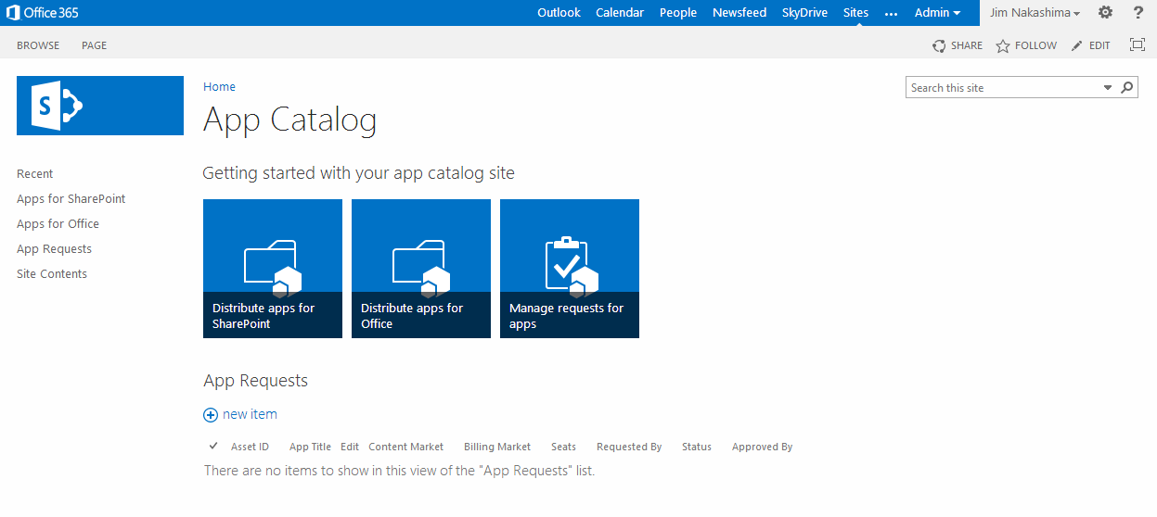
App catalog

Slide 16
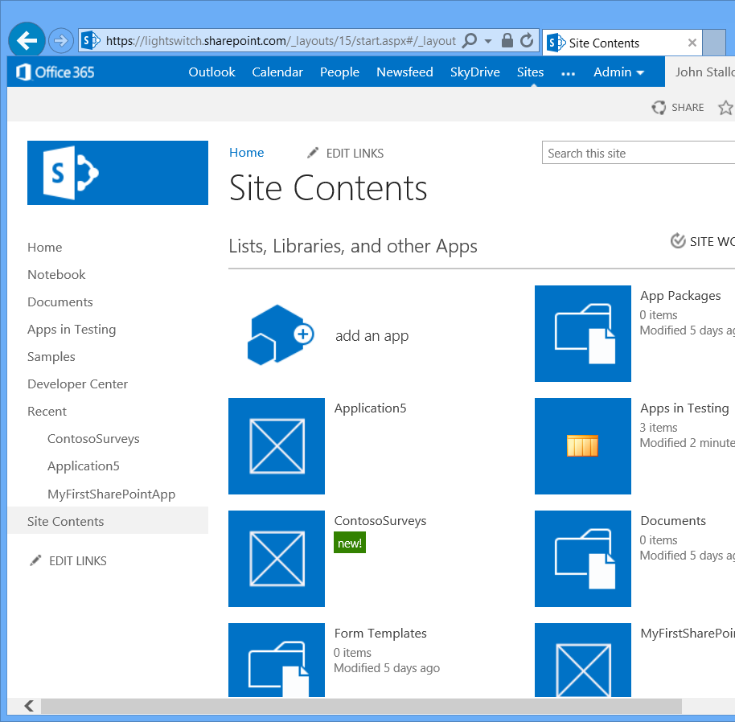
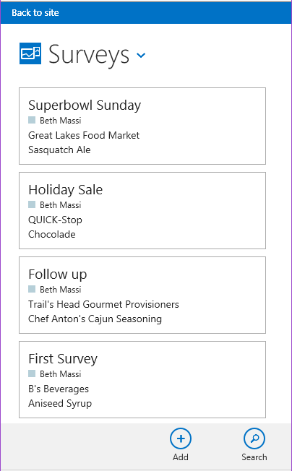
What did we cover?
Cloud business apps
Built on the Microsoft Cloud platform
Designed for the mobile enterprise
Uses the technologies you already know
Aggregates data sources
Business logic that crosses data sources
Focus on productivity
Focus on the unique aspects of your app

Slide 17
Resources
Get started, get the tools
http://aka.ms/BuildSharePointApps
http://dev.office.com
SAP NetWeaver gateway test OData feeds
http://scn.sap.com/docs/DOC-40986
Cloud business apps “How-to” videos
https://channel9.msdn.com/Series/CBA

Slide 18
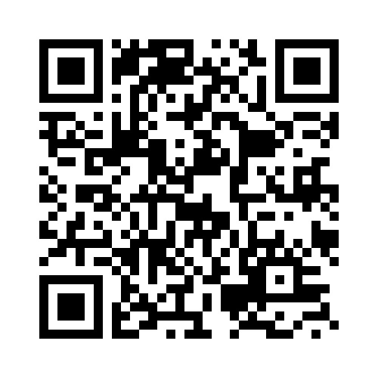
Your Feedback is Important
Fill out an evaluation of this session and help shape future events.
Scan the QR code to evaluate this session on your mobile device.
You’ll also be entered into a daily prize drawing!

Slide 19
© 2014 Microsoft Corporation. All rights reserved. Microsoft, Windows, Windows Vista and other product names are or may be registered trademarks and/or trademarks in the U.S. and/or other countries.
The information herein is for informational purposes only and represents the current view of Microsoft Corporation as of the date of this presentation. Because Microsoft must respond to changing market conditions, it should not be interpreted to be a commitment on the part of Microsoft, and Microsoft cannot guarantee the accuracy of any information provided after the date of this presentation. MICROSOFT MAKES NO WARRANTIES, EXPRESS, IMPLIED OR STATUTORY, AS TO THE INFORMATION IN THIS PRESENTATION.

