Slide 2
Diagnosing issues in Windows Phone 8.1 XAML Apps with Visual Studio 2013
3-578
Dan Taylor
Visual Studio Diagnostics
Microsoft

Slide 3
Motivation
Find and fix issues quickly
Build reliable, fast fluid apps

Slide 4
Scope and Terminology
Focusing on Windows Phone 8.1 Store apps using C# and XAML (XAML apps)
Almost all of this content applies to XAML apps on Windows
Some features apply to Silverlight 8.0/8.1, other app types, and platforms

Slide 5
Agenda
Setting the scene
Debugging
First-chance Exceptions
Data Binding
Async Debugging
JSON Visualizer
Lifecycle Events
Contracts
Performance and Diagnostics

Slide 6
Debugging

Slide 7
Demo
Debugging swallowed exceptions, async code, JSON, and data binding

Slide 8
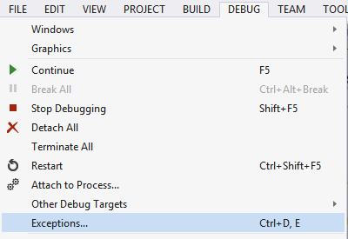
Features Covered
First-chance exceptions to break where exceptions are thrown

Slide 9
Features Covered
Async debugging shows causality of async code
The Tasks window shows active async operations and awaits

Slide 10
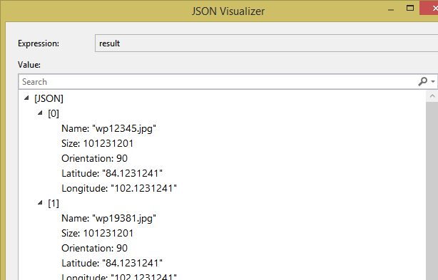
Features Covered
The JSON Visualizer is useful when JSON strings are used in server calls or other places in code (VS 2013 Update 2)

Slide 11
Features Covered
Data binding errors are shown in the output window (XAML Only)
In addition, you can add a callback and set a breakpoint

Slide 12
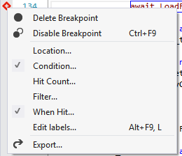
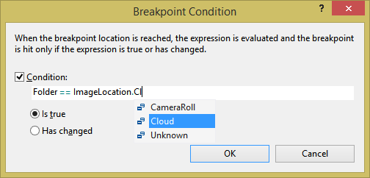
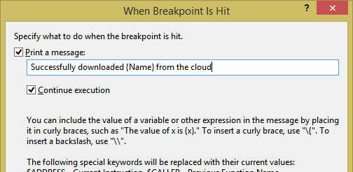
Features Covered
Pinned data tips show variables at a glance
Right-click to set tracepoints and conditional breakpoints

Slide 13
Demo
Debugging App Lifecycle Events

Slide 14
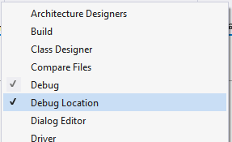
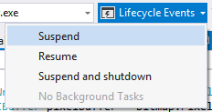
Features Covered
Turn on the Debug Location toolbar and use Lifecycle Events to trigger suspend, resume, and background tasks (XAML only)
Your app will otherwise not suspend while debugging (usually a good thing)

Slide 15
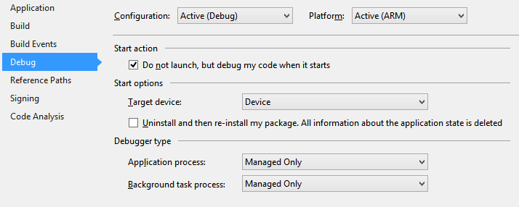
Features Covered
To debug share contracts, set the start action in project properties to debug when the app is started (XAML only)
For Silverlight: enable tombstoning

Slide 16
Agenda
Overview
Debugging
Performance and Diagnostics
UI Responsiveness
CPU Usage
Energy Consumption
Memory Usage

Slide 17
Performance and Diagnostics

Slide 18
Common Performance Problems
Operations take a long time to complete
UI is not responsive or “choppy”
App drains the battery and users notice
High memory usage: app is terminated
Always use a Release build on a physical device

Slide 19
Demo
Analyzing UI performance, energy consumption, and memory leaks

Slide 20
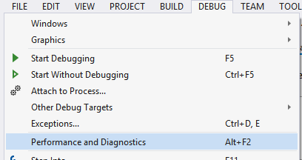
Features Covered
The Performance and Diagnostics hub is the starting point for performance investigations (XAML only)

Slide 21
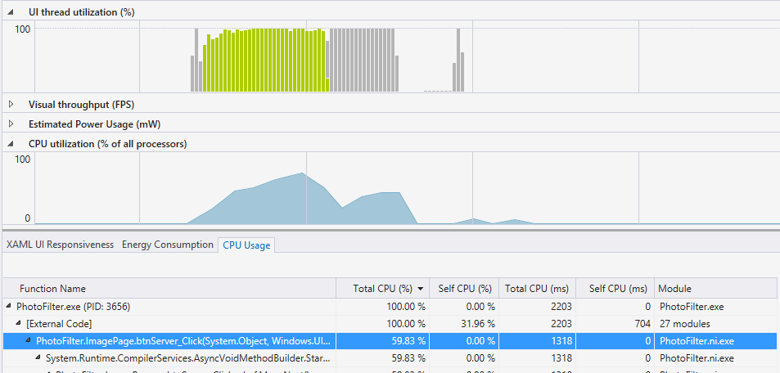
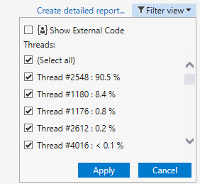
Features Covered
CPU Usage + XAML UI Responsiveness to see work on the UI thread and functions using the CPU (XAML only)

Slide 22
Features Covered
CPU Usage + Energy Consumption to estimate power consumption and evaluate tradeoffs between CPU, Network, and Display (XAML Only)

Slide 23
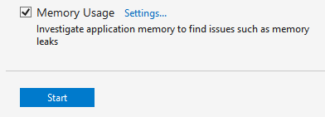
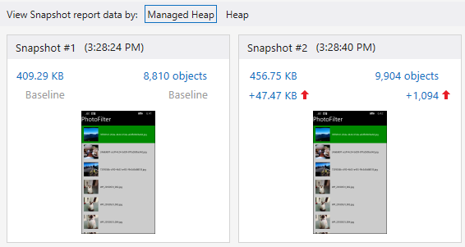
Features Covered
Use the Memory Usage tool to monitor memory usage and take snapshots of C#/VB/C++ memory (XAML only)

Slide 24
Features Covered
Open snapshots for detailed memory breakdown
Diff snapshots to identify causes of memory growth/leaks

Slide 25
Resources
For in-depth info on everything we covered and more:
http://blogs.msdn.com/b/visualstudioalm/archive/tags/diagnostics/
Related talks
3-579 Diagnosing Issues in Windows Phone JavaScript Apps Using Visual Studio
3-580 Internet Explorer 11’s Developer Tools, F12, Just Got Nicer (Again)
4-557 How to Analyze Performance Issues in Your Windows and Windows Phone Apps
3-591 Building Great Windows and Windows Phone XAML Apps with Visual Studio 2013

Slide 26
Your Feedback is Important
Fill out an evaluation of this session and help shape future events.
Scan the QR code to evaluate this session on your mobile device.
You’ll also be entered into a daily prize drawing!

