Slide 2
Building native client and mobile apps using Azure Active Directory for sign in
3-598
Vittorio Bertocci
Principal Program Manager
Azure Active Directory

Slide 3
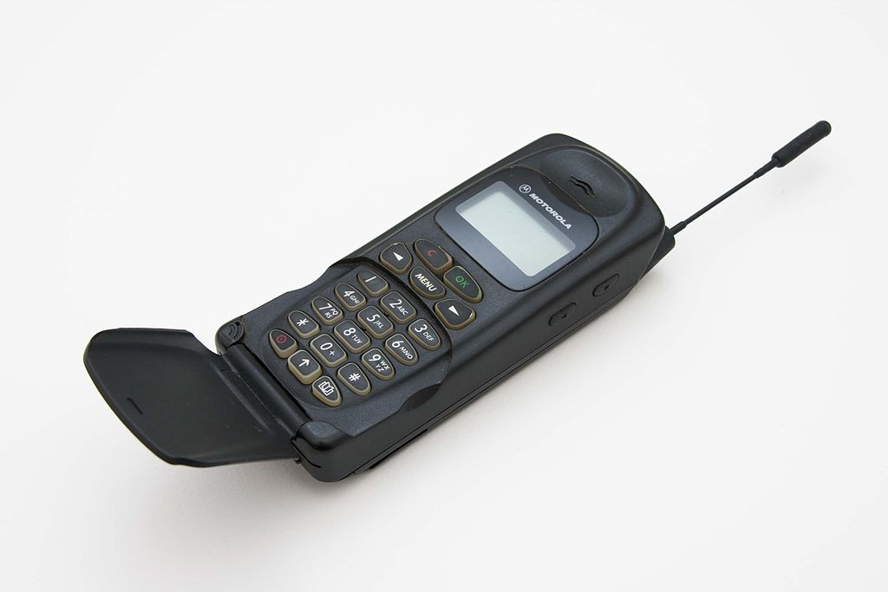
NOT YOUR FATHER’S ACTIVE DIRECTORY
© User:Digitalsignal / Wikimedia Commons / CC-BY-SA-3.0

Slide 4
Then vs. Now

Slide 5
Plan
How AAD represents resources
Implementing OAuth2 from scratch
  Windows Phone 8.1, Office 365 API
Client Libraries
  Windows Store, iOS, Office 365 API
Protecting your own API
    Windows Store, ASP.NET Web API
Multitenancy

Slide 6

Azure Active Directory Premium
Today, we announced Azure Active Directory Premium, an advanced offering that includes IAM capabilities for on-premises, hybrid and cloud environments. Built on top of the free Azure AD, provides an additional set of features to empower enterprises with demanding needs on identity and access management, such as:
Group-based access assignment for SSO to more than 1200 SaaS apps via “myapps.microsoft.com” or mobile apps.
Self-service password reset
Delegated group management
Multi-Factor Authentication
Customized branding
Reporting, alerting, and analytics
Additionally, Azure AD premium offers:
An Enterprise SLA of 99.9%
Usage rights to Forefront Identity Manager Server and CALs

Slide 7
Azure Active Directory App Model
user@domain
WebApp 1
NativeApp 1
Exposes:
Requires:
user@domain
Permission 1
Permission 1
WebApp 1
Permission 2

Slide 8
OAuth for Native Apps
A
<HTML>
T
Requires:
[CODE]
Read users’ mail
My New
Phone App
Exchange
Online

Slide 9
OAuth2 From Scratch
Call Office API from a Windows Phone 8.1 App
OAuth2 can be implemented without libraries…
…but it requires some work
DEMO

Slide 10
Active Directory Authentication Library (ADAL)
Abstracts away most protocol considerations
Handles tokens persistence & refresh automatically
AuthenticationContext ctx=
new AuthenticationContext("https://login.windows.net/contoso.onmicrosoft.com");
AuthenticationResult rez = await ctx.AcquireTokenAsync(
"https://outlook.office365.com/",
"5fc4a5a2-78d5-4d94-b890-a6e6b3341081");

Slide 11
Active Directory Authentication Library (ADAL)
Available on multiple platforms
  .NET, Windows Store, iOS, Android, Node.JS, Java
Open source (or in the process to be)
Same primitives, native programming models
Sophisticated features
  Works across Windows Server and Azure Active Directory
  Cache and automatic refresh
  Multi user support

Slide 12
ADAL for Windows Store
Call Office API from a Windows Store App
Note: here we use ADAL directly for demonstrative purposes…
…but there is an Office VS tool that adds it for you
DEMO

Slide 13
ADAL for iOS
Call Office API from an iOS App
Note: we also have ADAL for Android…
…but I’ll leave it as exercise for the reader
DEMO

Slide 14
Protecting Your Own API with AAD
Big OAuth2 providers issue tokens for their own resources
  Facebook for the Facebook Graph, AAD for the Graph, Azure management, Office…
In addition, Azure AD allows you to secure your own API
Easy as 1-2-3
  Add an entry for your API in your AAD tenant
  Define which permissions your app recognizes
  Add middleware in front of your API to validate AAD access tokens

Slide 15
Adding an Entry for your Web API in AAD
AAD needs to know how to identify your API
You can add an entry via the portal…
…or you can use VS2013

Slide 16
The Application’s Manifest
AAD needs to know which permissions your API exposes
You provide that info by uploading a manifest for your app
  JSON file holding a description of your app
  Download the default one, edit the AppPermissions node, upload it back
  Still VERY MUCH in preview
Fun fact: an API can also be a client of some other API!
  The RequiredResourceAccess node lists the resources & permissions the API requires

Slide 17
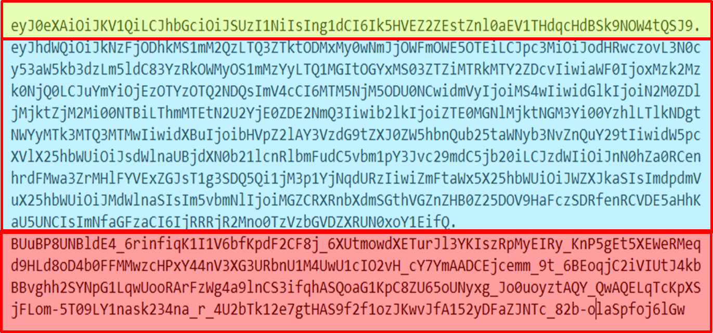
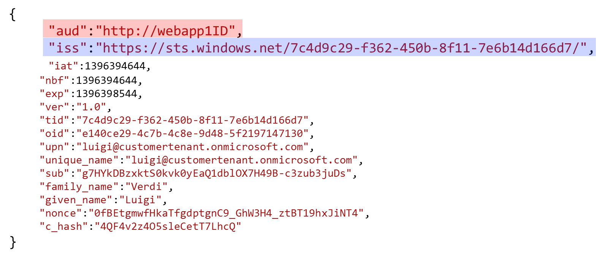
JWT Tokens, OAuth2 and ASP.NET
WebApp 1
contoso.onmicrosoft.com
WebApp 1

Slide 18
ASP.NET OWIN Security Components for AAD
OWIN middleware which automates
  Acquiring signing keys and issuer values
  Searching for a JWT in the request
  Validating it according to signature, issuer and audience value
Integrated in the VS2013 Web API templates
Very simple setup:
public void ConfigureAuth(IAppBuilder app)
{
app.UseWindowsAzureActiveDirectoryBearerAuthentication(
new WindowsAzureActiveDirectoryBearerAuthenticationOptions
{
Audience = “http://apps/mywebapi1/",
Tenant = “contoso.onmicrosoft.com"
});
}

Slide 19
ADAL and OWIN Middleware
Call your own API via AAD
DEMO

Slide 20
Multitenant API and Native Clients
Make your API available to other AAD tenants
  Ensure you comply with stricter requirements
    APP ID URI must use a registered domain
  Flip the multitenant switch in the portal
  Add the recognized clients in the knownClientApplications node in the manifest
Customers will be prompted for consent on 1st call
Attention points:
  Beware of the permissions you require
  Now there are multiple valid issuer values – you need to customize the validation

Slide 21
Get your hands dirty!
    ADAL source
    https://github.com/orgs/MSOpenTech
    ASP.NET OWIN components: http://katanaproject.codeplex.com/
Samples
https://github.com/orgs/AzureADSamples

Slide 22
Active Directory Reimagined

Slide 23
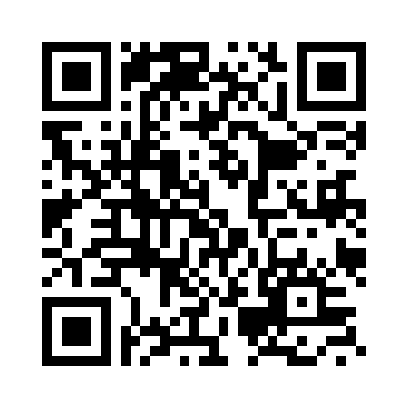
Your Feedback is Important
Fill out an evaluation of this session
and help shape future events.
Scan the QR code to evaluate
this session on your mobile device.
You’ll also be entered into
a daily prize drawing!

Slide 24

© 2014 Microsoft Corporation. All rights reserved. Microsoft, Windows, Windows Vista and other product names are or may be registered trademarks and/or trademarks in the U.S. and/or other countries.
The information herein is for informational purposes only and represents the current view of Microsoft Corporation as of the date of this presentation. Because Microsoft must respond to changing market conditions, it should not be interpreted to be a commitment on the part of Microsoft, and Microsoft cannot guarantee the accuracy of any information provided after the date of this presentation. MICROSOFT MAKES NO WARRANTIES, EXPRESS, IMPLIED OR STATUTORY, AS TO THE INFORMATION IN THIS PRESENTATION.

