Slide 2
Running Java and Oracle Applications on Azure
Brian Benz
Senior Technical Evangelist
Microsoft Open Technologies
Chris Risner
Senior Technical Evangelist
Microsoft
3-619

Slide 3
Agenda
Why Java?
Hosting options
Virtual Machines
Cloud Services & Tooling
Questions

Slide 4
Why Java?
Still heavily used inside and outside of the Enterprise
Regularly in top 3 languages on GitHub
Cross platform capable
Runs on Windows
Runs on Linux (20% of Azure hosting!)
Runs on phones

Slide 5
Java Hosting in Azure
Virtual Machines
Oracle
WebLogic Server
Database
Linux
Windows
Linux
Cloud Services

Slide 6
Cloud Computing
Packaged Software
Infrastructure
(as a Service)
Platform
(as a Service)
Software
(as a Service)
Applications
Applications
You manage
Applications
Applications
Data
You manage
Data
Data
Data
Runtime
Runtime
Runtime
Runtime
You manage
Middleware
Middleware
Middleware
Middleware
O/S
O/S
O/S
O/S
Virtualization
Virtualization
Virtualization
Virtualization
Servers
Servers
Servers
Servers
Storage
Storage
Storage
Storage
Networking
Networking
Networking
Networking

Slide 7
Java on Microsoft Azure: IaaS
IaaS
Services
Windows or Linux VMs
Official Oracle JDK v6 & v7
Other Azure SDKs and azure-cli / tools
Pre-configured VMs
Oracle WebLogic, VM Depot Java Image, or your own JVM
Windows Azure SDK for Java: Blob, table, queue, service bus, SQL, etc
Eclipse plugin for deployment, monitoring and management
Or bring any VM
64 bit OpenJDK build by Azul (Zulu)
PaaS

Slide 8
The Oracle Partnership
Oracle VMs in the Microsoft Azure Gallery
Oracle license mobility to Microsoft Azure
Oracle offers Oracle Linux on Microsoft Azure
Java tested and certified on Microsoft Azure
Became Generally Available in March

Slide 9
Java and Oracle VMs in the Gallery

Slide 10
Current Java and Oracle VM Images

Slide 11
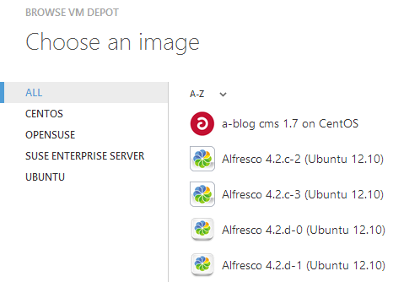
Current Linux Support in Azure
Azure IaaS: Supported Platform Images
Azure IaaS: VM Depot community images
Pre-built images optimized for cloud
Up-to-date VMs validated by Linux vendors
Microsoft support via forum
Easy path for moving on-prem VMs to cloud
Manage via familiar tools / SSH
Gallery of community-built images
Supported by 3rd party vendors (e.g. BitNami)
Integrated into Azure portal and management tools
Options to add vendor provided support for a VM
“Wired”
“Our biggest benefit is scalability, that's our main reason for a migration. We were sincerely and positively surprised by cost of migration and Azure server itself” Ivan Baruzin, Ademptio (2 Linux Servers VPS to 20 Linux VMs on Azure)
“Microsoft is playing quite nicely with Linux
and other open source tools. “
-Robert McMillan, Wired Enterprise

Slide 12
Public Cloud Licensing Options
Bring your own license, build a VM.
Install and configure software yourself on a Windows Server or Oracle Linux VM
2 VM Gallery Image Options – Oracle Linux or Windows Server:
Oracle Linux: Bring your own license
Get started faster with a pre-configured Oracle Database and/or Oracle WebLogic Server running on Oracle Linux
Windows Server: Use a license included with the VM
Choose a pre-configured Windows Server based VM image including licenses for Oracle Database and Oracle WebLogic Server.

Slide 13
Demo: Deploying a VM

Slide 14
Oracle
Full support for Oracle software
on Windows
Server Hyper-V and Microsoft Azure
Oracle license mobility for
Azure public cloud
Pay-as-you-go Azure images
of Oracle Database, WebLogic Server, and JDK
Oracle Linux as
preconfigured
instances on
Microsoft Azure
Fully licensed
and supported
Java on
Microsoft Azure

Slide 15
Java on Windows Azure: PaaS
IaaS
PaaS
Services
Windows or Linux VMs
Official Oracle JDK v6 & v7
64 bit OpenJDK build by Azul (Zulu)
Eclipse plugin for deployment, monitoring and management
Or bring any VM
Other Azure SDKs and azure-cli / tools
Pre-configured VMs
Oracle WebLogic, VM Depot Java Image, or your own JVM
Windows Azure SDK for Java: Blob, table, queue, service bus, SQL, etc

Slide 16
Cloud Services
PaaS
Web and Worker Roles
Worker Roles can host Java
Eclipse tooling
OpenJDK / Bring your own

Slide 17
Eclipse Tooling
Test with Azure Emulator
SSL
Sticky Sessions
Configure your roles
Instance count
Size
Endpoints
Names
Self-Signed Certs for testing
Publish to Azure

Slide 18
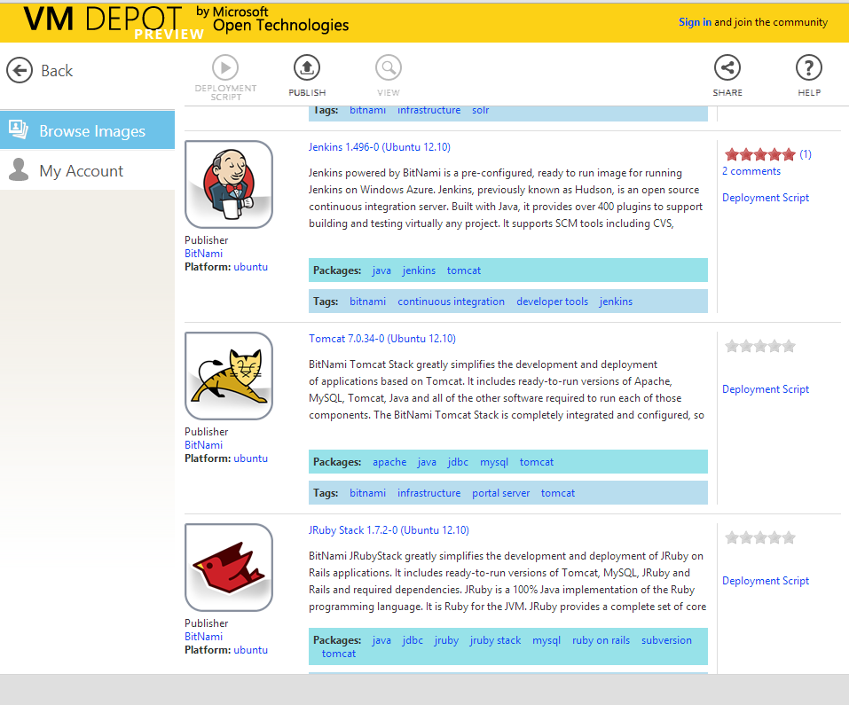
VM Depot – Tomcat (and other options)

Slide 19
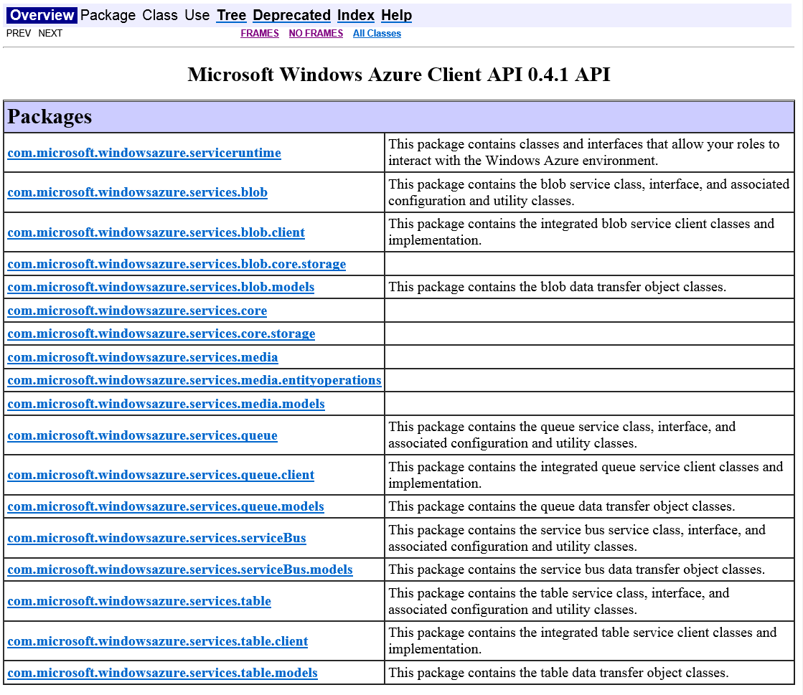
Reference, API Documentation

Slide 20
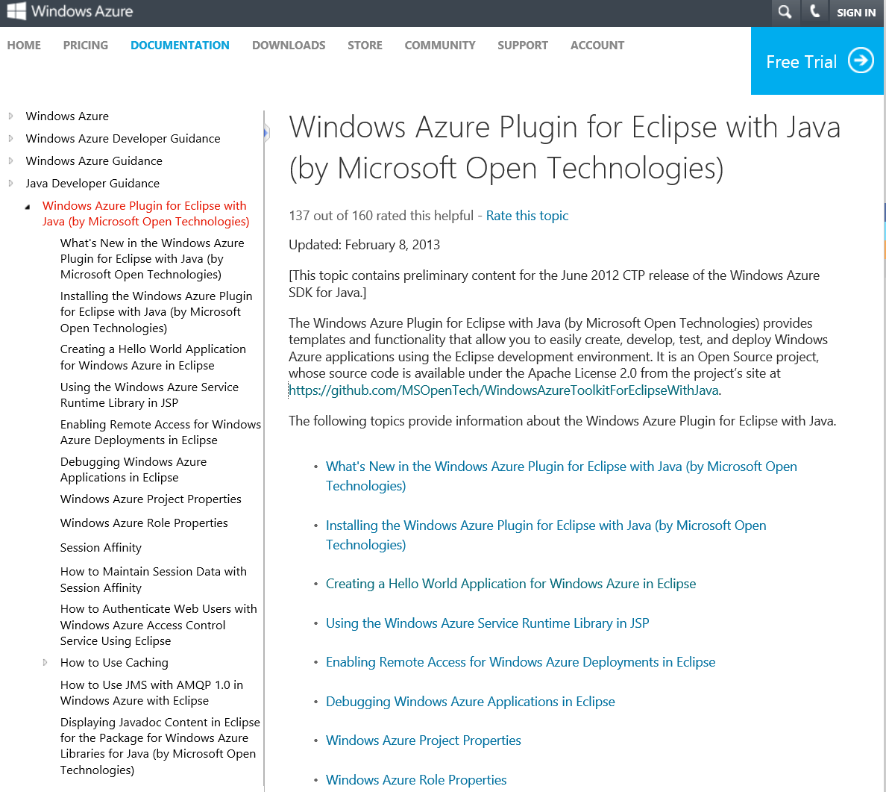
Articles and Updates

Slide 21
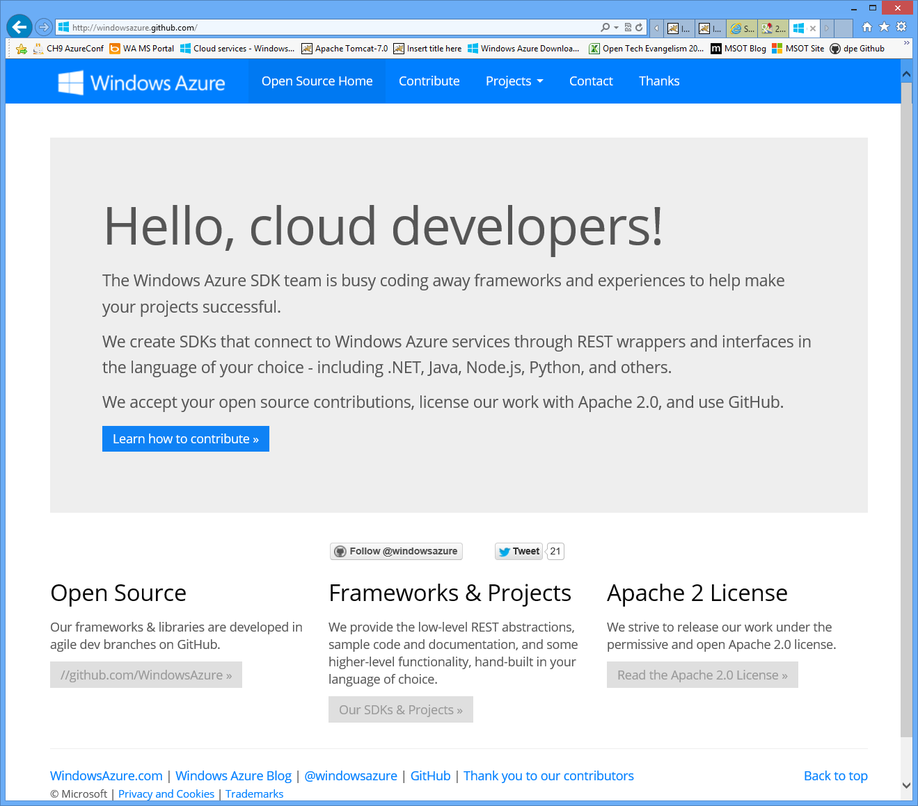
azure.github.com

Slide 22
Or use the Eclipse Plugin (includes SDK)

Slide 23
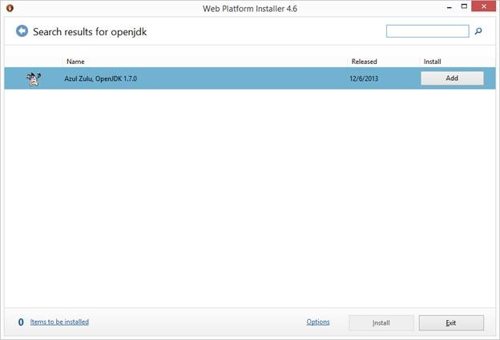
Azul Zulu OpenJDK on WebPI Installer
A result of our partnership with Azul
Zulu is a version of the Azul OpenJDK built for the Windows Azure Platform

Slide 24
Demos: WebPI & Eclipse Plugin

Slide 25
Java on Microsoft Azure: Services
IaaS
Services
Windows or Linux VMs
Official Oracle JDK v6 & v7
Other Azure SDKs and azure-cli / tools
Pre-configured VMs
Oracle WebLogic, VM Depot Java Image, or your own JVM
Microsoft Azure SDK for Java: Blob, table, queue, service bus, SQL, etc
Eclipse plugin for deployment, monitoring and management
Or bring any VM
64 bit OpenJDK build by Azul (Zulu)
PaaS

Slide 26
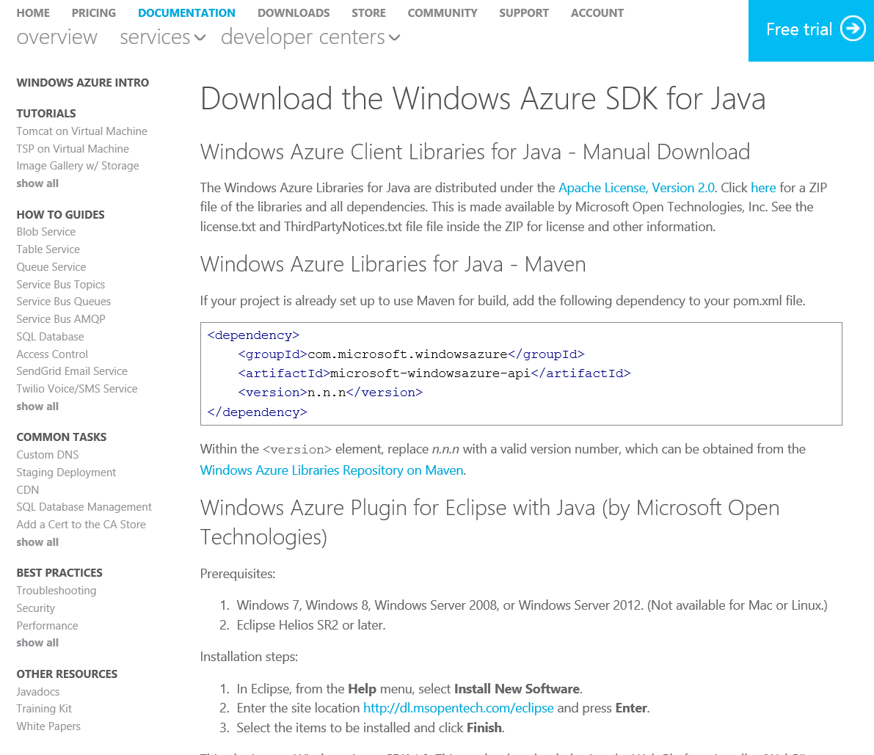
Download the SDK: Windows, Mac, Linux

Slide 27
Application building blocks
Big data
Database
Storage
Traffic
Caching
Messaging
Identity
Media
CDN
Networking

Slide 28
Cache
Low latency, in-memory distributed cache
Dynamically grow and shrink cache size
High availability support
Memcached protocol support

Slide 29
Identity
Integrate with enterprise identity
Enable single sign-on within your apps
Enterprise Graph REST API
93% of Fortune 1000 use Active Directory

Slide 30
Service bus
Secure messaging and relay capabilities
Easily build hybrid apps
Enable loosely coupled solutions

Slide 31
DB
SQL database
Relational SQL Server Engine in the Cloud
Clustered for high availability
Fully Managed Service
SQL Reporting support

Slide 32
Blob storage
Highly available, scalable and secure file system
Blobs can be exposed publicly over http
Continuous geo-replication across datacenters

Slide 33
Blob Storage Concepts
http://<account>.blob.core.windows.net/<container>/<blobname>
Account
Container
Blob
Pages/ Blocks
PIC01.JPG
images
Block/Page
PIC02.JPG
contoso
Block/Page
videos
VID1.AVI

Slide 34
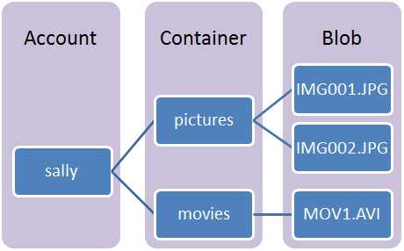
API Imports for Blob Storage
import com.microsoft.windowsazure.services.core.storage.*;
import com.microsoft.windowsazure.services.blob.client.*;

Slide 35
Connect and Open a Container
// Define the connection-string with your values
public static final String storageConnectionString = "DefaultEndpointsProtocol=http;" + "AccountName=your_storage_account;" + "AccountKey=your_storage_account_key";
CloudBlobContainer container = blobClient.getContainerReference("mycontainer");
// Option - Create the container if it does not exist container.createIfNotExist();

Slide 36
Output URIs for a Container
for (ListBlobItem blobItem : container.listBlobs()) { System.out.println(blobItem.getUri()); }

Slide 37
Notification Hubs
Beta SDK – http://aka.ms/JavaHubs
Manage device registrations
Trigger push notifications to:
WinStore
WinPhone
iOS
Android

Slide 38
Java Reference
VM Depot - vmdepot.msopentech.com
SDKs – www.windowsazure.com/en-us/develop/overview/
Developer Centers – http://www.windowsazure.com/en-us/documentation/
Eclipse Plugin - github.com/MSOpenTech/WindowsAzureToolkitForEclipseWithJava
Tutorial- http://aka.ms/JavaTutorial

Slide 39
Oracle Reference
Public News for Oracle software on Windows Azure at www.windowsazure.com/oracle
Oracle Self Service Kit http://aka.ms/orclssk
How to use Oracle images on Windows Azure http://go.microsoft.com/fwlink/?linkid=321002&clcid=0x409
Oracle Case Study – http://aka.ms/OracleCaseStudy

Slide 40
Contact Us
Brian Benz – @bbenz
bbenz@microsoft.com
Chris Risner - @chrisrisner
chrisner@microsoft.com

Slide 41
Questions & Answers

Slide 42
Your Feedback is Important
Fill out an evaluation of this session and help shape future events.
Scan the QR code to evaluate this session on your mobile device.
You’ll also be entered into a daily prize drawing!

Slide 43
© 2014 Microsoft Corporation. All rights reserved. Microsoft, Windows, Windows Vista and other product names are or may be registered trademarks and/or trademarks in the U.S. and/or other countries.
The information herein is for informational purposes only and represents the current view of Microsoft Corporation as of the date of this presentation. Because Microsoft must respond to changing market conditions, it should not be interpreted to be a commitment on the part of Microsoft, and Microsoft cannot guarantee the accuracy of any information provided after the date of this presentation. MICROSOFT MAKES NO WARRANTIES, EXPRESS, IMPLIED OR STATUTORY, AS TO THE INFORMATION IN THIS PRESENTATION.

