Slide 2
Powerful mobile apps with
Mobile Services and
ASP.NET Web API
3-623
Yavor Georgiev Kirill Gavrylyuk
Senior Program Manager Principal Program Manager Lead
Microsoft Azure Microsoft Azure

Slide 3

Lap around .NET backend
Data access and offline support
Authentication with AAD
Push notifications at scale
Q&A

Slide 4
Enable enterprise .NET developers to easily add a backend to their mobile apps, using their preferred frameworks, tools, and processes

Slide 5
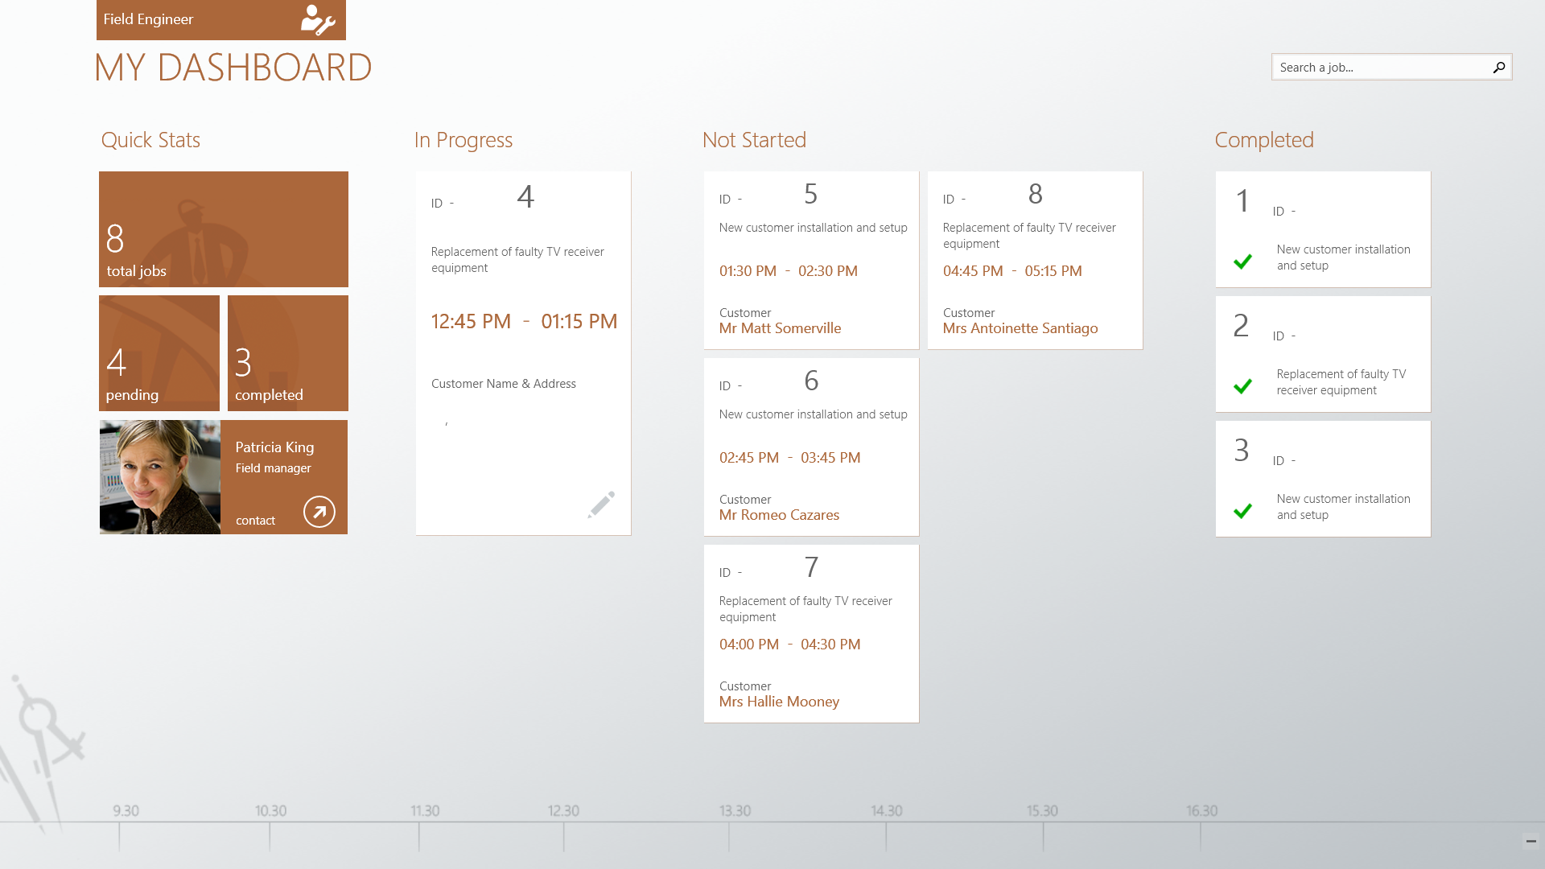

Slide 6
Lap around .NET backend

Slide 7
Principles
Don’t reinvent the wheel
Don’t scare away client developers
Focus on enablement, especially around data stores
Visual Studio is key
Deliver differentiated hosting value
Maintain side-by-side with existing Node.js story
Existing cross-platform clients continue to work

Slide 8
Core scenarios at //build/
Data
Based on WebAPI
Various data stores supported:
Azure Databases
SQL Server on-prem/IaaS
Table Storage
MongoDB
Flexible data mapping via automapper
Auth
Server flows supported:
Facebook
Twitter
Google
Microsoft Account
Client flows supported:
Azure Active Directory
Push
Uses Notification Hubs integration for high-scale cross-platform push
Tooling
Runtime available on NuGet
In-browser test client
Visual Studio support:
Local F5
IntelliSense
First-class deployment via WebDeploy and git
Remote debugging

Slide 9
Future-looking scope post //build/
Data
Additional data stores:
NHibernate
SharePoint
In-app messaging with SignalR
BizTalk integration
Auth
Client flows
Tooling
Integration with TFS
We want to hear from you!

Slide 10
Lap around the .NET backend
Programming model (data, scheduled jobs)
Visual Studio tooling
Local and remote debugging
Publish

Slide 11
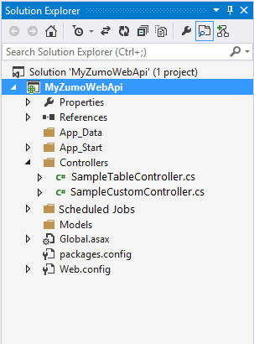
Website
XDRIVE\site\wwwroot
Mobile Services
compatible WebAPI
controllers
Web.config
C:\...\MobileServices
Mobile Services
runtime
Web.config
website root
git
User database:
EF code-first migrations
or custom migrations
Commit hook: Build project
load
source
WebDeploy
Mobile Services
compatible WebAPI
controllers
App settings
injected here

Slide 12
Data access and offline support

Slide 13
New data model (“greenfield”)
SQL Database
TableController
BYOD
DTO
DataManager
DTO
Table Storage
Device
Mobile Service
MongoDB

Slide 14
Existing data model (“brownfield”)
TableController
Existing
Tables
System
Properties
Table
DTO
DataManager
DTO
Model
Device
Mobile Service
SQL Azure/BYOD
AutoMapper

Slide 15
Offline support
SQL Database
Conflict resolution
TableController
(with optimistic concurrency)
BYOD
SQLite
Explicit Push/Pull
Table Storage
Device
Mobile Service
MongoDB

Slide 16
Authentication with AAD

Slide 17

Azure Active Directory and Mobile Services
Extend line-of-business to mobile
Bring turn-key login experience with corporate credentials to mobile developers
Enable applications built around organizational structures
Make AAD users a first-class concept in Mobile Services, with push-to-user and per-user data

Slide 18
Active Directory Authentication Library (ADAL)
Facilitates login to AAD-protected resources
Provides single sign-on to multiple enterprise resources
Available for Windows Store, iOS, and Android

Slide 19
Basic ADAL + Mobile Services Flow
1
Client app uses ADAL to initiate login, user enters credentials which are sent to AAD
AAD returns an Access Token / Refresh Token pair for the mobile service to ADAL
The client passes the Access Token to the mobile service, exchanges for the Mobile Services token for a continued session
2
3

Slide 20
Basic ADAL + Mobile Service flow
string authority = "https://login.windows.net/<your-tenant-name>.onmicrosoft.com";
string resourceURI = "https://service-name.azure-mobile.net/login/aad";
string clientID = "<your client app ID from Azure Active Directory portal>";
AuthenticationContext ac = new AuthenticationContext(authority);
AuthenticationResult ar = await ac.AcquireTokenAsync(resourceURI, clientID);
string accessToken = ar.AccessToken;
// Give the access token to the mobile service
JObject payload = new JObject();
payload["access_token"] = accessToken;
MobileServiceUser user = await App.MobileService.LoginAsync(
MobileServiceAuthenticationProvider.WindowsAzureActiveDirectory,
payload);

Slide 21
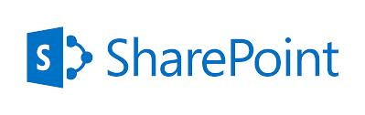
Access resources on behalf of the user
Mobile Service passes Access Token to AAD along with a requested resource URI and its Client ID / Client Secret
AAD sends back an Access Token / Refresh Token pair for the remote resource
Mobile Service talks to the remote resource on behalf of the logged-in user
1
2
3

Slide 22
Access resources on behalf of the user
ServiceUser user = ( ServiceUser ) this.User;
AzureActiveDirectoryCredentials creds = (await user.GetIdentitiesAsync())
.OfType<AzureActiveDirectoryCredentials>()
.FirstOrDefault();
string accessToken = creds.AccessToken;
string authority = "https://login.windows.net/tenant-name.onmicrosoft.com";
string resourceURI = "http://myresource";
string clientId = "b69ee3c9-c40d-4f2a-ac80-961cd1534e40“ ; // mobile service
string clientSecret = "oF2LC0pLyfwvUwT61/oVUJ+U8AuwTu+Lyorzt3yZTtE=“ ; // mobile service
AuthenticationContext ac = new AuthenticationContext (authority);
AuthenticationResult ar = ac.AcquireToken(resourceURI, new UserAssertion(accessToken), new ClientCredential(clientId, clientSecret));
string resourceToken = ar.AccessToken;

Slide 23
Push notifications at scale

Slide 24
Mobile Services + Notification Hubs
iOS, Windows, Google apps
Every Mobile Service gets a Notification Hub (included in the price)
Device tokens are automatically registered with Notification Hubs
Built-in push-to-user capability
Mobile Service
PNS
Notification
Hubs

Slide 25
Advantages of Notification Hubs
X-plat: one API to notify on any mobile platform
Support IOS, Android, Windows Phone, Windows, Kindle
Avoid storing device information in your tables
Notification Hub maintains the registry of devices and the associations to users/interest groups
Work with logical users and segments
Target individual users and large interest groups using tags
Personalization and localization
Keep your back-end free of presentation concerns like localization and user preferences using templates
Broadcast at scale, multicast, unicast
Push notifications to millions of devices (across platforms) with a single call
Rich Telemetry
Rich telemetry available through portal or APIs

Slide 27
Announcing
Mobile Services .NET Backend
Open Source

Slide 28
Mobile Services .NET
A Backend for Your Employee or Consumer app in seconds
Your Backend Logic via .NET Web API
Turn-key Mobile Backend Capabilities
    Secure data store/query/page with heterogeneous backends
    Azure Active Directory
    Support occasionally connected apps
Client SDK for iOS, Android, Windows, WinPhone, Xamarin, PhoneGap, Sencha
Integration With Your On-Premise Enterprise Systems, O365
We Manage, Run, and Monitor your backend for you

Slide 29
Resources
http://www.windowsazure.com/mobile
Talks
2-616 Mobile Push Notifications to Any Client with Azure Notification Hubs Elio Damaggio
3-603 Building Web APIs for Mobile Apps Using ASP.NET Web API 2.1
3-622 Building Cross-Platform Line of Business Apps with Mobile Services

Slide 30
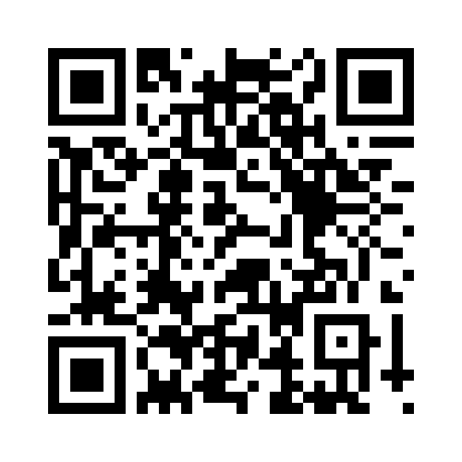
Your Feedback is Important
Fill out an evaluation of this session
and help shape future events.
Scan the QR code to evaluate
this session on your mobile device.
You’ll also be entered into
a daily prize drawing!

Slide 31

© 2014 Microsoft Corporation. All rights reserved. Microsoft, Windows, Windows Vista and other product names are or may be registered trademarks and/or trademarks in the U.S. and/or other countries.
The information herein is for informational purposes only and represents the current view of Microsoft Corporation as of the date of this presentation. Because Microsoft must respond to changing market conditions, it should not be interpreted to be a commitment on the part of Microsoft, and Microsoft cannot guarantee the accuracy of any information provided after the date of this presentation. MICROSOFT MAKES NO WARRANTIES, EXPRESS, IMPLIED OR STATUTORY, AS TO THE INFORMATION IN THIS PRESENTATION.

