Slide 2
Building Big: Lessons learned from Azure customers
3-633
Mark Simms, Principal Group Program Manager (@mabsimms)
Chris Clayton, Principal Program Manager Lead
AzureCAT

Slide 3
Setting the stage
This is meant to be an interactive discussion – if you don’t ask questions, we will!
Note: please use the mic.
This session will be customer stories, patterns & architecture.
Designing resilient large-scale services requires careful design and architecture choices
In this session we will explore how AzureCAT breaks down the architecture of a cloud service through a real-world example
Windows Azure Customer Advisory Team (CAT)
Works with internal and external customers to build out some of the largest applications on Azure
Get our hands dirty on all aspects of delivery; design, implementation and all too often firefighting

Slide 4
Agenda and Expectations
This will not be a discussion of features
Focus on architecture, choices and their impact on scalability and availability
  Details on implementation & best practices will be covered in Connecting the World: Building Services for Connected Devices on Azure (Thursday, 1pm room 3014)
Walkthrough of the approach that AzureCAT uses to analyze real-world customer solutions
  Take an architecture, find the breaking points, fix them, rinse and repeat

Slide 5
AzureCAT: Framing a Customer Discussion
Scalability. The ability to add additional capacity to the service to handle increases in load and demand, together with efficient and effective use of resources allocated.
Availability.
Manageability.
Feasibility.
Scalability
Manageability
Availability
Feasibility

Slide 6
AzureCAT: Framing a Customer Discussion
Scalability.
Availability. The ability of the solution to continue to provide value in the face of transient and enduring faults in the application and underlying service dependencies .
Manageability.
Feasibility.
Scalability
Manageability
Availability
Feasibility

Slide 7
AzureCAT: Framing a Customer Discussion
Scalability.
Availability.
Manageability. The ability to understand health and performance of the live system and manage site operations
Feasibility.
Scalability
Manageability
Availability
Feasibility

Slide 8
AzureCAT: Framing a Customer Discussion
Scalability.
Availability.
Manageability.
Feasibility. The ability to deliver and maintain the system, on time (ish) and under budget (ish).
Scalability
Manageability
Availability
Feasibility

Slide 9
Scalability == Capacity * Density
Adding more Capacity
Using Capacity more Efficiently
Identifying and breaking contention and choke points
How to add additional capacity to a solution?
There are subtle constraints to consider...
Traditional performance tuning
Collapsing tiers (web-app-db is increasingly a historical relic)
Improving network performance

Slide 10
Context – Sample Application
Thousands of fast food outlets publishing store activity updates
  Customer wait times (drive through, in store, delivery), order details, etc
  Updates published to central server every minute (~ 5kB XML files)
Classic 3-tier enterprise architecture

Slide 11
Scalability – What are the metered resources?
1 | HTTP(s) sockets through load balancer (single IP) | Software load balancer per cloud service; max socket count
 |  | Socket connection idle time (~ 4min)
2 | VMs deployed per cloud service | Each VM meters compute, memory, network (need more, add more VMs)
3 | Requests/sec per VM | Metered by efficiency of implementation
4 | Connections / database | Capped at 180 (default ASP.NET pool size is 100)
 | Database throughput | Multiple metered resources
Note: without an explicit security boundary the physical web/app separation is burning $$$

Slide 12
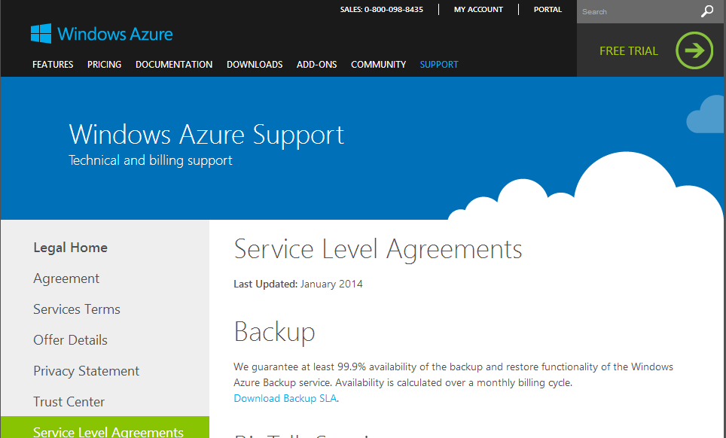
Availability – What are the SLAs?
http://www.windowsazure.com/en-us/support/legal/sla/

Slide 13
SLA numbers – quick refresh
Availability % | Downtime per year | Downtime per month* | Downtime per week
90% ("one nine") | 36.5 days | 72 hours | 16.8 hours
99% ("two nines") | 3.65 days | 7.20 hours | 1.68 hours
99.9% ("three nines") | 8.76 hours | 43.2 minutes | 10.1 minutes
99.99% ("four nines") | 52.56 minutes | 4.32 minutes | 1.01 minutes
99.999% ("five nines") | 5.26 minutes | 25.9 seconds | 6.05 seconds
99.9999% ("six nines") | 31.5 seconds | 2.59 seconds | 0.605 seconds

Slide 14
Availability – What are the SLAs?
This calculation doesn’t tell the full story. Each platform SLA is calculated differently:
Different time metrics (calculated monthly vs. 5-min increments)
Different success metrics (connectivity vs. successful valid operations)
The composite platform SLA is NOT your application’s availability to users..
 | Service | SLA | Impact
1 | Traffic Manager | 99.99% (calculated over monthly cycle) | Clients without cached DNS response cannot connect
2 | Cloud Service VMs | 99.95% external connectivity | May lose a fault domain (50% of capacity)
3 | SQL Database | 99.9% connectivity over monthly cycle (5 min increments) | Unable to fulfill primary workloads without SQL interaction

Slide 15
Architecture Breakdown
Pros
Cons
Go with what you know (scores well on feasibility).
Architecture is vulnerable to load spikes and backpressure
  Direct path end-to-end through system (complete coupling)
  No rate levelling or load shedding, no workload prioritization
Shared resources between workloads
  Same backing resources for mutable and immutable operations (1:100 workload ratio)
No way to add more capacity (scale-out) at each tier

Slide 16
Architecture Iteration 1
Load levelling through queues

Slide 17
Iteration 1 – Add Queuing
Introduce queuing through Azure Storage Queues
  Provide rate levelling and mitigate any ingest spikes or database throttling events
  Message exchange pattern is cooperating-producer / competing-consumer
  Batch inserts (chunky) into SQL
HTTP 200-OK response from web role now means “I have your data” not “I have processed your data”
  Trading latency for throughput

Slide 18
Scalability – What are the metered resources?
 | Resource | Limits
1 | Azure queue | ~ 2000 messages / second throughput
 |  | Provides backpressure relief during load spikes
Introducing queueing will rate level inserts and enable batching (better density)
To add more capacity for read operations, we can use a distributed cache

Slide 19
Availability – What are the SLAs?
Moving to a queue-driven insert pattern, our accept workload has no direct dependency on SQL Database
Transient error event for SQL Database increases latency (for inserting to DB) but does not affect receiving messages
Trading latency for availability
 | Service | SLA | Impact of Unavailability
1 | Traffic Manager | 99.99% (calculated over monthly cycle) | Clients without cached DNS response cannot connect
2 | Cloud Service VMs | 99.95% external connectivity | May lose a fault domain (50% of capacity)
4 | Azure Storage | 99.9% process requests | Unable to post messages to queue
3 | SQL Database | 99.9% connectivity over monthly cycle (5 min increments) | Unable to fulfill insert workloads without SQL interaction

Slide 20
Going Beyond SLAs..
What are our practical scale and availability considerations?

Slide 21
Availability – Digging deeper than SLAs
SLA calculations only cover dependency availability
  They don’t do anything about bad code + weird load.
The real SLA is delivering value to your customers
  This is measured workload by workload
Review end-to-end code flow, look for availability/scalability challenges

Slide 22
Availability – Digging deeper than SLAs
Does our solution require node affinity on new HTTP connections?
No – any web role instance can service any request. No localized or affintized state.

Slide 23
Availability – Digging deeper than SLAs
How many concurrent requests can our HTTP listener handle per node?
By default – 12x core count parallel “dispatch” threads
If requests back up in the queue (default 5000) web service goes into 503 Server Unavailable
Long running activities can block the queue (i.e. high latency code paths)
Must make all calls asynchronous, and bound downstream calls (to dependent services)
This is an example of availability and scalability being tightly coupled

Slide 24
Impact of blocking the queue
Graph is from a production Azure site (~240 cores)
Fully synchronous response rendering
One call – 0.5% of traffic – blocked due to downstream service failure
“Bad actors” (slow requests) dominated within 3 minutes and brought down site.

Slide 25
Availability – Digging deeper than SLAs
Does our identity solution carry any externalized dependencies?
Maybe…
Note: if your app has admin functions there should always be a no-dependency login path.
Identity / Auth Store | Pros/Cons
Shared secret (username/password) | Limited by availability and scalability of secret store (SQL, table store, etc) App responsible for maintaining secrets
Federated identity service (Active Directory, etc) | Limited by availability and scalability of availability service No user secrets stored in app

Slide 26
Availability – Digging deeper than SLAs
Does publish to queue carry any availability points?
Common Failure Modes | Remediation
Exceed queue throughput (throttling) | Scale out to multiple queues. Build application for N queues, initially deploy with 1. Likelihood – low for this workload
Exceed queue message size (64 kB). | Very likely – transform and publish to queue needs to: Publish raw content to blob storage Publish pointer to queue

Slide 27
Now to process queue messages
Continued in:
Connecting the World: Building services for connected devices on Azure
Thursday April 3rd, 1:00pm in 3014

Slide 28
Takeaways
When designing and implementing services carefully balance scalability, availability, manageability
Engineering choices are tradeoffs – what do I get vs. what do I give up?
How do I add more capacity at each layer, how do I use capacity efficiently?
How does my system buffer and absorb shocks (unexpected load, downstream failures)?

Slide 29

Your Feedback is Important
Fill out an evaluation of this session
and help shape future events.
Scan the QR code to evaluate
this session on your mobile device.
You’ll also be entered into
a daily prize drawing!

Slide 30

© 2014 Microsoft Corporation. All rights reserved. Microsoft, Windows, Windows Vista and other product names are or may be registered trademarks and/or trademarks in the U.S. and/or other countries.
The information herein is for informational purposes only and represents the current view of Microsoft Corporation as of the date of this presentation. Because Microsoft must respond to changing market conditions, it should not be interpreted to be a commitment on the part of Microsoft, and Microsoft cannot guarantee the accuracy of any information provided after the date of this presentation. MICROSOFT MAKES NO WARRANTIES, EXPRESS, IMPLIED OR STATUTORY, AS TO THE INFORMATION IN THIS PRESENTATION.

