Slide 2
Connecting the World: Building services for connected devices on Azure
3-634
Mark Simms, Principal Group Program Manager (@mabsimms)
Chris Clayton, Principal Program Manager Lead
AzureCAT

Slide 3
Setting the stage
This is meant to be an interactive discussion – if you don’t ask questions, we will!
This session will be code, patterns & customer stories.
We will get deeply nerdy with .NET and Azure services.
It’s a big, strange world of devices out there
In this session we will explore several common patterns and design decisions through the eyes of a sample implementation (drawn from real deployments).
This talk is drawn from working on IoT scenarios from 3000 to 300 million devices.
Windows Azure Customer Advisory Team (CAT)
Works with internal and external customers to build out some of the largest applications on Azure

Slide 4
Agenda and Expectations
Focus is on services for devices, not on device firmware, apps, etc.
Focus on implementation patterns, choices and their impact on scalability and availability
  All details have been drawn from real-world deployments. No really, we’re not making any of this up.
Key aspects:
  End to end asynchronous data flow
  Direct HTTP-based connectivity and inbound messaging
  Queue driven message processing

Slide 5
Other Cool Azure & Cloud Services Stuff
Title | Speaker | Location
The Present and Future of .NET in a World of Devices and Services | Jay Schmelzer | Hall 1A
The New Authentication Model for Web, Mobile, and Cloud Applications | Lucas Adams , Stuart Kwan | 3022
The Future of Azure DevOps: Managing the Development and Lifecycle of Cloud Applications | Michael Flanakin , Bradley Millington | 3rd floor Ballroom
What’s New in Azure Networking | Ganesh Srinivasan , Jonathan Tuliani | Hall 1B
Scheduling Jobs in the Cloud with the Azure Scheduler Service | Kevin Lam , Brad Olenick | 3018

Slide 6
General Purpose IoT Architecture

Slide 7
Context – Sample Application
Thousands of fast food outlets publishing store activity updates
  Customer wait times (drive through, in store, delivery), order details, etc
  Updates published to central server every minute (~ 5kB XML files)
Implicit:
  The point of sale devices (apps) publishing data already exist, and are probably really expensive to change (service has to snap to device)
  They likely store-and-forward data in case of connection loss (can experience inrush effect)
  They may or may not all send “at the same time”
  May or may not be able to trust sender time (this makes late arriving data really fun)
  ….

Slide 8
Context – Sample Application

Slide 9
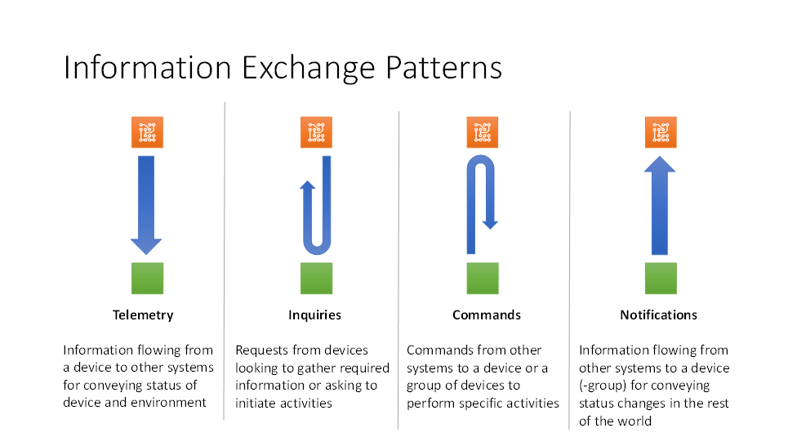
Messaging and Connectivity

Slide 10
Messaging and Connectivity
Devices support a wide variety of connection protocols, schemas and data types
Firmware (apps) are often fixed, and services must conform to the device’s communication protocol
  This is not always fun.
Generally need a custom protocol gateway to support extant devices which do not leverage common “standards”
  And even devices which speak HTTP/”REST”/XML/etc don’t always do it in a consistent fashion…

Slide 11
Ingest and Protocol Management
Device almost always has to initiate connections
  Firewalls, NATs, dynamic IP, general network weirdness
Socket management. Hold sockets open, keep alives – latency on push notifications
Protocol – HTTP(s), AMQP, MQTT, TCP, custom (Bluetooth, etc)
Direct connectivity vs. concentrator/local gateway
  Example: Smart Grid / Power meters
Message response – act vs. queue and act later

Slide 12
Queue Driven Message Processing
Many IoT style apps have bursty or unpredictable loads (new devices show up, etc)
Need to rate-level incoming work through messaging and queues
  Capture incoming requests to durable store as quickly/efficiently as possible
  Rate level processing to smooth load against back-end stores and systems
Lot of considerations to get queue-driven processing right/scalable/reliable

Slide 13
Less than optimal implementation approaches..

Slide 14
Observations and Challenges
Direct coupling between devices and backing store (no way to bleed off pressure or handle transients)
No layering or pluggability (no way to mediate between different backing stores)
Cross cuts: logging, configuration, error handling
Synchronous end-to-end; not making optimal use of system resources

Slide 15
More optimal implementation approach..

Slide 16
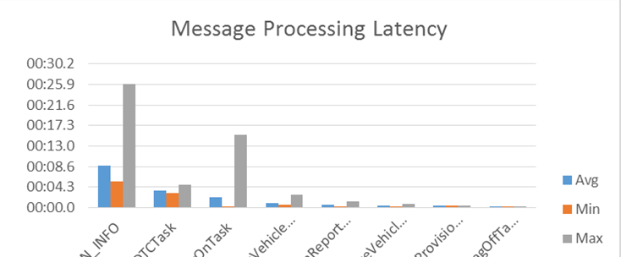
What does contention look like?
High variability between min/max/avg processing time hints to contention.
In this case it was scheduling contention..

Slide 17
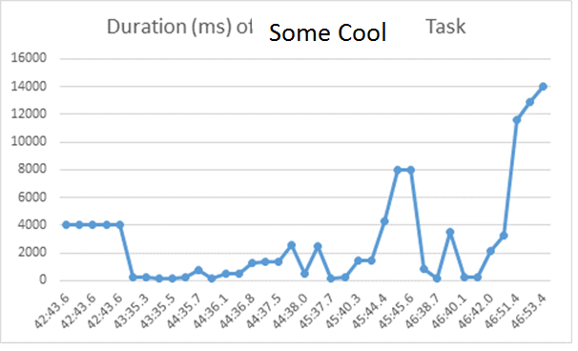
Why is ConcurrentDictionary<T,K> important for dispatch handlers?
The chain is as strong as its weakest link.
Tune your message dequeue code, increase concurrency.
Stack up on Dictionary ☹

Slide 18
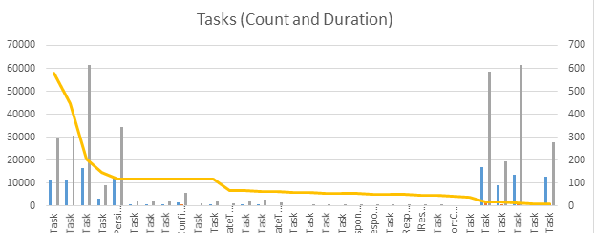
Not all workloads are created equal
Focus on optimizing these message handlers
These, probably not.
Pareto curve in message processing – can focus optimization efforts on a small number of message types.

Slide 19
Takeaways
IoT application present unique challenges for scalability and availability
  Wide range of devices, protocols, types, schemas, interactions
  Volume of requests to process, manage and coordinate
Majority of observed challenges in production fell into:
  Connection and request management (synchronous code, validation and error handling, direct coupling)
  Queue driven processing (concurrency, error handling, type matching, logging)

Slide 20
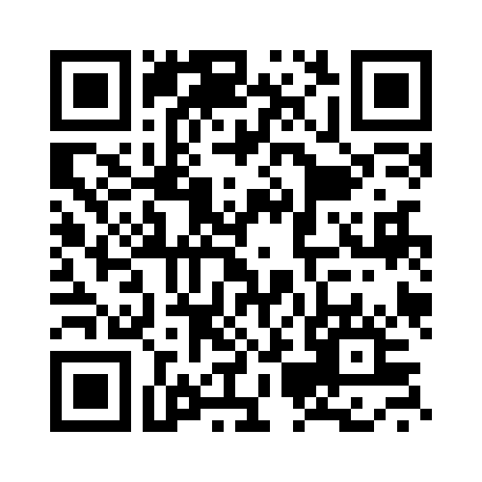
Your Feedback is Important
Fill out an evaluation of this session
and help shape future events.
Scan the QR code to evaluate
this session on your mobile device.
You’ll also be entered into
a daily prize drawing!

Slide 21

© 2014 Microsoft Corporation. All rights reserved. Microsoft, Windows, Windows Vista and other product names are or may be registered trademarks and/or trademarks in the U.S. and/or other countries.
The information herein is for informational purposes only and represents the current view of Microsoft Corporation as of the date of this presentation. Because Microsoft must respond to changing market conditions, it should not be interpreted to be a commitment on the part of Microsoft, and Microsoft cannot guarantee the accuracy of any information provided after the date of this presentation. MICROSOFT MAKES NO WARRANTIES, EXPRESS, IMPLIED OR STATUTORY, AS TO THE INFORMATION IN THIS PRESENTATION.

