Slide 2
The Internet of Things with Azure Service Bus
3-635
Todd Holmquist-Sutherland
Principal Group Program Manager
Azure Service Bus Team
Paolo Salvatori
Principal Program Manager
Azure Customer Account Team

Slide 3
Smart Products
Patients
Smart Health-care
Manufacturing Integration and Automation
Clinics
Remote Servicing
Mobile Care
Hospitals
Aircraft
Smart Factory
Cars
Fire
Nursing Homes
Smart Mobility
Pollution Control
Traffic
Buses
Emergency
Smart Cities
Renewables
Trains
Bikes
Predictive and Reactive Maintenance
Water
Smart Energy
Public
Safety
Oil/Gas/Coal Recovery and Distribution
Vessels
Trucks
Waste
Law Enforcement
Grid
Letters
Games
Hotels
Automation
Packages
Smart Logistics
Events
Smart Entertain-ment
Smart Building Home
Fuel Stations
Smart Retail
Lighting
Containers
Sports
Comfort
Points of Sale
Tanks
Bulkware
Streaming
Security
Safety
Television
Restaurants

Slide 4
Significance of the IoT Building the Business of Data-Driven Insight
Data –> Information –> Insight ($+)
Make more efficient use of resources (reduce cost, environmental impact)
Example: Power management in buildings and data centers
Provide more targeted products and services (increase revenue, social impact)
Example: Preventive maintenance, optimal usage analytics for expensive machines
“Things” = a rapidly expanding source of raw material for the Insight pipeline

Slide 5
Significance of the IoT Enabling Action at a Distance
Data isn’t the only raw material being unlocked by the IoT
The ability to act remotely – automatically and intelligently
Remote control is a source of efficiency
Enables new forms of customer interaction and engagement
IoT extends customer engagement opportunities to physical products
Taking engagement with customers beyond the point of sale
Preventive maintenance
Best practices guidance
Proactive sales
Remote servicing
From CRM to PRM – “Product Relationship Management”

Slide 6
Mobility Example: Door-to-Door Navigation
Enter details of an upcoming trip into your calendar application
Calendar is configured to share data with the D2D navigation service
Before your trip, you get departure time notifications on your phone
Service calculates when you should leave based on traffic and weather
It also considers when you need to allow time to refuel your car
Service sends notifications to your smart phone as departure time draws near
When you start your car, the map and directions are already on display
Service recommends a different path due to construction or congestion
Guides you to open parking spots near your destination
Automatically pays parking with pre-configured account
When you exit your car, the navigation experience transfers to your phone
Service delivers walking directions to complete your journey
Helps you find your car again when finished

Slide 7
Cloud Platform Enablers for Smart Mobility
100,000s of Drivers
100,000s of Vehicles
100,000s of Drivers
Identity Services (WAAD)
Custom Protocol Gateway
Mobile Platform Push Messaging
Mobile Solution Backend
Service Bus
Web Portal
Mobile Platform Push Messaging
Notification Hubs
Mobile Services Web Sites
Web Sites
SignalR Service Bus
Notification Hubs
Mobile Experience
Telemetry Router
Command Router
Portal Experience
Service Bus & Web API
Telemetry Adapters
Service Bus & Web API
Service Bus & Web API
Virtual Machines (IaaS) Cloud Services and Web Sites (PaaS)
Media Services
Navigation System
Vehicle Information System
Calendar Management System
Azure Database, Blob and Table Storage Real-Time Analytics, HDInsight
Service Bus + BizTalk Services/Server + Virtual Networks
3rd Party Data & Services (Maps, Weather, Traffic, Events)
Corporate and Divisional Line of Business and Information Systems

Slide 8
IoT Cloud Platform “Stack” – Abstract Model
A
B
C
D
E
F
Non-IP
Capable Devices
Field Gateway
Third-Party Data
and Services
Cloud Gateway
Cloud Platform Services
IP
Capable Devices
Custom Code
Enterprise
Systems

Slide 9
What Azure Provides – Hosting Options
A
B
C
D
E
F
Non-IP
Capable Devices
Field Gateway
Third-Party Data
and Services
Cloud Gateway
Cloud Platform Services
IP
Capable Devices
Custom Code
Enterprise
Systems
Web Sites
VM Roles
Mobile Services
Cloud Services
External Code

Slide 10
What Azure Provides – Platform Services
A
B
C
D
E
F
Non-IP
Capable Devices
Field Gateway
Third-Party Data
and Services
Cloud Gateway
Cloud Platform Services
IP
Capable Devices
Custom Code
Enterprise
Systems
Azure Databases
Table/Blob Storage
Service Bus
HD Insight
BizTalk Services
Media Services

Slide 11
What Azure Provides – IoT Cloud Gateway
A
B
C
D
E
F
Non-IP
Capable Devices
Field Gateway
Third-Party Data
and Services
Cloud Gateway
Cloud Platform Services
IP
Capable Devices
Custom Code
Enterprise
Systems
Pattern 1: Device Direct
Pattern 2: Custom Gateway
A/B
Service Bus
A/B
Custom
GW Role
Service Bus

Slide 12
Device Gateway Challenges
Connectivity
Addressability (non-IP devices, firewalls/NATs, online/offline, roaming)
Heterogeneity (OS/firmware, power/network constraints, protocols)
Security (identity, authorization, privacy, data integrity)
Efficient Scale (millions of devices per tenant, at a reasonable cost)
Messaging
Telemetry (collection, filtering, routing, throughput, per-message QoS)
Notifications (targeting devices/device groups within large populations)
Command/Query and Inquiries (correlation, sessions/batching)

Slide 13
The Default IoT Connectivity Model
IPv6 + VPN
Give every device a routable IP address
Devices expose services for control/query operations
Remote access is enabled within the VPN’s routing domain
Issues
Addressability
Requires network-layer intervention
Doesn’t work for devices that are loosely connected (roaming, frequently offline)
Security
By default, every protocol that can be routed over Ethernet can flow – and between any two nodes
VPN controls access to IP addresses and ports, not application endpoints (lack of granular authorization)
Efficient scale
Many devices are not VPN-capable due to resource/bandwidth constraints
VPN infrastructure is expensive and costly to maintain

Slide 14
Service-Assisted Communications
No inbound ports open, attack surface is minimized
DNS myapp.cloudapp.net
Connections are device-initiated and outbound
NAT/Firewall Device (Router)
Cloud Gateway
Command Source
Device does not listen for unsolicited traffic
Port mapping is automatic, outbound
Access-controlled command API
Secure, managed hosting platform
IP NAT

Slide 15
How it Works
Devices connect via open standard protocols
AMQP 1.0 and HTTP supported natively by the Service Bus
MQTT, CoAP and others can be implemented via custom gateway/adapter model
Sockets secured via TLS (or a lightweight variant)
Each device has a dedicated Inbox/Outbox on the Gateway
Device sends telemetry/alerts and routes service invocations via its Outbox
Device receives commands and queries from its Inbox
Correlated request/reply patterns can be implemented on top of these two messaging channels
The device knows, and has access to, only its own specific inbox/outbox endpoints (URI’s)
Cloud Gateway
Command API
Protocol Head
Backend Components
Outbox
Inbox
Device

Slide 16
Telemetry Routing with the Azure Service Bus
Topic
Filters
Subs
Alerts
Receiver 1
Alert Processor
Device 1
Device 2
Receiver 2a
Device 3
Data
Storage
Pre-processor
Receiver 2b
Service Bus
Split the stream
Enable parallel processing
Implement different QoS levels
Level and balance the load

Slide 17
Routing Commands with the Azure Service Bus
Subs
Filters
Topic
Model A
Device 1
Model A
Sender 1
Device 2
Model T
Model T
Sender 2
Device 3
Device 3
Service Bus
Target individuals or groups
Set delivery timeouts (TTL)
Deal with spotty connectivity
Traverse NATs/firewalls securely

Slide 18
Device Gateway – Reference Architecture
Devices
Custom Protocol Gateway
Telemetry Pump and Adapters
Command Gateway
Provisioning Service and Metadata Store
HTTP
AMQP
HTTP
MQTT
CoAP
…
4
Provisioning Service
Custom Protocol Gateway Host
Service Bus Messaging
1
Configuration
Device Metadata and Key Store
Telemetry/Request
Router
Notification/Command
Router
Adapters
Command API Host
2
3
HDInsight
BizTalk
Orleans
Azure Storage
Azure Dbs
Service Bus
HTTP

Slide 19
Device Gateway – Partition Topology
Master
Partition
Service Bus Standard Protocol
Custom Protocol
Custom Protocol Host
Deployment
Runtime
AMQP
HTTP
MQTT
Protocol Adapters
Ingestion Topics
Command Topics
Provisioning
Runtime
in0000
in0001
in0002
…
inFFFF
s0001
s0002
s03E7
s0001
s0002
s03E7
s0001
s0002
s03E7
s0001
s0002
s03E7
Device Repo
all
diag
all
diag
all
diag
all
diag
out0000
out0001
out0002
…
outFFFF
Partition Repo
N Instances
Telemetry Pump/Router
out0
out1
out2
out0
out1
out2
out0
out1
out2
out0
out1
out2
Command
API Host
g0000/ rte0000
g0000/ rte0001
g0001/ rte0000
g0001/ rte0001
Telemetry Adapter
Telemetry Adapter
Telemetry Adapter
n Groups of m Routers
The “Partition” is a set of resources dedicated to a specific device population (or subset thereof).
The “Master” role manages partition deployment and device provisioning into the partitions.

Slide 20
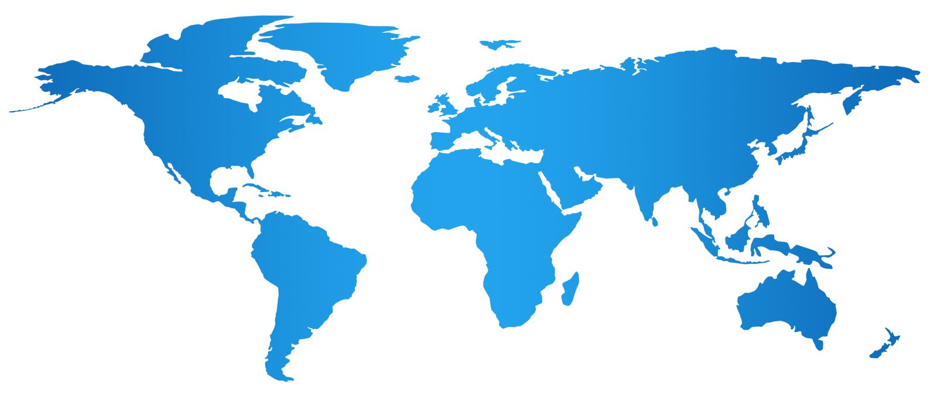
Device Gateway – Customer Topology
Global coverage achieved by spreading partitions across multiple Azure regions
Reference architecture supports up to 1000 distinct partitions
Number and distribution of partitions driven by data volumes, business continuity, legal and proximity considerations

Slide 21
Device Gateway Demo

Slide 22
Tribble
Real time analytics and IoT solution that consumes and processes events coming from sensors and devices and generates alerts.
Tribble is comprised of the following modules:
Gateway: translates between the device protocol and the back end systems. This service receives signals from devices and sends data to the core systems through a messaging system.
Ingress Messaging Layer: handles messaging between the gateway and backend system. This module can use adapters to support multiple messaging systems such as the Service Bus.
Processing Layer: leverages Project Orleans and Trill to process messages from devices through a set of queries and generate alerts.

Slide 23
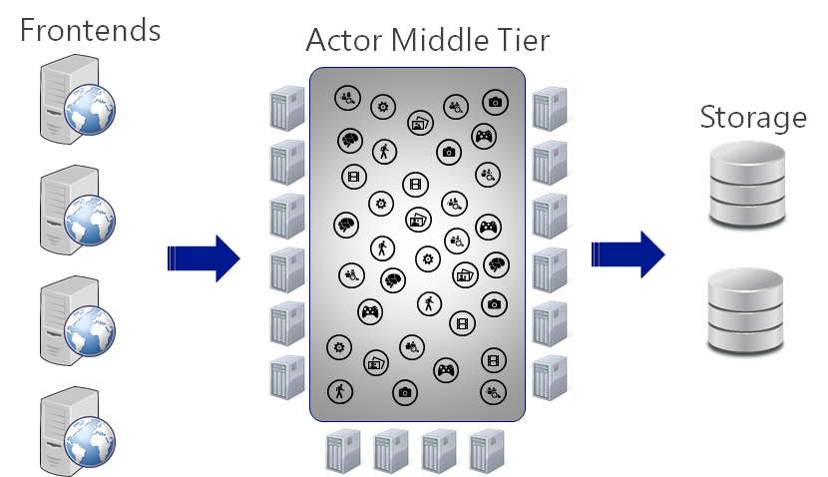
Orleans
A framework for building large scale, distributed applications, both on-premises and in the cloud.
Distributed Actor Runtime
Location Transparency
Actors (Grains) are .NET Classes
Messaging through .NET Interfaces
Asynch through async/await in C#
Single-Threaded Execution
Automatic Error Propagation
Proven in Production Since 2011

Slide 24
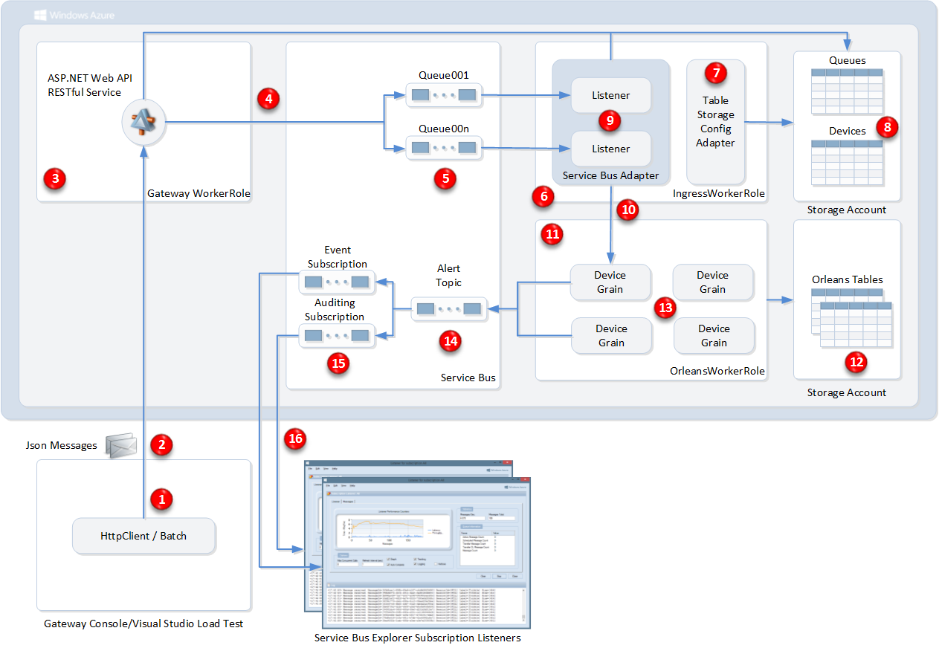
Architecture
HTTP protocol and web client were chosen to simulate the devices.
We chose to simulate two different types of devices:
On-Off devices
Value-Threshold devices
The gateway: ASP.NET Web API RESTful service hosted by OWIN\Katana in a worker role.
The gateway communicates with the Ingress Messaging Layer using Service Bus.
The Ingress Messaging Layer is responsible for receiving data from the SB and invoking processing logic for each message/event.
The processing logic is implemented using Project Orleans actor hosting temporal queries.
Devices are modeled as Project Orleans grains; each device has a corresponding grain which runs queries, looking for specific “alerts”.
When alerts are found, an alert message is sent to a Service Bus Topic that has an auditing subscription plus a subscription for each alert type.
The Service Bus Explorer is used to simulate a real command and control console and receive alerts

Slide 25
Tribble Demo

Slide 26
Looking Ahead
Roadmap
First and third-party IoT services are being built today on Service Bus
IoT related enhancements to Service Bus are coming soon
We will simplify and enrich support for Device Gateway patterns
Learn more
Attend Abhishek Lal’s session Fri @ 2:00 – “Messaging at Scale with the Service Bus”
Check out Clemens Vaster’s video blog: channel9.msdn.com/Blogs/Subscribe
Watch the video of Steve Teixeira’s earlier session – “Windows and the Internet of Things”
We are looking for customers and partners!
Connecting devices at scale to backing services on Azure
Willing to work closely with the product team and share learnings/results
Contact: Todd Holmquist-Sutherland – toddhs@microsoft.com

Slide 27
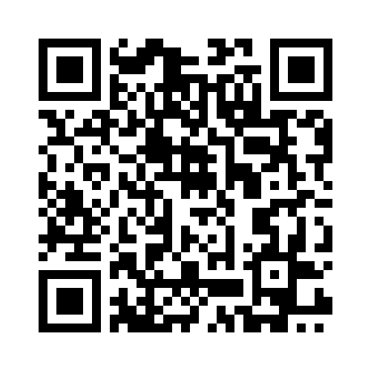
Your Feedback is Important
Fill out an evaluation of this session and help shape future events.
Scan the QR code to evaluate this session on your mobile device.
You’ll also be entered into a daily prize drawing!

Slide 28
© 2014 Microsoft Corporation. All rights reserved. Microsoft, Windows, Windows Vista and other product names are or may be registered trademarks and/or trademarks in the U.S. and/or other countries.
The information herein is for informational purposes only and represents the current view of Microsoft Corporation as of the date of this presentation. Because Microsoft must respond to changing market conditions, it should not be interpreted to be a commitment on the part of Microsoft, and Microsoft cannot guarantee the accuracy of any information provided after the date of this presentation. MICROSOFT MAKES NO WARRANTIES, EXPRESS, IMPLIED OR STATUTORY, AS TO THE INFORMATION IN THIS PRESENTATION.

