Slide 2
Understanding Neural Networks using .NET
3-643
Friday, April 4, 2014
10:30 AM – 11:30 AM
Room 3024
James McCaffrey
Microsoft Research

Slide 3
Agenda
What is a neural network?
Feed-forward and activation
Training and free parameters
Error and accuracy
Over-fitting
Dropout
The raw C# approach
The canned application approach
The commercial API approach
A vision for the (very near) future
Neural networks behind the scenes (speech recognition)
References and resources

Slide 4
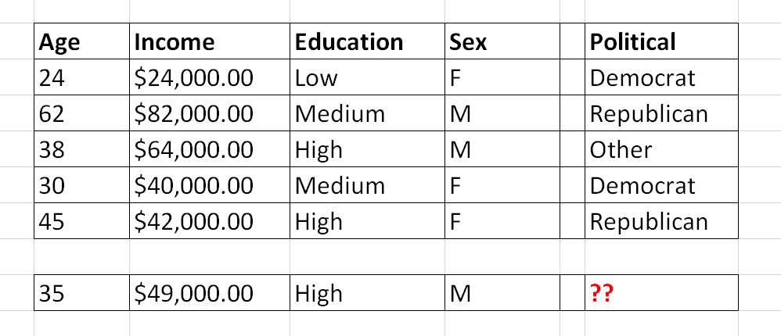
What is a Neural Network?
training data
independent variables / predictors / attributes / features / X-values
“the thing to classify (predict)” / dependent variable / Y

Slide 5
Age
35
3.5
input
hidden
output
Income
49,000
4.9
0.23
Political
0.0
0.62
Republican
Education
High
1.0
0.15
Sex
M
-1.0

Slide 6
Feed-Forward and Activation
1.0
1). (0.1)(4.0) + (0.2)(-5.0) + (0.3)(6.0) = 1.2
2). 1.2 + 2.0 = 3.2
3). Activation(3.2) = 0.73
4). Local output = 0.73
0.10
W₀ = 4.0
b = 2.0
W₃ = 2.0
0.73
0.20
W₁ = -5.0
0.73
Technical Note: most NN literature treats the bias as a special weight that has a dummy input which is always a 1.0 value
0.30
W₂ = 6.0

Slide 7
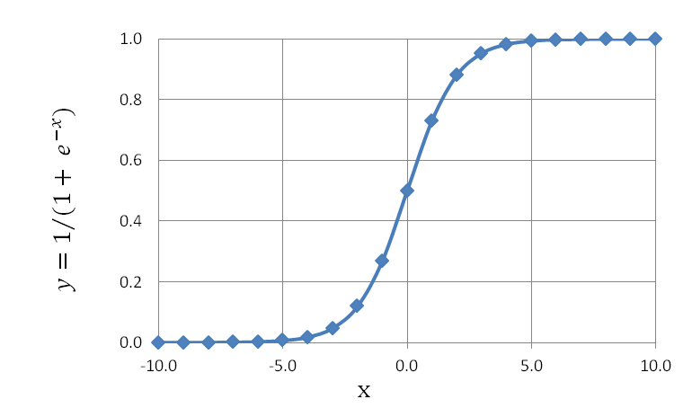
Four Most Common Activation Functions
Logistic Sigmoid
Output between [0, 1]
y = 1.0 / (1.0 + e^{–x})
Hyperbolic Tangent
Output between [-1, +1]
y = tanh(x) = (e^{x} – e^{-x}) / (e^{x} + e^{-x})
Heaviside Step
Output either 0 or 1
if (x < 0) then y = 0 else if (x >= 0) then y = 1
Softmax
Outputs between [0, 1] and sum to 1.0
y = (e^{-xi}) / Σ (e^{-xj})

Slide 8
Training and Free Parameters
Number of weights and bias values to determine =
(n_{i} * n_{h}) + (n_{h} * n_{o}) + (n_{h} + n_{o})
Ex: n_{i} = 10, n_{h} = 20, n_{o} = 3
(10 * 20) + (20 * 3) + (20 + 3)
= 283
Back-propagation
Fastest (relatively) technique
By far most common
Requires “learning rate” and “momentum”
Genetic Algorithm
Slowest technique
Sometimes highly effective
Requires “population size”, “mutation rate”, “max generations”, “selection probability”
Particle Swarm Optimization
Good compromise
Requires “number particles”, “max iterations”, “cognitive weight”, “social weight”

Slide 9
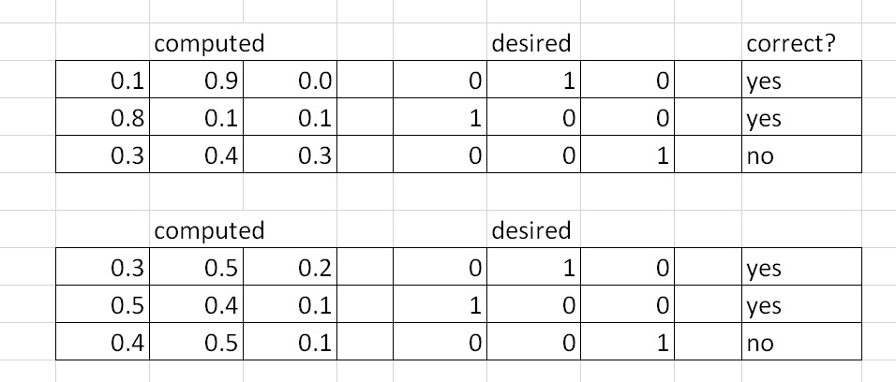
Error and Accuracy
Mean squared error:
A: (0.1 - 0)² + (0.9 - 1)² + (0.0 - 0)² +
(0.8 - 1)² + (0.1 - 0)² + (0.1 - 0)² +
(0.3 - 0)² + (0.4 - 0)² + (0.3 - 1)² / 3 = 0.273
B: (0.3 - 0)² + (0.5 - 1)² + (0.2 - 0)² +
(0.5 - 1)² + (0.4 - 0)² + (0.1 - 0)² +
(0.4 - 0)² + (0.5 - 0)² + (0.1 - 1)² / 3 = 0.733
Mean cross entropy error:
A: -( ln(0.1) * 0 + ln(0.9) * 1 + ln(0.0) * 0 ) + . . . / 3 = 0.511
B: -( ln(0.3) * 0 + ln(0.5) * 1 + ln(0.2) * 0 ) + . . . / 3 = 1.230

Slide 10
Avoiding Model Over-Fitting
What is it?
Symptom: Model is great on predicting existing data, but fails miserably on new data
Roulette example: red, red, black, red, red, black, red, red, black, red, red, ??
A serious problem for all classification/prediction techniques, not just neural networks
Five Most Common Techniques
1. K-fold cross validation
2. Use lots of training data
3. Train-Validate-Test (early stop when error on validate set begins to increase)
4. Repeated sub-sampling validation
5. Jittering – deliberately adding noise data to make over-fitting more difficult
Quite a few exotic techniques also available (weight decay, Bayesian learning, etc.)

Slide 11
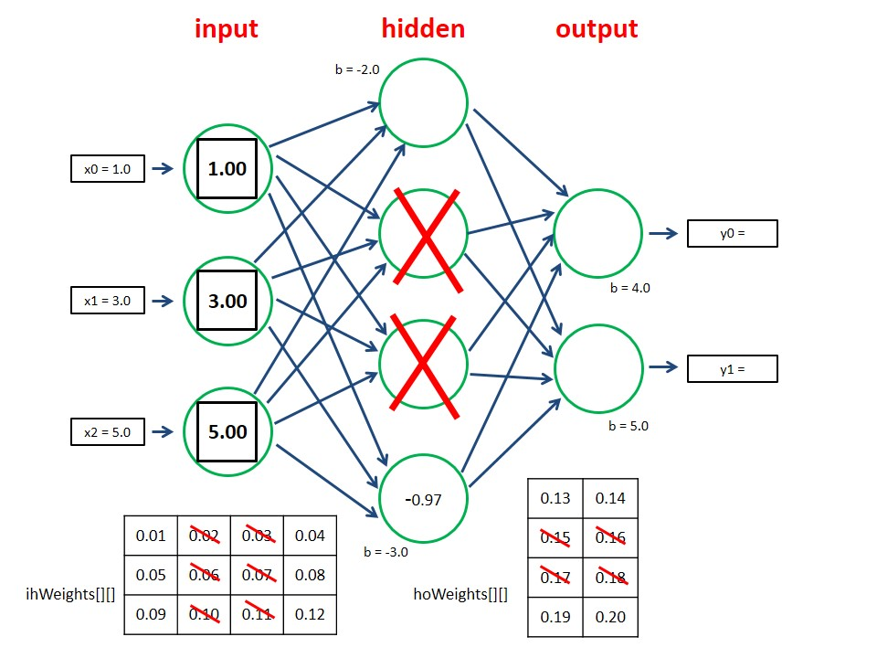
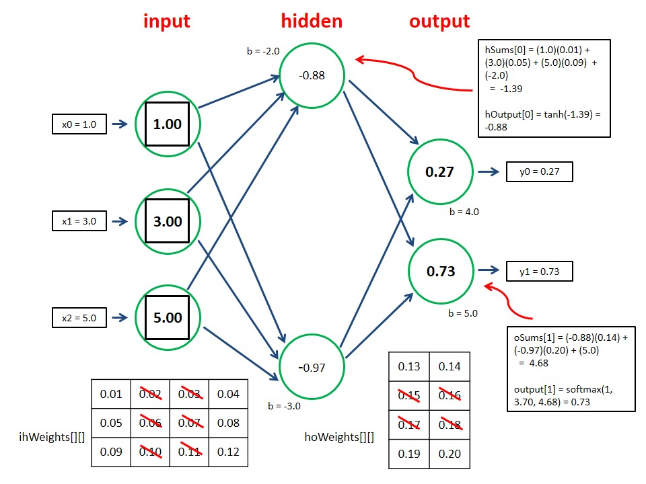
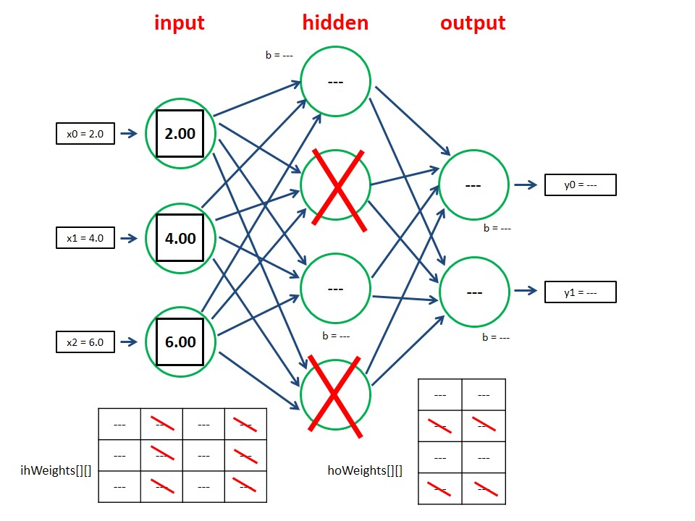
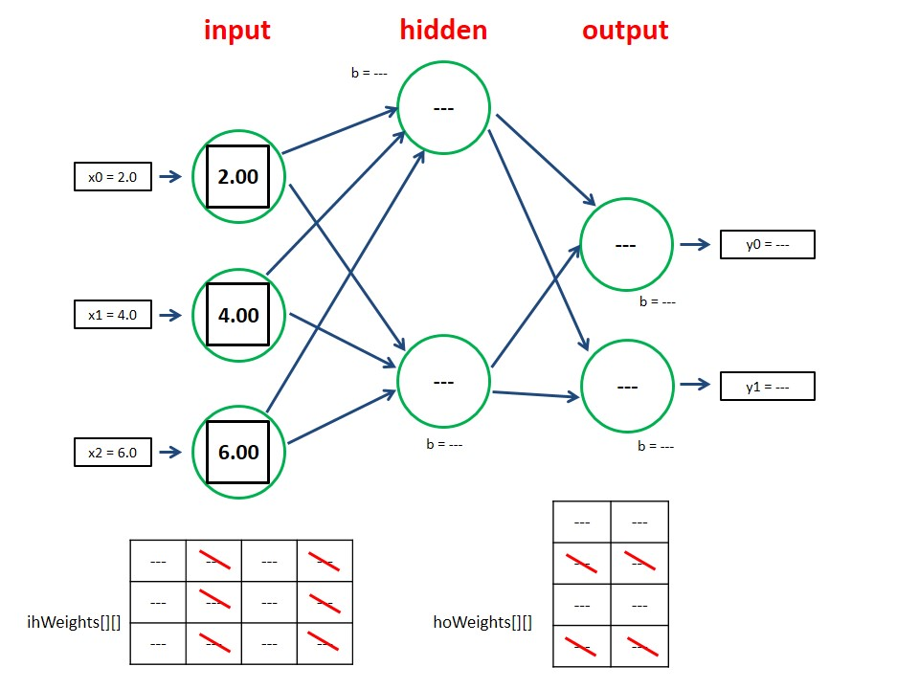
Dropout

Slide 12
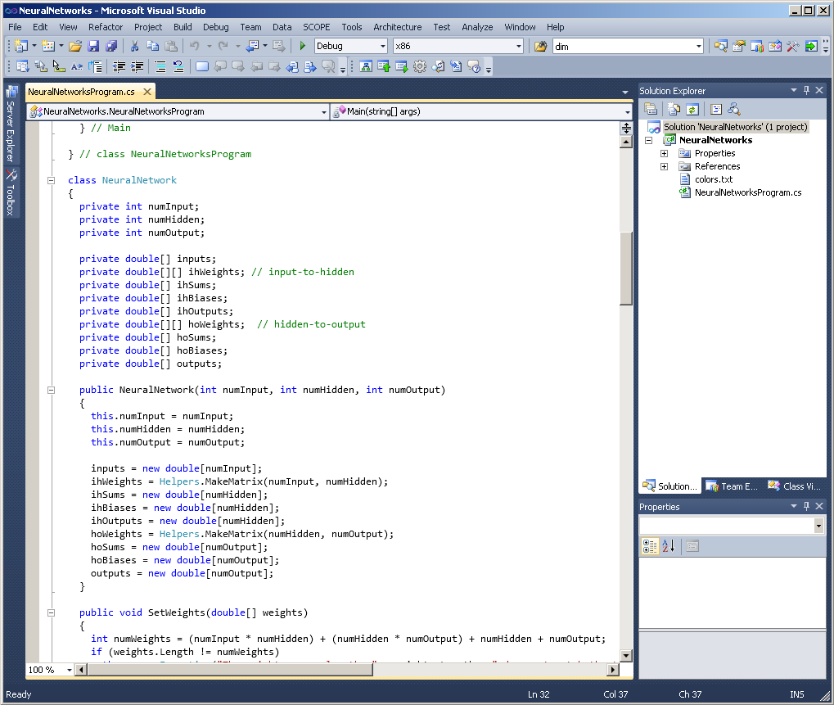
Approach 1 – Raw C#

Slide 13
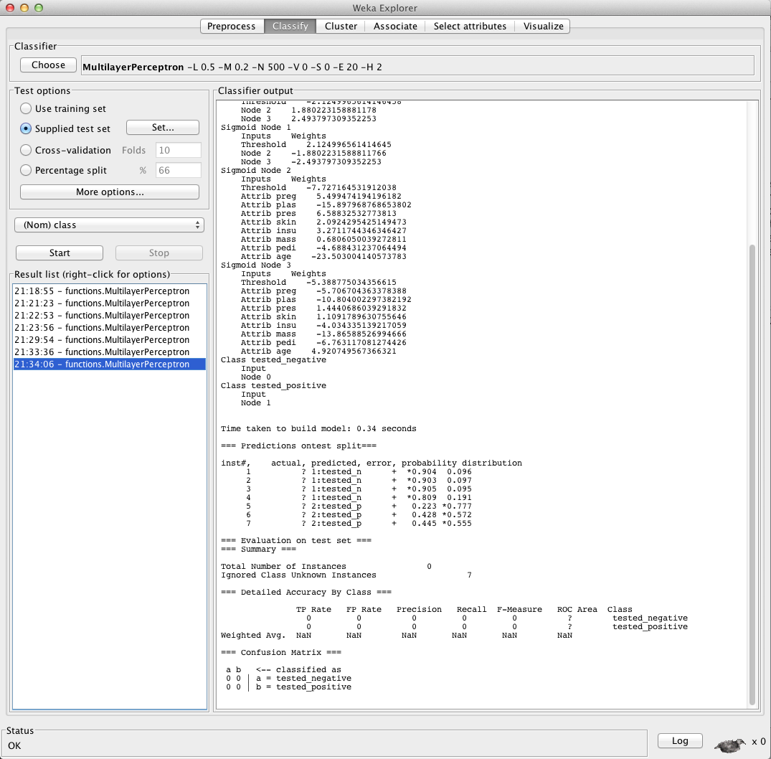
Approach 2 – Canned Application

Slide 14
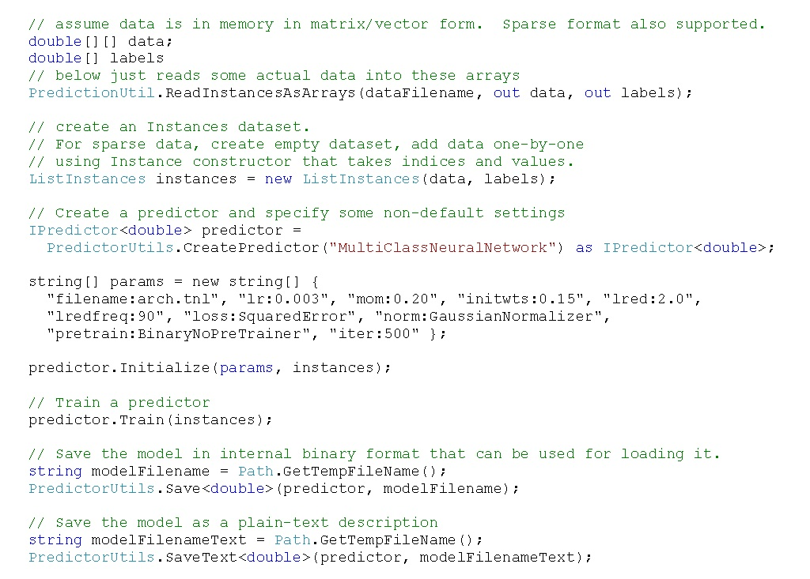
Approach 3 – Commercial (or Open Source) API Set

Slide 15
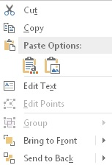
A Vision for the Future
Toolbox
Iris Data
Data Readers
Hidden nodes: 7
Data Converters
Iris Table
Data Tables
Loss function: MSE
Data Normalizers
Train: Back-propagation
Data Encoders
Train
Test
Exit error: 0.050
Binary Classifiers
Neural Networks
Learn rate: 0.010
Model Evaluators
NN Classifier
Momentum: 0.025
Evaluate

Slide 16
Neural Networks behind the Scenes
using System;
using Microsoft.Speech.Synthesis; // x86 version
using Microsoft.Speech.Recognition;
using System.Globalization;
namespace Build2014SpeechDemo
{
class Program
{
static SpeechSynthesizer ss = new SpeechSynthesizer();
static SpeechRecognitionEngine sre;
static bool done = false;
static void Main(string[] args)
{
try {
ss.SetOutputToDefaultAudioDevice();
ss.Speak("Hello");

Slide 17
Resources
Concepts:
ftp://ftp.sas.com/pub/neural/FAQ.html#questions
Weka:
http://www.cs.waikato.ac.nz/ml/weka/
Custom C#:
http://www.quaetrix.com/Build2014.html (case sensitive)
Speech:
http://www.quaetrix.com/SpeechDemo.html (case sensitive)

Slide 18
Thank You!
Session 3-643
Understanding Neural Networks using .NET
2014 Build Conference
April 2-4, 2014
San Francisco, CA
James McCaffrey
Microsoft Research
jammc@microsoft.com

Slide 19
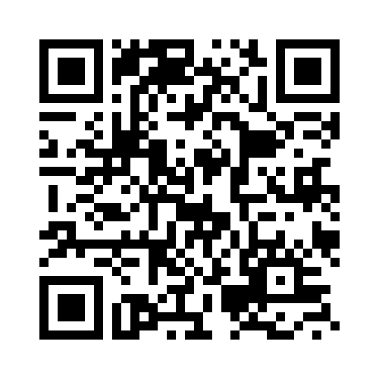
Your Feedback is Important
Fill out an evaluation of this session and help shape future events.
Scan the QR code to evaluate this session on your mobile device.
You’ll also be entered into a daily prize drawing!

Slide 20
© 2014 Microsoft Corporation. All rights reserved. Microsoft, Windows, Windows Vista and other product names are or may be registered trademarks and/or trademarks in the U.S. and/or other countries.
The information herein is for informational purposes only and represents the current view of Microsoft Corporation as of the date of this presentation. Because Microsoft must respond to changing market conditions, it should not be interpreted to be a commitment on the part of Microsoft, and Microsoft cannot guarantee the accuracy of any information provided after the date of this presentation. MICROSOFT MAKES NO WARRANTIES, EXPRESS, IMPLIED OR STATUTORY, AS TO THE INFORMATION IN THIS PRESENTATION.

