Slide 2
Go Mobile with C# and Xamarin
Miguel de Icaza
Chief Technical Officer, Xamarin

Slide 3
You are all Mobile Developers

Slide 4
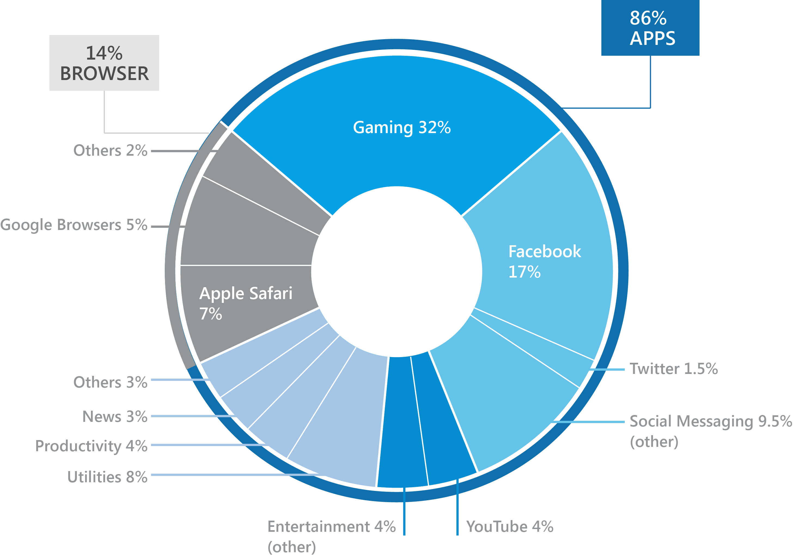
What’s
Driving
Mobile?

Slide 5
People Expect Great Experiences

Slide 6
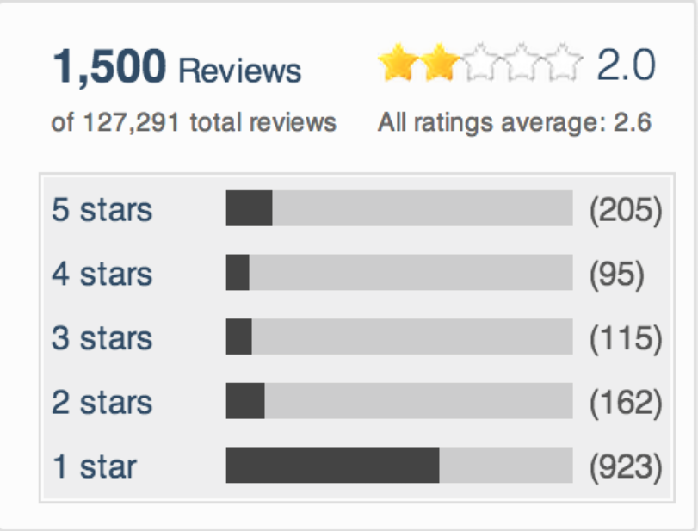
Facebook HTML

Slide 7
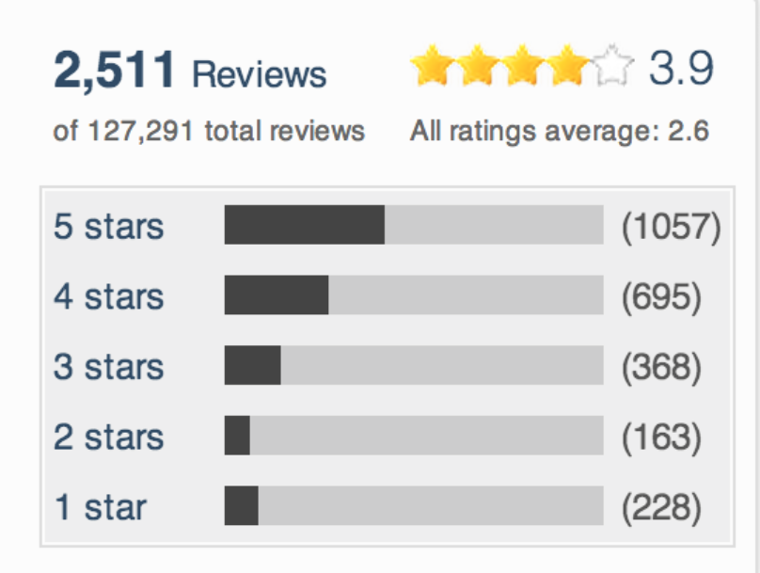
Facebook Native

Slide 8
Video

Slide 9
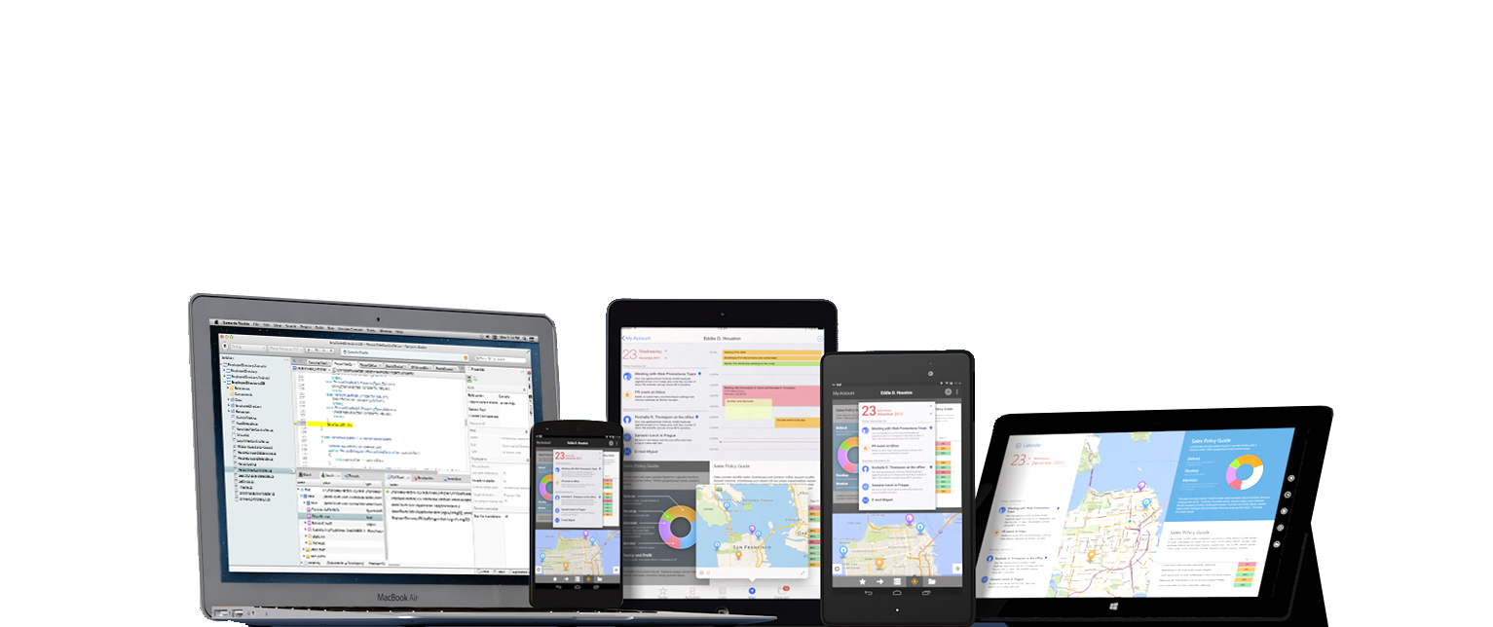
C# runs on 2.6 billion devices

Slide 10
Architecting Mobile Apps

Slide 11
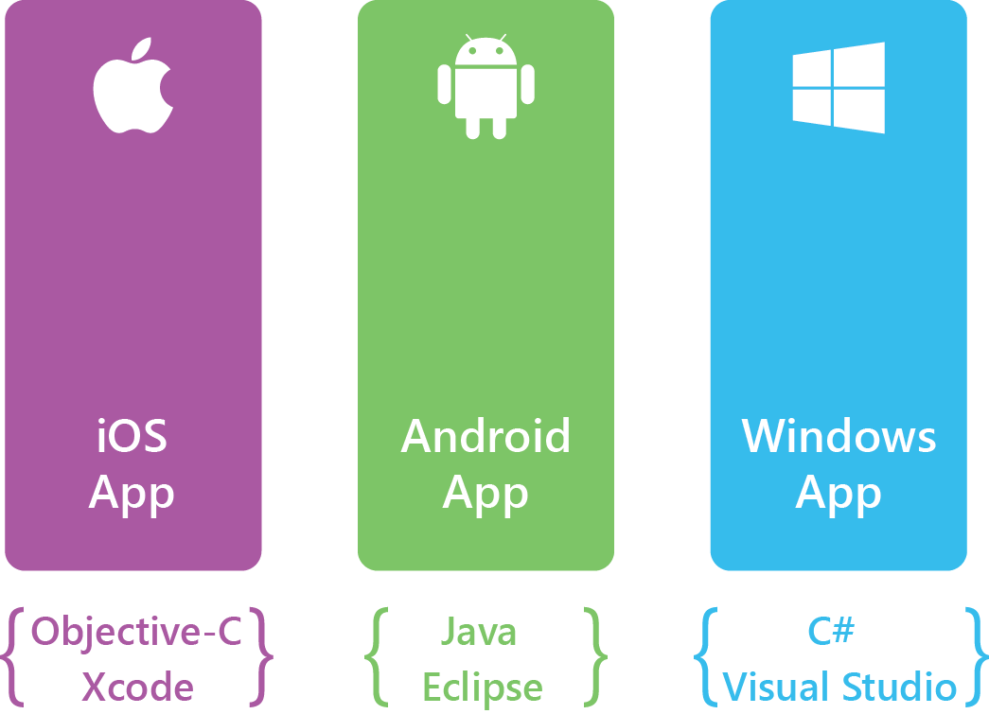
Silo Approach: Build Apps Multiple Times

Slide 12
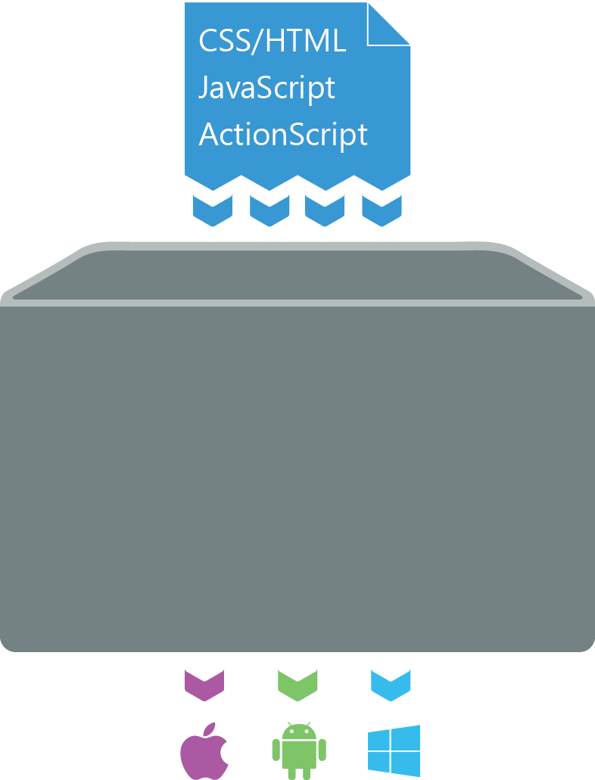
Write Once, Run Anywhere Approach Lowest Common Denominator
App Generation

Slide 13
Write Once, Run Anywhere Approach Lowest Common Denominator
App Generation

Slide 14
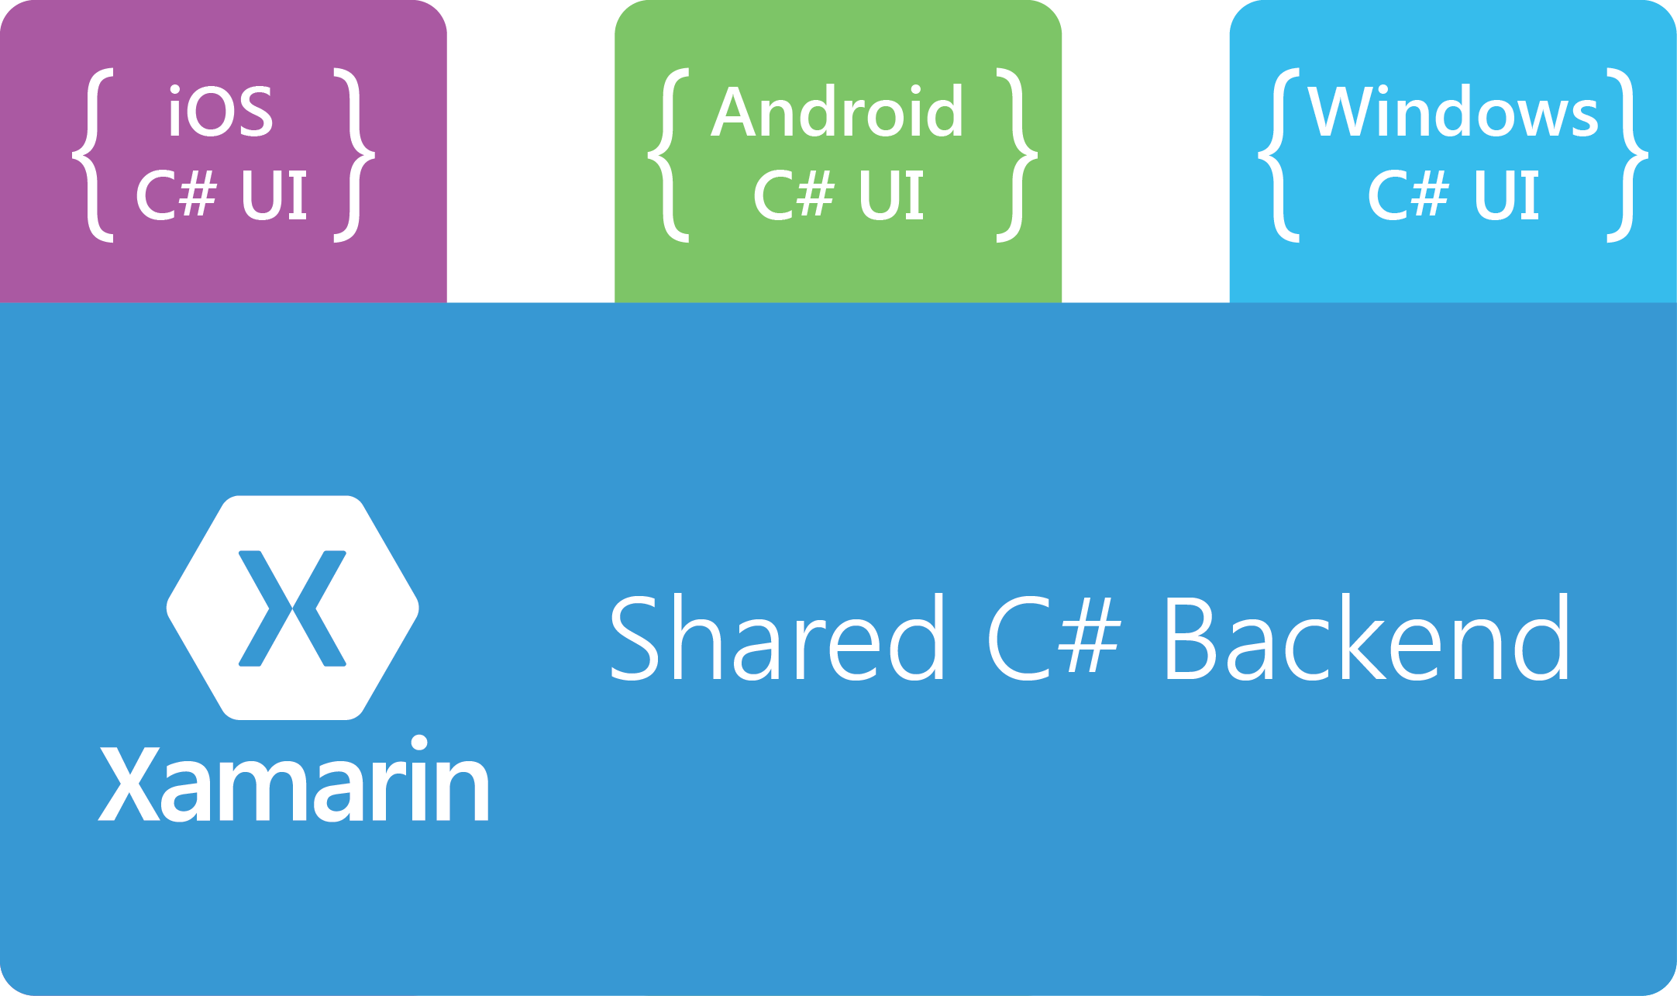
Xamarin Approach Native with Code Sharing

Slide 15
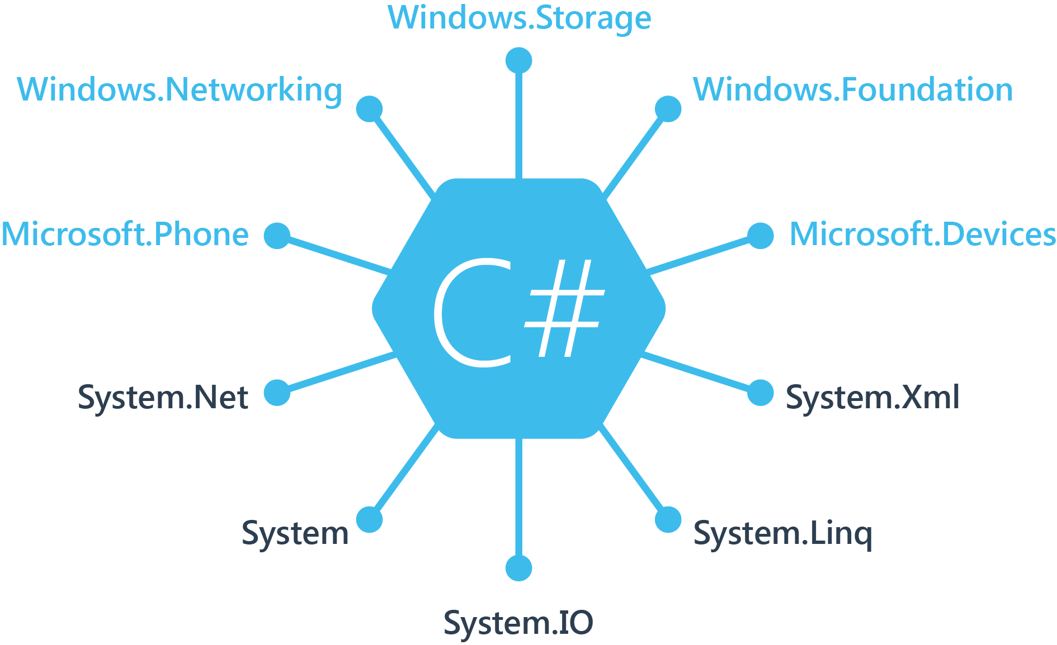
Windows APIs

Slide 16
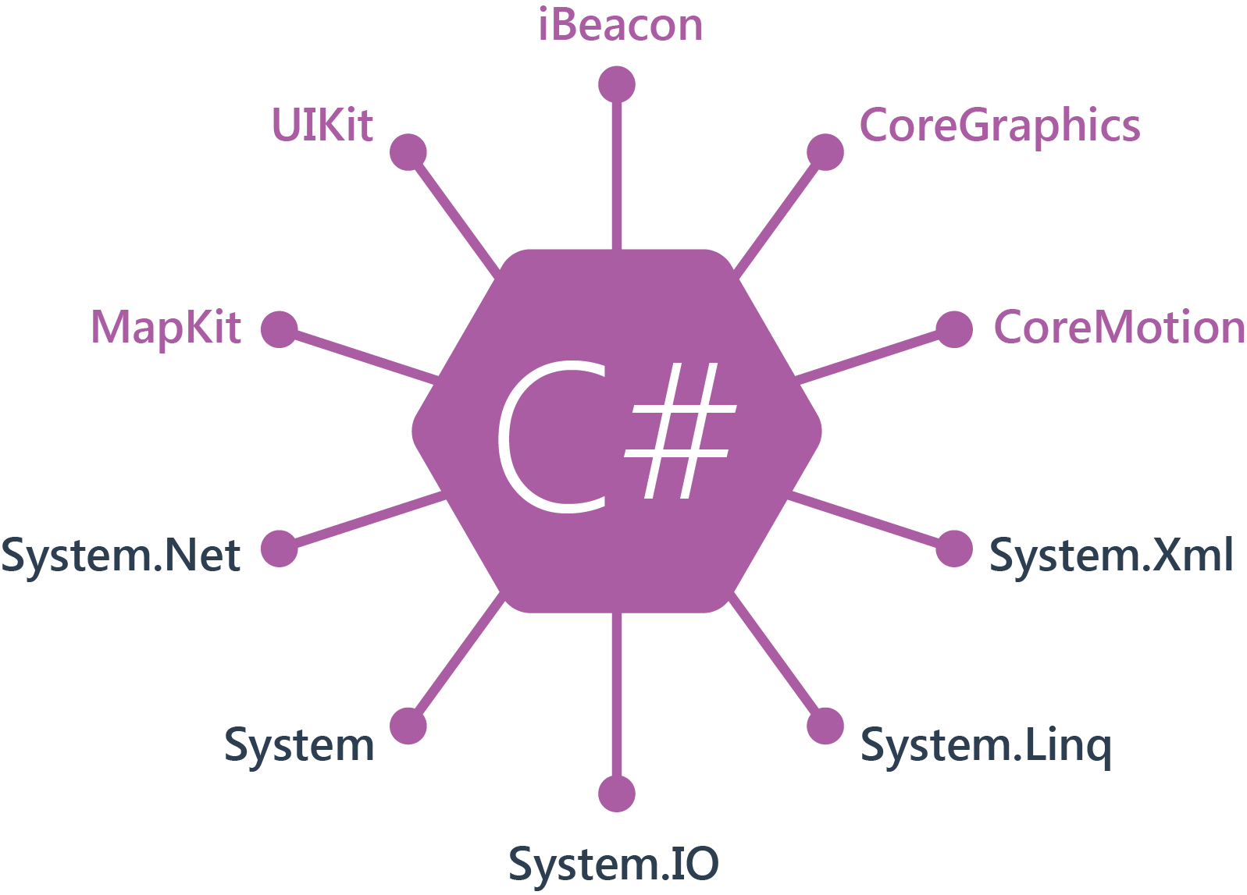
iOS APIs 100% coverage

Slide 17
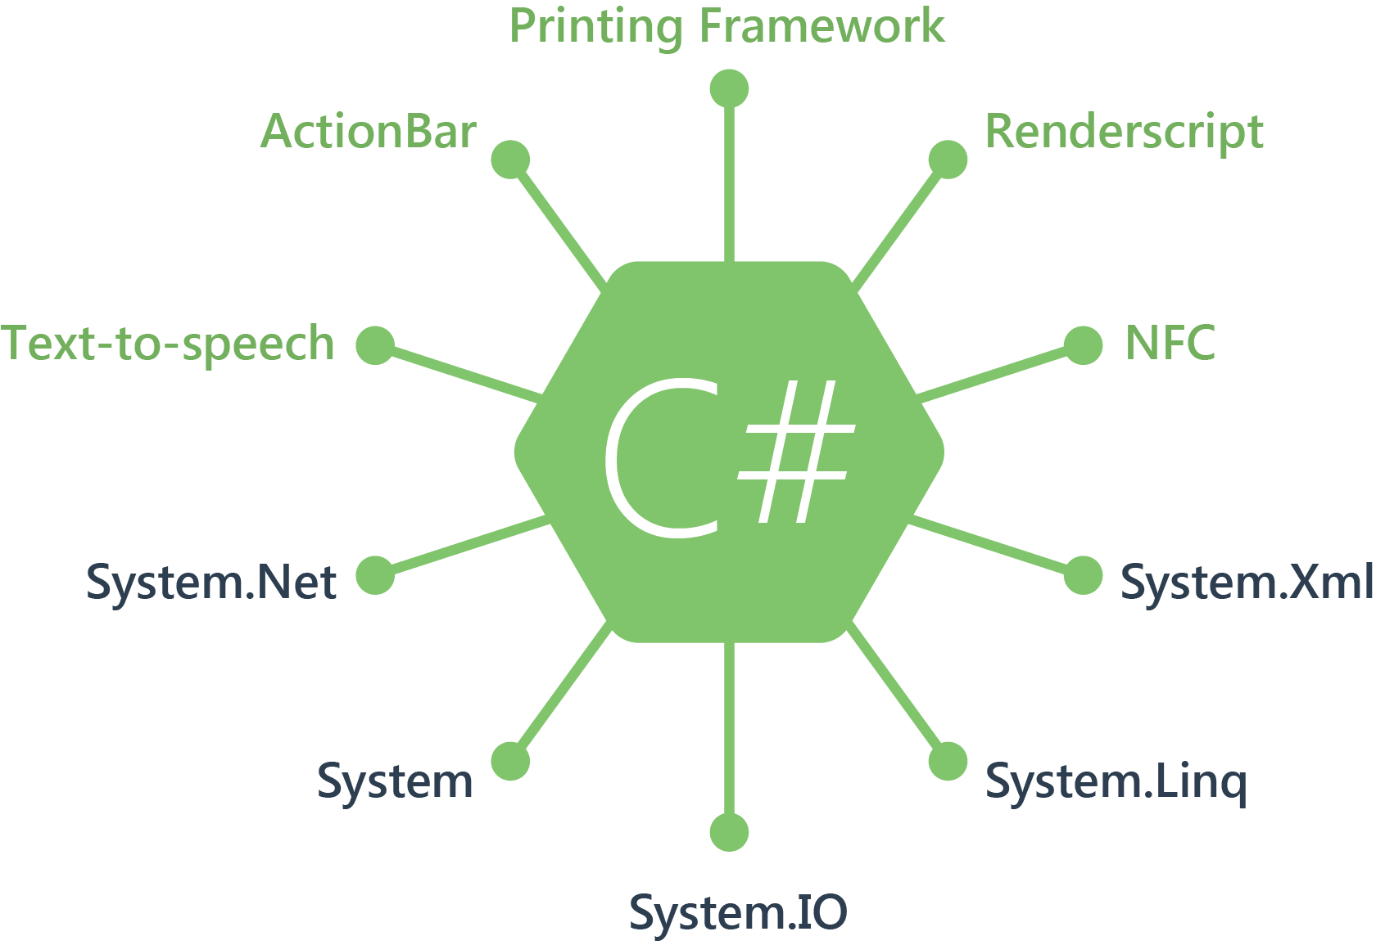
Android APIs 100% coverage

Slide 18
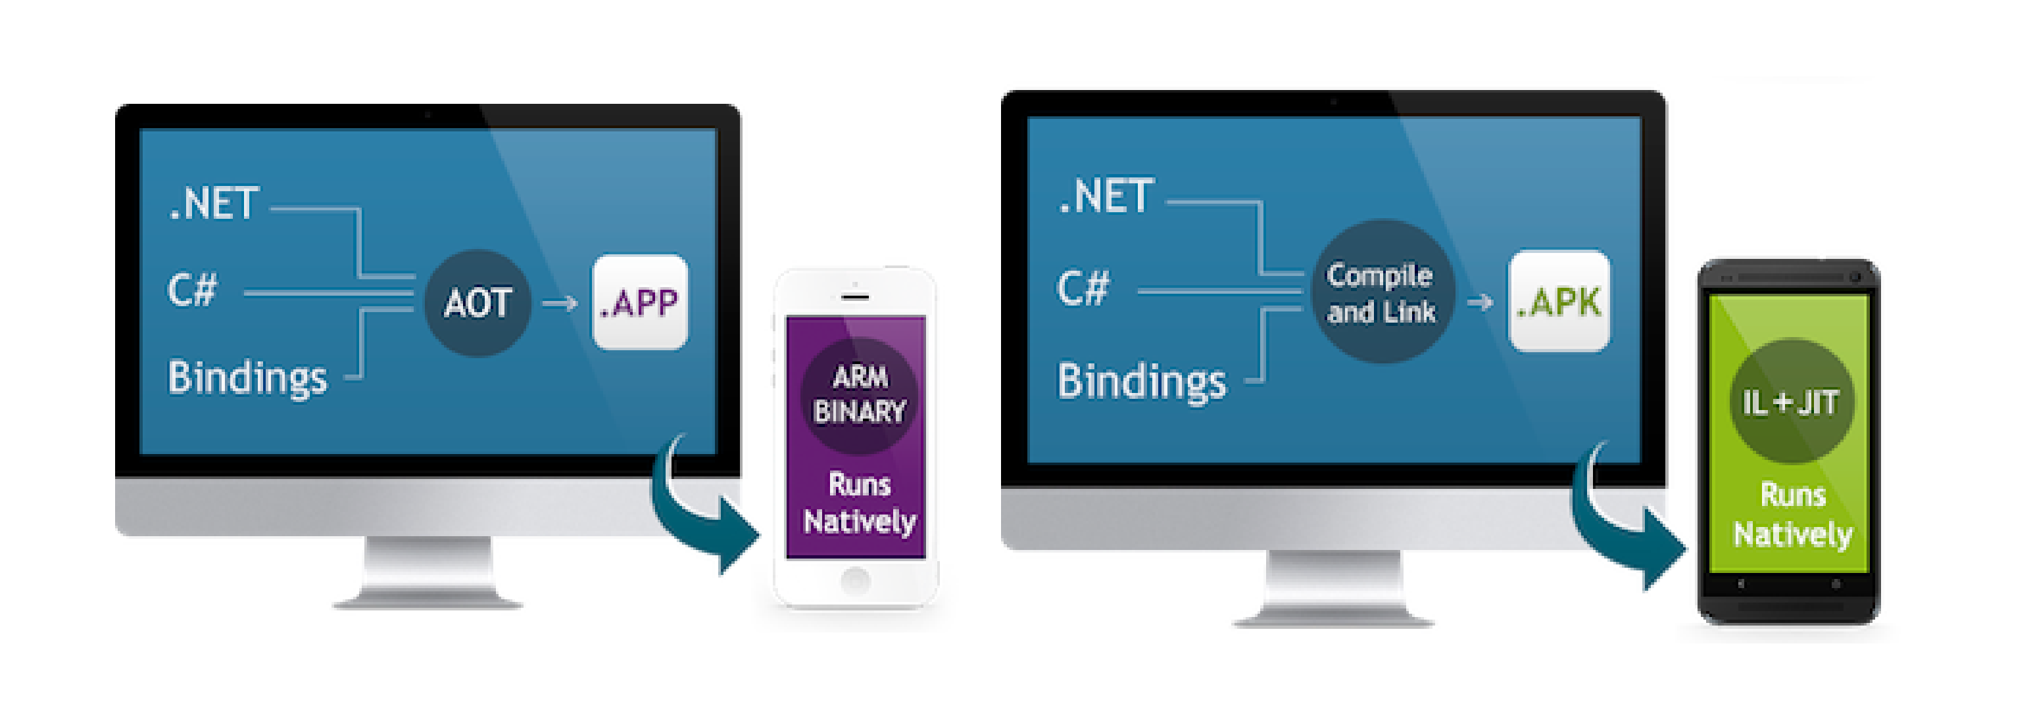
How Xamarin Works
C# + .NET Runtime
Native UI
Native Performance

Slide 19
C# Native Apps No Compromises

Slide 20
Let’s Build a Native iOS App with C#

Slide 21
Sharing Code
Across Platforms

Slide 22
Xamarin Approach Native with Code Sharing

Slide 23
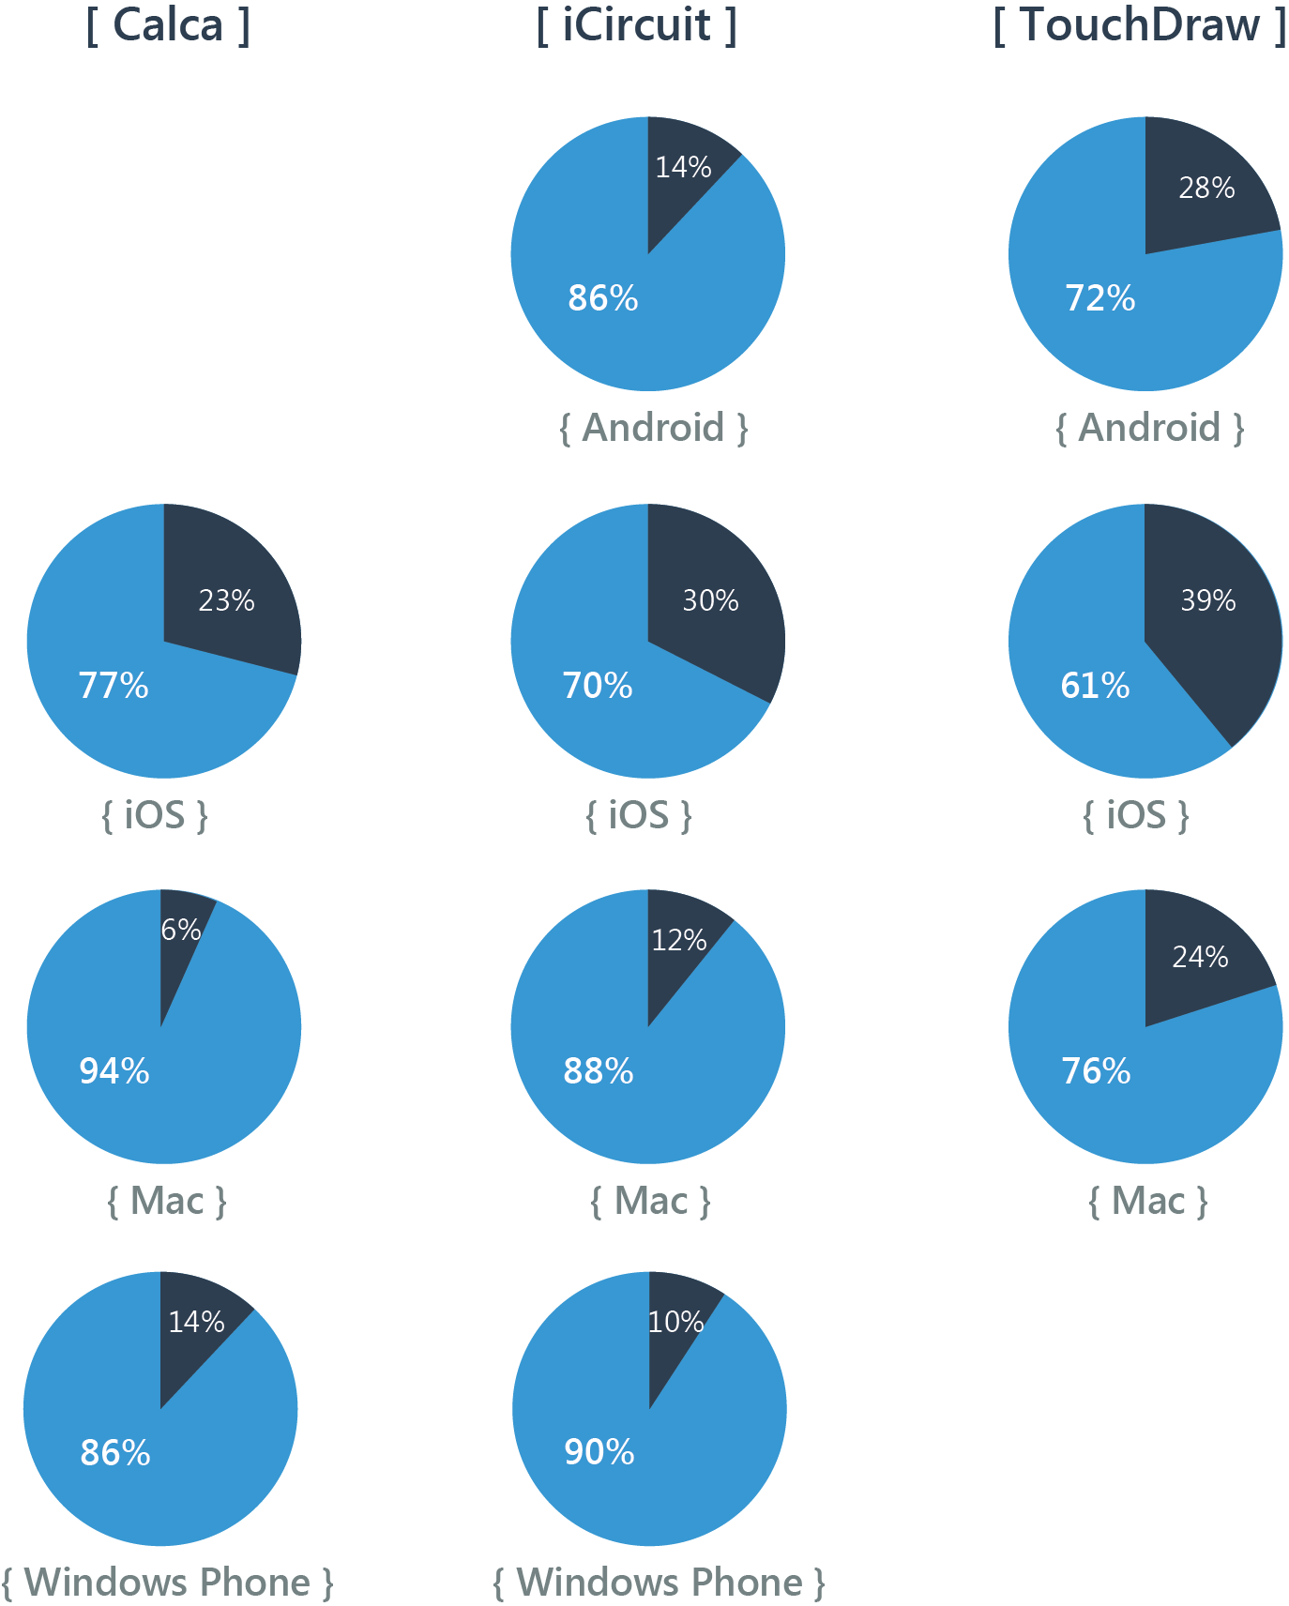
Code Sharing Stats
Android
iOS
Mac
WinPhone

Slide 24
Universal Apps
Universal Apps
Easily share code between platforms
Available in VS 2013
Just add Android and iOS
Coming soon to Xamarin Studio
For Mac users

Slide 25
Portable Class Libraries
Pure PCL
Limits expressiveness, but easy to build
Requires interfaces/plugs to work properly
Advanced PCL:
Combined PCL with NuGet
Public API remains “pure”
Implementation is as native and direct as you desire
PCL + NuGet

Slide 26
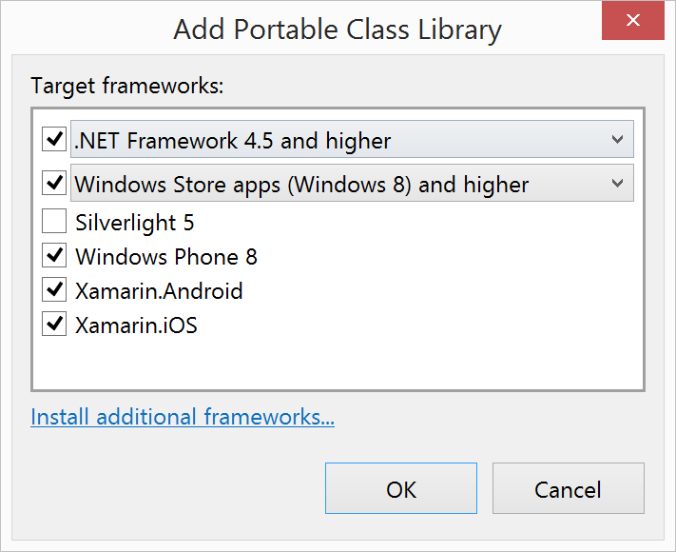
Portable Class Libraries
File/New/Portable Class Library

Slide 27
Portable Class Libraries
Xamarin is Moving Entirely to PCL
Profile 78 is our favorite one
Mono.Data.Sqlite
CouchBase
System.Drawing
MailKit/MimeKit
More, stay tuned!

Slide 28
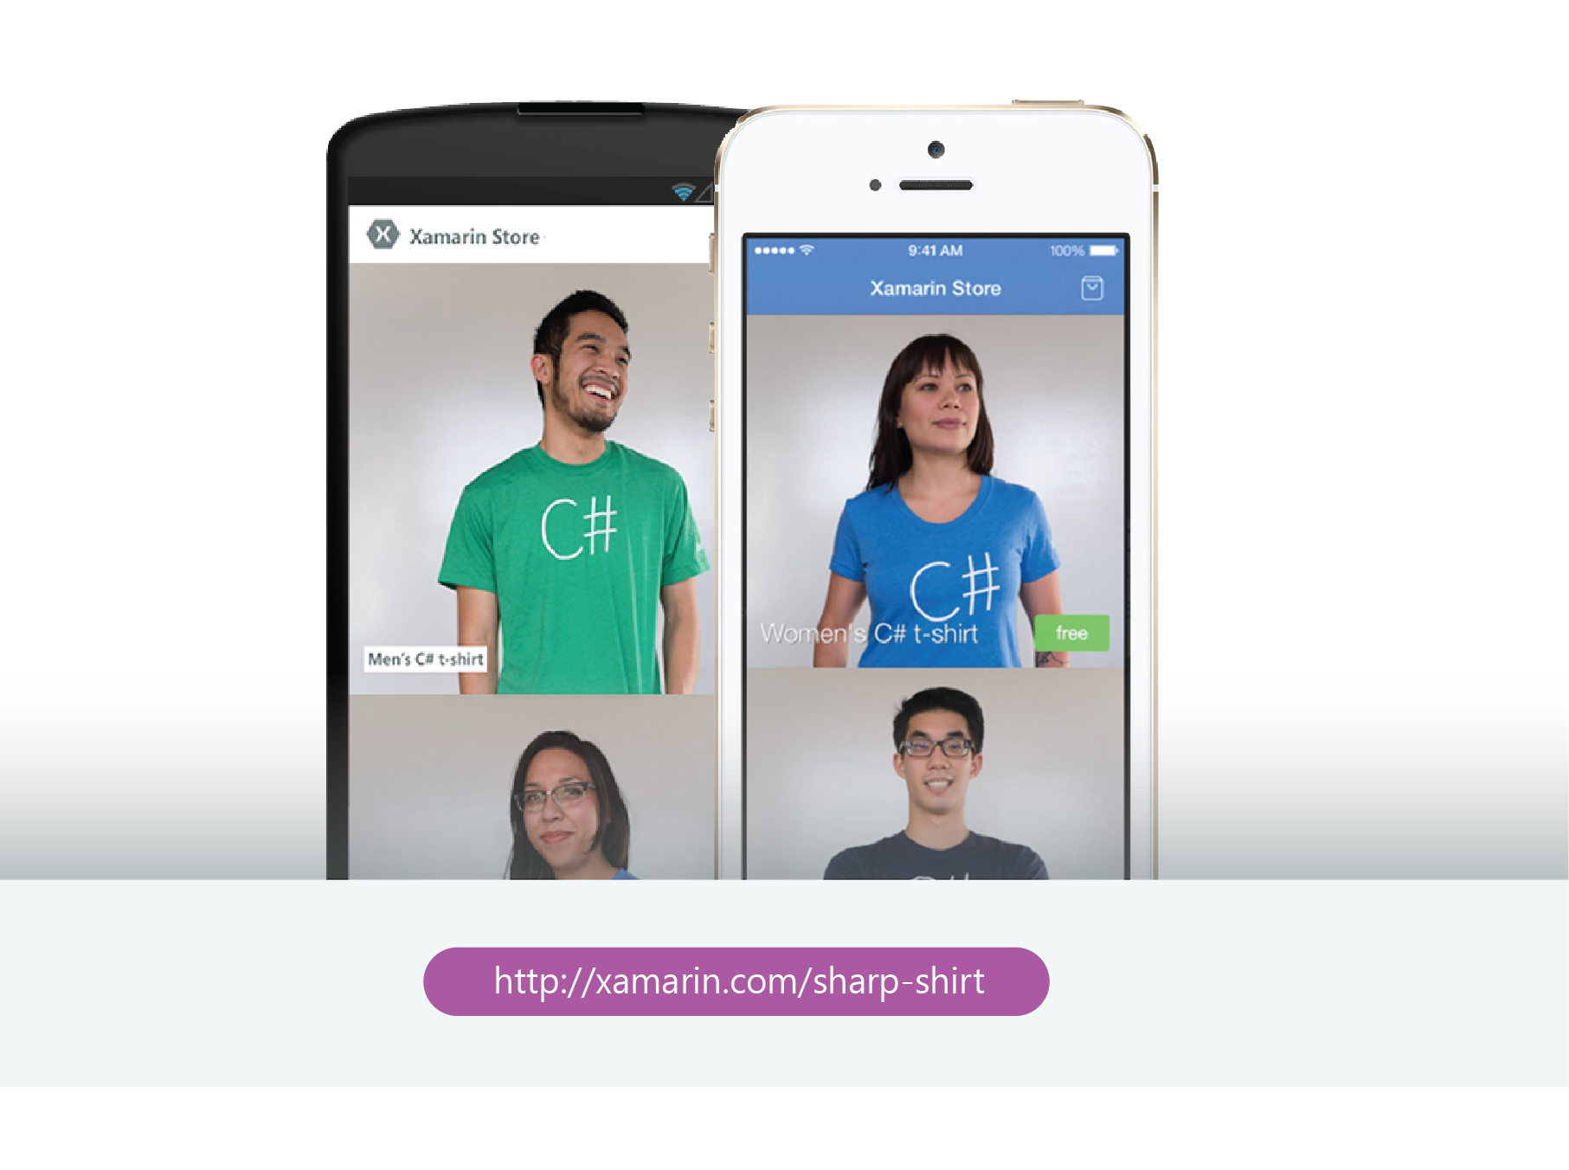
Demo: Xamarin Store

Slide 29
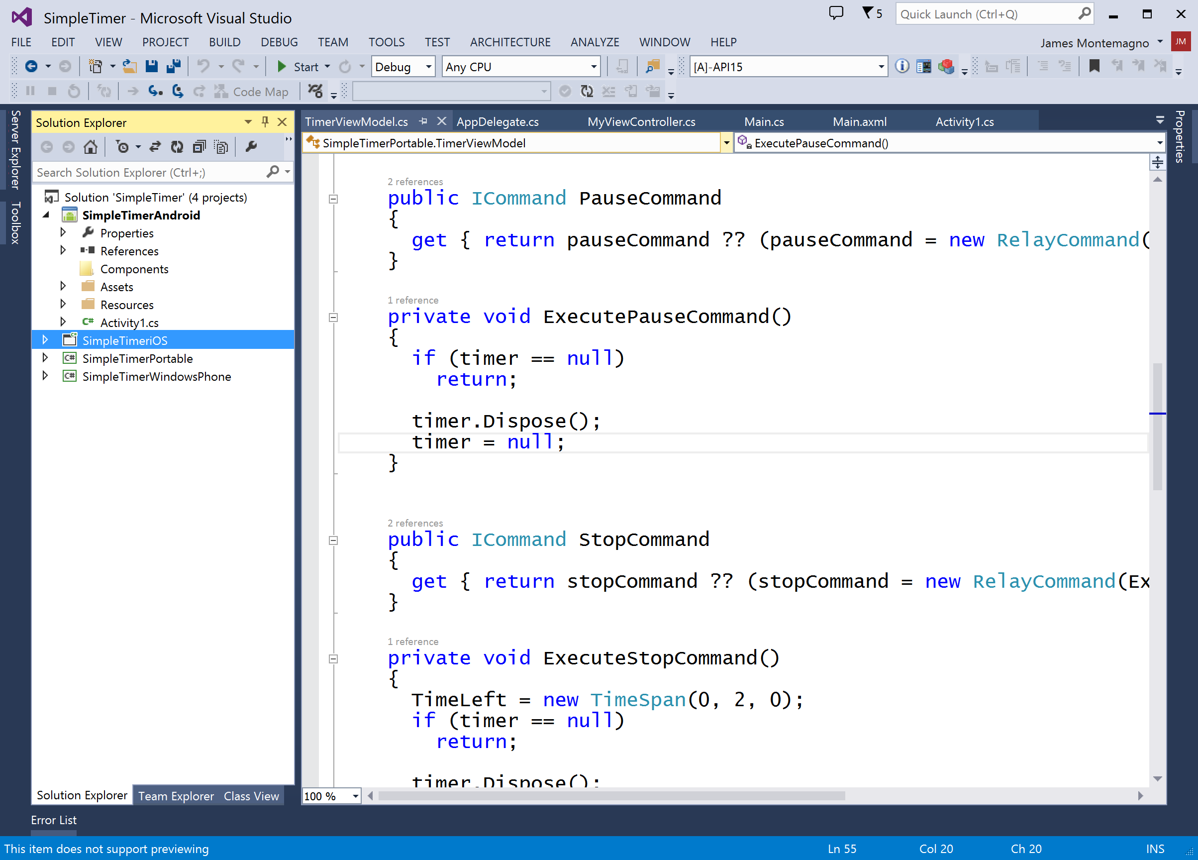
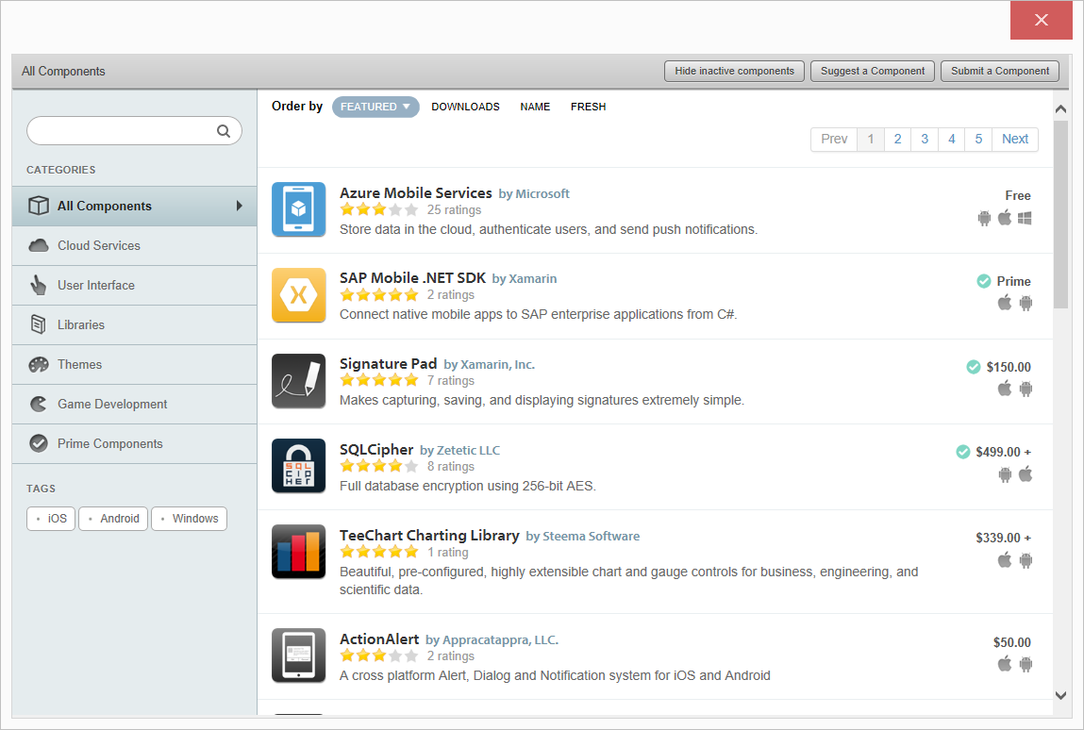
Component Store
Over 150 curated mobile components
Android
iOS
Windows

Slide 30
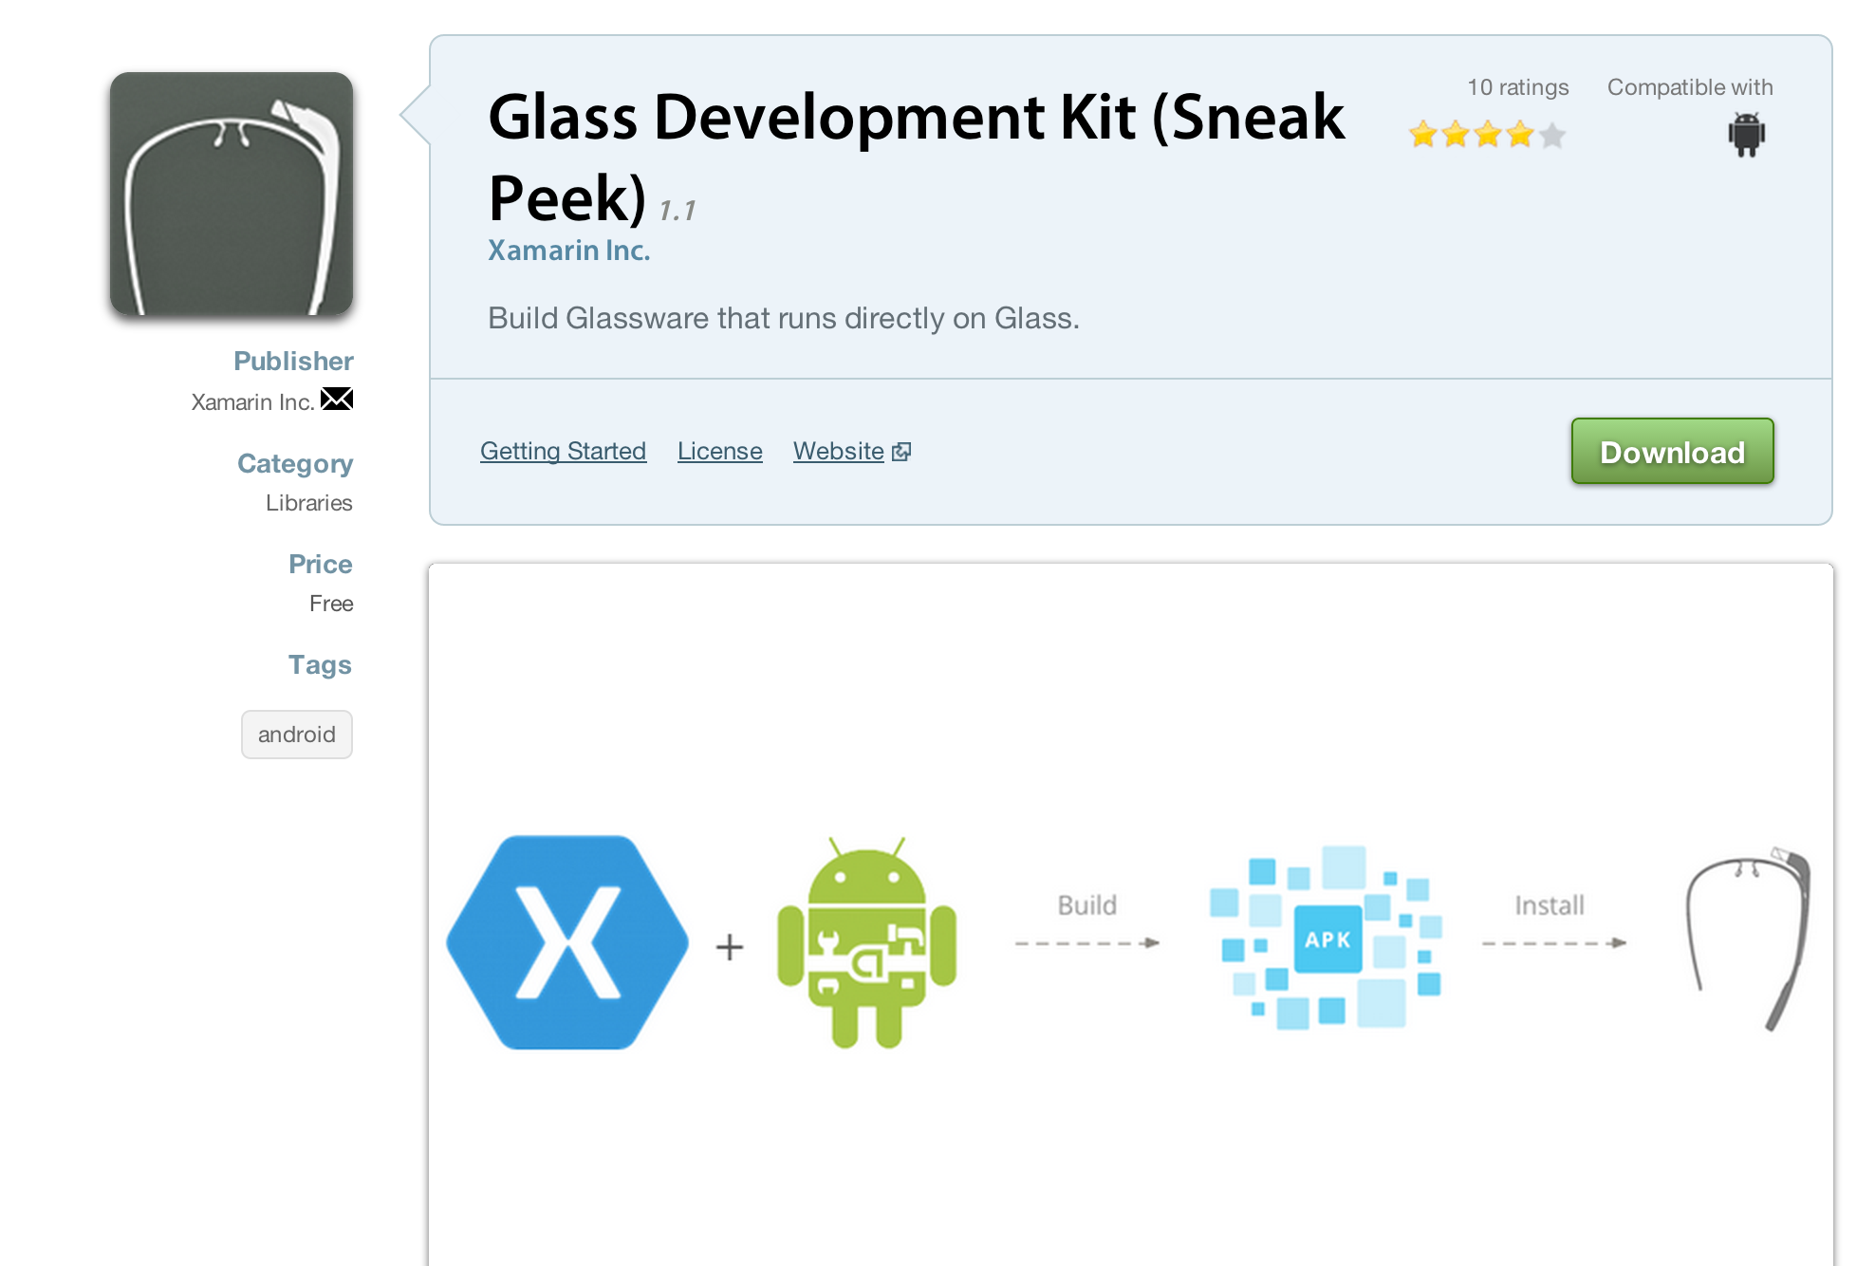
Google Glass Component

Slide 32
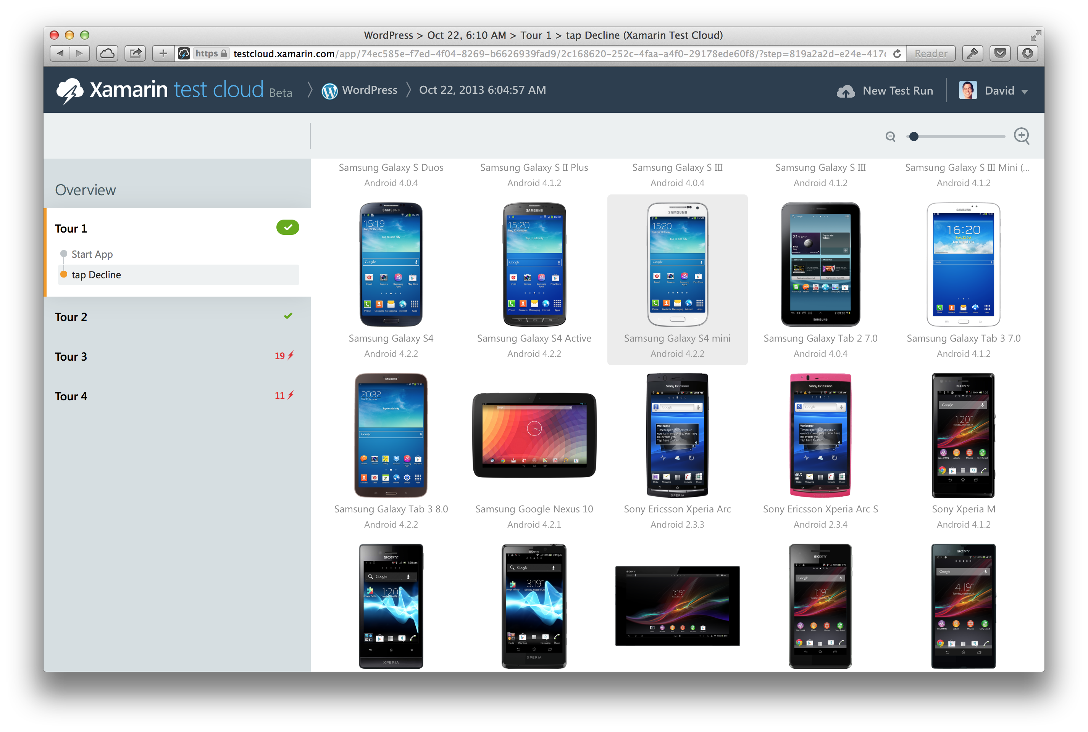
Automatically test your app on hundreds of mobile devices

Slide 33
Become a Mobile Developer Today

Slide 34
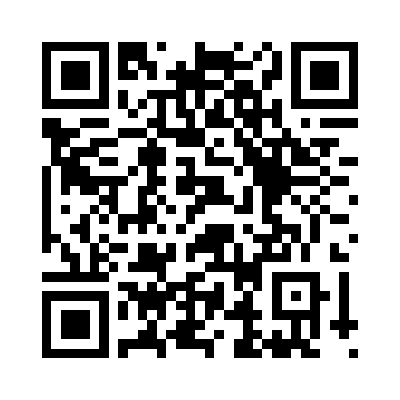
Your Feedback is Important
Fill out an evaluation of this session and help shape future events.
Scan the QR code to evaluate this session on your mobile device.
You’ll also be entered into a daily prize drawing!

