Slide 1
New tools from Microsoft Advertising to help app developers grow audience and revenue
Pooja Dave, Microsoft
Vijay Rajagopalan, Microsoft
Trevor Yeats, Microsoft

Slide 2
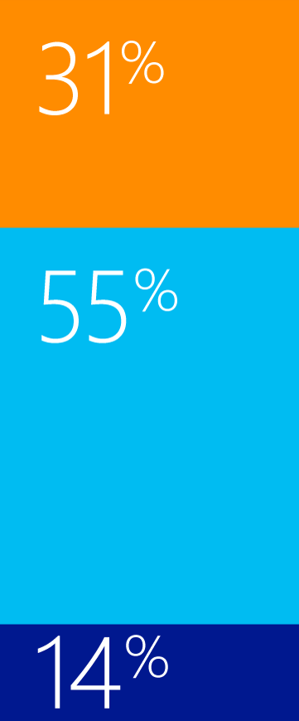
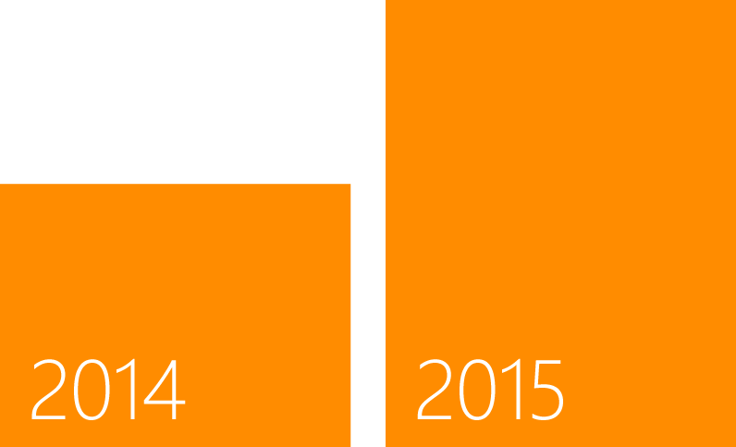
Advertising delivers tremendous value for app developers
The top 10 revenue-generating apps using the Microsoft ad SDK in 2015 are earning 70% more revenue compared to last year.¹
Developer Revenue by Source
Advertising
In-App Purchase
Paid Apps
Total Revenue
Worldwide, Microsoft Internal, Jan–Mar 2015
1. Worldwide, Microsoft Internal, Dec FY2015 vs. Dec FY2014

Slide 3
Video interstitials ads are a great opportunity!
Benefits
High CPMs*
Integrate ads during natural pauses
Rewards-based advertising
Availability
Windows 10 universal ad client SDK – preview available now!
Windows and Windows Phone 8.1 – coming Summer 2015
*Industry-wide, video interstitial CPMs are much higher than standard banner. Source: eMarketer, “Mobile Display Ad CPMs”, December 2014. Demand for video ads. delivered by Microsoft Advertising my vary by season and geography.

Slide 4
Demo: Interstitial Video Ads

Slide 5
Integrate Video Interstitials in your app!
Summary
Install the Ad SDK and add a reference
Instantiate the Ad
Wire up events
Pre-fetch the Ad
Call Show on the Interstitial Ad

Slide 6
“Promote Your App” is better than ever!
Available now!
Promote your app from Dev Center
Auto-targeting
Age & gender targeting - at no extra cost!
Track & analyze app installs
Cross promote your apps for free!
Coming summer 2015
Additional targeting features
Market expansion
3rd party analytics & measurements
Flexible payment options
Increased campaign budget

Slide 7
Promote your app in 3 steps
select creative
set
targeting
measure
install

Slide 8
Demo: Promote your app with auto targeting

Slide 9
Microsoft’s ‘Promote Your App‘ solution acquires users at roughly half the cost of the Amazon Ad Network.”
“
Random Salad

Slide 10
Learn more!
Microsoft Advertising Build blog
Visit adsinapps.microsoft.com and dev.windows.com

