Slide 2
Building Accessible Universal Windows Apps Remote access: https://build2015-612.com/
2-612
Chris Anderson – Distinguished Engineer
Brett Humphrey – Lead Program Manager

Slide 3
Agenda
What is accessibility?
Why do the work?
Who is the accessibility team?
Focus on screen reading
Two live walkthroughs

Slide 4
Accessibility for your app
Design for it
Few lines of code
Accessible across Windows Universal Platform

Slide 5
What is a disability?
Cognitive
Learning Disabilities
Visual
Motor
… and more ...

Slide 6
Visual perception
Font Size

Slide 7
Visual perception
Font Size

Slide 8
Visual perception
Font Size

Slide 9
Visual perception
Overall Size

Slide 10
Visual perception
Overall Size

Slide 11
Visual perception
Overall Size

Slide 12
Visual perception
Overall Size

Slide 13
Visual perception
Color perception

Slide 14
Visual perception
Color perception

Slide 15
Visual perception
Color perception

Slide 16
Visual perception
Color Contrast

Slide 17
Visual perception
Color Contrast

Slide 18
Visual perception
Color Contrast

Slide 19
Visual perception
Color Contrast

Slide 20
Steve Gleason Video
Color Contrast

Slide 21
Accessibility is…
Usability that connects lives

Slide 22
Why do the work?
Make lives simpler
Maximize reach of your app
Test automation
It’s fun

Slide 23
Parts of the stack
UI Automation
XAML, Web/HTML, Win32
Your App
Narrator
Windows Speech Recognition
3rd Party Assistive Technologies
Input Stack
High Contrast
DWM
On screen keyboard
Magnification
https://github.com/codemonkeychris/color-tree

Slide 24
What we think about
UI Automation
XAML, Web/HTML, Win32
Your App
Narrator
Windows Speech Recognition
3rd Party Assistive Technologies
Input Stack
High Contrast
DWM
On screen keyboard
Magnification
https://github.com/codemonkeychris/color-tree

Slide 25
Focus on screen reading
UI Automation
XAML, Web/HTML, Win32
Your App
Narrator
Input Stack
High Contrast
DWM
Magnification
Windows Speech Recognition
3rd Party Assistive Technologies
On screen keyboard

Slide 26
Benefit
UI Automation
XAML, Web/HTML, Win32
Your App
Narrator
Input Stack
High Contrast
DWM
Windows Speech Recognition
3rd Party Assistive Technologies
On screen keyboard
Magnification

Slide 27
Design your app to read aloud
“Your own app as you use it!”
Three simple steps
All done from a sketch

Slide 28
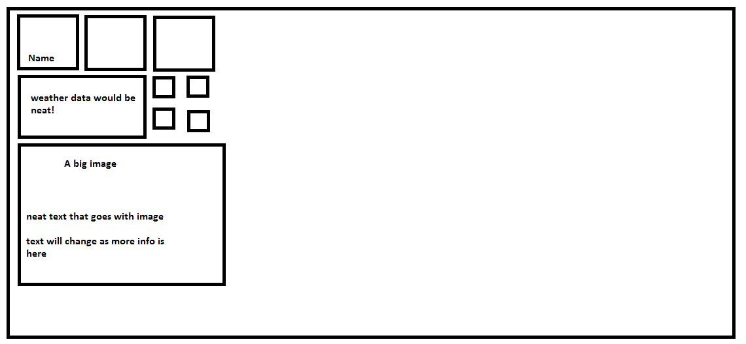
Start Menu rearrange

Slide 29
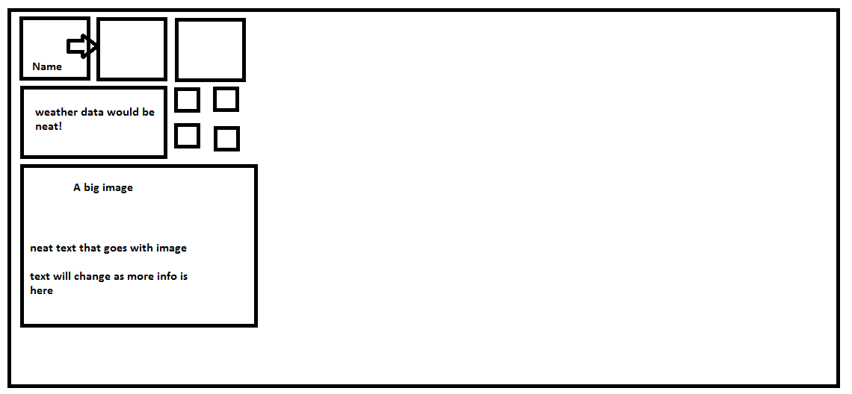
Start Menu rearrange

Slide 30
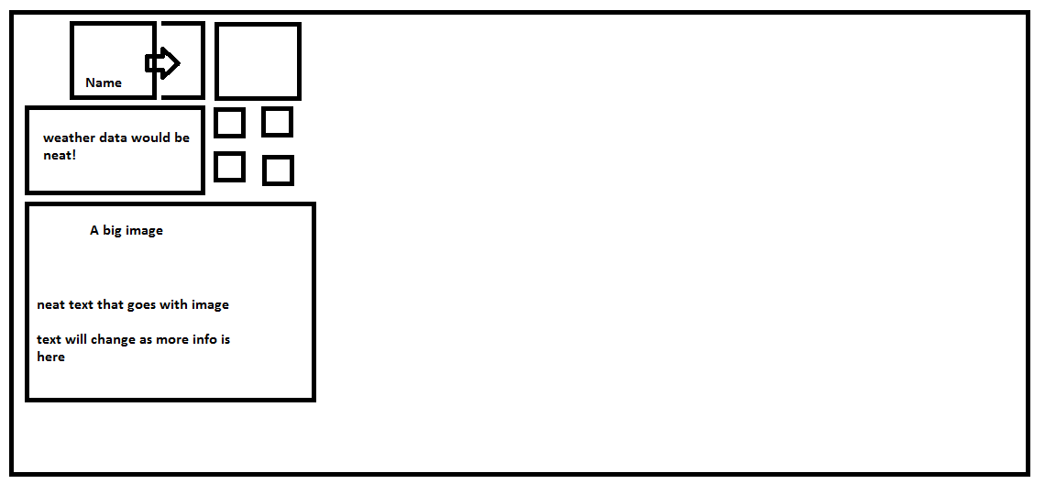
Start Menu rearrange

Slide 31
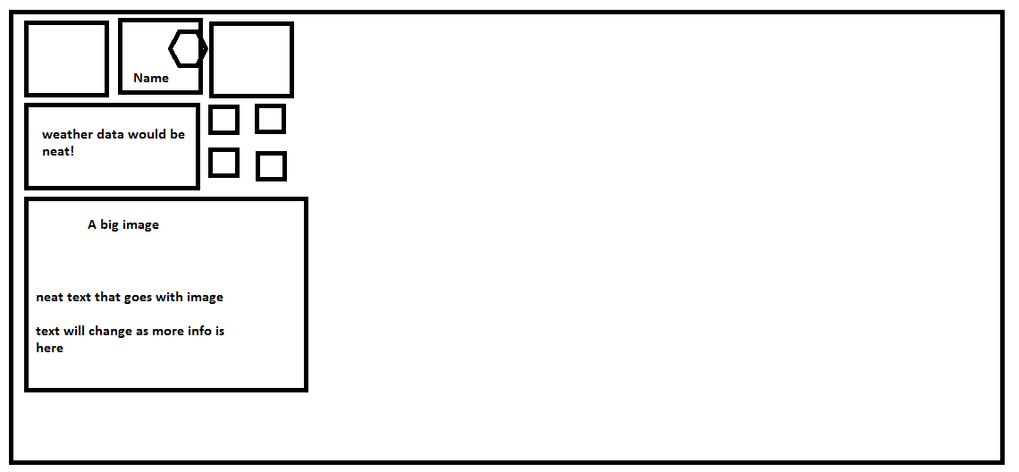
Start Menu rearrange

Slide 32
Start Menu Tile Rearrange with Narrator

Slide 33
The Color of Colors
Saying what we see

Slide 34
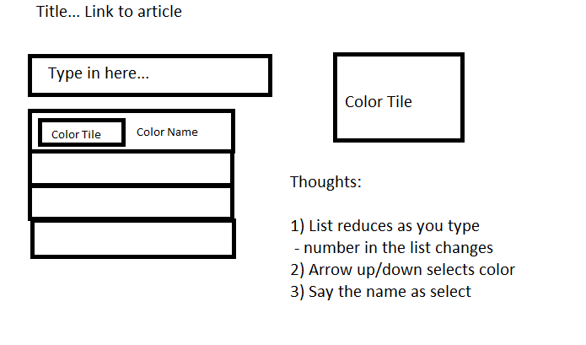
The color of colors…

Slide 35
Color Selection

Slide 36
Lost in transition
What? Where?

Slide 37
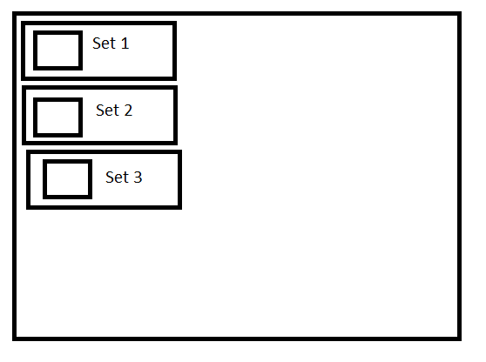
The high level list

Slide 38
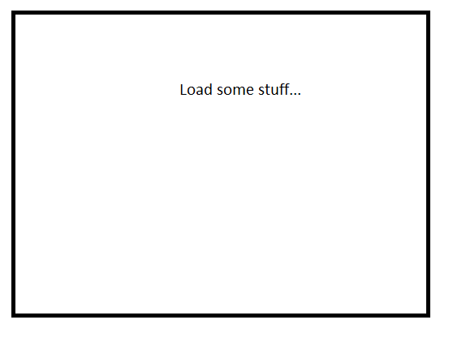
Loading…

Slide 39
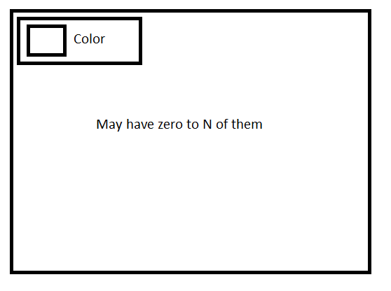
Results

Slide 40
Color Selection

Slide 41
Call to Action
Designing for accessibility
A few lines of code
Web uses HTML and ARIA
XAML uses AutomationPeer
Accessible across Universal Windows Platform
More information here: https://msdn.microsoft.com/enable
Github to see the demo apps
https://github.com/codemonkeychris/color-speak
https://github.com/codemonkeychris/color-tree

