Slide 2
Azure IoT Security
2-625
Clemens Vasters
Lead Architect, Azure IoT Services
@clemensv

Slide 3
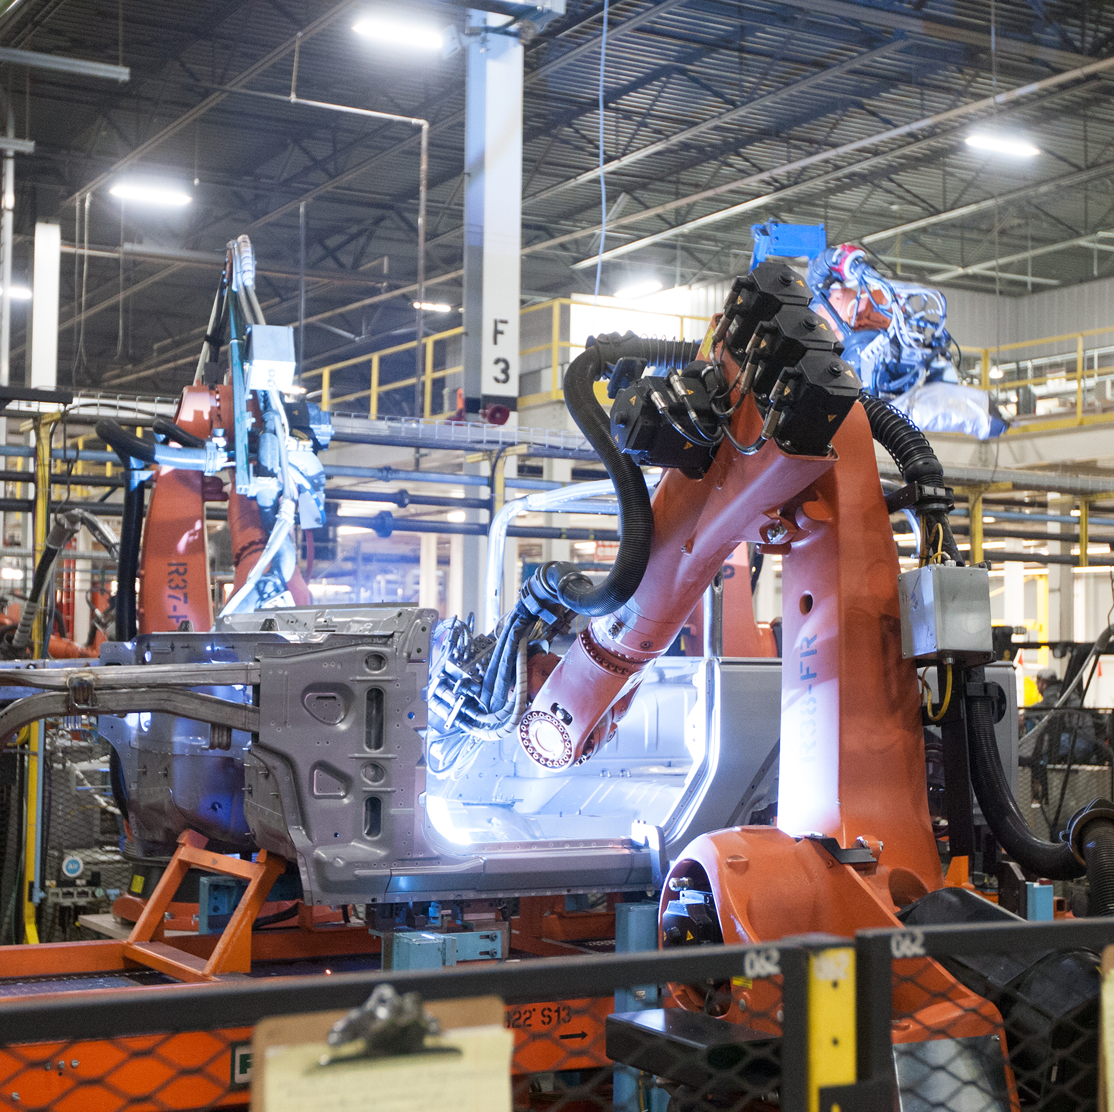
Agenda
Connected Things and the IoT
Inventory – What We Already Know
Security and Privacy Principles
Azure IoT Services
Outlook and Roadmap

Slide 4
Connected Things
Internet
Mobile & Web
Interaction
Local
Interaction
ISP
Cloud Systems
Cloud Portals and APIs
Personal Environment and Networks
Device
Device
Field Gateway
(Mobile) Network Operators
Cloud Gateway
Analytics
Device
Device
Device
Control System
Local Portals and APIs
Local Gateway
Control System
Analytics
Device
Data Management
MNO
Gateway
Data Management
Watches, Glasses, Work Tools, Hearing Aids, Robotic Assistance, …
Homes, Vehicles,
Vessels, Factories, Farms, Oil Platforms, …
Vehicle Fleets, Sea Vessels, LV Smart Grids, Cattle, …

Slide 5
IoT Enabled Infrastructure
City
Buildings
Energy
Health
Mobility
Fire Protection
Lighting
Electricity Distribution
Patient Tracking
Traffic Flow
Pollution Control
Water
Wind/Solar/Geothermal
Vital Monitoring
Traffic Alerts
Flood Control
Energy Management
Gas Distribution
Implants
Rule Enforcement
Medical Emergency
Climate Control
Fuel Distribution
Disability Aids
Toll Collection
OR Equipment
Bus/Tram/Train
Drinking Water
Air Quality
Power Plants
Lab Equipment
Taxi
Solid Waste
Lifts and Escalators
Nuclear Waste
Radiology Equipment
Street Quality
Waste Water
Signage
Coal Mining
Mobile Care
Air Traffic Control
Public Order
Safety Management
Oil/Gas Production
Diabetes
Airports

Slide 6
Many IoT solutions control critical operations at the core of industrial and civil infrastructure.
Digital security will be increasingly interwoven with physical safety of life and equipment.

Slide 7
Many IoT solutions will provide very deep and near-real time insight into industrial and business processes, as well as into homes and the immediate personal environment.
Privacy matters.

Slide 8
What Do We Already Know?
IT engineers know how to make digital things secure.
  Secure Development Lifecycle
  Secure Network Technologies
  Threat & Vulnerability Mitigation
  Monitoring and Alerting
  Software/Firmware Auto-Updates
  Privacy Models
OT engineers knows how to make physical things safe and secure
  Standards, Procedures, Training, Continuous Improvement
  Physical access management
  Hazard and Risk Analysis
  Monitoring and Maintenance
  Fail Safe and Safety Equipment
Best Practice: IT and OT engineers collaborate in making “cyberphysical” systems safe and secure.

Slide 9



Microsoft Cloud Security Principles
Security Development Lifecycle & Operational Security Assurance
Protect
Network and Identity Isolation
Least Privilege / Just-in-Time (JIT) Access
Vulnerability / Update Management
Auditing and Certification
Detect
Live Site Penetration Testing
Centralized Logging and Monitoring
Fraud and Abuse Detection
Breach Containment
Respond
Coordinated Security Response
Customer Notification

Slide 10
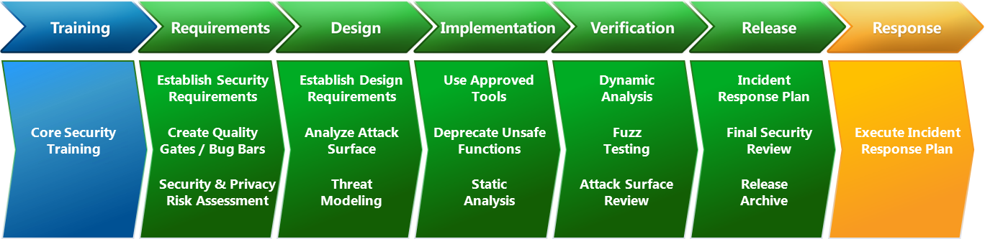
Secure Development Lifecycle
http://microsoft.com/sdl
Development process for creating (and running) secure software as practiced at Microsoft

Slide 11
Defense in Depth
Policies, Procedures, Guidance
Cloud
Field Gateways
Devices
Data Privacy Protection and Controls
Data
Data
Data
Application
Edge
Application
People and Device Identity Federation, Data Attestation
Identity and Access Control
Secure Networks, Transport and Application Protocols, Segmentation
Global Network
Local Network
Local Network
Trustworthy Platform Hardware, Signed Firmware, Secure Boot/Load
Host
Host
Host
Tamper/Intrusion Detection
Physical Access Security
Physical
Physical
Physical

Slide 12
Where things get tricky…

Slide 13
Capability constrained devices
IoT Sweet Spot
$400 Phones
$1000 PCs
$1 Sensor
Cost
$10000 Server
Computational Capabilities
Memory/Storage Capacity
Energy Consumption/Source
Component Quality
IoT capabilities are primarily value-add to other primary capabilities
How much computer, storage, and networking circuitry can you add to the BOM for a $40-range retail product for that value-add?
Tiny devices make awfully vulnerable network servers

Slide 14
Not everything is “green-field”
Factories and other industrial and utility environments are “brown-field”
  Production lines and facilities represent very significant capital investments
  Iterative technology deployment and upgrades
  Re-fit of existing (sometimes decades old) equipment with tech add-ons
Buildings and homes are too
  Entertainment systems (TV, A/V receivers, Set-Top boxes, Bluray Players)
  Comfort and sanitation systems (Heaters, A/C, Water, Gas, Thermostats)
  Kitchen appliances
  Security systems
IoT solutions must often integrate into environments with devices designed and deployed a decade or more apart

Slide 15
Legacy Network Design Attitude Reality
Network Security modeled after physical access security
Segregated networks. Well-defined gates.
Access control at the network/gateway level.
Network access sufficient to access assets.
Local
Interaction
AuthN/Z
Device
Device
Device
Local Portals and APIs
Local Gateway
Control System
Analytics
Device
Data Management

Slide 16

Legacy Remote Access Practices
LAN
LAN
VPN
PLC

Slide 17

Threats?
Spoofing
Tampering
Repudiation
Information Disclosure
Denial of Service
Elevation of Privilege
T,I,D
S,T,R,I,D,E
T,I,D
S,T,R,I,D,E
Service Desk
Machine Control Logic
Operator
T,I,D
S,R
PLC
T,I,D
T,I,D
Configuration
T,I,D
T,R,I,D

Slide 18
What do the boxes help with?
Spoofing
Tampering
Repudiation
Information Disclosure
Denial of Service
Elevation of Privilege
Not a whole lot …
T,I
Service Desk
Machine Control Logic
Operator
Configuration
T,I
… and they even broaden the attack surface area by fusing the networks

Slide 19
What do the boxes really nicely help with?
T,I
Service Desk
Machine Control Logic
Operator
Configuration
T,I
1. Pwn This
2. Pwn That

Slide 20
We’ve also seen this in vehicle telematics
Vehicle
Vehicle
Vehicle
Public APN
Entertainment
CAN BUS / “Telematics Box”
VPN Gateway
ERP
Fleet, Vehicle, and Driver Solutions
CRM
Diagnostics
MNO Private APN
Control
…
…
Vehicle
Vehicle
Own one, own them all
More issues:
+ Addressing and Discovery
+ Temporal Coupling

Slide 21
Defense Strategies
Will you defend a million tiny, underpowered, public network servers that must triage unsolicited traffic?
Or do you think they could use some help with defense?
Authentication Credentials Management
Authorization Policy Management
Denial of Service
Intrusion Detection
Auditing
Monitoring
Alerting

Slide 22
Service Assisted Communication (SAC)
Access Control Policies
Device Identity Registry/Directory
Connections are device-initiated and outbound
Non-IP
Field Gateway
Q
(CG)NAT
Firewall
Router
Service Gateway
Client
Q
Device does not actively listen for unsolicited traffic
Public address, full and well defendable server platform
No inbound ports open, attack surface is minimized
Isolated
Network
Port Mapping is automatic, outbound

Slide 23
Service Assisted Communication “Peer to Peer”
Device Authentication
Authorization (Access Policy Enforcement)
DoS Defense
Application Layer Integration (vs. Link/Network)
(CG)NAT Router
Mobile Backend
Q
(CG)NAT
Firewall
Router
Service Gateway
Q
Temporal Decoupling
Logical Addressing
Mobile Cell
Mobile Cell

Slide 24
SAC - Trust Brokerage for Nomadic Devices
“Nomadic Devices”
“Resident Devices”
Berlin
2
Local
Networking
Scope
Token expresses current membership of the device in the solution context.
Asymmetrically signed by directory. Cacheable. Expires periodically.
Tokens
Device Identity Registry/Directory
Access Policies
Cloud
Scope
Trust

Slide 25
Vehicle Telematics
AMQP 1.0 Link
Bi-Directional
Secure
Reliable Transfer
Application Level
No Peer Exposure
Datacenter(“Cloud”)
Vehicle
Entertainment
CAN BUS / “Telematics Box”
Telematics Gateway
ERP
Fleet, Vehicle, and Driver Solutions
CRM
Diagnostics
Control
…
…
Hard real-time
Control
Near real-time
Value-Add Services, Analysis and Optimization
Servicing

Slide 26
Industrial Automation
AMQP 1.0 Link
Bi-Directional
Secure
Reliable Transfer
Application Level
No Inbound Ports
Cloud Systems
OPC/TCP &
Fieldbuses
Cloud Portals and APIs
Device
OPC UA Gateway
AMQP
Cloud Gateway
Analytics
Device
Device
Control System
Local Portals and APIs
Local Gateway
Control System
Analytics
Device
Data Management
Data Management

Slide 27
Scale

Slide 28
The Scale Challenge
x Millions
Event Storage
Real Time Analytics
Time Series and State Storage
Historic and Predictive Analytics
Device Software Management
Connectivity
Data Flow
Device Identity Management
x GByte/sec
x PByte

Slide 29
Device Identities.
Device Management.
Hyper Scale.
Makers.
Prototypes.
Hackathons.
“Enterprise
Scale”
Consumer
Products
100
10,000
1,000,000

Slide 30
Azure IoT Hub

Slide 31
Azure IoT Hub
IoT Hub
Field
Cloud
IoT Hub Gateway
HTTPS,
AMQPS
Data and Command Flow
HTTPS
AMQPS
APIs
M
M
Event Hub
M
Self-Hosted Gateway
MQTT,
Custom
Field Gateway
OPC UA,
CoAP, AllJoyn,
…
Per-device
command
queues
Identity Registry
OSS Device Agents
Provisioning
Communication
Device Management
Provisioning
Management
Up to 10M Devices
per Hub

Slide 32
Azure IoT Hub
IoT Hub
IoT Hub Gateway
HTTPS,
AMQPS
Data and Command Flow
HTTPS
AMQPS
APIs
M
M
Event Hub
M
Self-Hosted Gateway
MQTT,
Custom
Field Gateway
OPC UA,
CoAP, AllJoyn,
…
Per-device
command
queues
Hyper-Scale Identity Registry for millions of devices per IoT Hub
Can federate identity with and via Azure Active Directory
Identity Registry
OSS Device Agents
Provisioning
Communication
Device Management
Provisioning
Management

Slide 33
Azure IoT Hub
Secure by Principle.
IoT Hub does not permit insecure connections. TLS is always enforced.
TLS/X509 initially; TLS/PSK & TLS/RPK on roadmap for compute-constrained devices and bandwidth limited or expensive metered links.
IoT Hub
IoT Hub Gateway
HTTPS,
AMQPS
Data and Command Flow
HTTPS
AMQPS
APIs
M
M
Event Hub
M
Self-Hosted Gateway
MQTT,
Custom
Field Gateway
OPC UA,
CoAP, AllJoyn,
…
Per-device
command
queues
Native support for Service Assisted Communication model, potentially holding millions of concurrent bi-directional connections.
AMQP 1.0 (with WebSockets), HTTP/2
Identity Registry
OSS Device Agents
Provisioning
Communication
Device Management
Provisioning
Management

Slide 34
Azure IoT Hub
IoT Hub
IoT Hub Gateway
HTTPS,
AMQPS
Data and Command Flow
HTTPS
AMQPS
APIs
M
M
Event Hub
M
Self-Hosted Gateway
MQTT,
Custom
Field Gateway
OPC UA,
CoAP, AllJoyn,
…
Per-device
command
queues
All messages are tagged with originator on service side allowing detection of in-payload origin spoofing attempts
Channel-level authentication and authorization against the gateway
Identity Registry
OSS Device Agents
Provisioning
Communication
Device Management
Provisioning
Validation of signatures against identity registry and blacklists (for signature tokens)
Management

Slide 35
Azure IoT Hub
Device management foundation capabilities for device state inventory and update delivery
Device management foundation capabilities for device state inventory and update delivery
IoT Hub
IoT Hub Gateway
HTTPS,
AMQPS
Data and Command Flow
HTTPS
AMQPS
APIs
M
M
Event Hub
M
Self-Hosted Gateway
MQTT,
Custom
Field Gateway
OPC UA,
CoAP, AllJoyn,
…
Per-device
command
queues
Identity Registry
OSS Device Agents
Provisioning
Communication
Device Management
Provisioning
Management

Slide 36
Roadmap

Slide 37
IoT Challenges
Policies, Procedures, Guidance
Cost pressure on device hardware
  Cheap sensors
  Weak/no crypto
  Source of randomness
Analog Gap
  Manipulations difficult to detect
Insecure Platforms
  Tiny Real-Time Operating Systems
  Legacy Protocols
Cloud
Field Gateways
Devices
Data
Data
Data
Application
Edge
Application
Identity and Access Control
Global Network
Local Network
Local Network
Host
Host
Host
Physical
Physical
Physical

Slide 38
What can we do architecturally?
Service Assisted Communication
  Reduce the attack surface area for system and devices
  Only accept commands to the device from a “trusted source”
  Enforce secure channel
Machine Identity and Access Authorization
  Who is part of a system and gets to submit data?
  Authorize the sender
Data Streams and Processing Authorization
  Which data gets sent and who is authorized to process which data?
  Authorize the receiver
Data Plausibility and Flow Authorization
  What is the data quality and how plausible is it considering the system context? Is it plausible enough to permit it flowing further into the system and for it to influence decisions?
  Authorize the data stream
Data Attestation, Lineage, and Privacy Control
  Where did data originate, who participated in producing it, and how can we answer these questions only in an authorized context and break the associations altogether when required by policy or law?
  Authorize identification and association
STRIDE
STRIDE
STRIDE
STRIDE
STRIDE

Slide 39
Call to Action!
IoT Security is a shared responsibility
  Security concepts to the edge
  Device code, provisioning, certificates, data management
Implement a Secure Development Lifecycle
  http://microsoft.com/sdl
  Keep track of the cyber supply chain
  Work out an incident response plan that includes updates
Leverage industry best practices for defense-in-depth
  Select device platforms by best balance between feature and security capabilities for your scenario and budget.
  Leverage best practice network design, but don’t just trust the network.
  Establish security boundaries at the application layer

Slide 40
Call to Action!
Build on the Azure IoT Suite and IoT Hub
  Secure, Service Assisted, Bi-Directional Communication
  Hyper-Scale Device Identity Management
  Device Management Foundation
Review our platform principles and certifications
  Azure Trust Center http://azure.microsoft.com/en-us/support/trust-center/
ISO 27001/27002
SOC 1/SSAE 16/ISAE 3402 and SOC 2
Cloud Security Alliance CCM
FedRAMP
FISMA
FBI CJIS (Azure Government)
PCI DSS Level 1
United Kingdom G-Cloud
Australian Government IRAP
Singapore MTCS Standard
HIPAA
CDSA
EU Model Clauses
Food and Drug Administration 21 CFR Part 11
FERPA
FIPS 140-2
CCCPPF
MLPS

Slide 41
Resources
Improve your skills by enrolling in our
free cloud development courses at the Microsoft Virtual Academy.
Try Microsoft Azure for free and deploy your first cloud solution in under 5 minutes!
Easily build web and mobile apps for any platform with AzureAppService for free.

