Slide 2
Azure App Service Architecture
2-628
Scott Hanselman
Principal Program Manager
@shanselman
Scott Hunter
Director of Program Management
@coolcsh

Slide 3
Azure App Service Overview and Architecture
2-628
Scott Hanselman
Principal Program Manager
@shanselman
Scott Hunter
Director of Program Management
@coolcsh

Slide 4
Azure Websites
Mobile Services
BizTalk Services
Key app services in Azure today

Slide 5
Introducing Azure App Service
Unique integrated offering
Build rich, engaging & intelligent apps
Scale as your business grows
Azure Websites
Mobile Services
BizTalk Services
Key app services in Azure today

Slide 6
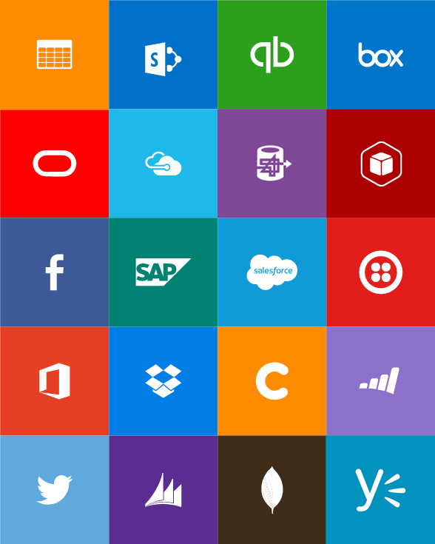

Slide 7
One price

Slide 8
Full capability set available including:
.NET, Node.js, Java, PHP, and Python
WebJobs for long running tasks
Integrated VS publish, remote debug…
CI with GitHub, BitBucket, VSO
Auto-load balance, Autoscale, Geo DR
Virtual networking and hybrid connections
Site slots for staged deployments
Web Apps
Web apps run as-is
no changes required

Slide 9
New capabilities for Mobile apps:
Webjobs for long running tasks
CI with GitHub, BitBucket, VSO
Auto-load balance, Autoscale, Geo DR
Virtual networking and hybrid connections
Site slots for staged deployments
Mobile Apps
Mobile services plus
a whole lot more

Slide 10
New Logic Apps for easy automation
No code designer for rapid creation
Dozens of pre-built templates to get started
Out of box support for popular SaaS and on-premises apps
Use with custom API apps of your own
Biztalk APIs for expert integration scenarios
LOGIC Apps
Automate SaaS and
on-premises systems

Slide 11
Easily use cloud or custom APIs:
Dozens of built-in APIs for popular SaaS
An ecosystem of APIs for any need
Create and publish custom, reusable APIs
Visual Studio tooling with one click publish and remote debugging
Automatic client SDK generation for many languages
Api Apps
Create, consume and
host APIs more easily

Slide 12
Built-in API Connectors
Connectors
Box
Chatter
Delay
Dropbox
Azure HD Insight
Marketo
Azure Media Services
OneDrive
SharePoint
SQL Server
Office 365
Oracle
QuickBooks
SalesForce
Sugar CRM
SAP
Azure Service Bus
Azure Storage
Timer / Recurrence
Twilio
Twitter
IBM DB2
Informix
Websphere MQ
Azure Web Jobs
Yammer
Dynamics CRM
Dynamics AX
Hybrid Connectivity
Protocols
BizTalk Services
HTTP, HTTPS
File
Flat File
FTP, SFTP
POP3/IMAP
SMTP
SOAP + WCF
Batching / Debatching
Validate
Extract (XPath)
Transform (+Mapper)
Convert (XML-JSON)
Convert (XML-FF)
X12
EDIFACT
AS2
TPMOM
Rules Engine

Slide 13
App Service
Web Apps
Mobile Apps
Web apps that scale with your business
Build Mobile apps for any device
LOGIC Apps
Api Apps
Automate business process across SaaS and on-premises
Easily build and consume APIs in the cloud

Slide 14
App Service
End-to-end car dealership example
Customer book appointment
Service Advisor assigns a technician
Service Technician closes out service work
Web Apps
LOGIC Apps
Mobile Apps
Api Apps

Slide 15
App Service
Web Apps
LOGIC Apps
Mobile Apps
Customer site
Service Advisor
Customer Appointment
Technician App
Web Apps
LOGIC Apps
Mobile Apps
Api Apps
Api Apps
http
SQL

Slide 16
Web Apps
LOGIC Apps
Mobile Apps
Customer site
Service Advisor
Customer Appointment
Technician App
Api Apps
http
SQL

Slide 17
Microsoft Integration
+
BizTalk Server
BizTalk Services
Azure App Service
Leader in integration on-premises
Handles mission critical workloads for hundreds of customers
Renowned brand
First version of BizTalk build ‘cloud-up’
Already running mission critical workload for large customers
Includes BizTalk Services capabilities – evolved to benefit from App Service approach
Inherently extensible
More accessible to a broader audience, not just integration specialists
Takes BizTalk brand and capabilities forward

Slide 18
API Apps addresses key pains around building and consuming APIs
Build your API
Consume APIs
Web Apps++: Bring you API as is in your language of choice
API discovery
SDK generation
SSO, handled by server
Authentication, built-in to mobile and web SDKs
Expose enterprise APIs
Microservice style
Metadata contract
SSO
Simple access control
Gallery – public & organization

Slide 19
Resources
Improve your skills by enrolling in our free cloud development courses at the Microsoft Virtual Academy.
Try Microsoft Azure for free and deploy your first cloud solution in under 5 minutes!
Easily build web and mobile apps for any platform with AzureAppService for free.

