Slide 2
What's New in XAML for Universal Windows Apps
Joe Stegman
Group Program Manager
2-629

Slide 3
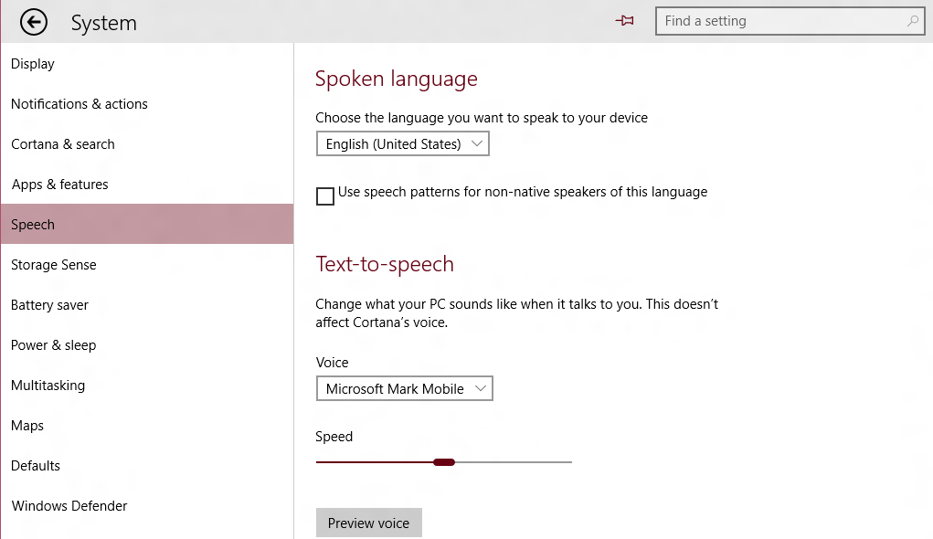
This Session: XAML UI
The “Native” UI Framework for Windows 10 Apps and Experiences
Supports C++ or C#/VB
<!-- XAML Outline -->
<Page>
<StackPanel Orientation="Horizontal">
<AppBarButton/>
<AutoSuggestBox/>
</StackPanel>
<Grid>
<ListView/>
<TextBlock Text="Spoken Language"/>
<ComboBox/>
<CheckBox/>
<Slider/>
<Button/>
</Grid>
</Page>

Slide 4
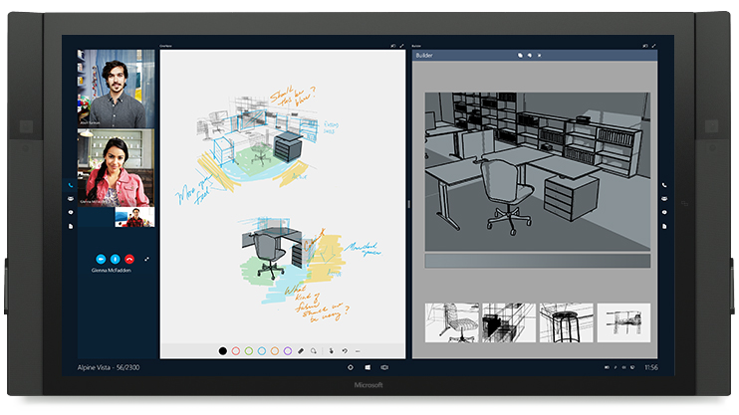
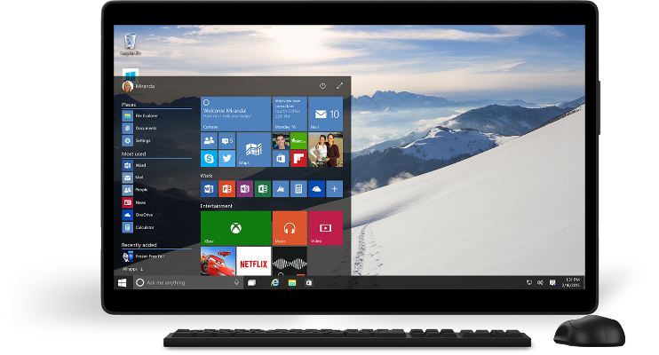
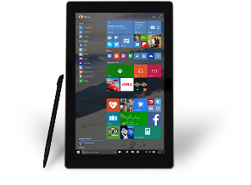
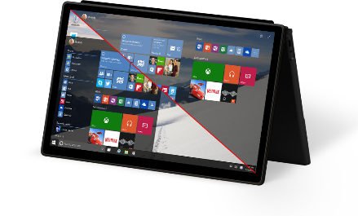
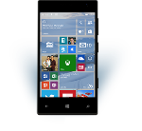
UWP in Windows 10
Windows 10 Goal: Increase reach and opportunity
UWP Goal: Reduce developer cost to deliver on the increased opportunity

Slide 5
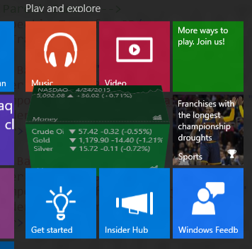
XAML in Windows 10: Beyond UW Apps New/enhanced controls, performance, much more…
We are listening…

Slide 6
Demo (s)

Slide 7
Getting to Universal Windows Controls

Slide 8
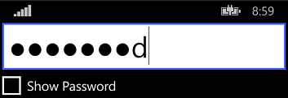
“Universal” Controls in 8.1 Some differences in look, feel and APIs
Windows 8.1 Desktop
Phone 8.1 (Blue)

Slide 9
Upgrading to Windows 10 But, that also means some things had to change
IsPasswordRevealButtonEnabled in 8.1 (bool value)

Slide 10
Newly Universal Controls

Slide 11
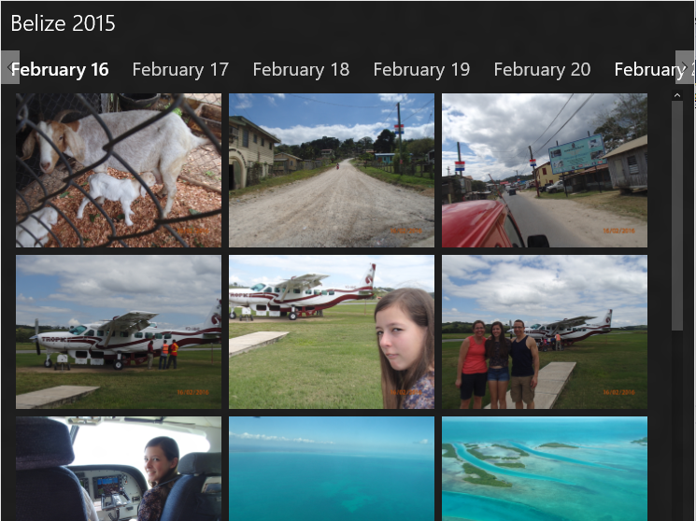
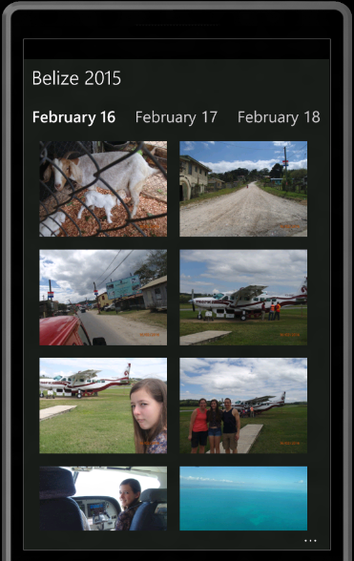
Newly Universal Controls: Pivot Great for 1-handed on Mobile, Tabs on desktop

Slide 12
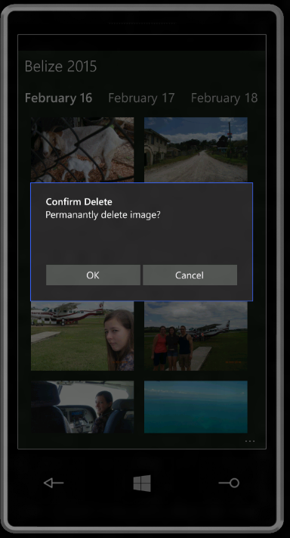
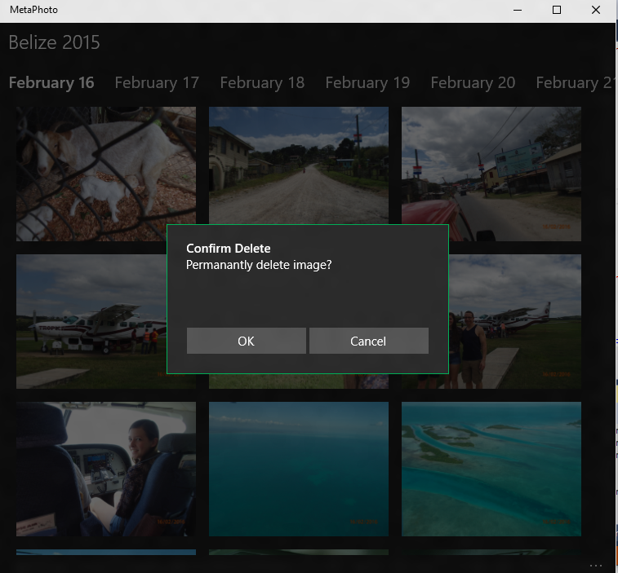
Newly Universal Controls: ContentDialog App model, XAML child content

Slide 13
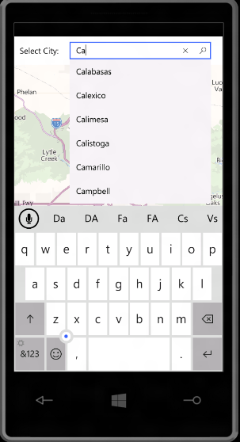
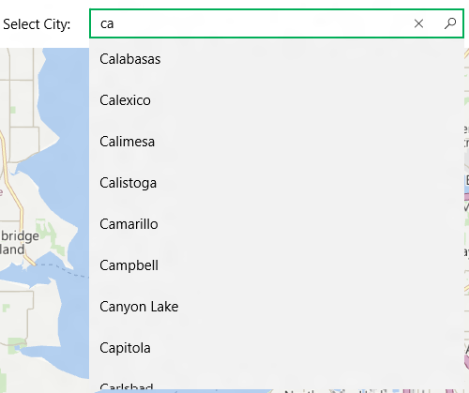
Newly Universal Controls: AutoSuggestBox And IME support, glyph

Slide 14
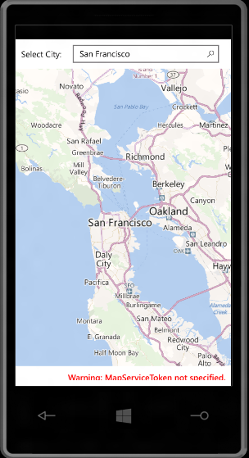
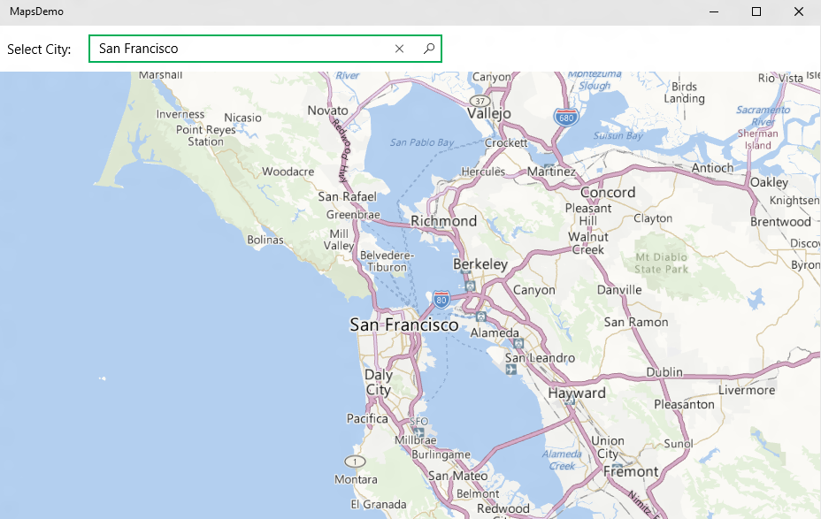
Newly Universal Controls: Maps Plus Offline, 3D, Street Side Panoramas

Slide 15
Using XAML to Build UW Apps It’s more than just universal controls

Slide 16
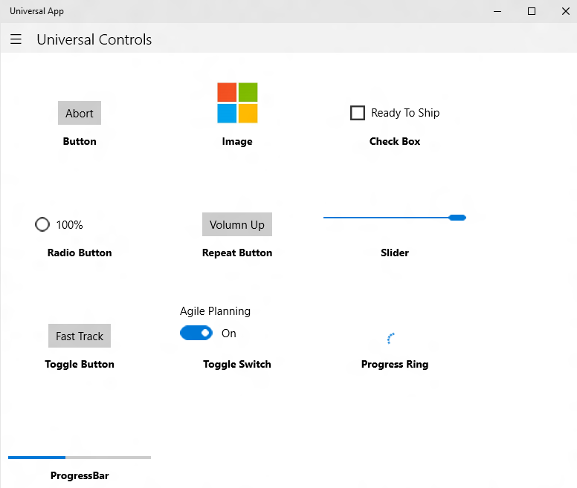
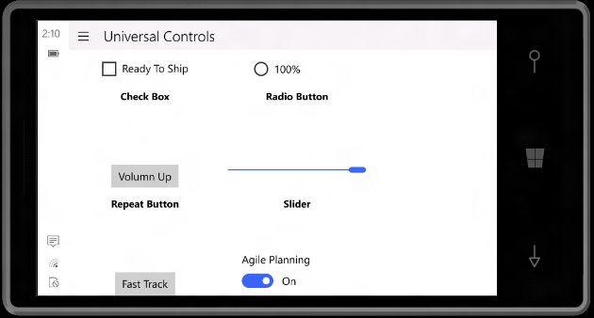
Common Controls Common Branding, Behavior, Scaling, Support Diverse Inputs

Slide 17
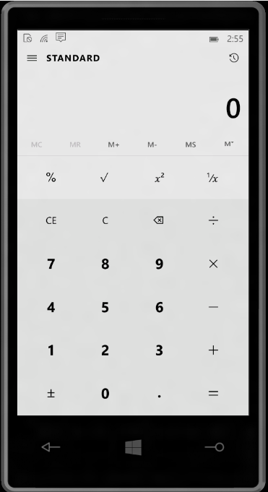
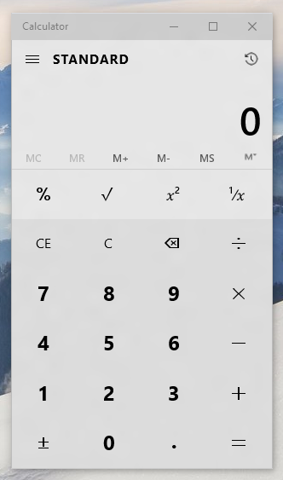
Controls Reusable Across Devices/Displays Views may be reusable (but likely to need tailoring)

Slide 18
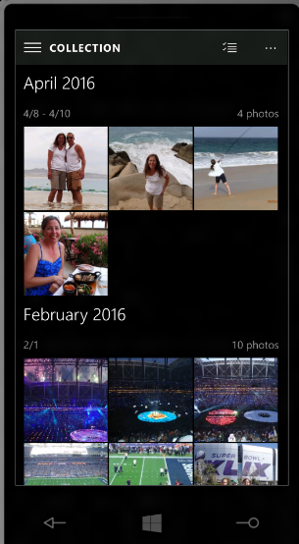
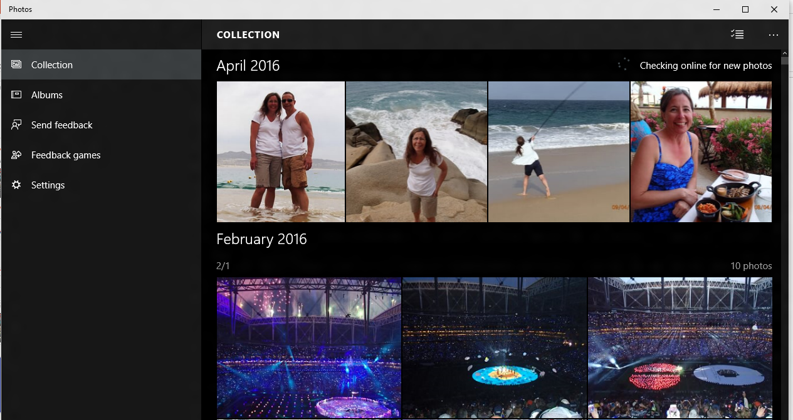
Tailoring App Experiences Typically via responsive pages or multiple views
Windows 10 has new features to help with responsive designs

Slide 19
Responsive/Adaptive Apps [Photos and SplitView]

Slide 20
New XAML Features for Building Responsive UW Apps

Slide 21
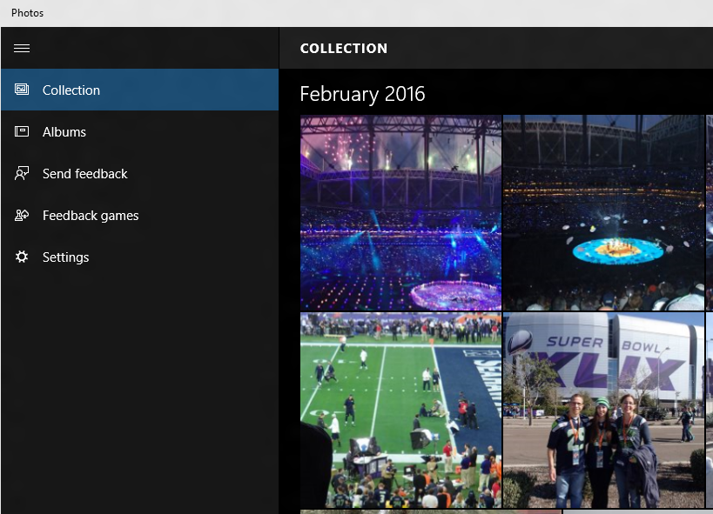
SplitView Adaptive navigation pane
<SplitView DisplayMode="Inline|Overlay|CompactInline|CompactOverlay">
<SplitView.Pane>
<!-- Navigation Content Here -->
</SplitView.Pane>
<!-- Main Content Here -->
</SplitView>

Slide 22
Simplifying Responsive View Development Triggers and Setters (XAML equivalent of Media Queries)
<VisualState.Setters>
<Setter Target="splitView.DisplayMode" Value="Inline" />
</VisualState.Setters>
<VisualState.StateTriggers>
<AdaptiveTrigger MinWindowWidth="720" />
</VisualState.StateTriggers>
<VisualState.Setters>
<Setter Target="splitView.DisplayMode" Value="Overlay" />
</VisualState.Setters>
<VisualState.StateTriggers>
<AdaptiveTrigger MinWindowWidth= "0" />
</VisualState.StateTriggers>
If the Window width is >= 720 effective pixels, then show SplitView in Inline mode

Slide 23
Responsive/Adaptive Apps [Settings]

Slide 24
RelativePanel Enables elements to layout relative to other elements
<Grid>
<Grid.ColumnDefinitions>
<ColumnDefinition Width="Auto"/>
<ColumnDefinition Width="*"/>
</Grid.ColumnDefinitions>
<Image x:Name="img" …/>
<StackPanel Grid.Column="1" …>
<TextBlock x:Name="title" …/>
<TextBlock x:Name="authors" …/>
<TextBlock x:Name="summary" …/>
<Button Content="Download" …/>
</StackPanel>
</Grid>
“Traditional” nested panel layout can be challenging for more complex layouts

Slide 25
RelativePanel
<RelativePanel>
<Image x:Name="img" …/>
<TextBlock x:Name="title" RelativePanel.RightOf="img" RP.AlignTopWith="img" …/>
<TextBlock x:Name="authors" RP.RightOf="img" RP.Below="title" …/>
<TextBlock x:Name="summary" RP.RightOf="img" RP.Below="authors" …/>
<Button Content="Download" RP.RightOf="img" RP.AlignBottomWithPanel="True" …/>
</RelativePanel>
Use with Triggers and Setters for more advanced responsive designs
Note: RP above should be replaced with RelativePanel (shortened for readability)

Slide 26
Demo

Slide 27
XAML Performance in Windows 10

Slide 28
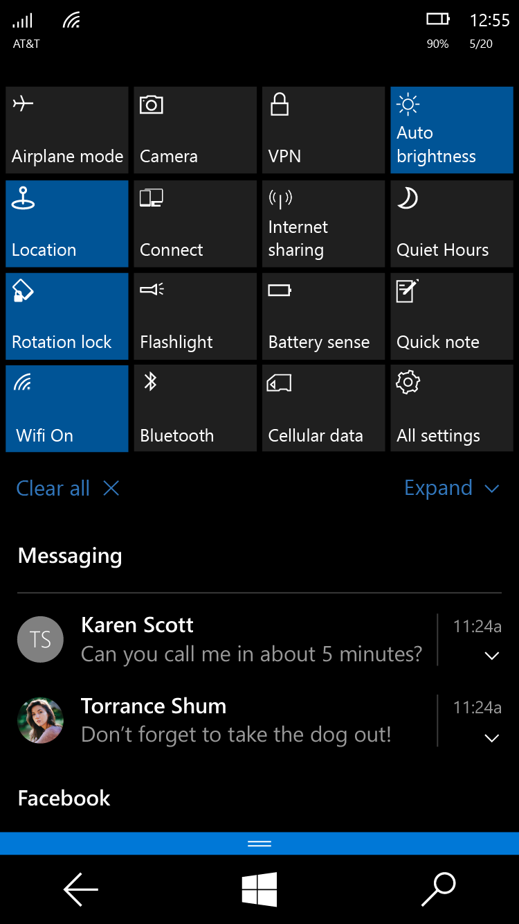
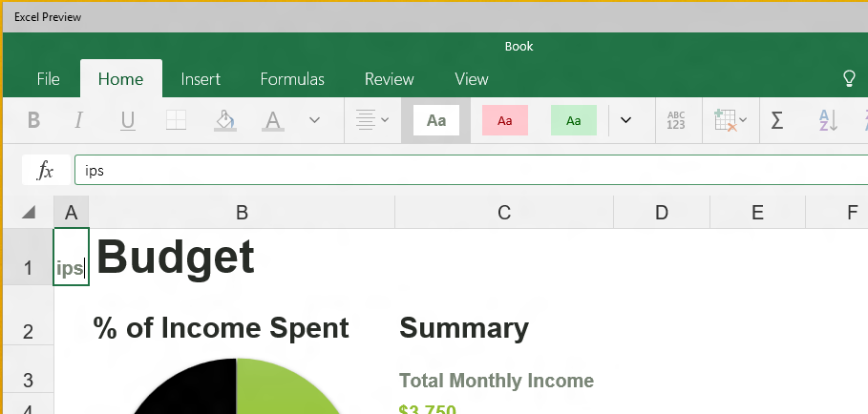
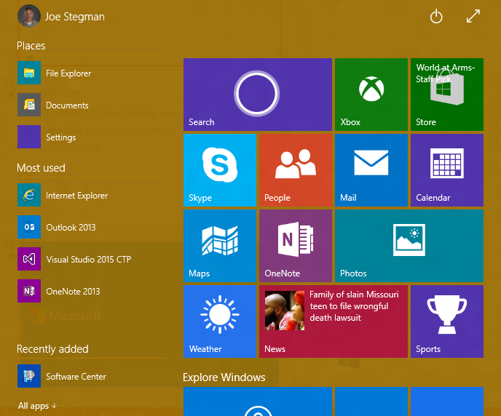
Validating XAML in Windows 10

Slide 29
Notable New Performance Features Compiled Bindings AKA {x:Bind}: Like {Binding}, only they go to 11
<ListView>
<ListView.ItemTemplate>
<DataTemplate>
<StackPanel>
<SymbolIcon Symbol="{Binding Symbol}"/>
<TextBlock Text="{Binding Name}"/>
<Button Click="Button_ClickHandler"/>
</StackPanel>
</DataTemplate>
</ListView.ItemTemplate>
</ListView>
<ListView>
<ListView.ItemTemplate>
<DataTemplate x:DataType="local:FreeBookCategory">
<StackPanel>
<SymbolIcon Symbol="{x:Bind Symbol}"/>
<TextBlock Text="{x:Bind Name}"/>
<Button Click="{x:Bind Click}"/>
</StackPanel>
</DataTemplate>
</ListView.ItemTemplate>
</ListView>
Resolved at compile time and produce compiler errors.

Slide 30
Other New UI Features

Slide 31
Change Notification on all Control Properties Technically, just the ones that are DependencyProperties
<!-- Get notifications when Button Content property changes -->
<Button x:Name="target" Content="{x:Bind Name}"/>
// Register for changes on “target.Current” property
target.RegisterPropertyChangedCallback(ContentControl.ContentProperty, ContentChanged);
// Handler
void ContentChanged(DependencyObject sender, DependencyProperty prop)
{
// Content Changed
Object content = (sender.GetValue(prop));
}

Slide 32
PerspectiveTransform3D Composable 3D Transforms (Effects: 3D Rotations, Parallax)
<Grid>
<Grid.Transform3D>
<!– Parent Camera -->
<PerspectiveTransform3D/>
</Grid.Transform3D>
<Border Background="#FF7F00">
<Border.Transform3D>
<CompositeTransform3D RotationX="-90 " …/>
</Border.Transform3D>
</Border>
<Border Background="#FF6700">
<Border.Transform3D>
<CompositeTransform3D RotationY="-90" …/>
</Border.Transform3D>
</Border>
</Grid>

Slide 33
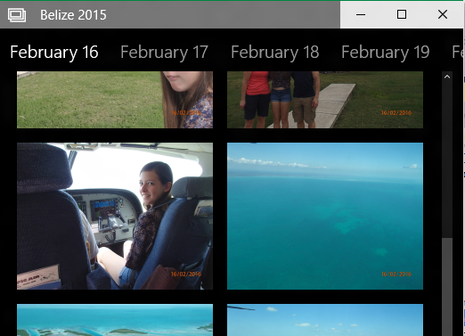
Windowing Custom chrome, branding, sizing
<!-- XAML -->
<StackPanel x:Name="customTitleBar" Height="32" …>
<FontIcon …/>
<TextBlock Text="Belize 2015" …/>
</StackPanel>
// Remove Standard Title Bar
CoreApplication.GetCurrentView().TitleBar.ExtendViewIntoTitleBar = true;
// Indicate Custom App UI to use as the TitleBar (for move, resize)
Window.Current.SetTitleBar(customTitleBar);

Slide 34
Ink Canvas Palm rejection, smoothing, high fidelity
<Grid>
<!-- It’s this simple -->
<InkCanvas/>
</Grid>

Slide 35
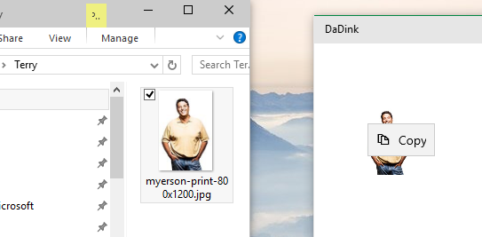
Drag and Drop Extended for “Windowed” Apps
<!-- XAML -->
<Grid AllowDrop="True" DragOver="Do_DragOver" Drop="Do_Drop" …>
…
</Grid>
File Explorer
My App

Slide 36
Demo

Slide 37
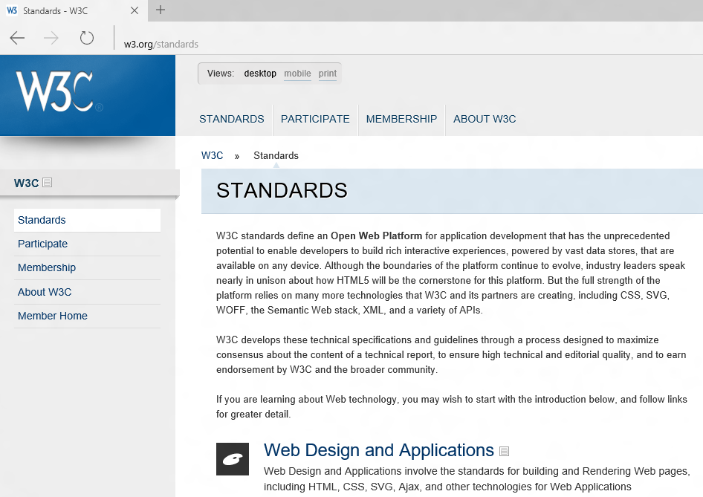
XAML WebView Enhancements
Spartan “Edge” in Windows 10
WinRT Access
And More…
See “Hosted Web” Apps session for details

Slide 38
XAML Improvements in Visual Studio

Slide 39
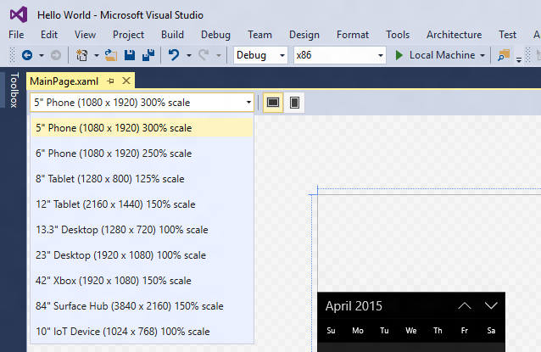
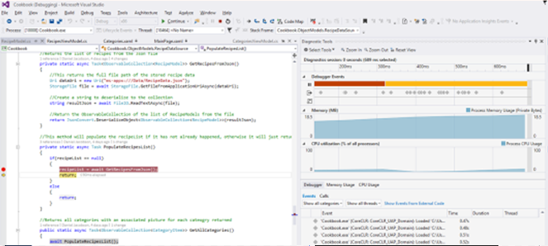
Visual Studio New design modes, performance instrumentation timeline tool and more…

Slide 40
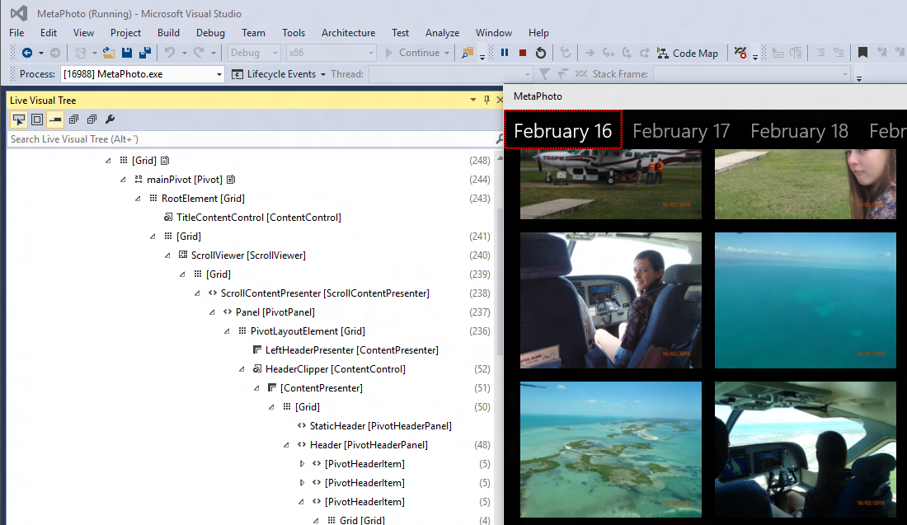
Visual Studio Visual Tree Inspector

Slide 41
Demo

Slide 42
And More…
CommandBar Updates
Vector Fonts
Property Change Improvements
New Content Presenter APIs
IME Composition Events
Directional Navigation
ListView Enhancements
Framework Element Loading Event
Improved Animation Experiences
Improved XAML/DX Interopability
Software Bitmap Source
Silverlight memory improvements
Printing APIs on Mobile
Improved BiDi handling
Improved ScrollViewer APIs
Casting in media elements

Slide 43
Call to Action
Try it out and provide feedback
Windows Feedback -> Developer Platform -> UI Frameworks and Controls (XAML)
http://wpdev.uservoice.com
Most Closely Related Sessions
Wednesday 3:30-4:30 PM: Data Binding: Boost Your App’s Performance…
Wednesday 5:00-6:00 PM: Windows User Experience: Models, Patterns…
Thursday 2:00-3:00 PM: From the Small Screen to the Big Screen…
Thursday 5:00-6:00 PM: XAML Performance: Techniques for Maximizing…
Friday 10:30-11:30 AM: Moving to the Universal Windows Platform…

Slide 44
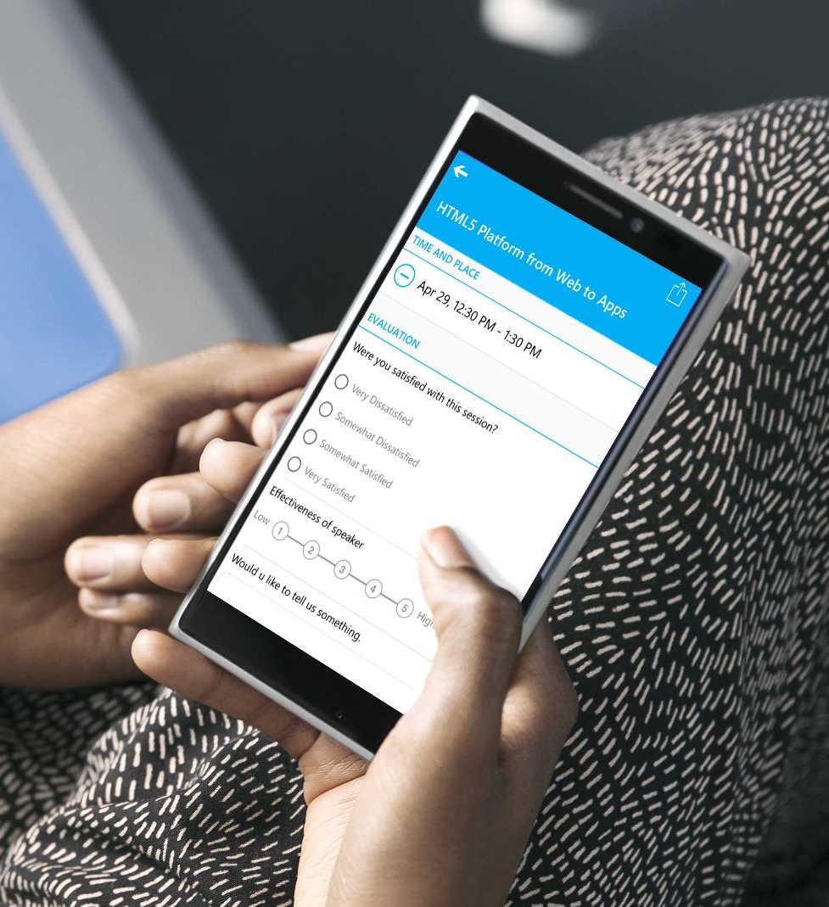
Evaluate this session
Your feedback is valuable!

Slide 46
And More (Again)…
CommandBar Updates
Vector Fonts
Property Change Improvements
New Content Presenter APIs
IME Composition Events
Directional Navigation
ListView Enhancements
Framework Element Loading Event
Improved Animation Experiences
Improved XAML/DX Interopability
Software Bitmap Source
Silverlight memory improvements
Printing APIs on Mobile
Improved BiDi handling
Improved ScrollViewer APIs
Casting in media elements
Speaker: jstegman@microsoft.com

Slide 47
Backup

Slide 48
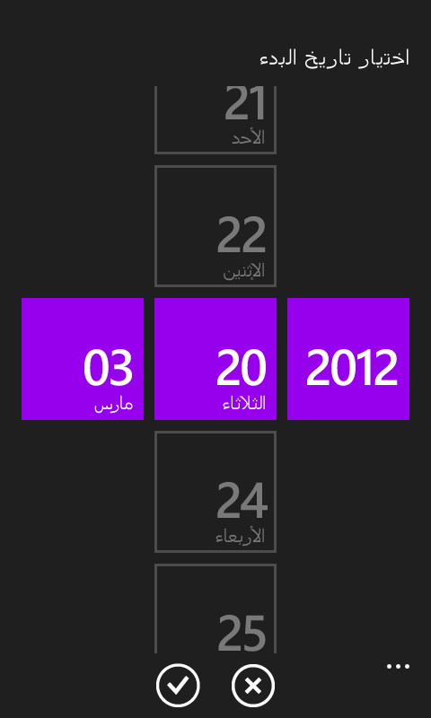
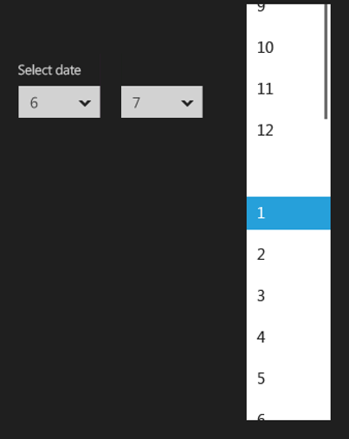
One design language. One control set.
Design
Develop
Debug
Distribute
WP 8.1
Win 10
Win 8.1
Animation should end with only Win10 control showing. Don’t want the old controls on screen too long.

Slide 49
RelativePanel Enables elements to layout relative to other elements
<RelativePanel>
<FontIcon x:Name="icon" …/>
<TextBlock x:Name="system" Text="System" RelativePanel.RightOf="icon" …/>
<TextBlock RelativePanel.RightOf="icon" RelativePanel.Below="system" …/>
</RelativePanel>

Slide 50
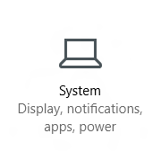
RelativePanel Enables elements to layout relative to other elements
<RelativePanel>
<FontIcon x:Name="icon" RelativePanel.AlignHorizontalCenterWithPanel="True" …/>
<TextBlock x:Name="system" RelativePanel.Below="icon"
RelativePanel.AlignHorizontalCenterWithPanel="True" …/>
<TextBlock RelativePanel.Below="system"
RelativePanel.AlignHorizontalCenterWithPanel="True" …/>
</RelativePanel>
Use with Triggers and Setters to enable responsive layout changes

Slide 51
Demo title (use for demo intros)

Slide 52
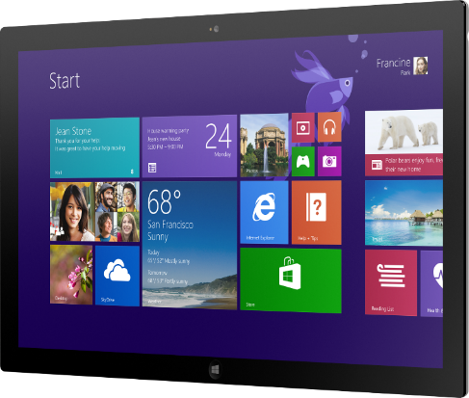
Single device preferred angle. This is another option for displaying a hardware image that sits at an angle.

Slide 53
Charts and code (this is a divider slide)

Slide 54
Slide title here
Code content here in 24pt Consolas font. Always use this white slide for code.

Slide 55
Charts
For content: Type is what articulates the message. Text doesn’t need to be bulleted. Text size can reinforce and impact.

Slide 56
Charts
For content: Type is what articulates the message. Text doesn’t need to be bulleted. Text size can reinforce and impact.

Slide 57
Table
Column 1 | Column 2 | Column 3 | Column 4 | Column 5
Text | Text | Text | Text | Text
Text | Text | Text | Text | Text
Text | Text | Text | Text | Text
Text | Text | Text | Text | Text
Text | Text | Text | Text | Text
Text | Text | Text | Text | Text
Text | Text | Text | Text | Text
Text | Text | Text | Text | Text
This is a content box, always 24pts and sentence case.

Slide 58
Diagram with text
This is a content box, always 24pts and sentence case.
Windows Style App
<audio src=“…”>
<video src=“…”>
Windows Runtime (WinRT)
Playback/Preview
(Media Engine)
Capture
(Capture Engine)
Transcode
Streaming
(Sharing Engine)
Media Foundation
Audio/Video
Source
Video
Decoder
Video
Effect 1
Video
Effect N
Video
Encoder
Audio/Video
Sink
Audio
Decoder
Audio
Effect 1
Audio
Effect N
Audio
Encoder

Slide 59
Diagram without text
New Windows 8 app
<audio src=“…”>
<video src=“…”>
Windows Runtime (WinRT)
Playback/Preview
(Media Engine)
Capture
(Capture Engine)
Transcode
Streaming
(Sharing Engine)
Media Foundation
Audio/Video
Source
Video
Decoder
Video
Effect 1
Video
Effect N
Video
Encoder
Audio/Video
Sink
Audio
Decoder
Audio
Effect 1
Audio
Effect N
Audio
Encoder

Slide 60
Screenshots

Slide 61
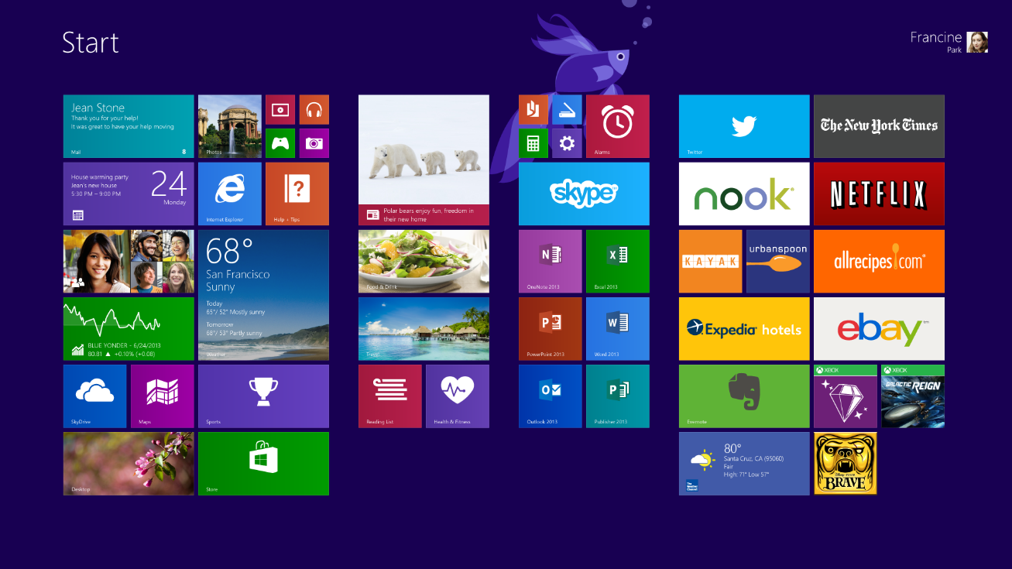

Slide 62
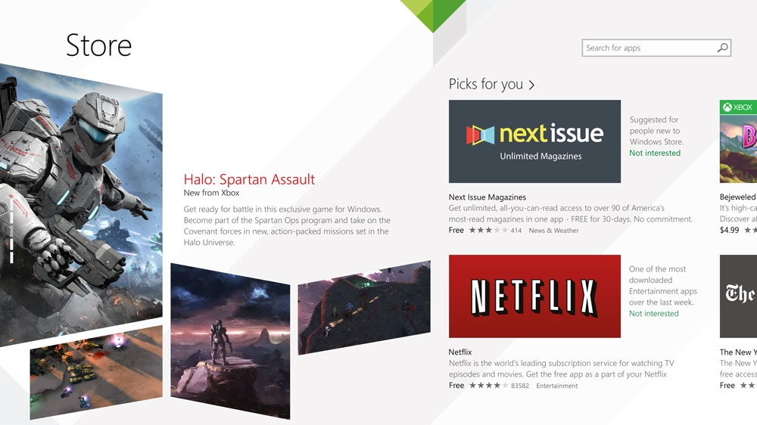

Slide 63
Resources for Microsoft employees
Can’t find the image that you have in mind for your presentation? The Media Acquisitions team can help you find and license imagery through our stock photography providers. You will also find imagery and information via these links:
Mediaacq
Microsoft Brand Tools
Presentation guidelines
Microsoft photography
Microsoft illustrations
www.superstock.com/
www.gettyimages.com/creativeimages/royaltyfree
www.corbisimages.com/stock-photo/royalty-free
(Media Acquisitions alias)
There are agreements in place with these providers.
For information on the use of third-party copyrighted content: http://lcaweb/CTP/Copyrights/Third-Party-Content-Use/Pages/default.aspx

