Slide 2
Developing Universal Windows Apps in Visual Studio 2015
2-650
Navit Saxena
Senior Program Manager – Visual Studio

Slide 3
Universal Windows App Development Tools
Download Now !!!
Visual Studio 2015 RC with
Install latest Windows 10 OS (10.0.10075.0)
insider.windows.com
Install VS 2015 RC w/ Universal Windows SDK & Tools
www.visualstudio.com
Build your first Universal Windows App

Slide 4
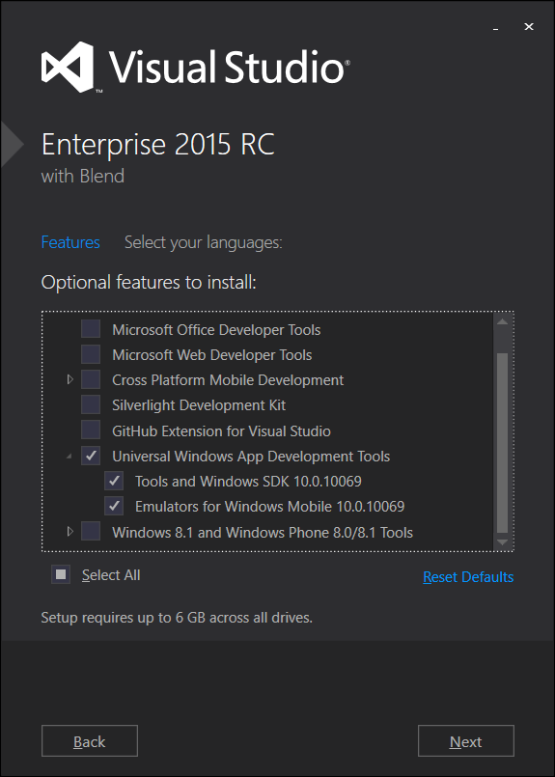
Acquiring Windows 10 Tools/SDKs/Emulators
Select “Universal Windows App Development Tools” using Custom setup option

Slide 5
Agenda
Introduction to Universal Windows Platform
Universal Windows Tooling
Q&A

Slide 6
Universal Windows Platform
Mobile
Desktop
Unified Developer Platform
Single Application Package
Adaptive Code
Universal Windows Platform
Core APIs
IoT
Xbox
Holographic
Surface Hub

Slide 7
Supported OS for Universal Windows development
Windows 8.1
Windows 10
Windows Server 2012 R2
*Windows 7
Best developer experience for building Universal Windows apps
Deploy/Debug/Profile
Simulator
Local Machine
Mobile Emulators
Remote Machine
Device
XAML Designer/Intellisense
All other features work at parity with Windows 10, except:
Deploy/Debug/Profile
Mobile Emulators
Remote Machine
Device
XAML Intellisense
No WACK (Server R2)
All other features work at parity with Windows 10, except:
Deploy/Debug/Profile
Remote Machine
Device
XAML Intellisense
*will be supported at RTM

Slide 8
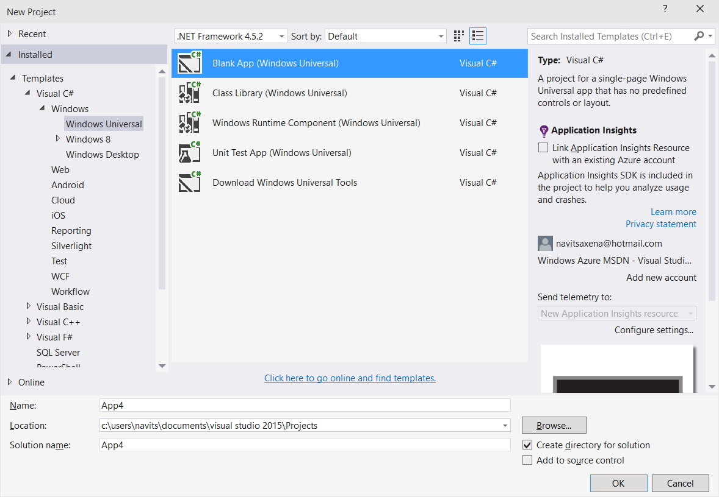
Project Templates

Slide 9
Universal Windows Samples
https://github.com/Microsoft/Windows-universal-samples

Slide 10
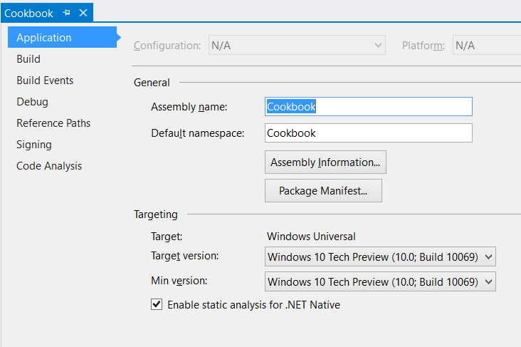
Project Properties
Target version (TargetPlatformVersion)
Defines the version of Universal Windows SDK being targeted by project
Defines the available API surface for the application
Is stamped as TargetDeviceFamily.MaxVersionTested property in the AppX manifest file as part of the build process
<Dependencies>
<TargetDeviceFamily
Name="Windows.Universal" MinVersion="10.0.10069.0" MaxVersionTested="10.0.10069.0" />
</Dependencies>

Slide 11
Project Properties
Min version (TargetPlatformMinVersion)
Defines the minimum version of Universal Windows platform being supported by the project (adaptive application package)
Is stamped as TargetDeviceFamily.MinVersion property in the AppX manifest as part of the build process
<Dependencies>
<TargetDeviceFamily
Name="Windows.Universal" MinVersion="10.0.10069.0" MaxVersionTested="10.0.10069.0" />
</Dependencies>

Slide 12
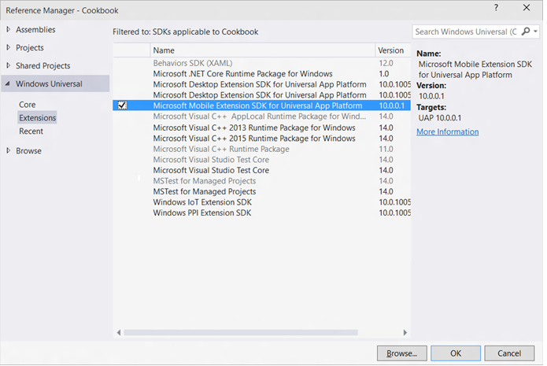
Windows Device Family Extension SDKs
Use device family specific APIs by adding references to Windows Device Family Extension SDKs

Slide 13
Adaptive Code
Use Windows.Foundation.Metadata.ApiInformation APIs to write adaptive code across different Universal Windows versions or different target device families
if (Windows.Foundation.Metadata.ApiInformation.IsTypePresent
("Windows.Phone.UI.HardwareButtons"))
{
Windows.Phone.UI.Input.HardwareButtons.BackPressed += HardwareButtons_BackPressed;
}
Code | Title | Speaker
679 | From the Small Screen to the Big Screen: Building Universal Windows App Experiences with XAML | Tim Heuer Harini Kannan

Slide 14
3rd Party Extension SDKs
Developers can reference Windows 8.1 Extension SDKs in a Universal Windows app
Referencing a native Windows 8.1 Extension SDK requires referencing “Microsoft Visual C++ 2013 Runtime Package for Windows Universal” SDK
Developers can build Extension SDKs for Universal Windows platform and write adaptive code against platform APIs
Universal Windows Extension SDKs are installed under:
\Program Files\Microsoft SDKs\Windows Kits\10\ExtensionSDKs

Slide 15
3rd Party Extension SDKManifest.xml
<FileList
TargetPlatform="UAP"
MinVSVersion="14.0"
SDKType="External"
TargetPlatformMinVersion="10.0.10069.0"
TargetPlatformVersion="10.0.10069.0"
DisplayName = "Sample Extension SDK"
AppliesTo = "WindowsAppContainer + (Managed | Javascript)"
SupportsMultipleVersions="Error">
<File Reference = "Sample.winmd">
<ToolboxItems VSCategory = "Toolbox.Default"/>
</File>
</FileList>

Slide 16
VSIX Manifest
<PackageManifest Version="2.0.0" xmlns="http://schemas.microsoft.com/developer/vsx-schema/2011">
<Metadata>
<Identity Id="Microsoft.PlayerFramework.Win10.XAML.f1f3ff2b-1658-456c-9862-0ce64eda4130" Version="1.0“
Language="en-US"
Publisher="Microsoft" />
<DisplayName>Microsoft Player Framework for Windows 10 XAML UAP</DisplayName>
</Metadata>
<Installation AllUsers="true" Scope="Global">
<InstallationTarget Id="Microsoft.ExtensionSDK"
TargetPlatformIdentifier="Windows Kits"
TargetPlatformVersion="10"
SdkName="Microsoft.PlayerFramework.Xaml" SdkVersion="1.0" />
</Installation>
<Dependencies>
<Dependency Id="Microsoft.Framework.NDP"
DisplayName="Microsoft .NET Framework"
Version="[4.5,)" />
</Dependencies>
</PackageManifest>

Slide 17
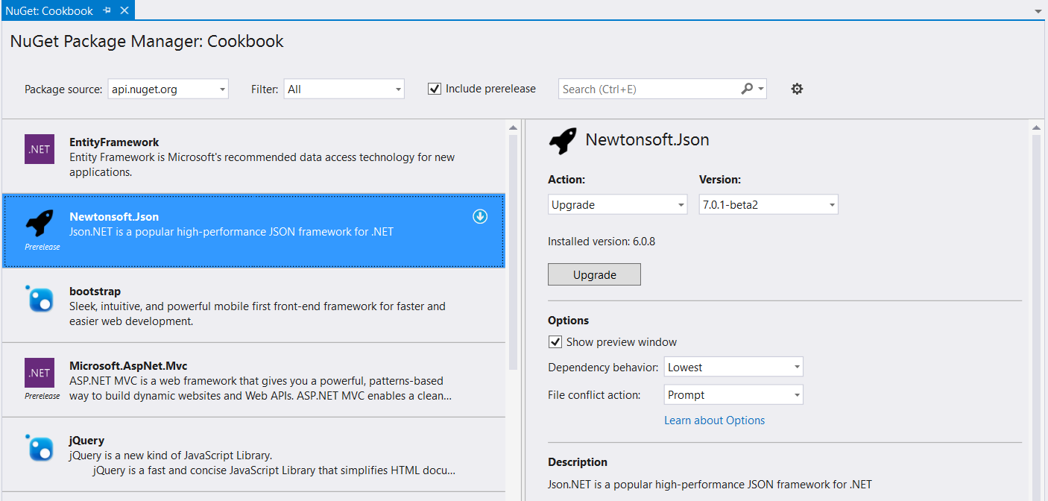
NuGet
Universal Windows apps support referencing Windows 8.1 NuGet packages

Slide 18
NuGet – RTM
Universal Windows apps will support referencing Windows Phone 8.1 NuGet packages
Developers will be able to author NuGet packages specific to Universal Windows platform
If you want an early preview of NuGet bits for Universal Windows platform, send me an email: navits@microsoft.com

Slide 19
App Insights
App Insights enable developers to monitor app’s performance and usage statistics
Universal Windows project templates are enabled for App Insights and monitors app users, sessions, page view, crashes and real time usage without writing any additional code
Developers can easily add custom events to collect additional telemetry data for the app

Slide 20
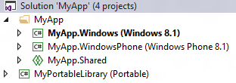
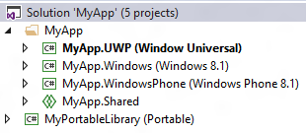
Universal 8.1 App
Upgrade Windows/Windows Phone 8.1 projects
Add single Universal Windows project to target different Windows 10 devices
Use Adaptive code for device family specific APIs
Use Adaptive UI to support different form factors
Use Shared projects, WinRT components, PCLs to share code between Universal Windows, Windows 8.1 and WP 8.1 projects
1: Single Universal Windows Project

Slide 21
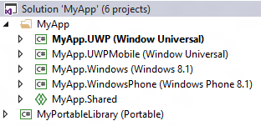
Universal 8.1 App
Add a new Universal Windows project to target a specific Windows 10 device (ex: Mobile)
Update Package.appxmanifest to include “Windows.Mobile” device family with matching MinVersion/MaxVersionTested
<Dependencies>
<TargetDeviceFamily
Name="Windows.Mobile"
MinVersion=“<Windows.Mobile MinVersion>“
MaxVersionTested=“<Windows.Mobile MaxVersionTested>"/>
</Dependencies>
Add a new Universal Windows project to target other Windows 10 devices
Use Shared projects, WinRT components, PCLs to share code between Universal Windows, Windows 8.1 and WP 8.1 projects
2: Different project/package for a device family

Slide 22
Resources
Windows 10 Samples
Developer Assistant for Visual Studio
http://aka.ms/devassistant
https://github.com/Microsoft/Windows-universal-samples

Slide 23
Related Sessions
Code | Title | Speaker
749 | Deep dive into XAML & .NET Universal Windows app development | Unni Ravindranathan
697 | New XAML Tools in Visual Studio 2015 | Unni Ravindranathan
719 | Fast and Powerful Diagnostics, and Problem Solving with Application Insights | Victor Mushkatin
617 | Introducing the App Model for the Universal Windows Platform (UWP) | Andrew Clinick Matt Hidinger
629 | What's New in XAML for Universal Windows Apps | Joe Stegman
679 | From the Small Screen to the Big Screen: Building Universal Windows App Experiences with XAML | Tim Heuer Harini Kannan
741 | Moving to the Universal Windows Platform: Porting an App from Windows 8.1 XAML or Windows Phone Silverlight to Windows 10 | Sam Jarawan
733 | API Contracts (or How I Learned to Stop Checking OS Versions and Love Feature Detection) | Brent Rector

Slide 24
Questions
Navit Saxena
Program Manager
navits@microsoft.com
@saxenanavit

