Slide 1
Updated Agenda
12:00PM–1:00PM | Session #1
1:00PM–2:00PM | Lunch

Slide 3
Maximize Your Coding Productivity for Apps, Devices, and Services with Visual Studio 2015
2-669
Mark Wilson-Thomas
Program Manager, Visual Studio IDE
: @MarkPavWT
 mark.wilson-thomas@microsoft.com

Slide 4
Agenda
Your Visual Studio
Code, navigate and fix issues
Share your feedback

Slide 5
Simpler choices: Visual Studio 2015 Product Family
More details at aka.ms/vs2015compare

Slide 6
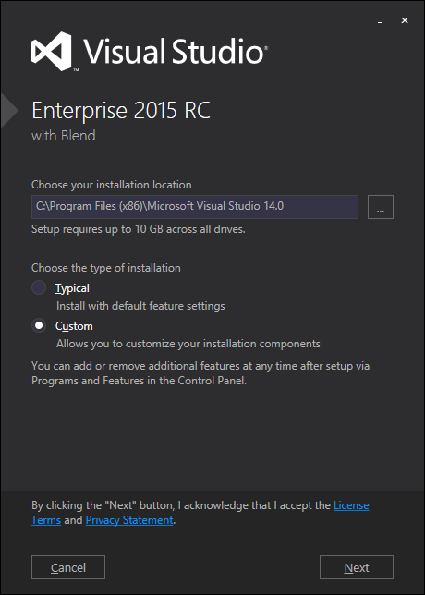
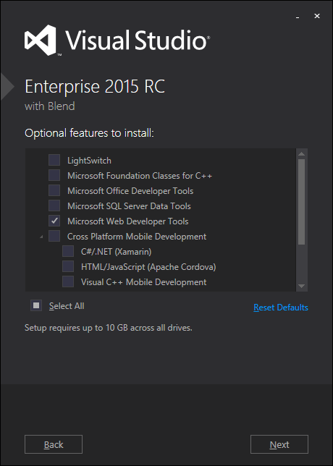
Your Visual Studio: Customize your setup
Smaller default
More choices
More platforms
Side-by-side compatible
Smaller, faster updates

Slide 7
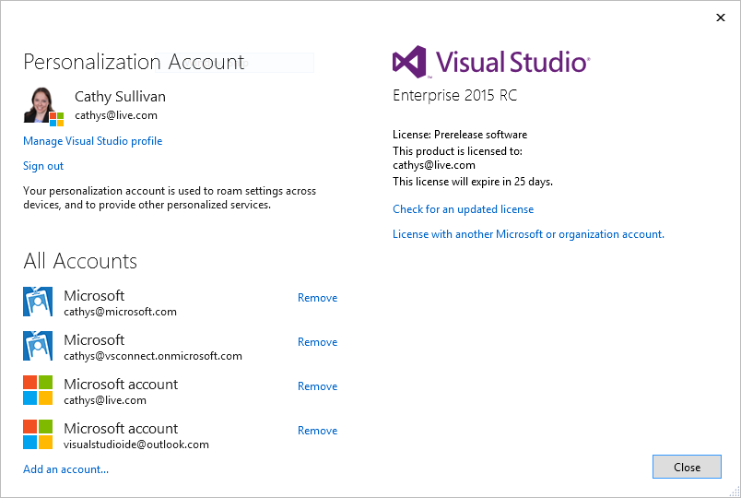
Your Visual Studio: Settings and services
Personalization Account
Tamara Howell
tamarah@live.com
tamarah@live.com
tamarah@microsoft.com
tamarah@vsconnect.onmicrosoft.com
tamarah@live.com
contoso@live.com
Settings and connected services roam
Supports work or school account

Slide 8
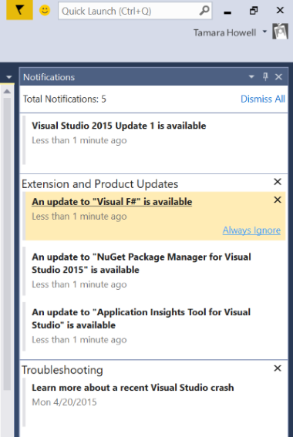
Your Visual Studio: Notifications
Reduced clutter
See what you care about

Slide 9
Your Visual Studio: On all your devices
Improved High-DPI support
Custom window layouts
Touch in the editor

Slide 10
Code, navigate and fix issues
Navigate without losing context
Understand code without leaving it
Find and eliminate issues
Refactor with ease
Extensible

Slide 11
Announcing….
CodeLens available in Visual Studio 2015 Professional

Slide 12
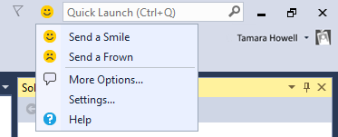
Sharing your feedback
Send a smile
UserVoice for suggestions
Connect for bugs

Slide 13
Now you’ve seen this talk…
See these related sessions at //build/
Analyzers:
3-725 - Thursday, 6:30-7:30 PM - .NET Compiler Platform ("Roslyn"): Analyzers and the Rise of Code-Aware Libraries [Dustin Campbell]
C# and VB Enhancements:
3-711 - Friday, 9:00-10:00 AM - What's New in C# 6 and Visual Basic 14 [Dustin Campbell, Mads Torgersen]
Extending Visual Studio and Visual Studio Online :
2-772 - Thursday 11:30-12:30 - Money, Fame, and Flexibility: New Extensibility for Visual Studio and Visual Studio Online [Tarek Madkour, Will Smythe, Sam Harwell]
Get Visual Studio 2015 RC - http://aka.ms/GetVS2015
Give us feedback via Send-a-Smile
Try Bing Developer Assistant - http://aka.ms/devassistant

Slide 14
Share your story, see what’s new!
What?
Talk to a Visual Studio team member about your experience with the Visual Studio IDE, and have an early look at what we’re developing
When?
Schedule a time with George Engelbeck in the back of the room or email vsdr@microsoft.com
Why?
Your input and feedback will influence future Visual Studio tools

