Slide 2
Introduction to ASP.NET 5
2-687
Scott Hanselman and Scott Hunter
The Lesser Scotts
ASP.NET and Azure Web Tools

Slide 3
ASP.NET 5 and the Modern Web
Totally Modular
Faster Development Cycle
Seamless transition from on-premises to cloud
Choose your Editors
and Tools
Open Source with Contributions
OSS
Cross-Platform
Fast

Slide 4
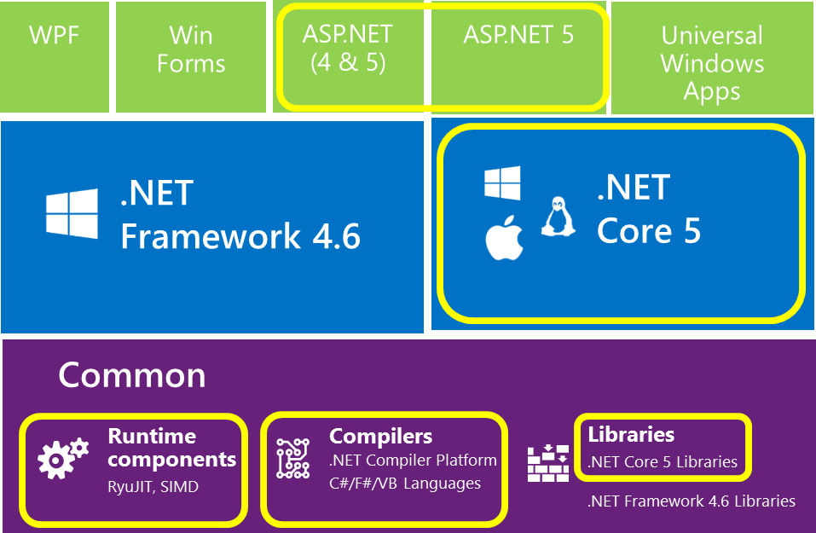
What is open source?
WPF
Win Forms
ASP.NET (4 & 5)
ASP.NET 5
Universal Windows Apps
ASP.NET 5
.NET
Framework 4.6
.NET
Core 5
Common
Runtime components
Compilers
Libraries
.NET Compiler Platform
C#/F#/VB Languages
.NET Core 5 Libraries
.NET Framework 4.6 Libraries
RyuJIT, SIMD

Slide 5
Resources
Improve your skills by enrolling in our free cloud development courses at the Microsoft Virtual Academy.
Try Microsoft Azure for free and deploy your first cloud solution in under 5 minutes!
Easily build web and mobile apps for any platform with AzureAppService for free.

