Slide 2
Azure Virtual Machines Deep Dive
2-688
Mahesh Thiagarajan
Senior Program Manager, Azure Compute
Boris Scholl
Principal Program Manager, Cloud Platform Tools

Slide 3
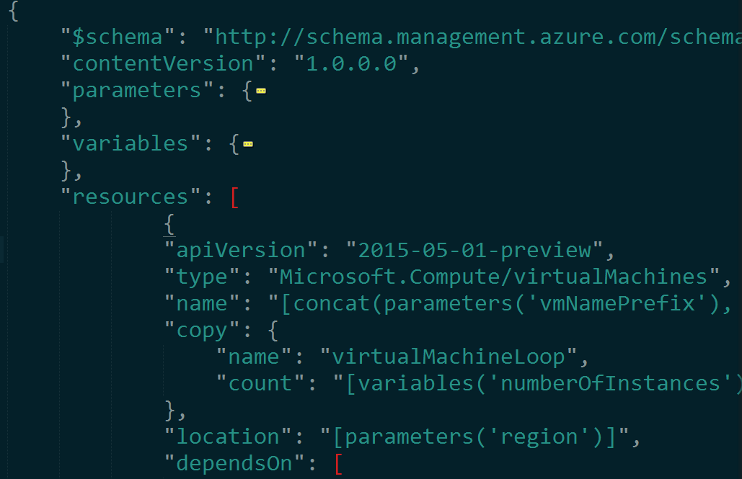
What are we covering today?
What’s new in IaaS (v2)
Dev/Test on Azure IaaS Simplified. Again.
Deploying Complex Applications on IaaS
A single unified Azure Stack for the Microsoft Cloud
Closing

Slide 4
Resource Groups
Tightly coupled containers of multiple resources of similar or different types
Lifecycle, Access, Billing & Identity control the resources placed in a resource group
Spans multiple regions
RESOU
R
CE G
R
OUP

Slide 5
Resource Group Lifecycle
Question:
Should these resources be in the same group or a different one?
Hint:
Do they have common lifecycle and management?

Slide 6
Power of Repeatability
SQL-A
Instantiation of repeatable config.
Configuration → Resource Group
Azure Templates can:
Ensure Idempotency
Simplify Orchestration
Simplify Roll-back
Provide Cross-Resource Configuration and Update Support
Azure Templates are:
Source file, checked-in
Specifies resources and dependencies (VMs, WebSites, DBs) and connections (config, LB sets)
Parametized input/output
Website
[SQL CONFIG] VM (2x)
DEPENDS ON SQL
DEPENDS ON SQL
SQL - A
Website
Virtual
Machines
SQL
C
ONFIG

Slide 7
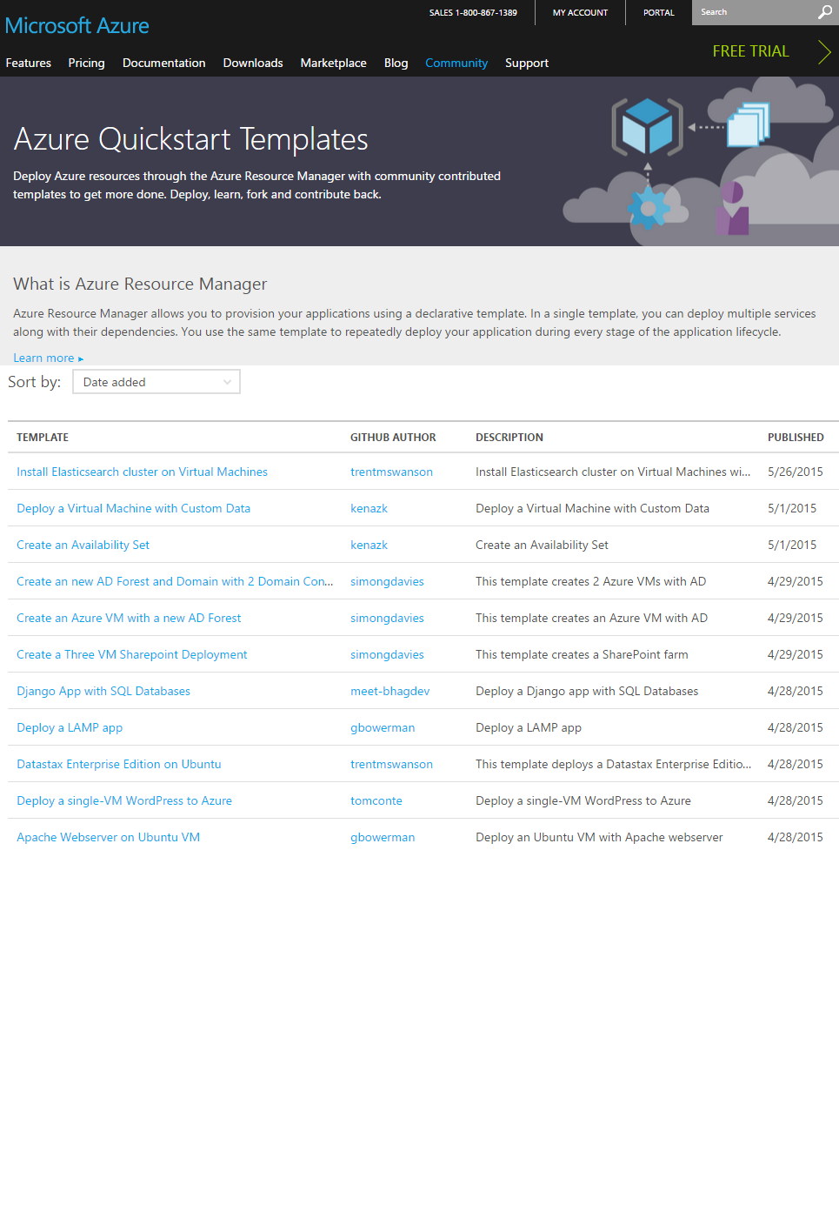
Azure Templates for IaaS Stack
  Complexity made Simple – Build, integrate and deploy complex applications with ease using Azure Templates
  Build applications using IaaS & PaaS Azure Services in a single Template (For Example: Websites + VM)
  Easily Scalable Deployments using Copy & CopyIndex (Loops) in Azure RM
  Role-Based Access Control support
  Tags Configuration and billing propagation to the monthly usage bill

Slide 8
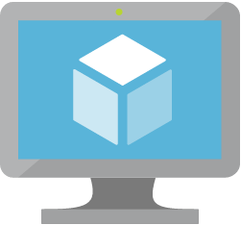
Azure Virtual Machines (v2)
  Massive and parallel deployment of Virtual Machines
  3 Fault Domains in Availability Sets
  Custom URLs for Custom Script VM Extensions for VMs
  SSH-2 RSA Format Support for SSH keys for Linux VMs
  Premium Storage Support

Slide 9


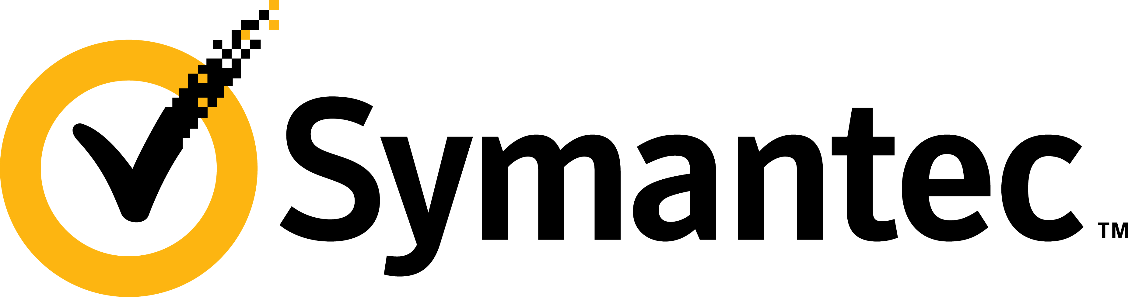

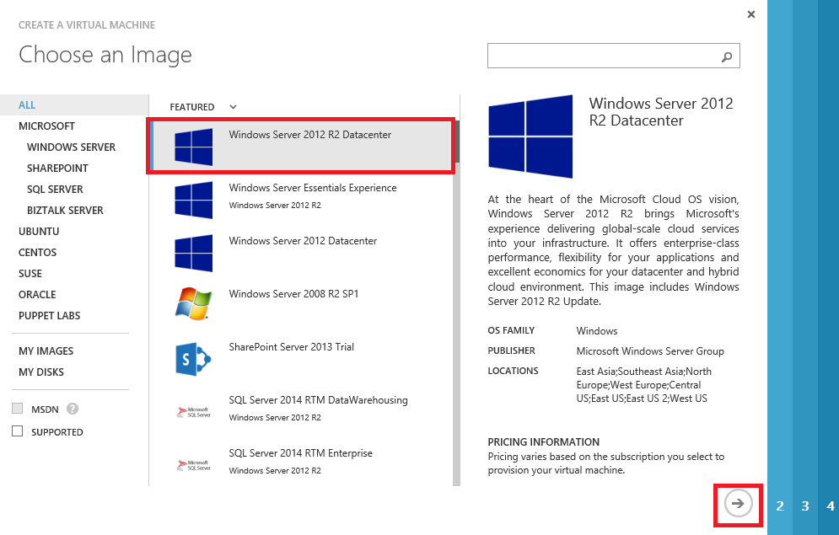
Azure VM Extensions
Extending the power of your VM
Enable easier management
Support partner ecosystem
Full control still with you!
IaaS extended
Curated Extensions
Agent
Azure

Slide 10





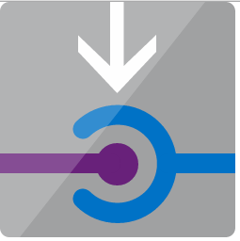
Improved Azure Networking APIs
  Floating Network Interfaces as a new object
  Load Balancers as a first-class resource
  Granular Virtual Network APIs to simplify the management of individual Virtual Networks
  Public IP Addresses – Dynamic & Static
  Static Public IP Addresses can be assigned to
  Network Security Groups

Slide 11
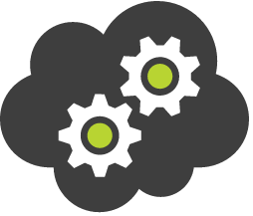

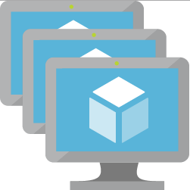
Notable Changes to the APIs
Concept | Azure Service Management (XML-Based) | Azure Resource Manager (JSON-Based)
Cloud Services | Container for holding virtual machines | Not a concept anymore
Affinity Groups | Places Compute & Network together. | Not a concept anymore
Availability Sets | Configured as a label on the VM | New resource type
Load Balancing | Implicit Load Balancing with Cloud Service | New resource type
Virtual IP Address | Implicit VIP associated with Implicit LB in a Cloud Service | New resource type. It can be attached to NIC or LB
DNS Name | Implicit globally unique DNS Name with Cloud Service. | Optional parameter that can be specified on a Public IP Address resource.
Endpoints | Input Endpoints configured to open up connectivity for certain ports. | Inbound NAT Rules can be configured on Load Balancers to achieve the same capability.
Network Interfaces | Expressed as Network Configuration on VM | New resource type. The lifecycle of a NIC is outside of a VM.

Slide 12
What are we covering today?
What’s new in IaaS (v2)
Dev/Test on Azure IaaS Simplified. Again.
Deploying Complex Applications on IaaS
A single unified Azure Stack for the Microsoft Cloud
Closing

Slide 13

Simplifying Dev/Test on IaaS
Repeatable Deployments
Manage the entire application as an entity
Integrate with continuous Build Delivery Pipeline
Easy Monitoring & Alerting
Hybrid connectivity

Slide 14
Demo: Simplifying Dev/Test on Azure
Single-Click SharePoint Template Deployment & Load Testing from Visual Studio

Slide 15
Resource Tags
Name-value pairs assigned to VMs or resource groups
Subscription-wide taxonomy and complete for tag consistency
Each resource can have up to 15 tags
Tagging Tips
Notes: attach notes to VMs via tags
Creator: track who is the “owner” of a VM
Department/Cost center: record who is responsible for paying for a resource or application
Environment: group resources in production vs. pre-production vs. test

Slide 16
Access Control: RBAC
Role Definitions
describes the set of permissions (e.g. read actions)
can be used in multiple assignments
What is RBAC
allows secure access with granular permissions to resources
assignable to users, groups or service principals
built-in roles make it easy to get started
Role Assignments
  associate role definitions with an identity (e.g. user/group) at a scope (e.g. resource group)
  always inherited – subscription assignments apply to all resources

Slide 17
Role Based Access Control

Slide 18
Granular Scopes
/subscriptions/{id}/resourceGroups/{name}/providers/…/virtualmachines/{vmname}
subscription level – grants permissions for all resources in the sub
resource group level – grants permissions for all resources in the group
resource level – grants permissions to the specific resource

Slide 19

Simplified Manageability of Applications on IaaS
Upgrade
master template can be updated can be used to rollout upgrades
imperative APIs, Client tools support to update the resources
Manageability, Auditing & Debugging
operations can be tracked for 90 days
management Locks to lock down resources from deletion
debugging can be done resources.azure.com

Slide 20
Demo: Simplified Management of Azure IaaS
Scaling up a Web Tier Farm in a single click

Slide 21
What are we covering today?
What’s new in IaaS (v2)
Dev/Test on Azure IaaS Simplified. Again.
Deploying Complex Applications on IaaS
A single unified Azure Stack for the Microsoft Cloud
Closing

Slide 22






















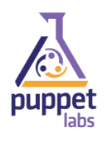


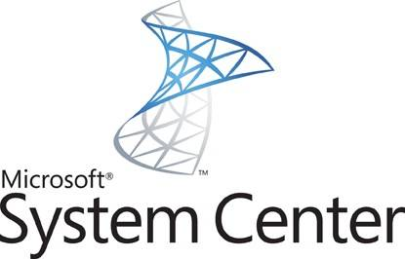

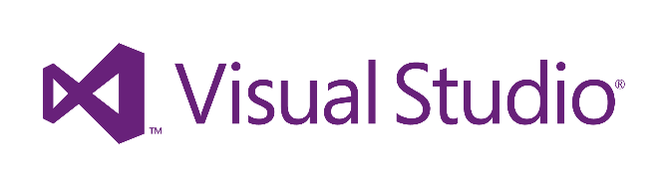
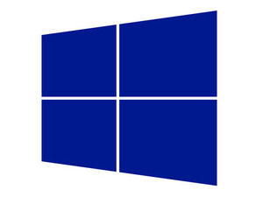
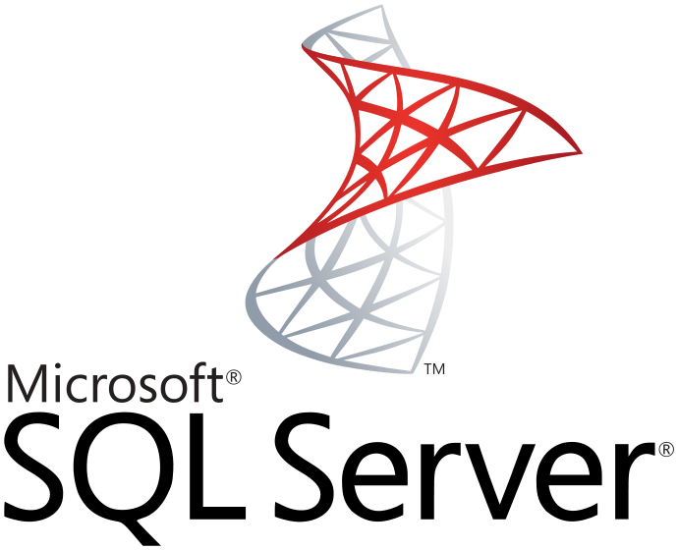
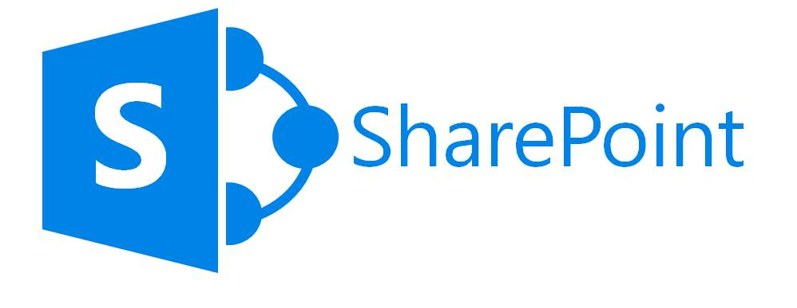



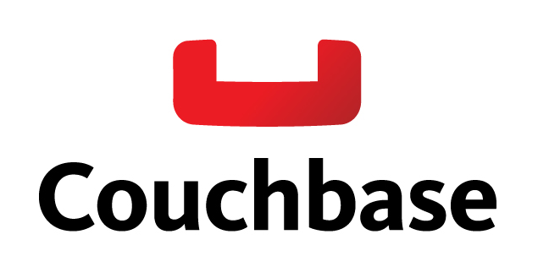

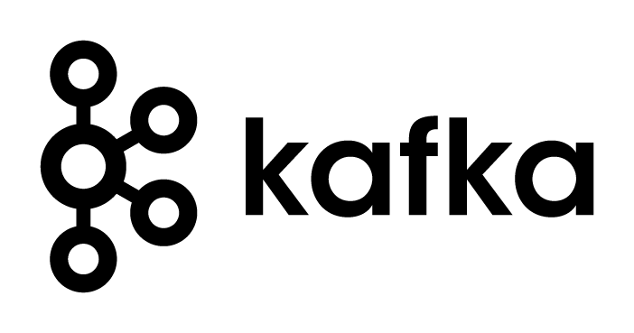
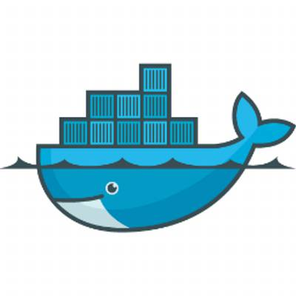
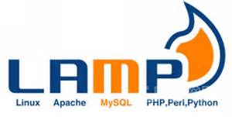

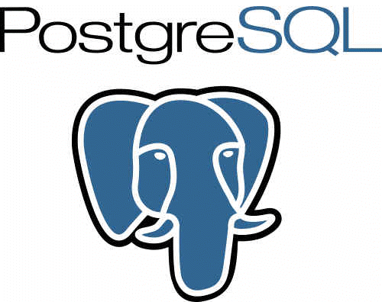
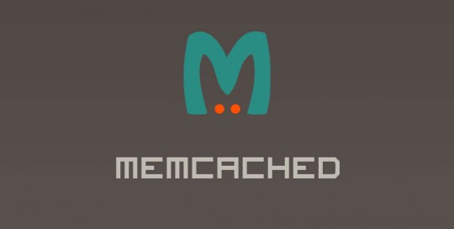




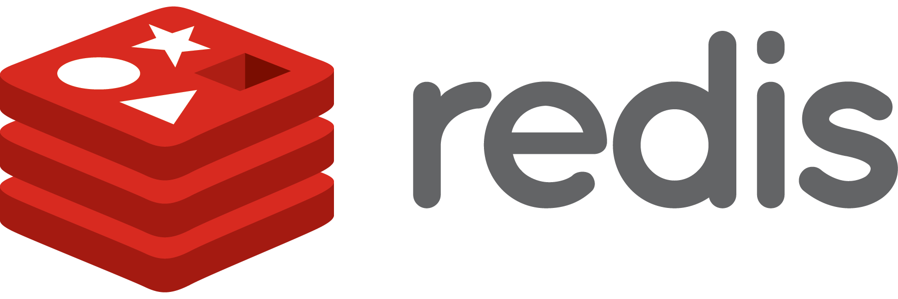



Azure: Open and Easy
Operating System
Data
Development
Tooling
DevOps
Application Templates

Slide 23


Architecting Complex Applications on IaaS
Infrastructure
Templates for different environments (eg: Dev, Test, Prod)
orchestration of multiple infrastructure tiers (eg: VMs, VNETs)
orchestration across multiple azure resources (eg: VMs, Websites)
In-VM Configuration
common scripts/recipes that can be shared across multiple VMs
app-specific scripts that will be used for application setup

Slide 24
Architecting Complex Applications using Templates
Master Template
Parameters
adminUserName
adminPassword
storageAccountname
region
virtualNetworkName
addressPrefix
subnetName
subnetPrefix
jumpbox
tshirtSize
osFamily
Known Configuration Resources Template [Small, Medium, Large]
Member Resources
Template(s)
Shared Resource (App-Tier) Template
Member Resources
Template
Widely Re-Usable
Script(s)
Optional Resource
Template(s)
Optional Capability
Template
Optional Capability
Template
Purpose Specific
Script(s)
setup.sh

Slide 25
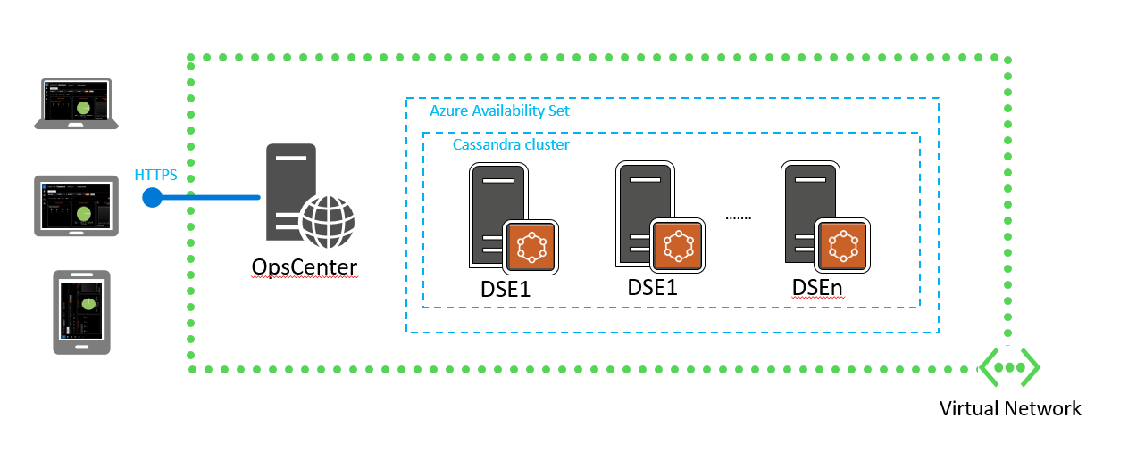
DataStax on Azure Virtual Machines (v2)

Slide 26
DataStax on Azure Virtual Machines
opscenter-resources.json
Parameters
storageAccountPrefix
dnsName
virtualNetworkName
adminUsername
adminPassword
region
opsCenterAdminPassword
clusterVmSize
clusterNodeCount
clusterName
metadata.json
opscenter-install-resources.json
azuredeploy.json
opscenter.sh
ephemeral-nodes-resources.json
dsenode.sh

Slide 27
Demo: Azure & Open Source
Deploying DataStax (Cassandra) Cluster on Azure Virtual Machines (v2)

Slide 28
What are we covering today?
What’s new in IaaS (v2)
Dev/Test on Azure IaaS Simplified. Again.
Deploying Complex Applications on IaaS
A single unified Azure Stack for the Microsoft Cloud
Closing

Slide 29

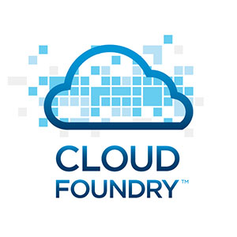
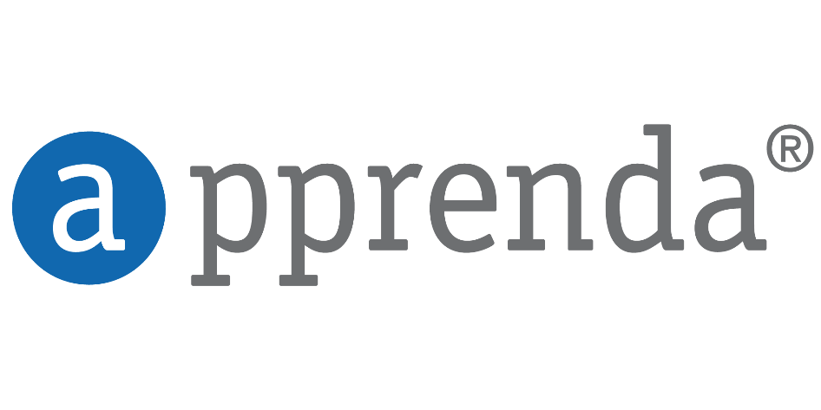
Consistent Management Layer
Curated Extensions

Slide 30
Demo: Single unified Azure Stack
Walkthrough Templates & Tooling Support for unified Azure Stack

Slide 31
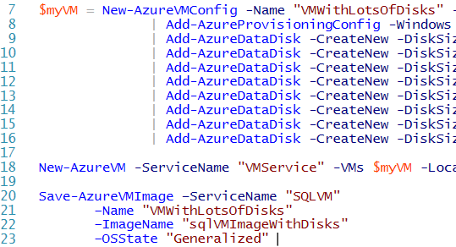
What are we covering today?
Azure Platform Overview
Applications on IaaS
What’s New and Open with IaaS
Closing

Slide 32
Resources
Improve your skills by enrolling in our
free cloud development courses at the Microsoft Virtual Academy.
Try Microsoft Azure for free and deploy your first cloud solution in under 5 minutes!
Easily build web and mobile apps for any platform with AzureAppService for free.

