Slide 2
Building Data Analytics Pipelines using Azure Data Factory, HDInsight, Azure ML and more
2-690
Mike Flasko
Principal Group Program Manager

Slide 3
Agenda
What & Why?
Deep Dive: Customer Churn Analysis
Common Use Cases
Roadmap, Q & A

Slide 4
Customers are looking to derive more and more value from data…
EXAMPLES
Sales and marketing
Finance and risk
Customer and channel
Operational Excellence
Sales forecasting
Fraud detection
User segmentation
Agent allocation
Demand forecasting
Risk management
Personalized offers
Usage optimization
Sales lead scoring
Actuarial modeling
Product recommendation
Operational telemetry
Predict customer churn
Enhanced Customer Service
Predictive maintenance
Supply chain optimization

Slide 5
Customers are looking to derive more and more value from data…
EXAMPLES
Sales and marketing
Finance and risk
Customer and channel
Operational Excellence
Sales forecasting
Fraud detection
User segmentation
Agent allocation
Demand forecasting
Risk management
Personalized offers
Usage optimization
Sales lead scoring
Actuarial modeling
Product recommendation
Operational telemetry
Predict customer churn
Enhanced Customer Service
Predictive maintenance
Supply chain optimization

Slide 7
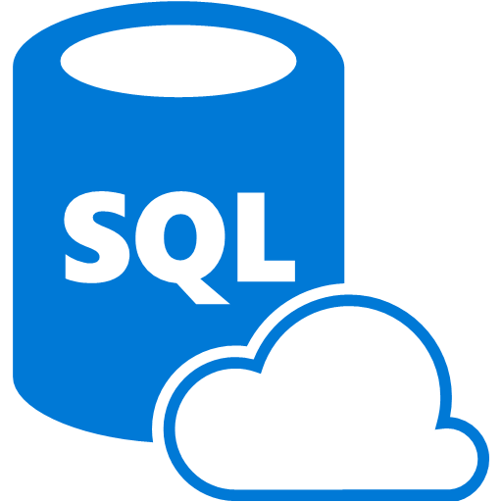
Data Sources
Ingest
Transform & Analyze
Publish
Raw Materials
Acquire Raw Materials
Transform raw materials into “finished goods”
Deliver
Azure Blob Storage
Azure DB

Slide 8
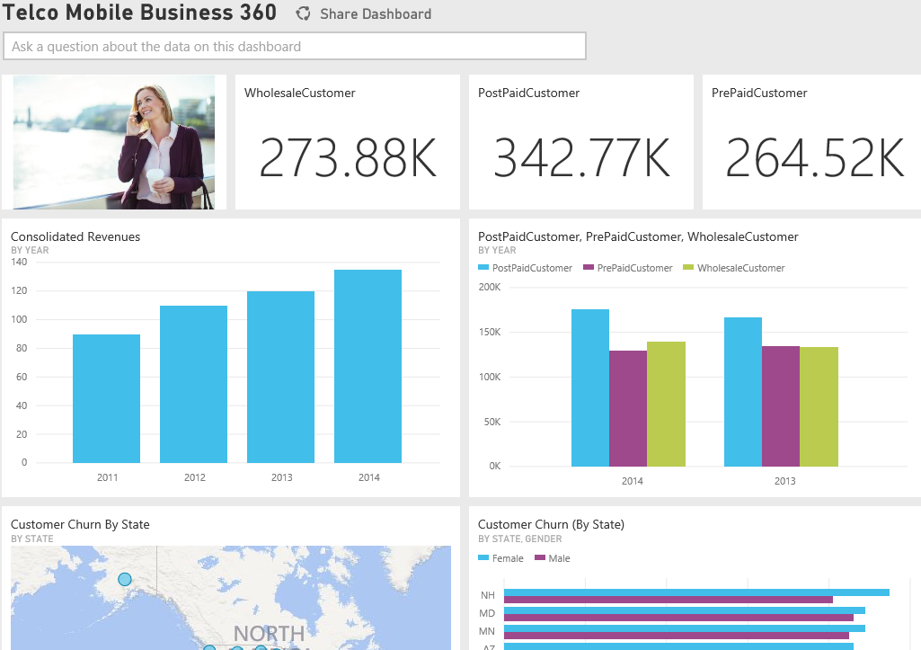
Predict customer churn
Raw Materials
“Finished Good”
Last Name | First Name | At risk of churning | ….
Flasko | Mike | Yes
Anand | Subbaraj | No
Gaurav | Malhotra | Yes
… | ….
Last Name | First Name | Country | Age | …
Flasko | Mike | Canada | 32
Anand | Subbaraj | USA | 30
Gaurav | Malhotra | USA | 72
… | …. | …. | ….

Slide 9
Data Factory Concepts
Data Set
(Collection of files, DB table, etc)
Activity: a processing step
(Hadoop job, custom code, ML model, etc)
Pipeline: a sequence of
activities (logical group)
…
Data Sources
Ingest
Transform & Analyze
Publish
Call Log Files
Call Log Files
Transform, Combine, etc
Analyze
Move
Visualize
Customer Table
Customer Table
On Premises
Data Mart
Customer Call Details
Customers Likely to Churn
Customer Churn Table
Azure Blob Storage
Azure DB

Slide 10
Demo: Customer Churn Pipeline

Slide 11
Data Sets: time slicing
Monthly
Data Set 1
Run 1
Monthly
Data Set 2
Jan
Run 2
Activity
Jan
Feb
Run 3
Feb
March
March
Hourly
Data Set 3
Daily
Data Set 4
1
Run 1
Activity
Mon
…
Tues
24
Wed

Slide 12
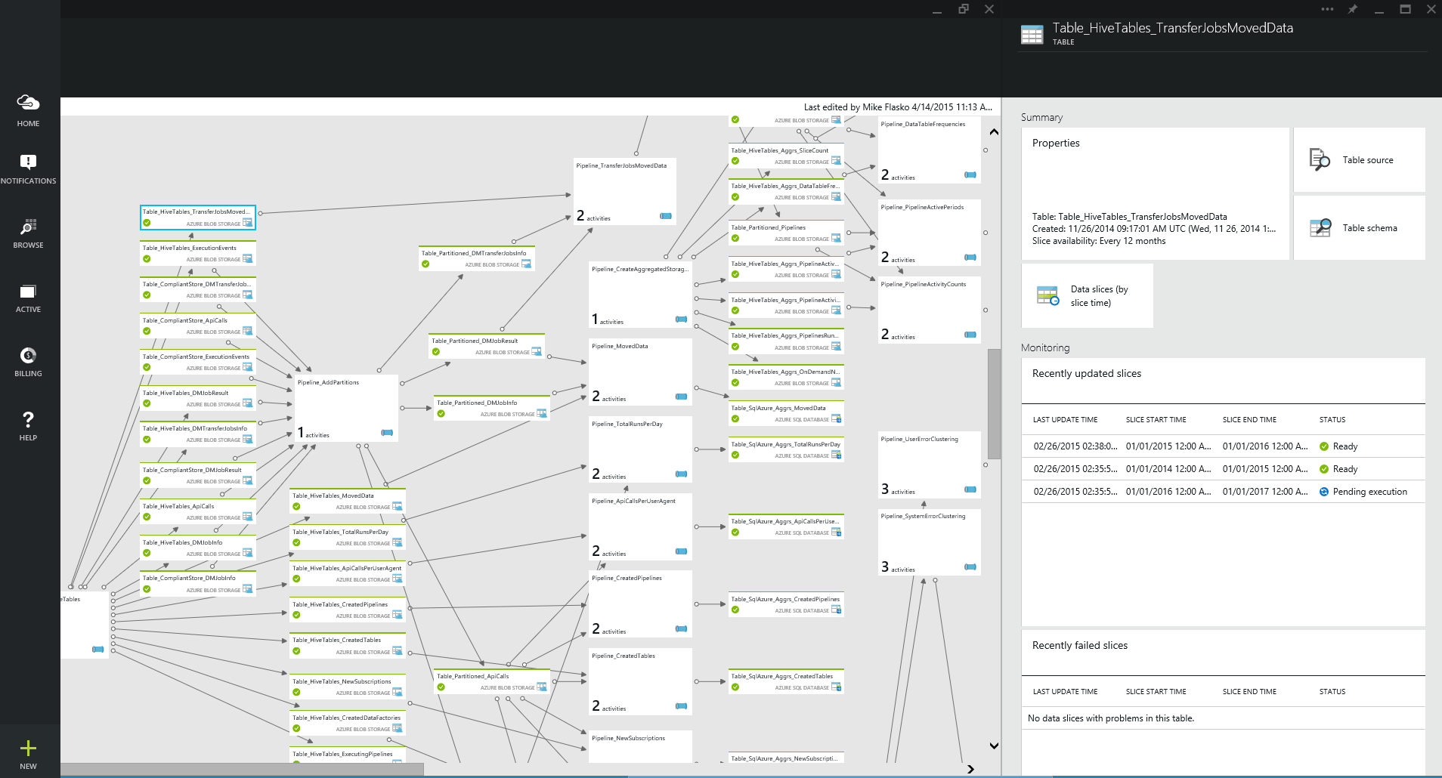
Azure Data Factory
A managed cloud service for building & operating data pipelines (aka. data flows)
Orchestrate, monitor & schedule
compose data processing, storage & movement services (on premises & cloud)
Automatic infrastructure mgmt
combine pipeline intent w/ resource allocation & mgmt
data movement as a service (global footprint & on premises)
Single pane of glass
one place to manage your network
of data flows

Slide 13
Customers are looking to derive more and more value from data…
EXAMPLES
Sales and marketing
Finance and risk
Customer and channel
Operational Excellence
Sales forecasting
Fraud detection
User segmentation
Agent allocation
Demand forecasting
Risk management
Personalized offers
Usage optimization
Sales lead scoring
Actuarial modeling
Product recommendation
Operational Telemetry
Predict customer churn
Enhanced Customer Service
Predictive maintenance
Supply chain optimization

Slide 14
Additional Common Use Cases: Customer Profiling: Product Recommendations, customized offers, etc. Operational Excellence: Telemetry systems, usage optimization, etc

Slide 15
 | Added Recently | Roadmap
Authoring | Web-based editor | Visual Studio (intellisense & pipeline templates) Application templates (customer churn, recommendations, etc)
Data Movement | On premises: Oracle DB, file shares | Data sources added each month Azure Document Db, Azure Search, Azure SQL DW, Azure Data Lake
Data Production | Azure Machine Learning HDInsight enhancements Azure Batch | Additional Activities Reference Data enhancements
Data Management | Monitoring diagram: lineage views, custom layout “Recently updated datasets” view | Monitoring enhancements: new views, customization, resource utilization views, etc. Enhanced alerting
Extensibility | Extension SDK -> limited preview | Extension SDK release
Geo Location | Note: can orchestrate/schedule/monitor resources in all geo-regions now | Additional geo-regions

Slide 16
Call to Action
Documentation: azure.com/df
Samples on GitHub
Ask questions: MSDN Forum
Request & vote on new features
Financial services blueprint
Case Studies
Milliman - Actuarial Automation
Rockwell Automation - Operational Excellence
Ziosk – Improved Guest Experience & Satisfaction

Slide 17
Questions ?
@mflasko
mike.flasko@microsoft.com

Slide 18
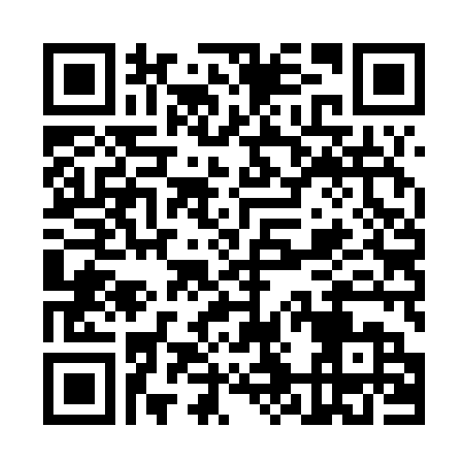
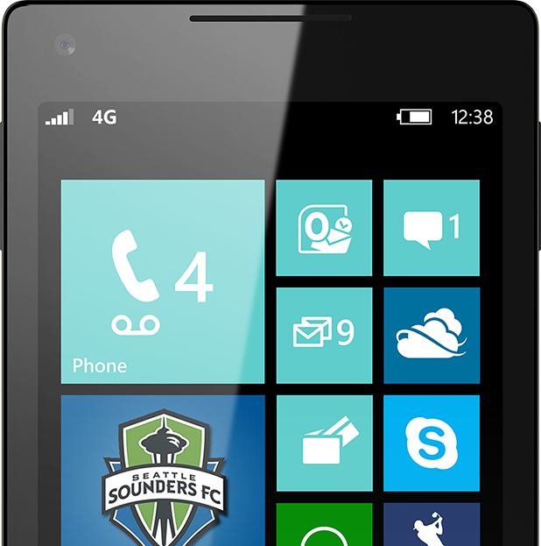
Please Complete An Evaluation Form Your input is important!
or
SAMPLE

Slide 19
Resources
Improve your skills by enrolling in our free cloud development courses at the Microsoft Virtual Academy.
Try Microsoft Azure for free and deploy your first cloud solution in under 5 minutes!
Easily build web and mobile apps for any platform with AzureAppService for free.

