Slide 2
Optimizing Windows Apps for Continuum
2-703
Keri Moran
Principal Program Manager Lead, Windows
Gino Sega
Principal Program Manager, Windows
Liz Threlkeld
Program Manager, Windows

Slide 3




“Continuum for Phones made this entire trip worth it.” – Paul Thurrott, @thurrott
“Boom…they did it….and with panache” – jeevanm, The Verge
“It’s a more radical vision than you’d think.” – Kelsey Cambell-Dollaghan, Gizmodo
“You had me at Continuum for Phones” – Paul Thurrott, @thurrott
“The first glimpse Microsoft provided of Continuum for Windows 10 phones during its Build keynote on Wednesday already looks spectacular.” – Brad Chacos, PC World

Slide 4

People love their smartphones

Slide 5
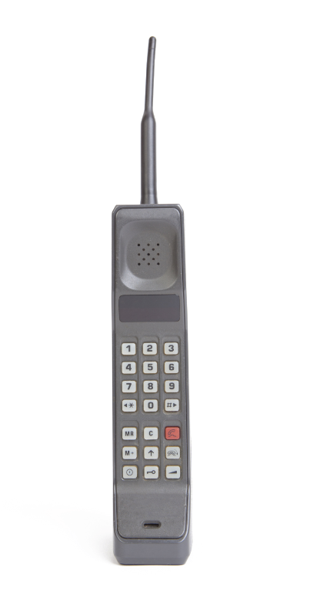
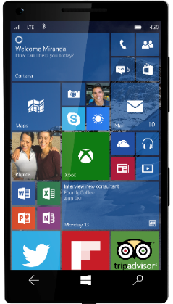
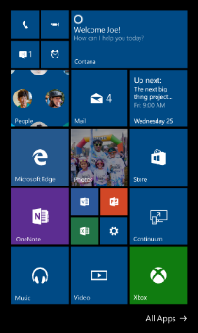
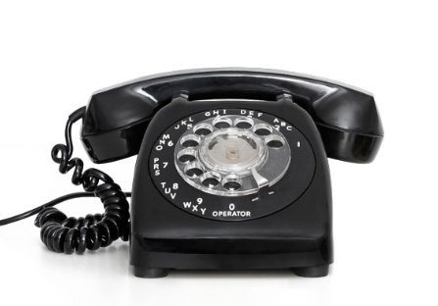
Phones are powerful

Slide 6
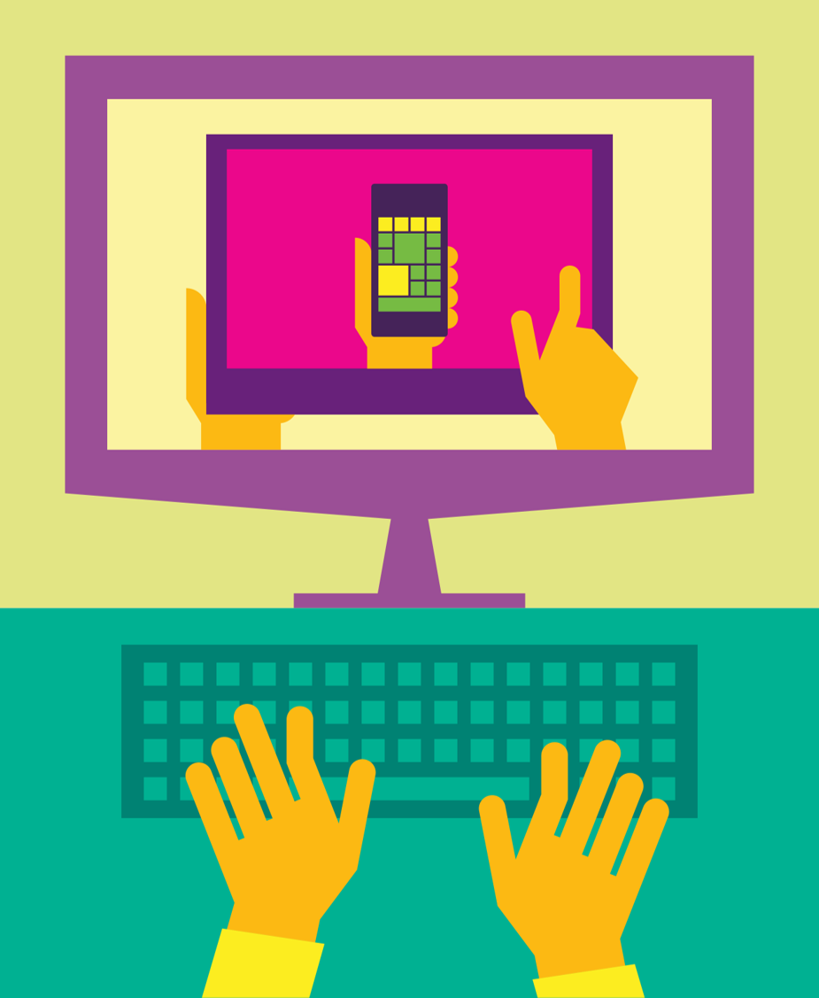


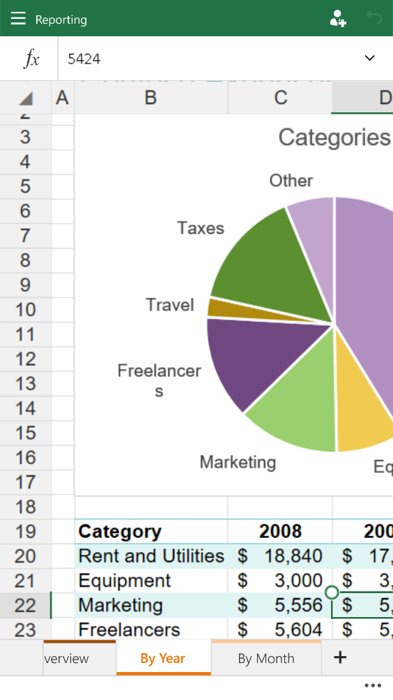
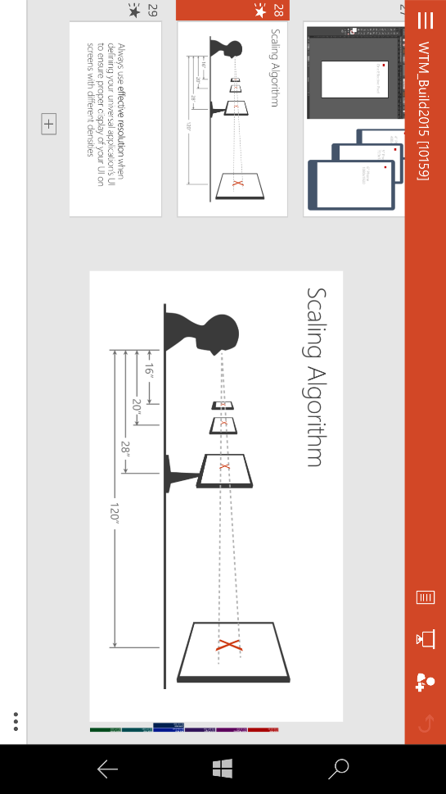
Sometimes a phone is not enough

Slide 7
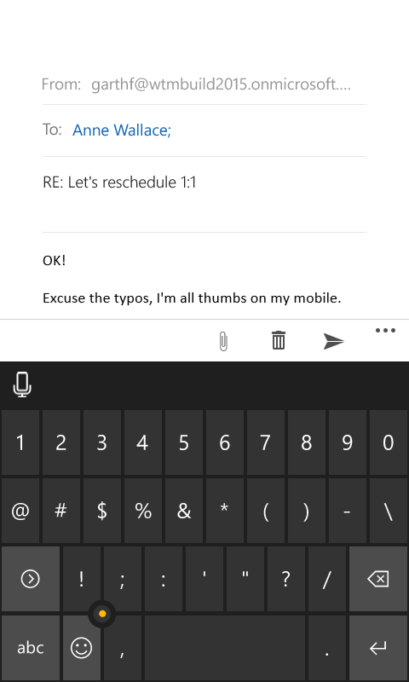
And we want more

Slide 8
Introducing Continuum

Slide 9
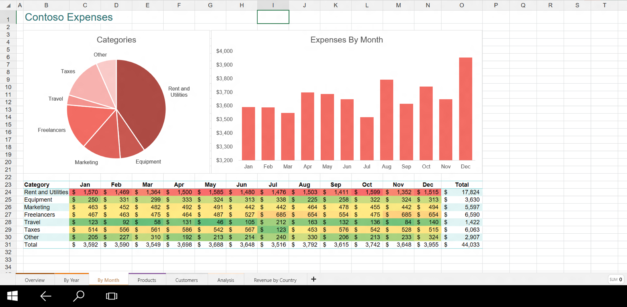
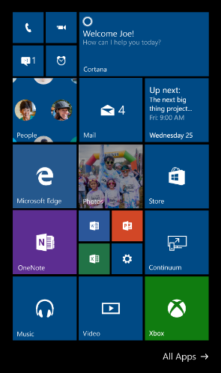
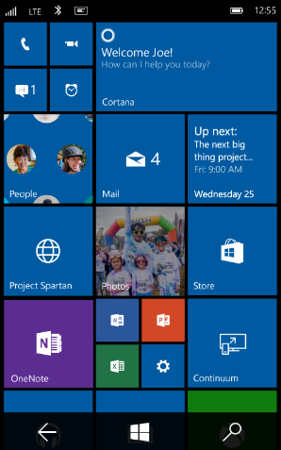

Slide 10
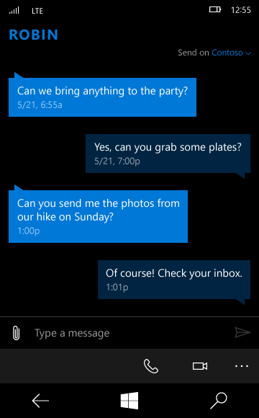

Slide 11
Continuum
Two apps run simultaneously on two screens
Windows Apps transition seamlessly and look beautiful on any screen
Keyboard and mouse support

Slide 12
Continuum brings Universal Windows Apps to any screen, powered by a phone. Write once, run everywhere.

Slide 13
Demo

Slide 14
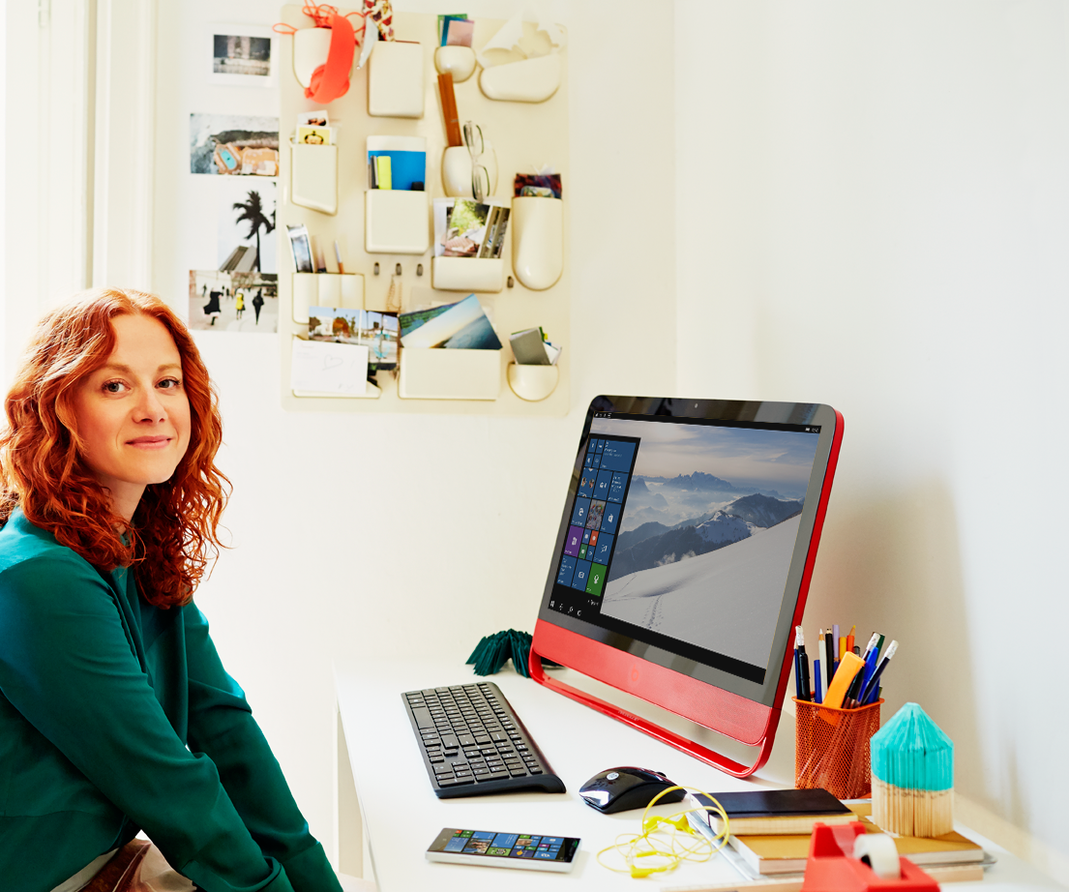
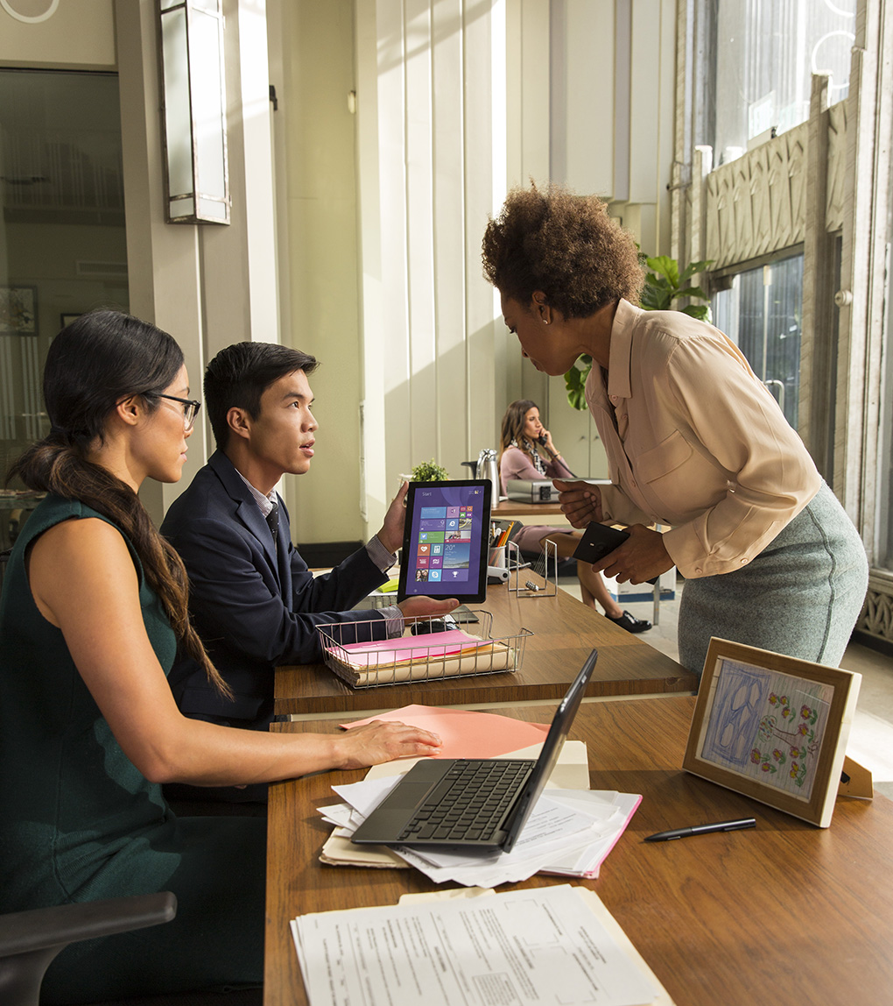
Looks like a phone
Does like a PC

Slide 15

Enabling the PC Everywhere

Slide 16
Continuum for phones can deliver a PC experience to any screen

Slide 17
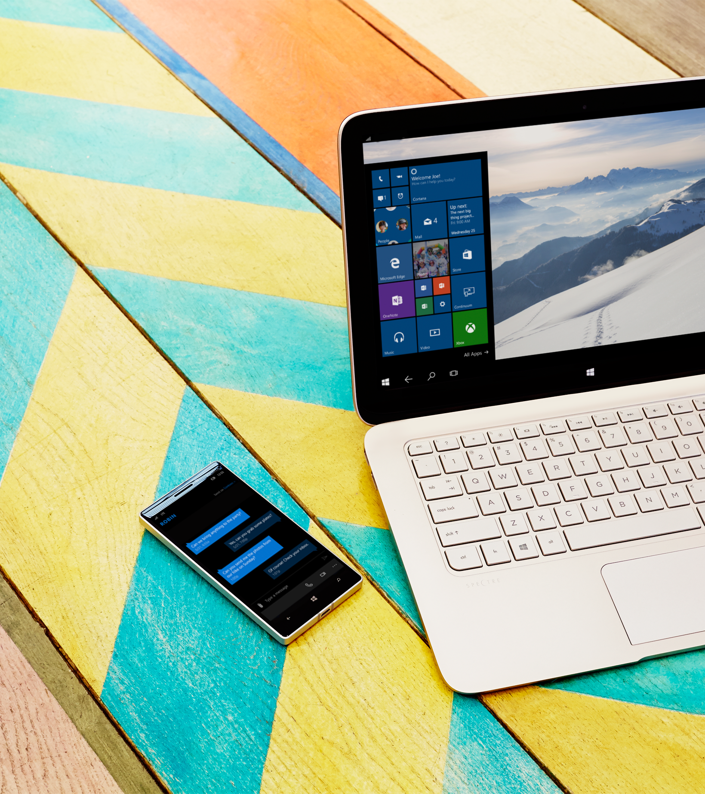
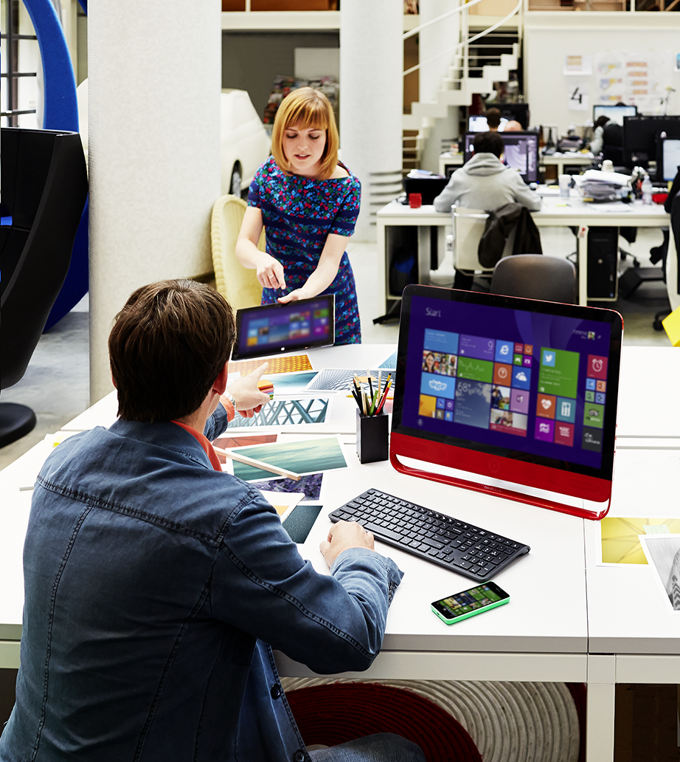
Continuum is the future

Slide 18
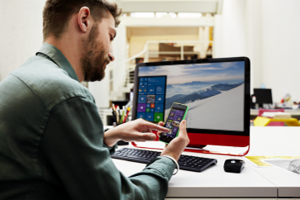
Developer considerations
Integral
Hardware
Adaptive Apps
Packaging
Testing
Scaling
Multi-screen

Slide 19
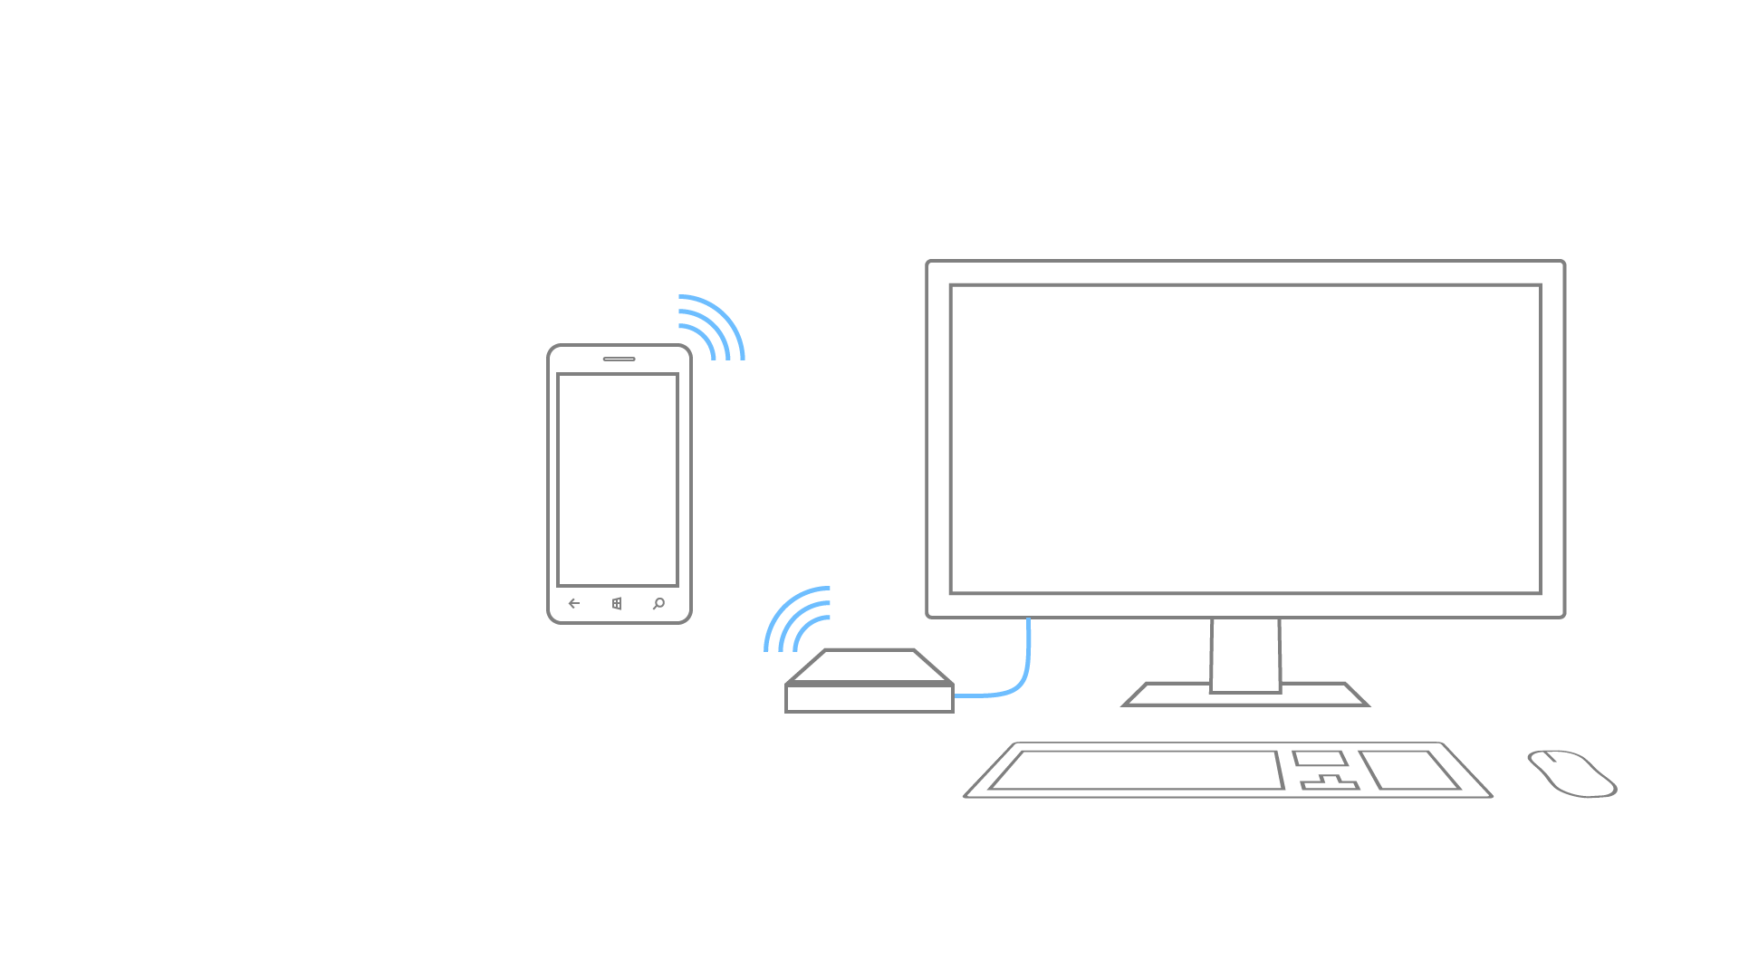
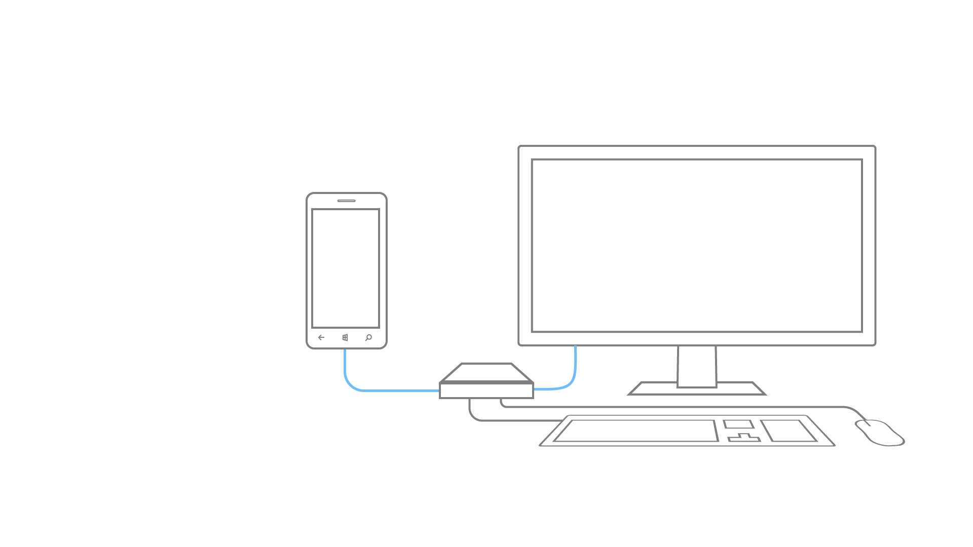
Wired dock
Wireless dock

Slide 20
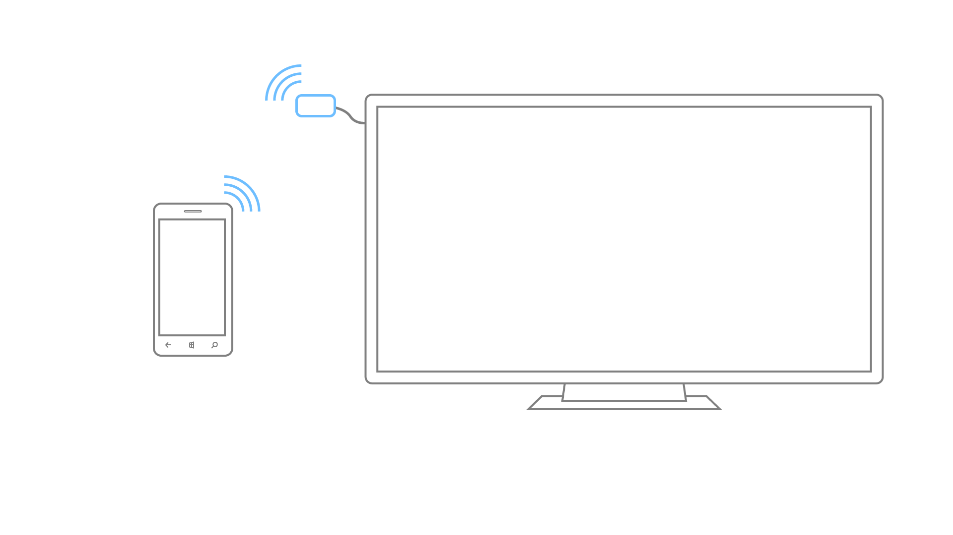
Wireless dongle

Slide 21
Users will interact with your app on a big screen with keyboard and mouse.

Slide 22
Developer considerations
Integral
Hardware
Adaptive Apps
Packaging
Testing
Scaling
Multi-screen

Slide 23

Understanding effective pixels is key.

Slide 24
Developing for Continuum means making sure your Windows Apps dynamically adapt to any screen size from a phone.

Slide 25
“Phone optimized UI”
“Big Screen optimized UI”

Slide 26
Fluid UI

Slide 27
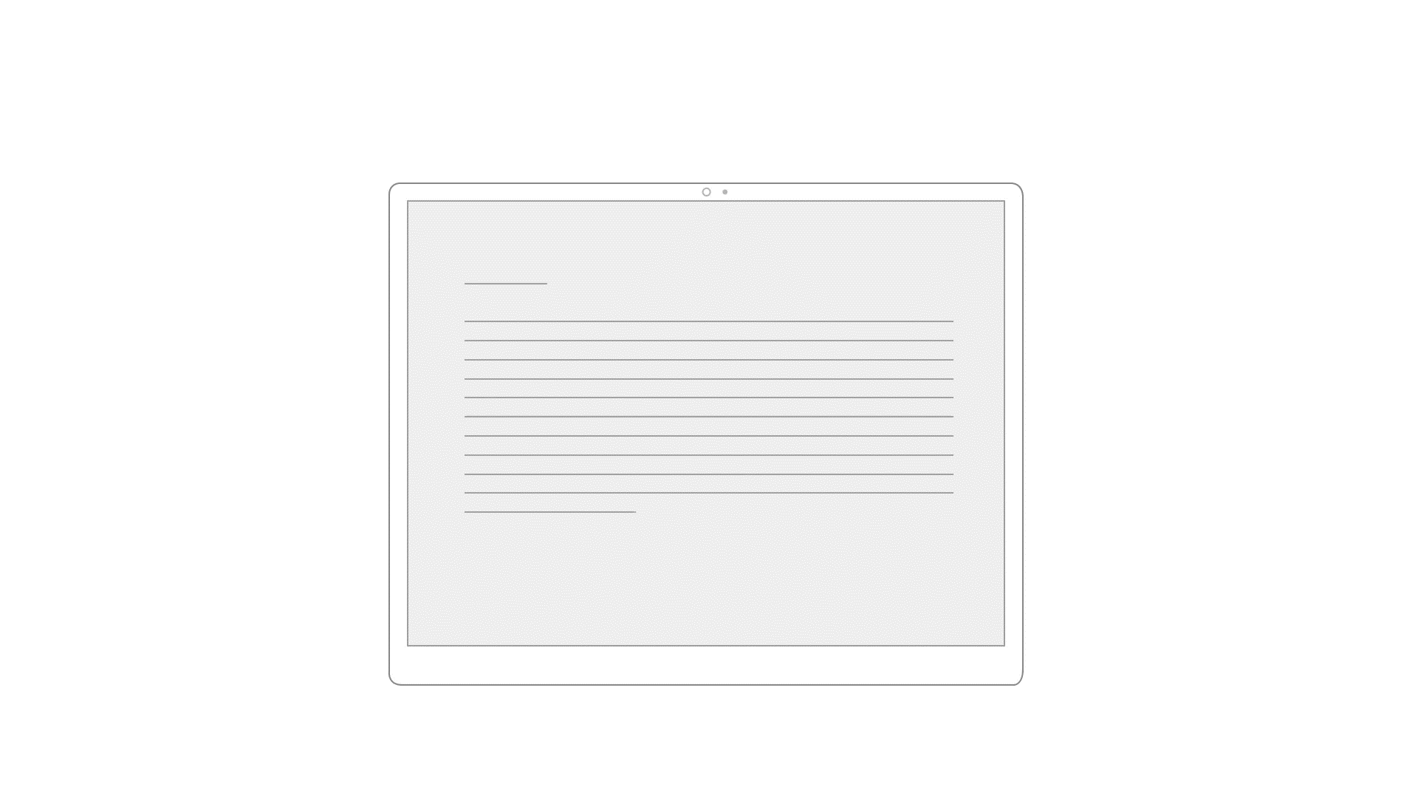
Fluid UI
Given a window size change, your app should resize to any screen .

Slide 28
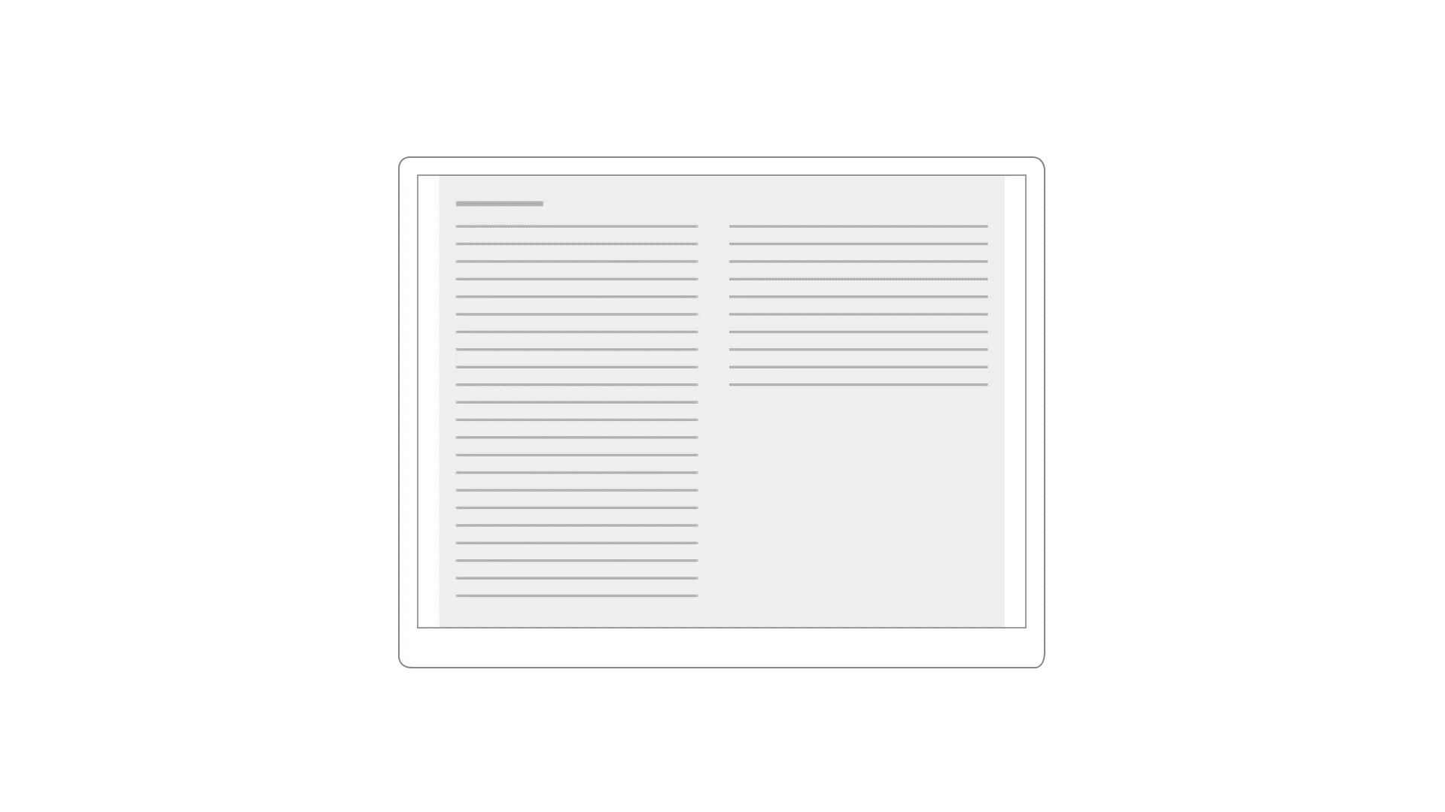
Fluid UI
Use WrapGrid style controls to reflow app content to better fit any screen.

Slide 29
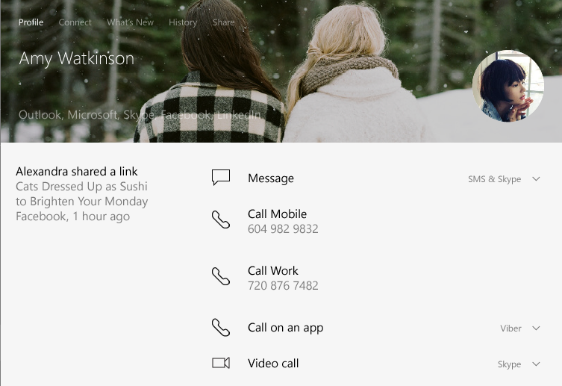
Fluid UI
66.6%
33.3%

Slide 30
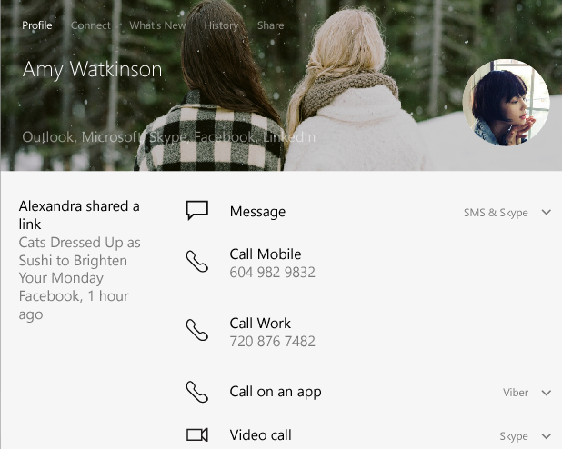
Fluid UI
66.6%
33.3%
66.6%
33.3%

Slide 31
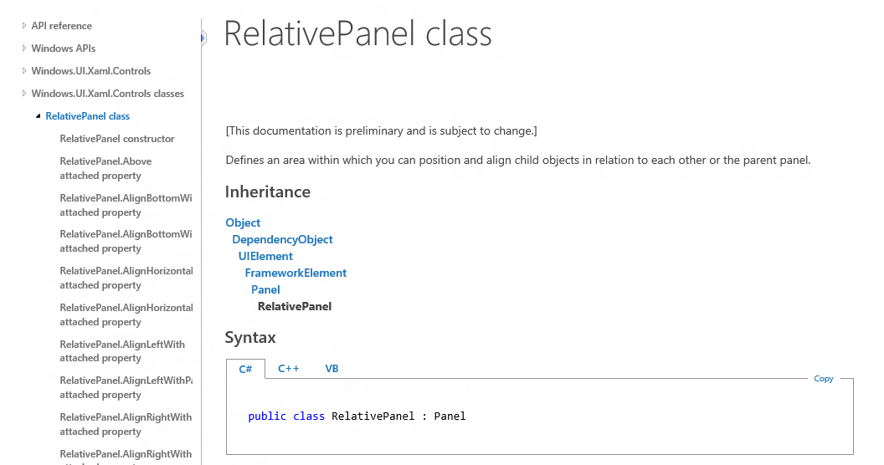
Fluid UI

Slide 32
Responsive UI
Fluid UI

Slide 33
“Phone Optimized UI”
Effective Width <= 768
“Big Screen Optimized UI”
Effective Width > 768

Slide 34
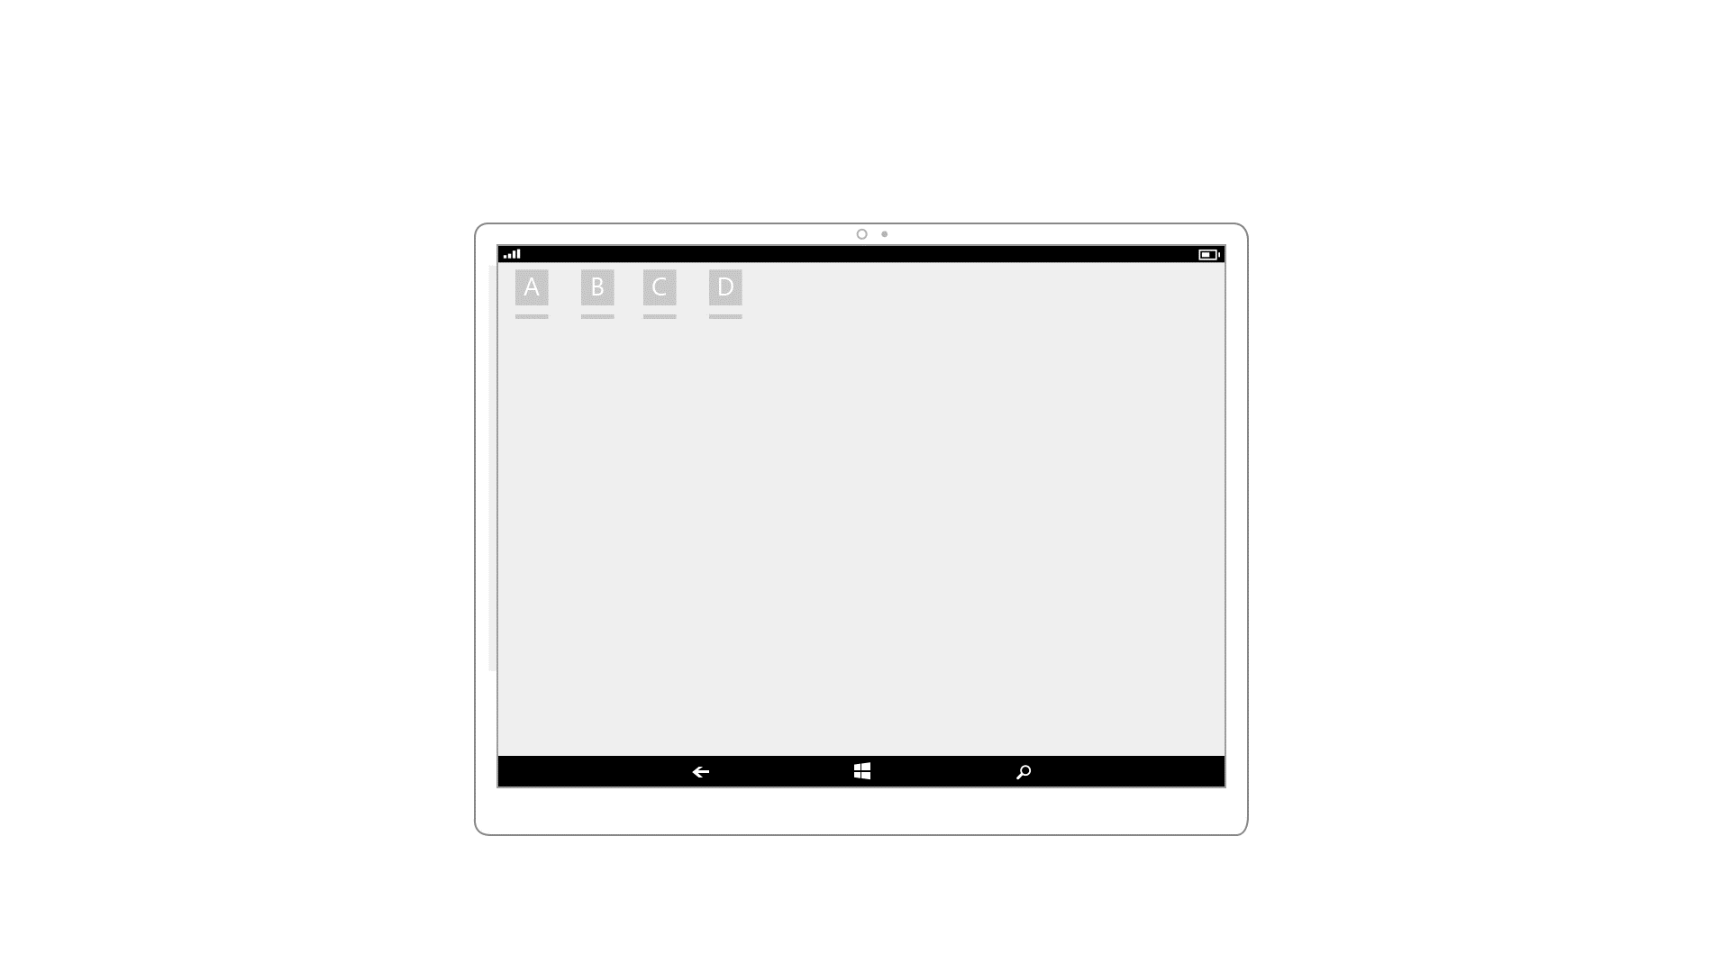
Responsive UI
Use AdaptiveTriggers to reveal or hide content at set snap points.

Slide 35
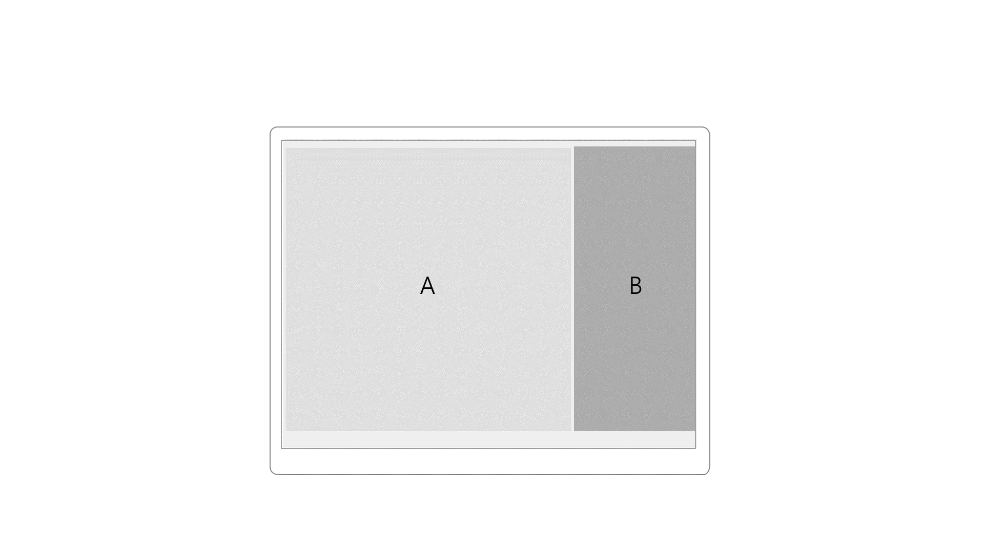
Responsive UI
Use AdaptiveTriggers to reposition UI at specific snap points.

Slide 36
Responsive UI
Reposition
66.6%
33.3%

Slide 37
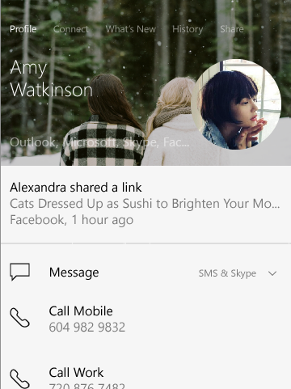
Responsive UI
Reposition
66.6%
33.3%
100%
100%

Slide 38
Adaptive Triggers
<VisualState>
<!-- VisualState to be triggered when window width is >768 effective pixel-->
<VisualState.StateTriggers>
<AdaptiveTrigger MinWindowWidth=“769" />
</VisualState.StateTriggers>
<VisualState.Setters>
<Setter Target="Button1.Content” Value="Wide"/>
</VisualState.Setters>
</VisualState>
<VisualState>
<!-- VisualState to be triggered when window width is between 0 to 768 effective pixels-->
<VisualState.StateTriggers>
<AdaptiveTrigger MinWindowWidth="0" />
</VisualState.StateTriggers>
<VisualState.Setters>
<Setter Target="Button1.Content” Value=“Narrow"/> </VisualState.Setters>
</VisualState>

Slide 39
Adaptive Triggers
<VisualState>
<!-- VisualState to be triggered when window width is >768 effective pixel-->
<VisualState.StateTriggers>
<AdaptiveTrigger MinWindowWidth=“769" />
</VisualState.StateTriggers>
<VisualState.Setters>
<Setter Target="Button1.Content” Value="Wide"/>
</VisualState.Setters>
</VisualState>
<VisualState>
<!-- VisualState to be triggered when window width is between 0 to 768 effective pixels-->
<VisualState.StateTriggers>
<AdaptiveTrigger MinWindowWidth="0" />
</VisualState.StateTriggers>
<VisualState.Setters>
<Setter Target="Button1.Content” Value=“Narrow"/> </VisualState.Setters>
</VisualState>

Slide 40
Adaptive Triggers
<VisualState>
<!-- VisualState to be triggered when window width is >768 effective pixel-->
<VisualState.StateTriggers>
<AdaptiveTrigger MinWindowWidth=“769" />
</VisualState.StateTriggers>
<VisualState.Setters>
<Setter Target="Button1.Content” Value="Wide"/>
</VisualState.Setters>
</VisualState>
<VisualState>
<!-- VisualState to be triggered when window width is between 0 to 768 effective pixels-->
<VisualState.StateTriggers>
<AdaptiveTrigger MinWindowWidth="0" />
</VisualState.StateTriggers>
<VisualState.Setters>
<Setter Target="Button1.Content” Value=“Narrow"/> </VisualState.Setters>
</VisualState>

Slide 41
Tailored UI
Responsive UI
Fluid UI

Slide 42
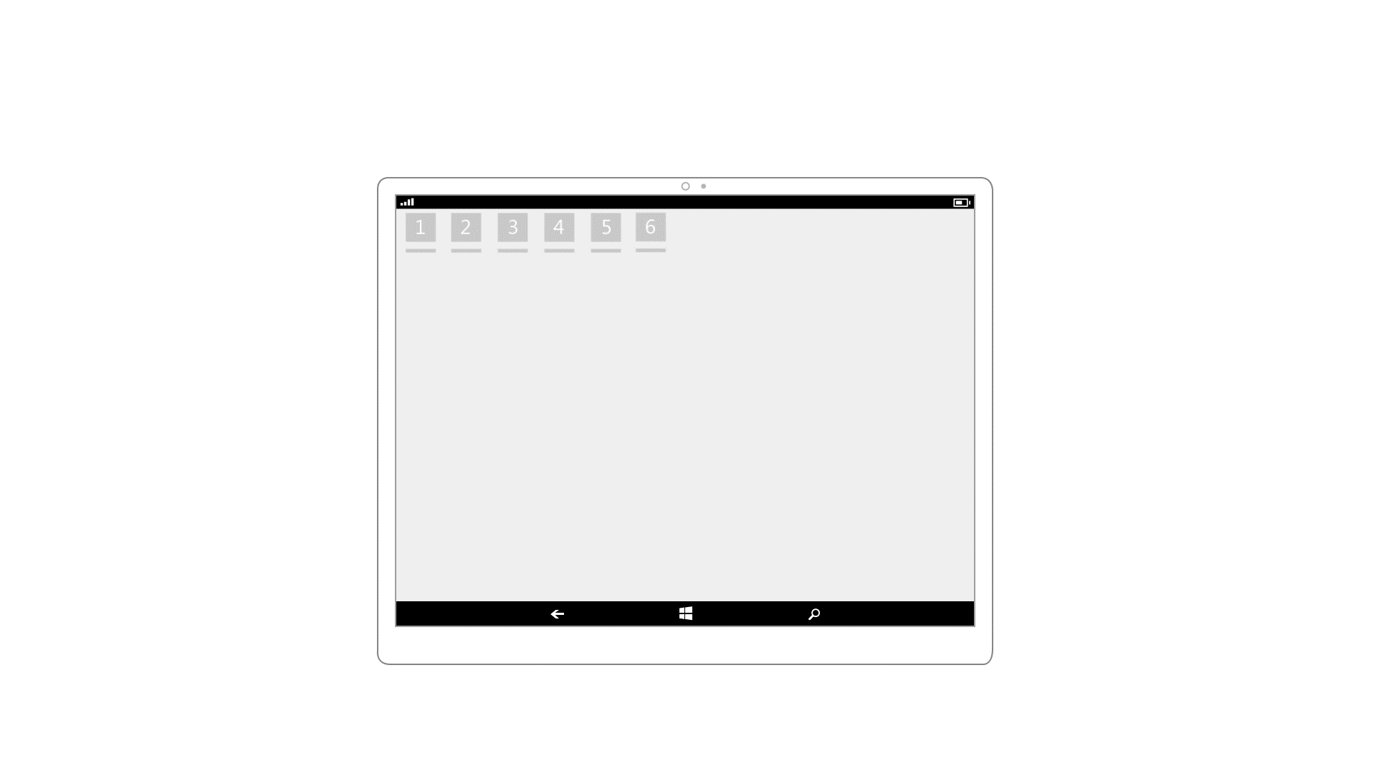
Tailored UI
Replace controls and UI elements.

Slide 43
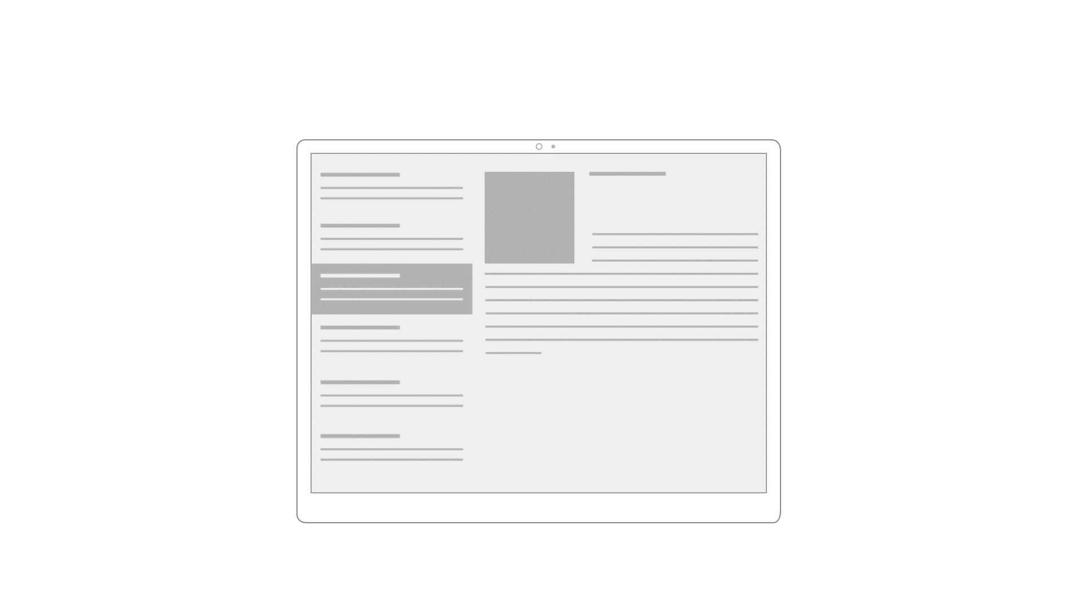
Tailored UI
Re-architect the navigation and layout of your application.

Slide 44
Adaptive Triggers
<VisualState>
<!-- VisualState to be triggered when window width is >768 effective pixel-->
<VisualState.StateTriggers>
<AdaptiveTrigger MinWindowWidth=“769" />
</VisualState.StateTriggers>
<VisualState.Setters>
<Setter Target="Button1.Content” Value="Wide"/>
</VisualState.Setters>
</VisualState>
<VisualState>
<!-- VisualState to be triggered when window width is between 0 to 768 effective pixels-->
<VisualState.StateTriggers>
<AdaptiveTrigger MinWindowWidth="0" />
</VisualState.StateTriggers>
<VisualState.Setters>
<Setter Target="Button1.Content” Value=“Narrow"/> </VisualState.Setters>
</VisualState>

Slide 45
Demo

Slide 46
Developer considerations
Integral
Hardware
Adaptive Apps
Packaging
Testing
Scaling
Multi-screen

Slide 47
If you build an adaptive Windows App that runs on Windows Mobile , your app will have a default behavior that is compatible with Continuum.

Slide 48
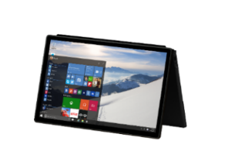
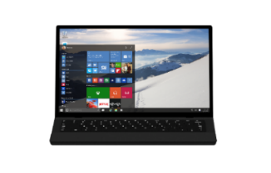
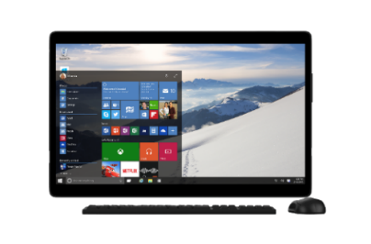
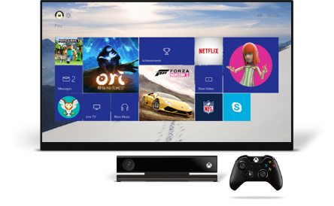
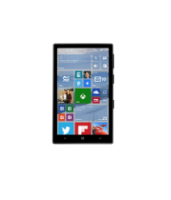
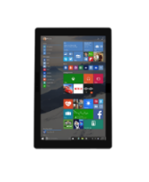
Universal App Package
Default
App will reflow and adapt to any display

Slide 49
Mobile-Only App Package
Default
App will reflow and adapt to any display

Slide 50
Mobile-Only App Package
Default | A little work
App will reflow and adapt to any display | Further optimize large screen layout

Slide 51
Mobile-Only App Package
Default | A little work | More work
App will reflow and adapt to any display | Further optimize large screen layout | Build a Universal Windows App

Slide 52
Demo

Slide 53
Separate App Packages
Default | A little work | More work
Mobile app will reflow and adapt to any display | Further optimize large screen layout | Build a Universal Windows App

Slide 54
Separate App Packages
Default | A little work | More work
Mobile app will reflow and adapt to any display | Further optimize large screen layout | Build a Universal Windows App Pull PC views/assets into mobile package

Slide 55
Switching Views
private void Page_SizeChanged(object sender, SizeChangedEventArgs e)
{
if (e.NewSize.Width <= 768)
{
Frame.Navigate(typeof(PhoneView), null);
}
else
{
Frame.Navigate(typeof(PCView), null);
}
}

Slide 56
Demo

Slide 57
Developer considerations
Integral
Hardware
Adaptive Apps
Packaging
Testing
Scaling
Multi-screen

Slide 58
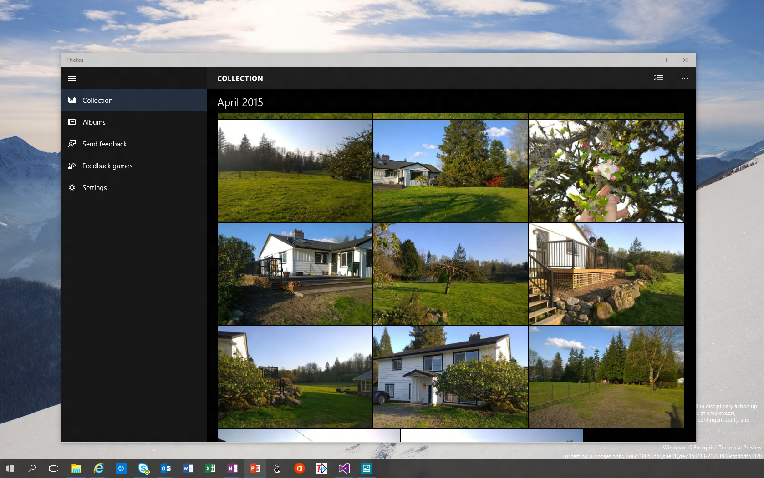
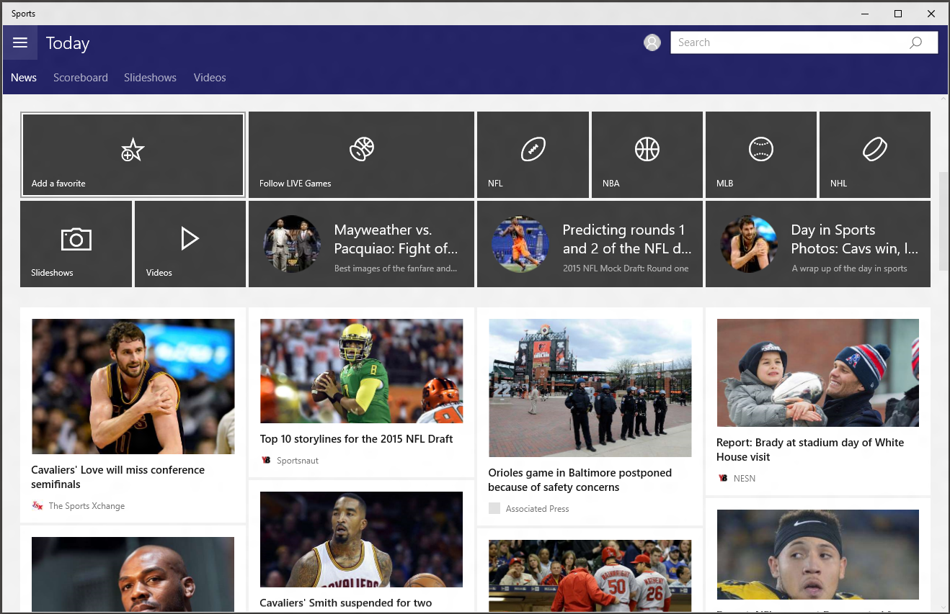
[resizing simple UAP]
Show a different app

Slide 59
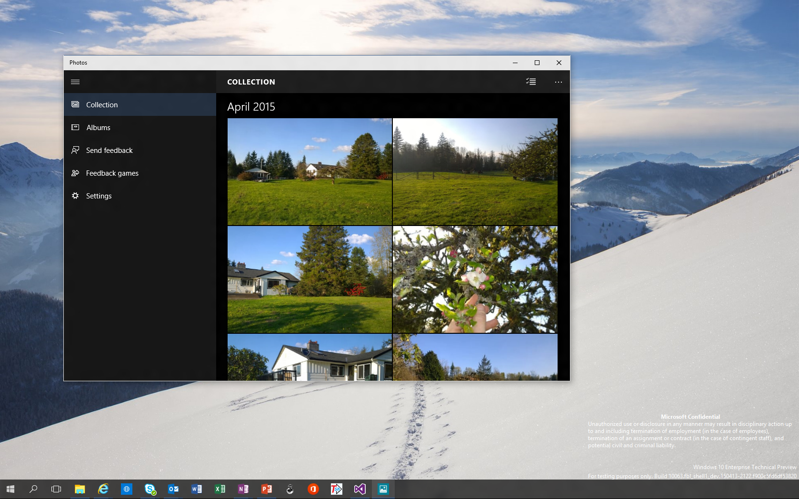
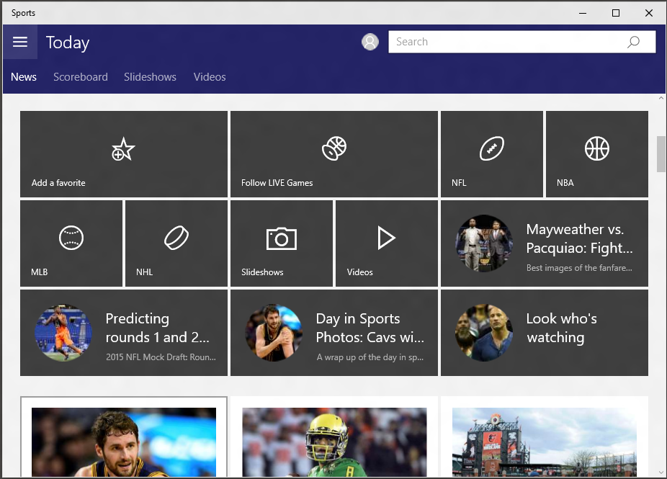

Slide 60
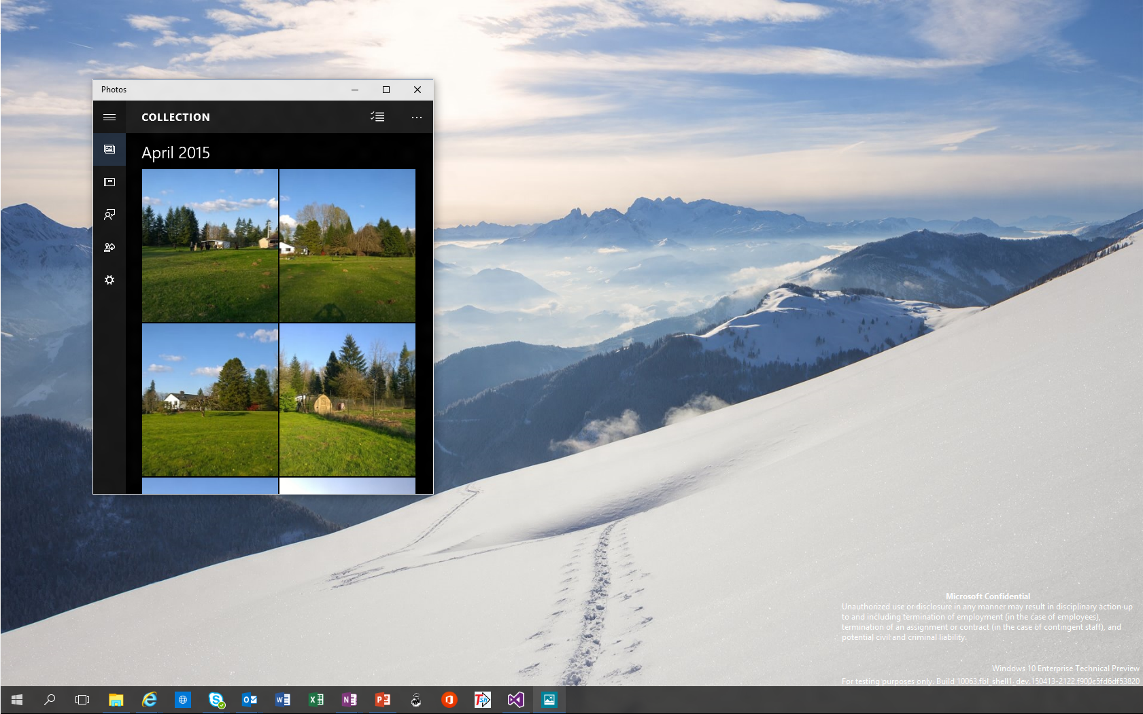
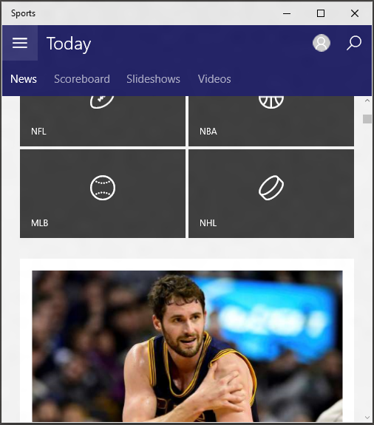
[resizing simple UAP]

Slide 61
Developer considerations
Integral
Hardware
Adaptive Apps
Packaging
Testing
Scaling
Multi-screen

Slide 62
Think about how your app scales to the big screen.

Slide 63
Scale-300
Scale-100
Scale-150

Slide 64
Resource Management System
Scale-300
Scale-100
Scale-150

Slide 65
Scale
200-400

Slide 66
Scale
100-150
Scale
200-400

Slide 67
Scale resources available:
Scale-300
Scale-300

Slide 68
Scale resources available:
Scale-300
Scale-100
Scale-300

Slide 69
Scale resources available:
Scale-300
Scale-400
Scale-300

Slide 70
Scale resources available:
Scale-300
Scale-100
Scale-100
Scale-300

Slide 71



Downscaling
System scales down UI elements.
Common scenario for continuum.
Original (400)

Slide 72



Downscaling
System scales down UI elements.
Common scenario for continuum.
Original (400)
Compressed (100)

Slide 73
Downscaling
System scales down UI elements.
Common scenario for continuum.
Compressed (400)
Pixel Perfect (100)

Slide 74
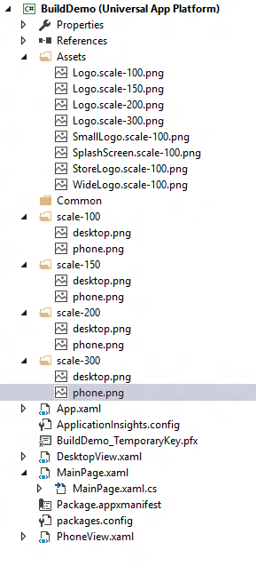
How to add and reference scale resources

Slide 75
Add a new resource with .scale-xxx

Slide 76
Add a new scale resource folder

Slide 77
Reference resources with a URI, leaving out the "scale-xxx".
The platform does the rest for you.
"ms-appx:///Assets/Logo.png"
"ms-appx:///desktop.png"

Slide 78
An image tag in XAML could look like this:

Slide 79
Developer considerations
Integral
Hardware
Adaptive Apps
Packaging
Testing
Scaling
Multi-screen

Slide 80
Take advantage of the phone and big screen simultaneously.

Slide 81

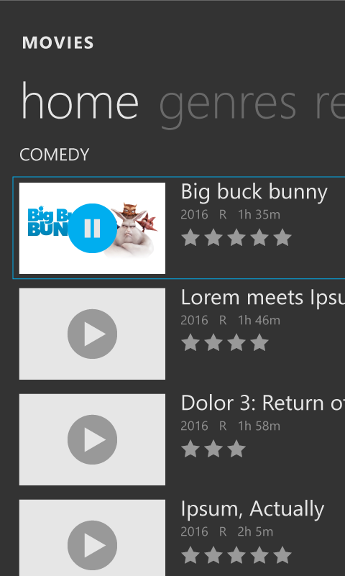
Cast API

Slide 82
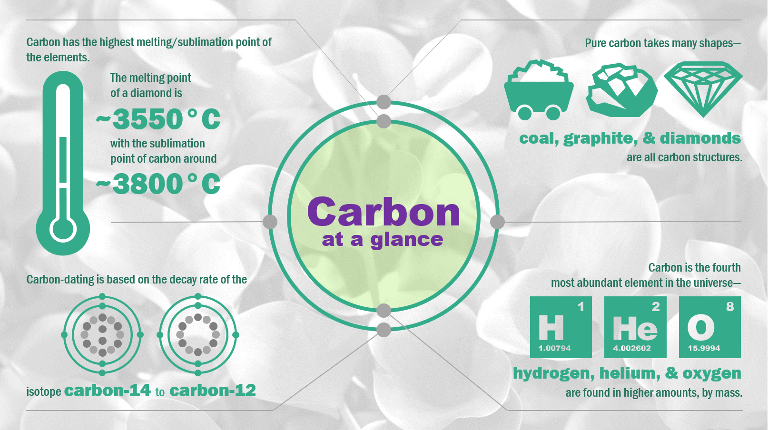
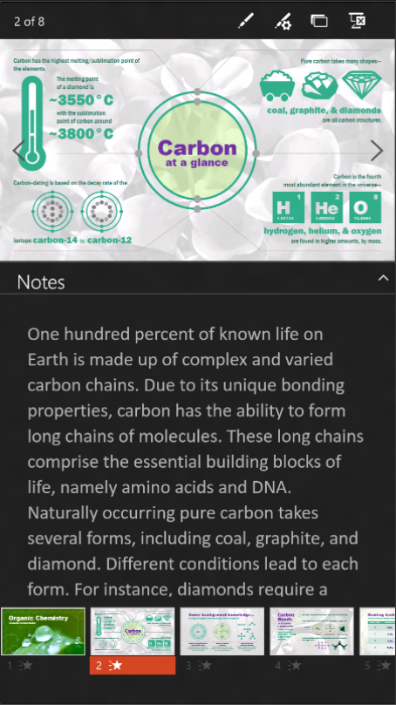
ProjectionManager API

Slide 83
private async void StartProjecting_Click(object sender, RoutedEventArgs e)
{
//Check whether there is already active connection to an external display
if (ProjectionManager.DisPlayAvailable)
{
int thisViewId;
thisViewId = ApplicationView.GetForCurrentView().Id;
var thisDispatcher = Window.Current.Dispatcher;
await CoreApplication.CreateNewView().Dispatcher.RunAsync(CoreDispatcherPriority.Normal,()=>
{
// Display the page in the view. Not visible until “StartProjectionAsync” called
var rootFrame = new Frame();
rootFrame.Navigate(typeof(ProjectionViewPage), initData);
Window.Current.Content = rootFrame;
Window.Current.Activate();
});
// Show the view on a second display
await ProjectionManager.StartProjectingAsync(rootPage.Id, thisViewId);
}
}
private async void StopProjecting_Click(object sender, RoutedEventArgs e)
{
await ProjectionManager.StopProjectingAsync(rootPage.ProjectionViewPageControl.Id, thisViewId);
}

Slide 84
private async void StartProjecting_Click(object sender, RoutedEventArgs e)
{
//Check whether there is already active connection to an external display
if (ProjectionManager.DisPlayAvailable)
{
int thisViewId;
thisViewId = ApplicationView.GetForCurrentView().Id;
var thisDispatcher = Window.Current.Dispatcher;
await CoreApplication.CreateNewView().Dispatcher.RunAsync(CoreDispatcherPriority.Normal,()=>
{
// Display the page in the view. Not visible until “StartProjectionAsync” called
var rootFrame = new Frame();
rootFrame.Navigate(typeof(ProjectionViewPage), initData);
Window.Current.Content = rootFrame;
Window.Current.Activate();
});
// Show the view on a second display
await ProjectionManager.StartProjectingAsync(rootPage.Id, thisViewId);
}
}
private async void StopProjecting_Click(object sender, RoutedEventArgs e)
{
await ProjectionManager.StopProjectingAsync(rootPage.ProjectionViewPageControl.Id, thisViewId);
}

Slide 85
private async void StartProjecting_Click(object sender, RoutedEventArgs e)
{
//Check whether there is already active connection to an external display
if (ProjectionManager.DisPlayAvailable)
{
int thisViewId;
thisViewId = ApplicationView.GetForCurrentView().Id;
var thisDispatcher = Window.Current.Dispatcher;
await CoreApplication.CreateNewView().Dispatcher.RunAsync(CoreDispatcherPriority.Normal,()=>
{
// Display the page in the view. Not visible until “StartProjectionAsync” called
var rootFrame = new Frame();
rootFrame.Navigate(typeof(ProjectionViewPage), initData);
Window.Current.Content = rootFrame;
Window.Current.Activate();
});
// Show the view on a second display
await ProjectionManager.StartProjectingAsync(rootPage.Id, thisViewId);
}
}
private async void StopProjecting_Click(object sender, RoutedEventArgs e)
{
await ProjectionManager.StopProjectingAsync(rootPage.ProjectionViewPageControl.Id, thisViewId);
}

Slide 86
private async void StartProjecting_Click(object sender, RoutedEventArgs e)
{
//Check whether there is already active connection to an external display
if (ProjectionManager.DisPlayAvailable)
{
int thisViewId;
thisViewId = ApplicationView.GetForCurrentView().Id;
var thisDispatcher = Window.Current.Dispatcher;
await CoreApplication.CreateNewView().Dispatcher.RunAsync(CoreDispatcherPriority.Normal,()=>
{
// Display the page in the view. Not visible until “StartProjectionAsync” called
var rootFrame = new Frame();
rootFrame.Navigate(typeof(ProjectionViewPage), initData);
Window.Current.Content = rootFrame;
Window.Current.Activate();
});
// Show the view on a second display
await ProjectionManager.StartProjectingAsync(rootPage.Id, thisViewId);
}
}
private async void StopProjecting_Click(object sender, RoutedEventArgs e)
{
await ProjectionManager.StopProjectingAsync(rootPage.ProjectionViewPageControl.Id, thisViewId);
}

Slide 87
private async void StartProjecting_Click(object sender, RoutedEventArgs e)
{
//Check whether there is already active connection to an external display
if (ProjectionManager.DisPlayAvailable)
{
int thisViewId;
thisViewId = ApplicationView.GetForCurrentView().Id;
var thisDispatcher = Window.Current.Dispatcher;
await CoreApplication.CreateNewView().Dispatcher.RunAsync(CoreDispatcherPriority.Normal,()=>
{
// Display the page in the view. Not visible until “StartProjectionAsync” called
var rootFrame = new Frame();
rootFrame.Navigate(typeof(ProjectionViewPage), initData);
Window.Current.Content = rootFrame;
Window.Current.Activate();
});
// Show the view on a second display
await ProjectionManager.StartProjectingAsync(rootPage.Id, thisViewId);
}
}
private async void StopProjecting_Click(object sender, RoutedEventArgs e)
{
await ProjectionManager.StopProjectingAsync(rootPage.ProjectionViewPageControl.Id, thisViewId);
}

Slide 88
Demo

Slide 89
Call to Action
Build Universal Windows Apps or optimize mobile apps for Continuum
Validate that your Windows Apps
  Look and work great on small and large screens
  Work with keyboard and mouse
Include scaling assets for the big screen
Leverage multi-screen API

Slide 90
Reference Sessions
622: Harnessing the full power of input in
Universal Windows Apps
658: Design: UX Patterns and Responsive Techniques for Universal Windows Apps
672: Bring Fluid, Responsive, and Highly Scalable UI experiences to Universal Windows Apps
679: From the Small Screen to the Big Screen: Building Universal App Experiences with XAML
695: App packaging and deployment for Universal Windows Apps
723: Screen Casting : Develop multi-screen Universal Windows Apps using Casting technologies

