Slide 2
Build with Bing
Use Bing APIs and tools to enrich your apps and make them more discoverable
2-727
Andre Furtado
Product Lead, Bing APIs
Vincent Wehren
Product Lead, Webmaster Experiences

Slide 3




















is the industry’s intelligence engine
Across Microsoft
Across Devices
With the industry
#BingSolutions

Slide 4

Bing can also take your app to the next level
Users spend 5x more time in apps than the browser
12:38
Bring users here!
Keep them engaged!
your app
🔎 app discovery



🎥
📰
🔤
…
 app linking

Slide 5

Agenda
Bing DevCenter
Bing Search API
Demos, demos, demos!
App discovery & app linking
Conclusions

Slide 6
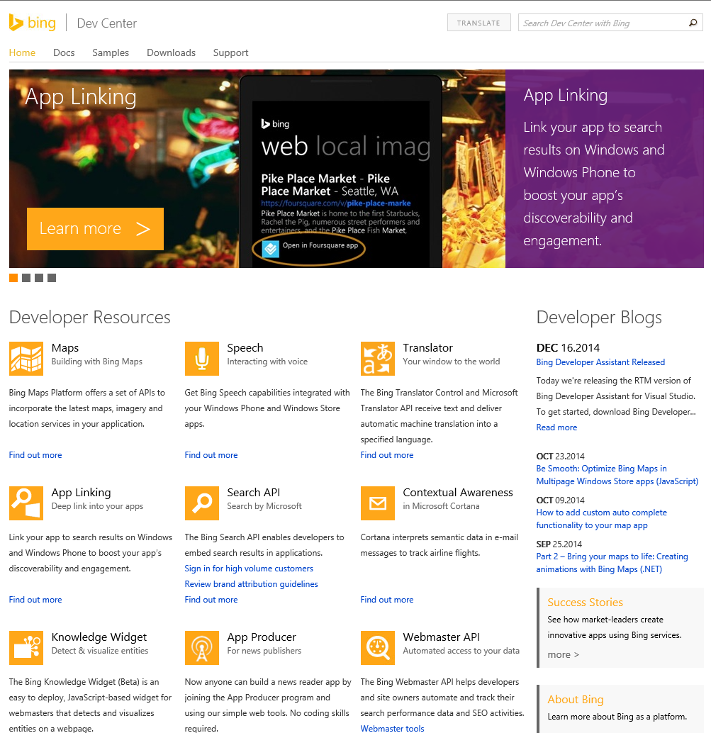
Bing DevCenter
http://dev.bing.com
Your first-stop shop for
public Bing APIs
Many APIs there covered by other Build talks

Slide 7
The Bing Search API
Embed or consume search results in your app
No payment required to start using the Search API
web
results
related
searches
web
results
images
videos
news
spell
composite


🎥
📰
💫
🔤


Bing Search API
Bing Search API – Web Only

Slide 8

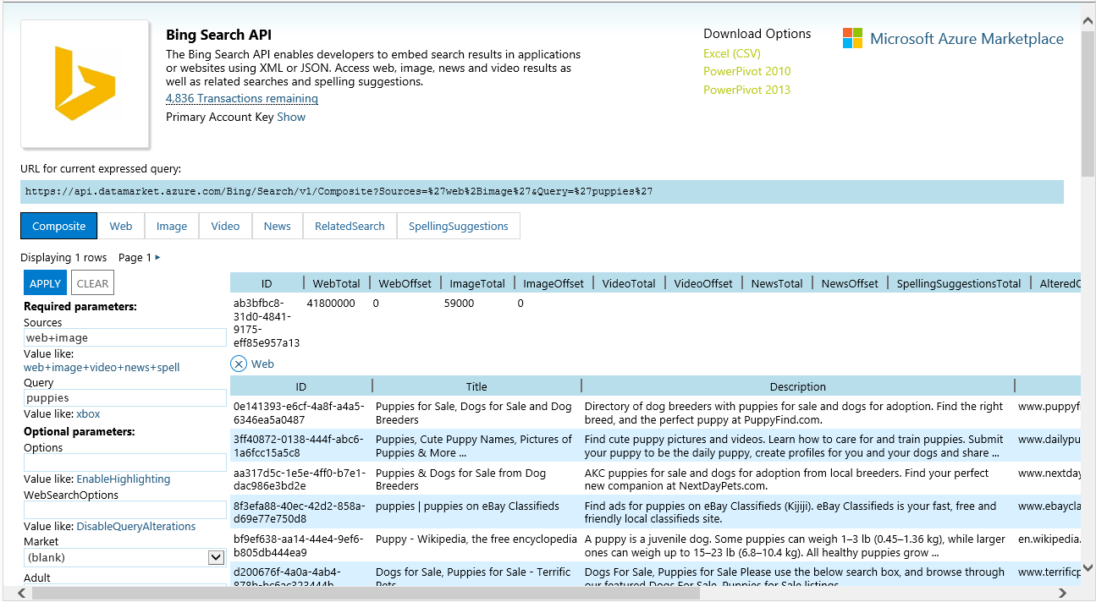
Service Explorer

Slide 9
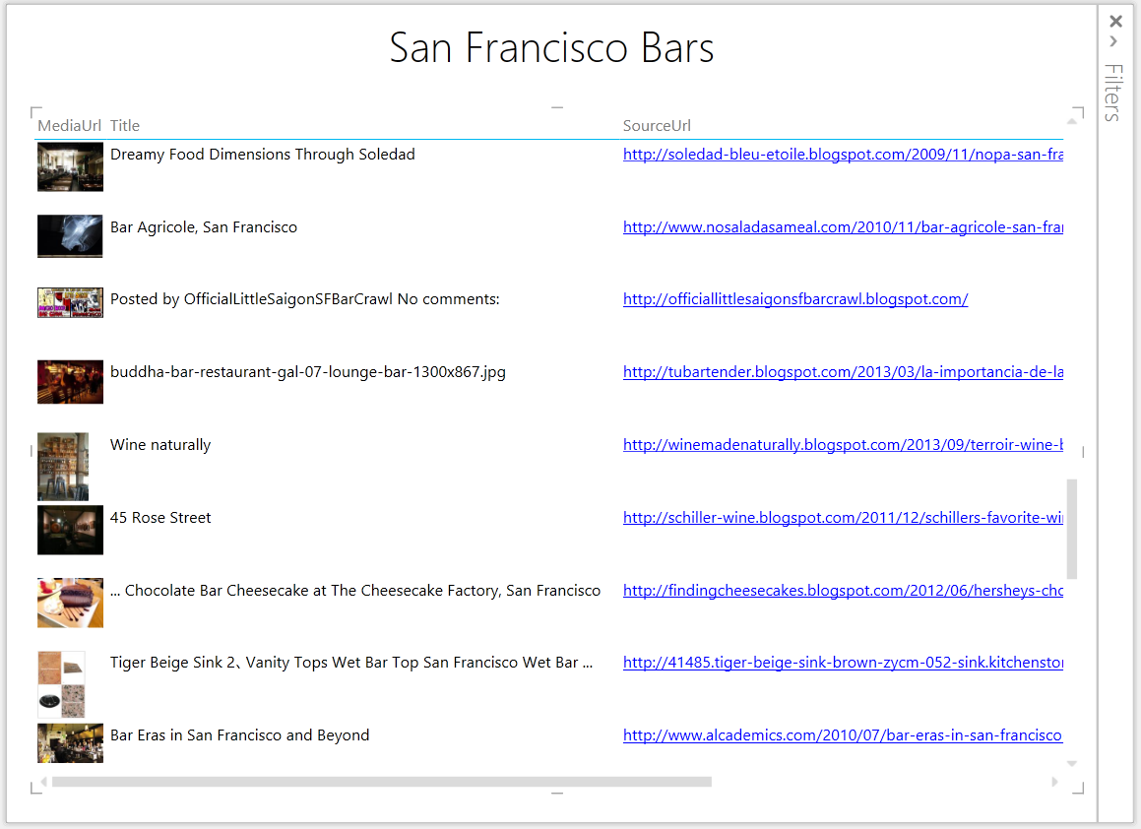
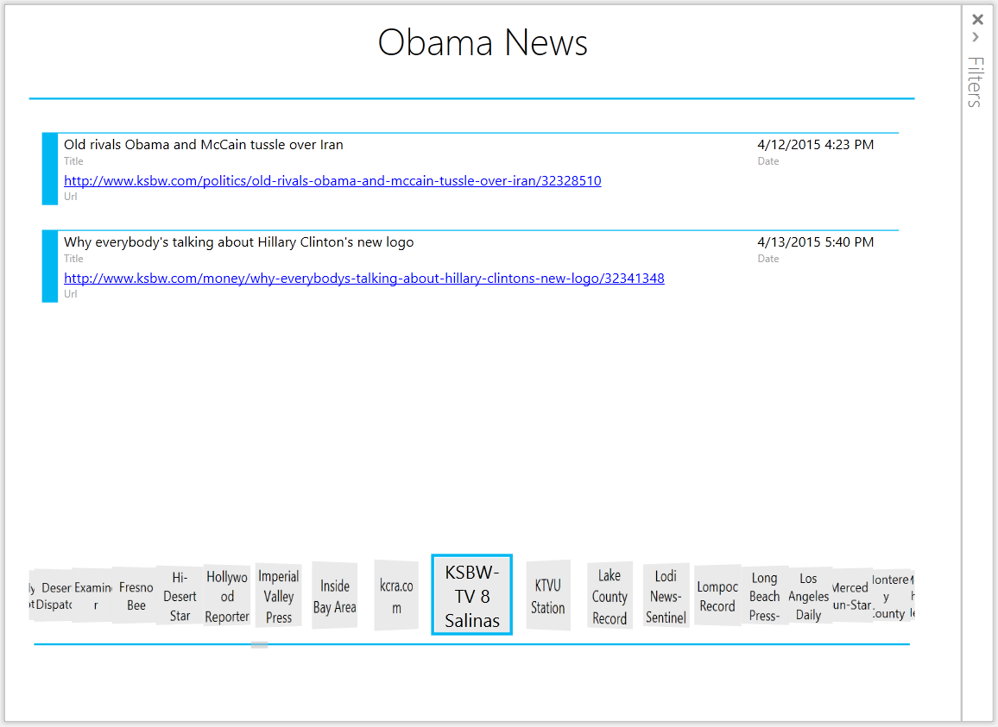
Demo: PowerPivot/PowerView integration
No coding required!

Slide 10
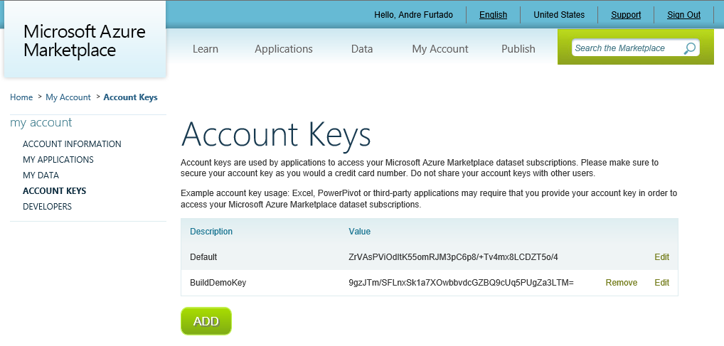
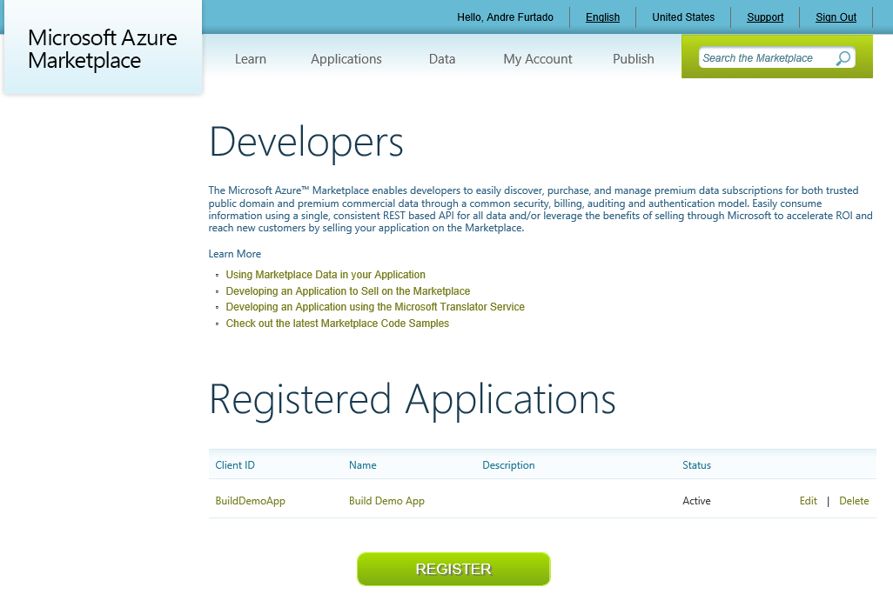
Ready to code?
Get an account key
Register your application(s)

Slide 11
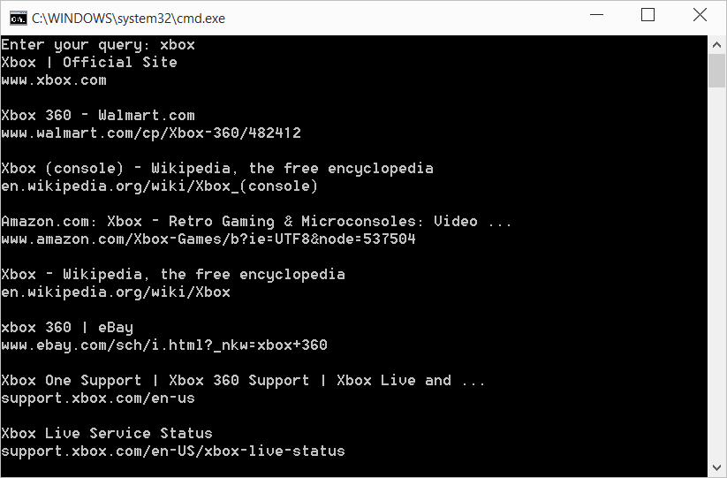
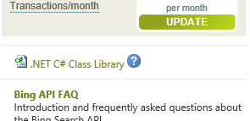
Demo: Hello API World
Notes
Add a reference to System.Data.Services.Client
Root API URL
https://api.datamarket.azure.com/Bing/Search

Slide 12
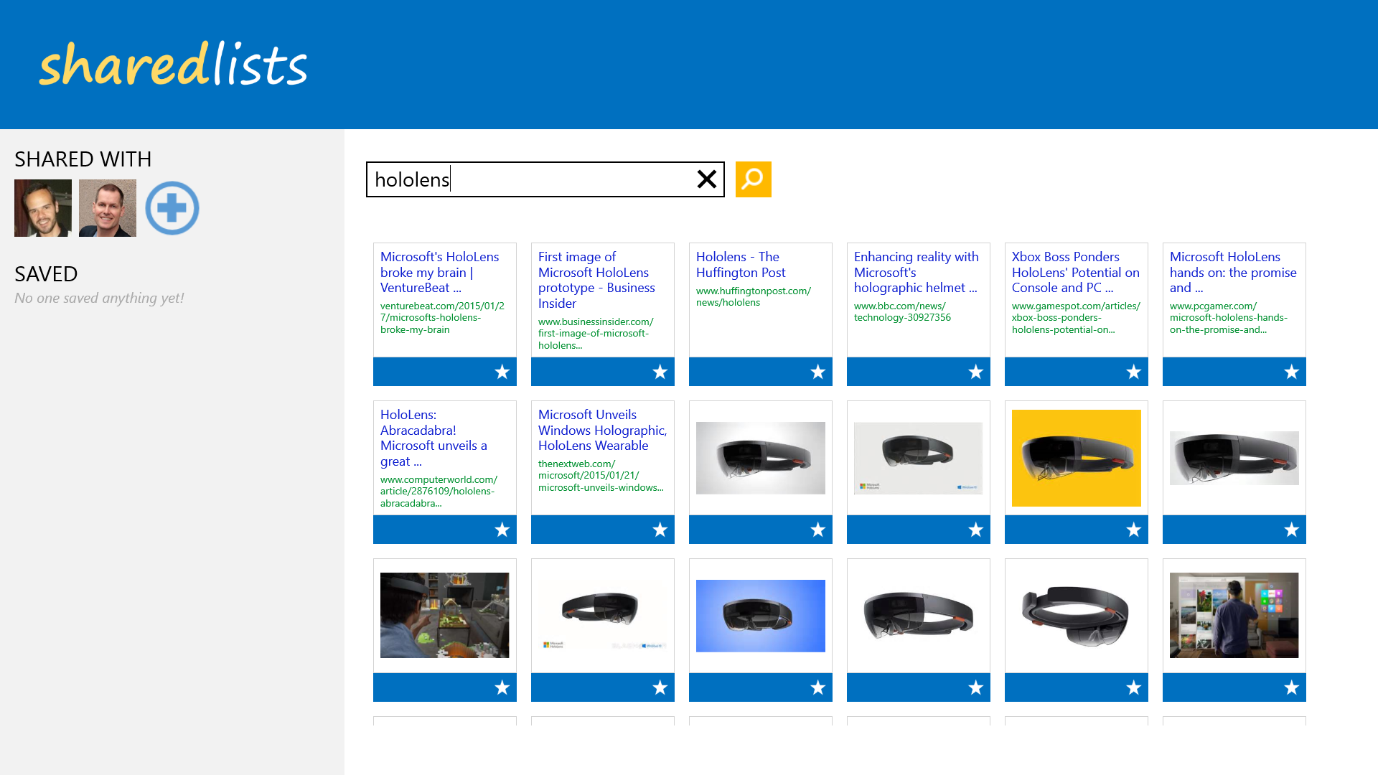
Demo: Modern app using Composite call
Web API
HttpClient
Async calls
Dynamic serialization
vs. data contracts

Slide 13
Leverage the best of Bing via Bing APIs
Bing APIs inherit Bing.com logic, capabilities and optimizations
Global by design
Pagination support
Hit highlight
Adult parameters
Query alteration
Filter by file type, domain, and others
...

Slide 14
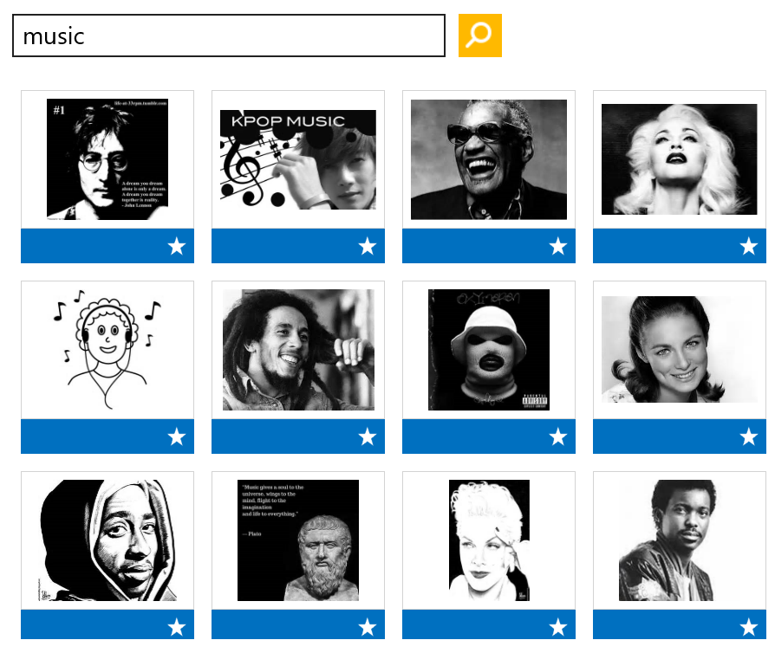
Demo: filters
ImageFilters
Size
Aspect
Color
Style
Face
NewsCategory
rt_Business
rt_Entertainment
rt_Health
rt_Politics
rt_Sports
rt_US
rt_World
rt_ScienceAndTechnology
VideoFilters
Duration
Aspect
Resolution
ImageFilters='Color:Monochrome+Face:Face'

Slide 15
Demo: spell suggestions

Slide 16

Demo: adding translation

Slide 17
App Discovery
1
2
App Content Discovery
3
App Action Discovery

Slide 18

App discovery
The pure activity of finding an app works great in the Store for app name and app category searches
The Store catalog also is plugged into the universal search canvas

Slide 19
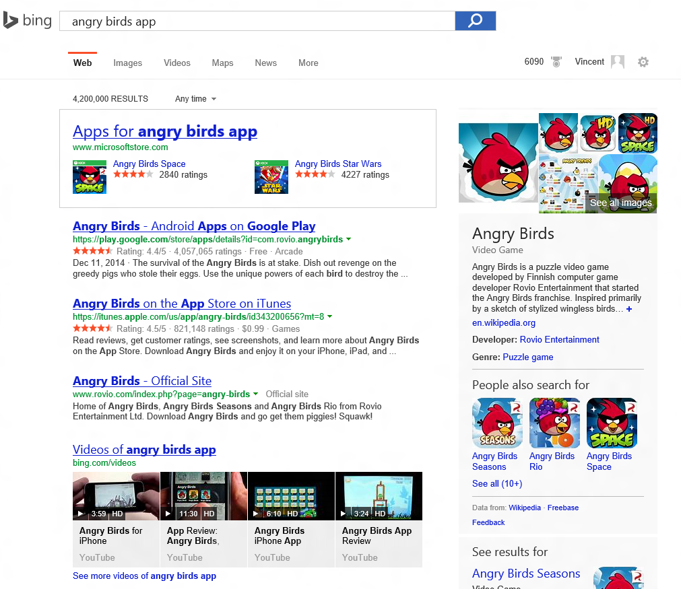
Bing.com on Windows 10
Bing.com on learns from the Store and can surface its listings in a special way.
Yet another canvas for app discovery!

Slide 20
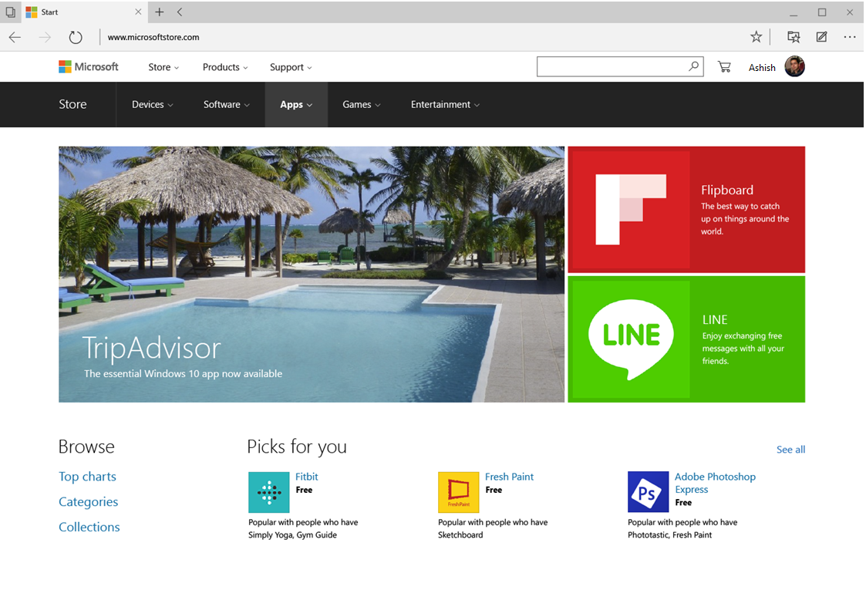
Store on the Web
The Store on the web makes your Store app listings accessible to all search engines.

Slide 21
How people search: content and task completion.

Slide 22
Today’s App Use Model
app
actions
actions
app
?
actions
app
Content
actions
users
actions
actions
app

Slide 23


A More Efficient Use Model
app
app
app
actions
Content
app

Slide 24
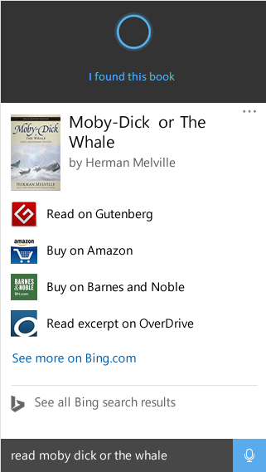
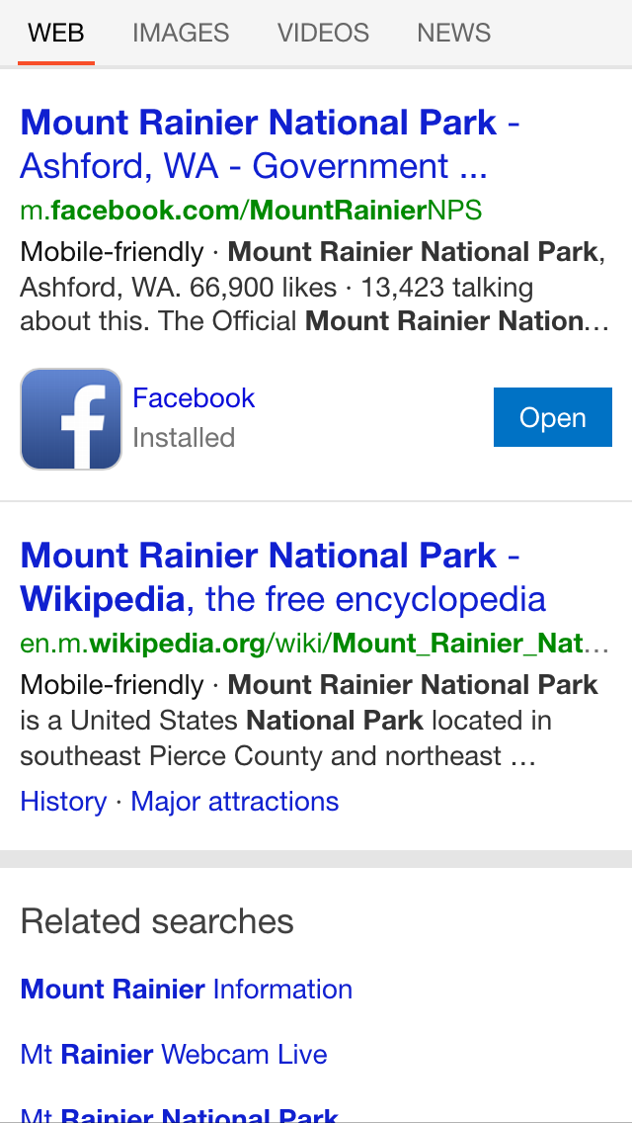
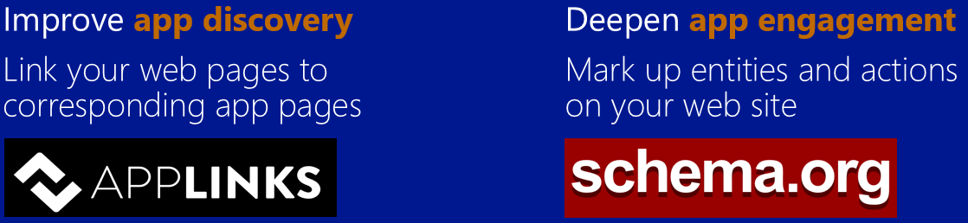


Apps, content and actions
Improve app discovery
Link your web pages to corresponding app pages
Deepen app engagement
Mark up entities and actions on your web site
Users can take action using your app directly from the search results or from Cortana.
Users can discover your app and launch it to a specific location directly from search results.

Slide 25
Applinks.org
http://contoso.com/doc
contoso://doc

Slide 26
Enabling applinks.org
1
Markup your published pages
Register the protocol handler for your app
2
3
Handle URI activation in your app

Slide 27
Markup your published pages
1
<html>
<head>
<title>Doc Page – Contoso</title>
<link rel="canonical" href="http://contoso.com/docs">
<!-- other headers -->
</head>
<body>
…
</body>
</html>

Slide 28
Publish Applinks.org markup
1
<html>
<head>
<title>Doc Page – Contoso</title>
<link rel="canonical" href="http://contoso.com/docs">
<!-- other headers -->
</head>
<body>…
</body>
</html>
<meta property="al:windows_universal:url "content="contoso://doc">
<meta property="al:windows_universal:app_id"
content="356bcbbe-2021-4e26-9db2-0766bbc146bf">
<meta property="al:windows_universal:app_name" content="contoso app">
<meta property="al:windows_universal:package_name" content="Contoso.ContosoApp_54ggd3ev8bvz6">

Slide 29
Registering the protocol handler
2
<Application Id="Contoso.App"
Executable="$targetnametoken$.exe"
EntryPoint="Contoso.Windows.App">
...
<Extensions>
<Extension Category="windows.protocol">
<Protocol Name="contoso" m2:DesiredView="default">
<Logo>Assets\SmallLogo.png</Logo>
<DisplayName>Contoso Applinks Demo App</DisplayName>
</Protocol>
</Extension>
</Extensions>
</Application>

Slide 30
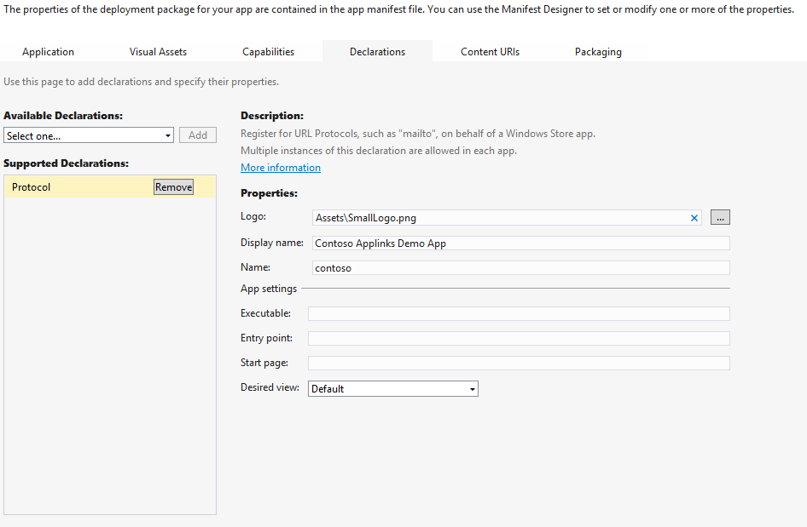
To do this in Visual Studio
Open deployment package
Select Declarations tab
Select Protocol from Available Declarations
Add the right properties

Slide 31
Handling URI Activation
3
protected async override void OnActivated(IActivatedEventArgs args)
{
if (args.Kind == ActivationKind.Protocol)
{
var eventArgs = args as ProtocolActivatedEventArgs;
// Your navigation service here, something like
await NavigateToPageByUri(eventArgs.Uri);
}
}

Slide 32
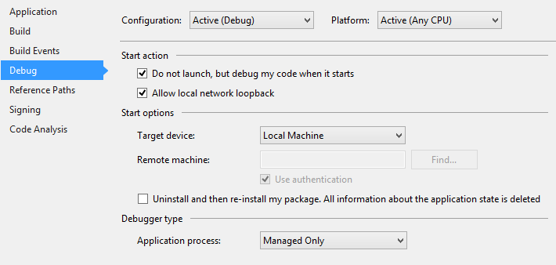
Debugging Tip
To debug URI activation check “Do not launch, but debug my code when it starts” in Project > Options > Debug
Now start the client with a URI call e.g. Windows + r and debugger will attach
For a deep dive on how your app can deep link to another app, visit session 765

Slide 33
App Action Answers

Slide 34
Listen to Coraline
Action
Entity

Slide 35
Schema.org
A collection of schemas that can be used to markup web pages with structured data
Originally focused on providing vocabulary to describe entities
2014:
Actions vocabulary
  Connecting potential actions to entities
  Connecting potential entity actions to entry points (including apps)

Slide 36
Enabling action answers
1
Markup you pages
(schema.org/Action)
Register the protocol handler for your app
2
Already done!
3
Handle URI activation in your app
Already done!

Slide 37
Publish schema.org on your page
1
<script type="application/ld+json">
{ "@context": "http://schema.org",
"@type": "Book",
"additionalType" : "http://www.productontology.org/id/Audiobook">
"name": "Coraline",
"author" : "Neil Gaiman",
"isbn" : "9781937091415"
}
</script>

Slide 38
Enhance with action vocabulary
1
<script type="application/ld+json">
{ "@context": "http://schema.org",
"@type": "Book",
"additionalType" : "http://www.productontology.org/id/Audiobook">
"name": "Coraline",
"author" : "Neil Gaiman",
"isbn" : "9781937091415",
"potentialAction":
{
"@type": "PlayAction",
"target": [
"http://www.audible.com/pd/Kids/Coraline-Audiobook/B0036GTJ48",
{
"@type": "EntryPoint",
"urlTemplate": "audible://listennow?asin=B0036GTJ48&title=Coraline",
"application": {
"@type": "SoftwareApplication",
"@id": "bdc813dd-c20b-41f8-8646-de72fa0b365d"
"name": "Audible",
"operatingSystem": "Windows Phone 8.1"
}
]
}
} </script>

Slide 39
Start now!
Bing is actively crawling & indexing applinks.org markup ahead of Windows 10 release
Action Answers: coming soon to Windows 10
Time to get an edge is now, so plan ahead when building or porting your apps

Slide 40
Tools
Essential tools to help you get things done
Bing Webmaster Tools: aka.ms/webmaster
  Submit your site to get crawled & index, get data & reports about how you are performing in search
App Links Checker
aka.ms/applinks
  Quickly evaluate the applinks.org markup on your page for all device types

Slide 41
Developer Call to Action
Explore Bing APIs and tools at dev.bing.com
Sign-up for the Search API datamarket.azure.com/dataset/bing/search
Learn more about translator at hub.microsofttranslator.com
Participate in Cortana and other search canvasses by enabling applinks.org, protocol handler, URI activation
Enhance entity-centric pages with schema.org actions markup
Use the free Bing tools to help you get things done and stay up to date about how you are performing in search

Slide 42

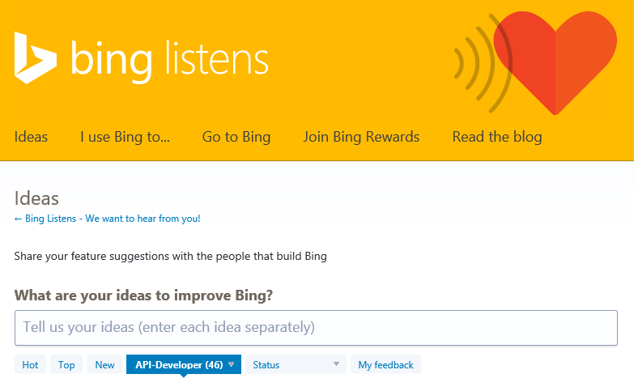
We want to hear from you!
How can we make Bing better for developers?
Visit us at our
Bing booth (3rd floor)
Submit and vote on Bing API/dev ideas via
aka.ms/BingDevFeedback

Slide 44
Appendix

Slide 45
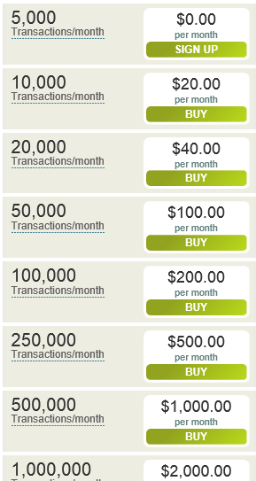
The Bing Search API: billing details
Trial offer available
Billing happens every month
If you exceed your quota
  API returns 403 Forbidden
  You can however choose for auto-rollout

Slide 46
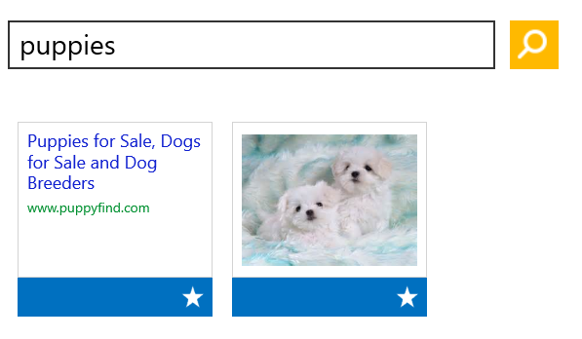
Need to paginate? Use $top and $skip
Parameter | Description | Default value | Value range | Example
$top | Specifies the number of results to return. | Web: 50 Image:50 Video: 50 News: 15 | Web: 1–50 Image: 1–50 Video: 1–50 News: 1–15 | https://api.datamarket.azure.com/Bing/SearchWeb/Web?Query=%27Xbox%27&$top=10
$skip | Specifies the offset requested for the starting point of results returned. | Web: 0 Image: 0 Video: 0 News: 0 | Web: 0–1000 Image: 0–1000 Video: 0–1000 News: Between 0 and 1 less than the total number of results | https://api.datamarket.azure.com/Bing/SearchWeb/Web?Query=%27Xbox%27&$top=10&$skip=20
Notes
$top applies to all source types in a composite query except for News
News will always return a fixed number of 15 news results when you use it in a composite query

Slide 47
Advanced parameters
WebSearchOptions
  WebSearchOptions='DisableHostCollapsing'
  Prevents Bing from suppressing results from the same top-level URL for a request
  WebSearchOptions='DisableQueryAlterations'
  Example: “billy gatas” won’t be altered to “bill gates”
WebFileType
DOC
DWF
FEED
HTM
HTML
PDF
PPT
RTF
TEXT
TXT
XLS

Slide 48
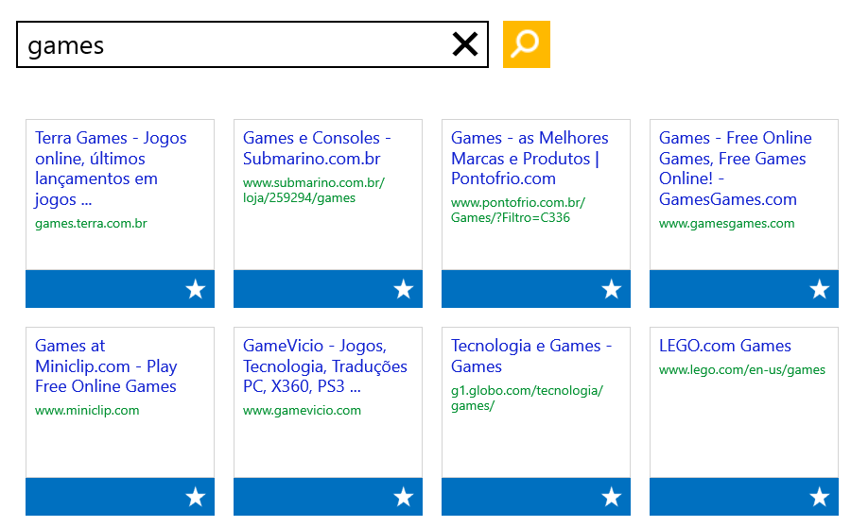
Results are market aware
The API uses IP address of the request, cookies, and other elements (if available) to find the market
Developer can also specify one via Market parameter
Note: Not all service operations support all markets.
ar-XA
bg-BG
cs-CZ
da-DK
de-AT
de-CH
de-DE
el-GR
en-AU
en-CA
en-GB
en-ID
en-IE
en-IN
en-MY
en-NZ
en-PH
en-SG
en-US
en-XA
en-ZA
es-AR
es-CL
es-ES
es-MX
es-US
es-XL
et-EE
fi-FI
fr-BE
fr-CA
fr-CH
fr-FR
he-IL
hr-HR
hu-HU
it-IT
ja-JP
ko-KR
lt-LT
lv-LV
nb-NO
nl-BE
nl-NL
pl-PL
pt-BR
pt-PT
ro-RO
ru-RU
sk-SK
sl-SI
sv-SE
th-TH
tr-TR
uk-UA
zh-CN
zh-HK
zh-TW

Slide 49
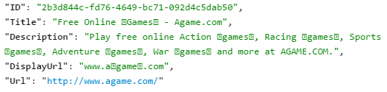
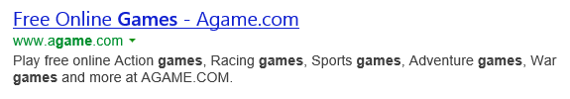
Advanced parameters: Options
  Options='DisableLocationDetection'
  Prevents Bing from inferring location from the terms of a query
  Options='EnableHighlighting'
  Bing will use a special character to identify the beginning and the end of a query term that appears in results
E000 start character
E001 end character
Equivalent Bing.com result
(notice the bolding)
You can also combine both parameter values: Options='DisableLocationDetection+EnableHighlighting'
Don’t forget to encode!

Slide 50
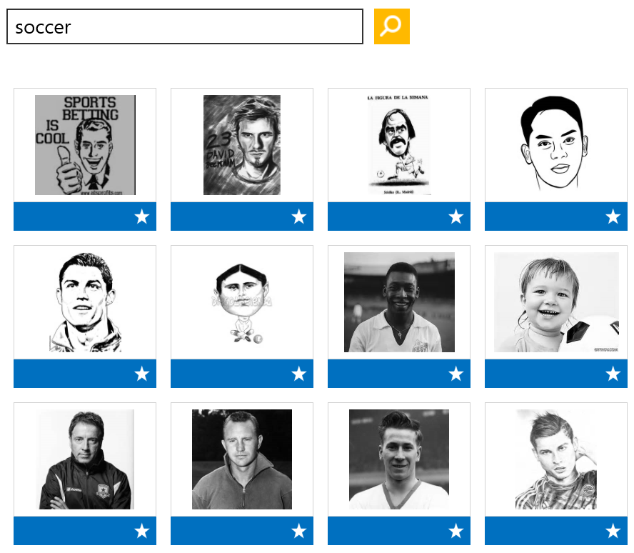
Advanced parameters: filters
Image
Filters
Size
Small
Medium
Large
Height:<value>
Width:<value>
Aspect
Wide
Tall
Color
Color
Monochrome
Style
Photo
Graphics
Face
Face
Portrait
Other
ImageFilters='Color:Monochrome+Face:Face'

Slide 51
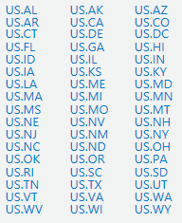
Advanced parameters: filters
Video
Filters
Duration
Short
Medium
Long
Aspect
Standard
WideScreen
Resolution
Low
Medium
High
News Category
rt_Business
rt_Entertainment
rt_Health
rt_Politics
rt_Sports
rt_US
rt_World
rt_ScienceAndTechnology
News Location Override
rt_Business
rt_Entertainment
rt_Health
rt_Politics
rt_Sports
rt_US
rt_World
rt_ScienceAndTechnology

Slide 52
Advanced parameters: sorting
Video
SortyBy
Date
Relevance
News
SortyBy
Date
Relevance

Slide 53
API endpoints
Consider Web Only API if you only need web results
  Reduced transaction cost
  Smaller payload
Product Offering | Query URL
Bing Search API | https://api.datamarket.azure.com/Bing/Search/
Bing Search API – Web Results Only | https://api.datamarket.azure.com/Bing/SearchWeb/

Slide 54
Don’t forget!
Encode string parameter values
Surround string parameters with single quotes
Use the adult parameter to change adult preferences
  Moderate, Strict, Off
To compress requests, add header
  Accept-Encoding: gzip

Slide 55

Translator
Ship your app in multiple languages and support your customers around the world
Start using it today
  Try the Translator web API for free, for as long as you want
    MicrosoftTranslator.com/getstarted
  Add the free Translator Widget to your site or blog
    bing.com/widget/translator
  Install the Multilingual App Toolkit in Visual Studio
    https://dev.windows.com/en-us/develop/multilingual-app-toolkit
https://hub.microsofttranslator.com

