Slide 2
Azure Active Directory: Identity Management as a Service for
Modern Applications
2-738
Stuart Kwan

Slide 3
“If you are successful, enterprise customers will require you to integrate your application with their enterprise identity management system.”
Active Directory
- Stuart Kwan

Slide 4
Azure Active Directory:
Identity Management as a Service for Modern Applications
Stuart Kwan @stuartkwan
Principal Program Manager
Microsoft Corporation
2-738

Slide 5

Agenda
Azure AD and IDMaaS
Benefits of integrating
How to integrate
Futures
Next steps

Slide 6
Before Azure AD and IDMaaS
Per-customer custom code
and manual steps
for user provisioning
Complex per-customer steps
to set up federation
Your application
federation
user provisioning
Enterprise customer
with Active Directory

Slide 7
With Azure AD
Office 365 and more
Sync and federation
between on-premises and
cloud identity systems
Manage as single logical directory
Your
Application
1
2
Azure AD
3
On-premises identity
management functions from cloud
Use Azure AD for sign up, sign in, provisioning, and directory services
Enterprise customer
with Active Directory
Integrating with Azure AD == Integrating with AD

Slide 8
Azure AD by the Numbers
86%
of Fortune 500 companies on Microsoft Cloud (Azure, O365, CRM Online and PowerBI)
Azure AD manages identity data for
>5 M organizations
More than
500 M objects hosted on Azure Active Directory
1 Trillion
Azure AD authentications since the release of the service
50 M
Office 365 users active every month
>1 Billion authentications every day on Azure AD
Every Office 365 and Microsoft Azure customer
uses Azure Active directory

Slide 9
Azure AD Can Help Promote Your App

Slide 10
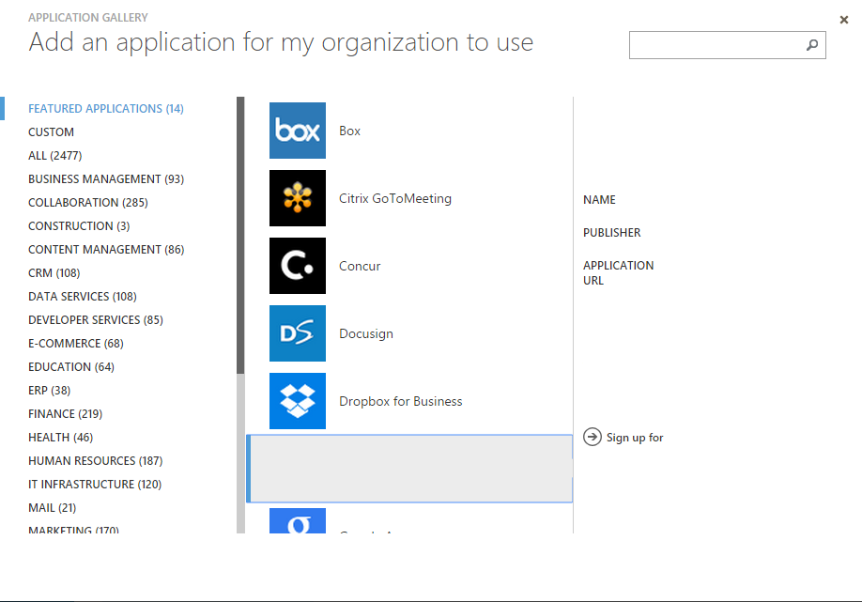
Promote Your App in Azure AD App Gallery
Your logo
Register your app to appear in Azure AD App Gallery
Your details
Your description
Your app
Your app here

Slide 11
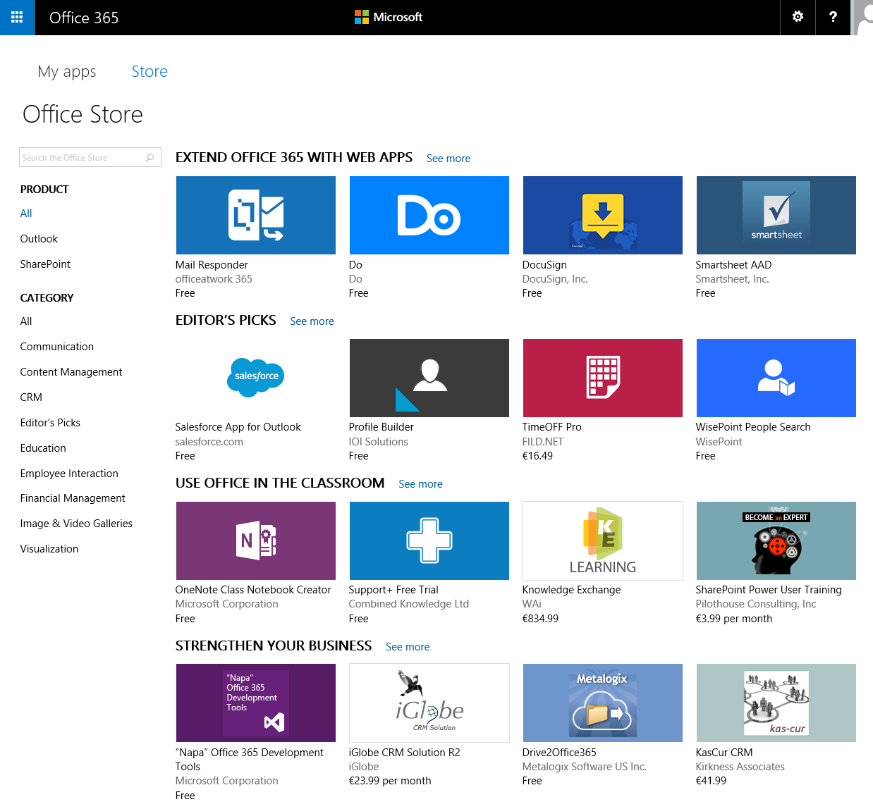

Promote Your App in Office 365 Store
Register your app to
appear in Office 365
Store – coming soon
Your app here

Slide 12
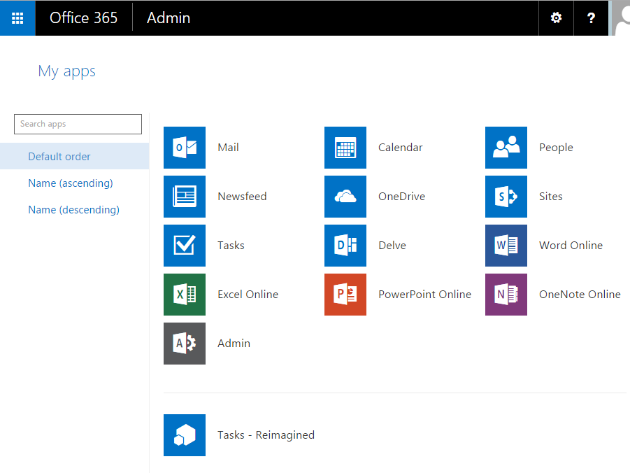

Appear in Office 365 My Apps Listing
Your app will appear in user’s
My Apps listing
User can pin your app to their App Launcher
Your app

Slide 13
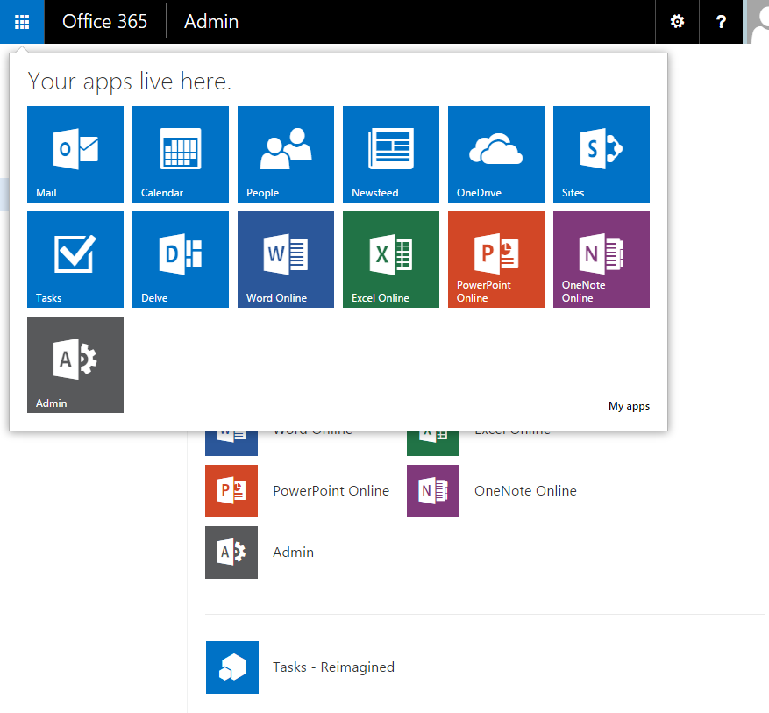
Pin To App Launcher – Drive User Engagement
Pinned app will appear in user’s
App Launcher
Your app here

Slide 14
Advanced Security Monitoring Benefits

Slide 15
Detect:
Brute Force Attack
1: <qwrsd!@@#> Nah! Didn’t work
2: <sdsaswer> Nah! Didn’t work
3: <34sdfs> Nah! Didn’t work
4: <sdsaswer> Nah! Didn’t work
5: <asas> Nah! Didn’t work
6: <qwrsd!@@#> Nah! Didn’t work
7: <sdsaswer> Nah! Didn’t work
8: <34sdfs> Nah! Didn’t work
9: <sdsaswer> Nah! Didn’t work
10: <asas> Nah! Didn’t work
……………………………………
……………………………………….
………………………………………….
……………………………………..
…………………………………..
78: <Password>Aha!!!!! That worked! Duh!
Signal if appears attacker has brute forced user’s password

Slide 16

Detect: Sign In From Anonymizer Network
IP Address:
31.172.30.4
IP address: 199.34.28.10
TOR Network
Signal if requests originate from anonymizer network

Slide 17


Detect: Unlikely Travel
Joe@Contoso.com
Location: Somewhere in Asia
Time: 7:54 AM, local time
(3:54 PM, UTC)
Joe@Contoso.com
Location: Seattle, WA
Time: 8:29 AM, PST
(3:29 PM, UTC)
Signal if user signs in from locations distant from each other in short time period

Slide 18
Detect: Anomalous Activity Spanning Tenants
X Bad password
X Bad username
X Bad password
X Bad username
X Bad password
IP Address: 199.34.28.10
X Bad username
X Bad username
X Bad password
Signal if multiple failed requests from single IP to many tenants

Slide 19
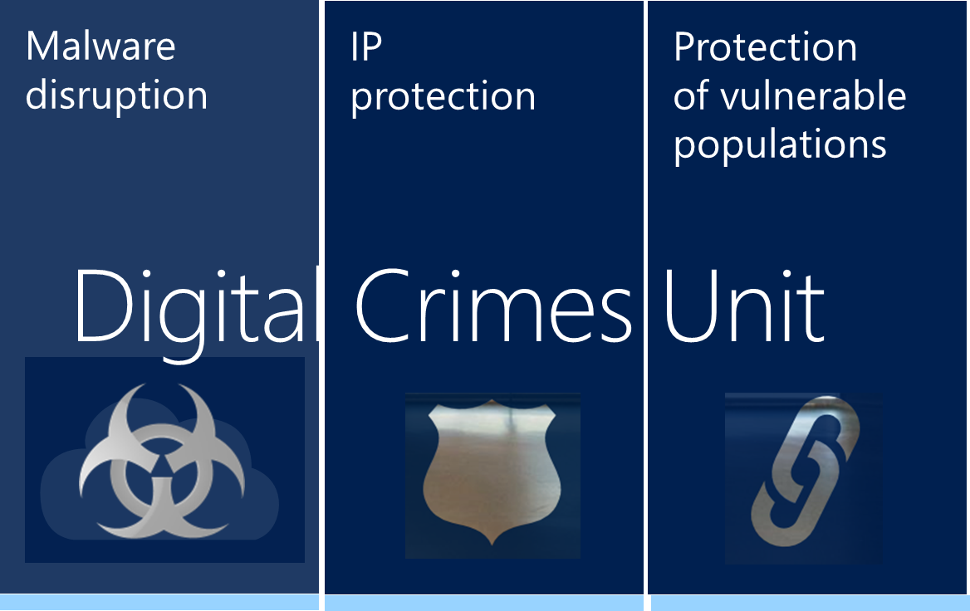




Detect: Sign In From Known Infected Device
Botnet control center
IP = 199.34.28.10
IP = 199.34.28.10
Signal if requests from known infected devices

Slide 20
How to Integrate With Azure AD

Slide 21
Integration Steps
Register your app in AD section of Azure portal
  Get a client ID, secret (if needed), register redirect URL, request API permissions
Add code for sign in
  Send request, process response, validate token, extract claims, redeem auth code
Add code to query Azure AD Graph API (optional)
  OData v3 compliant REST API

Slide 22
Browser
Azure AD
Web App
authorize
token
graph
Navigate to your application
No session,
send authN
request
302 redirect for sign in
OpenID Connect request
(user signs in)
Post token and auth code to your application’s redirect URL
Verify
token
signature
Set cookie and return user to page they started on
Redeem auth code
Return access token and refresh token
Call the Graph API

Slide 23
Demo:
Integrating with Azure AD for Sign In and Directory Services https://github.com/skwan/WebApp-GroupClaims-DotNet

Slide 24



Authentication Scenarios
Browser
Web application
Web API
js
Native app
Web API
Web API
Server app
Clients using wide variety of devices/languages/platforms
Server applications using wide variety of platforms/languages

Slide 25
Authentication Scenarios
WS-Fed, SAML 2.0, OpenID Connect
Web application
OAuth 2.0
Web API
Browser
js
Native app
OAuth 2.0
OAuth 2.0
Web API
Web API
Server app
OAuth 2.0
OAuth 2.0
Standard-based, http-based protocols for maximum platform reach

Slide 26
Azure AD Graph API
Azure AD doesn’t support LDAP as a query protocol – REST is simpler and cloud and mobile friendlier
RESTful access to directory
  Objects: users, groups, devices, licenses
  Relationships: member/memberOf, manager/directReport
  POST, GET, PATCH, DELETE to create, read, update, delete
  Full text search (in preview)
  Supports CORS
  Response in JSON (optionally XML)
  OData v3 compatible (v4 support coming soon)
  .Net, Cordova, iOS, Android libraries available
  Check out the API ref at: https://msdn.microsoft.com/en-us/Library/Azure/Ad/Graph/api/api-catalog

Slide 27
OSS Libraries: http://github.com/AzureAD
Client: Active Directory Authentication Library (ADAL)
  .Net, Windows Store, Windows Phone
  JavaScript
  iOS
  Android
Server
  .Net: ASP.Net OWIN middleware for OpenID Connect and OAuth 2.0
  Node.js
In use today by Office apps, Visual Studio, and more
More languages to come!
  Xamarin
  Cordova
  Node.js
  Java

Slide 28
Futures:
There’s lots more coming!

Slide 29
Key Vault – Safeguarding Keys and Secrets
Future capability - in development
Key Vault is designed to promote good key hygiene and aid in meeting compliance requirements
- in preview now
Reduce exposure of keys to dev/ops
  Keys stored encrypted in Key Vault service
  Store secrets e.g. Storage keys
  Store and perform key operations e.g. encryption keys
Enable customer to bring own keys
  Many customers need control for compliance purposes
Access to keys monitored and audited
  Only Azure AD users/apps can be granted access to keys
  If identity revoked from Azure AD, access to keys lost

Slide 30
Key Vault Example: Protect Storage Keys
Future capability - in development
Reduce dev/ops exposure to Storage keys
At setup time
  Developer creates Key Vault, adds Storage keys
  Developer registers new application in Azure AD
  Developer creates cert as credential for app and uploads to Azure and Azure AD
  Developer grants application identity access to Storage keys
At runtime
  Application requests token to Key Vault from Azure AD
  Application retrieves Storage secrets from Key Vault
Net – no secrets in source code

Slide 31
Azure AD B2C: “IDMaaS for Applications”
Future capability - in development
The goal of
Azure AD B2C is to provide all IDM functions an app needs to handle a customer audience –
preview coming soon
Azure AD security, availability, and scalability for customer IDM
Adds B2C features to Azure AD
  Social IdPs and “application local accounts”
  Self-service sign up, password reset, profile management
  Customizable sign in and sign up UI
  Same protocols, libraries, and programming model
Consumption based pricing
  Meters for # of users and # of authentications

Slide 32
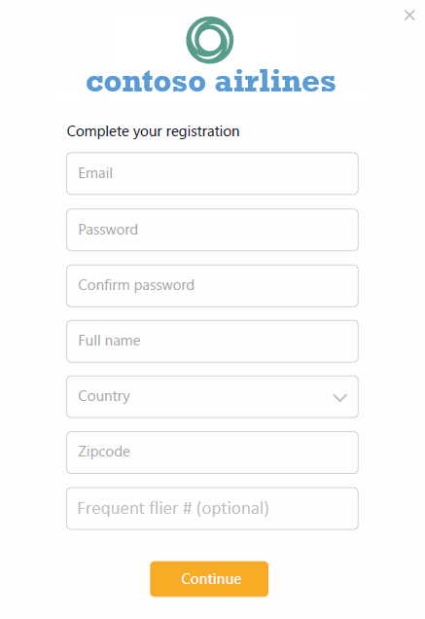
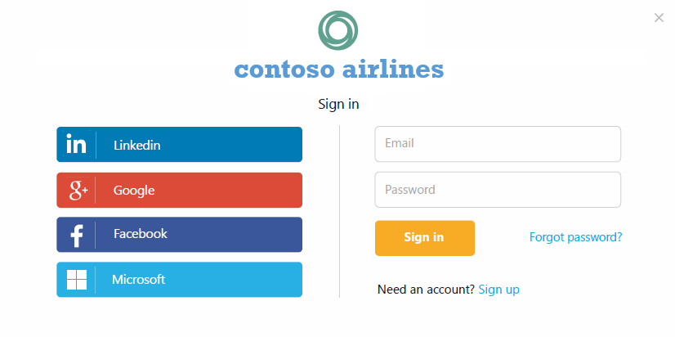
Azure AD B2C
Future capability - in development
Define attributes to
gather during sign up
Social and
local accounts
Customize
UI
Handles sign up,
password reset

Slide 33
Microsoft account + Azure AD
Future capability - in development
Making it easier to support both Microsoft account and Azure AD sign-in in the same app -
preview coming soon
Many apps want to sign users in from both Microsoft account and Azure AD
Working on unified dev experience
  Single endpoint, OpenID Connect and OAuth 2.0
  Single SDK
  Single end user sign in experience
  Single streamlined app registration experience, outside of Azure portal, no Azure subscription required
Works with unified Office business + consumer APIs

Slide 34
First, sign in with an Azure AD account

Slide 35
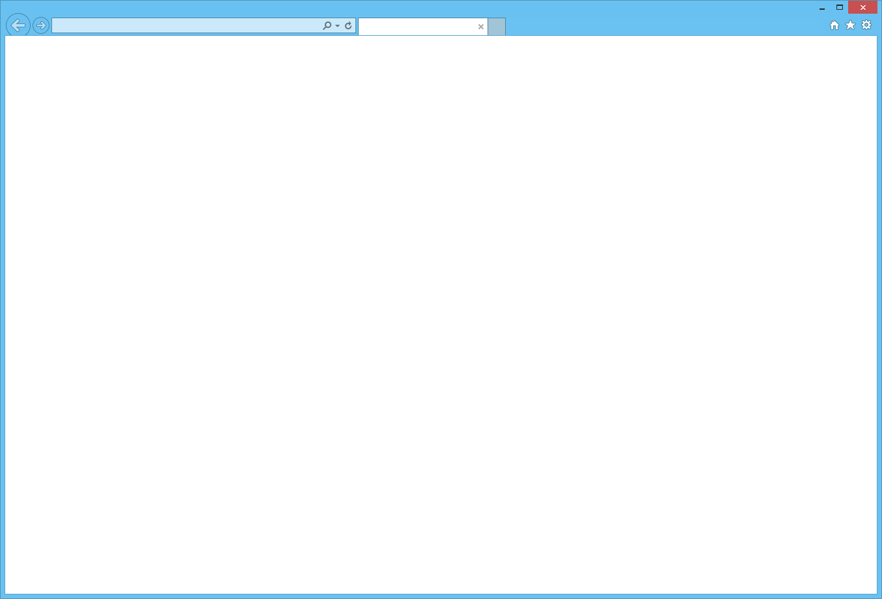




Microsoft Account + Azure AD
Future capability - in development
https://login.microsoft.com/xxxxx
Sign in to your account
Fabrikam Calendar
Microsoft account (personal or business)
Password
Sign in
Back
Can’t access your account?
Other sign in options
Get a new account
© 2015 Microsoft Terms of Use Privacy & Cookies

Slide 36
Microsoft Account + Azure AD
Future capability - in development
https://login.microsoft.com/xxxxx
Sign in to your account
Fabrikam Calendar
Microsoft account (personal or business)
kelly@contoso.com
Password
Sign in
Back
Can’t access your account?
Other sign in options
Get a new account
© 2015 Microsoft Terms of Use Privacy & Cookies

Slide 37
Microsoft Account + Azure AD
Future capability - in development
https://login.microsoft.com/xxxxx
Sign in to your account
Fabrikam Calendar
Microsoft account (personal or business)
kelly@contoso.com
٠ ٠ ٠ ٠ ٠ ٠٠
Password
Sign in
Back
Can’t access your account?
Other sign in options
Get a new account
© 2015 Microsoft Terms of Use Privacy & Cookies

Slide 38


Microsoft Account + Azure AD
Future capability - in development
https://login.microsoftonline.com/xxxxx
Sign in to your account
Sign in to Fabrikam Calendar
kelly@contoso.com
Password
Keep me signed in
Sign in
Back
Can’t access your account?
Contact Help Desk at (206) 555-1234. This site is operated by Microsoft on behalf of Contoso Inc and is for the exclusive use of its employees and partners.
© 2015 Microsoft Terms of Use Privacy & Cookies

Slide 39
Or, sign in with a Microsoft account

Slide 40
Microsoft Account + Azure AD
Future capability - in development
https://login.microsoft.com/xxxxx
Sign in to your account
Fabrikam Calendar
Microsoft account (personal or business)
Password
Sign in
Back
Can’t access your account?
Other sign in options
Get a new account
© 2015 Microsoft Terms of Use Privacy & Cookies

Slide 41
Microsoft Account + Azure AD
Future capability - in development
https://login.microsoft.com/xxxxx
Sign in to your account
Fabrikam Calendar
Microsoft account (personal or business)
kelly@outlook.com
Password
Sign in
Back
Can’t access your account?
Other sign in options
Get a new account
© 2015 Microsoft Terms of Use Privacy & Cookies

Slide 42
Microsoft Account + Azure AD
Future capability - in development
https://login.microsoft.com/xxxxx
Sign in to your account
Fabrikam Calendar
Microsoft account (personal or business)
kelly@outlook.com
٠ ٠ ٠ ٠ ٠ ٠٠
Password
Sign in
Back
Can’t access your account?
Other sign in options
Get a new account
© 2015 Microsoft Terms of Use Privacy & Cookies

Slide 43
Microsoft Account + Azure AD
Future capability - in development
https://login.microsoft.com/xxxxx
Sign in to your account
Taking you to the sign in page for Microsoft accounts. Cancel
kelly@outlook.com
٠ ٠ ٠ ٠ ٠ ٠٠
Password

Slide 44
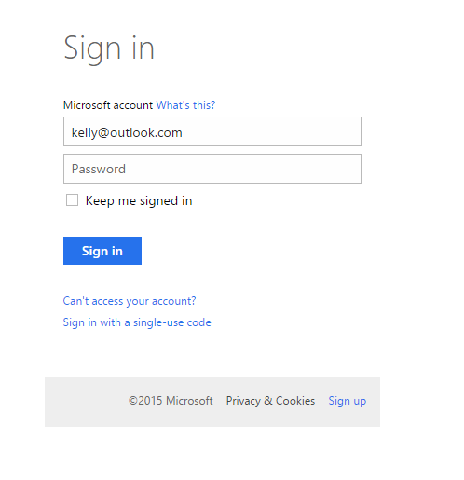
Microsoft Account + Azure AD
Future capability - in development
https://login.live.com/xxxxx
Sign in to your Microsof…
kelly@outlook.com

Slide 45
If you sign in with both Azure AD and MSA and return to sign in again later…

Slide 46



Microsoft Account + Azure AD
Future capability - in development
https://login.microsoft.com/xxxxx
Sign in to your account
Fabrikam Calendar
Which account do you want to use?

Kelly Yang
kelly@outlook.com
•••

Kelly
kelly@contoso.com
•••

Use another account
© 2015 Microsoft Terms of Use Privacy & Cookies

Slide 47
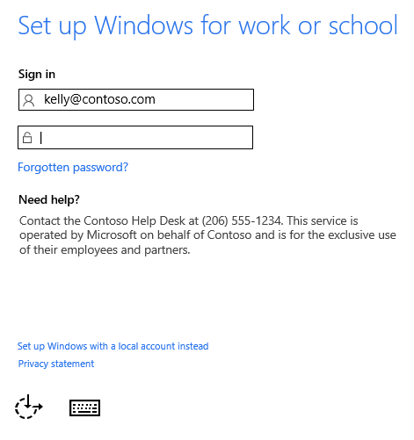
Enhanced Device Support – Windows 10
Future capability - in development
Windows 10 Azure AD Join: sign-in to desktop with
Azure AD account
Single sign on to:
  Kerberos-based on-premises applications
  Native applications that use WebAccountManager
  Web apps that support Azure AD sign-in

Slide 48
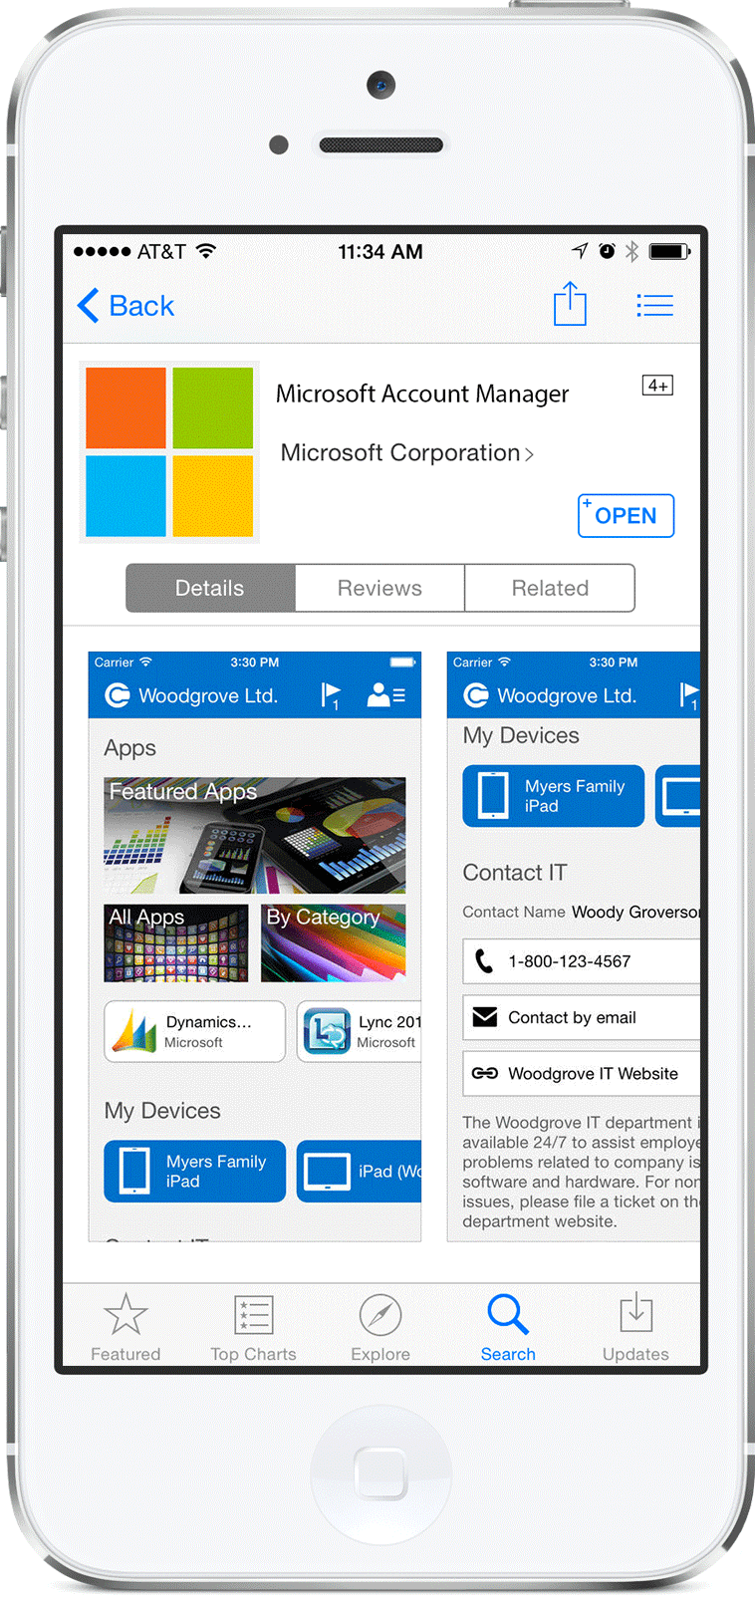
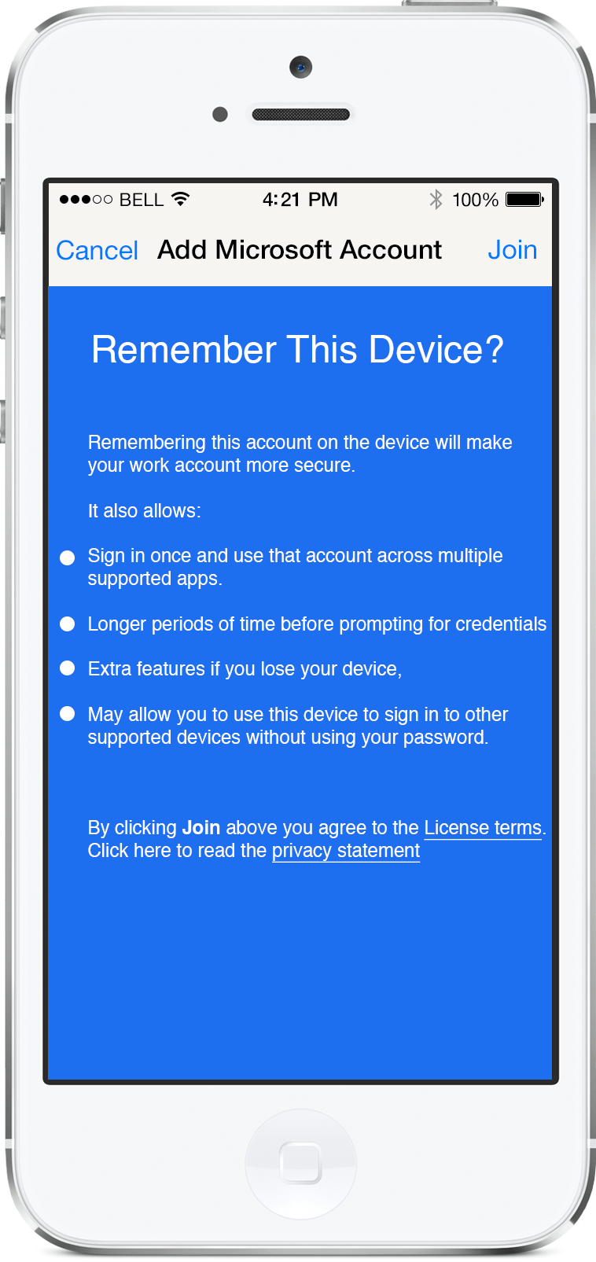
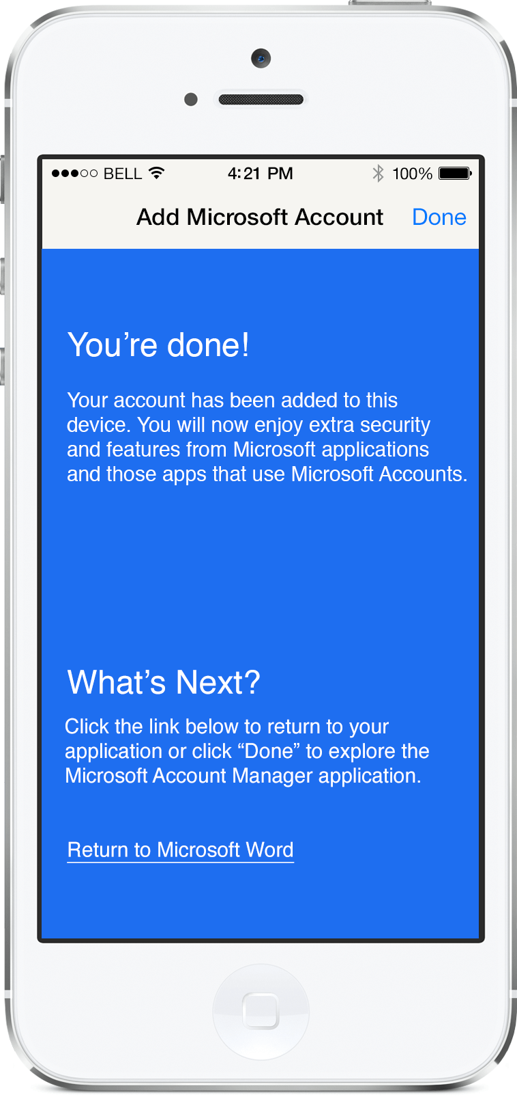
Enhanced Device Support – iOS & Android
Future capability - in development
Updated iOS & Android authenticator apps
  Single sign on across mobile apps that use ADAL library
  Device conditional access
  Multi-factor authentication
  Apps using ADAL seamlessly take advantage of authenticator

Slide 49
Next Steps
Sign up for an Azure trial to get Azure AD
  You won’t be charged if you only use Azure AD free capabilities
Check out the Azure AD Developer Guide
  Azure.com → Documentation → ID&A Management → Active Directory → Develop
  http://azure.microsoft.com/en-us/documentation/articles/active-directory-developers-guide/
Go deeper at //build
  Vittorio Bertocci: “Develop Modern Web Applications with Azure AD” (2-753)
  Vittorio Bertocci: “Develop Modern Native Applications with Azure AD” (2-769)
  Mat Velloso: “Cloud Auth Troubleshooting and Recipes for Developers” (2-740)
Subscribe to AD team blog
  http://blogs.technet.com/b/ad/ or search for “active directory team blog”

Slide 50
Summary
If you’re successful, enterprises will require you to integrate with Active Directory
Integrating with Azure AD == integrating with AD
Benefits
  Reduce security surface area
  Reduce sign in friction and sign up drop off
  Promote your application in the Office 365 and Azure Marketplaces
  Increase using engagement by appearing in the Office 365 application launcher
Standard protocols and open source libraries

Slide 51
Resources
Improve your skills by enrolling in our
free cloud development courses at the Microsoft Virtual Academy.
Try Microsoft Azure for free and deploy your first cloud solution in under 5 minutes!
Easily build web and mobile apps for any platform with AzureAppService for free.

