Slide 2
Develop Modern Native Applications with Azure Active Directory
2-769
Vittorio Bertocci @vibronet
www.cloudidentity.com
Principal Program Manager

Slide 3


Going Native or Multi Target Stacks?

Slide 4


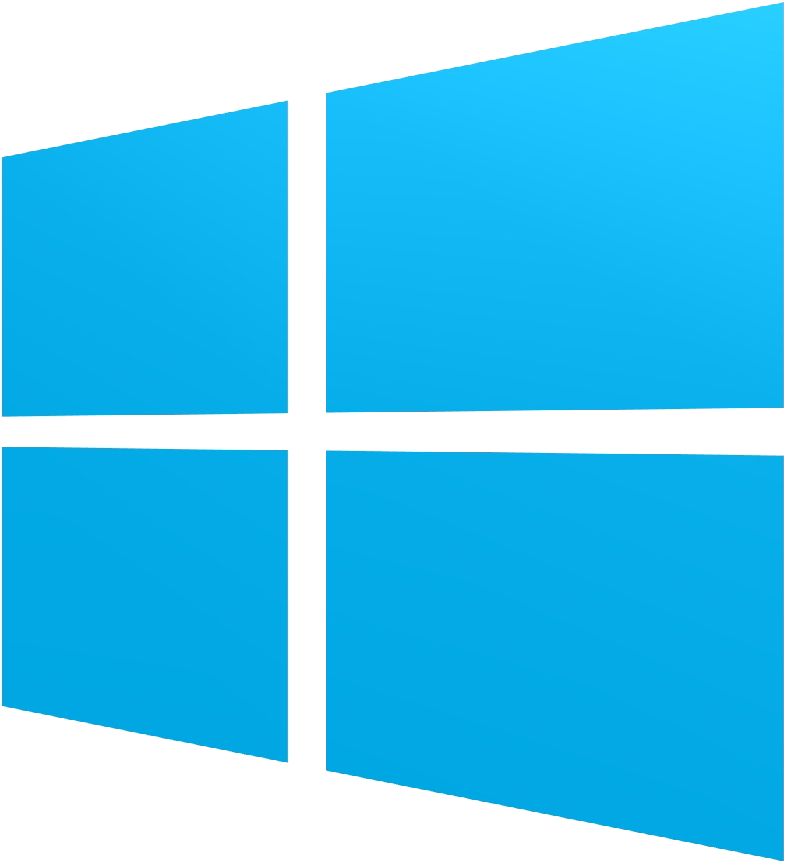
Choose any platform or dev stack…
iOS
Android
Windows
ADAL .NET + Xamarin
C#/JS
Apache Cordova Plugin for ADAL
ADAL Obj-C
ADAL Android
ADAL .NET
Native
WebAccountManager
…Azure AD has your back.

Slide 5
Agenda
The Token Requestor Pattern
Going Native
  Windows 10, Windows 7+
  iOS
  Android
Going Multitarget
  Xamarin
  Cordova

Slide 6
Azure AD by the Numbers
86%
of Fortune 500 companies on Microsoft Cloud (Azure, O365, CRM Online and PowerBI)
Azure AD manages identity data for
>5 M organizations
More than
500 M objects hosted on Azure Active Directory
1 Trillion
Azure AD authentications since the release of the service
50 M
Office 365 users active every month
>1 Billion authentications every day on Azure AD
Every Office 365 and Microsoft Azure customer
uses Azure Active directory

Slide 7
Identity, Native Clients, and Azure AD

Slide 8
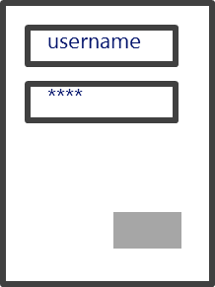

Native Clients and Identity
R1
App1

Slide 9
Native Clients, Identity and Azure AD
R1
App1
R2
OAuth-A
contoso.onmicrosoft.com
OAuth-T
SAML
R1
WS-Fed
App1
R2

Slide 10
Going Native

Slide 11
Going Native
Windows 10 – WebAccountManager
Windows 7+– ADAL .NET
iOS – ADAL ObjC
Android – ADAL Android

Slide 12
Windows 10 WebAccountManager
R1
App1
Web Account Manager
Windows
Web Account Provider 1
Web Account Provider 1
<<<
<<<
System accounts

Slide 13
WebAccountManager API and AAD
General token acquisition pattern
FindAccountProviderAsync
<WebTokenRequest>
RequestTokenAsync / GetTokenSilentlyAsync
WebTokenRequestResult

Slide 14
Registering a Universal App with Azure AD
Every app must
  be registered in Azure AD
  declare in advance what resources it wants to access
To register your app to use WAM, you need its SID
  Execute WebAuthenticationBroker.GetCurrentApplicationCallbackUri().ToString();
  The SID is the red part: ms-app://s-1-15-2-976907911-141810403-2436685389-2899494419-3003676602-2661416415-1464266181
  Important: change the ‘s’ in the SID to UPPERCASE
  You need to use the SID at registration time to build a redirect uri as follows:
  ms-appx-web://Microsoft.AAD.BrokerPlugIn/S-1-15-2-976907911-141810403-2436685389-2899494419-3003676602-2661416415-1464266181

Slide 15
DEMO
Getting Azure AD tokens via WebAccountManager

Slide 16
Targeting Windows 7 onward
Redistributable libraries help you to prompt users, perform requests, handle sessions

Slide 17
Active Directory Authentication Library (ADAL)
Available on multiple platforms
  .NET, Windows Store, Windows Phone 8.1, iOS, Android, Node.JS, Java
Open source
Consistent primitives, native programming models
Sophisticated features
  Works across Windows Server and Azure Active Directory
  Cache and automatic refresh
  Multi user support
NOT a protocol library

Slide 18
ADAL – Main Token Acquisition Pattern
Abstracts away most protocol considerations
Handles tokens persistence & refresh automatically
AuthenticationContext ctx=
new AuthenticationContext("https://login.windows.net/contoso.onmicrosoft.com");
AuthenticationResult rez = await ctx.AcquireTokenAsync(
"https://outlook.office365.com/",
"5fc4a5a2-78d5-4d94-b890-a6e6b3341081");

Slide 19
ADAL .NET
Current supported version: V2.x
Desktop
  Default cache in-memory
  Extra flows for public clients only:
  Windows integrated authentication
  Direct use of username & password
Windows Store, Windows Phone 8.1
  Persistent per-app cache
  Windows Runtime Components
    Works with C#, WinJS, C++

Slide 20
DEMO
Getting Tokens via ADAL .NET

Slide 21
ADAL or WebAccountManager?
WebAccountManager
  If you are targeting Windows 10 onward exclusively
  For apps that use more than one provider type
ADAL .NET
  For Azure AD and ADFS only
  If you are targeting all versions of Windows from Win7 onward
  If you want to target iOS and Android via Xamarin
  If you need authentication flows not covered by WebAuthenticationBroker
    direct username/password, app identity
A future ADAL .NET release will use WAM on Win10

Slide 22
ADAL iOS
OSS Objective C library
How to get it: source ZIP, Cocoapods
Persistent cache via KeyChain
  Apps from the same publisher can share tokens
NTLM

Slide 23
ADAL Android
OSS Java library
How to get it: source ZIP, git clone, Gradle, Maven
Persistent cache on shared preference file
  Encrypted via AndroidKeyStore
Integrated with the Account Manager
  Via Azure Authenticator app - https://play.google.com/store/apps/details?id=com.azure.authenticator
NTLM

Slide 24
Targeting Multiple Platforms at Once: Xamarin, Apache Cordova

Slide 25
Xamarin
Use C# to target popular mobile platforms
Reuse code across multiple platforms
iOS
Android
Win8+ Store
Shared C# code

Slide 26
ADAL v3 and Xamarin
A PCL containing all the main primitives
Platform specific assemblies handling presentation, token storage
Dynamic dependency injection
ADAL .NET v3 Nuget
C# iOS Project
C# Android Project
C# Windows Project
PCL
iOS
PCL
Android
PCL
iOS
.NET Desktop
Android
PCL Project
Windows Store
Windows Phone
8.1 Store
PCL

Slide 27
DEMO
Getting Azure AD tokens for a C# iOS app

Slide 28

Apache Cordova Plugin for ADAL
JavaScript façade to native ADALs
App1
R1
Cordova Frame
JS App
Adal Cordova Plugin
Adal Native

Slide 29
DEMO
Getting Azure AD Tokens from a Cordova JavaScript App

Slide 30
Choose any platform or dev stack…
iOS
Android
Windows
ADAL .NET + Xamarin
C#/JS
Apache Cordova Plugin for ADAL
ADAL Obj-C
ADAL Android
ADAL .NET
Native
WebAccountManager
…Azure AD has your back.

Slide 31
Next Steps
Sign up for an Azure trial to get Azure AD
  You won’t be charged if you only use Azure AD free capabilities
Check out the Azure AD Developer Guide
  Azure.com → Documentation → ID&A Management → Active Directory → Develop
  http://azure.microsoft.com/en-us/documentation/articles/active-directory-developers-guide/
Go deeper at //build
  Vittorio Bertocci: “Develop Modern Web Applications with Azure AD” (2-753)
  Vittorio Bertocci: “Develop Modern Native Applications with Azure AD” (2-769)
  Mat Velloso: “Cloud Auth Troubleshooting and Recipes for Developers” (2-740)
Subscribe to AD team blog
  http://blogs.technet.com/b/ad/ or search for “active directory team blog”

Slide 32
Resources
Improve your skills by enrolling in our
free cloud development courses at the Microsoft Virtual Academy.
Try Microsoft Azure for free and deploy your first cloud solution in under 5 minutes!
Easily build web and mobile apps for any platform with AzureAppService for free.

