Slide 2
Localizing Windows UAP apps using the Multilingual App Toolkit
Cameron Lerum
Sr. Program Manager
Operating Systems Group
Francis Zhou
Sr. Program Manager
Developer Platform
2-90

Slide 3
Multilingual App Toolkit
Developers focus on features, not languages
Seamless localization workflow
Instant access to translation services
Enables community and professional services

Slide 4
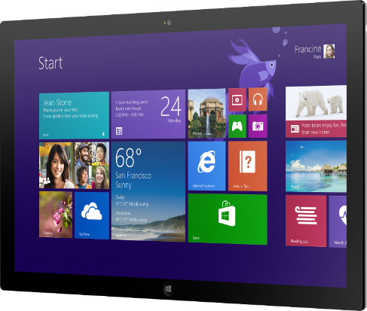
SimpleInk Localization demo

Slide 5
Globalization Demystified
Windows.Globalization.NumberFormatting
DecimalFormatter
PercentFormatter
CurrencyFormatter
PermilleFormatter
Windows.Globalization.DateTimeFormatting
DateTimeFormatter
Windows.Globalization
Calendar

Slide 6
Globalization Demystified
AVOID
Handcrafted formatting
String.Format(“{0}/{1}/{2}”, Month, Day, Year)
String.Format("${0:0.00}", 100.00);
Ignoring user’s language preferences
PrimaryLanguageOverride is permanent – use with care.
Creating specialized calendar UI controls

Slide 7
Localization Demystified
Use resource files for all localizable strings
However, hard-code strings that should not be localized
Translations may require 40% more space
Utilize resource binding
Store: x:Uid for XAML, data-win-res for HTML
ResourceLoader.GetString(“MyResourceID”)
Use resource qualifiers for culture specific images

Slide 8
Resources

Slide 9
Multilingual App Toolkit Resources
http://aka.ms/matinstallv4
Download v4.0
http://aka.ms/matblog
Announcements
http://aka.ms/matvoice
User voice site

Slide 10
Translation Resources
http://www.MicrosoftTranslator.com/dev
Microsoft Translator Developer Site
http://www.microsoft.com/Language
Microsoft Language Portal

Slide 11
Localization Samples
http://aka.ms/datetime
Date and time formatting sample
http://aka.ms/numbers
Number formatting and parsing sample
http://aka.ms/apploc
Application resources and localization sample

