Slide 2
Supercharging your custom solutions with the
Office 365 unified API (preview)
3-641
Yina Arenas
Senior Program Manager
Office Extensibility

Slide 3
Supercharging your custom solutions with the
Office 365 unified API (preview)
3-641
Documents
IM
Tasks
Office Graph
Contacts
Users
https://graph.microsoft.com/
Mail
Groups
Files
Calendar
Conversations
Spreadsheets
Yina Arenas
Senior Program Manager
Office Extensibility
Notes
Presentations
Sites

Slide 4
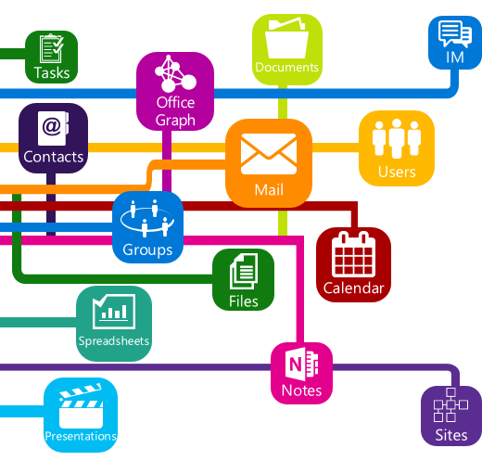
Agenda
Why? What? How?
Demos, demos, demos
What’s supported now?
What’s coming next?
Partner showcase
Call to action

Slide 5

“
The most strategic developer surface area for us is Office 365
”
—Satya Nadella

Slide 6

Office 365 by the numbers
4
Trillion Emails sent with Office 365
50
Million objects in the directory
60
Billion attachments
470
Petabytes of data
8
Billion relationships
in Office graph
850
Million meetings
per month
70%
Fortune500 companies
purchased Office 365
in the last 12 months

Slide 7
Why?
Office 365….
important data but in separate silos

Slide 8








Data silos in the enterprise
USER
FILES
EMAIL AND CONVERSATIONS
EVENTS
PEOPLE
GROUPS

Slide 9
Directory
USER
PEOPLE
GROUPS
Azure Active Directory Graph API
https://graph.windows.net/contoso.com/users
https://graph.windows.net/contoso.com/groups

Slide 10
Extended Profile
USER
PEOPLE
GROUPS
SharePoint User Profile
https://contoso.sharepoint.com/_api/SP.UserProfiles.PeopleManager/GetMyProperties
Exchange HD Picture
https://outlook.office365.com/api/v1.0/me/userPhoto

Slide 11
Mail, calendar and conversations
USER
EMAIL AND CONVERSATIONS
EVENTS
GROUPS
Exchange REST API
https://outlook.office365.com/api/v1.0/me/Messages
https://outlook.office365.com/api/v1.0/me/Events

Slide 12
Files
USER
FILES
PEOPLE
GROUPS
OneDrive for Business/SharePoint Files API
https://contoso-my.sharepoint.com/personal/yina_contoso_com/_api/v1.0/files
https://contoso.sharepoint.com/sites/designCouncil/_api/v1.0/files

Slide 13
Office Graph
USER
FILES
PEOPLE
Office Graph in SharePoint Online
https://contoso.sharepoint.com/_api/search/query?Querytext='*'&Properties='GraphQuery:actor(ME,action\:1020,or(action\:1020\,action\:1003,action\:1001,action\:1024,action\:1005,action\:1037,action\:1039,action\:1036)'&SelectProperties='Docid,Title

Slide 14
What?
graph.microsoft.com (preview)
One API to rule them all

Slide 15
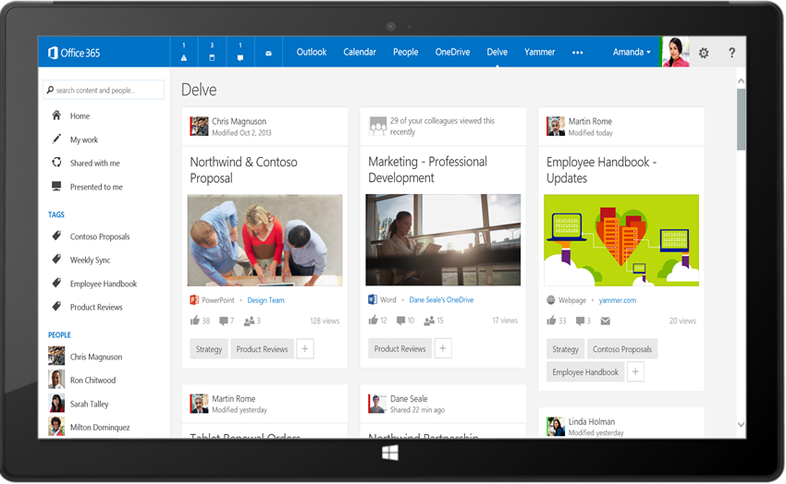
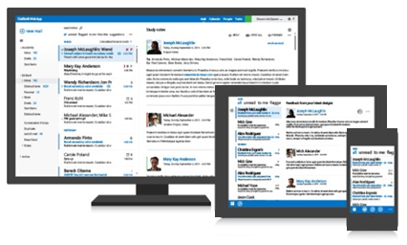
Office 365 unified API
Your
App
https://graph.microsoft.com/
USERS
GROUPS
FILES
MAIL
CALENDAR
TASKS
Insights and relationships from Office Graph

Slide 16
Breaking silos
USER
FILES
EMAIL AND CONVERSATIONS
EVENTS
PEOPLE
GROUPS

Slide 17
/me
USER
ME
userPhoto
thumbnailPhoto
responsibilities
department
pastProjects
aboutMe
hireDate
birthday
address
mobile
jobTitle
schools
name
skills
tags
alias

Slide 18
Code
GET https://graph.microsoft.com/beta/contoso.com
/users/yina@contoso.com
GET https://graph.microsoft.com/beta/me
GET https://graph.microsoft.com/beta/contoso.com
/users/<id>
GET https://graph.microsoft.com/beta/contoso.com
/users/yina@contoso.com?$select=aboutMe
GET https://graph.microsoft.com/beta/me/userphotos/96X77

Slide 19
/users
manager
USER
directReports
memberOf
GROUPS

Slide 20
Code
GET https://graph.microsoft.com/beta/me/manager
GET https://graph.microsoft.com/beta/contoso.com
/users/yina@contoso.com/directReports
GET https://graph.microsoft.com/beta/me/memberOf
GET https://graph.microsoft.com/beta/contoso.com
/users/<id>
GET https://graph.microsoft.com/beta/contoso.com
/users/alex@contoso.com/directReports

Slide 21
/messages
manager
USER
directReports
memberOf
GROUPS
MESSAGES

Slide 22
Code
GET https://graph.microsoft.com/beta/me/messages
GET https://graph.microsoft.com/beta/me/messages?$top=5
GET https://graph.microsoft.com/beta/me
/messages?$top=5&$skip=5&$orderby=DateTimeCreated
GET https://graph.microsoft.com/beta/me
/messages?$top=5&$select=Subject,Sender&
$search="from:alexd@contoso.com"

Slide 23
/events
manager
USER
directReports
EVENTS
memberOf
GROUPS
MESSAGES
MESSAGES

Slide 24
Code
GET https://graph.microsoft.com/beta/me/events
GET https://graph.microsoft.com/beta/me/events?$top=5
GET https://graph.microsoft.com/beta/me
/calendarview?startdatetime=2015-04-01t01:00:00z
&enddatetime=2015-04-16t23:00:00z

Slide 25
/files
Shared with me
createdBy
public
manager
USER
directReports
directReports
EVENTS
EVENTS
modifiedBy
FILES
memberOf
GROUPS
MESSAGES

Slide 26
Code
GET https://graph.microsoft.com/beta/me/files
GET https://graph.microsoft.com/beta/me/files/<id>
GET https://graph.microsoft.com/beta/me
/files/<id>/lastModifiedByUser
GET https://graph.microsoft.com/beta/mary@contoso.com/files
GET https://graph.microsoft.com/beta/mary@contoso.com
/files/<id>/lastModifiedByUser/manager

Slide 27
/groups
Shared with me
Shared with me
createdBy
createdBy
CONVERSATIONS
public
public
manager
USER
directReports
directReports
directReports
directReports
EVENTS
EVENTS
modifiedBy
modifiedBy
FILES
FILES
memberOf
memberOf
GROUPS
GROUPS
createdBy
MESSAGES
FILES

Slide 28
Code
GET https://graph.microsoft.com/beta/contoso.com
/groups?$filter=groupType+eq+'Unified'
GET https://graph.microsoft.com/beta/contoso.com/groups/<id>/members
GET https://graph.microsoft.com/beta/contoso.com
/groups/<id>/files
GET https://graph.microsoft.com/beta/contoso.com
/groups/<id>/conversations
GET https://graph.microsoft.com/beta/contoso.com
/groups/<id>/events/<id>/accept

Slide 29
/workingWith
Shared with me
createdBy
CONVERSATIONS
CONVERSATIONS
public
manager
USER
workingWith
directReports
directReports
EVENTS
EVENTS
EVENTS
modifiedBy
FILES
memberOf
memberOf
memberOf
workingWith
GROUPS
GROUPS
GROUPS
createdBy
createdBy
MESSAGES
FILES
FILES

Slide 30
Code
GET https://graph.microsoft.com/beta/me/workingWith
GET https://graph.microsoft.com/beta/contoso.com
/users/yina@contoso.com/workingWith
GET https://graph.microsoft.com/beta/contoso.com
/users/mary@contoso.com/workingWith

Slide 31
/trendingAround
trendingAround
Shared with me
createdBy
CONVERSATIONS
public
workingWith
manager
USER
workingWith
directReports
directReports
directReports
EVENTS
EVENTS
trendingAround
modifiedBy
FILES
memberOf
memberOf
workingWith
workingWith
GROUPS
GROUPS
createdBy
MESSAGES
FILES

Slide 32
Code
GET https://graph.microsoft.com/beta/me/trendingAround
GET https://graph.microsoft.com/beta/contoso.com
/users/yina@contoso.com/trendingAround
GET https://graph.microsoft.com/beta/contoso.com
/users/mary@contoso.com/trendingAround

Slide 33
/tasks (future)
trendingAround
trendingAround
Shared with me
createdBy
CONVERSATIONS
public
manager
USER
workingWith
directReports
directReports
directReports
directReports
EVENTS
EVENTS
trendingAround
trendingAround
modifiedBy
TASKS
FILES
memberOf
memberOf
memberOf
workingWith
TASKS
GROUPS
GROUPS
GROUPS
createdBy
MESSAGES
FILES

Slide 34
Code
GET https://graph.microsoft.com/beta/me/tasks
GET https://graph.microsoft.com/beta/contoso.com
/users/yina@contoso.com/tasks
GET https://graph.microsoft.com/beta/contoso.com
/groups/<id>/tasks

Slide 35
/notes (future)
trendingAround
Shared with me
createdBy
CONVERSATIONS
public
manager
USER
workingWith
directReports
directReports
directReports
EVENTS
EVENTS
trendingAround
modifiedBy
TASKS
TASKS
FILES
memberOf
memberOf
memberOf
workingWith
TASKS
TASKS
GROUPS
GROUPS
GROUPS
createdBy
NOTES
NOTES
MESSAGES
FILES

Slide 36
Code
GET https://graph.microsoft.com/beta/me/notes/notebooks
GET https://graph.microsoft.com/beta/me/notes/pages
GET https://graph.microsoft.com/beta/contoso.com
/users/yina@contoso.com/notes/sections
GET https://graph.microsoft.com/beta/contoso.com
/groups/<id>/notes/notebooks

Slide 37
API
trendingAround
Shared with me
createdBy
CONVERSATIONS
public
manager
USER
workingWith
directReports
EVENTS
trendingAround
modifiedBy
TASKS
FILES
memberOf
workingWith
TASKS
GROUPS
createdBy
NOTES
NOTES
MESSAGES
FILES

Slide 38
API
trendingAround
Shared with me
createdBy
CONVERSATIONS
public
manager
USER
workingWith
directReports
EVENTS
trendingAround
https://graph.microsoft.com/
modifiedBy
TASKS
FILES
memberOf
workingWith
TASKS
GROUPS
createdBy
NOTES
NOTES
MESSAGES
FILES

Slide 39
How?

Slide 40
Get to all data, connections and relationships in Office 365
Same platform, just simpler
Abstraction layer
Same
  App registration
  Permission scopes and security
  OAuth2.0 and OpenID Connect
Simpler
  Single endpoint
  Single access token
Powerful
  Get to all data, connections and relationships

Slide 41
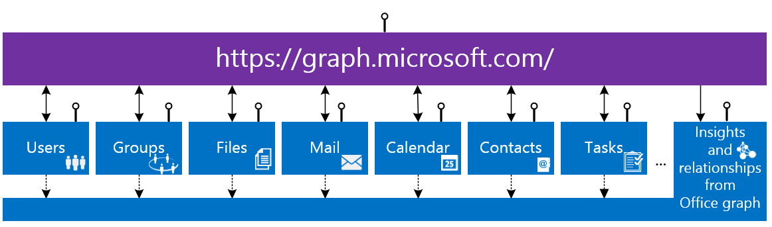
Office 365 unified API
Your
App
https://graph.microsoft.com/

Slide 42
Navigating the API
  Get a tenant-level entity set:
  /user
  Select a member from the entity set:
    /user/{id}
  Get an entity property:
  /user/{id}/department
  Traverse to related entity type via navigation properties:
  /user/{id}/files
  https://graph.microsoft.com
  /
  /{version}
  /{tenant}
  /{entity-set}
  /{id}
  /{property}

Slide 43
Demos
App registration, permission scopes,
OpenId Connect, CORS…

Slide 44
What is supported now?

Slide 45
Supported functionality
Users
Files
Mail
Calendar
Org. Contacts
Groups*
Social Activity*
Commercial
OAuth2.0
CORS
CRUD
OData query operations
Actions and functions
Client libraries .Net, Android, iOS

Slide 46
API
trendingAround
Shared with me
createdBy
CONVERSATIONS
public
manager
USER
workingWith
directReports
EVENTS
trendingAround
https://graph.microsoft.com/beta/$metadata
modifiedBy
TASKS
FILES
memberOf
workingWith
TASKS
GROUPS
createdBy
NOTES
NOTES
MESSAGES
FILES

Slide 47
Demos
Client library, CRUD, Actions…

Slide 48
What’s coming next?

Slide 49
Roadmap
Notifications / web hooks
Consumer
Instant-on
Personal contacts
Tasks
Notes
Skype
Additional insights and relationships
Extensibility

Slide 50
Roadmap
Notifications / web hooks
Consumer
Instant-on
Personal contacts
Tasks
Notes
Skype
Additional insights and relationships
Extensibility

Slide 51
Partner showcase
Smartsheet.com

Slide 52
Call to action

Slide 53
Call to action - http://dev.office.com/unifiedAPIs
Try it NOW!
    http://apisandbox.msdn.com/
    https://graphexplorer2.azurewebsites.net/
Get the client libraries
    http://dev.office.com/unifiedAPIs
Run the sample code
    http://dev.office.com/unifiedAPIs
Read our documentation
    http://dev.office.com/unifiedAPIs

Slide 54
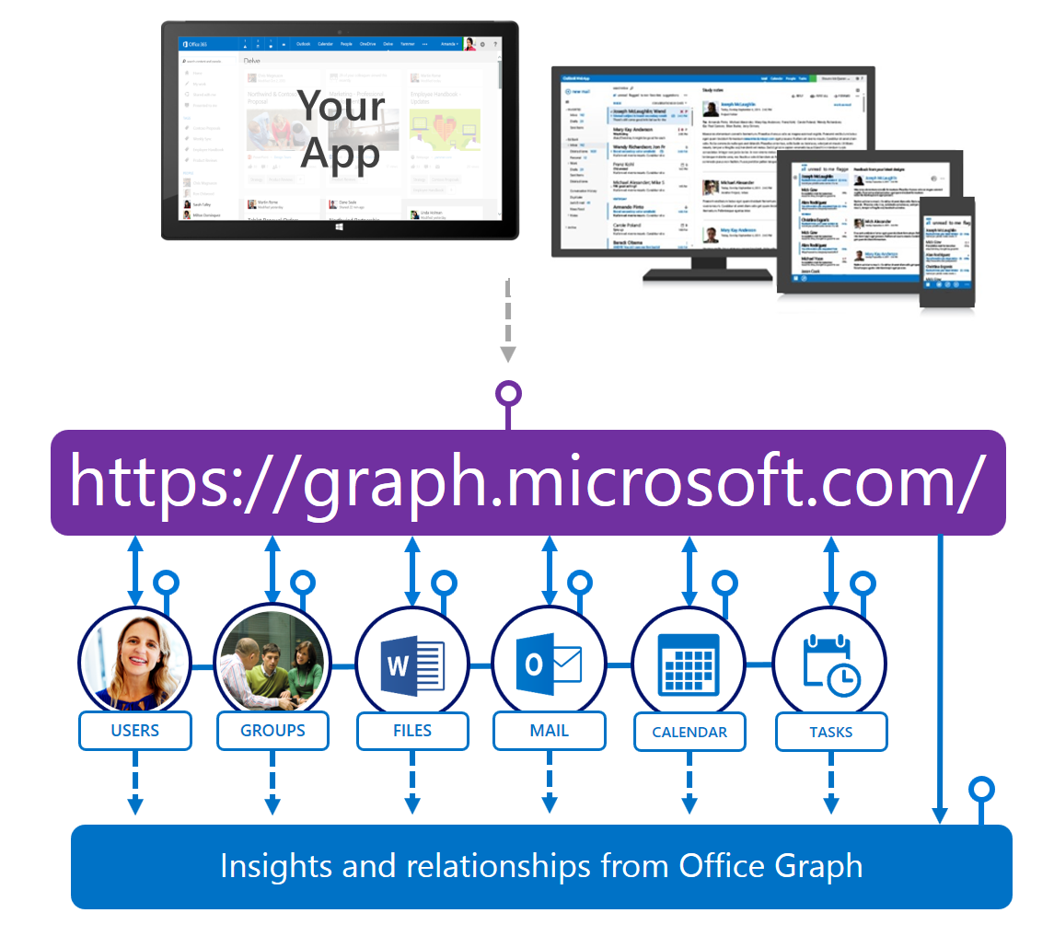
Summary
Office 365 unified API (preview)
One API to rule them all
  Great developer experience for consuming Microsoft services from a single URL space with a single token.
  Directly navigate between currently siloed Office 365 services.
  Combine the full O365 services and the rich relationships and queries enabled by the Office Graph into a single service.

Slide 55
Related sessions
CODE | TITLE | DATE | START
630 | Get your hands dirty with the Office 365 APIs, authentication, and SDKs | Online soon
728 | Integrating Web applications for Office 365 | Online soon
676 | Building solutions with Office Graph | 4/30/2015 | 2:00PM
701 | Deep dive into the Office 365 groups REST API | 4/30/2015 | 3:30PM
632 | Office 365 and Azure: A developer's guide for maximizing the Cloud | 4/30/2015 | 5:00PM
722 | Mobile development with iOS, Android, and Office 365 | 4/30/2015 | 6:30PM
715 | Connecting to OneNote in the Cloud with Office 365 APIs | 4/30/2015 | 6:30PM
661 | Building multi-device applications with Xamarin with Office 365 APIs | 5/1/2015 | 9:00AM
689 | Building a single page app using Angular and Typescript using Office 365 APIs | 5/1/2015 | 10:30AM
767 | Building universal apps with connected services | 5/1/2015 | 2:00PM

Slide 56
Developer Program Launch
1 YEAR FREE
E-mail
Newsletters
Free Developer Subscription
Free
Training
Free
Tools
Webinars
http://dev.office.com/devprogram

Slide 57
Call to action
Sign up for
Developer Program
Check out the
express talks
Collect your
stickers at //build

Slide 58
Your
App
trendingAround
Shared with me
createdBy
CONVERSATIONS
public
manager
USER
workingWith
https://graph.microsoft.com/
directReports
EVENTS
trendingAround
modifiedBy
TASKS
FILES
memberOf
USERS
GROUPS
FILES
MAIL
CALENDAR
TASKS
workingWith
TASKS
GROUPS
Insights and relationships from Office Graph
createdBy
NOTES
NOTES
MESSAGES
FILES

