Slide 2
The Future of TypeScript: ECMAScript 6, Async/Await and Richer Libraries
3-644
Anders Hejlsberg
Technical Fellow
Microsoft

Slide 3
TypeScript: A typed superset of JavaScript that compiles to plain JavaScript.

Slide 4
Static Types → Better Tooling.

Slide 5
Features from the Future, Today.

Slide 6
Any browser. Any host. Any OS.

Slide 7
Open Source.

Slide 8
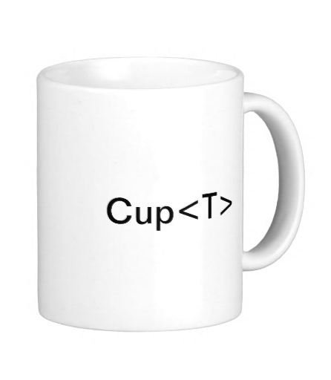
+
+

Slide 9
+
+

Slide 10
Demo

Slide 11
Brad Green Miško Hevery Google Angular Team

Slide 12
AtScript

Slide 13
Angular <3 TypeScript

Slide 14
Built on TypeScript

Slide 15
angular.io

Slide 16
Meet the TypeScript and Angular teams Today @ 1-2 PM Lounge area across from room 3014

Slide 17
TypeScript Server
Editor
TSServer Node.js
JSON
TypeScript plug-in

Slide 18
Type System
An accurate static representation of JavaScript’s dynamic run-time type system
Structural typing and type inference
In practice very few type annotations are necessary
Interfaces, generics, union types, tuple types
Increases accuracy and expressiveness of type system
Works with existing JavaScript libraries
Declaration files can be written and maintained separately
Types enable tooling
Provide verification and assistance, but not hard guarantees

Slide 19
Features from the Future, Today
Compiles ECMAScript 6 code to ECMAScript 3 or 5 code using CommonJS or AMD modules
Modules
Classes
Arrow functions
Default parameters
Destructuring
Spread and rest
Let and const
for...of
Object literal methods
Shorthand properties
Computed properties
Octal / binary literals
Symbols
Template strings

Slide 21
TypeScript Ecosystem
An Open Source language for large scale JavaScript development.
Community
https://github.com/Microsoft/TypeScript
Over 3500 StackOverflow questions
Frameworks
Over 800 .d.ts library definitions on Definitely Typed repository covering practically all popular JavaScript frameworks
Tool support
IDEs: Visual Studio, Sublime Text, Atom, Eclipse, WebStorm, …
Build and test: ASP.NET, grunt, gulp, node.js, tsUnit

Slide 22
TypeScript Roadmap
An Open Source language for large scale JavaScript development.
TypeScript 1.4
Union types, type guards, const enums, let and const, template strings
TypeScript 1.5
Most of ES6, tsconfig.json, TSServer, Sublime Text plug-in
TypeScript 1.6
Async/await, generators, module bundling
TypeScript 2.0
Class expressions, local types
Investigate mixins, abstract classes, etc.

Slide 23
http://typescriptlang.org

