Slide 2
Managing Mobile Devices and Applications in an Enterprise
3-654
Janani Vasudevan
Senior Program Manager
Twitter: @jananivasudevan

Slide 3
Windows 10 : Managing Mobile Devices and Applications in an Enterprise
Janani Vasudevan
Senior Program Manager
Twitter: @jananivasudevan
Session code: 3-654

Slide 4
Managing Windows devices
Challenges today
With Windows 10
Lack of control for mobile devices
Granular mobile device mgmt
Different tools for phone & PC
Converged admin controls
Policy conflict
Automatic policy resolution
Inconsistent user experience…
…not anymore
Windows 10 makes management easy

Slide 5
Management options – Windows 10
IDENTITY
Active Directory
Azure Active Directory
GROUPING
Domain join | Workgroup
Azure AD join
MANAGEMENT
Group policy
New GPOs | AGPM scripting
ConfigMgr
MDM policies via WMI bridge
MDM
New configuration | Initial provisioning
Exchange Active Sync
Powershell | WMI

Slide 6




Go ahead. Pick any configuration tool.
MDM
Provisioning
EAS
ConfigMgr
Service/Server
Device
MDM Client
Provisioning Engine
EAS Client
WMI Bridge
Common Device Configurator
WMI provider
MDM Configuration Service Providers (CSP)
Common component
PC component

Slide 7
The story of an employee in your company

Slide 8
Windows 10 makes it easy to enroll
Easy enroll

Slide 9
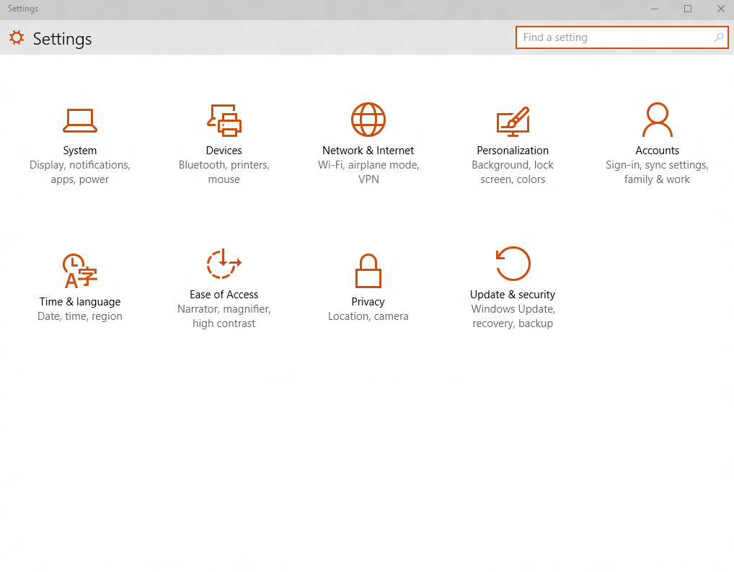
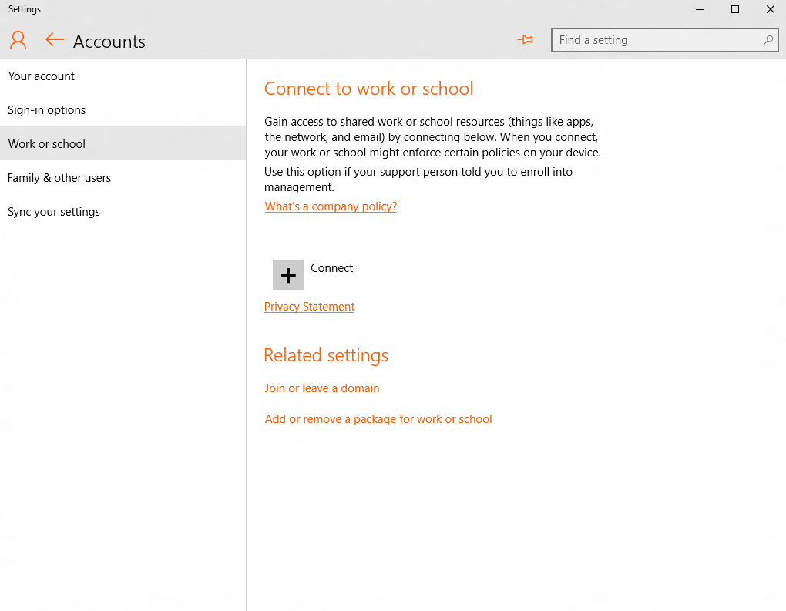
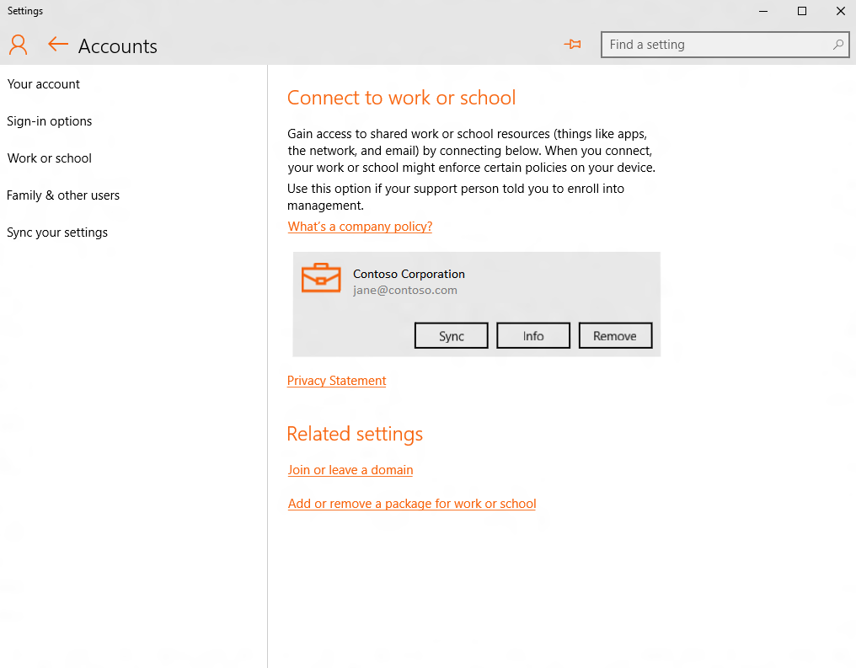
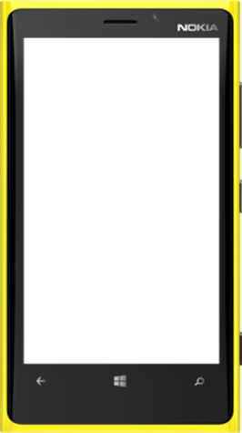
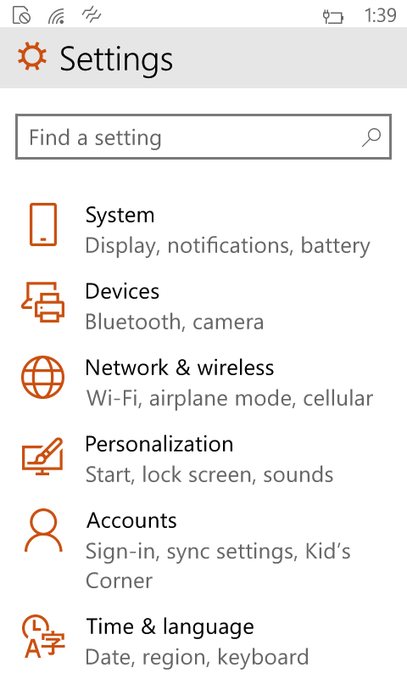
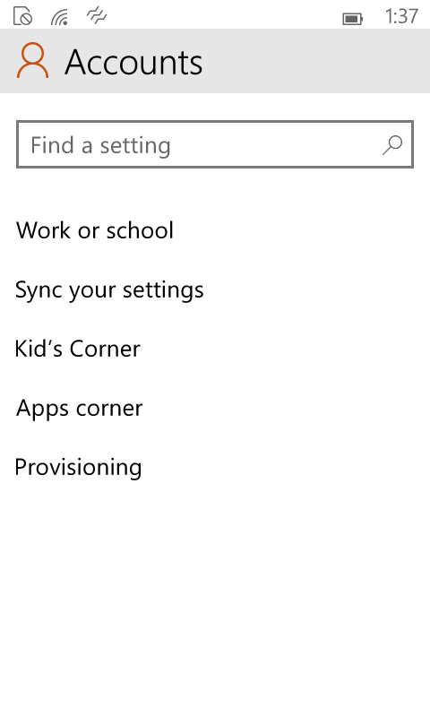
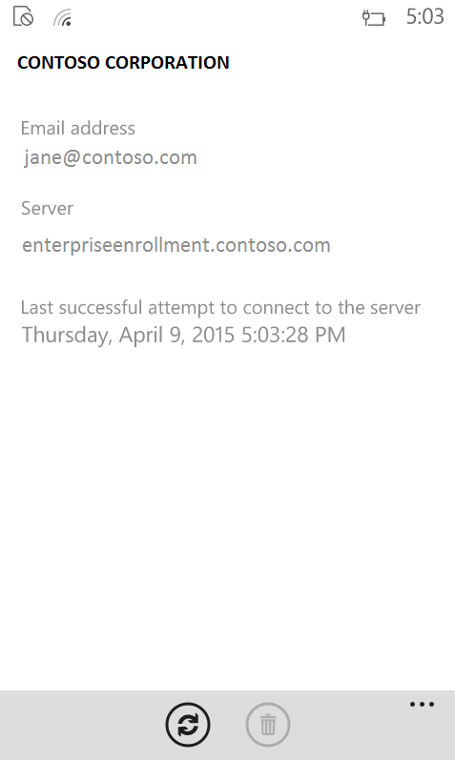
A single experience across all Windows devices
NOT FINAL UI

Slide 10
Demo: Enrollment

Slide 11
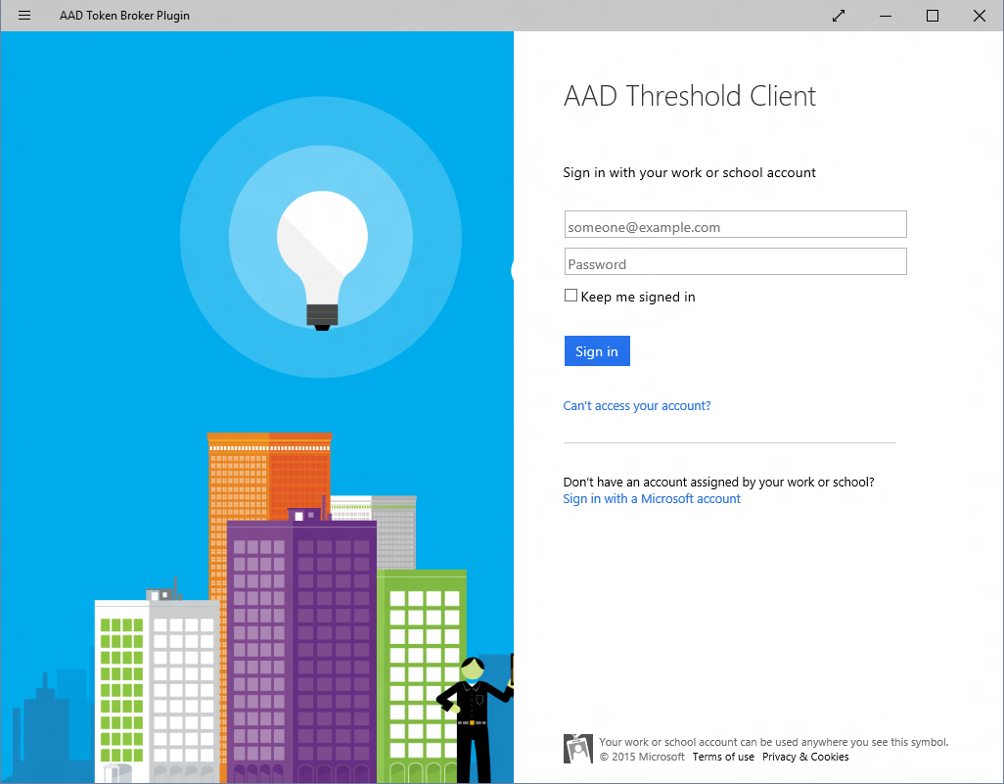
Windows 10 gives you more enroll options
Work or school account
Contoso Corp
Auto MDM enroll with Azure AD
AAD join: Company owned
Add AAD account: Personally owned
Bulk enrollment simplifying IT setup
Sign in to your work or school account
Sign in
|someone@example.com
Allow this PC to be managed ?
Password
Contoso requires this PC to be managed before it can access org resources.
What you get on this PC:
Email, Calendar, Contacts
OneDrive for Business
Access to company apps
How this PC is controlled by Contoso:
Enforce PIN lock
Partial device wipe
Enforce password policy
Monitor device location
Questions? Contact Contoso IT Help Desk at (206) 555-1234.
Forgot your password?
What account should I use?
If your organization uses Office 365 or other business services from Microsoft, use the same user name and password to sign in here.
Privacy statement
Cancel
Sign in
Cancel
Accept
Curious to know how Microsoft IT has adopted AAD? See Microsoft Ignite session by Laura Hunter | May 8 | 12.30 [Link]
Need more info? See Microsoft Ignite session on “Provisioning Windows 10 Devices with New Tools” by Vladimir Holostov [Link]

Slide 12
Windows 10 makes it easy to provide “secure“ productivity
Easy enroll
Secure device, data & access

Slide 13
A step in the right direction – Windows 8.1
Security policies
Email profiles [Now on PC]
Remote lock
Remote wipe [Now on PC]
and all that goodness…
Want a recap of Windows/Phone 8.1 MDM features? Watch //BUILD 2014 session by Katharine Holdsworth on Channel9 here

Slide 14
You have more policies for granular control
Security
Connectivity
Experience
Microsoft Passport PIN policies
Firewall & Defender
Block sharing internet via Wifi
Auto connect VPN
Cortana
Theme background & color
Hardware
System
Email
Camera policies
Bluetooth
Sync settings
Telemetry & flighting
Exchange Active Sync policies
Email profiles configuration
This is only a sample list…there are over 100 new policies!
Need more info on Microsoft Passport? See Microsoft Ignite session on “Secure authentication with Windows Hello” by Nelly Porter [Link]

Slide 15
Demo: Policy configuration

Slide 16
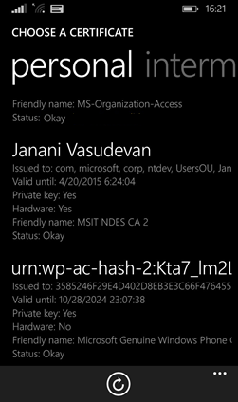
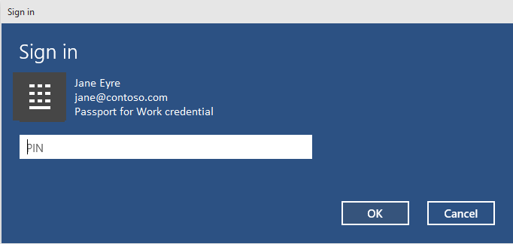

Certificate management has never been easier
  Available now in 8.1
  SCEP (TPM or software)
  Added in Windows 10
  Install certificate directly
  “Microsoft Passport” certificates
  “Certificates” app available now
  View certificates on phone
Get a cert
MDM server
MDM server
Here’s your cert!
Cert please?
SCEP server

Slide 17
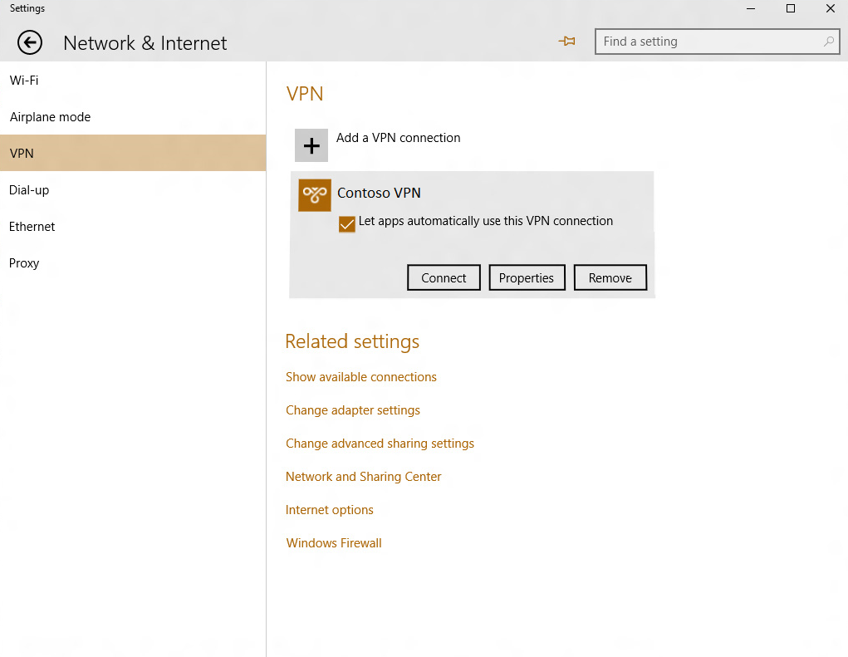
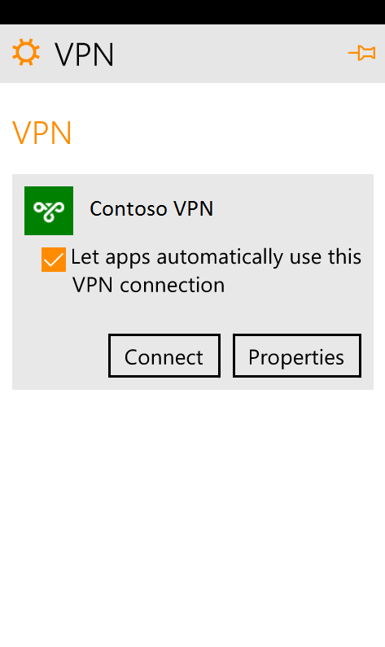
Better VPN management
  Auto connect VPN
  VPN traffic filters
  Application based filters
  Unified platform
  VPN: open to 3rd party plug-ins
Refer to //Build video session on “Secure Enterprise Network Access and VPN” by Aman Arneja for more info

Slide 18
Need access? Prove you’re healthy
Company
resources
  MDM evaluates compliance
Device health attestation state
Windows health attestation service
MDM & Windows Attestation Service
1
Documents
Access please
Request
3
4
2
You’re in
Email
Approved
Company
resources
5
Documents
Here is my proof
2
Prove to me you are healthy
Email
1
Access please
Refer session @ Microsoft Ignite on “Securing Access to Microsoft Exchange and SharePoint Online services with Microsoft Intune“ by Dilip Radhakrishnan & Chris Green

Slide 19
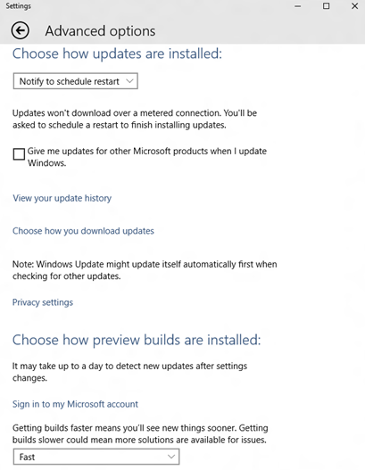
You can now manage device updates
  Control when & how
  Scan & download
  Approval for auto install
  Choose your source
  Microsoft Update
  Company update server (WSUS)
  Update compliance

Slide 20
Company data stays separate & secure

Slide 21









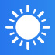

Company data stays separate & secure
  “Enterprise data protection”
  User friendly work-personal separation
  Manage what data is “Enterprise”
  Audit intentional data disclosure
Data exchange is blocked or audited
Business Apps & Data
Managed
Personal Apps & Data
Unmanaged
for business
personal
Here @ //Build: “Building apps that keep work-personal data separate & secure” by Derek Adam

Slide 22
Windows 10 makes it easy for admins to assist users & maintain consistency
Easy enroll
Secure device, data & access
Improve user experience

Slide 23

Help admins help users
Assist remotely
Locate device
Enterprise data wipe or Full wipe
Provide a familiar UI
Start menu, tiles, lock screen
Kiosk mode

Slide 24
Windows 10 makes it easy to manage applications
Easy enroll
Secure device, data & access
Improve user experience
Manage applications

Slide 25

Managing apps has never been so easy
  Common platform
  All-user apps
  Consistent side loading
  Device unlock – no limit, no internet
  Symantec or Enterprise cert
  Win32 (MSI) app mgmt.
  App restrictions by “Applocker”
For more info, see session @ Microsoft Ignite on “Windows 10 Universal App Deployment for Enterprises” by John Vintzel

Slide 26
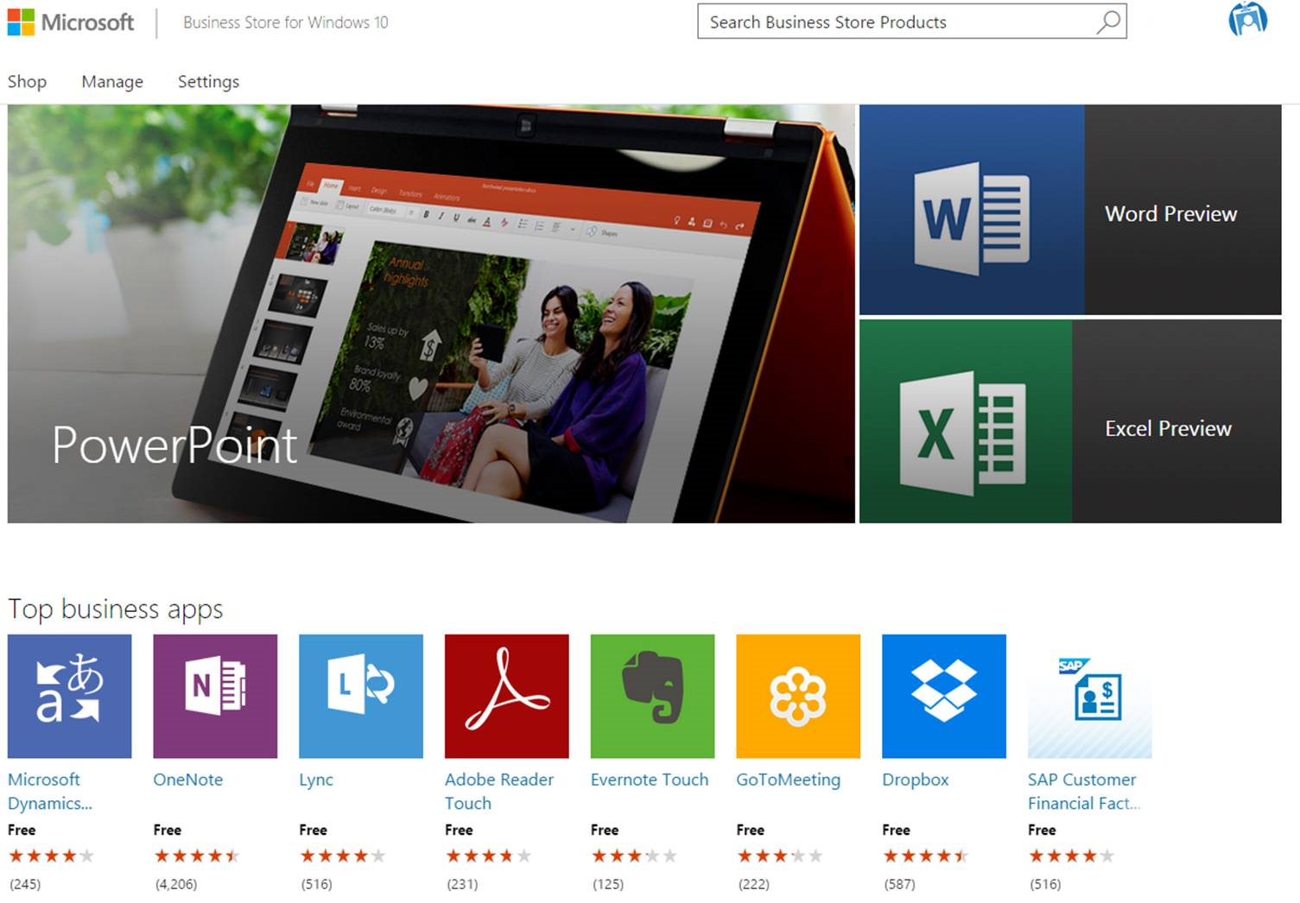
Acquire store apps through Business Store
Licensing apps in bulk
Free and Paid apps
Flexible distribution models
Azure AD for store
Windows app license mgmt
Need info? See session @ Microsoft Ignite on “Using the Business Store Portal with Windows 10 Devices” by Tejas Patel

Slide 27
Windows 10 makes it easy to unenroll
Easy enroll
Secure device, data & access
Improve user experience
Manage applications
Easy unenroll

Slide 28
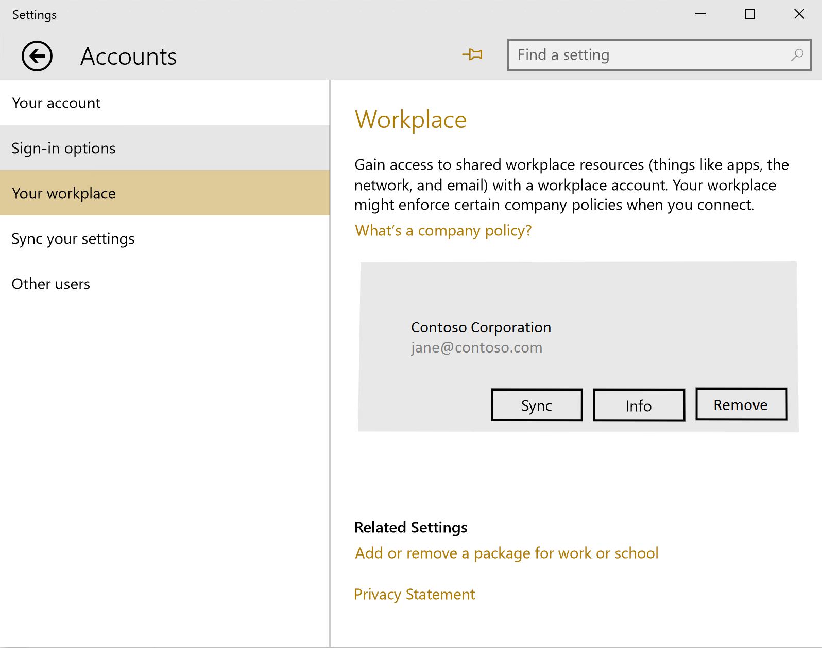
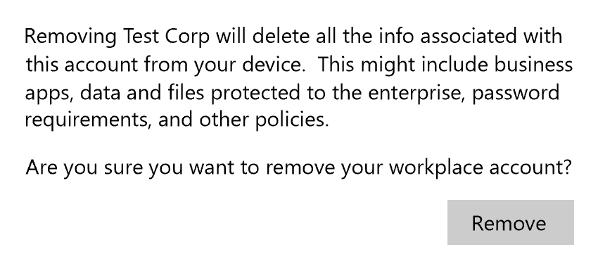
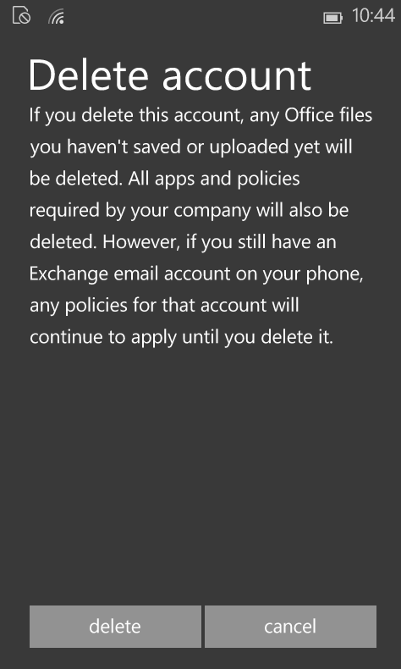
Remove all enterprise data with a single action
Smarter asset removal
Certificates, VPN, Wifi, Email profiles
Policies
Application & App data
“Enterprise data protection” data
Either admins or users can unenroll
Admins control if users can unenroll
Server notified on user unenroll
Consistent experience

Slide 29














THANK YOU

Slide 30
Evaluate Windows 10 insider preview builds http://aka.ms/apf9wk
Next Steps
Talk to your MDM server vendor about Windows 10 support
Develop Windows applications for your Enterprise needs
Let us know your feedback!
http://windows.uservoice.com

Slide 31
Resources!
Related sessions here @ \\Build
639 | April 29 | 15.30 | Anoosh Saboori & Mike Stephens | Microsoft Passport & Windows Hello
662 | April 30 | 11:30 | Derek Adam | Enterprise Data Protection
[VIDEO SESSION] Aman Arneja | Secure Enterprise Network Access and VPN platform enhancements
Sessions @ Microsoft Ignite (video recording available online)
May 6 | 13:30 | John Vintzel | Windows 10 Universal App Deployment for Enterprises [Link]
May 6 | 13:30 | Jason Githens | Managing Windows 10 with Microsoft Intune and SCCM [Link]
May 7 | 10:45 | Vladimir Holostov | Provisioning Windows 10 Devices with New Tools [Link]
May 7 | 13:30 | Tejas Patel | Using the Business Store Portal with Windows 10 Devices [Link]
May 7 | 13:30 | Yogesh Mehta | Protecting your data with containers without boxing yourself in [Link]
Windows 10 MDM documentation ONLINE http://aka.ms/kw2vwj

