Slide 2
DirectX 12 Advanced Graphics and Performance
3-673
Max McMullen
Direct3D Development Lead

Slide 3
Agenda
DirectX 12 Update
Developer Experiences
Multiadapter

Slide 4
It’s been a busy year…
API is complete with working drivers
Over 50% of gamers have DirectX 12 hardware*, 67% estimated by Holiday 2015
1 year free upgrade to Windows 10 from Windows 7 and 8.x
* Based on Steam survey

Slide 5
DirectX 12 Tools
Visual Studio 2015 Graphics Diagnostics now supports D3D12
Graphics Analysis
Shader Debugging, API frame capture/replay/analysis
GPU Usage
Integrated GPU timeline and GPU performance data
Download free Visual Studio Community Edition
Graphics Tools require install of Windows Optional Component
Available from System settings
Direct3D SDK layers for runtime debugging/validation
Command line tool enables automation, regression testing, etc.

Slide 6
DirectX 12 Adoption
Supported by a broad range of game engines, including Unreal 4, Unity 5, and several custom
Fastest adoption by titles under development since Direct3D 9
Titles developed by Microsoft Game Studios and third-party, from all over the world

Slide 7
Snail Games
DirectX 12 Experience

Slide 8
Snail Games and DirectX 12
One of top game developers in China
70% employees in R&D
Owning many independent intellectual properties on games, movies, and mobile services
50 digital products for 85M users in over 100 countries
First game from China to adopt DirectX 12
2 engineers in 6 weeks for game engine porting from DirectX 11
Currently ~10% higher FPS than DirectX 11, with more perf to grab
King of Wushu coming to Windows 10 and DirectX 12 in Q4 2015

Slide 9
King of Wushu by Snail Games
Direct3D 11 versus Direct3D 12 Comparison Video

Slide 10
Snail Games and DirectX 12
DirectX 12 improves game performance
Parallelizes command list building and execution across CPUs
Coordinates workload across multiple GPU engines
Improves memory efficiency and reduces memory fragmentation
Improves frame rate stability with object caching
DirectX 12 releases creativity
Enables direct hardware control and more game-specific optimizations
DirectX 12 maximizes rendering code sharing between PC and Xbox

Slide 11
Multiadapter
Direct3D 12 API Feature

Slide 12
Implicit Multiadapter
Same experience and guidance as Direct3D 11
Reduce cross-frame dependencies
Use multibuffer swapchains to allow AFR parallelism
Work with hardware vendors to profile and optimize multiadapter experience
Windows 10 supports implicit multiadapter in windowed mode swapchains

Slide 13
Art & Tech Demo: Witch
Square Enix

Slide 14
Art & Tech Demo: Witch Developer Experience
Ivan Gavrenkov - Square Enix

Slide 15
Explicit Multiadapter
Ability to leverage all the hardware in a system
Parallel command generation and execution
Independent memory management
Multiple GPU topologies
Multiple discrete GPUs
Integrated and discrete GPUs
More control, more capability, more performance
Supports custom load balancing of work
Two distinct API patterns
Linked GPUs
Unlinked GPUs

Slide 16
Explicit Multiadapter – Linked GPUs
Linked GPUs look like a single GPU with multiple command processors per engine (3D/Compute/Copy) and memory regions
Command processor and memory regions indicated by a node mask on the API
Use resources from one GPU in the other linked GPUs’ rendering pipeline
The rest of this talk discusses unlinked GPUs

Slide 17
Explicit Multiadapter – Unlinked GPUs
Works across multiple discrete and/or integrated and discrete GPUs
Two main areas of API improvements
Independent resource management with cross-adapter memory transactions
Parallel queues with cross-adapter synchronization

Slide 18
Explicit Multiadapter Resource Management
GPU A
GPU B
Buffer
T2D
Texture2D
Texture2D
Buffer
T2D
API
Resource Heap
Resource Heap
Resource Heap
Resource Heap
Hardware
GPU VA
GPU VA
GPU VA
GPU VA
Physical Pages
Physical Pages
Physical Pages
Physical Pages
Physical Pages

Slide 19
Explicit Multiadapter Cross-adapter memory
GPU A
GPU B
Buffer
T2D
Texture2D
Texture2D
Buffer
T2D
API
Resource Heap
Resource Heap
Resource Heap
Resource Heap
Hardware
GPU VA
GPU VA
GPU VA
Physical Pages
Physical Pages
Physical Pages

Slide 20
Explicit Multiadapter Parallel Queues
Render
Render
Compute
Render
Wait B1
3D Queue
GPU B
Stream textures
Signal B1
Copy Queue
Render
Render
Compute
Render
Wait A1
3D Queue
GPU A
Stream textures
Signal A1
Copy Queue

Slide 21
Explicit Multiadapter Cross-adapter Sync
Render
Render
Render
Signal B1
Signal B2
3D Queue
GPU B
Signal A0
Signal A1
Copy to GPU A
Copy to GPU A
Copy to GPU A
Frame
Frame
Frame
Copy Queue
Wait B1
Wait B2
GPU A
Wait A0
Postprocess
Render
Postproc
Postproc
Wait A1
3D Queue

Slide 22
UE4 Explicit Multiadapter Tech Demo
Heterogeneous multiadapter
Integrated and Discrete GPUs
Offload some postprocessing to the slower integrated GPU
Discrete is used as the primary adapter
Integrated is used as the secondary adapter

Slide 23
Postprocessing
Easily pipelined
Separable and contiguous
Predictable workload
Makes consistent performance gains possible
Low workload variance frame over frame. Post-processing chain does not change frequently
Clear dependency relationships, such as render targets
Small and predictable memory footprint
Bus bandwidth not affected too much from copying a lot of resources around
Most large assets no longer needed when post-processing begins: atlas textures, large meshes, etc

Slide 24
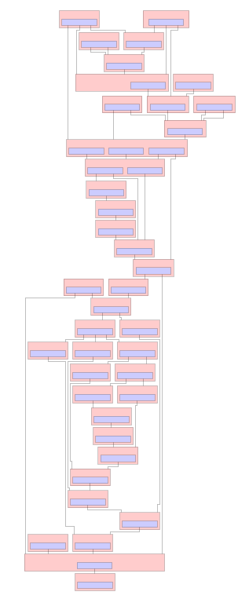
Postprocessing Data Flow
Implemented as a DAG
Each node is a postprocessing step
Each edge is a render target dependency

Slide 25
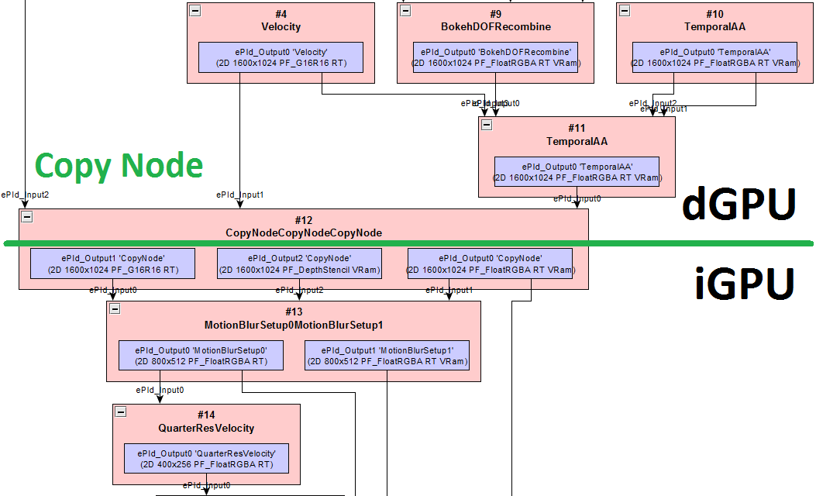
Postprocessing Graph Modification
A ‘copy node’ implemented as a postprocess step is used to record resource copies between GPUs
Executes the following:
Record copy for render target dependencies on copy engine
Use the integrated GPU for remaining nodes

Slide 26
Resource Copies using Multiengine
A copy queue is created alongside the primary 3D queue on the dGPU
Enables async multiengine copies that occur in parallel with the 3D queue
Copy and 3D parallel execution
3D - NVIDIA
Frame 1
Frame 2
Copy - NVIDIA
3D - Intel
Frame 0
Frame 1

Slide 27
Resource Copies using Multiengine
…
dGPU3D->Draw(frame1A)
dGPU3D->Signal(renderComplete)
dGPUCopy->Wait(renderComplete)
dGPUCopy->Copy(frame1A, sharedHeap)
dGPUCopy->Signal(copyComplete)
iGPU3D->Wait(copyComplete)
iGPU3D->Bind(sharedFrame)
iGPU3D->Draw(frame1B)
iGPU3D->Present(frame1B)
…
Crossadapter fences enables synchronization across multiple GPUs
Can be used in conjunction with shared heaps

Slide 28
UE4 Multiadapter Demo
Integrated and Discrete Cooperative Rendering

Slide 29
UE4 Elemental Single vs Multiadapter Timeline
28.2ms (~35.5fps)
3D – NVIDIA
Frame 1
Frame 2
Frame 3
25.3ms (~39.5fps)
3D - NVIDIA
Frame 1
Frame 2
Frame 3
Copy - NVIDIA
3D - Intel
Frame 0
Frame 1
Frame 2

Slide 30
Summary
API Finalized
Tools available and continuously updated
Amazing games and technology demos already running on the API, now available in the SDK
Multiadapter gives Direct3D developers more control, more performance, and more capability than ever before

Slide 31
Resources – Previous Talks
GDC 2015:
http://channel9.msdn.com/Events/GDC/GDC-2015/Advanced-DirectX12-Graphics-and-Performance
http://amd-dev.wpengine.netdna-cdn.com/wordpress/media/2012/10/D3D12-A-new-meaning-for-efficiency-and-performance.ppsx
DirectX Tools: http://channel9.msdn.com/Events/GDC/GDC-2015/Solve-the-Tough-Graphics-Problems-with-your-Game-Using-DirectX-Tools
Direct3D 12 Power & Performance: http://channel9.msdn.com/Events/GDC/GDC-2015/Better-Power-Better-Performance-Your-Game-on-DirectX12
IDF 2014: https://intel.lanyonevents.com/sf14/connect/sessionDetail.ww?SESSION_ID=1315
GDC 2014/Build 2014: http://channel9.msdn.com/Events/Build/2014/3-564

Slide 32
Resources
Graphics Tools
Download Visual Studio Community Edition free: http://www.visualstudio.com/downloads/visual-studio-2015-downloads-vs
More info on: http://blogs.msdn.com/b/vcblog/
DirectX 12
Blog: http://blogs.msdn.com/b/directx/
Documentation: https://msdn.microsoft.com/en-us/library/dn903821(v=vs.85).aspx
Early Access Program: http://1drv.ms/1dgelm6
Samples coming soon, watch the blog

Slide 34
Snail Games – King of Wushu Details
Test machine spec
i7-3770, 16GB RAM, NVidia GTX980 (4GB GDDR5)
Scene complexities
Scene #1: 25 generals with all visual effects on
6k drawcalls and 10M polygons per frame
Scene #2: Fighting flocks of enemies
15k drawcalls and 17M polygons per frame (on DX12)
1.5x more enemies on DX12 compared to DX11

Slide 35
Explicit Multiadapter Resource Management
GPU A
GPU B
Buffer
Texture2D
Texture3D
Buffer
Texture2D
Texture3D
API
Resource Heap
Resource Heap
Hardware
GPU VA
GPU VA
Physical Pages
Physical Pages
Physical Pages

Slide 36
Multiadapter Resource Management
UE4 Resource
UE4 resource objects abstract D3D resources
Each UE4 resource can hold a reference to a valid D3D resource per adapter
D3D resource copied across adapters only when needed on a different adapter
D3D Resource
on
GPU A
D3D Resource
on
GPU B

