Slide 2
Using Visual Studio, Team Foundation Server, Visual Studio Online, and SonarQube to Understand and
Prevent Technical Debt
3-696
Olivier Gaudin, CEO, SonarSource
Stuart Kent, Group Program Manager, Microsoft

Slide 3

Using Visual Studio, Team Foundation Server, Visual Studio Online, and SonarQube to Understand and
Prevent Technical Debt
3-696
Olivier Gaudin, CEO, SonarSource
Stuart Kent, Group Program Manager, Microsoft

Slide 4
Agenda
Problem of Technical Debt
SonarQube
Integration with TFS and .Net
What’s Next
Resources
Questions

Slide 5
Technical Debt

Slide 7

The deadly sins of the developer
Duplications
Bad distribution of complexity
Spaghetti Design
Lack of unit tests
No coding standards
Potential bugs
Not enough or too many comments

Slide 8
This is hard!
Too late
Pushback from teams
Lack of ownership
Heterogeneous requirements
Quality gate

Slide 9
Changing the Game
Development team owns quality
Shorter feedback loop
Unified quality gate
Cost is non-significant
This is fun!

Slide 10


Slide 11
In Numbers
50K+ live instances
56% of Java developers use it daily*
110K+ downloads per year
20+ languages covered
60+ plugins in the open source forge
*According to 2014 survey by RebelLabs

Slide 12


Slide 13
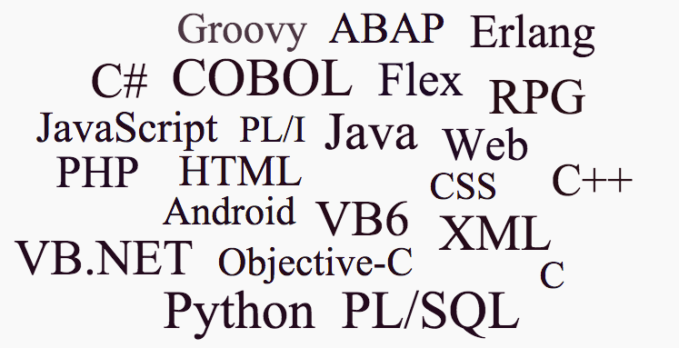

Slide 14
SonarQube hasn’t worked well with .Net…
Very important is to support SonarQube tooling for .NET. SonarQube has become the defacto standard of providing code quality stats for your product and this is heavily used in the Java space. In enterprises this is also used for .NET projects, but the metrics don't match the VS tooling metrics.
Marcel de Vries
Microsoft MVP and CTO Xpirit
You guys do not get it because you think Java. You definitely need to hire C# developers!
SonarQube Community
Both Microsoft and SonarSource have received similar messages from many customers

Slide 15

Be actionable in controlling and remediating technical debt
Define the quality lens
Choose rules and data relevant to your team
Define a baseline
- Last commit
- Specific version
Define acceptable
thresholds
Define
Remediation policy
Don’t make it worse
Clean-up as you go
Quality Profile
Baseline
Quality Gates
Remediation
Policy
Code Quality Data
Code Analysis Issues
Code Metrics, Clones, Coverage
Architectural insights
ALM insights
Application insights
Filtered Code Quality Data
Still
overwhelming
overwhelming
Issues to focus on

Slide 16



ALM Workflow
Understand
Technical Debt Dashboard
Technical Debt DataMart
Control
Measure
Build
IDE
/ TFS
VS
Prevent &
Remediate
Web based
experience
TFS
VSO
Source Control
Work Items

Slide 17
TFS/.Net Integration – Issues
Fixed
Fragile | Duplicates MSBuild configuration in manually edited files Tries to externally replicate complex MSBuild processing
Not Integrated | No integration with build in TFS/VSO Results from new Roslyn-based analysers not uploaded SonarQube analysers don’t run in Visual Studio
Inconsistent | Metrics calculated in Visual Studio are different to the ones calculated by SonarQube
✓
✓
✓
todo
✓
todo

Slide 18
Demo – Integration of SonarQube with Microsoft ALM and .Net

Slide 19
TFS/.Net Integration – Approach
Build Agent
Pre-Build
Fetch configuration from SonarQube server
MSBuild
Collect project info
Quality Profile
Quality Gates
SonarQube
Analysis Data
Solution & Project Data
File Store
Test
Code Coverage Data
Post-Test
Detect code clones
Perform additional code analysis (e.g. Javascript)
Calculate metrics
Tech Debt Data

Slide 20
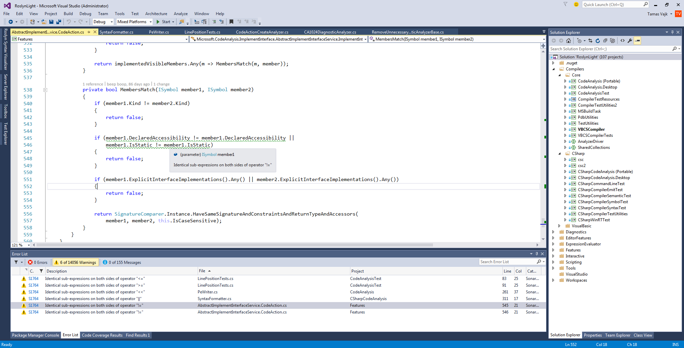

Slide 21
What’s Next?
Continuous update of .Net code analyzers
Understand
Tasks for new TFS/VSO build
Cloud build pre-configured with SonarQube analysis
Send data from new Roslyn-based code analysers
Sending data from Java builds
Integration of SQ runner for msbuild with other CI systems
Technical Debt Dashboard
Baseline support in IDE
Align SonarQube metrics with those calculated in VS
Technical Debt DataMart
Control
Measure
Build
IDE
/ TFS
VS
Prevent &
Remediate
Web based
experience
TFS
VSO
Source Control
Work Items

Slide 22
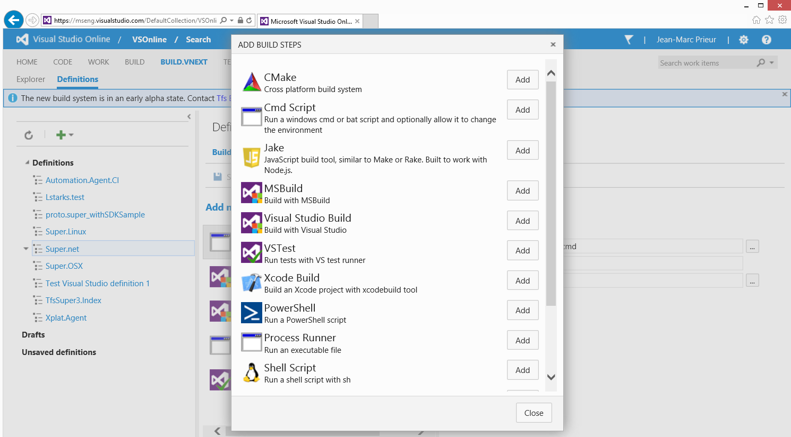

https://contoso-w3.visualstudio.com/DefaultCol
Contoso / Contoso Web.
Lan C.
SonarQube pre-build
Prep build for SonarQube analysis
SonarQube post-test
Send analysis data to SonarQube

Slide 23
Summary
✓
Problem of Technical Debt
SonarQube
Integration with TFS and .Net
What’s Next
Resources
Questions
✓
✓
✓

Slide 24
Resources
This is ready to use now
http://aka.ms/sonarqubeintegration has all the details

Slide 25
© 2015 SonarSource SA. All rights reserved.

