Slide 2
Building Cross-Platform Mobile Apps in C++ with Visual Studio 2015
Ankit Asthana
Senior Program Manager
3-714

Slide 3
More Platforms = More Opportunities
Mobile users want to use same application across devices
Developers want to target many platforms

Slide 4
The Silo Approach
Benefits
Full native experience
Total access to the device as provided by the SDK
Negatives
Minimal code reuse
Higher development cost
One platform becomes the dominant platform
Windows
iOS
Android
C#, C++/CX
ObjC, Swift
Java

Slide 5
Trivia!
How many of the top 50 applications on the Android Playstore (U.S.) leverage C++ code?
None
10%
40%
80%
Android
Java

Slide 6
Trivia!
How many of the top 50 applications on the Android Playstore (U.S.) leverage C++ code?
None
10%
40%
80%
Android
Java -------------- C++

Slide 7
Top 50 Android Playstore applications (U.S.)
Facebook Messenger
Facebook
Pandora
Clean Master
Go Keyboard
Instagram
SnapChat
Super-Bright LED
Candy Crush Soda
Spotify
CrossRoads
Netflix
Subway Surfers
Kik
WhatsApp Messenger
Skype
Clash of Clans
Jelly Jump
DubsMash
Temple Run 2
Surgery Simulator
Pinterest
Candy Crush Saga
CM Security Antivirus
Trivia Crack
Zedge Ringtones
Apus Launcher
Bingo Crush
Amazon Shipping
Texas Holdem
ZigZag
8 ball pool
Yahoo Mail
Game of War
Despicable Me
Fast and Furious Legacy
Five Nights at Freddy’s
Sound Cloud – Music and Audio
iHeart Radio
Twitter
Fruit Ninja Free
The Weather Channel
Flow Free 2
Minicraft
Magic Piano
ooVoo video call
Solitare
Wish Shopping Made Fun
Google Earth
Angry Birds
Android
Java -------------- C++

Slide 8
C++ the common denominator
Benefits
Full native experience
Total access to the device as provided by the SDK
Code Reuse
Performance
Security
Windows
iOS
Android
C#, CX
ObjC, Swift
Java
---------- C++
---------- C++
---------- C++

Slide 9
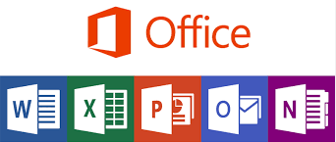
C++ the common denominator
.appx
.apk
.ipa
Shared C++ backend is compiled as:
XAML
XML
.appx | .apk | .ipa
C#, C++/Cx | Java Dex / ART | ObjC Swift
Dynamic Link Library (.dll) Static Library (.lib) | Dynamic shared library (.so) Static library (.a) | Static library (.a)
Cocoa Touch
C#
Cx
Java
Pinvoke C++ Wrapper
Java/C++ JNI Wrappers
ObjC Wrapper
Shared C++ Backend
DropBox

Slide 10
Development tools for C++ cross-platform
Compilers | Visual C++ Compiler | GCC Clang/LLVM | Clang/LLVM
Build Engine | MSBuild, Nmake | NDK Build, Make files, Gradle, Ant | Xcode Build
IDE(s) | Visual Studio | Eclipse CDT | Xcode
Host Platform | Windows 8/8.1/10 | MacOS X, Linux, Windows | Mac OS X

Slide 11
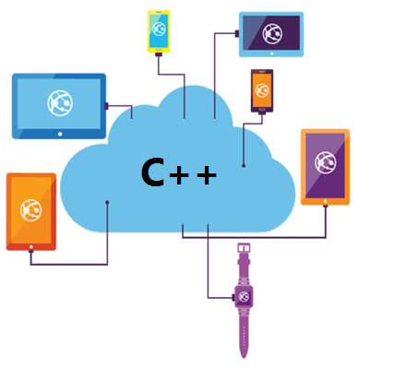
Challenges with C++ cross-platform mobile
Multiple installation experiences
Maintaining multiple build tools and build systems
Debugging experience is not ideal
Multiple C++ IDE(s)

Slide 12
Visual Studio 2015 RC
Visual Studio 2015
Easy installation
One C++ IDE for your cross-platform needs
Share and reuse cross-platform code
State of the Art code-editing features
Powerful debugging experience
Fast emulation

Slide 13
Demo 1: Developing for the Android Platform
Description
More TeaPots Native-Activity Android application. Mostly ‘C++’ code with a little Java wrapper
Feature Capabilities
Building Android Native-Activity application
Clang – GCC toolchain
Android Code Editing (Refactoring, Intellisense)
Android Native Debugger
Logcat Viewer
Fast Emulation

Slide 14
Demo 2: Building a C++ cross-platform mobile application
Description
An OpenCV based Image Manipulation cross-platform application targeting the Android and Windows platform
Feature Capabilities
Cross-Platform Mobile Application
Easily share code easily across mobile-platforms
Cross-Platform productivity features (Intellisense, refactoring)
Powerful debugging (NATVIS)
Build Simultaneously

Slide 15
Demo 3: Debugging an existing Android Application
Description
Debug a pre-existing Android Application in Visual Studio.
The Application is large:- BingMaps Android Application.
Feature Capabilities
Debug pre-existing Android Application
For more information: refer to this blog

Slide 16
Introducing!, Visual C++ 2015 (iOS)
Develop iOS applications using Visual C++
Easily edit, build and debug your iOS code
Share and reuse your cross-platform code
Productivity of Visual Studio now available for iOS

Slide 17
Demo 4: Building iOS applications using Visual Studio
Description
Cross-Platform OpenGL ES application targeting the iOS and Android Platform.
Feature Capabilities
Building iOS binaries
Code Sharing across multiple platforms (iOS and Android)
Code Editing (Intellisense, Refactoring etc.) for iOS
Debugging iOS C++ code
Fast Deployment

Slide 18
Xamarin and Visual C++ 2015
Xamarin Android native (C/C++) users will now be able to:
Build Android native Libraries (.so and .a) using Visual Studio
Debug their Android native using a powerful debugging experience
For more information: refer to this blog

Slide 19
Resources
https://www.visualstudio.com/en-us/features/cplusplus-mdd-vs.aspx
blogs.msdn.com/b/vcblog/
Email: aasthan@microsoft.com

