Slide 2
Debugging Performance Issues Using Visual Studio 2015
3-731
Andrew Hall, Angelos Petropoulos
Visual Studio Program Managers

Slide 3
Loading…

Slide 4
Why is performance important?
(source: http://www.businessnewsdaily.com)

Slide 5
Agenda
Continuously evaluate performance during normal debugging
PerfTips
Memory tool
CPU graph
Drill into the details of a performance issue
Timeline tool
CPU tool
Standalone Profiler

Slide 6
DEMO
PerfTips
CPU Graph

Slide 7
PerfTips
Quickly measure time between breaks
Excludes major debugger related overhead
Time stopped under the debugger (e.g. stopped at a breakpoint)
Symbol loading
Etc.
Best suited for order of magnitude measurements
Greatest accuracy on CLR 4.6 and Windows 10

Slide 8
CPU graph
Shows CPU utilization across all available cores
Spikes can be interesting, even if less than 100%
Available after debugging session has stopped

Slide 9
DEMO
Memory Tool

Slide 10
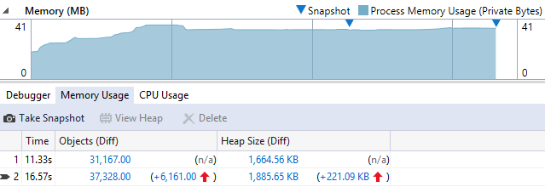
Memory tool
Compare memory consumption over time
Provides sizes and count for each type
Filters out objects marked for garbage collection (.NET)
Works for both C++ and .NET apps

Slide 11
DEMO
Diagnostic Tools Without Debugging
Timeline Tool

Slide 12
Timeline tool
Identify app performance issues due to
Parsing & Layout
Application code or other runtime CPU consumption
Monitor FPS throughput

Slide 13
DEMO
CPU Tool

Slide 14
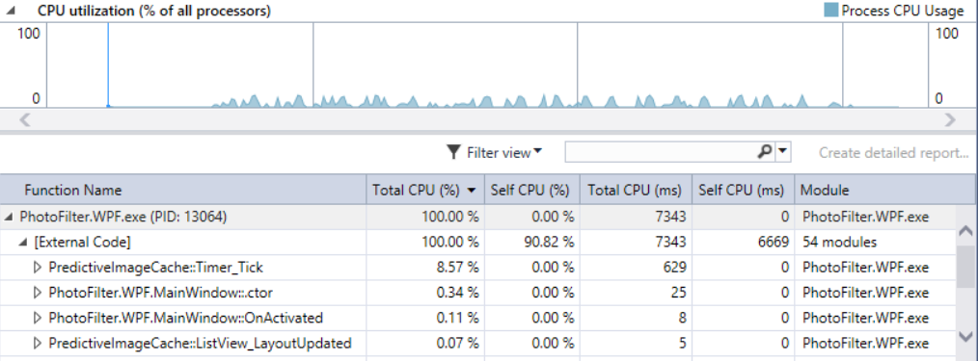
CPU tool
Records which functions are using the CPU the most
Takes a call stack from the CPU every millisecond
Shows aggregate report
Collects mixed mode stacks (.NET & C++)

Slide 15
DEMO
Performance Wizard
Standalone Profiler

Slide 16
Standalone Profiler
Part of Visual Studio Remote tools http://www.microsoft.com/en-us/download/details.aspx?id=46874
CPU sampling on Windows 8+ works with x-copy

Slide 17
Keep up to date and tell us what you think
For everything Visual Studio diagnostics related
http://aka.ms/diagnosticsblog
Make suggestions and vote
http://visualstudio.uservoice.com
Let us know when something works well (or doesn’t) for you via Send-a-Smile

