Slide 2
Building Consumer and Enterprise Device Solutions with Windows 10 IoT
3-752
Cyra Richardson
Principal Group Program Manager

Slide 3
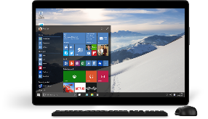
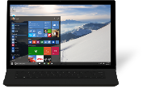
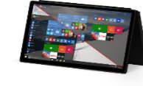
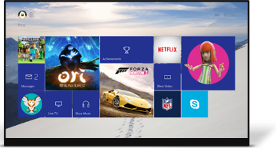
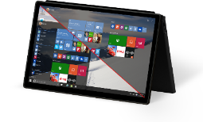
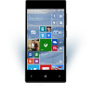
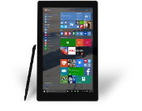
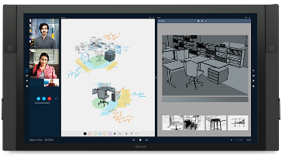
One App Platform
Multiple device families
PC
HoloLens
Mobile
Xbox
Devices +IoT
Surface Hub
Adaptive user interface
Common APIs and SDK
Natural user inputs
Common store and dev center
Common toolset
One Device Platform

Slide 4
Windows 10 for IoT Devices The power of Windows and the Windows ecosystem on my embedded devices gets me to value faster
Windows 10 IoT for Industry Devices
Windows 10 IoT for Mobile Devices
Windows 10 IoT for Small Devices
One Windows core scalable across devices
One universal app and driver platform
One management and deployment approach
Enterprise-grade security
Advanced Customization and lockdown capabilities
Continued innovation and support
Local connectivity
Cloud connectivity
Device services
One Windows Platform
Secure
Connected

Slide 5
Windows 10 IoT Editions
Requires desktop or desktop apps– Win32, .NET, WPF, etc. ?
For Industry Devices
Desktop Shell, Win32 apps
1 GB RAM, 16 GB Storage
Requires a Shell experience, multiple applications, Windows first-party applications, or mobile voice?
For Mobile Devices
Modern Shell
Mobile Chassis requirement
512 MB RAM, 4 GB storage
Windows Device Services
On all Windows IoT clients
Extends value of Windows for OEMs
OS telemetry, update management, interoperability
Azure IoT-ready
Otherwise
For Small Devices
Dedicated devices
Optional Display No Shell/Store/MS Apps
256MB RAM, 2GB storage
Universal Apps

Slide 6
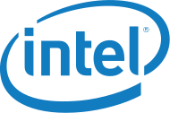
Broad Silicon Support

Slide 7
Reusing Code on Windows 10 IoT Core UWP app portability
One Windows Platform
Cyra Richardson

Slide 8
Building IoT Devices with UWP: “Embedded Mode”
One Windows Platform
Policy Managed
Headless operation
Access to system settings
power state, radio control and Wifi connection.
APIs to access busses
GPIO, I2C, SPI and easy access to custom hardware
Background applications for long running tasks
Full control for your device, free of standard Process Lifecycle Management

Slide 9
Apps controlling hardware UWP extensions on Windows 10 IoT Core
One Windows Platform
Cyra Richardson

Slide 10
OSS for IoT
Why
Innovation in IoT space drives developer productivity
How
Operate within communities’ norms
Contribute abstractions for IoT APIs (e.g. GPIO)
Prioritize IoT supporting projects (e.g. Python & Node.JS)

Slide 11
Building On-Device Management Experiences Node.JS used to create a web interface on Windows 10 IoT Core
One Windows Platform
Cyra Richardson

Slide 12
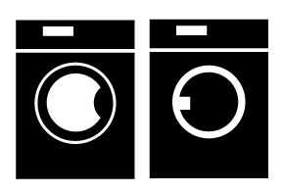
Windows 10 IoT – AllJoyn Overview
Discovery
Cross Platform
Management
Interoperability
Security
Open Source
I can send notifications.
I have a clock interface
I can send notifications
I display notifications.
I have the clock interface!
Your Devices Work Together
Across Protocol and Ecosystem Barriers
I display notifications.
I have the clock interface!
I can send and display notifications
72°
120
80
I can send notifications
I display notifications.
I have the clock interface!
I have lighting interface

Slide 13
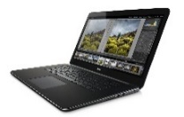
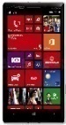
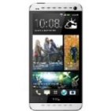
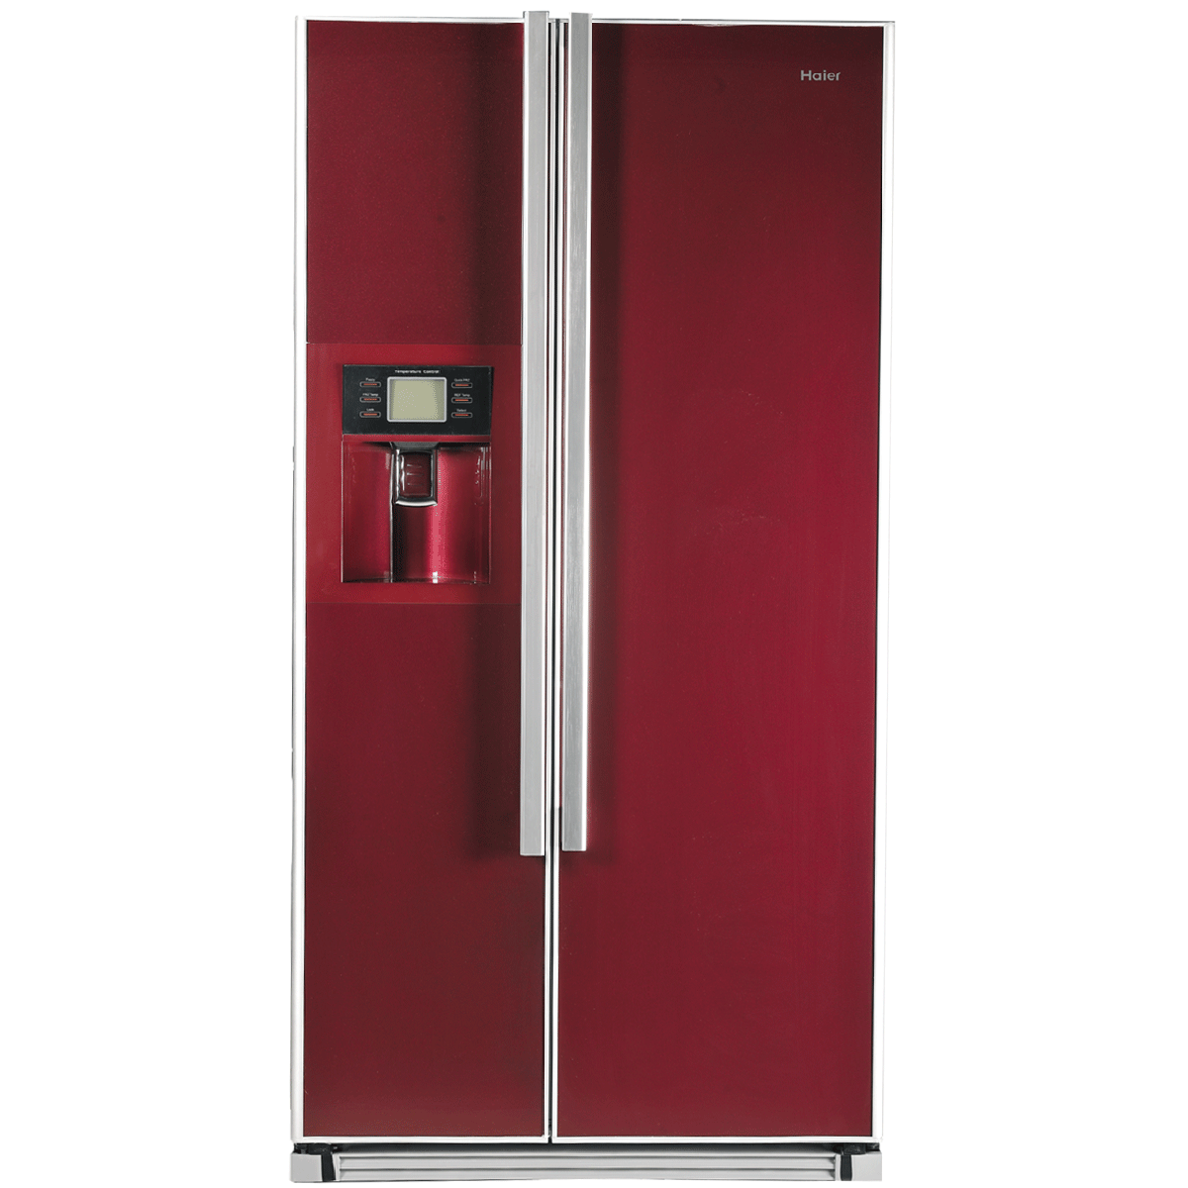
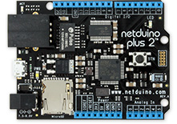
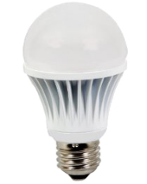
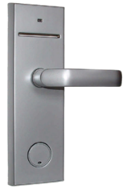
Windows 10 IoT AllJoyn Device Network
Other Proximal
Devices
AllJoyn Node
AllJoyn Thin Client
AllJoyn Common Inerface for Proximal and Cloud
Wired Busses
USB, UART, I2C, GPIO…

Slide 14
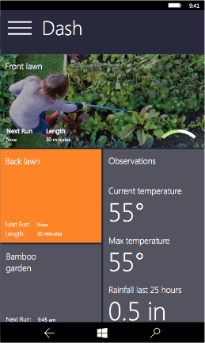
AllJoyn as a common language
An application developer wants the temperature from any temperature sensor available.
Today:
1. Search, Connect and Check Bluetooth temperature devices
2. Search, Connect, and Check Zwave temperature devices
3. Search, Connect, and Check Zigbee temperature devices
4. etc…
With AllJoyn the application developer only needs to look in one place!
new AllJoynBusAttachment();
…
new TemperatureSensorWatcher(watcherBus);
…
await alljoynsensor[0].temperature;

Slide 15
Device Abstraction and Interconnect Using Alljoyn on Windows 10 IoT Core
Cyra Richardson

Slide 16
Securing IoT Devices
TPM Protection
Malware Protection
”Secure Boot” and enable remote attestation with “Measured Boot”
Protect customer data
Enterprise grade device encryption and secure key storage
Resist tampering
Authenticity with a strong, hardware-bound device identity using Trusted Platform Modules (TPMs)
Win10 IoT TPM Options
On-Chip
Firmware
Discrete (I2C or SPI)
TPM Simulator

Slide 17
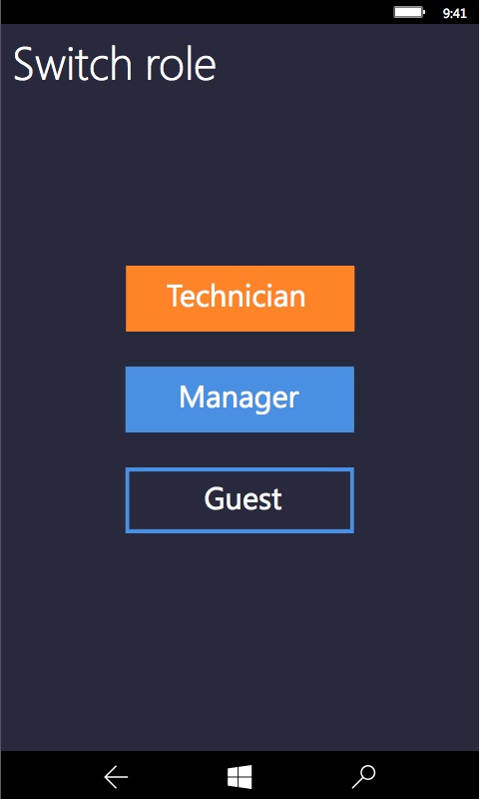
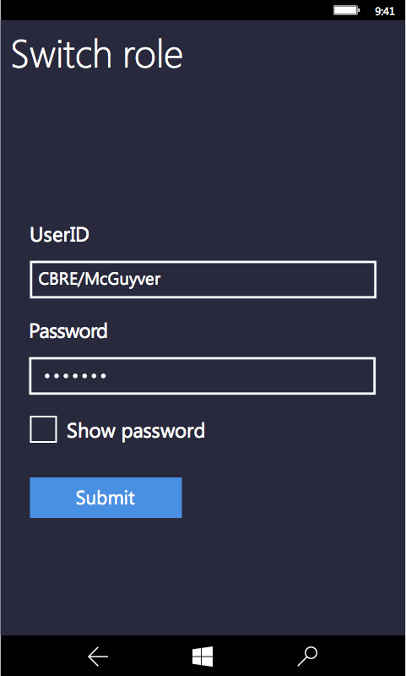
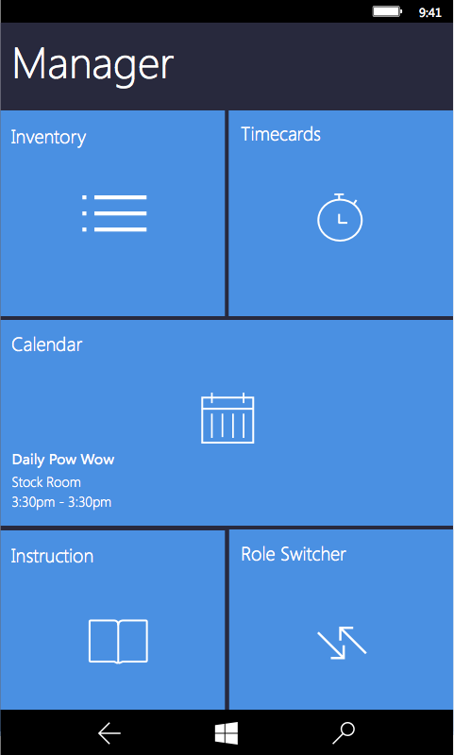
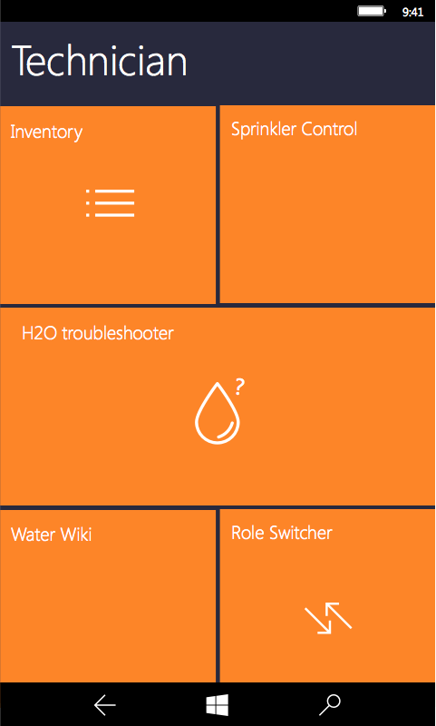
Customize Device Experience Based on Roles

Slide 18
Choosing the Best Servicing Option For your Device
Always up to date - Features and security updates
Secure - get only security updates
Locked Down - Devices can be configured to never update

Slide 19
Consistent Device Management for all Windows 10 IoT devices
Many different devices on Windows IoT platforms; One device management surface for all
SC Config Man
3rd Party MDM
OMA DM
Windows 10 IoT
Industry Devices
Mobile
Devices
Small Devices
Converged MDM Stack
Converged Servicing Stack
Common CSPs
One Windows Platform

Slide 20
Device Imaging: Full Flash Update
FFU image format is sector-based and describes all partitions on disk
FFU images created using Windows Imaging and Configuration Designer (WICD) or command-line tools (imageapp.exe)
FFU images flashed to up to 8 USB-tethered devices using ffutool.exe or directly to disk using WICD or dism.exe

Slide 21
FFU Device Imaging
OEMInput.xml
Device-Image.ffu
OS-Package.cab
FeatureManifest.xml
OS-Package.cab
OS Packages
FeatureManifest.xml
OS-Package.cab
OS-Package.cab
FeatureManifest.xml
WICD
or
IMAGEAPP
BSP Packages
FeatureManifest.xml
Device-Image.ffu
Kernel-mode Driver
Kernel-mode Driver
FeatureManifest.xml
Driver Packages
FeatureManifest.xml
CustomApp.appx
CustomApp.appx
CustomApp.appx
OEMCustomization.xml

Slide 22
FFU Device Imaging
Flash to up-to 8 tethered Windows devices
Device-Image.ffu
FFUTOOL
…
or
WICD
or
DISM
Write directly to disk
EFI Partition

Slide 23
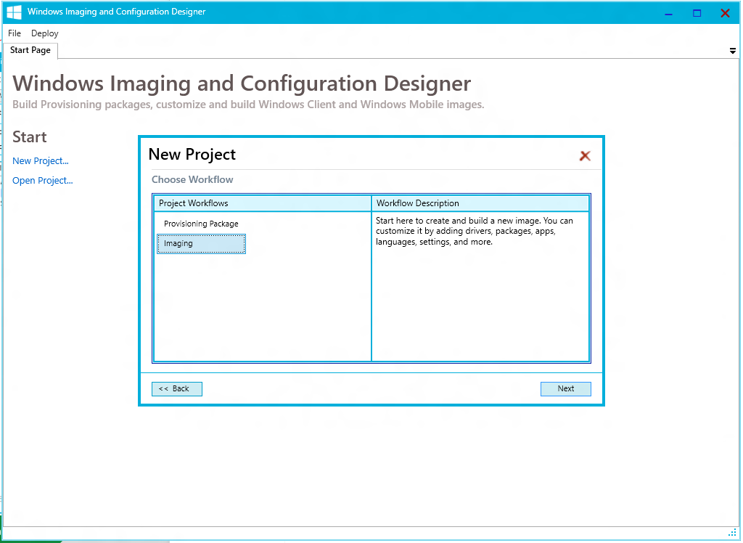
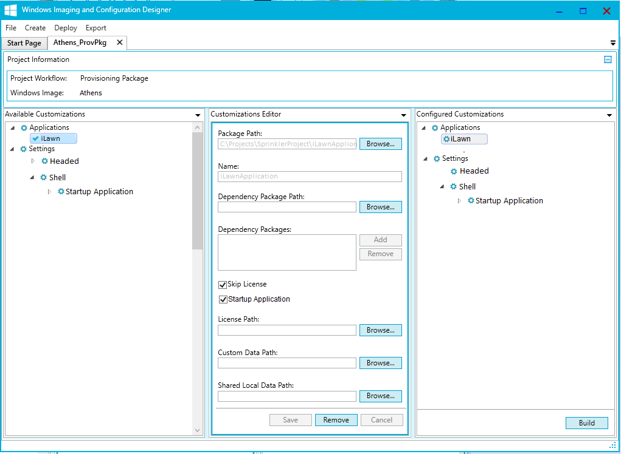
Configure OS to create your device experience
Windows Image Configuration Designer (ICD) making it easier for OEM partners to create industry devices
Customize with Universal Applications, Drivers, Configuration settings
Design-in Lockdown settings
Customize experience including startup screen
Test experience on target device
Provisioning Package
Industry Device
Mobile Device
wim / ffu
Image
Image Configuration Designer
Small Device
One tool for all your OS configuration needs

Slide 24
Call to Action
Get your application working on UWP
Try your UWP app on “Athens” on Raspberry Pi 2
Join us on www.WindowsOnDevices.com for more info

