Slide 1
Updated Agenda
12:00PM–1:00PM | Session #1
1:00PM–2:00PM | Lunch

Slide 3
On the Shoulders of Giants: Building Apps that Consume Modern SaaS Endpoints with Visual Studio 2015
Steve Lasker
Program Manager, Microsoft
Dave Carroll
Dir. Developer Evangelism, Salesforce
3-759

Slide 4
Agenda
What Are Modern Services
Demos – Consuming Services
Salesforce
Visual Studio Online
Azure Active Directory
Azure Storage
App Insights
Demo – Creating a Connected Service
Resources

Slide 5
What are Connected Services?
Categories | Examples
Advertising | Bing, Google, MoPub (Twitter)
Analytics | App Insights, Flurry, New Relic
Authentication | Active Directory, Facebook, Twitter
Caching | Azure, Redis, Memcached
Content Delivery Network | Azure, Akamai, Limelight
Database | SQL Server, Mongo, MySQL
Social | Yammer, Facebook, Twitter
Productivity (Files, email) | Office 365, Evernote, Send Grid
Mapping | Bing, Google, OpenStreetMap
CRM | Dynamics, Salesforce, SAP
Payment | Dwolla, Google Wallet, Paypal
Storage / Queue | Azure, Amazon, Heroku
Push Notifications | Android, iOS, Windows
OData
WebAPI
REST
JSON
OAuth
$metadata
RAML
SOAP
Swagger

Slide 6
Modern Service Consumption
A Multi Step Process;
Provision and/or Configure the Service
Proxies for the Service
Consume the Service
Now What?

Slide 7
Using Data to Inform Decisions
Systems Management
Security Management
IT Service Management
Asset Lifecycle Management
Enterprise Mobility Management
Salesforce Customer Data Prioritizes TFS Work Items

Slide 8
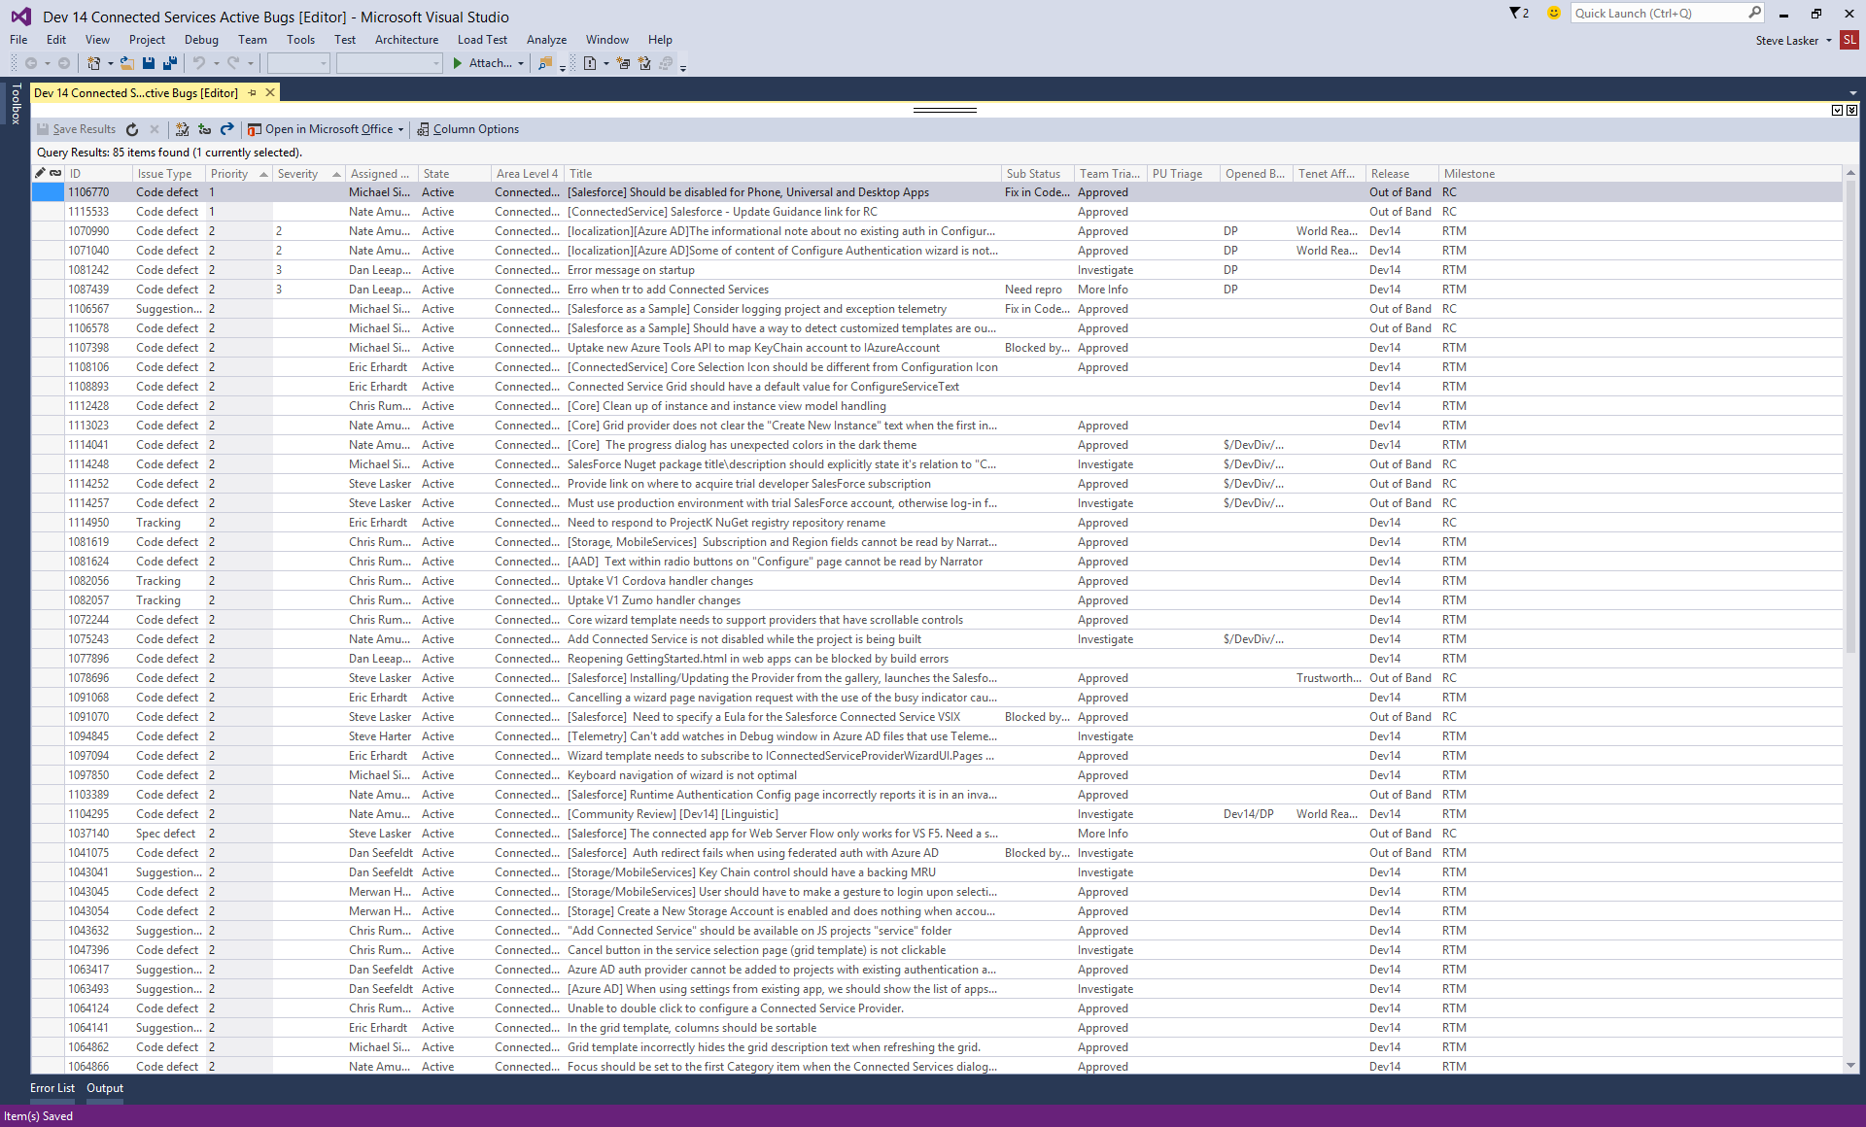
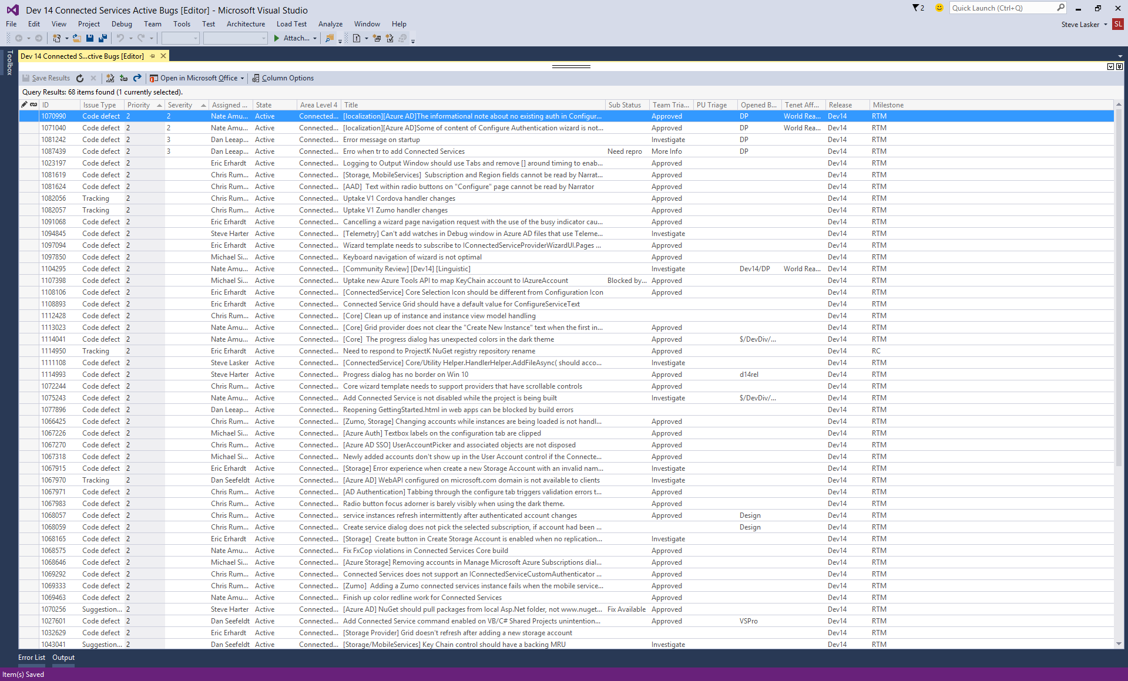
Size of customer
Customer Spend
Entitlement Points
Cases associated w/Bugs
Number of customers impacted

Slide 9
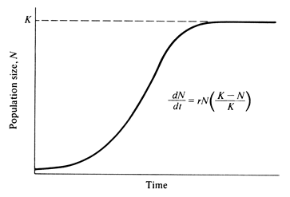
Using the Population Growth and Regulation formula to prioritize bugs
$P_{(x)}=\frac{K}{1+\frac{K−P_{0}}{P_{0}}e^{−rt}}$ and $r_{\left(c\right)}= .01\sqrt{C}+\frac{.005}{C}$
$P_{(x)}=\frac{K}{1+\frac{K−P_{0}}{P_{0}}e^{−rp_{e}}}$ and $r_{\left(x\right)}= .075+ \frac{S_{c}−1}{30}$
P_{(x)} = UMP Score 1
K = Max score = 5000
P₀ = The initial value
Sev 0 = 1000
Sev 1 = 500
Sev 2 = 100
Sev 3 = 10
Sev 4 = 1
r = growth rate
t = time in days since defect was filed
C = number of cases attached
P_{(x)} = UMP Score 2
K = Max score = 5000
P₀ = Initial value = 1
r = growth rate
p_{(e)} = sum of entitlement points of attached accounts / 25000
S_{c} = Average of case severity with highest thrown out.
Sev 1 = 4, Sev 2 = 3, Sev 3 = 2, Sev 4 = 1.
The final UMP* Score is the sum of the two formulas where the MAX will work out to be 10,000.
*Unified Metric Priority

Slide 10
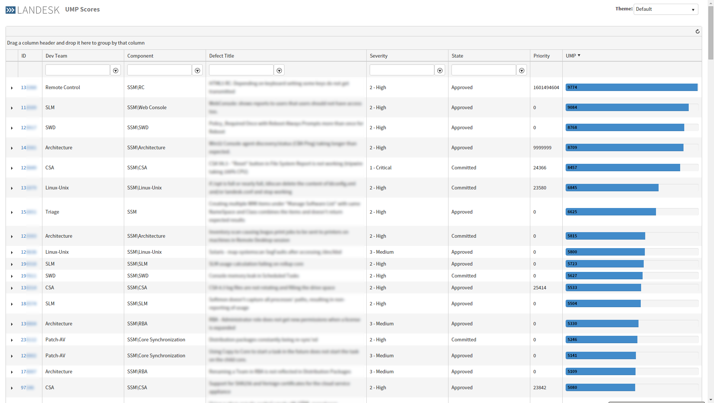
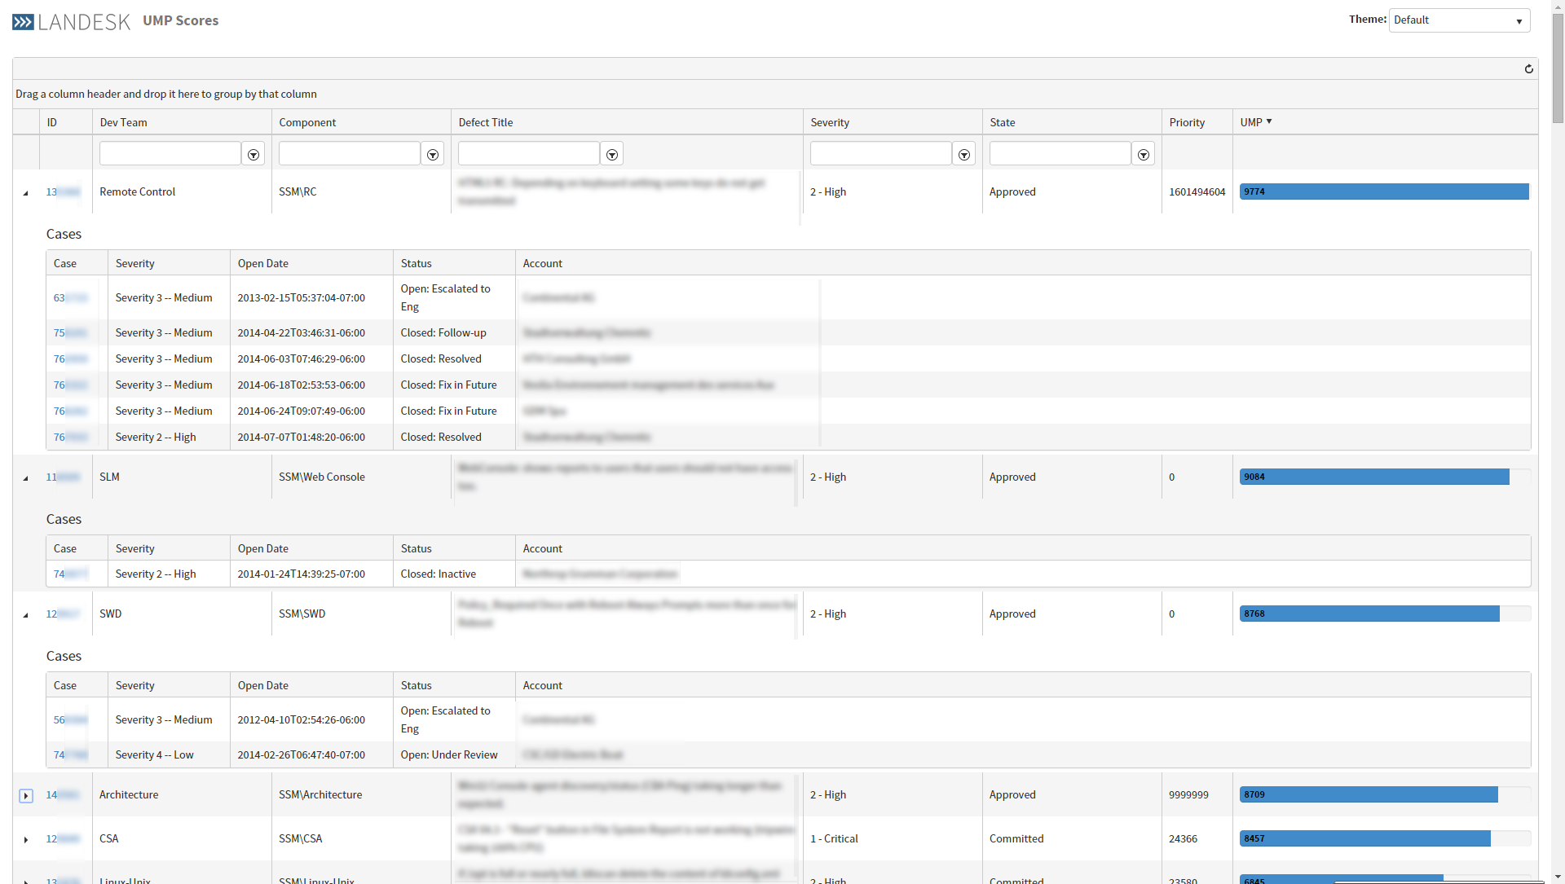

Slide 11
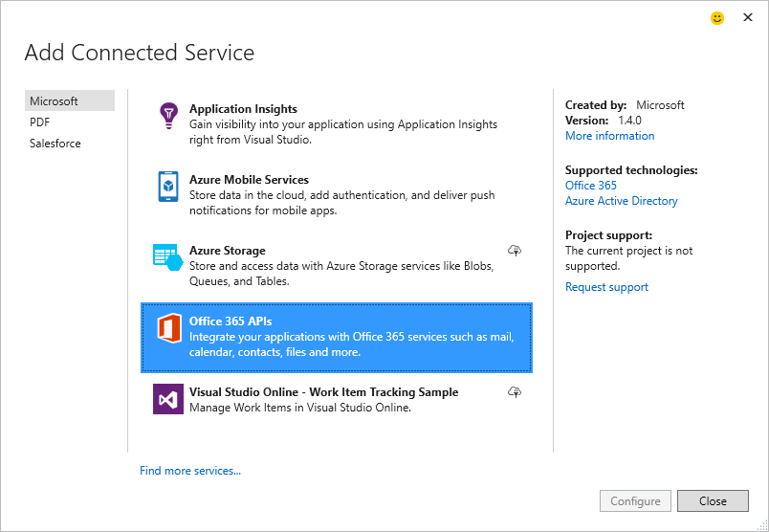
Demo: Adding Connected Services

Slide 12
Connected Services
…enables the breadth of services
…configures the service, your project
…guides you to next steps
…gives you ownership
…supports extensibility by 3rd parties

Slide 13
References:
aka.ms/ConnectedServices
aka.ms/ConnectedServicesSDK
Developer.Salesforce.com
go off and Consume More Services…
Speshal thanks to:
Tanner Lindsay
www.TannerLindsay.com
LANDESK.com
Steve Lasker
@SteveLasker
blogs.msdn.com/SteveLasker
Steve.Lasker@Microsoft.com
Dave Carroll @DCarroll

