Slide 2
Building a Web of Apps
3-765
Sandeep M. George
@sandtweetstech
Arun Singh
@aruntalkstech
http://aruntalkstech.com
http://github.com/arunjeetsingh

Slide 3
Application Model Map - Arun
App Model
Andrew
617
Store
Barclay
695
Thomas
762
App
Shell
John
Ignite
Enterprise
Roberth
779
Arun
765
App Services
Title: App-to-App Communication: Building a Web of Apps
Code: 765
Speaker: Arun Singh
Room: 2004
Date: 5/1
Time: 2.00
Tony
684
User Data
Shawn
626
Kernel

Slide 4
The Web is Vast
The Web is Inter-connected
The Web is Easy to Navigate

Slide 5
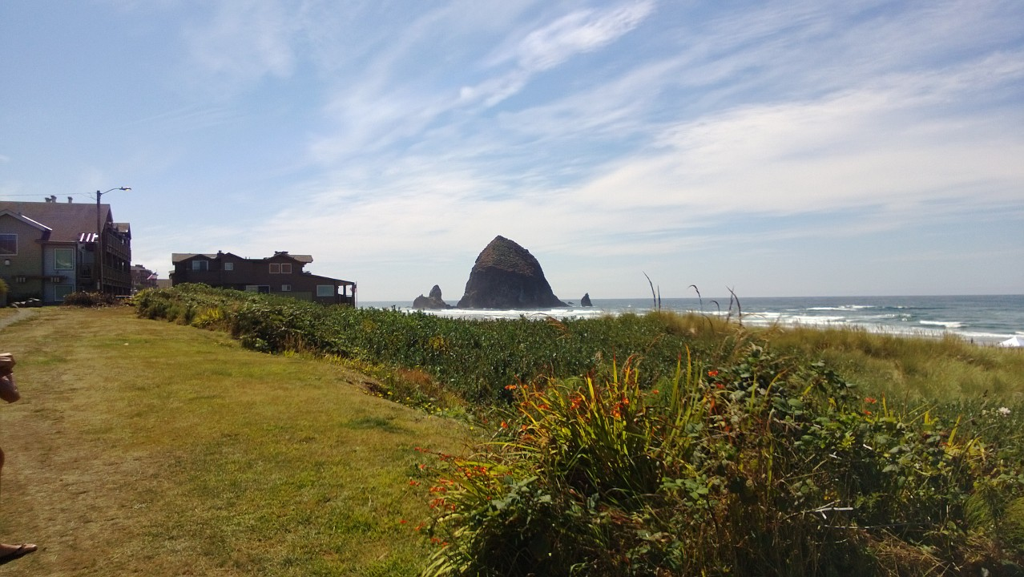
Linking to An App

Slide 6
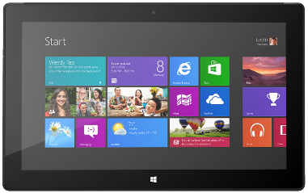
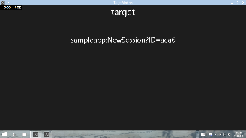


How Do I Link to an App?
LaunchUri – http://aka.ms/launchwindowsapp
Custom schemes (LaunchUriAsync)
Works Today!
Launcher.LaunchUriAsync(new Uri(“myapp:?Oh=yes“));
App A
App B

Slide 7
Why are Custom Schemes Interesting
Custom schemes have been around since ’96
Custom schemes work on all platforms. Spotify:// launches the Spotify app everywhere
There are emerging industry standards
  http://applinks.org
  http://www.bing.com/dev/en-us/applink
  https://developers.google.com/app-indexing/webmasters/server

Slide 8
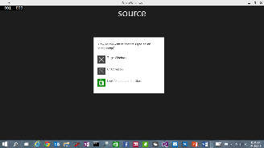


Deep Linking Improvements
The Evil Twin Problem!
App B
Launcher.LaunchUriAsync
(new Uri(“myapp:?Oh=no“));
App A
User/OS chooses target
Evil Twin!

Slide 9
DEMO
URI Launching a Windows App

Slide 10
Deep Linking Improvements
The Evil Twin Problem!
App B
var options = new LauncherOptions();
options.TargetApplicationPackageFamilyName= “12Me.MyApp";
Launcher.LaunchUriAsync(new Uri(“myapp:?Oh=yes"), options);
Launcher.LaunchUriAsync
(“myapp:?Oh=no");
App A
User/OS chooses target
Evil Twin!

Slide 11
Getting the Package Family Name
private string GetPackageFamilyName()
{
return Windows.ApplicationModel.Package.Current.Id.FamilyName;
}

Slide 12
Deep Linking Improvements
Send Files
var options = new LauncherOptions();
options.TargetApplicationPackageFamilyName= “12Me.MyApp";
Launcher.LaunchUriAsync(new Uri(“myapp:?Oh=yes"), options);
string thumbnailToken = SharedStorageAccessManager.AddFile (gpxFile);
var launchUri = new Uri(“myapp:?Oh=yes&file=" + thumbnailToken);
await Launcher.LaunchUriAsync(launchUri, options, inputData);
App A
App B

Slide 13
Deep Linking Improvements
Query for Support
//Query for a custom scheme (myapp)
var queryUri = new Uri(“myapp:");
await Launcher.QueryUriSupportAsync(queryUri, LaunchQuerySupportType.Uri);
//Query for a custom scheme supported by a specific app
var queryUri = new Uri(“myapp:");
string packageFamilyName = " 12Me.MyApp ";
await Launcher.QueryUriSupportAsync(queryUri, LaunchQuerySupportType.Uri, packageFamilyName);

Slide 14
Deep Linking Improvements
Enumerate Apps
//Find all apps that support custom scheme myapp:
var customSchemeProviders = await Launcher.FindUriSchemeHandlersAsync(“myapp");
//Find all apps that can launch a file of type .foo
var fileTypeHandlers = await Launcher.FindFileTypeHandlersAsync(“.foo");

Slide 15
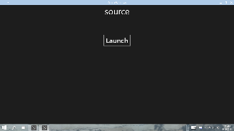

Deep Linking Improvements
Launching for Results
var options = new LauncherOptions();
options.TargetApplicationPackageFamilyName= “12Me.MyApp";
Launcher.LaunchUriForResultsAsync(new Uri(“myapp-forresults:?Oh=yes"), options);
App A
App B
var resultData = new ValueSet();
resultData.Add("Result", value);
operation.ProtocolForResultsOperation.ReportCompleted(resultData);

Slide 16
DEMO
Launching an App for results

Slide 17

App Services

Slide 18
What is an App Service?
With App Services, store apps can provide services to other store apps
Think Web Services…on a device

Slide 19


What is an App Service?
Package with App Service
Client App A
App Service
Background Task
var conn = new AppServiceConnection();
conn.AppServiceName = “FooAppService”;
conn.PackageFamilyName = “12Me.MyApp“;
var status = await conn.OpenAsync();

Slide 20
What is an App Service?
Package with App Service
Client App A
App Service
Background Task
var conn = new AppServiceConnection();
conn.AppServiceName = “FooAppService”;
conn.PackageFamilyName = “12Me.MyApp“;
var status = await conn.OpenAsync();
var message = new ValueSet();
message.Add(“Hi”, “There”);
var r = await conn.SendMessageAsync(message);
conn.Dispose();

Slide 21
What is an App Service?
Package with App Service
Client App A
App Service
Background Task
App Service Connection
Client App B
App Service
Background Task
App Service Connection

Slide 22
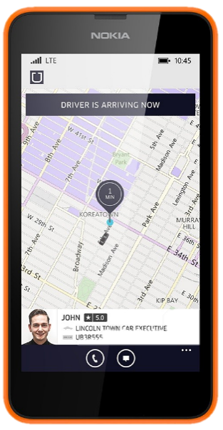
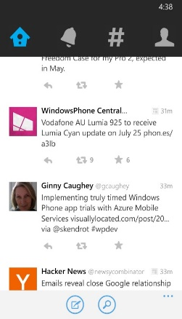

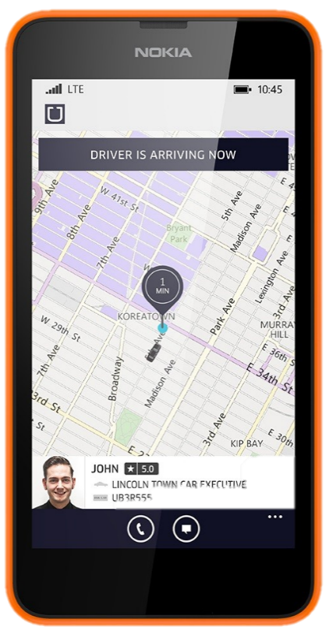
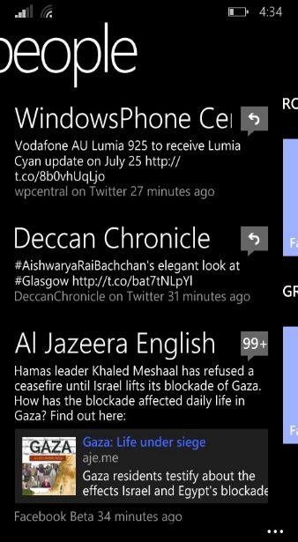
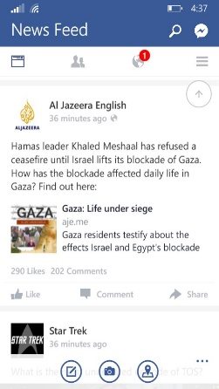

Scenario: Pulling Data
Request social data
Twitter
Request social data
People
Facebook

Slide 23
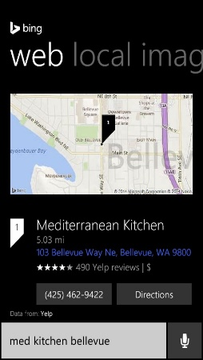
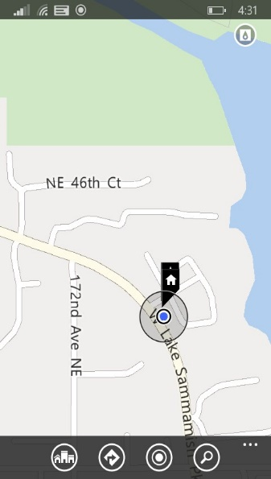



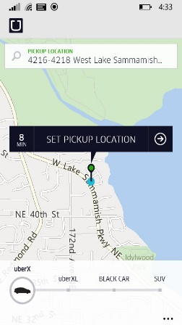

Scenario: Sharing Cached Data
Consume
Cache
Expose Endpoint
Cortana
maps
Consume
service
maps

Slide 24
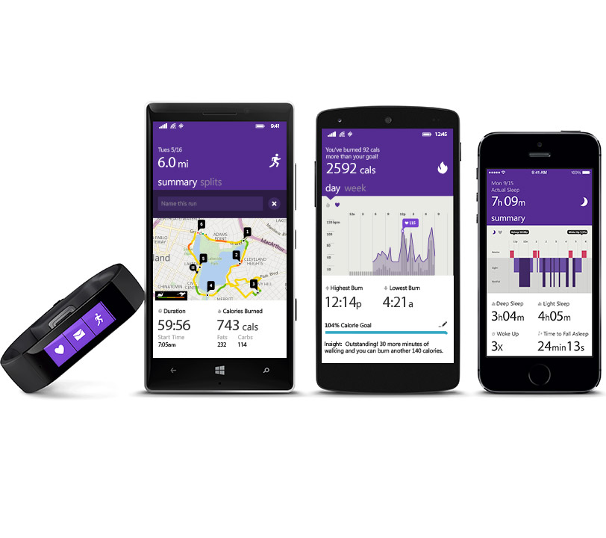

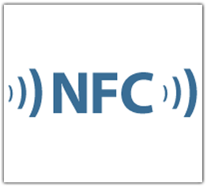
Scenario: Hardware Access
Client App A
Communicate
Provide
App service
Communicate
Client App B
Band App

Slide 25
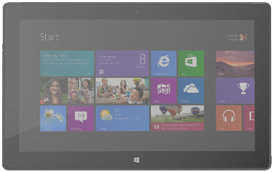
Scenario: Enterprise Suite of Apps
Product Scanner
Inventory App
Inventory
Service
Checkout App
Payment Gateway

Slide 26
DEMO
The Ship Tracker App Service

Slide 27
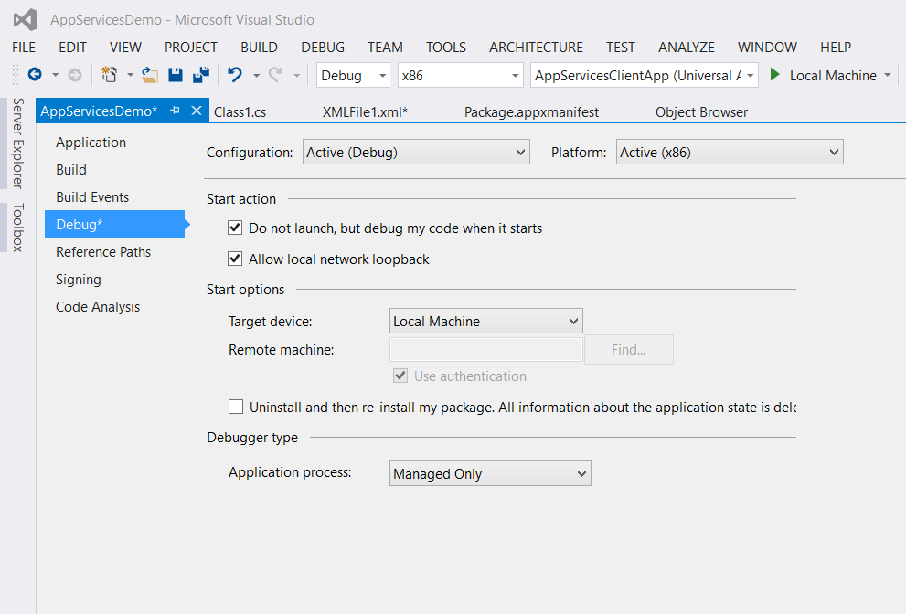
Debugging an App Service
Set breakpoints in app service code
Check ‘Do not launch but debug my code when it starts’ in project properties
Launch app service foreground app in debugger – nothing happens!
Run client app to connect to app service
Debugger attaches and breaks on your breakpoint

Slide 28
App Service Lifetime
Service is activated on-demand
Client may terminate service by disposing its AppServiceConnection
If the invoking app is suspended, app services sponsored by the app will be terminated
Insufficient resources may cause launch failure or service termination

Slide 29

Wrap Up

Slide 30
Best Practices
Wrap your custom scheme or app service in an SDK
Use NuGet to distribute SDK
Use REST-style versioning. For breaking changes, expose a new endpoint

Slide 31
Oh, the things you’ll do!
Windows.System.Launcher
  Link to a specific app
  Pass arbitrary data
  Send files
  Launch apps for results
Windows.ApplicationModel.AppServices
  Provide services to other apps
  Consume services provided by other apps

Slide 32
Who’s Using these APIs?
Cortana
Office
Interactive Toasts
Token Broker (Single Sign On)
People/Contacts
Photos
Camera
You!

Slide 33
Sessions We Like
709: Single Sign On with Secure Authentication
619: Microsoft Band
716: Cortana and the speech platform
744: HoloLens App Development

Slide 34
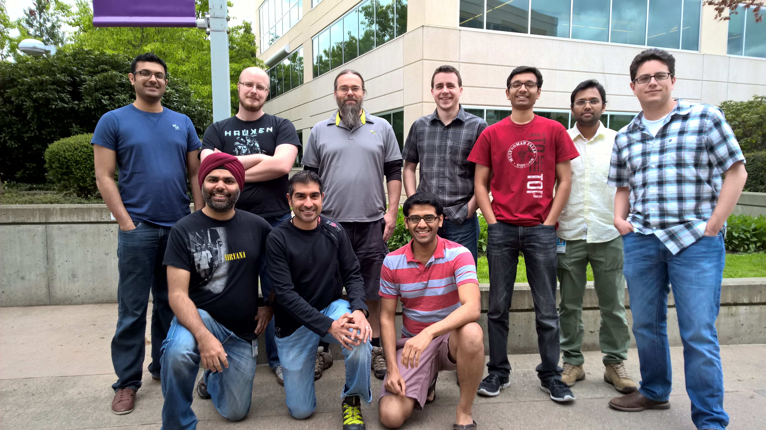
Thank you!
Hello from Seattle

