Slide 2
Building Universal Windows Apps with Office 365 APIs
3-767
Chakkaradeep (Chaks) Chandran
Program Manager

Slide 3
Developer vision
USERS
DATA
HTML

Slide 4


Agenda
Hello, Windows App
Adaptive Controls in Windows
Integrated Authentication in Windows
Hello, Office 365 APIs
Office 365 API Features
What’s Next
Call to action
Demos, Demos and Demos…

Slide 5
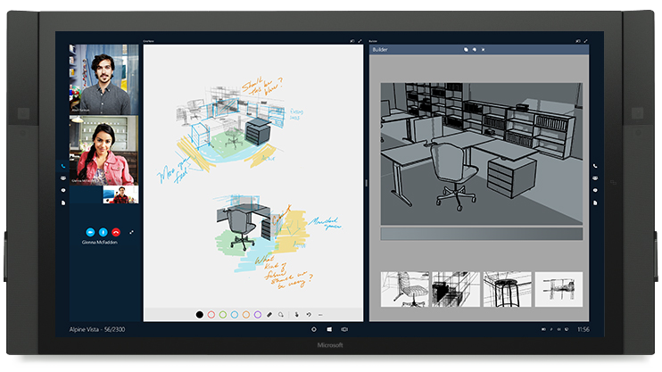
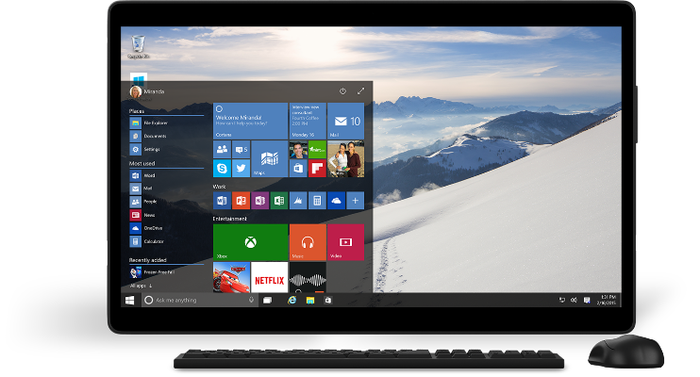
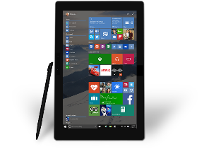
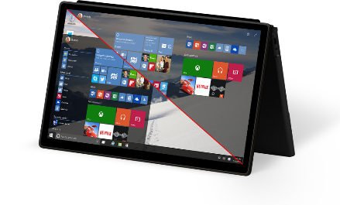
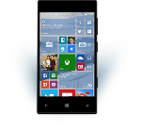
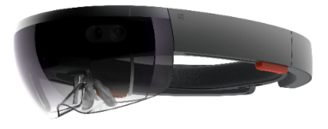
Build one app for all Windows devices
One operating system
One Windows core for all devices
One developer platform
Apps run across phone, tablet, PC, Xbox and more
One Dev Center
Single submission flow and dashboard
One Store Global reach, local monetization Consumers, Business and Education

Slide 6
Universal Windows Platform
Unified Developer Platform
Single Application Package
Adaptive Code/UX
Scales to Phone, Tablet, PC, XBOX and More
Mobile
Desktop
Universal
Windows Platform
Core APIs
IoT
Xbox
Holographic
Surface Hub

Slide 7
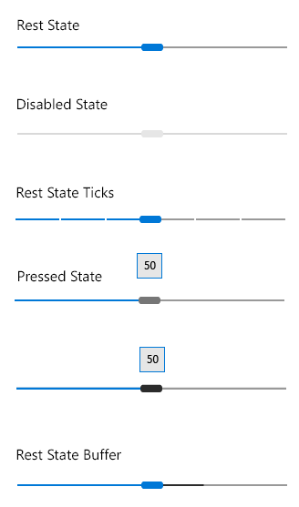
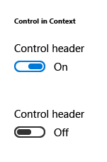
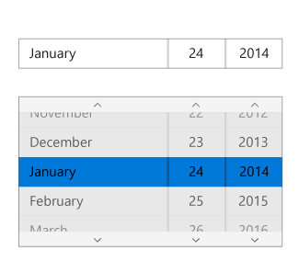
Adaptive UX
Based on a set of adaptive controls and enable an experience tailored to the device
Base building blocks:
Ensure large and small screen appropriateness
Deliver polished and attractive user experience
Support mouse, keyboard, touch, etc.

Slide 8
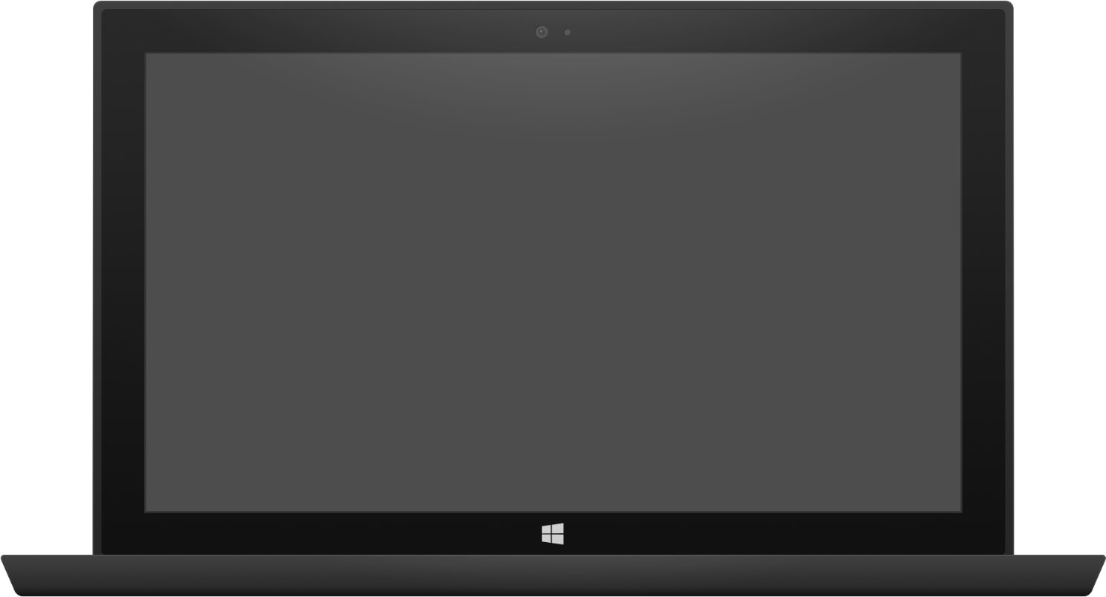

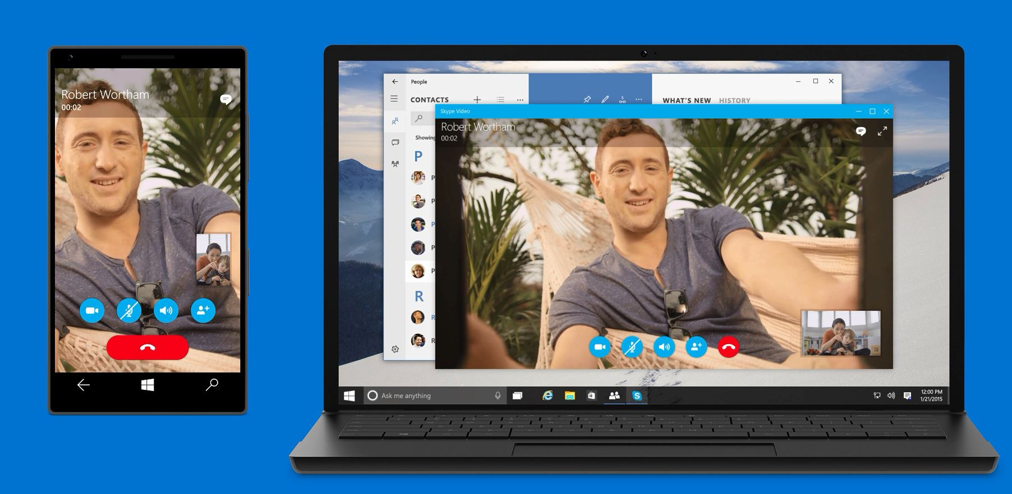
Adaptive UX
Same code, Same controls, Optimized layout
Tablet (landscape) / Desktop
Phone (portrait)

Slide 9
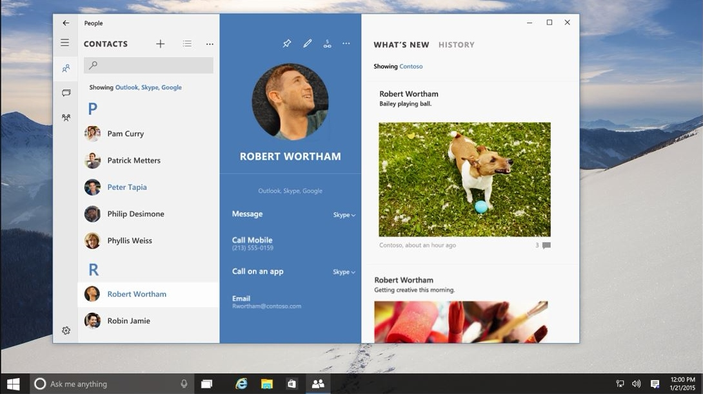
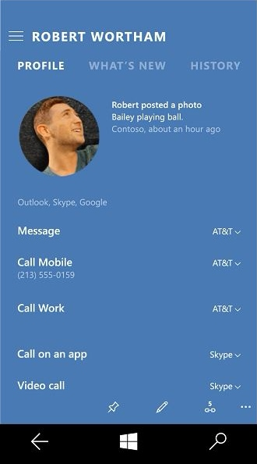
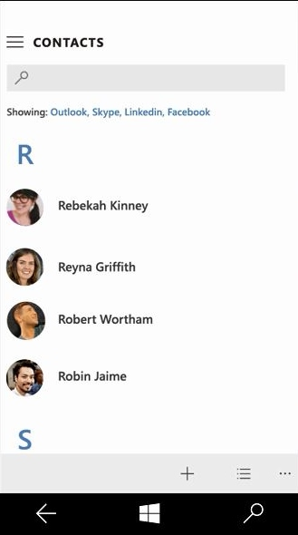
Adaptive UX
Same code, Same controls, Optimized layout
Tablet (landscape) / Desktop
Phone (portrait)

Slide 10
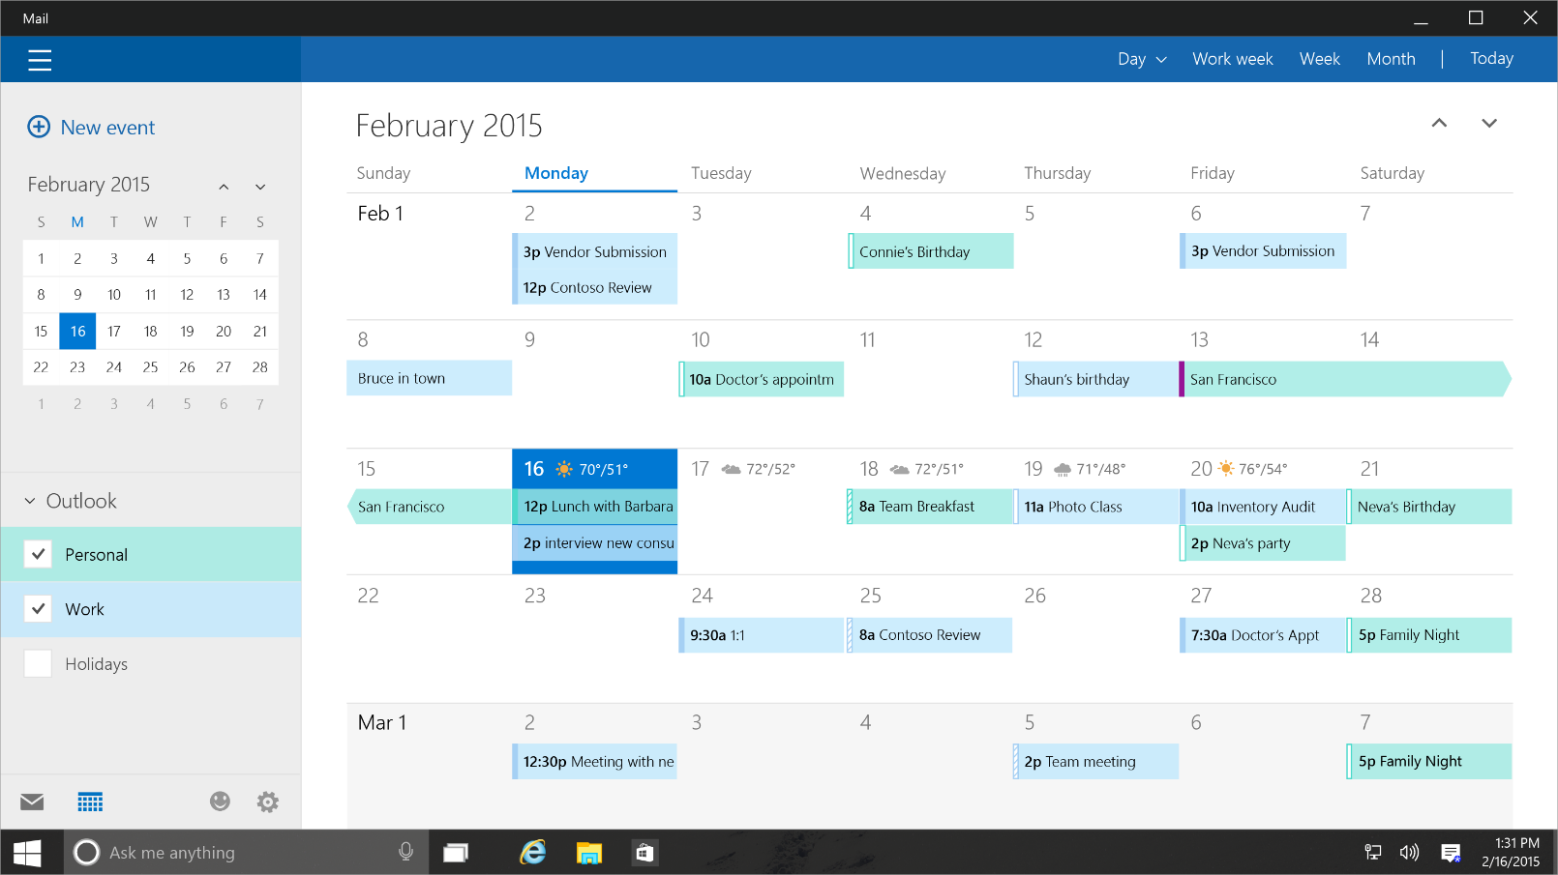
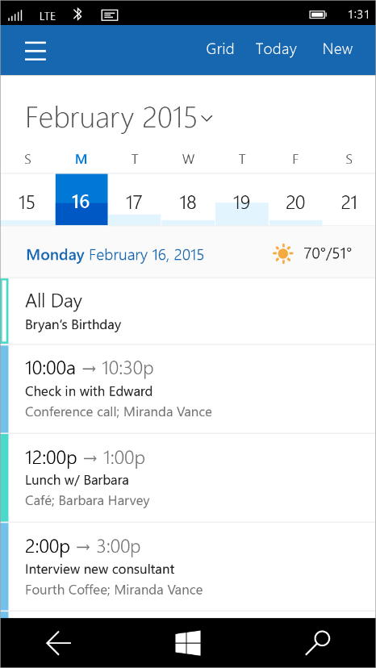
Tailored experiences
Based on a set of adaptive controls and enable an experience tailored to the device
Tablet (landscape) / Desktop
Phone (portrait)

Slide 11
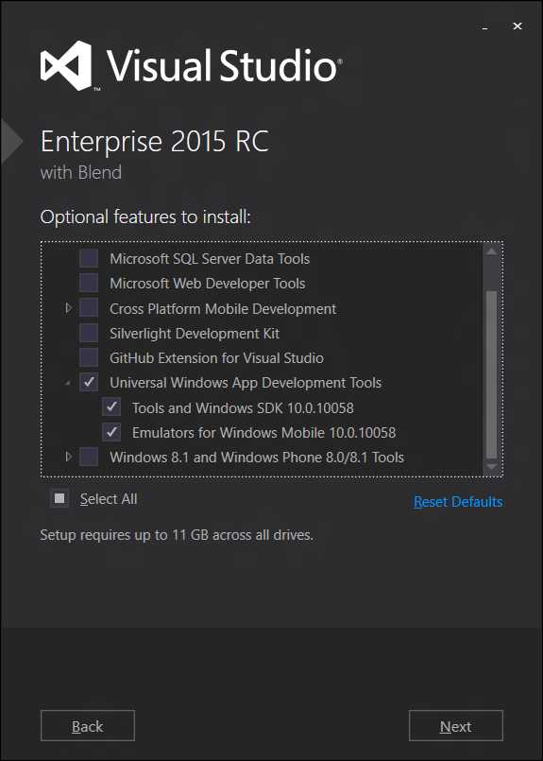
Acquiring Windows 10 Tools/SDKs/Emulators
Select “Universal Windows App Development Tools” using Custom setup option

Slide 12
DEMO
“Hello World” Windows App

Slide 13








Data silos in the enterprise
USER
FILES
EMAIL AND CONVERSATIONS
EVENTS
PEOPLE
GROUPS

Slide 14
Developer vision
USERS
DATA
HTML

Slide 15
Office 365 APIs
Simple REST/OData Service APIs
Part of Azure AD Common Consent Framework
Expose Files, Sites, Mail, Calendar, Users, Groups, Conversations and Notes
Videos, Yammer and OneNote in preview
EVENTS
MANAGEMENT
Mail
FILES

Slide 16
Office 365 Platform Overview
Apps
1st & 3rd party apps
Android App
iOS App
Windows App
Cordova MDD App
Xamarin App
..Net Web Site
Java Web Site
Java Script
Site
Office Extensions
Controls
HTML-Based and Native Controls
HTML Controls for key high value data( + Native controls for differentiation):
People Picker; File Picker; Item Previews…
SDKs
Platform-specific SDKs, partially generated from service metadata and open-sourced on GitHub
Android SDK
iOS SDK
Windows SDK
Cordova SDK
Xamarin SDK
.Net Server SDK
Java Server SDK
Office.js
REST
Protocol
Single domain, namespace, and protocol
Auth
3rd-party app registration and runtime authentication through OAuth 2.0
Azure Active Directory
Workload
Individual service workloads
Files
Mail
Calendar
People
Groups
Spread Sheets
Documents
Presentations
Tasks
Social Comms
Dynamics CRM
…
Salesforce.com
http://aka.ms/Office365DevAPIs
16

Slide 17
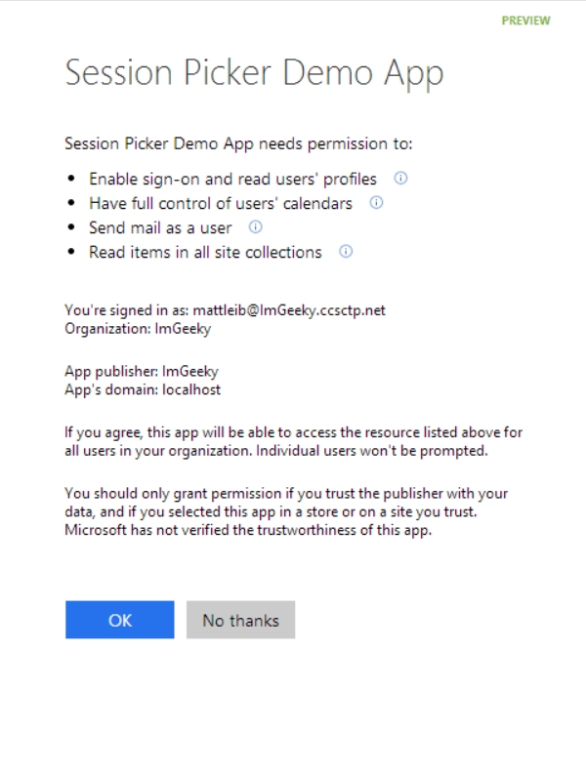
Azure AD and Office 365 APIs
Single authentication flow
  Azure AD Graph, Exchange, SharePoint
  Mobile apps and web sites
  Admin and end-user consent
Industry Standard Protocol
  OAuth 2.0
  No capturing user credentials
  Fine-grained access scopes
  Supports MFA and federated user sign-in
  Long-term access through refresh tokens
630: Get Your Hands Dirty with the Office 365 APIs, Authentication and SDKs

Slide 18
Office 365 API Features

Slide 19
Directory
USER
PEOPLE
GROUPS
Azure Active Directory Graph API
https://graph.windows.net/contoso.com/users?api-version=1.5
https://graph.windows.net/contoso.com/groups?api-version=1.5

Slide 20
Extended Profile
USER
PEOPLE
GROUPS
SharePoint User Profile
https://contoso.sharepoint.com/_api/SP.UserProfiles.PeopleManager/GetMyProperties
Exchange HD Picture
https://outlook.office365.com/api/v1.0/me/userPhoto

Slide 21
Mail, calendar, contacts and conversations
USER
EMAIL AND CONVERSATIONS
EVENTS
PEOPLE
GROUPS
Exchange REST API
https://outlook.office365.com/api/v1.0/me/Messages
https://outlook.office365.com/api/v1.0/me/Events
https://outlook.office365.com/api/v1.0/Me/Contacts/

Slide 22
Files
USER
FILES
PEOPLE
GROUPS
OneDrive for Business/SharePoint Files API
https://contoso-my.sharepoint.com/personal/yina_contoso_com/_api/v1.0/files
https://contoso.sharepoint.com/sites/designCouncil/_api/v1.0/files

Slide 23
Office 365 Discovery Service API
Determine your app capabilities
  Mail
  Calendar
  Contacts
  Files
  Sites
Determine Resource Id and Endpoint Uri of the Office 365 Service API

Slide 24
Rich Query Syntax using OData
Scenario | URL
Get 5 messages from Inbox | https://outlook.office365.com/api/v1.0/Me/Folders/Inbox/Messages?$top=5
Get selective properties on messages | https://outlook.office365.com/api/v1.0/Me/Folders/Inbox/Messages?$top=5&$select=From,DateTimeCreated,Subject
Get Inbox messages with subject and attachment info | https://outlook.office365.com/api/v1.0/Me/Folders/Inbox/Messages?$format=application/json;odata.metadata=none&$select=Subject&$expand=Attachments
Get count and selective props on messages with attachment(s) | https://outlook.office365.com/v1.0/Me/Folders/Inbox/Messages?$format=application/json;odata.metadata=none&$select=Subject&$filter=HasAttachments%20eq%20true&$count=true
Get contact with a given name | https://outlook.office365.com/v1.0/Me/Contacts/?$filter=Givenname eq ‘John’
742: New Outlook REST APIs for Developing Against Outlook.com AND Office 365
734: New OneDrive APIs for Developing Against OneDrive AND OneDrive for Business
734: New OneDrive APIs for Developing Against OneDrive AND OneDrive for Business

Slide 25
Authenticating to Office 365 APIs in Windows Apps

Slide 26
Windows 10 takes a bold step forward…
Windows connects with AD and AAD too!
Log on to Windows with work accounts
Access apps & resources in either environment
Device and app state roams
Install apps from the Business Store Portal
Devices are automatically enrolled in MDM
IT can use Conditional Access
+

Slide 27
Web Account Provider API
Retrieve token for any identity provider
Integrated with Windows
Native support for Azure AD Authentication
FindAccountProviderAsync
Accepts a web account provider Id
    https://login.windows.net is the account provider Id for Azure AD

Slide 28
Web Account Manager APIs
RequestTokenAsync
Used to request a token
    First attempts to retrieve the token silently
    And if required, does so with UI.
GetTokenSilentlyAsync
Used to request a token from a background task/thread
  Returns token by activating TB plugin without any UI.
709: Single Sign On with Secure Authentication

Slide 29
Web Token Response
WebTokenRequestResult
Results
  WebTokenResponse i.e. Token and WebAccount
  Status e.g. success, user cancelled, provider not available, provider specific errors, etc.
WebAccount
Object that represents a web account specific to an Identity Provider
  ID, WebAccountProvider, User Name, State, Properties, etc.
  Can be used as a hint for subsequent token requests

Slide 30
Active Directory Authentication Library (ADAL)
Easy to use authentication functionality for your apps
Abstracts away most protocol considerations
Handles tokens persistence & refresh automatically
Available for all platforms
  .NET
  iOS
  Android
738: Azure Active Directory: Identity Management as a Service for Modern Applications
769: Develop Modern Native Applications with Azure Active Directory

Slide 31
Web Account Manager vs ADAL
Web Account Manager
  If your app targets Windows 10 (and higher) exclusively
  If your app uses more than one provider
ADAL .NET
  If your app uses Azure AD and ADFS only
  If your app targets all versions of Windows from Windows 7 onward
  If your app targets Windows and Cross-Platform devices (Xamarin)
  If your app needs authentication flows that are not covered by Web Account Manager
    Direct username/password
    App Identity flow
  Future ADAL .NET release will use Web Account Manager on Windows 10
Existing apps built using ADAL will continue to work

Slide 32
Building your app
Create the Windows App
Register your app in Azure AD
Configure app permissions
Get token for the target API service
Build your code using O365 APIs

Slide 33
Registering a Windows App with Azure AD
Every app must:
  Be registered with Azure AD
  Declare in advance what resources it wants to access
To register your app to use Web Account Manager:
  You need the app’s SID
  Execute WebAuthenticationManager.GetCurrentApplicationCallbackUri().ToString()
    The SID will be part of the callback URI:
      ms-app://s-1-15-2-9667BCE9-6AC0-4E3B-9283-EDDB3E7B2D9F
  You need to use this SID to build the Redirect URI for your Windows App as follows:
    ms-appx-web://Microsoft.AAD.BrokerPlugIn/s-1-15-2-9667BCE9-6AC0-4E3B-9283-EDDB3E7B2D9F
To register your app to use ADAL:
  Use the app Callback Uri
  Execute WebAuthenticationManager.GetCurrentApplicationCallbackUri().ToString()
Use Office 365 API Tools for Visual Studio when doing Office 365 development to streamline the app registration.

Slide 34
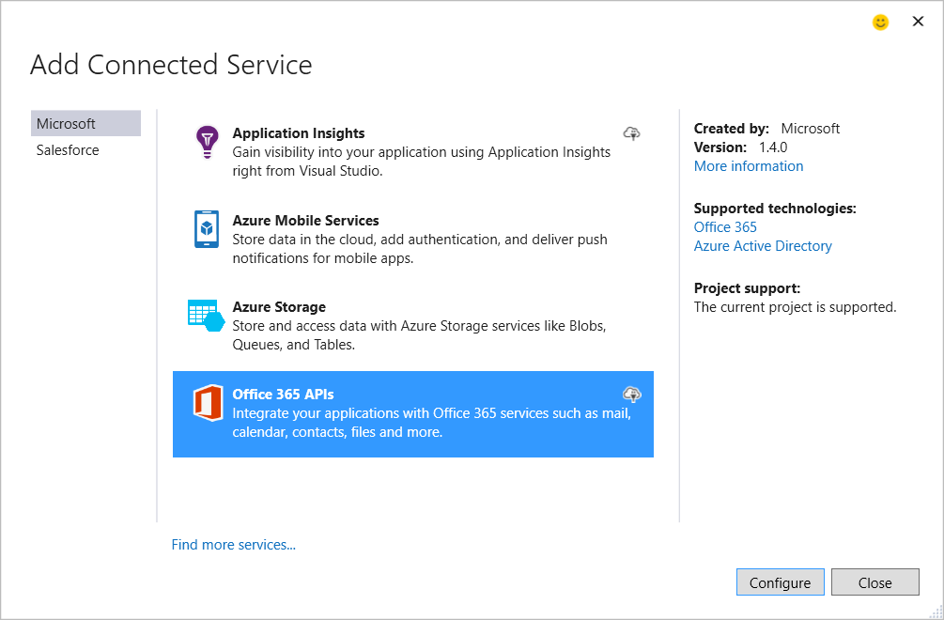
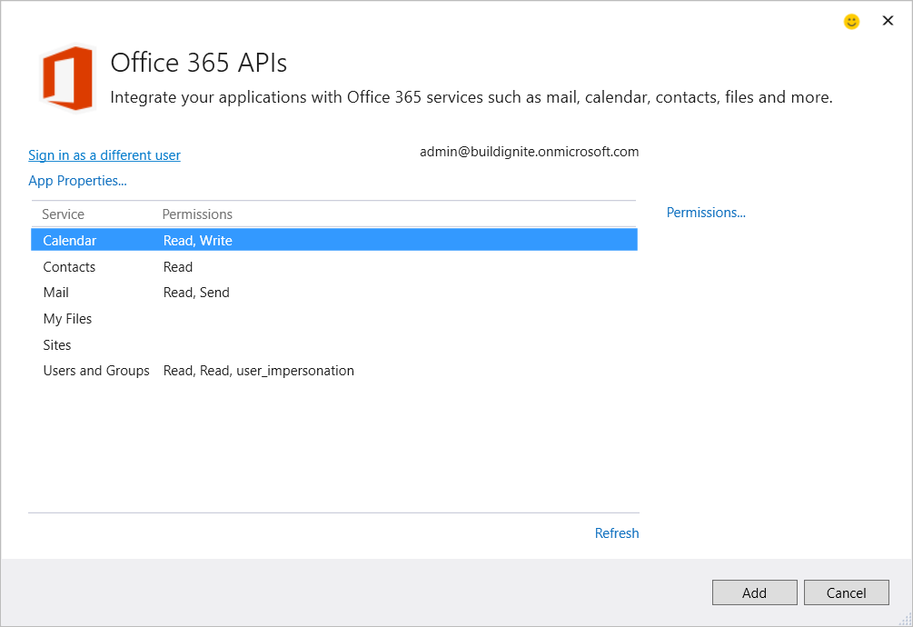
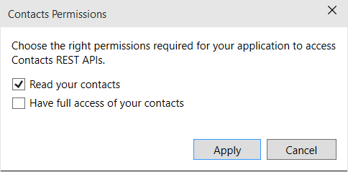
Office 365 API Tools for Visual Studio 2015
Integrate Visual Studio applications with Office 365 API services
Once the services are selected, Visual Studio performs the following:
  Registers an Azure AD application (if there isn’t an application registered yet) in Microsoft Azure Active Directory to consume Office 365 services.
  Applies the selected service permissions for the Azure AD application
  Adds Office 365 API client libraries from Nuget for the configured services to the project.

Slide 35
Office 365 API SDKs
Web Account Manager (Windows 10 onwards)
Azure Active Directory Graph Library (ADAL .NET)
Office 365 API .NET Libraries
  Exchange SDK (mail, contacts and calendar)
  SharePoint SDK (files)
  Azure Active Directory Graph Client Library SDK (users and groups)

Slide 36
DEMO
Authenticating to Azure AD Using Web Account Manager

Slide 37
DEMO
“Hello World” Office 365 APIs

Slide 38
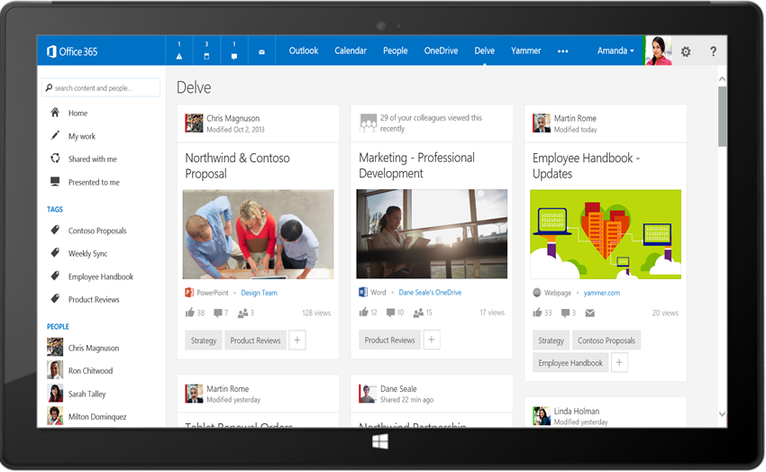
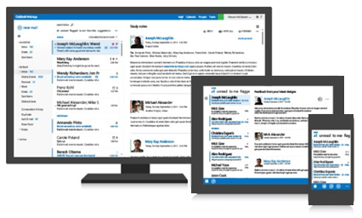
Office 365 unified API
Your
App
https://graph.microsoft.com/
USERS
GROUPS
FILES
MAIL
CALENDAR
TASKS
Insights and relationships from Office Graph
641: Supercharging your custom solutions with Office 365 unified API (preview)

Slide 39
Breaking silos
USER
FILES
EMAIL AND CONVERSATIONS
EVENTS
PEOPLE
GROUPS

Slide 40
/me
USER
ME
userPhoto
thumbnailPhoto
responsibilities
department
pastProjects
aboutMe
hireDate
birthday
address
mobile
jobTitle
schools
name
skills
tags
alias

Slide 41
/users
manager
USER
directReports
memberOf
GROUPS

Slide 42
/messages
manager
USER
directReports
memberOf
GROUPS
MESSAGES

Slide 43
/events
manager
USER
directReports
EVENTS
memberOf
GROUPS
MESSAGES
MESSAGES

Slide 44
/files
Shared with me
createdBy
public
manager
USER
directReports
directReports
EVENTS
EVENTS
modifiedBy
FILES
memberOf
GROUPS
MESSAGES

Slide 45
/groups
Shared with me
Shared with me
createdBy
createdBy
CONVERSATIONS
public
public
manager
USER
directReports
directReports
directReports
directReports
EVENTS
EVENTS
modifiedBy
modifiedBy
FILES
FILES
memberOf
memberOf
GROUPS
GROUPS
createdBy
MESSAGES
FILES

Slide 46
/workingWith
Shared with me
createdBy
CONVERSATIONS
CONVERSATIONS
public
manager
USER
workingWith
directReports
directReports
EVENTS
EVENTS
EVENTS
modifiedBy
FILES
memberOf
memberOf
memberOf
workingWith
GROUPS
GROUPS
GROUPS
createdBy
createdBy
MESSAGES
FILES
FILES

Slide 47
/trendingAround
trendingAround
Shared with me
createdBy
CONVERSATIONS
public
workingWith
manager
USER
workingWith
directReports
directReports
directReports
EVENTS
EVENTS
trendingAround
modifiedBy
FILES
memberOf
memberOf
workingWith
workingWith
GROUPS
GROUPS
createdBy
MESSAGES
FILES

Slide 48
/tasks (future)
trendingAround
trendingAround
Shared with me
createdBy
CONVERSATIONS
public
manager
USER
workingWith
directReports
directReports
directReports
directReports
EVENTS
EVENTS
trendingAround
trendingAround
modifiedBy
TASKS
FILES
memberOf
memberOf
memberOf
workingWith
TASKS
GROUPS
GROUPS
GROUPS
createdBy
MESSAGES
FILES

Slide 49
/notes (future)
trendingAround
Shared with me
createdBy
CONVERSATIONS
public
manager
USER
workingWith
directReports
directReports
directReports
EVENTS
EVENTS
trendingAround
modifiedBy
TASKS
TASKS
FILES
memberOf
memberOf
memberOf
workingWith
TASKS
TASKS
GROUPS
GROUPS
GROUPS
createdBy
NOTES
NOTES
MESSAGES
FILES

Slide 50
API
trendingAround
Shared with me
createdBy
CONVERSATIONS
public
manager
USER
workingWith
directReports
EVENTS
trendingAround
modifiedBy
TASKS
FILES
memberOf
workingWith
TASKS
GROUPS
createdBy
NOTES
NOTES
MESSAGES
FILES

Slide 51
API
trendingAround
Shared with me
createdBy
CONVERSATIONS
public
manager
USER
workingWith
directReports
EVENTS
trendingAround
https://graph.microsoft.com/
modifiedBy
TASKS
FILES
memberOf
workingWith
TASKS
GROUPS
createdBy
NOTES
NOTES
MESSAGES
FILES

Slide 52
Office 365 unified API Code Samples
GET https://graph.microsoft.com/beta/me/manager
GET https://graph.microsoft.com/beta/contoso.com
/users/yina@contoso.com/directReports
GET https://graph.microsoft.com/beta/me/memberOf
GET https://graph.microsoft.com/beta/me/trendingAround
GET https://graph.microsoft.com/beta/contoso.com
/users/chaks@contoso.com/trendingAround
GET https://graph.microsoft.com/beta/me/tasks
GET https://graph.microsoft.com/beta/me/workingWith

Slide 53
Developer Program Launch
1 YEAR FREE
E-mail
Newsletters
Free Developer Subscription
Free
Training
Free
Tools
Webinars
http://dev.office.com/devprogram

Slide 54
Call to action
Sign up for
Developer Program
Check out the
express talks
Collect your
stickers at //build

