Slide 2
Navigation and Windowing in Universal Windows Apps
3-779
Roberth Karman
Senior Program Manager
Application Model

Slide 3
Application Model Map
App Model
Andrew
617
Store
Barclay
695
Thomas
762
App
Shell
John
Ignite
Enterprise
Roberth 779
Arun
765
App Services
Title: Navigation and Windowing in Windows 10 Apps
Code: 779
Speaker: Roberth Karman
Room: 2004
Date: 5/1
Time: 10.30
Tony
684
User Data
Shawn
626
Kernel

Slide 4
What is a Navigation Model?
The Navigation Model is the cornerstone of the user experience
Launching and dismissing apps
Displaying pages within an app
Displaying new views of an app
How the user moves between these

Slide 5
Navigation Model Goals
Enable intuitive user interaction across the Windows 10 device family
Unified developer experience across the Universal Windows Platform
Customized for device form factor

Slide 6
Windows is now Windows again

Slide 7
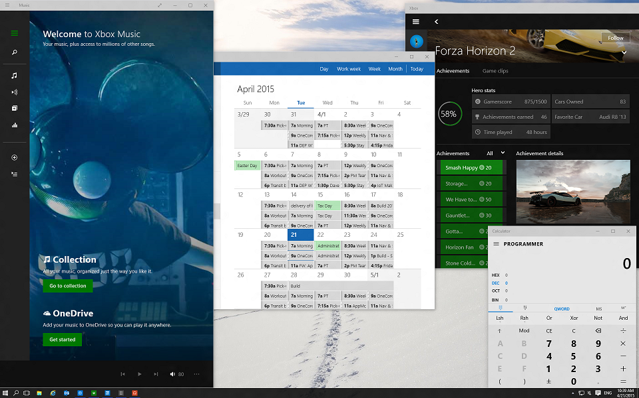
Windowed mode for Universal Windows Apps

Slide 8
Sizing yourself up
Set preferred view size on launch
Launch into Full Screen Mode
Specify a minimum view size
Change view size at runtime

Slide 9
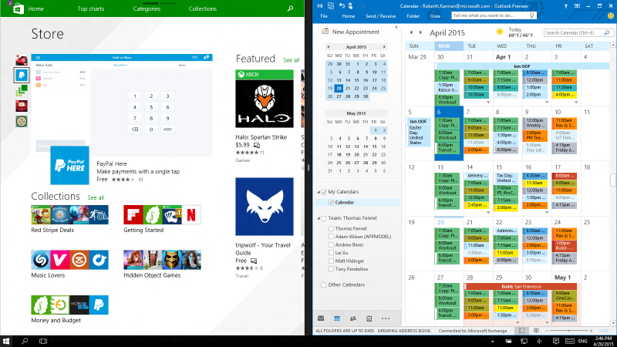
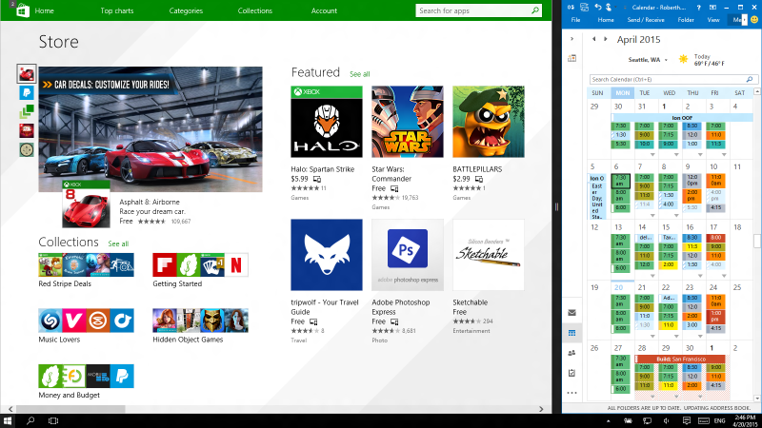
What about immersive mode devices?
Converged on the Windows 8.1 model
Limited sizing options
User initiated resizing
Windowed mode APIs ”no-op”

Slide 10
Change in size
SizeChanged is your cue to
re-draw
Subscribe to SizeChanged event
Fires for both user initiated and app initiated size changes
Re-layout and re-draw your UI to fit new geometry

Slide 11
Windowing 101 – multiple application views
API surface from Windows 8.1
Change: Window.Activate() call needed on secondary views
Same API for Windowed and Immersive mode
Available across the Windows 10 family
Windows.ApplicationModel.Core.CoreApplication.CreateNewView
Windows.UI.ViewManagement.ApplicationViewSwitcher.SwitchAsync
Windows.UI.ViewManagement.ApplicationViewSwitcher.TryShowAsStandaloneAsync

Slide 12
Multi view app activation

Slide 13
Windowing 202 – controlling launch
When you need to be in control
Opt-in to the new activation policy
ApplicationViewSwitcher.DisableSystemViewActivationPolicy();
ViewSwitcher on activated event args
ViewSwitcher.ShowAsStandaloneAsync(viewID);
Fallback UX for immersive mode

Slide 14
Windowing TNG – making it easier
When you always want the same window behavior for a certain launch point
Shell driven window creation connected to activation points
Behaves like hosted scenarios (Share, Picker)
No manifest updates needed

Slide 15
Back for Universal Windows apps
One event to rule them all
The back button is now available everywhere!
Title bar UI can be opted in to for Windowed mode
Back in tablet mode works just like the back button on Phone
Need to handle BackRequested for page to page navigation and to dismiss temporary UI

Slide 16
Back guidelines
Always support back button navigation
Opt in to back in Windowed mode
Remember to turn off the UI when no back stack remains in app
Don’t strand users in your app – respect global back navigation

Slide 17
Universal Building Blocks

Slide 18
Basic navigation APIs
Same APIs as in 8.1
Frame and page to host the content
Windows.UI.XAML.Frame
Windows.UI.XAML.Page
Add/Remove pages to the navigation journal
Windows.UI.XAML.Frame.Navigate
Windows.UI.XAML.Frame.Backstack
Windows.UI.XAML.Frame.ForwardStack
Each journal entry contains Page type, Parameter, Navigation Transition
Windows.UI.XAML.Navigation.PageStackEntry
To save and restore the navigation journal
Windows.UI.XAML.Frame.GetNavigationState
Windows.UI.XAML.Frame.SetNavigationState

Slide 19
Page Caching
Caches the content of the page type
Same APIs and behavior as in 8.1
Pages are not cached by default
Set NavigationCacheMode in the page constructor
Watch memory limits – set the CacheSize
Use NavigationCacheMode.Required to always keep the page cached
Windows.UI.XAML.Frame.CacheSize
Windows.UI.XAML.Page.NavigationCacheMode

Slide 20
Splash screens
<uap:VisualElements
<uap:SplashScreen Image="Assets\SplashScreen.png" BackgroundColor=“Black" />
</uap:VisualElements>
Same asset on all devices
Extended splash screen
Windows 8.1 API converged across the Windows Universal Platform
Providing an asset is optional
Opt-out only after verifying user experience
Fast loading - The app content “just appears”
Slow loading – Shell fallback UI

Slide 21
Recycling is goodness

Slide 22
Suspending and resuming
Recreate user’s state when resumed
Fast Application Resume
Re-launching an app will reuse the suspended app instance
On Suspend
Save the app state and navigation journal
Optionally, save a time-stamp
On resume
Restore navigation journal and app state

Slide 23
What to present when resumed
Return the user to where it makes sense to be
Check the PreviousExecutionState and timestamp
If ClosedByUser, NotRunning, or not used recently, start fresh
If Suspended, resume
If Terminated, restore state and navigation journal and resume

Slide 24
Suspending and resuming multiview apps
Secondary views are not restored
On Suspend
All secondary views will be destroyed
Save view state if the user should be able to re-construct them later
On Resume
Provide a good landing-point
Provide in-app UI to restore individual views
DO NOT try to restore all views without user consent

Slide 25
Want more details?
Build 2014 session 2-537 - Navigation Model for Windows XAML Applications
http://channel9.msdn.com/Events/Build/2014/2-537

Slide 26
Need to know how app was re-launched?
After termination, being re-launched from back stack vs from a Tile can mean different things to the user
Check PreviousExecutionState and if it is Terminated check the TileID on the activation event args
If TileID == ”” the app was relaunched from back stack

Slide 27
UX Guidance Summary
Resume your app if the user has done work that would be frustrating to lose.
Start the app fresh if a long period of time has elapsed since the user last used it
Global Back button takes user where they came from
Don’t rely on set window sizes
Re-layout and refresh your app UI if view size changes
Be careful when restoring secondary views

Slide 28
What does this mean to the developer
Same Page Navigation Model on all Windows 10 devices
Fast App Resume is the launch policy on all Windows 10 devices
Opt-in back button for Windowed apps, Global Back for immersive mode
Follow UX guidance to preserve Global Back Button behavior on immersive mode/devices
Always subscribe to the SizeChanged event and update your UI accordingly

Slide 29
Things that may interest you
AppModel talks later today
762 – tiles’n’stuff
765 – web of apps
Talks in the past, go watch the videos...
626 - Windows App Lifecycle: From Activation & Suspension to Background Execution and Multitasking
679 - From the Small Screen to the Big Screen: Building Universal App Experiences with XAML
741 - Moving to Windows 10: Porting an app from Windows 8.1 XAML or Windows Phone Silverlight to Windows 10

Slide 30
Now go do epic stuff!

