Slide 2
How to use this template
This is the Build PPT template. The template itself is formatted
to reflect the Windows brand and the guidelines outlined
within the template.
White is the lead template background color and the supporting colors are dark blue, cyan, and purple.
Please note there are dark blue background content slide options if the speaker desires to use a colored background.

Slide 3
Deadlines & Resources
Below is a list of key dates and resources:
Important Content Deadlines – detailed instructions are found on the Speaker Portal:
  ASAP Complete your event registration ASAP
  April 7 Fill out an ERT Request for additional equipment needed for your session
    April 26 Upload your FINAL PPT at the Speaker Portal
    Your spoken presentation may change until delivery of the session, but create and lock your PPT by the deadline
    YOUR PROMPT FINAL PPT SUBMISSION IS APPRECIATED
    Limited PPT support is available onsite
  Points of Contact
  Direct presentation questions to Erika Seven at v-erseve@microsoft.com
  Direct content questions to your Track Owner
NOTE: PPTs or Recordings with licensing issues will not be published until resolved.
Notes:
© 2010 Microsoft Corporation. All rights reserved. Microsoft, Windows, Windows Vista and other product names are or may be registered trademarks and/or trademarks in the U.S. and/or other countries.
The information herein is for informational purposes only and represents the current view of Microsoft Corporation as of the date of this presentation. Because Microsoft must respond to changing market conditions, it should not be interpreted to be a commitment on the part of Microsoft, and Microsoft cannot guarantee the accuracy of any information provided after the date of this presentation.
MICROSOFT MAKES NO WARRANTIES, EXPRESS, IMPLIED OR STATUTORY, AS TO THE INFORMATION IN THIS PRESENTATION.

Slide 4
Scrub Checklist
Upload your final deck on the speaker portal on or before April 26, 2015.
The Scrub Process will include:
Verification that required slides are included
Remove any non-template logos and graphics from the walk-in slide
Remove all comments, hidden slides and speaker notes from slides
Set file properties box
Reset printability to grayscale
Notify Speaker of any images identified as unlicensed for immediate resolution
Rename files to match naming convention
Correct session title and session code to match printed Session Schedule and Schedule Builder
Add QR code for use onsite
  PRINTING: This template is intentionally set to print in color or grayscale, not black and white
As speakers, you must:
Use the provided event template and associated colors, fonts, layout and transition slides
Correct product names to follow applicable branding rules
Remove any unlicensed images

Slide 5
ATTENTION: PLEASE READ
Photography and copyright infringement.
Using imagery from movies, television, music and pop-culture is illegal, unless purchased, licensed or by express written consent from the owner. Please do not include unlicensed imagery in your presentation.
Sessions with questionable imagery will not be published until resolved. The speaker will be contacted via email for immediate resolution. If additional costs are incurred in editing, an I/O Code will be required.
If you have any questions regarding your imagery please contact
Media Acquisitions Inquiries: mediaacq@microsoft.com.
The PPT deck and Recording will not be published until the editing is complete.

Slide 6
Wi-Fi Direct & Wi-Fi Direct Services API
3-98
Yatharth Gupta, Senior Program Manager
Vishal Mhatre, Software Engineer
Notes:
Hi, my name is Yatharth Gupta – I am a PM in Windows for Wi-Fi & I am here with Vishal Mhatre to talk about Wi-Fi Direct Direct & Services API in Windows 10.

Slide 7
Agenda
Intro to Wi-Fi Direct & Services
What can do you this ?
What’s new in Windows 10
Demo
Walkthrough & Debugging
Notes:
Today, we will spend some time talking about what is Wi-Fi Direct & Services, what can you do with these APIs and this technology, What is new in Windows 10. Then we will show you a little demo of an application using these APIs, Vishal will walk you through the code and we can will provide some tips for debugging as you build your own application.

Slide 8
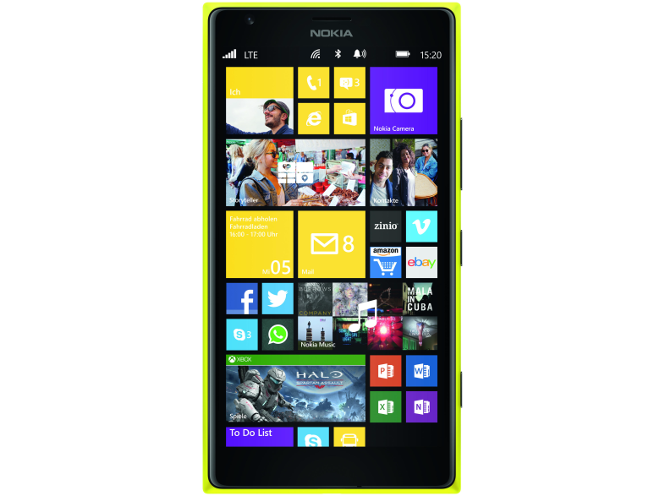
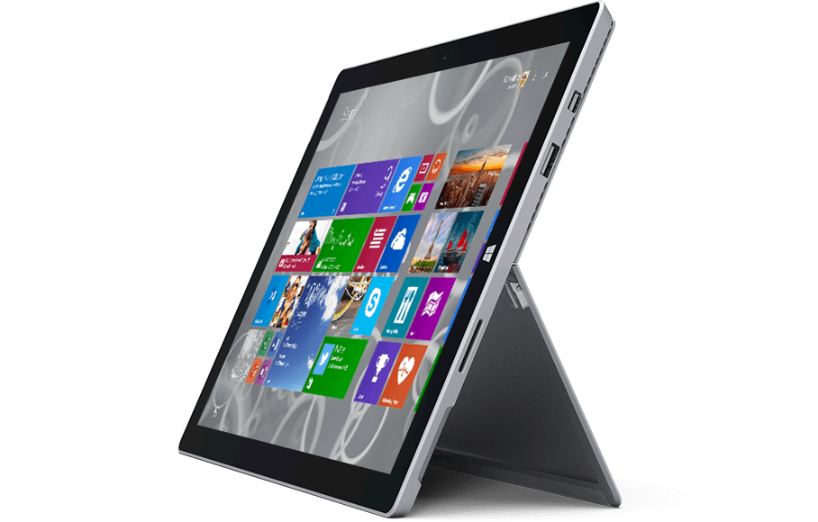

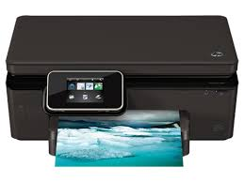

Intro to Wi-Fi Direct & Wi-Fi Direct Services
A mechanism that allows for PCs, Phones & Devices to connect & communicate directly with each other
Does not the devices to be connected to the same or any network
Provides a high bandwidth transport for bi-directional data exchange
Not just 1:1, can support multiple devices
Notes:
In today’s world, most applications connect to internet to provide a service to the user such as Facebook or Yelp. However, there are a class of Apps & Devices that can benefit from direct connectivity. Wi-Fi Direct & Services is a technology that provides this direct connectivity. It allows for
PCs, Phone or other devices running Windows to connect to other PCs, Phone or Devices
The unique value is that these devices don’t need to be on the same network or even be connected to any network
Once you are connected, you have a very high bandwidth connection between the devices
And this is not limited to just 2 devices, you can do this more than 2 that devices

Slide 9


What can you do with Wi-Fi Direct & Services ?
Games
Remote Control Devices
Utility Application
Notes:
Some of the interesting things that are built on this technology are things like
Games : Let us say, you were building a chess application you wanted to enable two people playing chess in the park – you can use Wi-Fi Direct to communicate between those two devices.
You can use this technology to Remote Control Device : You walk up to a printer and you want to print to it. You can do this over Wi-Fi Direct
You can built utility applications such as file transfer between a PC & another PC or phone

Slide 10

Wi-Fi Direct & Wi-Fi Direct Services
Both are standards based
Wi-Fi Direct finds Devices while Services can help find an Application running on the Device
Existing Devices support Wi-Fi Direct, Services is new
Notes:
Before we starting getting into details, I wanted explain the difference between Wi-Fi Direct & Wi-Fi Direct Services. It is important to note that both of these are industry standards – which means you can interoperate with devices outside the windows ecosystem. Wi-Fi Direct came first, it allowed you to find a another device and connect & communicate to that device.
Wi-Fi Direct Services adds another layer on Wi-Fi Direct that allows you to find a services running on the device before connecting – so if you were building a game, you can find other users playing that game vs. just finding other users and connecting to them to see if they were playing the game.

Slide 11

What is new in Window 10
Wi-Fi Direct Services introduced in Windows 10
An updated and more powerful API set for both Wi-Fi Direct and addition of Wi-Fi Direct Services
Notes:
We’ve supported Wi-Fi Direct since Windows 8.1, our OS uses this technology for scenarios such as Wireless Display. In Windows 10 we’ve done two things
We’ve introduced Wi-Fi Direct Services
We’ve enhanced our Wi-Fi Direct API based on feedback from Application Developers to make it more flexible and powerful
Let us talk about this API ..

Slide 12
Flexible and Powerful API
Apps control experience, while Windows allows users to be in control
Find, Pair, Connect & Communicate from within your Application
Bi-directional : supports both seeking and advertising as a service or Wi-Fi Direct device
Notes:
In Windows 10, the applications have complete control – from within the Application
- you can find other devices or services
- you can pair with them, pairing is a concept that is used to establish trust since we use the air to communicate
- you can connect/reconnect & communicate to the devices
- and most importantly – you can hide these concepts from the users of the applications
Contrast this to Windows 8.1, where the users had to use a Windows UI to find and connect to the device and then launch the application.
The second most important change that we’ve done is made the API bidirectional. Previously you would always had to find from Windows, now with the proliferation of Windows to a diversity of Devices it was important the we support the API so that the users could put Windows is a mode where other devices can find it.
We’ve also decided to go the extra mile with flexibility

Slide 13
Flexible & Powerful API
Application can send custom information to other devices before connecting using Information Elements
Applications can start a Legacy AP for interop with old devices
Low level control such as setting the group owner intent
Notes:
Applications can put in what is called “Information Elemenents” in the messages that go over the air. So if you are using Wi-Fi Direct to talk to your printer and you want to pass on additional information you can now do that. Inforamtion Elements are the standard way to tack on custom information in all Wi-Fi Management Packets. You can add or read these elements from the messages before you start connecting to the device. One example of this in action is, say you had an application that could talk to a Device – to better represent the Device in the Application – you could tack on the color of the device or the battery level or whatever you chose.
We’ve added APIs that allow for those devices that don’t support Wi-Fi Direct to connect to Windows. This is done by bringing up Windows as an AP since any device with just Wi-Fi can connect to an AP. We’ve also gone deep – if you are familiar with Wi-Fi Direct, you probably know what is group intent – it is one of the several parameters used during the process of associating, You can now set that.
But enough talking .. Lets get to a demo.

Slide 14
Demo
Notes:
What we are going to show today is two Demos, one for Wi-Fi Direct & one for Services. Rather than going with Pretty – we thought we should show you our swiss knife application that demonstrates all the knobs that you application can use. We wont’ go through each of them but ..

Slide 15
Wi-Fi Direct – Advertiser
// Create an Advertisement Publisher
var publisher = new WiFiDirectAdvertisementPublisher();
// Turn on Listen state
publisher.Advertisement.ListenStateDiscoverability = WiFiDirectAdvertisementListenStateDiscoverability.Normal;
// Register for connection requests
var listener = new WiFiDirectConnectionListener();
listener.ConnectionRequested += OnConnectionRequested;
// Start the advertiser
publisher.Start();

Slide 16
Wi-Fi Direct – Connector
String deviceSelector = WiFiDirectDevice.GetDeviceSelector(WiFiDirectDeviceSelectorType.AssociationEndpoint);
// Get all WiFiDirect devices that are advertising and in range
DeviceInformationCollection devInfoCollection = await DeviceInformation.FindAllAsync(deviceSelector);
// Connection parameters – GO Intent
WiFiDirectConnectionParameters connectionParams = new WiFiDirectConnectionParameters();
connectionParams.GroupOwnerIntent = “1”;
// Connect to the WiFiDirect device
String deviceId = devInfoCollection[0].Id;
var wfdDevice = await WiFiDirectDevice.FromIdAsync(deviceId, connectionParams);
// Get the local and remote IP addresses
var EndpointPairs = wfdDevice.GetConnectionEndpointPairs();
// Establish standard WinRT socket with above IP addresses

Slide 17
Wi-Fi Direct – Accept incoming connection
private async void OnConnectionRequested(WiFiDirectConnectionListener sender,
WiFiDirectConnectionRequestedEventArgs args)
{
var ConnectionRequest = args.GetConnectionRequest();
// Prompt the user to accept/reject the connection request
// If rejected, exit
// Connect to the remote device
WiFiDirectDevice wfdDevice = await WiFiDirectDevice.FromIdAsync(ConnectionRequest.DeviceInformation.Id);
// Get the local and remote IP addresses
var EndpointPairs = wfdDevice.GetConnectionEndpointPairs();
// Establish standard WinRT socket with above IP addresses
}

Slide 18
Wi-Fi Direct Services – Advertiser
// Create a Service Advertiser
WiFiDirectServiceAdvertiser Advertiser = new WiFiDirectServiceAdvertiser(ServiceName);
// Register for session requests from Seeker(s)
Advertiser.SessionRequested += OnSessionrequested;
// Start the advertiser
Advertiser.Start();

Slide 19
Wi-Fi Direct Services – Service Seeker
string ServiceSelector = WiFiDirectService.GetSelector(ServiceName);
// Get all WiFiDirect services that are advertising and in range
DeviceInformationCollection devInfoCollection = await DeviceInformation.FindAllAsync(ServiceSelector);
// Get a Service Seeker object
WiFiDirectService Service = await WiFiDirectService.FromIdAsync(devInfoCollection[0].Id);
// Connect to the Advertiser
WiFiDirectServiceSession Session = await Service.ConnectAsync();
// Get the local and remote IP addresses
var EndpointPairs = Session.GetConnectionEndpointPairs();
// Establish a standard WinRT socket with above IP addresses

Slide 20
Wi-Fi Direct Services – Accepting connections
private async void OnSessionrequested(WiFiDirectServiceAdvertiser sender,
WiFiDirectServiceSessionRequestedEventArgs args)
{
// Get the Session Request object
WiFiDirectServiceSessionRequest sessionRequest = args.GetSessionRequest();
// Retrieve DeviceInformation from the Session Request
DeviceInformation deviceInfo = sessionRequest.DeviceInformation;
// Accept the session request from Service Seeker
WiFiDirectServiceSession Session = await sender.ConnectAsync(deviceInfo);
// Get the local and remote IP addresses
var EndpointPairs = Session.GetConnectionEndpointPairs();
// Establish a standard WinRT socket with above IP addresses
}

Slide 21
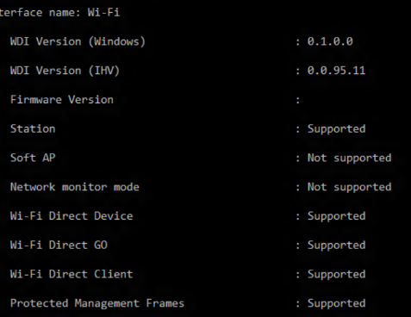
Debugging
How to check if your Windows 10 PC supports Wi-Fi Direct & Services
“c:\> netsh wlan show wirelesscap”
A Wireless Sniffer is your best friend
Notes:
As with any interop story, specially with messages going over Air – debugging is always a challenge. We wanted to share two tips with you to debug interoperability
First : Windows works on a Diversity of PCs from folks like HP, Dell to our own Surface. Some PCs running Windows 10 will be older and some brand new. Before you start, you want to check if you PC supports Wi-Fi Direct & Services. You can do this using this command and we will print out all the Wireless Capabilities of your Wi-Fi H/W & Driver. As a tip – please always install the latest driver.
The second one and the most important one is using a Sniffer. If you are working with between two non-identical devices such as a PC & lets us say a TV if you hit issues you will want to use a Sniffer. A sniffer shows you what is going on over the air. Here is an example

Slide 22
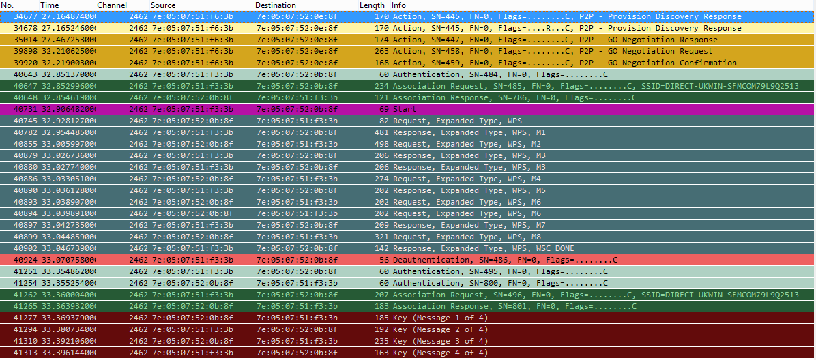
Example of a Sniffer capture for Wi-Fi Direct
Notes:
Now to make sense of this, you will have to be familiar with the Wi-Fi Direct Specification. But if you are building a device, you likely are – here you can see all the different things that are going on. You can map each of these messages to the Wi-Fi Alliance specification.

Slide 23
Recap
Wi-Fi Direct & Wi-Fi Direct Services are a Industry Standard
Wi-Fi Direct & Services allow you to build applications that talk to other PCs or Devices directly
Games, Utilities & Application to control devices can be built using this technology. What other interesting things can you build ?
Standards Definition is available from Wi-Fi Alliance
API Documentation will be available shortly on MSDN

